Slide 1
Chapter 4
Message-Passing Programming

Slide 2
Outline
Message-passing model
Message Passing Interface (MPI)
Coding MPI programs
Compiling MPI programs
Running MPI programs
Benchmarking MPI programs
Learning Objectives
Become familiar with fundamental MPI functions
Understand how MPI programs execute

Slide 3
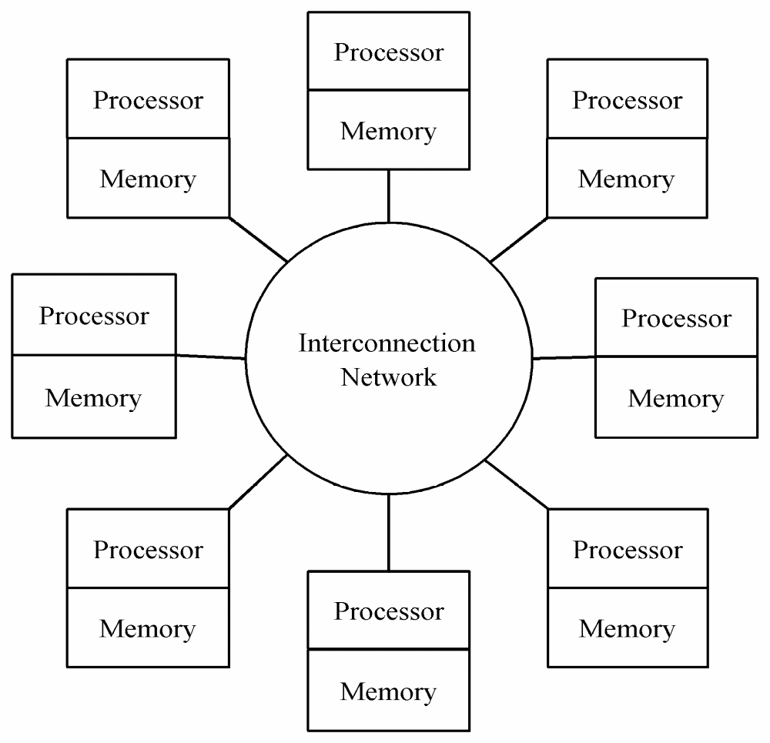
Message-passing Model

Slide 4
Task/Channel vs. Message-Passing
Task/Channel | Message-passing
Task | Process
Explicit channels | Any-to-any communication

Slide 5
Characteristics of Processes
Number is specified at start-up time
Remains constant throughout the execution of program
All execute same program
Each has unique ID number
Alternately performs computations and communicates
Passes messages both to communicate and to synchronize with each other.

Slide 6
Advantages of Message-passing Model
Runs well on a variety of MIMD architectures.
  Natural fit for multicomputers
  Execute on multiprocessors by using shared variables as message buffers
Gives programmer ability to manage the memory hierarchy
Easier to create a deterministic program
Simplifies debugging
  Debugging message passing programs easier than debugging shared-variable programs.

Slide 7
The Message Passing Interface
Late 1980s: vendors had unique libraries
  Usually FORTRAN or C augmented with functions calls that supported message-passing
1989: Parallel Virtual Machine (PVM) developed at Oak Ridge National Lab
  Supported execution of parallel programs across a heterogeneous group of parallel and serial computers
1992: Work on MPI standard begun
  Chose best features of earlier message passing language
  Not for heterogeneous setting – i.e., homogeneous
1994: Version 1.0 of MPI standard
1997: Version 2.0 of MPI standard
Today: MPI is dominant message passing library standard

Slide 8
What We Will Assume
The programming paradigm typically used with MPI is called a SPMD paradigm (single program multiple data.)
Consequently, the same program will run on each processor.
The effect of running different programs is achieved by branches within the source code where different processors execute different branches based on their processor ID.
As usual, we’ll approach learning the MPI language (and either recalling or learning the language C) by looking at a problem.

Slide 9
Circuit Satisfiability Problem
Classic Problem: Given a circuit containing AND, OR, and NOT gates, find if there are any combinations of input 0/1 values for which the circuit output the value 1.
Version Considered Here: Given a circuit, find for which combinations of input 0/1 values (if any) will the circuit output the value 1.

Slide 10
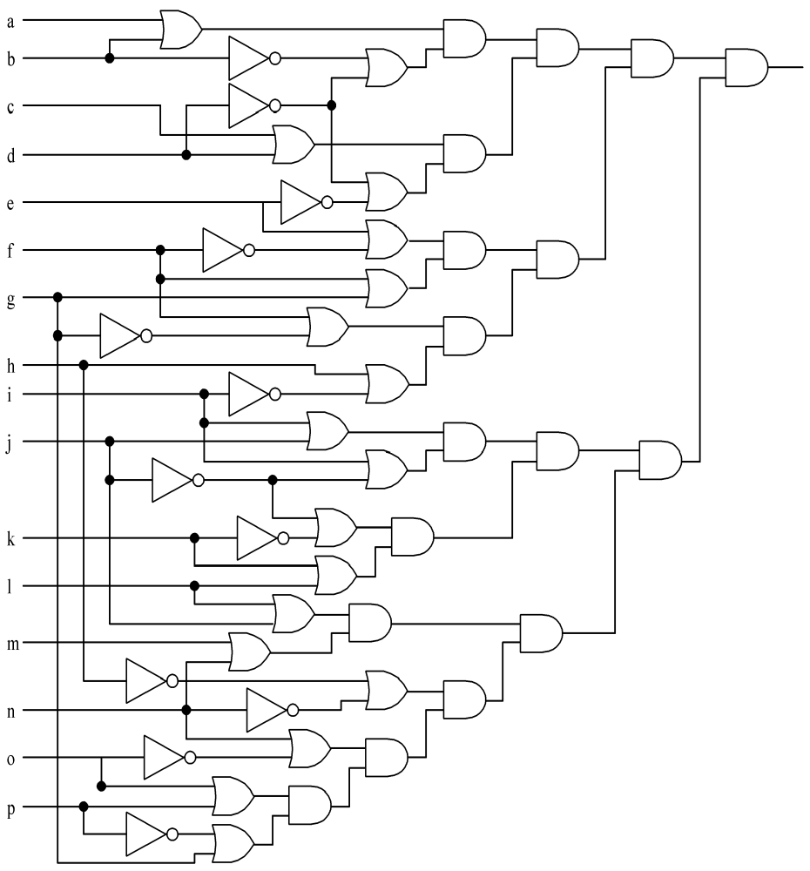
Circuit Satisfiability
1
0
1
1
1
Not satisfied
1
1
1
Note: The input consists of variables a, b, ..., p
1
1
1
1
1
1
1
1
1

Slide 11
Solution Method
Circuit satisfiability is NP-complete
No known algorithms solve problem in polynomial time
We seek all solutions
We find through exhaustive search
16 inputs ⇒ 2¹⁶ = 65,536 combinations to test
Functional decomposition natural here

Slide 12
Embarrassingly Parallel
When the task/channel model is used and the problem solution falls easily into the definition of tasks that do now need to interact with each other – i.e. there are no channels – then the problem is said to be embarrassingly parallel.
Recently some researchers have begun to call this situation instead pleasingly parallel.
This situation does allow a channel for output from each task as having no output is not acceptable naturally.

Slide 13
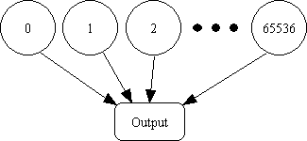
Partitioning: Functional Decomposition
Embarrassingly (or pleasing) parallel: No channels between tasks

Slide 14
Agglomeration and Mapping
Properties of parallel algorithm
  Fixed number of tasks
  No communications between tasks
  Time needed per task is variable
    Bit sequences for most tasks do not satisfy circuit
    Some bit sequences are quickly seen unsatisfiable
Consult mapping strategy decision tree
  Map tasks to processors in a cyclic fashion

Slide 15
Cyclic (interleaved) Allocation
Assume p processes
Each process gets every p^{th} piece of work
Example: 5 processes and 12 pieces of work
  P₀: 0, 5, 10
  P₁: 1, 6, 11
  P₂: 2, 7
  P₃: 3, 8
  P₄: 4, 9
i.e. piece of work i is assigned to process k where k = i mod 5.

Slide 16
Questions to Consider
Assume n pieces of work, p processes, and cyclic allocation
What is the most pieces of work any process has?
What is the least pieces of work any process has?
How many processes have the most pieces of work?

Slide 17
Summary of Program Design
Program will consider all 65,536 combinations of 16 boolean inputs
Combinations allocated in cyclic fashion to processes
Each process examines each of its combinations
If it finds a satisfiable combination, it will print it

Slide 18
Introduction to MPI Programming
Each active MPI process executes its own copy of the program.
Thus, each process will have its own copy of all the variables declared in the program whether they are external variables which are declared outside of any function or automatic variables declared inside a function.

Slide 19
C Code
Include Files
#include <mpi.h> /* MPI header file */
#include <stdio.h> /* Standard C I/O header file */
These appear at the beginning of the program file.
The file extension will be .c as these will be C programs augmented with the MPI library.

Slide 20
Header for C Function Main
(Local Variables)
int main (int argc, char *argv[]) {
int i; /* loop index */
int id; /* Process rank (number) */
int p; /* Number of processes */
void check_circuit (int, int);
Include argc and argv: they are needed to initialize MPI
The i, id, and p are local (or automatic) variables.
One copy of every variable is needed for each process running this program
If there are p processes, then the ID numbers start at 0 and end at p -1.

Slide 21
Replication of Automatic Variables
(Shown for id and p only)
id
1
id
0
p
6
p
6
id
5
id
2
p
6
id
4
6
p
id
3
p
6
p
6

Slide 22
Initialize MPI
MPI_Init (&argc, &argv);
First MPI function called by each process
Not necessarily first executable statement
In fact, it need not be located in main.
But, it must be called before any other MPI function is invoked.
Allows system to do any necessary setup to handle calls to MPI library

Slide 23
MPI Identifiers
All MPI identifiers (including function identifiers) begin with the prefix “MPI_”
The next character is a capital letter followed by a series of lowercase letters and underscores.
Example: MPI_Init
All MPI constants are strings of capital letters and underscores beginning with MPI_
Rcall C is case-sensitive as it was developed in a UNIX environment.

Slide 24
Communicators
When MPI is initialized, every active process becomes a member of a communicator called MPI_COMM_WORLD.
Communicator: Opaque object that provides the message-passing environment for processes
MPI_COMM_WORLD
  This is the default communicator
  It includes all processes automatically
  For most programs, this is sufficient.
It is possible to create new communicators
  These are needed if you need to partition the processes into independent communicating groups.
  We’ll see later how to do this.

Slide 25
Communicators
Processes within a communicator are ordered.
The rank of a process is its position in the overall order.
In a communicator with p processes, each process has a unique rank, which we often think of as an ID number, between 0 and p-1.
A process may use its rank to determine for which portion of a computation or portion of a dataset it is responsible.

Slide 26
Communicator
Communicator Name
Communicator
MPI_COMM_WORLD
Processes
0
5
Ranks
2
1
4
3

Slide 27
Determine Process Rank
MPI_Comm_rank (MPI_COMM_WORLD, &id);
A process can call this function to determines its rank with a communicator.
The first argument is the communicator name.
The process rank (in range 0, 1, …, p-1) is returned through second argument.
Note: The & before the variable id in C means the variable is passed by address (i.e. location or reference).

Slide 28
For Those New to C – By value pass is the default
Data can be passed to functions by value or by address.
Data passed by value just makes a copy of the data in the memory space for the function.
If the value is changed in the function, it does not change the value of the variable in the calling program.
Example:
  k = check(i,j);
is passing i and j by value. The only data returned
would be the data returned by the function check.
The values for i and j in the calling
program do not change.

Slide 29
For Those New to C – By address pass
By address pass is also called by location or by reference passing.
This mode is allowed in C and is designated in the call by placing the & symbol before the variable.
The & is read “address of” and allows the calling program to access the address of the variable in the memory space of the function in order to obtain the value stored there.
Example: k = checkit(i, &j) would change the value of j in the calling program as well as returning a value for checkit.
Consequently, this allows a function to change a variable’s value in the calling program.

Slide 30
Determine Number of Processes
MPI_Comm_size (MPI_COMM_WORLD, &p);
A process can call this.
First argument is the communicator name
This call will determine the number of processes.
The number of processes is returned through the second argument as this is a call by address.

Slide 31
What about External Variables or Global Variables?
int total;
int main (int argc, char *argv[]) {
int i;
int id;
int p;
…
Try to avoid them. They can cause major debugging problems. However, sometimes they are needed.
We’ll speak more about these later.

Slide 32
Cyclic Allocation of Work
for (i = id; i < 65536; i += p)
check_circuit (id, i);
Now that the MPI process knows its rank and the total number of processes, it may check its share of the 65,536 possible inputs to the circuit.
For example, if there are 5 processes, process id = 3 will check i = id = 3
      i += 5 = 8
      i += 5 = 13 etc.
Parallelism is in the outside function check_circuit
It can be an ordinary, sequential function.

Slide 33
After the Loop Completes
printf (“Process %d is done\n”, id);
fflush (stdout);
After the process completes the loop, its work is finished and it prints a message that it is done.
It then flushes the output buffer to ensure the eventual appearance of the message on standard output even if the parallel program crashes.
Put an fflush command after each printf command.
The printf is the standard output command for C. The %d says integer data is to be output and the data appears after the comma – i.e. insert the id number in its place in the text.

Slide 34
Shutting Down MPI
MPI_Finalize();
return 0;
Call after all other MPI library calls
Allows system to free up MPI resources
A return of 0 to the operating system means the code ran to completion. A return of 1 is used to signal an error has happened.

Slide 35
MPI Program for Circuit Satisfiability (Version 1-main)
#include <mpi.h>
#include <stdio.h>
int main (int argc, char *argv[]) {
int i;
int id;
int p;
void check_circuit (int, int);
MPI_Init (&argc, &argv);
MPI_Comm_rank (MPI_COMM_WORLD, &id);
MPI_Comm_size (MPI_COMM_WORLD, &p);
for (i = id; i < 65536; i += p)
check_circuit (id, i);
printf ("Process %d is done\n", id);
fflush (stdout);
MPI_Finalize();
return 0;}

Slide 36
The Code for check_circuit
check_circuit receives the ID number of a process and an integer
check_circuit (id, i);
It first extracts the values of the 16 inputs for this problem (a, b, ..., p) using a macro EXTRACT_BITS.
In the code, v[0] corresponds to input a; v[1] to input b, etc.
Calling the function with i ranging from 0 through 65,535 generates all the 2¹⁶ combinations needed for the problem. (Recall the truth tables introduced in cpsc 171 where we generated all input to circuits by listing the numbers in binary from 0 to 2^{k} – 1.) The same idea is used here.

Slide 37
Code for check_circuit
/* Return 1 if 'i'th bit of 'n' is 1; 0 otherwise */
#define EXTRACT_BIT(n,i) ((n&(1<<i))?1:0)
void check_circuit (int id, int z) {
int v[16]; /* Each element is a bit of z */
int i;
for (i = 0; i < 16; i++) v[i] = EXTRACT_BIT(z,i);
We’ll look at the macro definition next time. Just assume for now that it does what it is supposed to do.

Slide 38
The Circuit Configuration Is Encoded as ANDs, ORs and NOTs in C
if ((v[0] || v[1]) && (!v[1] || !v[3]) && (v[2] || v[3])
&& (!v[3] || !v[4]) && (v[4] || !v[5])
&& (v[5] || !v[6]) && (v[5] || v[6])
&& (v[6] || !v[15]) && (v[7] || !v[8])
&& (!v[7] || !v[13]) && (v[8] || v[9])
&& (v[8] || !v[9]) && (!v[9] || !v[10])
&& (v[9] || v[11]) && (v[10] || v[11])
&& (v[12] || v[13]) && (v[13] || !v[14])
&& (v[14] || v[15])) {
printf ("%d) %d%d%d%d%d%d%d%d%d%d%d%d%d%d%d%d\n", id,
v[0],v[1],v[2],v[3],v[4],v[5],v[6],v[7],v[8],v[9],
v[10],v[11],v[12],v[13],v[14],v[15]);
Note that the logical operators of AND, OR, and NOT are syntactically the same as in Java or C++.
A solution is printed whenever that mess evaluates to 1 (i.e. TRUE). In C, FALSE is 0 and everything else is TRUE.

Slide 39
MPI Program for Circuit Satisfiability (cont.)
/* Return 1 if 'i'th bit of 'n' is 1; 0 otherwise */
#define EXTRACT_BIT(n,i) ((n&(1<<i))?1:0)
void check_circuit (int id, int z) {
int v[16]; /* Each element is a bit of z */
int i;
for (i = 0; i < 16; i++) v[i] = EXTRACT_BIT(z,i);
if ((v[0] || v[1]) && (!v[1] || !v[3]) && (v[2] || v[3])
&& (!v[3] || !v[4]) && (v[4] || !v[5])
&& (v[5] || !v[6]) && (v[5] || v[6])
&& (v[6] || !v[15]) && (v[7] || !v[8])
&& (!v[7] || !v[13]) && (v[8] || v[9])
&& (v[8] || !v[9]) && (!v[9] || !v[10])
&& (v[9] || v[11]) && (v[10] || v[11])
&& (v[12] || v[13]) && (v[13] || !v[14])
&& (v[14] || v[15])) {
printf ("%d) %d%d%d%d%d%d%d%d%d%d%d%d%d%d%d%d\n", id,
v[0],v[1],v[2],v[3],v[4],v[5],v[6],v[7],v[8],v[9],
v[10],v[11],v[12],v[13],v[14],v[15]);
fflush (stdout);
}
}

Slide 40
Execution on 1 CPU
0) 1010111110011001
0) 0110111110011001
0) 1110111110011001
0) 1010111111011001
0) 0110111111011001
0) 1110111111011001
0) 1010111110111001
0) 0110111110111001
0) 1110111110111001
Process 0 is done
With MPI you can specify how many processors are to be used. Naturally, you can run on one CPU.
This has identified 9 solutions which are listed here as having been found by process 0.

Slide 41
Execution on 2 CPUs
Again, 9 solutions are found. Process 0 found 3 of them and process 1 found the other 6.
The fact that these are neatly broken into process 0’s occurring first and then process 1’s, is purely coincidental as we will see.
0) 0110111110011001
0) 0110111111011001
0) 0110111110111001
1) 1010111110011001
1) 1110111110011001
1) 1010111111011001
1) 1110111111011001
1) 1010111110111001
1) 1110111110111001
Process 0 is done
Process 1 is done

Slide 42
Execution on 3 CPUs
0) 0110111110011001
0) 1110111111011001
2) 1010111110011001
1) 1110111110011001
1) 1010111111011001
1) 0110111110111001
0) 1010111110111001
2) 0110111111011001
2) 1110111110111001
Process 1 is done
Process 2 is done
Process 0 is done
Again all 9 solutions are found, but note this time that the ordering is haphazard,
Do not assume, however, that the order in which the messages appear is the same as the order the printf commands are executed.

Slide 43
Deciphering Output
Output order only partially reflects order of output events inside parallel computer
If process A prints two messages, the first message will appear before second
But, if process A calls printf before process B, there is no guarantee process A’s message will appear before process B’s message.
Trying to use the ordering of output messages to help with debugging can lead to dangerous conclusions,

Slide 44
Enhancing the Program
We want to find the total number of solutions.
A single process can maintain an integer variable that holds the number of solutions it finds, but we want the processors to cooperate to compute the global sum of the values.
Said another way, we want to incorporate sum-reduction into program. This will require message passing.
Reduction is a collective communication – i.e. a communication operation in which a group of processes works together to distribute or gather together a set of one or more values.

Slide 45
Modifications
Modify function check_circuit
  Return 1 if the circuit is satisfiable with the input combination
  Return 0 otherwise
Each process keeps local count of satisfiable circuits it has found
We will perform reduction after the for loop.

Slide 46
Modifications
In function main we need to add two variables:
  An integer solutions – This keeps track of solutions for this process.
  An integer global_solutions – This is used only by process 0 to store the grand total of the count values from the other processes. Process 0 will also be responsible for printing the total count at the end.
  Keep remembering that each process runs the same program, but if statements and various assignment statements dictate which code a process executes.

Slide 47
New Declarations and Code
int solutions; /* Local sum */
int global_solutions; /* Global sum */
int check_circuit (int, int);
solutions = 0;
for (i = id; i < 65536; i += p)
solutions += check_circuit (id, i);
This loop calculates the total number of solutions for each individual process. We now have to collect the individual values with a reduction operation,

Slide 48
The Reduction
After a process completes its work, it is ready to participate in the reduction operation.
MPI provides a function, MPI_Reduce, to perform one or more reduction operation on values submitted by all the processes in a communicator.
The next slide shows the header for this function and the parameters we will use.
Most of the parameters are self-explanatory.

Slide 49
Header for MPI_Reduce()
int MPI_Reduce (
void *operand, /* addr of 1st reduction element */
void *result, /* addr of 1st reduction result */
int count, /* reductions to perform */
MPI_Datatype type, /* type of elements */
MPI_Op operator, /* reduction operator */
int root, /* process getting result(s) */
MPI_Comm comm /* communicator */
)
Our call will be:
MPI_Reduce (&solutions, &global_solutions, 1, MPI_INT, MPI_SUM, 0,MPI_COMM_WORLD);

Slide 50
MPI_Datatype Options
MPI_CHAR
MPI_DOUBLE
MPI_FLOAT
MPI_INT
MPI_LONG
MPI_LONG_DOUBLE
MPI_SHORT
MPI_UNSIGNED_CHAR
MPI_UNSIGNED
MPI_UNSIGNED_LONG
MPI_UNSIGNED_SHORT

Slide 51
MPI_Op Options for Reduce
MPI_BAND B = bitwise
MPI_BOR
MPI_BXOR
MPI_LAND L = logical
MPI_LOR
MPI_LXOR
MPI_MAX
MPI_MAXLOC Max and location of max
MPI_MIN
MPI_MINLOC
MPI_PROD
MPI_SUM

Slide 52
Our Call to MPI_Reduce()
MPI_Reduce (&solutions,
&global_solutions,
1,
MPI_INT,
MPI_SUM,
0,
MPI_COMM_WORLD);
If count > 1, list elements for reduction are found in contiguous memory.
Only process 0
will get the result
After this call, process 0 has in global_solutions the sum of all of the other processes solutions. We then conditionally execute the print statement:
if (id==0) printf ("There are %d different solutions\n", global_solutions);

Slide 53
Version 2 of Circuit Satisfiability
The code for main is on page 105 and incorporates all the changes we made plus we make trivial changes for check_circuit to return the values of 1 or 0.
First, in main, the declaration must show an integer being returned instead of a void function:
int check_circuit(int, int);
and in the function we need to return a 1 if a solution is found and a 0 otherwise.

Slide 54
Some Cautions About Thinking “Right” About MPI Programming
The printf statement must be a conditional because only process 0 has the total sum at the end.
That variable is undefined for the other processes.
In fact, even if all of them had a valid value, you don’t want all of them printing the same message over and over for 9 times!

Slide 55
Some Cautions About Thinking “Right” About MPI Programming
Every process in the communicator must execute the MPI_Reduce.
Processes enter the reduction by volunteering the value – they cannot be called by process 0.
If you fail to have all process in a communicator call the MPI_Reduce, the program will hang at the point the function is executed,

Slide 56
Execution of Second Program with 3 Processes
0) 0110111110011001
0) 1110111111011001
1) 1110111110011001
1) 1010111111011001
2) 1010111110011001
2) 0110111111011001
2) 1110111110111001
1) 0110111110111001
0) 1010111110111001
Process 1 is done
Process 2 is done
Process 0 is done
There are 9 different solutions
Compare this with slide 42.
The same solutions are found, but output order is different,

Slide 57
Benchmarking
Is There Any Benefit to Parallel Execution?
(Hard to Tell Since We are Running on Sequential Machines)

Slide 58
Benchmarking – What is It?
Benchmarking: Uses a collection of runs to test how efficient various programs (or machines ) are.
Usually some kind of counting function is used to count various operations.
Complexity analysis provides a means of evaluating how good an algorithm is and you don’t examine a specific implementation necessarily.
Once you decide to use benchmarking, you must first have a program as well as a machine on which you can run.
There are advantages and disadvantages to both types of analysis.

Slide 59
Benchmarking
We didn’t consider this with ASC because to some extent, complexity analysis is done as with sequential machines since all PRs are working in lockstep.
Thus, as with sequential machines, you basically have to look at your loops to judge complexity.
ASC does have a performance monitor that counts the number of scalar operations performed and the number of parallel operations performed.
Then, given data about a specific machine, run times can be estimated.

Slide 60
ASC Performance Monitor
To turn the monitor on insert:
perform = 1;
where you want to start counting and
perform = 0;
when you want to turn off the monitor.
Normally you don’t count I/O operations.
Then, to obtain the values you output the scalar values of sc_perform and pa_perform using the msg command.
Note: These two variables are predefined and should not be declared.

Slide 61
For Example in MST
Adding
  msg “Scalar operation count: “ sc_perform;
  msg “Parallel operation count: “pa_perform;
with the monitor turned on right after input and turned off right before the solution is printed yields the values:
  Scalar operation count: 115
  Parallel operation count: 1252
This can be used to compare an algorithm on different size problems or to compare two algorithms as to efficiency.

Slide 62
Benchmarking with MPI
When running on a parallel machine that is not synchronized as a SIMD is, we have more difficulties in seeing the effect of parallelism by looking at the code.
Of course, we can always, in that situation, use the wall clock provided the machine is not being shared with anyone else – background jobs can completely louse up your perceptions.
As with the ASC, we want to exclude some things from our timings:

Slide 63
What Will We Exclude From our Benchmarking of MPI Programs
I/O is always excluded – even for sequential machines.
  Should it be? Even for ASC- is this reasonable?
Initiating MPI processes
Establishing communication sockets between processes.
  Again, is it reasonable to exclude these?
Note: This approach is rather standard and some people would argue that the communication set up costs should not be ignored.

Slide 64
Benchmarking a Program
We will use several MPI-supplied functions:
double MPI_Wtime (void)
  current time
  By placing a pair of calls to this function, one before code we which to time and one after that code, the difference will give us the execution time.
double MPI_Wtick (void)
  timer resolution
  Provides the precision of the result returned by MPI_Wtime.
int MPI_Barrier (MPI_Comm comm)
  barrier synchronization

Slide 65
Barrier Synchronization
Usually encounter this term first in operating systems classes.
A barrier is a point where no process can proceed beyond it until all processes have reached it.
A barrier ensures that all processes are going into the covered section of code at more or less the same time.
MPI processes theoretically start executing at the same time, but in reality they don’t.
That can throw off timings significantly.
In the second version, the call to reduce requires all processes to participate.
Processes that execute early may wait around a lot before stragglers catch up. These processes would report significantly higher computation times than the latecomers.

Slide 66
Barrier Synchronization
In operating systems you learn how barriers can be implemented in either hardware or software.
In MPI, a function is provided that implements a barrier.
All processes in the specified communicator wait at the barrier point.

Slide 67
Benchmarking Code
double elapsed_time; /* local in main */
…
MPI_Init (&argc, &argv);
MPI_Barrier (MPI_COMM_WORLD); /* wait */
elapsed_time = - MPI_Wtime();
… /* timing all in here */
MPI_Reduce (…); /* Call to Reduce */
elapsed_time += MPI_Wtime();/* stop timer */
As we don’t want to count I/O, comment out the printf and fflush in check_circuit.

Slide 68
Benchmarking Results for Second Version of Satisfiability Program
Processors | Time (sec)
1 | 15.93
2 | 8.38
3 | 5.86
4 | 4.60
5 | 3.77

Slide 69
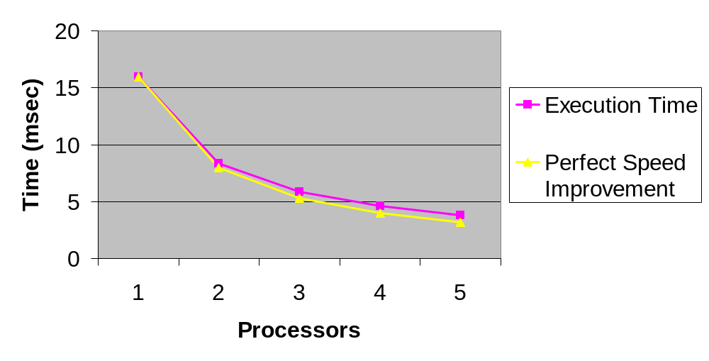
Benchmarking Results
Perfect speed improvement means p processors execute the program p times as fast as 1 processor. The difference is the communication overhead on the reduction.

Slide 70
Summary (1/2)
Message-passing programming follows naturally from task/channel model
Portability of message-passing programs
MPI most widely adopted standard

Slide 71
Summary (2/2)
MPI functions introduced
  MPI_Init
  MPI_Comm_rank
  MPI_Comm_size
  MPI_Reduce
  MPI_Finalize
  MPI_Barrier
  MPI_Wtime
  MPI_Wtick

