Slide 1
Chapter 5
The Sieve of Eratosthenes

Slide 2
Chapter Objectives
Analysis of block allocation schemes
Function MPI_Bcast
Performance enhancements
Problem to solve: The Greek mathematician Eratosthenes (276-194 BC) wanted to find a way of generating the prime numbers up to some number n.
No formula will generate these.
However, he devised a method which has become known as the sieve of Eratosthenes.

Slide 3
Outline to the Solution
The sequential algorithm
Sources of parallelism
Data decomposition options
Parallel algorithm development, analysis
An MPI program
Benchmarking
Optimizations

Slide 4
Sieve of Eratosthenes
Sequential Algorithm in Pseudocode
1. Create a list of unmarked natural numbers 2, 3, …, n
2. k ← 2
3. Repeat
(a) Mark all multiples of k between k² and n
(b) Let k ← smallest unmarked number > k
until k² > n
4. The unmarked numbers are primes

Slide 5
Sequential Algorithm
2
2
3
3
4
4
5
5
6
6
7
7
8
8
9
9
10
10
11
12
12
13
14
14
15
15
16
16
17
18
18
19
20
20
21
21
22
22
23
24
24
25
25
26
26
27
27
28
28
29
30
30
31
32
32
33
33
34
34
35
35
36
36
37
38
38
39
39
40
40
41
42
42
43
44
44
45
45
46
46
47
48
48
49
49
50
50
51
51
52
52
53
54
54
55
55
56
56
57
57
58
58
59
60
60
61
The algorithm is not practical for large values of n.
Its complexity is Θ(n ln ln n) and n is exponential in the number of digits.
But, finding prime numbers is important for encryption purposes.

Slide 6
Data Structure Used For Sequential Algorithm
Assume a Boolean array of n elements
Array indices are 0 through n-2 and they represent the numbers 2, 3, ..., n.
The boolean value at index i represents whether of not the number i+2 is marked.
  Indices that are marked represent composite numbers (i.e., not prime)
Initially, all numbers are unmarked

Slide 7
Sources of Parallelism
Because the guts of the algorithm is the marking of elements in an array, domain decomposition makes sense.
Domain decomposition
  Divide data into n-1 pieces
  Associate computational steps with data
One primitive task per array element
  These will be agglomerated into larger groups of elements.

Slide 8
Making 3(a) Parallel
3 a) Mark all multiples of k between k² and n
This is straightforward:
for all j where k² ≤ j ≤ n do
if j mod k = 0 then
mark j (i.e. it is not a prime)
endif
endfor

Slide 9
Making 3(b) Parallel
3 b) Find smallest unmarked number > k
This requires two steps:
Min-reduction (to find smallest unmarked
number > k)
Broadcast (to get result to all tasks)
Plus- remember these are in a repeat-until loop which
loops until k² > n.

Slide 10
Good News – Bad News
We have found lots of parallelism to exploit.
That is the good news!
Look back at the last slide – there are a lot of reduction and broadcast operations.
That is the bad news!
As usual, we will try to agglomerate the primitive tasks into more substantial tasks and hopefully improve the situation.
We will see that we end up with an algorithm that requires less computation and less communication than the original algorithm.

Slide 11
Agglomeration Goals
We want to:
  Consolidate tasks
  Reduce communication cost
  Balance computations among processes
We often call the result of partitioning, agglomeration, and mapping the data decomposition or just the decomposition.

Slide 12
Data Decomposition Options
1. Interleaved (cyclic)
  Different PEs handle different primes, e.g.,
    P₀ handles 2, 2+p, 2+2p, ... (multiples of 2)
    P₁ handles 3, 3+p, 3+2p,... (multiples of 3)
    P₂ handles 4, 4+p, 4+2p, ... (multiples of 4)
  It’s easy to determine the owner or handler of each index:
    Given i, i is handled by (i-2) mod p

Slide 13
Data Decomposition Options
Interleaved (cyclic) - continued
  But, this scheme leads to a load imbalance for this problem.
  If we are marking multiples of 2, process 0 marks ⎡(n-1)/2⎤ elements while process 1 marks none.
  On the other hand, process 2 is also marking multiples of 2 which is duplicating process 0’s work.
  Moreover, finding the next prime still requires a reduction/broadcast operation so nothing is saved there.

Slide 14
Data Decomposition Options
2. Block
  Array [1,n] will be divided into p contiguous blocks of roughly the same size for each PE
  We want to balance the loads with minimum differences between the processes.
  It is not desirable to have some processes doing no work at all.
  We’ll tolerate it be more complicated to determine the owner if n not a multiple of p

Slide 15
Block Decomposition Options
We want to balance the workload when n is not a multiple of p
Each process gets either ⎡n/p⎤ or ⎣n/p⎦ elements
We seek simple expressions as we must be able to find”
  Low & high indices in block for each PE
  The PE that handles a given index
  The owner given an index

Slide 16
Method #1
Let r = n mod p
If r = 0, all blocks have same size
Else
  First r blocks have size ⎡n/p⎤
  Remaining p-r blocks have size ⎣n/p⎦
Example: p = 8 and n = 45
  Find r = 45 mod 8 = 5
  So 5 blocks have size ⎡45/8⎤ = 6 and
  p-r=8-5=3 have size ⎣45/8⎦ = 5.
  (i.e. we’ve distributed 5*6 + 3*5 = 45 items.)

Slide 17
Examples
17 elements divided among 7 processes
17 elements divided among 5 processes
17 elements divided among 3 processes

Slide 18
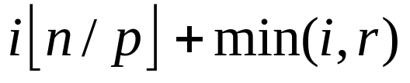
Method #1 Calculations
Let r = n mod p
First element controlled by process i
Example: The first element controlled by process 1 is 1*3 + min(1,2) = 4.
17 elements divided among 5 processes

Slide 19
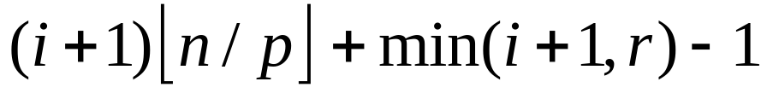
Method #1 Calculations
Let r = n mod p
Last element controlled by process i
Note this is just the element immediately before the first element controlled by process i+ 1.
Example: The last element controlled by process 2 is (2+1)*3 + min(2+1,2) -1 = 3*3+2-1 = 10.
17 elements divided among 5 processes

Slide 20
Method #1 Calculations
Let r = n mod p for n =
Process controlling element j
Example: The process controlling element j = 6 is
min(⎣6/4⎦, ⎣4/3⎦) = min(1,1) = 1.
17 elements divided among 5 processes

Slide 21
Method #1 Calculations
Although deriving the expressions could be a hassle, the expressions themselves are not too complicated to compute.
The only worrisome one is the last one, where given an element index, we need to compute the controlling process.
This action must be done repeatedly and while ⎣n/p⎦ can be precalculated, the two divisions can’t because they involve j.
So, we’ll try for another block data decomposition.

Slide 22
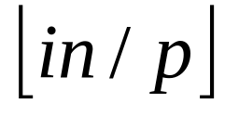
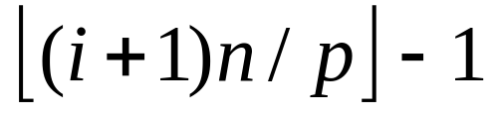
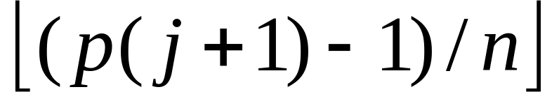
Method #2
Scatters larger blocks among processes
  Not all blocks given to PEs with lowest indices
First element controlled by process i will be
Last element controlled by process i will be
Process controlling element j will be

Slide 23
Method #2
Scatters larger blocks among processes
  Not all blocks given to PEs with lowest indices
First element controlled by process i will be
Example: 17 tasks, 5 processes
P_{i} | 1st of P_{i}
0 | 0
1 | 3
2 | 6
3 | 10
4 | 13
17 elements divided among 5 processes

Slide 24
Method #2
If the first element controlled by process i is
then the last element controlled by process i will have to 1 less than 1st element controlled by process (i+1)

Slide 25
Method #2
Process controlling element j will be
17 elements divided among 5 processes
Example: The process controlling element 7 is ⎣(5*8-1)/17⎦ = ⎣39/17⎦ = 2
Note this involves only 1 division.

Slide 26
Some Examples
17 elements divided among 7 processes
17 elements divided among 5 processes
17 elements divided among 3 processes

Slide 27
Comparing Methods
Our choice
Operations | Method 1 | Method 2
Low index | 4 | 2
High index | 6 | 4
Owner | 7 | 4
Assuming no operations for “floor” function

Slide 28
Another Example
Illustrate how block decomposition method #2 would divide 13 elements among 5 processes.
13(0)/ 5 = 0
13(2)/ 5 = 5
13(4)/ 5 = 10
13(1)/5 = 2
13(3)/ 5 = 7

Slide 29
Macros in C
A macro (in any language) is an in-line routine that is expanded at compile time.
Function-like macros can take arguments, just like true functions.
To define a macro that uses arguments, you insert parameters between a pair of parentheses in the macro definition.
The parameters must be valid C identifiers, separated by commas and optionally whitespace.
Typically macro functions are written in all caps.

Slide 30
Short if-then-else in C
The construct in C of
  logical ? if-part : then-part
  For example,
  a = (x < y) ? 3 : 4;
  is equivalent to
  if x < y then a = 3 else a = 4;

Slide 31
Example of a C Macro
#define MIN(X, Y) ((X) < (Y) ? (X) : (Y))
This macro is invoked (i.e. expanded) at compile time by strict text substitution:
x = MIN(a, b); ➔ x = ((a) < (b) ? (a) : (b));
y = MIN(1, 2); ➔ y = ((1) < (2) ? (1) : (2));
z = MIN(a + 28, *p); ➔ z = ((a + 28) < (*p) ? (a + 28) : (*p));

Slide 32
Define Block Decomposition Macros
#define BLOCK_LOW(id,p,n) \ ((i)*(n)/(p))
Given id, p, and n, this expands to the lowest index controlled by process id.
#define BLOCK_HIGH(id,p,n) \
(BLOCK_LOW((id)+1,p,n)-1)
Given id, p, and n, this expands to the highest index controlled by process id.
continuation line

Slide 33
Define Block Decomposition Macros
#define BLOCK_SIZE(id,p,n) \
(BLOCK_LOW((id)+1)- \ BLOCK_LOW(id))
Given id, p, and n this expands to the size of the block controlled by id.
#define BLOCK_OWNER(index,p,n) \
(((p)*(index)+1)-1)/(n))
Given index, p, and n this expands to the process id that controls the given index.

Slide 34
Local vs. Global Indices
L 0 1
L 0 1 2
G 0 1
G 2 3 4
L 0 1
G 5 6
L 0 1 2
L 0 1 2
G 7 8 9
G 10 11 12
Note: We need to distinguish between these.

Slide 35
Example: Looping over Elements
Sequential program
  for (i = 0; i < n; i++) {
  …
  }
Parallel program
  size = BLOCK_SIZE (id,p,n);
  for (i = 0; i < size; i++) {
  gi = i + BLOCK_LOW(id,p,n);
  }
Index i on this process…
…takes place of sequential program’s index. Think of
this as the global index.

Slide 36
Fast Marking
Block decomposition allows for the same marking as the sequential algorithm, but it is sped up:
We don’t check each array element to see if it is a multiple of k (which requires n/p modulo operations for each prime).
Instead within each block
  Find the first multiple of k, say cell j
  Then mark the cells j, j + k, j + 2k, j + 3k, …
This allows a loop similar to the one in the sequential program and requires about (n/p)k assignment statements.

Slide 37
Decomposition Affects Implementation
Largest prime used by sieve algorithm is bounded by √n
First process has ⎣n/p⎦ elements
  If n/p > √n , then the first process will control all primes through √n .
  Normally n is much larger than p, so this will be the case.
Consequently, in this case, the first process can broadcast the next sieving prime and no reduction step is needed. Example: 17/3 > √17 ~ 5 so 2,3,5 are in 1st block:
17 elements divided among 3 processes

Slide 38
Convert the Sequential Algorithm to a Parallel Algorithm
1. Create list of unmarked natural numbers 2, 3, …, n
2. k ← 2
3. Repeat
(a) Mark all multiples of k between k² and n
(b) k ← smallest unmarked number > k
until k² > n
4. The unmarked numbers are primes
Each process creates its share of list
Each process does this
Each process marks its share of list
Process 0 only
(c) Process 0 broadcasts k to rest of processes
5. Reduction to determine number of primes found

Slide 39
Function MPI_Bcast
int MPI_Bcast (
void *buffer, /* Addr of 1st element */
int count, /* # elements to broadcast */
MPI_Datatype datatype, /* Type of elements */
int root, /* ID of root process */
MPI_Comm comm) /* Communicator */
MPI_Bcast (&k, 1, MPI_INT, 0, MPI_COMM_WORLD);

Slide 40
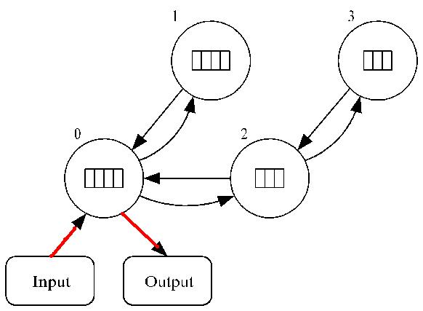
Task/Channel Graph for 4 Processes
Red are I/o channels
Black are used for the reduction step.

Slide 41
Task/Channel Model Assumption
The analysis of algorithms typically performed assumes that this model supports the concurrent transmission of messages from multiple tasks, as long as
  they use different channels
  no two active channels have the same source or destination.
This is claimed to be a reasonable assumption
  based on current commercial systems
  for some clusters
This is not a reasonable assumption for networks of workstations connected by hub or any communications systems supporting only one message at a time.
See Ch. 3, pg 88 of Quinn’s textbook for more details
This assumption is not reasonable for many communication-intensive applications.

Slide 42
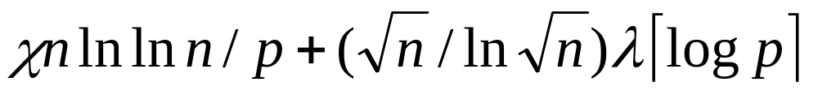
Analysis
χ (i.e.,‘ki’) is time needed to mark a cell
Sequential execution time: ~ χ n ln ln n
Number of broadcasts: ~ √n / ln √n
Broadcast time: λ ⎡ log p ⎤ with λ latency
Expected execution time:
This uses the fact that the number of primes between 2 and n is about n/ln n. So, a good approximation to the number of loop iterations is the term underlined above.

Slide 43
Code: Complete code starts on page 124
#include <mpi.h>
#include <math.h>
#include <stdio.h>
#include "MyMPI.h"
#define MIN(a,b) ((a)<(b)?(a):(b))
MyMPI.h is a header file containing the macros we are needing and function prototypes for the utilities we are developing.
After this, we will always include this file in our code.
It will be posted on the web site.

Slide 44
int main (int argc, char *argv[])
{
... /* Bunch of data declarations here */
MPI_Init (&argc, &argv);
/* Start timer here */
MPI_Barrier(MPI_COMM_WORLD);
elapsed_time = -MPI_Wtime();
MPI_Comm_rank (MPI_COMM_WORLD, &id);
MPI_Comm_size (MPI_COMM_WORLD, &p);
This is stuff we’ve seen before, but now we need to know what argc and *argv are.

Slide 45
Capturing Command Line Values
Example: Invoking a UNIX compiler gcc
gcc -o myprog myprog.c
would result in the following values being passed to gcc:
argc 4 i.e. number of tokens on command line – an int
argv[0] gcc each argv[i] is a char array argv[1] -o
argv[2] myprog
argv[3] myprog.c

Slide 46
if (argc != 2) {
if (!id) printf ("Command line: %s <m>\n", argv[0]);
MPI_Finalize();
exit (1);
}
n = atoi(argv[1]);
We are assuming the user will specify the upper range of the sieve as a command line argument.
If this argument is missing (argc != 2), we terminate the processing and return a 1.
Otherwise, we convert the command string upper range number (which is in a character array argv[1]) to an integer.
atoi is a C predefined conversion routine that converts alphanumeric (i.e. char data) to integer data.

Slide 47
low_value = 2 + BLOCK_LOW(id,p,n-1);
high_value = 2 + BLOCK_HIGH(id,p,n-1);
size = BLOCK_SIZE(id,p,n-1);
We use the macros defined to do the block decomposition by method 2.
Remember these are defined in a header file MyMPI.h
We will give each process a contiguous block of the array that will store the marks.

Slide 48
proc0_size = (n-1)/p;
if ((2 + proc0_size) < (int) sqrt((double) n)) {
if (!id) printf ("Too many processes\n");
MPI_Finalize();
exit (1);
}
Recall, this algorithm works only if the square of the largest value in process 0 is greater than the upper limit of the sieve.
This code checks for that and exits if the assumed condition is not true.
Note: The error message could be more informative!

Slide 49
marked = (char *) malloc (size);
if (marked == NULL) {
printf ("Cannot allocate enough memory\n");
MPI_Finalize();
exit (1); }
This allocates memory for the process’ share of the array.
A byte is the smallest unit of memory that can be indexed in C, so the array marked is declared to be a char array.
malloc is the way to dynamically allocate array space in C.
If we are out of memory, we exit.

Slide 50
for (i = 0; i < size; i++) marked[i] = 0;
At last, we have step 1 of the algorithm!
if (!id) index = 0;
prime = 2;
This looks strange, but the variable index is only the index in the array of process 0.
We conditionalize its initialization to process 0 to emphasize this. Only the id of 0 will make this true.
It is a good idea to do this to keep straight the local and global indices.

Slide 51
do { if (prime * prime > low_value)
first = prime * prime - low_value;
else {
if (!(low_value % prime))
first = 0;
else first = prime - (low_value % prime);
}
This is step 3 in the sequential algorithm.
We need to determine the index corresponding to the first integer needing marking.
% is the modulo operator in C.

Slide 52
for (i = first; i < size; i += prime) marked[i] = 1;
This loop does the sieving.
Each process marks the multiples of the current prime number from the first index through the end of the array.
if (!id) {
while (marked[++index]);
prime = index + 2; }
Process 0 now finds the next prime by locating the next unmarked location in the array.

Slide 53
MPI_Bcast (&prime, 1, MPI_INT, 0, MPI_COMM_WORLD);
} while (prime * prime <= n);
Process 0 broadcasts the value of the next prime to the other processes.
We loop back to continue to sieve as long as the prime squared is less than or equal to n.
And, we’re coming down the homestretch!
count = 0;
for (i = 0; i < size; i++)
if (!marked[i]) count++;
Each process counts the number of primes in its portion of the list.

Slide 54
MPI_Reduce (&count, &global_count, 1, MPI_INT, MPI_SUM,
0, MPI_COMM_WORLD);
The processes compute the grand total and store the result in global_count in process 0 after a reduction.
elapsed_time += MPI_Wtime();
if (!id) { printf ("%d primes are less than or equal to %d\n", global_count, n);
printf ("Total elapsed time: %10.6f\n", elapsed_time);
}
MPI_Finalize ();
return 0; }
Turn off timer, print the results, and finalize.

Slide 55
Benchmarking
Execute sequential algorithm
Determine χ = 85.47 nanosec
Execute series of broadcasts
Determine λ = 250 μsec

Slide 56
Execution Times (sec)
Processors | Predicted | Actual (sec)
1 | 24.900 | 24.900
2 | 12.721 | 13.011
3 | 8.843 | 9.039
4 | 6.768 | 7.055
5 | 5.794 | 5.993
6 | 4.964 | 5.159
7 | 4.371 | 4.687
8 | 3.927 | 4.222
Observation: As illustrated in Fig 5.7, this is a very close approximation, with only about a 4% error.

Slide 57
Improvements
Delete even integers
  Cuts number of computations in half
  Frees storage for larger values of n
  Cuts the execution time almost in half.
Each process finds own sieving primes
  Replicating computation of primes to √n
  Eliminates about √n / ln √n broadcast steps
Reorganize loops
  As designed, the algorithm is marking widely dispersed elements of a very large array.
  Changing this can increase the cache hit rate

Slide 58
Reorganize Loops
Suppose cache has 4 lines of 4 bytes each. So
line 1 holds 3,5,7,9
line 2 holds 11,13,15,17 etc.
Then if we sieve all the multiples of one prime before doing the next one, all of the yellow numbers will be cache misses. Note: Multiples of 2 are already not included.
multiples of 3: 9 15 21 27 33 39 45 51 57 63 69 75 81 87 93 99
multiples of 5: 25 35 45 55 65 75 85 95
multiples of 7: 49 63 77 91

Slide 59
Reorganize Loops
Now use 8 bytes in two cache lines and sieve multiples of all primes for the first 8 bytes before going to the next 8 bytes. Again yellow numbers show cache misses:
3-17: Multiples of 2 : 9 15
19-33: Multiples of 3,5: 21 27 33 25
35-49: Multiples of 3,4,7: 39 45 35 45 49
51-65: Multiples of 3,5,7: 51 57 63 55 65 63
67-81: Multiples of 3,5,7: 63 69 75 81 75 77
83-97: Multiples of 3,5,7: 87 93 85 95 92
99: Multiples of 3,5,7: 99

Slide 60
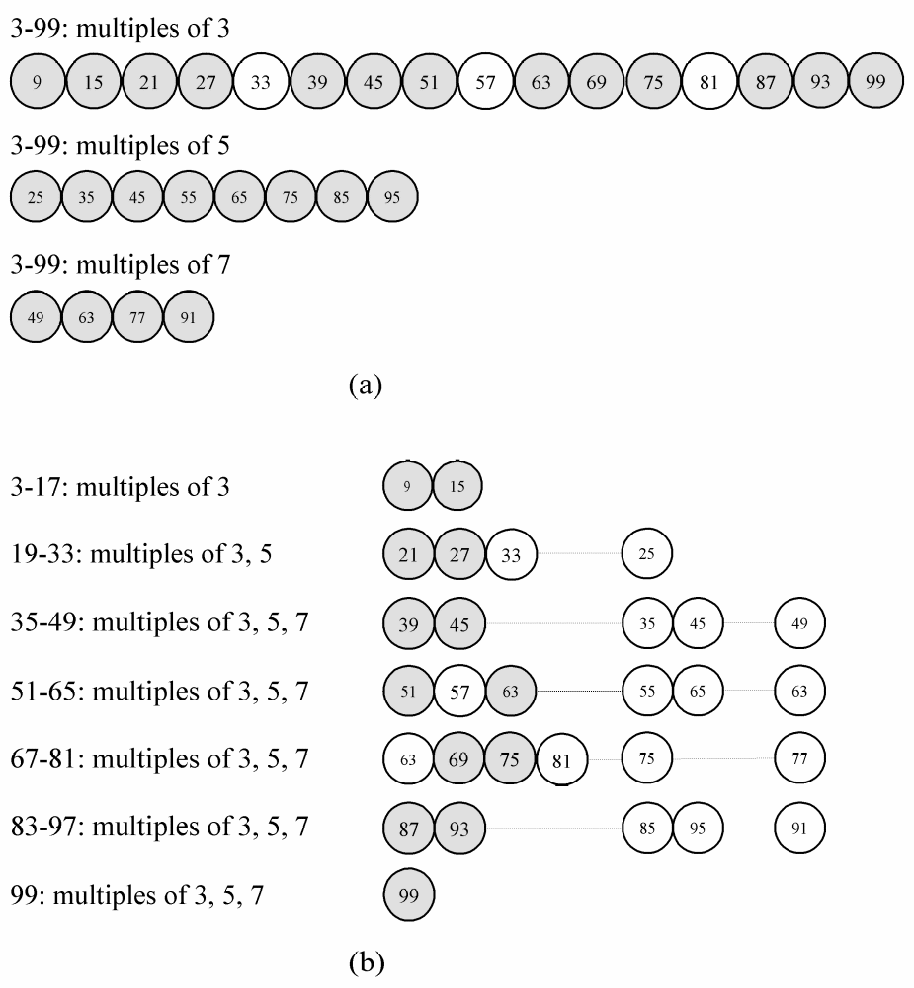
Comparing (as shown in text)
Lower
Cache hit rate
Higher

Slide 61
Comparing 4 Versions
Procs | Sieve 1 | Sieve 2 | Sieve 3 | Sieve 4
1 | 24.900 | 12.237 | 12.466 | 2.543
2 | 12.721 | 6.609 | 6.378 | 1.330
3 | 8.843 | 5.019 | 4.272 | 0.901
4 | 6.768 | 4.072 | 3.201 | 0.679
5 | 5.794 | 3.652 | 2.559 | 0.543
6 | 4.964 | 3.270 | 2.127 | 0.456
7 | 4.371 | 3.059 | 1.820 | 0.391
8 | 3.927 | 2.856 | 1.585 | 0.342
10-fold improvement
7-fold improvement
Note: Graphical display of this chart in Fig. 5.10

Slide 62
Summary
Sieve of Eratosthenes: parallel design uses domain decomposition
Compared two block distributions
  Chose one with simpler formulas
Introduced MPI_Bcast
Optimizations reveal importance of maximizing single-processor performance

Slide 63
New Sieve Material Added
Reference: Parallel Computing: Theory and Practice, Second Edition, Michael Quinn, McGraw-Hill, 1994, pages 10-13.
The following slides are not from material in our current textbook.

Slide 64
Sieve of Eratosthenes
A Control-Parallel Approach
Data parallelism refers to using multiple PEs to apply the same sequence of operations to different data elements.
Functional or control parallelism involves applying a different sequence of operations to different data elements
Model assumed for this example:
  Shared-memory MIMD

Slide 65
A Control Parallel Sieve Approach
Each processor repeats the following two step process:
  Identify the next prime number
  Strike out the multiples of that prime, starting with its square.
Each processor continues until a prime greater than √n is found.
Shared memory contains
  Boolean array containing numbers being sieved,
  Integer corresponding to largest prime found so far
PE’s local memories contain local loop indexes keeping track of multiples of its current prime (since each is working with different prime).

Slide 66
Control Parallel Sieve (cont.)
Basic algorithm for shared memory MIMD
  Processor accesses variable holding current prime
  Searches for next unmarked value, which it uses as its next prime
  Updates variable containing current prime
    Must avoid having two processors doing this at same time
Problems and Inefficiencies
  A processor could waste time sieving multiples of a composite number
  More than one processor could strike out multiples of the same number
  Must avoid having two processors access the same memory location at the same time as marking is a write operation.
Notes:
Algorithm still works, but is wasteful
Processor is sieving 2, another starts sieving 3, yet another starts sieving 4 (because first processor has not yet marked it)
Again, wasteful
See Figure 1-9 on Quinn, p. 13

Slide 67
Parallel Speedup Metric
(Initial Overview)
A measure of the increase in running time due to parallelism.
Speedup = (sequential time)/(parallel time)
  The sequential time is the worst case sequential running time
  The parallel time is the worst case parallel running time.

Slide 68
How Much Speedup is Possible?
Suppose n = 1000
Sequential algorithm
  Time to strike out multiples of prime p is
    ⎡(n+1- p²)/p⎤
  Multiples of 2: ((1000+1) –4)/2=997/2=498
  Multiples of 3: ((1000+1) –9)/3=992/3=330
  Total time to strike primes = 1411 (number of “steps”)
2 PEs gives speedup 1411/706=2.00
3 PEs gives speedup 1411/499=2.83
3 PEs require 499 strikeout time units, so no more speedup is possible using additional PEs
  Multiples of 2’s dominate with 498 strikeout steps

