Slide 1
Chapter 5
The Sieve of Eratosthenes

Slide 2
Chapter Objectives
Analysis of block allocation schemes
Function MPI_Bcast
Performance enhancements
Problem to solve: The Greek mathematician Eratosthenes (276-194 BC) wanted to find a way of generating the prime numbers up to some number n.
No formula will generate these.
However, he devised a method which has become known as the sieve of Eratosthenes.

Slide 3
Outline to the Solution
The sequential algorithm
Sources of parallelism
Data decomposition options
Parallel algorithm development, analysis
An MPI program
Benchmarking
Optimizations

Slide 4
Sieve of Eratosthenes
Sequential Algorithm in Pseudocode
1. Create a list of unmarked natural numbers 2, 3, …, n
2. k ← 2
3. Repeat
(a) Mark all multiples of k between k² and n
(b) Let k ← smallest unmarked number > k
until k² > n
4. The unmarked numbers are primes

Slide 5
Sequential Algorithm
2
2
3
3
4
4
5
5
6
6
7
7
8
8
9
9
10
10
11
12
12
13
14
14
15
15
16
16
17
18
18
19
20
20
21
21
22
22
23
24
24
25
25
26
26
27
27
28
28
29
30
30
31
32
32
33
33
34
34
35
35
36
36
37
38
38
39
39
40
40
41
42
42
43
44
44
45
45
46
46
47
48
48
49
49
50
50
51
51
52
52
53
54
54
55
55
56
56
57
57
58
58
59
60
60
61
The algorithm is not practical for large values of n.
Its complexity is Θ(n ln ln n) and n is exponential in the number of digits.
But, finding prime numbers is important for encryption purposes.

Slide 6
Data Structure Used For Sequential Algorithm
Assume a Boolean array of n elements
Array indices are 0 through n-2 and they represent the numbers 2, 3, ..., n.
The boolean value at index i represents whether of not the number i+2 is marked.
  Indices that are marked represent composite numbers (i.e., not prime)
Initially, all numbers are unmarked

Slide 7
Sources of Parallelism
Because the guts of the algorithm is the marking of elements in an array, domain decomposition makes sense.
Domain decomposition
  Divide data into n-1 pieces
  Associate computational steps with data
One primitive task per array element
  These will be agglomerated into larger groups of elements.

Slide 8
Making 3(a) Parallel
3 a) Mark all multiples of k between k² and n
This is straightforward:
for all j where k² ≤ j ≤ n do
if j mod k = 0 then
mark j (i.e. it is not a prime)
endif
endfor

Slide 9
Making 3(b) Parallel
3 b) Find smallest unmarked number > k
This requires two steps:
Min-reduction (to find smallest unmarked
number > k)
Broadcast (to get result to all tasks)
Plus- remember these are in a repeat-until loop which
loops until k² > n.

Slide 10
Good News – Bad News
We have found lots of parallelism to exploit.
That is the good news!
Look back at the last slide – there are a lot of reduction and broadcast operations.
That is the bad news!
As usual, we will try to agglomerate the primitive tasks into more substantial tasks and hopefully improve the situation.
We will see that we end up with an algorithm that requires less computation and less communication than the original algorithm.

Slide 11
Agglomeration Goals
We want to:
  Consolidate tasks
  Reduce communication cost
  Balance computations among processes
We often call the result of partitioning, agglomeration, and mapping the data decomposition or just the decomposition.

Slide 12
Data Decomposition Options
Interleaved (cyclic)
  Different PEs handle different primes, e.g.,
    P₀ handles multiples of 2 and P₁ multiples of 3
  Easy to determine “owner” of each index
  Leads to load imbalance for this problem
Block
  Array [1,n] divided into block for each PE
  Balances loads
  More complicated to determine owner if n not a multiple of p

Slide 13
Block Decomposition Options
Want to balance workload when n is not a multiple of p
Each process gets either ⎡n/p⎤ or ⎣n/p⎦ elements
We seek simple expressions so we can
  Find low & high indices in block for each PE
  Find the PE that handles a given index
  Find the owner given an index

Slide 14
We Will Start Here After Fall Weekend
Enjoy!

Slide 15
Method #1
Let r = n mod p
If r = 0, all blocks have same size
Else
  First r blocks have size ⎡n/p⎤
  Remaining p-r blocks have size ⎣n/p⎦

Slide 16
Examples
17 elements divided among 7 processes
17 elements divided among 5 processes
17 elements divided among 3 processes

Slide 17
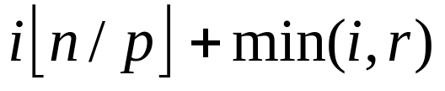
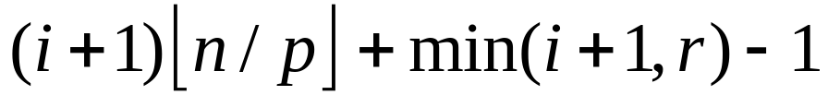
Method #1 Calculations
First element controlled by process i
Last element controlled by process i
Process controlling element j

Slide 18
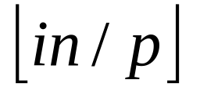
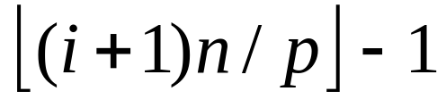
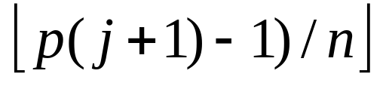
Method #2
Scatters larger blocks among processes
  Not all blocks given to PEs with lowest indices
First element controlled by process i
Last element controlled by process i
Process controlling element j

Slide 19
Examples
17 elements divided among 7 processes
17 elements divided among 5 processes
17 elements divided among 3 processes

Slide 20
Comparing Methods
Our choice
Operations | Method 1 | Method 2
Low index | 4 | 2
High index | 6 | 4
Owner | 7 | 4
Assuming no operations for “floor” function

Slide 21
Pop Quiz
Illustrate how block decomposition method #2 would divide 13 elements among 5 processes.
13(0)/ 5 = 0
13(2)/ 5 = 5
13(4)/ 5 = 10
13(1)/5 = 2
13(3)/ 5 = 7

Slide 22
Block Decomposition Macros
#define BLOCK_LOW(id,p,n) ((i)*(n)/(p))
#define BLOCK_HIGH(id,p,n) \
(BLOCK_LOW((id)+1,p,n)-1)
#define BLOCK_SIZE(id,p,n) \
(BLOCK_LOW((id)+1)-BLOCK_LOW(id))
#define BLOCK_OWNER(index,p,n) \
(((p)*(index)+1)-1)/(n))

Slide 23
Local vs. Global Indices
L 0 1
L 0 1 2
G 0 1
G 2 3 4
L 0 1
G 5 6
L 0 1 2
L 0 1 2
G 7 8 9
G 10 11 12

Slide 24
Looping over Elements
Sequential program
  for (i = 0; i < n; i++) {
  …
  }
Parallel program
  size = BLOCK_SIZE (id,p,n);
  for (i = 0; i < size; i++) {
  gi = i + BLOCK_LOW(id,p,n);
  }
Index i on this process…
…takes place of sequential program’s index gi

Slide 25
Fast Marking
Block decomposition allows same marking as sequential algorithm:
  Each block finds first multiple of k say cell j
  Mark the cells j, j + k, j + 2k, j + 3k, …
Avoids computing for all j in block
if j mod k = 0 then mark j (as it is not a prime)
  Requires n/p modulo operations

Slide 26
Decomposition Affects Implementation
Largest prime used to sieve is √n
First process has ⎣n/p⎦ elements
It has all sieving primes if p < √n
  Normally n is much larger than p.
First process always broadcasts next sieving prime
No reduction step needed

Slide 27
Parallel Algorithm Development
1. Create list of unmarked natural numbers 2, 3, …, n
2. k ← 2
3. Repeat
(a) Mark all multiples of k between k² and n
(b) k ← smallest unmarked number > k
until k² > m
4. The unmarked numbers are primes
Each process creates its share of list
Each process does this
Each process marks its share of list
Process 0 only
(c) Process 0 broadcasts k to rest of processes
5. Reduction to determine number of primes

Slide 28
Function MPI_Bcast
int MPI_Bcast (
void *buffer, /* Addr of 1st element */
int count, /* # elements to broadcast */
MPI_Datatype datatype, /* Type of elements */
int root, /* ID of root process */
MPI_Comm comm) /* Communicator */
MPI_Bcast (&k, 1, MPI_INT, 0, MPI_COMM_WORLD);

Slide 29
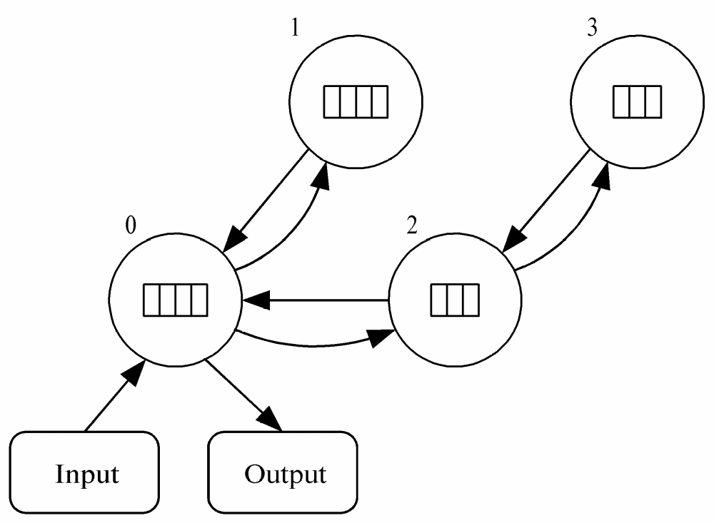
Task/Channel Graph

Slide 30
Task/Channel Model Assumption
Analysis of algorithms assumes that this model supports the concurrent transmission of messages from multiple tasks, as long as
  they use different channels
  no two active channels have the same source or destination.
Claimed to be a reasonable assumption
  based on current commercial systems
  for some clusters
Not reasonable assumption for networks of workstations connected by hub or any communications systems supporting only one message at a time.
See Ch. 3, pg 88 of Quinn’s textbook for more details
Assumption is not reasonable for many communication-intensive applications.

Slide 31
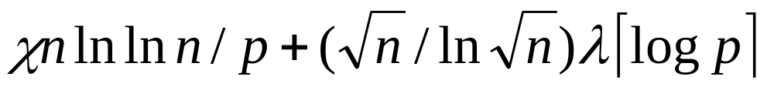
Analysis
χ (i.e.,‘ki’) is time needed to mark a cell
Sequential execution time: ~ χ n ln ln n
Number of broadcasts: ~ √n / ln √n
Broadcast time: λ ⎡ log p ⎤ with λ latency
Expected execution time:

Slide 32
Code (1/4)
#include <mpi.h>
#include <math.h>
#include <stdio.h>
#include "MyMPI.h"
#define MIN(a,b) ((a)<(b)?(a):(b))
int main (int argc, char *argv[])
{
...
MPI_Init (&argc, &argv);
MPI_Barrier(MPI_COMM_WORLD);
elapsed_time = -MPI_Wtime();
MPI_Comm_rank (MPI_COMM_WORLD, &id);
MPI_Comm_size (MPI_COMM_WORLD, &p);
if (argc != 2) {
if (!id) printf ("Command line: %s <m>\n", argv[0]);
MPI_Finalize(); exit (1);
}

Slide 33
Code (2/4)
n = atoi(argv[1]);
low_value = 2 + BLOCK_LOW(id,p,n-1);
high_value = 2 + BLOCK_HIGH(id,p,n-1);
size = BLOCK_SIZE(id,p,n-1);
proc0_size = (n-1)/p;
if ((2 + proc0_size) < (int) sqrt((double) n)) {
if (!id) printf ("Too many processes\n");
MPI_Finalize();
exit (1);
}
marked = (char *) malloc (size);
if (marked == NULL) {
printf ("Cannot allocate enough memory\n");
MPI_Finalize();
exit (1);
}

Slide 34
Code (3/4)
for (i = 0; i < size; i++) marked[i] = 0;
if (!id) index = 0;
prime = 2;
do {
if (prime * prime > low_value)
first = prime * prime - low_value;
else {
if (!(low_value % prime)) first = 0;
else first = prime - (low_value % prime);
}
for (i = first; i < size; i += prime) marked[i] = 1;
if (!id) {
while (marked[++index]);
prime = index + 2;
}
MPI_Bcast (&prime, 1, MPI_INT, 0, MPI_COMM_WORLD);
} while (prime * prime <= n);

Slide 35
Code (4/4)
count = 0;
for (i = 0; i < size; i++)
if (!marked[i]) count++;
MPI_Reduce (&count, &global_count, 1, MPI_INT, MPI_SUM,
0, MPI_COMM_WORLD);
elapsed_time += MPI_Wtime();
if (!id) {
printf ("%d primes are less than or equal to %d\n",
global_count, n);
printf ("Total elapsed time: %10.6f\n", elapsed_time);
}
MPI_Finalize ();
return 0;
}

Slide 36
Benchmarking
Execute sequential algorithm
Determine χ = 85.47 nanosec
Execute series of broadcasts
Determine λ = 250 μsec

Slide 37
Execution Times (sec)
Processors | Predicted | Actual (sec)
1 | 24.900 | 24.900
2 | 12.721 | 13.011
3 | 8.843 | 9.039
4 | 6.768 | 7.055
5 | 5.794 | 5.993
6 | 4.964 | 5.159
7 | 4.371 | 4.687
8 | 3.927 | 4.222
Observation: As illustrated in Fig 5.7, this is a very close approximation, with only about a 4% error.

Slide 38
Improvements
Delete even integers
  Cuts number of computations in half
  Frees storage for larger values of n
Each process finds own sieving primes
  Replicating computation of primes to √n
  Eliminates about √n / ln √n broadcast steps
Reorganize loops
  Increases cache hit rate

Slide 39
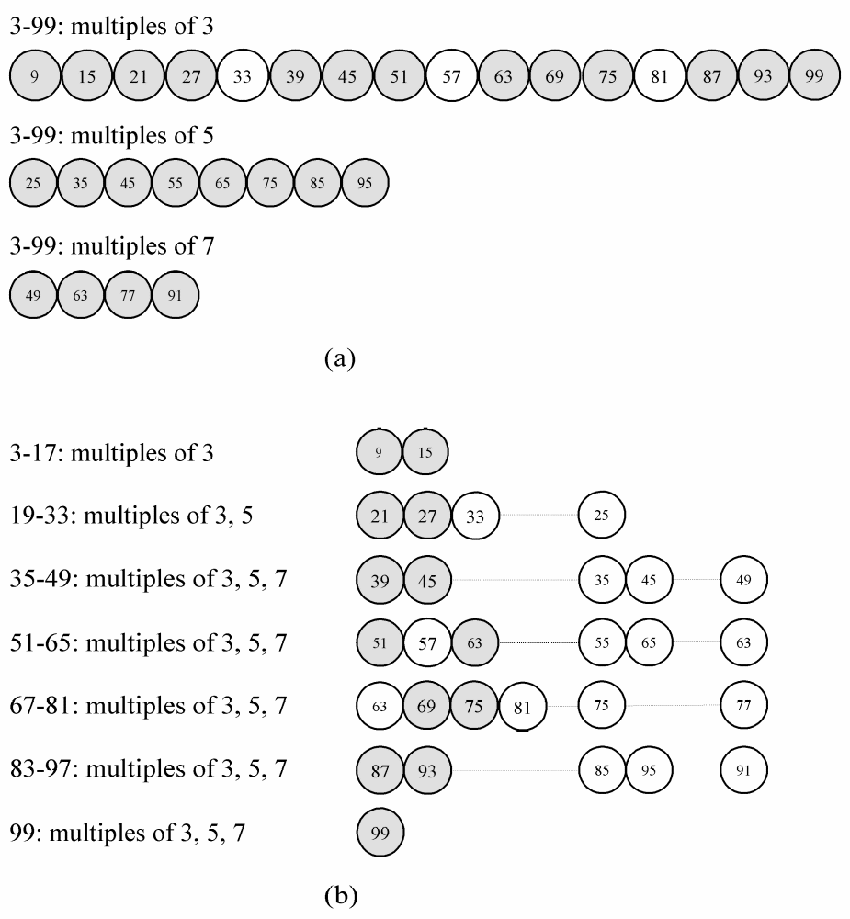
Reorganize Loops
Lower
Cache hit rate
Higher

Slide 40
Comparing 4 Versions
Procs | Sieve 1 | Sieve 2 | Sieve 3 | Sieve 4
1 | 24.900 | 12.237 | 12.466 | 2.543
2 | 12.721 | 6.609 | 6.378 | 1.330
3 | 8.843 | 5.019 | 4.272 | 0.901
4 | 6.768 | 4.072 | 3.201 | 0.679
5 | 5.794 | 3.652 | 2.559 | 0.543
6 | 4.964 | 3.270 | 2.127 | 0.456
7 | 4.371 | 3.059 | 1.820 | 0.391
8 | 3.927 | 2.856 | 1.585 | 0.342
10-fold improvement
7-fold improvement
Note: Graphical display of this chart in Fig. 5.10

Slide 41
Summary
Sieve of Eratosthenes: parallel design uses domain decomposition
Compared two block distributions
  Chose one with simpler formulas
Introduced MPI_Bcast
Optimizations reveal importance of maximizing single-processor performance

Slide 42
New Sieve Material Added
Reference: Parallel Computing: Theory and Practice, Second Edition, Michael Quinn, McGraw-Hill, 1994, pages 10-13.

Slide 43
Sieve of Eratosthenes
A Control-Parallel Approach
Data parallelism refers to using multiple PEs to apply the same sequence of operations to different data elements.
Functional or control parallelism involves applying a different sequence of operations to different data elements
Model assumed for this example:
  Shared-memory MIMD

Slide 44
A Control Parallel Sieve Approach
Each processor repeats the following two step process:
  Identify the next prime number
  Strike out the multiples of that prime, starting with its square.
Each processor continues until a prime greater than √n is found.
Shared memory contain
  Boolean array containing numbers being sieved,
  Integer corresponding to largest prime found so far
PE’s local memories contain local loop indexes keeping track of multiples of its current prime (since each is working with different prime).

Slide 45
Control Parallel Sieve (cont.)
Basic algorithm for shared memory MIMD
  Processor accesses variable holding current prime
  Searches for next unmarked value, which it uses as its next prime
  updates variable containing current prime
    Must avoid having two processors doing this at same time
Problems and Inefficiencies
  A processor could waste time sieving multiples of a composite number
  More than one processor could strike out multiples of the same number
  Must avoid having two processors access the same memory location at the same time.
Notes:
Algorithm still works, but is wasteful
Processor is sieving 2, another starts sieving 3, yet another starts sieving 4 (because first processor has not yet marked it)
Again, wasteful
See Figure 1-9 on Quinn, p. 13

Slide 46
Parallel Speedup Metric
(Initial Overview)
A measure of the increase in running time due to parallelism.
Speedup = (sequential time)/(parallel time)
  The sequential time is the worst case sequential running time
  The parallel time is the worst case parallel running time.

Slide 47
How Much Speedup is Possible
Suppose n = 1000
Sequential algorithm
  Time to strike out multiples of prime p is
    ⎡(n+1- p²)/p⎤
  Multiples of 2: ((1000+1) –4)/2=997/2=498
  Multiples of 3: ((1000+1) –9)/3=992/3=330
  Total time to strike primes = 1411 (number of “steps”)
2 PEs gives speedup 1411/706=2.00
3 PEs gives speedup 1411/499=2.83
3 PEs require 499 strikeout time units, so no more speedup is possible using additional PEs
  Multiples of 2’s dominate with 498 strikeout steps

