Slide 1
Chapter 6
Floyd’s Algorithm

Slide 2
Chapter Objectives
Creating 2-D arrays
Thinking about “grain size”
Introducing point-to-point communications
Reading and printing 2-D matrices
Analyzing performance when computations and communications overlap

Slide 3
Outline
All-pairs shortest path problem
Dynamic 2-D arrays
Parallel algorithm design
Point-to-point communication
Block row matrix I/O
Analysis and benchmarking

Slide 4
All-Pairs Shortest Path
Have a directed weighted graph with the weights positive.
We want to find the shortest path from each vertex i to each vertex j, if it exists.
If the path doesn’t exist, the distance is assumed to be infinite.
For this problem, an adjacency matrix is the best representation – i.e. for row i and column j, we place the initial weight in row i and column j, if the edge exists, otherwise we indicate ∞.

Slide 5
All-pairs Shortest Path Problem
4
A
B
3
6
A
B
C
D
E
A
0
6
3
∞
∞
1
3
C
5
B
4
0
∞
1
∞
1
D
C
∞
0
5
1
∞
E
2
D
∞
3
∞
0
∞
E
∞
∞
∞
2
0
Initial Adjacency Matrix Containing Distances

Slide 6
All-pairs Shortest Path Problem
4
A
B
3
6
A
B
C
D
E
A
0
6
3
6
4
1
3
C
5
B
4
0
7
1
8
1
D
C
12
6
0
3
1
E
2
D
7
3
10
0
11
E
9
5
12
2
0
Resulting Adjacency Matrix Containing Distances

Slide 7
Why Use an Adjacency Matrix?
It allows constant time access to every edge.
It does not require more memory than what is required for storing the original data.
How do we represent the infinity?
  Normally a number not allowed as an edge value is given – either something like -1 or a very, very large number.
Floyd’s Algorithm transforms the first matrix into the second in Θ(n³) time.

Slide 8
Floyd’s Algorithm
for k ← 0 to n-1
for i ← 0 to n-1
for j ← 0 to n-1
a[i,j] ← min (a[i,j], a[i,k] + a[k,j])
endfor
endfor
endfor
Note: This gives you the distance from i to j, but not the path that has that distance.
So- don’t use this for the ASC HW problem where you are to find the path!

Slide 9
Why It Works
Shortest path from i to k
through 0, 1, …, k-1
i
k
Computed
in previous
iterations
Shortest path from i to j
through 0, 1, …, k-1
Shortest path from k to j
through 0, 1, …, k-1
j

Slide 10
Creating Arrays at Run Time
Best if the array size can be specified at run time as then the program doesn’t have to be recompiled.
In C, for a 1 dimensional array this is easily done by declaring a scalar pointer and allocating memory from the heap with a malloc statement:
    int *A;
    ...
    A = (int *) malloc (n * sizeof(int));
or, pictorially.....

Slide 11
Dynamic 1-D Array Creation
Run-time Stack
A
Heap
The word heap is just another word for unallocated memory. It is not the data structure called a heap.

Slide 12
Allocating 2 Dimensional Arrays
This is more complicated since C views a 2D array as an array of arrays.
We want array elements to occupy contiguous memory locations so we can send or receive the entire contents of the array in a single message.
Here is one way to allocate a 2-D array:
  First, allocate the memory where the array values are to be stored.
  Second, allocate the array of pointers.
  Third, initialize the pointers.
Or, pictorially ....

Slide 13
Dynamic 2-D Array Creation
1) Allocate memory for 4 X 3 array (with 12 values)
Run-time Stack
Bstorage
B
Heap
2) Allocate pointer memory to point to start of rows
3) Initialize pointers

Slide 14
The C Code for This Allocation of m X n 2D Array of Integers
int **B, *Bstorage,i;
...
BStorage = (int *) malloc(m*n*sizeof(int));
//Allocate memory for m X n array
B = (int **) malloc (m * sizeof(int *));
// Allocate pointer memory to point to // start of rows
for (i = 0; i < m; i++)
B[i] = &Bstorage[i*n];
// Initialize pointers

Slide 15
Designing Parallel Algorithm
As with other MPI algorithms, we need to handle
Partitioning
Communication
Agglomeration and Mapping

Slide 16
Partitioning
Domain or functional decomposition?
Look at pseudocode
It’s a big loop. The same assignment statement is executed n³ times
There is no functional parallelism
So, we look at domain decomposition: divide matrix A into its n² elements
A primitive task will be an element of the adjacency distance matrix.

Slide 17
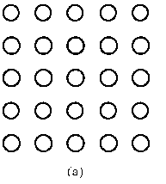
These are Our Primitive Tasks
i.e. A[i,j ] is handled by process thought of as i,j (although it really is i * n + j where n is 5 here.)
Example: A[2,3] is handled by process 2*5 + 3 = 13

Slide 18
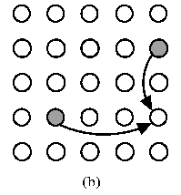
Updating
Update step is : A[i,j] ← min (A[i,j], A[i,k] + A[k,j])
Example: When k = 1, A[3,4] needs the shaded values of A[3,1] and A[1,4] as shown above.

Slide 19
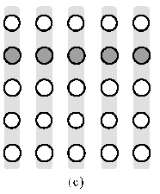
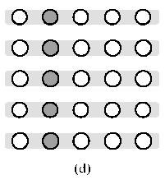
Broadcasting
(c) In iteration k, every task in row k must broadcast its value within the task column.
Here k is 1.
(d) In iteration k, every task in column k must broadcast its value to the other tasks in the same row. Again, k = 1.

Slide 20
Obvious Question
Since updating A[i,j] requires the values of A[k,k] and A[k,j], do we have to do those calculations first?
An important observation is that the values of A[i,k] and A[k,j] don’t change during iteration k:
  A[i,k] ← min (A[i,k], A[i,k] + A[k,j])
  and
  A[k,j] ← min (A[k,j], A[k,k] + A[k,j])
As the weights are positive, A[k,j] can’t decrease and these two are independent of each other and independent of A[i,j]’s calculation.
So, we can for each iteration of the outer loop, we can broadcast and then update every element of A in parallel.
This type of analysis of loops are critical in designing parallel algorithms!

Slide 21
Agglomeration and Mapping
Number of tasks: static
Communication among tasks: structured
Computation time per task: constant
Strategy: (Use are decision tree again from earlier)
  Agglomerate tasks to minimize communication
  Create one task per MPI process

Slide 22
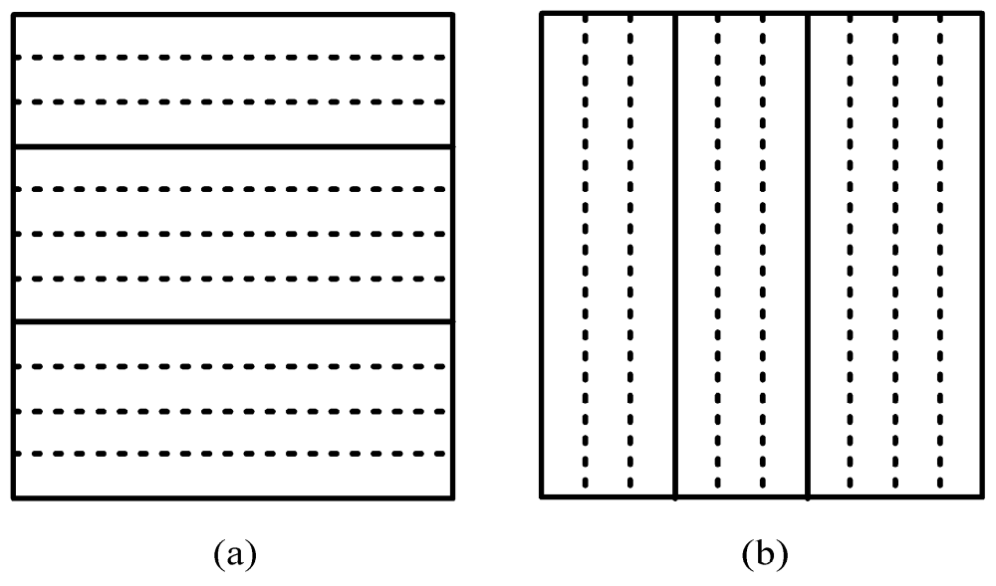
Two Natural Choices for Data Decompositions to Agglomerate n² Primitive Tasks into p Tasks
Rowwise block striped
Columnwise block striped

Slide 23
Comparing Decompositions
Columnwise block striped
  Broadcast within columns eliminated
Rowwise block striped
  Broadcast within rows eliminated
  Reading matrix from file simpler as we tend to naturally organize matrices by rows (called row-major order).
Choose rowwise block striped decomposition
Note: There is a better way to do this which requires more MPI functions that Quinn doesn’t introduce until Chapter 8. But, this approach is reasonable.

Slide 24
I/O
Could open the file, have each process seek to the proper location in the file, and read its part of the adjacency matrix. (Can run into contention as well as need to do disk seeks at low level).
More natural to have one process input the file and distribute the matrix elements to the other processes.
The simplest approach for p processes is to have the p-1 process handle this as it can use its allocated memory to do the input for each of the other processes.
i.e. no other memory is required. Pictorially,...

Slide 25
File Input
File

Slide 26
Question
Why don’t we input the entire file at once
and then scatter its contents among the
processes, allowing concurrent message
passing?

Slide 27
We Need Two Functions for
Reading and Writing
void read_row_striped_matrix (char *, void ***, void **, MPI_Datatype, int *, int *, MPI_Comm);
void print_row_striped_matrix (void **, MPI_Datatype, int, int, MPI_Comm);
A lot of the code for these are straight forward and is given in Appendix B of the text – page 495+ for the first and page 502+ for the second. We will consider only a few points.

Slide 28
Overview of I/O
The read operates as shown – i.e. process p-1 reads a contiguous group of matrix rows and sends a message containing these rows directly to the process that will manage them.
The print function each process other than process 0 sends process 0 a message containing its group of matrix rows. Process 0 receives each of these messages and prints the rows to standard output.
These are called point-to-point communications:
  Involves a pair of processes
  One process sends a message
  Other process receives the message

Slide 29
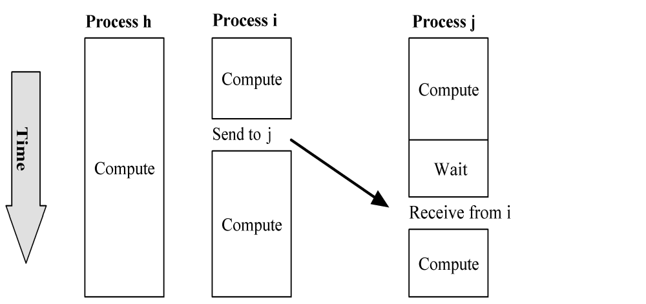
Send/Receive Not Collective
In previous examples of communications, all processes were involved in the communication.
Above, process h is not involved at all and can continue computing.
How can this happen if all processes execute the same program? We’ve encountered this problem before.
The calls must be inside conditionally executed code.

Slide 30
Function MPI_Send
int MPI_Send (
void *message, //start address of msg
int count, // number of items
MPI_Datatype datatype, //must be same type
int dest, //rank to receive
int tag, //integer label- this //allows different types of //messages to be sent
MPI_Comm comm //the communicator being used
)

Slide 31
Function MPI_Recv
int MPI_Recv (
void *message,
int count,
MPI_Datatype datatype,
int source,
int tag,
MPI_Comm comm,
MPI_Status *status)
*status is a pointer to a record of type MPI_Status.
After completion, it will contain status information (see pg 148) – i.e. one indicates an error.

Slide 32
Inside MPI_Send and MPI_Recv
Sending Process
Receiving Process
Program
Memory
System
Buffer
System
Buffer
Program
Memory
MPI_Send
MPI_Recv

Slide 33
Return from MPI_Send
Function blocks until message buffer free
Message buffer is free when
  Message copied to system buffer, or
  Message transmitted
Typical scenario
  Message copied to system buffer
  Transmission overlaps computation
Return from MPI_Recv
Function blocks until message in buffer
If message never arrives, function never returns

Slide 34
Deadlock
Deadlock: process waiting for a condition that will never become true
It is very, very easy to write send/receive code that deadlocks
  Two processes: both receive before send
  Send tag doesn’t match receive tag
  Process sends message to wrong destination process
Writing operating system code that doesn’t deadlock is another challenge.

Slide 35
Example 1
Have process 0 (which holds a) and 1(which holds b). Both want to compute the average of a and b. Process 0 must receive b from 1 and process 1 must receive a from 0.
We write the following code:
if (id == 0) {
MPI_Recv (&b,...);
MPI_Send (&a,...);
c = (a + b)/2.0;
} else if (id == 1) {
MPI_Recv (&a,...);
MPI_Send (&b,...);
c = (a + b)/2.0;
}
Process 0 blocks waiting for message from 1, but 1 blocks waiting for a message from 0.
Deadlock!

Slide 36
Example 2 – Same Scenario
We write the following code:
if (id ==0) {
MPI_Send(&a, ... 1,MPI_COMM_WORLD);
MPI_Recd(&b, ... 1, MPI_COMM_WORLD,&status);
c = (a+b)/2.0;
}else if (id ==1) {
MPI_Send(&a, ... 0,MPI_COMM_WORLD);
MPI_Recd(&b, ... 0, MPI_COMM_WORLD,&status);
c = (a+b)/2.0;}
Both processes send before they try to receive, but they still deadlock. Why?
The tags are wrong. Process 0 is trying to receive a tag of 1, but Process 1 is sending a tag of 0.

Slide 37
Coding Send/Receive
…
if (ID == j) {
…
Receive from i
…
}
…
if (ID == i) {
…
Send to j
…
}
…
Receive is before Send.
Why does this work?

Slide 38
Coding
Again, the coding should be straight-forward at this point.
See the code on page 150+ for Floyd’s algorithm.
If you have been using C++ (or Java), the only unrecognizable code should be
some of the pointer stuff
typedef int dtype; //just an alias

Slide 39
Computational Complexity
Innermost loop has complexity Θ(n)
Middle loop executed at most ⎡n/p⎤ times
Outer loop executed n times
Overall complexity Θ(n³/p)

Slide 40
Communication Complexity
No communication in inner loop
No communication in middle loop
Broadcast in outer loop — complexity is Θ(n log p)
Overall complexity Θ(n² log p)

Slide 41
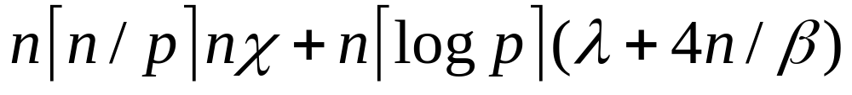
Execution Time Expression (1)
Message-passing time
Messages per broadcast
Iterations of outer loop
Cell update time
Iterations of inner loop
Iterations of middle loop
Iterations of outer loop

Slide 42
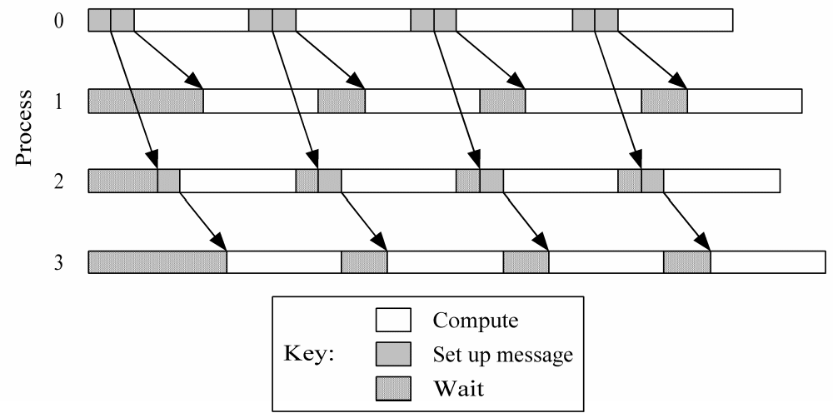
Computation/communication Overlap

Slide 43
Execution Time Expression (2)
Message transmission
Message-passing time
Messages per broadcast
Iterations of outer loop
Cell update time
Iterations of inner loop
Iterations of middle loop
Iterations of outer loop

Slide 44
Predicted vs. Actual Performance
 | Execution Time (sec)
Processes | Predicted | Actual
1 | 25.54 | 25.54
2 | 13.02 | 13.89
3 | 9.01 | 9.60
4 | 6.89 | 7.29
5 | 5.86 | 5.99
6 | 5.01 | 5.16
7 | 4.40 | 4.50
8 | 3.94 | 3.98

Slide 45
Summary
Two matrix decompositions
  Rowwise block striped
  Columnwise block striped
Blocking send/receive functions
  MPI_Send
  MPI_Recv
Overlapping communications with computations

