Slide 1
Chapter 7
Performance Analysis

Slide 2
Additional References
Selim Akl, “Parallel Computation: Models and Methods”, Prentice Hall, 1997, Updated online version available through website.
Barry Wilkinson and Michael Allen, “Parallel Programming: Techniques and Applications Using Networked Workstations and Parallel Computers ”, Prentice Hall, First Edition 1999 or Second Edition 2005, Chapter 1..
Michael Quinn, Parallel Computing: Theory and Practice, McGraw Hill, 1994.

Slide 3
Learning Objectives
Predict performance of parallel programs
Understand barriers to higher performance

Slide 4
Outline
Running time
Cost
General speedup formula
Amdahl’s Law
Gustafson’s Law (not the Gustafson-Baris’s Law)

Slide 5
Speedup
A measure of the increase in running time due to parallelism. The number of PEs is given by n.
Based on running times, S(n) = t_{s}/t_{p} , where
  t_{s} is the execution time on a single processor, using the fastest known sequential algorithm
  t_{p} is the execution time using a parallel processor.
For theoretical analysis, S(n) = t_{s}/t_{p} where
  t_{s} is the worst case running time for of the fastest known sequential algorithm for the problem
  t_{p} is the worst case running time of the parallel algorithm using n PEs.

Slide 6
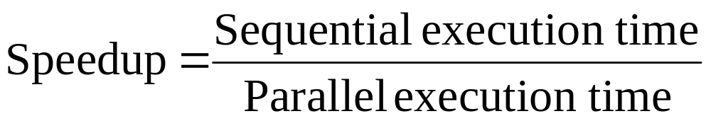
Speedup in Simplest Terms

Slide 7
Linear Speedup Usually Optimal
Speedup is linear if S(n) = Θ(n)
Claim: The maximum possible speedup for parallel computers with n PEs for ‘normal problems’ is n.
Proof:
  Assume a computation is partitioned perfectly into n processes of equal duration.
  Assume no overhead is incurred as a result of this partitioning of the computation – (e.g., partitioning process, information passing, coordination of processes, etc),
  Under these ideal conditions, the parallel computation will execute n times faster than the sequential computation.
  The parallel running time is t_{s} /n.
  Then the parallel speedup of this computation is
  S(n) = t_{s} /(t_{s} /n) = n

Slide 8
Linear Speedup Usually Optimal (cont)
We shall later see that this “proof” is not valid for certain types of nontraditional problems.
Unfortunately, the best speedup possible for most applications is much less than n, as
  Assumptions in proof are usually invalid.
  Usually some parts of programs are sequential and only one PE is active.
  Sometimes a large number of processors are idle for certain portions of the program.
    E.g., during parts of the execution, many PEs may be waiting to receive or to send data. Remember the blocking.

Slide 9
Superlinear Speedup
Superlinear speedup occurs when S(n) > n
Most texts besides Akl’s and Quinn’s argue that
  Linear speedup is the maximum speedup obtainable.
    The preceding “proof” is used to argue that superlinearity is impossible.
  Occasionally speedup that appears to be superlinear may occur, but can be explained by other reasons such as
    the extra memory in parallel system.
    a sub-optimal sequential algorithm used.
    luck, in case of algorithm that has a random aspect in its design (e.g., random selection)

Slide 10
Superlinearity (cont)
Selim Akl has shown that for some less standard problems, superlinear algorithms can be given.
  Some problems cannot be solved without the use of parallel computation.
    It is reasonable to consider these solutions to be “superlinear”.
    Examples include most large software systems (e.g., ATC) and “person who can only keep driveway open during a severe snowstorm with the help of the whole family” type problems.
  Some problems are natural to solve using parallelism and sequential solutions are inefficient.

Slide 11
Superlinearity (cont)
  The final chapter of Akl’s textbook and several journal papers have been written to establish these claims are valid, but it may still be a long time before they are fully accepted.
  Superlinearity has been a hotly debated topic for too long to be accepted quickly.
For more details on superlinearity, see [2] “Parallel Computation: Models and Methods”, Selim Akl, pgs 14-20 (Speedup Folklore Theorem) and Chapter 12.

Slide 12
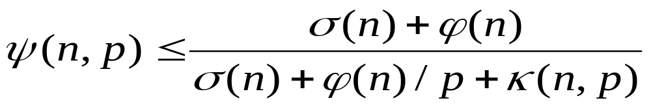
Speedup Expression
Inherently sequential computations: σ(n)
Potentially parallel computations: ϕ(n)
Communication operations: κ(n,p)
Note that the right side of above equation assumes the speedup of the parallel portion of computation will be p.

Slide 13
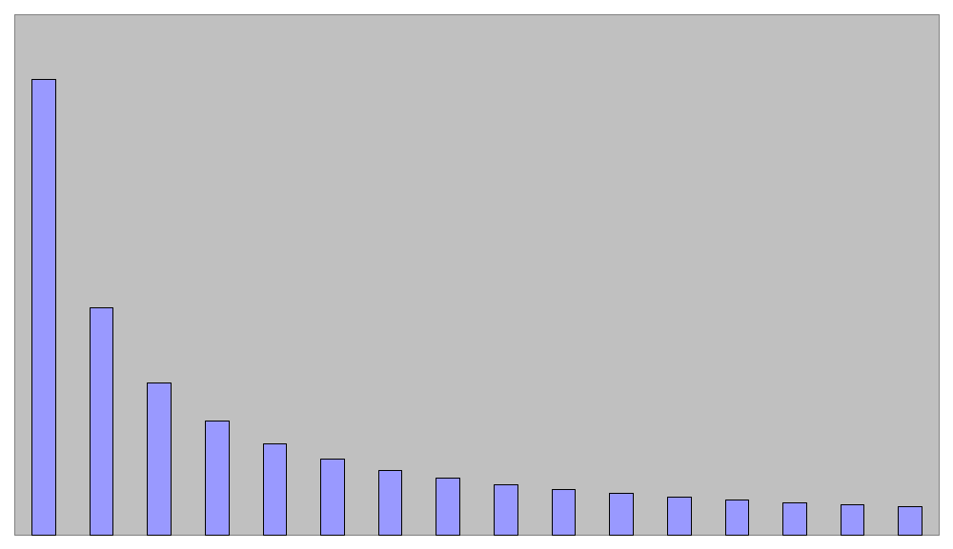
Execution time for parallel portion ϕ(n)/p
time
processors
Shows nontrivial parallel algorithm’s computation component as a decreasing function of the number of processors used.

Slide 14
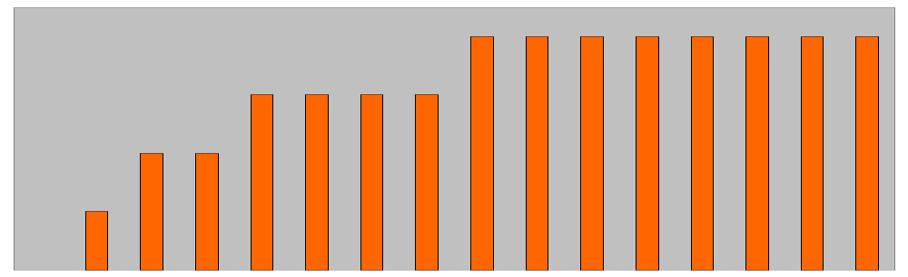
Time for communication κ(n,p)
time
processors
Shows a nontrivial parallel algorithm’s communication component as an increasing function of the number of processors.

Slide 15
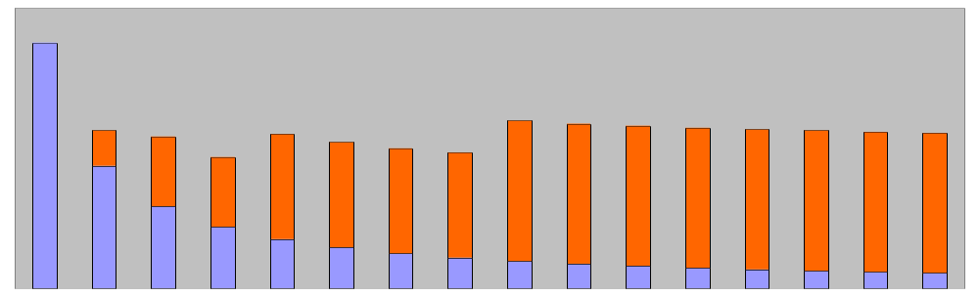
Execution Time of Parallel Portion ϕ(n)/p + κ(n,p)
time
processors
Combining these, we see for a fixed problem size, there is an optimum number of processors that minimizes overall execution time.

Slide 16
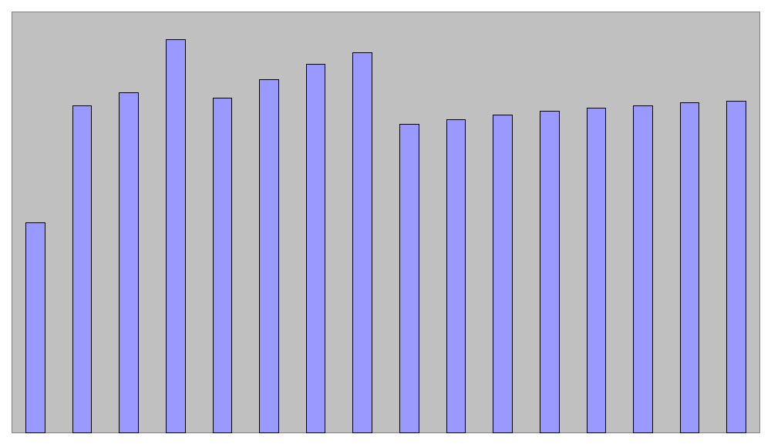
Speedup Plot
“elbowing out”
speedup
processors

Slide 17
Performance Metric Comments
The performance metrics introduced in this chapter apply to both parallel algorithms and parallel programs.
  Normally we will use the word “algorithm”
The complexity the execution time of a parallel program depends on the algorithm it implements.
The terms parallel running time and parallel execution time have the same meaning

Slide 18
Cost
The cost of a parallel algorithm (or program) is
Cost = Parallel running time × #processors
Since “cost” is a much overused word, the term “algorithm cost” is sometimes used for clarity.
The cost of a parallel algorithm should be compared to the running time of a sequential algorithm.
  Cost removes the advantage of parallelism by charging for each additional processor.
  A parallel algorithm whose cost equals the running time of an optimal sequential algorithm is also called optimal.

Slide 19
Cost Optimal
A parallel algorithm for a problem is said to be cost-optimal if its cost is proportional to the running time of an optimal sequential algorithm for the same problem.
  By proportional, we means that
  cost = t_{p} × n = k × t_{s}
  where k is a constant.
Equivalently, a parallel algorithm is optimal if
  parallel cost = O(f(t)),
where f(t) is the running time of an optimal sequential algorithm.
In cases where no optimal sequential algorithm is known, then the “fastest known” sequential algorithm is often used instead.

Slide 20
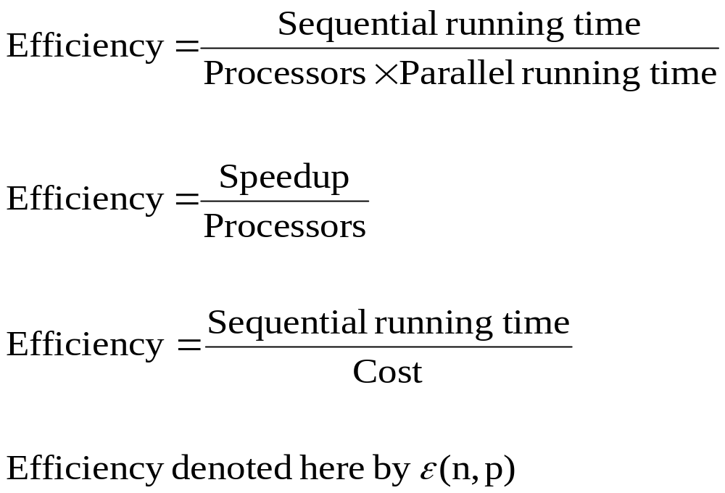
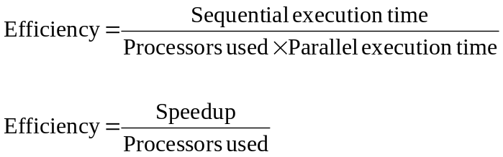
Efficiency

Slide 21
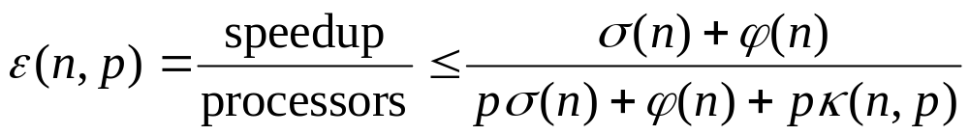
0 ≤ ε(n,p) ≤ 1
All terms > 0 ⇒ ε(n,p) > 0
Denominator > numerator ⇒ ε(n,p) < 1

Slide 22
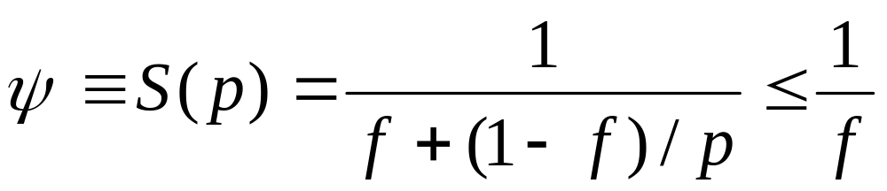
Amdahl’s Law
Let f be the fraction of operations in a computation that must be performed sequentially, where 0 ≤ f ≤ 1. The maximum speedup ψ achievable by a parallel computer with p processors is
Note: The word law is often used by computer scientists when it is an observed phenomena, not a theorem that has been proven in a strict sense.
Example: Moore’s Law

Slide 23
Amdahl’s Law
“Proof” assumes that speedup can not be superliner; i.e.,
S(n) = t_{s}/ t_{p} ≤ n
  Assumption only valid for traditional problems.
A pictorial proof is given in chapter 1 of Wilkinson and Allen
Sometimes Amdahl’s law is just stated as
S(n) ≤ 1/f
Note that S(n) never exceeds 1/f and approaches 1/f as n increases.

Slide 24
Observations: Amdahl’s law places limitations on parallelism:
  For a long time, Amdahl’s law was viewed as a fatal limit to the usefulness of parallelism.
  However, recently it has be observed that
  Amdahl’s law is valid, but needs to be interpreted properly.
  Some textbooks use Amdahl’s law to increase the efficient of parallel algorithms
  Law (a person) shows that efforts required to further reduce the fraction of the code that is sequential may pay off in large performance gains.
  Hardware that achieves even a small decrease in the percent of things executed sequentially may be considerably more efficient.

Slide 25
Amdahl & Gustafon’s Laws
  A key flaw in past arguments that Amdahl’s law is a fatal limit to the future of parallelism is
    Gustafon’s Law: The proportion of the computations that are sequential normally decreases as the problem size increases.
  Other limitations in applying Amdahl’s Law:
    Its proof focuses on the steps in a particular algorithm, and does not consider that other algorithms with more parallelism may exist
    Amdahl’s law applies only to ‘standard’ problems were superlinearity can not occur

Slide 26
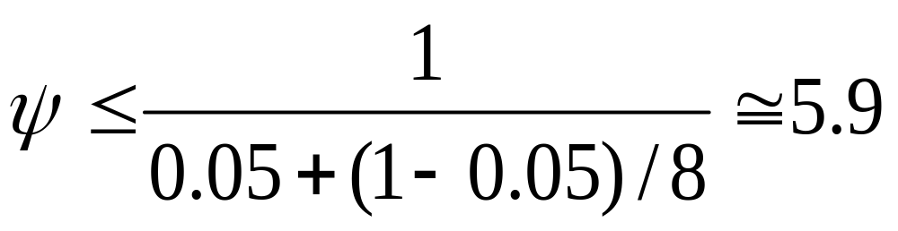
Example 1
95% of a program’s execution time occurs inside a loop that can be executed in parallel. What is the maximum speedup we should expect from a parallel version of the program executing on 8 CPUs?

Slide 27
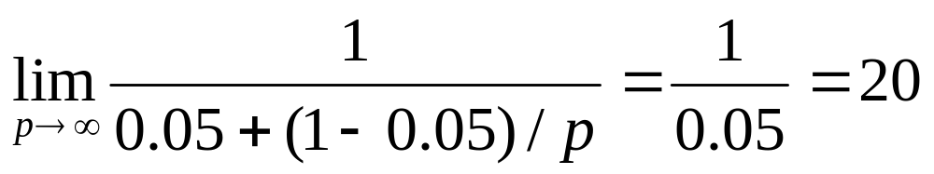
Example 2
5% of a parallel program’s execution time is spent within inherently sequential code.
The maximum speedup achievable by this program, regardless of how many PEs are used, is

Slide 28
Pop Quiz
An oceanographer gives you a serial program and asks you how much faster it might run on 8 processors. You can only find one function amenable to a parallel solution. Benchmarking on a single processor reveals 80% of the execution time is spent inside this function. What is the best speedup a parallel version is likely to achieve on 8 processors?
1/(0.1 + (1-0.1)/8) ≅ 8.88

Slide 29
Limitations of Amdahl’s Law
Ignores communication cost κ(n,p)
On communications-intensive applications, the κ(n,p) does not capture the additional communication slowdown due to congestion.
Usually overestimates speedup achievable

Slide 30
Amdahl Effect
Typically communications time κ(n,p) has lower complexity than ϕ(n)/p (i.e., time for parallel part)
As n increases, ϕ(n)/p dominates κ(n,p)
As n increases,
  sequential portion of algorithm decreases
  speedup increases

Slide 31
Illustration of Amdahl Effect
Speedup
n = 10,000
n = 1,000
n = 100
Processors

Slide 32
Review of Amdahl’s Law
Treats problem size as a constant
Shows how execution time decreases as number of processors increases
However, not everyone believes Amdahl’s law holds in all cases – i.e. it is often interpreted incorrectly.

Slide 33
Background on Amdahl’s Law¹
Gene Amdahl, a recognized authority on parallel processing, crafted "Amdahl's Law" in 1967, which states that there are communication issues that eventually place an upper limit on the maximum speed of parallel processing systems, therefore mitigating much of the benefit of parallelization.
Amdahl's Law limited parallel processing's appeal as a commercially viable solution.
1 This slide and the next two are from the following article: Massively Parallel Tech Responds To Amdahl Questions
by Tim Curns, Editor, January 9, 2005, HPCwire

Slide 34
Background on Amdahl’s Law
For 35 plus years, traditional non-mathematical interpretations of Amdahl's Law have led developers of supercomputers to believe that only 20 percent or less efficiency was possible through parallel processing, with larger machines achieving only 7 percent to 10 percent efficiency.
The limitations implied by this interpretation led developers to concentrate on building expensive systems that relied on the fastest components available.

Slide 35
Background on Amdahl’s Law
The Massively Parallel approach, now confirmed by Amdahl's Law as the most efficient method of parallel processing, concentrates on improving the efficiency of the communication methodology between processors.
This has resulted in systems that exceed 90 percent efficiency rather than the previously believed limit of 20 percent.
The breakthrough also allows systems to be built with low cost commodity hardware to solve problems in minutes rather than hours.

Slide 36
Summary (1)
Performance terms
  Cost
  Efficiency
  Speedup
Model of speedup
  Serial component
  Parallel component
  Communication component

Slide 37
Summary (2)
What prevents linear speedup?
  Serial operations
  Communication operations
  Process start-up
  Imbalanced workloads
  Architectural limitations

