Slide 1
Chapter 9
Document Classification

Slide 2
Chapter Objectives
Show how to implement manager-worker programs in parallel
Introduces some more MPI functions

Slide 3
Outline
Introduce problem
Parallel algorithm design
Creating communicators
Non-blocking communications
Implementation
Pipelining

Slide 4
Document Classification Problem
Search directories, subdirectories for documents (look for .html, .txt, .tex, etc.)
Using a dictionary of key words, create a profile vector for each document
Store profile vectors
Interesting thing about this problem – unlike earlier problems, this exhibits functional decomposition not data decomposition.

Slide 5
Document Classification Problem
Read a dictionary.
Search directory structure for text files.
Open file, read it, generate a profile vector indicating how often a word in the dictionary is in the file.

Slide 6
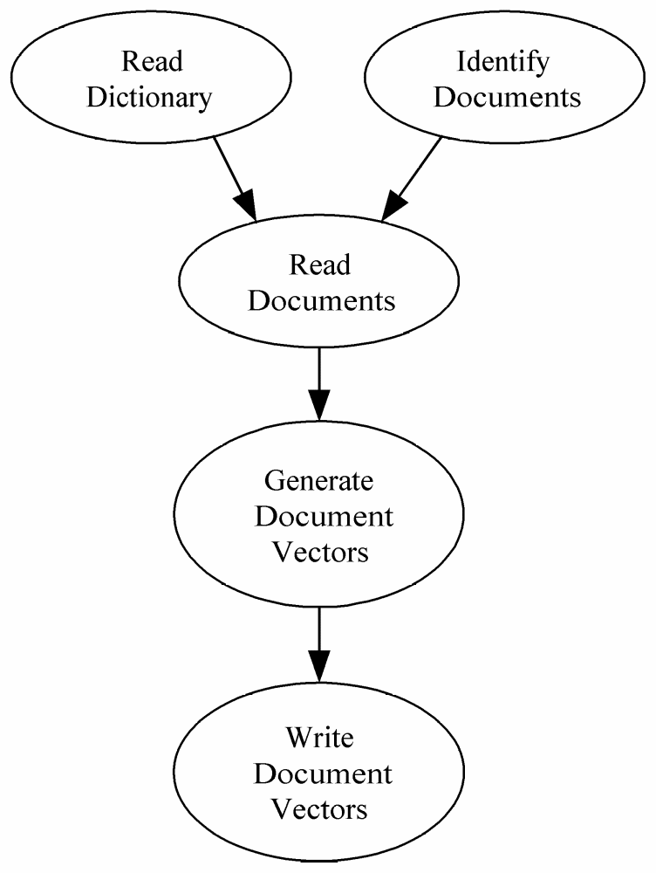
Data Dependence Graph (1)
There are 5 general steps in the problem.

Slide 7
Partitioning and Communication
Most of the time is spent reading documents and generating profile vectors than in any other task.
So, we create two primitive tasks for each document
  1) Reads the document file
  2) Generate the vector
Natural candidate for functional decomposition.
Each operation is a primitive task.
A data element – i.e. a document – is associated with each task.

Slide 8
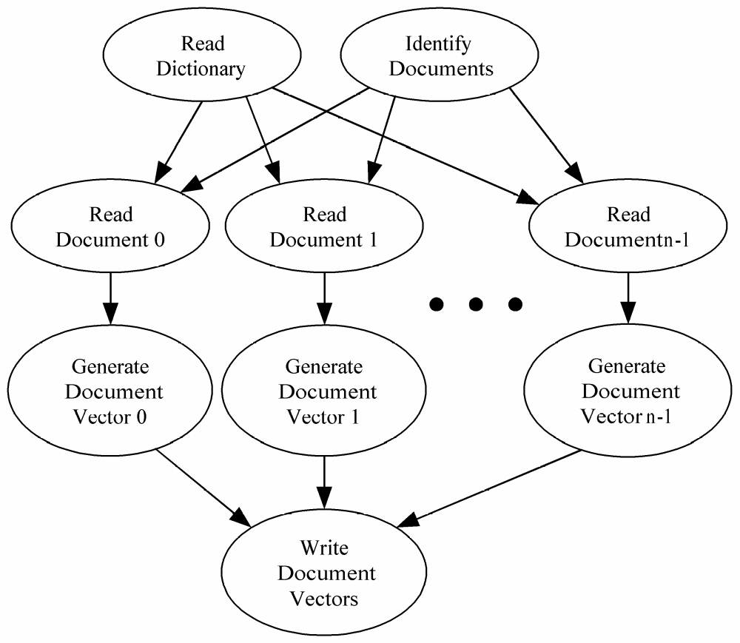
Data Dependence Graph (2)

Slide 9
Agglomeration and Mapping
Number of tasks not known at compile time
Tasks do not communicate with each other
Time needed to perform tasks varies widely . Documents differ in size and some documents are more difficult to process (.html vs .txt files)
Strategy: map tasks to processes at run time (according to decision tree on pg 72).

Slide 10
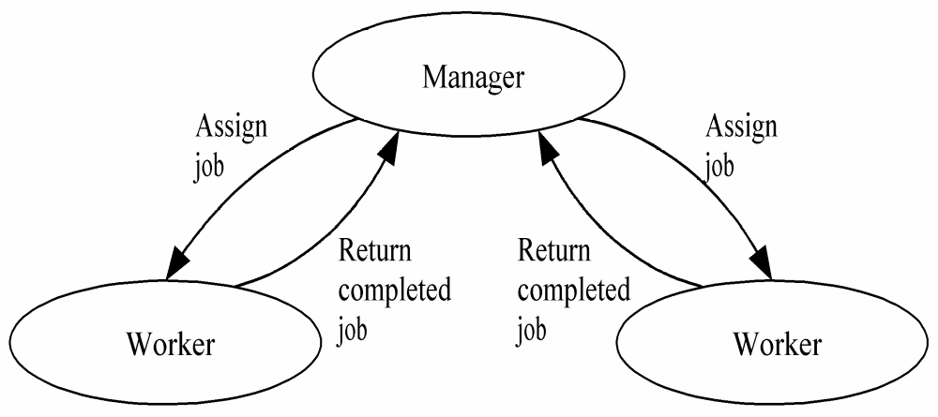
Manager/worker-style Algorithm
Advantage of this style: Can balance workloads as a worker gets only one task at a time.
Disadvantage of this style: There is additional communication overhead and, consequently, increasing execution time and decreasing speedup.

Slide 11
Manager/Worker vs. SPMD
SPMD (single program multiple data)
  Every process executes same functions
  Our prior programs fit this mold
Manager/worker
  Manager process has different responsibilities than worker processes
  An MPI manager/worker program has an early control flow split (manager process one way, worker processes the other way)

Slide 12
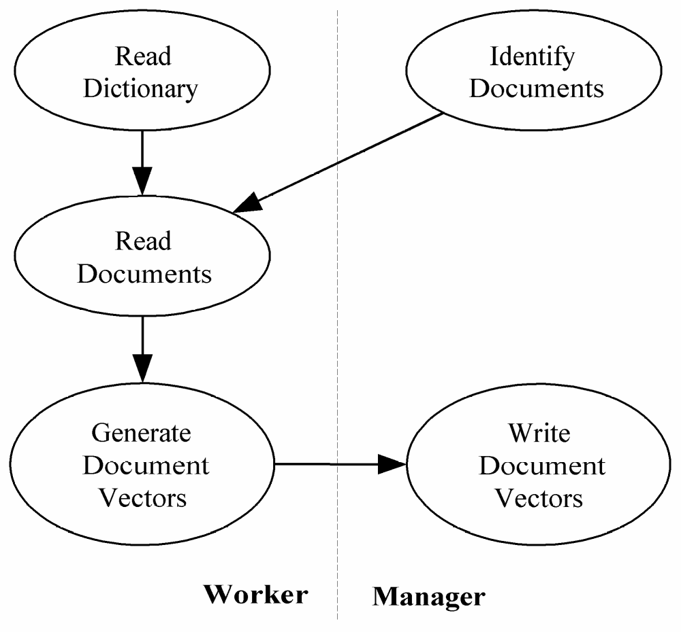
Roles of Manager and Workers
Observe that the manager operates very differently than the workers.

Slide 13
A Task/channel Graph of the Algorithm
The manager interacts with each worker.
Who initiates a cycle? The manager or a worker?
If the manager does, it might send to a worker that is not ready yet because different processors could run at different speeds.
Therefore, it is best to design the algorithm so the worker initiates the cycle by sending a message to the manager saying it is ready for work.

Slide 14
Manager Pseudocode
Identify n documents in user-specified directory
Receive size k , the number of elements in each document vector from worker 0
Allocate n X k matrix to store document vectors
repeat
Receive message from worker
if message contains document vector
Store document vector
endif
if documents remain then Send worker file name
else Send worker termination message
endif
until all workers terminated

Slide 15
Worker Pseudocode
Write document vectors to file
Send first request for work to manager
if worker 0 then
Read dictionary from file
endif
Broadcast dictionary among workers
Build hash table¹ from dictionary
if worker 0 then
Send dictionary size to manager
endif
¹A hash table is an easy data structure for doing searches. See a later slide for a description.

Slide 16
Worker Pseudocode
repeat
Receive file name from manager
if file name is NULL then terminate endif
Read document, generate document vector
Send document vector to manager
forever

Slide 17
Hash Tables
Review for some – Introduction to others.
In this problem, we need to determine quickly if a word in a document is in the dictionary of desired words or not.
Sequential searching (obviously) and even binary searching are not fast enough for something that is this search intensive.
Hash tables provide some of the fastest means of searching.
There are many ways to implement hash tables, but one of the easiest ways is to use bucket lists.

Slide 18
Hash Codes
A hash code is a function that takes a word, in this case, and converts it to an integer lying in some range such as 0 to k.
A good hash code has these properties:
  1) It is fast to compute.
  2) The numbers between 0 and k are used at somewhat the same rate.
  3) There are a minimal number of collisions – i.e. two words, word1 and word2, such that
    hash(word1) = hash(word2)
Hash codes have been widely studied and there are many good ones in use.

Slide 19
Implementing a Hash Table with a Bucket List
Suppose we have a hash code, h, which maps words to integers in the range 0 to k.
Then, we put the words in a hash table as follows:
  We use an array of pointers with indices 0 to k.
  Each pointer points to a linked list, which we call a bucket, where the words are stored.
  There are various schemes for storing the words in a bucket (alphabetize or not, for example) but in all cases, a word is stored at the bucket at h(word).
  To locate a word, we find the array index of h(word) and look at the bucket linked there.

Slide 20
Example with Numbers
Let h(number) = number mod 7
Show how the numbers 8, 12, 4, 23, 16, 19 would be stored.
If the hash code is a good one and the k is chosen well, the buckets will be short.
The result is a constant search time.
0
1
2
3
4
5
6
8
16
23
4
12
19
Hash tables are used for these types of problems and for search tables for compilers.

Slide 21
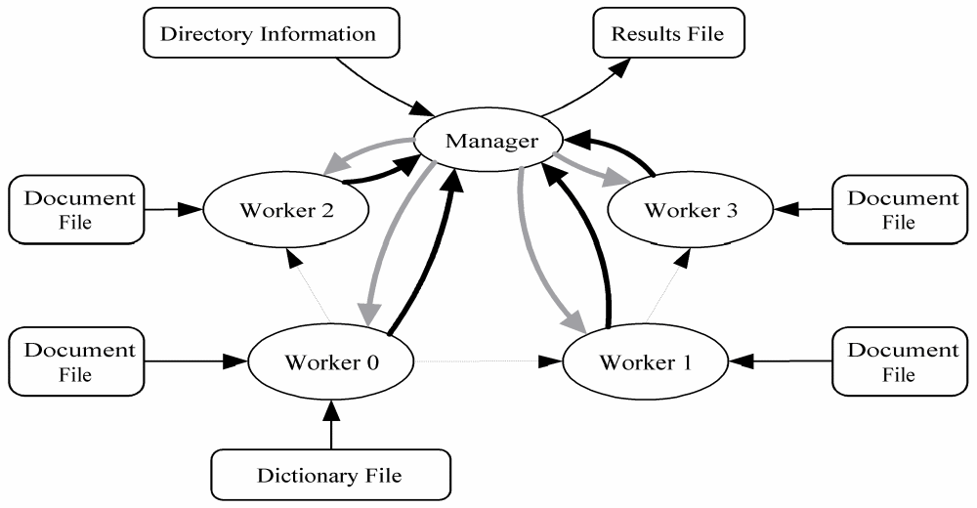
Final Task/Channel Graph
Faint supposedly dashed lines are channels broadcasting the dictionary.
Gray lines are channels carrying document names to workers.
Black lines are channels carrying document vectors to the manager.

Slide 22
MPI_Abort
A “quick and dirty” way for one process to terminate all processes in a specified communicator
Example use: If manager cannot allocate memory needed to store document profile vectors
int MPI_Abort (
MPI_Comm comm, /* Communicator */
int error_code) /* Value returned to
calling environment */

Slide 23
Creating a Workers-only Communicator
The dictionary is broadcast among workers
To support workers-only broadcast, need workers-only communicator
Note- before we broadcast to all processes in communicator or we did point to point communication.
Can use MPI_Comm_split which is introduced in Chapter 8, the chapter we skipped.

Slide 24
MPI_Comm_split
Partitions the processes of a communicator into one or more subgroups
Constructs a communicator for each subgroup
Allows processes in each subgroup to perform their own collective communications
Needed to allow a worker-only broadcast in this problem.
Note: this is one way we can have different processes perform different tasks.

Slide 25
Header for MPI_Comm_split
int MPI_Comm_split (
MPI_Comm old_comm,
/* In - Existing communicator */
int split_key,/* In -An identifying number */
int new_rank,
/* In - Ranking order of processes
in new communicator */
MPI_Comm *new_comm)
/* Out - New communicator shared by
processes in same partition */
Note: Every process in old communicator must call this.
The In-Out refers to what is passed in and what is passed out.

Slide 26
Every Process in a Communicator Being Split Must Call MPI_Comm_split
This means that although we want to exclude the manager from the new communicator, it must still call the splitting function.
We have the manager pass MPI_UNDEFINED as the value of split_key, meaning it will not be part of any new communicator.
We must also declare a name for the new communicator.
Recall that MPI_COMM_WORLD is the existing communicator by default.

Slide 27
Establishing a Workers-only Communicator
int id;
MPI_Comm worker_comm; /* New communicator */
...
if (!id) /* Manager */
MPI_Comm_split (MPI_COMM_WORLD,
MPI_UNDEFINED, id, &worker_comm);
else /* Worker */
MPI_Comm_split (MPI_COMM_WORLD, 0,
id, &worker_comm);

Slide 28
The Work of the Manager
There are three phases to the manager:
Phase 1:
  1) Find the plain text files in the directory structure specified by the user.
  2) Receive the dictionary size from worker 0
  3) Allocate the 2D array that is used to store the document profile vectors.
Phase 2:
  Allocate documents to workers and collect profile vectors.
Phase 3:
  Write the complete set of profile vectors to a file.

Slide 29
Phase 1
The manager must search a directory structure and receive a message from worker 0.
So far, to do point-to-point communications we only had the blocking operations MPI_Send and MPI_Recv.
Recall the scenario we had in Chapter 6 ...

Slide 30
Inside MPI_Send and MPI_Recv
Sending Process
Receiving Process
Program
Memory
System
Buffer
System
Buffer
Program
Memory
MPI_Send
MPI_Recv

Slide 31
Return from MPI_Send
Function blocks until message buffer free
Message buffer is free when
  Message copied to system buffer, or
  Message transmitted
In either case, you can overwrite the message buffer as soon as the function returns.
Return from MPI_Recv
Function blocks until message in buffer
You may access the message value as soon as the function returns.
If message never arrives, function never returns

Slide 32
It is Not Always Best to Block
With MPI_Send, the system may not copy the message into the system buffer for some reason.
Then you have blocking even if you don’t intend to overwrite the buffer any time soon.
Posting a receive before a message arrives can save time because the system can save a copy operation by transferring the contents of the incoming message directly into the destination buffer instead of to a temporary system buffer.
MPI_Revd makes it hard to do this because it blocks until the message arrives.
So, blocking, while sometimes necessary, in other cases can limit the performance of the parallel program.

Slide 33
Nonblocking Send / Receive
MPI_Isend, MPI_Irecv initiate the operation of posting the appropriate communication
MPI_Wait blocks until the operation is complete
Calls can be made early
  MPI_Isend as soon as value(s) assigned
  MPI_Irecv as soon as buffer available
This can eliminate a message copying step
Allows communication / computation overlap

Slide 34
Function MPI_Irecv
int MPI_Irecv (
void *buffer,
int cnt,
MPI_Datatype dtype,
int src,
int tag,
MPI_Comm comm,
MPI_Request *handle
)
Pointer to object that identifies
communication operation

Slide 35
Function MPI_Wait
int MPI_Wait (
MPI_Request *handle,
MPI_Status *status
)

Slide 36
Function MPI_Isend
int MPI_Isend (
void *buffer,
int cnt,
MPI_Datatype dtype,
int dest,
int tag,
MPI_Comm comm,
MPI_Request *handle
)
Pointer to object that identifies
communication operation

Slide 37
Receiving Path Name
Worker does not know length of longest path name it will receive
Alternatives
  Allocate huge buffer
  Check length of incoming message, then allocate buffer
We’ll take the second alternative

Slide 38
Function MPI_Probe
Blocks until message is available to be received
int MPI_Probe (
int src,
int tag,
MPI_Comm comm,
MPI_Status *status
)

Slide 39
Function MPI_Get_count
int MPI_Get_count (
MPI_Status *status,
MPI_Datatype dtype,
int *cnt
)

Slide 40
Enhancements
Middle ground between pre-allocation and one-at-a-time allocation
Pipelining of document processing

Slide 41
Allocation Alternatives
Time
Load imbalance
Excessive
communication
overhead
1
n/p
Documents Allocated per Request

Slide 42
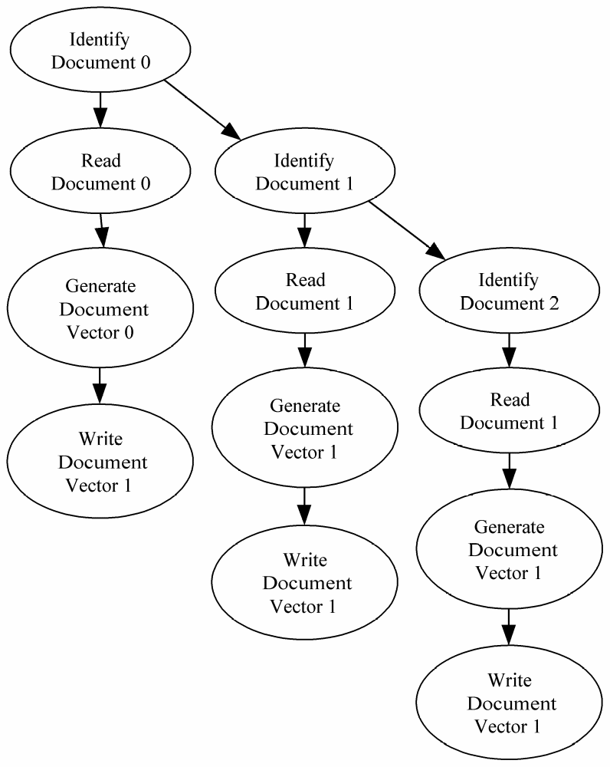
Pipelining

Slide 43
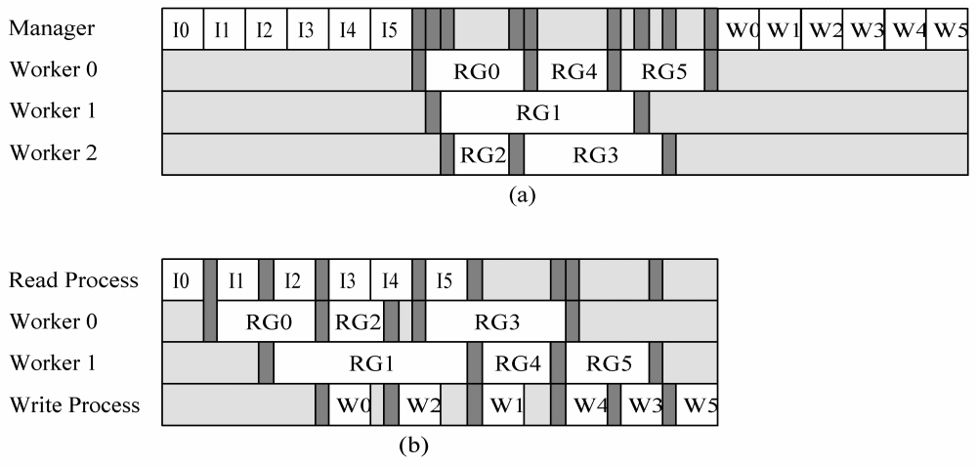
Time Savings through Pipelining

Slide 44
Pipelined Manager Pseudocode
a ← 0 {assigned jobs}
j ← 0 {available jobs}
w ← 0 {workers waiting for assignment}
repeat
if (j > 0) and (w > 0) then
assign job to worker
j ← j – 1; w ← w – 1; a ← a + 1
elseif (j > 0) then
handle an incoming message from workers
increment w
else
get another job
increment j
endif
until (a = n) and (w = p)

Slide 45
Function MPI_Testsome
int MPI_Testsome (
int in_cnt, /* IN - Number of
nonblocking receives to check */
MPI_Request *handlearray, /* IN -
Handles of pending receives */
int *out_cnt, /* OUT - Number of
completed communications */
int *index_array, /* OUT - Indices of
completed communications */
MPI_Status *status_array) /* OUT -
Status records for completed comms */

Slide 46
Summary
Manager/worker paradigm
  Dynamic number of tasks
  Variable task lengths
  No communications between tasks
New tools for “kit”
  Create manager/worker program
  Create workers-only communicator
  Non-blocking send/receive
  Testing for completed communications

