Slide 1
A SIMD MACHINE
ASC
Both a Language and an Architecture

Slide 2
Historical Remarks
Recall that all active processors of a SIMD computer must simultaneously access the same memory location.
These locations can be viewed as components of a vector.
SIMD machines are sometimes called vector computers [Jordan,et.al.] or processor arrays [Quinn 94,04] based on their ability to execute vector and matrix operations efficiently.

Slide 3
Historical Remarks
SIMD computers that focus on vector operations usually
  support some vector and possibly matrix operations in hardware, and
  limit or provide less support for non-vector type operations involving “vector components”.
The inner loops of some sequential algorithms consist only of performing the same operation on a set of disjoint data items.
  Easy to parallelize using a SIMD by assigning each data item to a different processor and having each operation performed simultaneously.

Slide 4
SIMD Execution Style
The traditional (SIMD, vector, processor array) execution style ([Quinn 94, pg 62], [Quinn 2004, pgs 37-43]:
  The sequential processor that broadcasts the commands to the rest of the processors is called the front end or control unit.
  The front end is a general purpose CPU that stores the program and the data that are not manipulated in parallel.
  The front end normally executes the sequential portions of the program.

Slide 5
SIMD Execution Style
  Each processing element has a local memory that can not be directly accessed directly by the host or other processing elements.
  Collectively, the individual memories of the processing elements (PEs) store the vector data that is processed in parallel.
  When the front end encounters an instruction whose operand is a vector, it issues a command to the PEs to perform the instruction in parallel.
  Although the PEs execute in parallel, some units can be allowed to skip any particular instruction.
  SIMDs are also called MPPs (massively parallel processors – although there is a specific machine named MPP. )

Slide 6
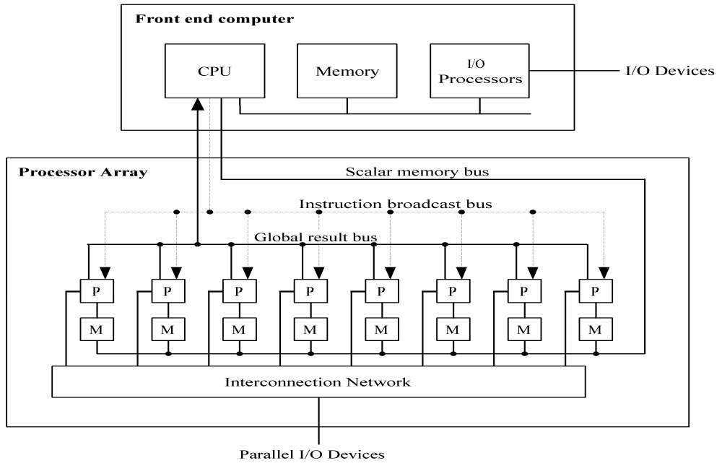
Possible Architecture for a Generic SIMD

Slide 7
Real SIMD Architectures
An early SIMD computer designed for vector and matrix processing was the Illiac IV computer built at the University of Illinois. [Jordan et. al., pg 7].
The CRAY-1 and the Cyber-205 use pipelined arithmetic units to support vector operations and are viewed as pipelined SIMDs ([Jordan, et al, p7], [Quinn 94, pg 61-2], [Quinn 2004, pg37).

Slide 8
Real SIMD Architectures
The MPP, DAP, the Connection Machines CM-1 and CM-2, MasPar MP-1 and MP-2 are examples of SIMD computers given in [Akl, pg 8-12]
  The MP-1 and Connection Machines are briefly discussed there.
Quinn [1994, pg 63-67] discusses the Connection Machine CM-200, a smaller & updated CM-2.
Professor Batcher at Kent State was the chief architect for the STARAN and the MPP (Massively Parallel Processor) and an advisor for the ASPRO (small, second generation STARAN)

Slide 9
Today’s SIMDs
Many SIMDs are being embedded in SISD machines.
Others are being build as part of hybrid architectures.
Others are being build as special purpose machines, although some of them could classify as general purpose.

Slide 10
A Company Trying to Build an Inexpensive SIMD
WorldScape is building a COTS SIMD.
The architecture is changing rapidly as they are in development.
See http://www.wscapeinc.com/

Slide 11
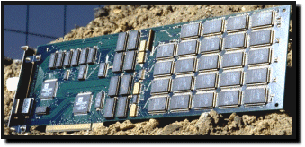
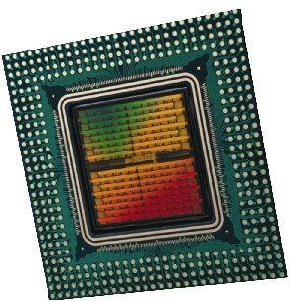
An Example of a Hybrid SIMD
Embedded Massively Parallel Accelerators
  Systola 1024: PC add-on board with 1024 processors
  Fuzion 150: 1536 processors on a single chip
  Other accelerators: Decypher, Biocellerator, GeneMatcher2, Kestrel, SAMBA, P-NAC, Splash-2, BioScan
(Slides 10-12 are due to Prabhakar R. Gudla (U of Maryland) at a CMSC 838T Presentation, 4/23/2003.)

Slide 12

Hybrid Architecture
Systola1024
Systola1024
Systola1024
Systola1024
Systola1024
Systola1024
Systola1024
Systola1024
High speed Myrinet switch
Systola1024
Systola1024
Systola1024
Systola1024
Systola1024
Systola1024
Systola1024
Systola1024
  combines SIMD and MIMD paradigm within a parallel architecture ⇒ Hybrid Computer

Slide 13

Architecture of Systola 1024
Instruction Systolic Array:
  32 × 32 mesh of processing elements
  wavefront instruction execution
RAM NORTH
RAM WEST
program memory
Controller
host computer bus
ISA
Interface processors

Slide 14
SIMDs Embedded in SISDs
Intel's Pentium 4 includes what they call MMX technology to gain a significant performance boost
IBM and Motorola incorporated the technology into their G4 PowerPC chip in what they call their Velocity Engine.
Both MMX technology and the Velocity Engine are the chip manufacturer's name for their proprietary SIMD processors and parallel extensions to their operating code.
This same approach is used by NVidia and Evans & Sutherland to dramatically accelerate graphics rendering.

Slide 15
Special Purpose SIMDs in the
Bioinformatics Market
Paracel, Inc. (acquired by Celera Genomics for $283 million in March of 2000)
  Paracel's systems are based on a proprietary SIMD processor packaged as an integrated system with proprietary software algorithms.
  One of their machines is called GeneMatcher.
TimeLogic, Inc
  Has DeCypher, a reconfigurable SIMD.

Slide 16
MASC
MASC (Massively ASsociative Computing)
Several professors and their graduate students at Kent State University are designing a SIMD machine with special properties.
We will discuss an early version of this machine, the ASC, and program it using a simulator.
That will let you
Dr. Baker is working with theoretical models of the machine.
Dr. Walker is working with the hardware design of the machine.
Advisors involved are Dr. Batcher and Dr. Potter.

Slide 17
Comparisons of SIMD and MIMD
Features
Reference: [Roosta, pg 10]
Less hardware than MIMDs as they have only one control unit.
Less memory needed than MIMD
  Only one copy of the instructions need to be stored
  Allows more data to be stored in memory, which reduces movement of data between primary and secondary storage.

Slide 18
Comparisons of SIMD and MIMD
Features -continued
Less startup time in communicating between PEs.
Single instruction stream and synchronization of PEs make SIMD applications easier to program, understand, & debug.
Control flow operations and scalar operations can be executed on the control unit while PEs are executing other instructions.

Slide 19
Comparisons of SIMD and MIMD
Features -continued
  MIMD architectures require explicit synchronization primitives, which create a substantial amount of additional overhead.
  During a communication operation between PEs,
    PEs send data to a neighboring PE in parallel and in lock step
    the entire communication operation is executed synchronously
  Less complex hardware is needed in a SIMD since no message decoder is needed in PEs
    MIMDs need a message decoder in each PE.

Slide 20
Associative Computing
Overview
Introduction
  The ASC model
  Language designed for the ASC model
  Some ASC Programs
  Introduction to the ASC simulator and how to run ASC programs
  Note: MASC is an extension of the ASC model which allows for multiple instruction streams. We won’t look at this model.

Slide 21
Associative Computing References
Note: KSU papers listed below are available usually on a website which, unfortunately is down right now.
www.cs.kent.edu/~parallel/
Maher Atwah, Johnnie Baker, and Selim Akl, An Associative Implementation of Classical Convex Hull Algorithms, Proc of the IASTED International Conference on Parallel and Distributed Computing and Systems, 1996, 435-438
Johnnie Baker and Mingxian Jin, Simulation of Enhanced Meshes with MASC, a MSIMD Model, Proc. of the Eleventh IASTED International Conference on Parallel and Distributed Computing and Systems, Nov. 1999, 511-516.

Slide 22
Associative Computing References
Mingxian Jin, Johnnie Baker, and Kenneth Batcher, Timings for Associative Operations on the MASC Model, Proc. of the 15th International Parallel and Distributed Processing Symposium, (Workshop on Massively Parallel Processing, San Francisco, April 2001.
Jerry Potter, Johnnie Baker, Stephen Scott, Arvind Bansal, Chokchai Leangsuksun, and Chandra Asthagiri, An Associative Computing Paradigm, Special Issue on Associative Processing, IEEE Computer, 27(11):19-25, Nov. 1994. (Note: MASC is called ‘ASC’ in this article.)
Jerry Potter, Associative Computing - A Programming Paradigm for Massively Parallel Computers, Plenum Publishing Company, 1992

Slide 23
Downloads for ASC Simulator
There is a compiler and a simulator at the following site:
http://zserver.zephyr.cs.kent.edu/PACL/downloads.htm
These will install in a Windows environment.
They are on the C-106 machines.

Slide 24
Associative Computers
Associative Computer: A SIMD computer with certain additional features supported in hardware.
These additional features can be supported (less efficiently) in traditional SIMDs in software.
The name “associative” is due to its ability to locate items in the memory of PEs by content rather than location.

Slide 25
ASC
The STARAN Computer (Goodyear Aerospace, early 1970’s) provided an architectural model for associative computing embodied in the ASC model.
Associative computing extends the data parallel paradigm to a complete computational model.
Provides a practical model that supports massive parallelism.

Slide 26
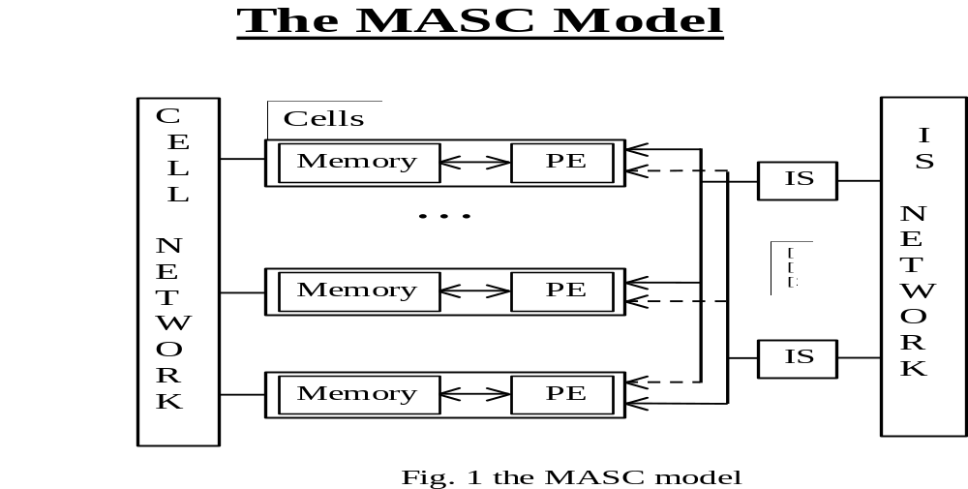
Basic Components
  An array of cells, each consisting of a simple PE (or enhanced ALU) and its local memory
  An interconnection network between the cells
  One instruction stream (IS)
  An IS communications network

Slide 28
Basic Properties of MASC
Reference: Paper by [Potter, Baker, et. al.]
Instruction Streams or ISs
  Logically a processor with a bus to each cell
  Each IS has a copy of the program and can broadcast instructions to cells in unit time
  NOTE: MASC(n,1) is called ASC
Cell Properties
  Each cell consists of a PE and its local memory
  All cells listen to only one IS
  Cells can switch ISs in unit time, based on a data test.
  A cell can be active, inactive, or idle
    Inactive cells listen but do not execute IS commands until reactivated
    Idle cells contain no essential data and are available for reassignment
Responder Processing
  An IS can detect if a data test is satisfied by any of its responder cells in constant time (i.e., any-responders?).
  An IS can select an arbitrary responder in constant time (i.e., pick-one).
  Justified by implementations using a resolver in paper by Jin, Baker, & Batcher.

Slide 29
Constant Time Global Operations (across PEs with a common IS)
  Logical OR and AND of binary values
  Maximum and minimum of numbers
  Associative searches (see next slide)
Communications
  There are three real or virtual networks
    PE communications network
    IS broadcast/reduction network
    IS communications network
  Communications can be supported by various techniques
    actual networks such as 2D mesh
    bus networks
    shared memory
Control Features
  PEs, ISs, and networks all operate synchronously, using the same clock
  Restricted control parallelism used to coordinate the multiple ISs.
Observation: The ASC properties that are unusual for SIMDs are the constant time operations:
  Constant time responder processing
  Constant time global operations

Slide 30
The Associative Search
On
lot
Busy-
idle
Make
Color
Year
Model
Price
PE1
Dodge
red
1994
1
1
PE2
0
0
PE3
Ford
blue
1996
1
1
IS
PE4
0
Ford
white
1998
1
PE5
0
0
PE6
0
0
PE7
Subaru
red
1997
1
1

Slide 31
Characteristics of Associative Programming
Consistent use of data parallel programming
Consistent use of global associative searching & responder processing
Usually, frequent use of the constant time global reduction operations: AND, OR, MAX, MIN
Broadcast of data using IS bus (and IS fork and join operations for MASC) allows the use of the PE network to be restricted to parallel data movement.
Tabular representation of data
Use of searching instead of sorting
Use of searching instead of pointers
Use of searching instead of the ordering provided by linked lists, stacks, queues
Promotes an highly intuitive programming style that promotes high productivity
Uses structure codes (i.e., numeric representation) to represent data structures such as trees, graphs, embedded lists, and matrices.
  See Nov. 1994 IEEE Computer article.
  Also, see “Associative Computing” book by Potter.

Slide 32
Languages Designed for MASC
The ASC language was designed by Jerry Potter for MASC(n,1) (or ASC).
  Based on C and Pascal
  Initially designed as a parallel language.
  Avoids compromises required to extend an existing sequential language
    E.g., avoids unneeded sequential constructs such as pointers
  Implemented on several SIMD computers
    Goodyear Aerospace’s STARAN
    Goodyear/Loral’s ASPRO
    Thinking Machine’s CM-2
    WaveTracer
ACE is a higher level language that uses natural language syntax; e.g., plurals, pronouns.
Anglish is an ACE variant that uses an English-like grammar (e.g., “their”, “its”)
An OOPs version of ASC for MASC(n,k) is planned (by Potter and his students)
Language References:
  ASC Primer
  “Associative Computing” book by Potter [11]
  Potter’s website: www.cs.kent.edu/~potter
  Websites identified on the class website

Slide 33
Algorithms and Programs Implemented in ASC
A wide range of algorithms implemented in ASC without use of PE network
  Graph Algorithms
    minimal spanning tree
    shortest path
    connected components
  Computational Geometry Algorithms
    convex hull algorithms (Jarvis March, Quickhull, Graham Scan, etc)
    Dynamic hull algorithms
  String Matching Algorithms
    all exact substring matches
    all exact matches with “don’t care” (i.e., wild card) characters.
  Algorithms for NP-complete problems
    traveling salesperson
    2-D knapsack.
  Data Base Management Software
    associative data base
    relational data base

Slide 34
(Cont) ASC Algorithms and Programs
  A Two Pass Compiler for ASC
    first pass
    optimization phase
  Two Rule-Based Inference Engines
    OPS-5 interpreter
    PPL (Parallel Production Language interpreter)
  A Context Sensitive Language Interpreter
    (OPS-5 variables force context sensitivity)
  An associative PROLOG interpreter
Numerous Programs in ASC using a PE network
  2-D Knapsack Algorithm using a 1-D mesh
  Image Processing algorithms using 1-D mesh
  FFT using Flip Network
  Matrix Multiplication using 1-D mesh
  An Air Traffic Control Program (using Flip network connecting PEs to memory)
    Demonstrated using live data at Knoxville in mid 70’s.

Slide 35
Preliminaries for ASC Algorithm for MST
Next, a “data structure” level presentation of Prim’s algorithm for the MST is given.
The data structure used is illustrated in the next two slides.
  This example is from the Nov. 1994 IEEE Computer paper cited in the references.
There are two types of variables for the ASC model, namely
  the parallel variables (i.e., ones for the PEs)
  the scalar variables (ie., the ones used by the control unit).
  Scalar variables are essentially global variables.
    Can replace each with a parallel variable.
In order to distinguish between them here, the parallel variables names end with a “$” symbol.
Each step in this algorithm is constant.
One MST edge is selected during each pass through the loop in this algorithm.
Since a spanning tree has n-1 edges, the running time of this algorithm is O(n) and its cost is O(n ²).
Since the sequential running time of the Prim MST algorithm is O(n ²) and is time optimal, this parallel implementation is cost optimal.

Slide 36
a
2
2
8
b
7
c
4
3
9
6
d
3
e
f
Figure 6 in [Potter, Baker, et. al.]

Slide 37
candidate$
current_best$
mask$
node$
a$
b$
d$
e$
parent$
PEs
c$
f$
a
∞
2
8
∞
∞
∞
no
b
2
∞
7
4
3
∞
no
a
2
IS
c
8
7
∞
∞
6
9
yes
b
7
sequential
program
control
d
∞
4
∞
∞
3
∞
yes
b
4
root
a
e
∞
3
6
3
∞
∞
yes
b
3
next-
node
b
f
∞
∞
9
∞
∞
∞
wait

Slide 38
Algorithm: ASC-MST-PRIM(root)
Initialize candidates to “waiting”
If there are any finite values in root’s field,
set candidate$ to “yes”
set parent$ to root
set current_best$ to the values in root’s field
set root’s candidate field to “no”
Loop while some candidate$ contain “yes”
for them
restrict mask$ to mindex(current_best$)
set next_node to a node identified in the preceding step
set its candidate to ‘no”
if the values in next_node’s field are less than current_best$, then
set current_best$ to value in next_node’s field
set parent$ to next_node
if candidate$ is “waiting” and the value in next_node’s field is finite
set candidate$ to “yes”
set parent$ to next_node
set current_best to the values in next_node’s field
Figure 6(c) in [10, Potter, Baker, et. al.]

Slide 39
Comments on Figure 6
The three preceding slides show figure 6 from the [Potter, Baker, et.al.] IEEE Computer, Nov 1994].
Figure 6c gives a compact, data-structures level pseudo-code description for this algorithm
  Pseudo-code illustrates Potter’s use of pronouns (e.g., them) and possessive nouns.
  The mindex function returns the index of a processor holding the minimal value.
  This MST pseudo-code is much shorter and simpler than data-structure level sequential MST pseudo-codes
    e.g., see one of Baase’s textbook cited below
    Algorithm given in Baase’s books is essentially the same as this parallel algorithm
Next, a more detailed explanation of the algorithm in Figure 6c will be given.
Reference:
Sara Baase, Computer Algorithms: Introduction to Design and Analysis, 2nd Edition, Addison Wesley Publishing Co.,1988, 162-166. (Alternately, see the 3rd edition by Baase & Van Gelder, 2000.)

Slide 40
Algorithm: ASC-MSP-PRIM
Initially assign any node to root.
All processors set
  candidate$ to “waiting”
  current-best$ to ∞
  the candidate field for the root node to “no”
All processors whose distance d from their node to root node is finite do
  Set their candidate$ field to “yes
  Set their parent$ field to root.
  Set current_best$ = d.
While the candidate field of some processor is “yes”,
  Restrict the active processors to those responding and (for these processors) do
    Compute the minimum value x of current_best$.
    Restrict the active processors to those with current_best$ = x and do
      pick an active processor, say one that contains node y.
        Set the candidate$ value of node y to “no”
      Set the scalar variable next-node to y.

Slide 41
      If the value z in the next_node column of a processor is less than its current_best$ value, then
        Set current_best$ to z.
      Set parent$ to next_node
For all processors, if candidate$ is “waiting” and the distance of its node from next_node is not ∞, then
  Set candidate$ to “yes”
  Set parent$ to next-node
  Set current_best$ to the distance of its node from next_node.

Slide 42



Quickhull Algorithm for ASC
Reference:
  [Maher, et.al, Associative Convex Hull]
Review of Sequential Quickhull Algorithm
  Suffices to find the upper convex hull of points in below diagram that are on or above line
Select point h so that the area of triangle weh is maximal.
Proceed recursively with the sets of points on or above the lines and .
_{h}
_{e}
_{w}

Slide 43
_{point$}
_{y-coord$}
_{left-point$}
_{x-coord$}
_{right-pt$}
_{name$}
_{area$}
_{hull$}
_{job$}
p₁
1
3
p1
p3
1
1
_{w}
0
p₂
7
1
p1
p3
0
IS
p₃
12
2
p1
p3
1
1
_{e}
p₄
8
4
p1
p3
1
h
p₅
11
7
p1
p3
1
ctr
p₆
8
9
p1
p3
1
1
_{h}
p₇
2
6
p1
p3
1
_{P6, h}
_{p5}
_{p7}
_{p4}
_{p1, w}
_{P3, e}
_{p2}

Slide 44
ASC Quickhull Algorithm
(Upper Convex Hull)
ASC-Quickhull( planar-point-set )
Initialize: ctr = 1, area$ = 0, hull$ = 0
Find the PE with the minimal x-coord$ and let w be its point$
  Set its hull$ value to 1
Find the PE with the PE with maximal x-coord$ and let e be its point$
  Set its hull$ to 1
All PEs set their left-pt to w and right-pt to e.
If the point$ for a PE lies above the line
  Then set its job$ value to 1
  Else set its job$ value to 0

Slide 45


ASC Quickhull (continued)
Loop while parallel job$ contains a nonzero value
  The IS makes its active cell those with a maximal job$ value.
  Each active PE stores in area$ the area of triangle( left-pt$, right-pt$, point$ )
  Find the PE with the maximal area$ and let h be its point.
    Set its hull$ value to 1
  Each active PE whose point$ is above
    sets its job$ value to ++ctr
  Each active PE whose point$ is above
    sets its job$ to ++ctr
  Each active PE with job$ < ctr -2 sets its job$ value to 0

Slide 46
Performance of ASC-Quickhull
₅
₃
₄
₁
₆
₂
₀
•
Average Case:
Assume
  Roughly 1/3 of the points above each line being processed are eliminated.
  O(lg n) points are on the convex hull.
Then the average running time is O(lg n)
The average cost is O(n lg n)
Worst Case:
Running time is O(n).
Cost is O(n²)

Slide 47
MASC Quickhull Algorithm
(Upper Convex Hull)
Algorithm:
Use IS₁ to execute the first loop of ASC-Quickhull
Idle ISs request problems from busy ISs who have inactive jobs on their job$ list.
Control of the PEs for an inactive job are transferred to the idle IS. The control of these PEs is returned to original IS after the job is finished.
₂
₂
₁
₁
₂
₂
₀
•

Slide 48
Analysis for MASC Quicksort
Average Case:
Assumptions:
  roughly 1/3 of the points above each line being processed are eliminated.
  O(lg n) Instruction Streams are available.
  There are O(lg n) convex hull points
The average running time is O(lg lg n)
Essentially constant time for real world problems.
Worst Case
O(n)
Note: Taken from a latex presentation prepared by Atwah called “An Associative Model of Computation” in directory ~jbaker/slides/matwah.

Slide 49
MASC SIMULATION
RESULTS
Remaining slides in this chapter were covered very quickly and lightly in F04
They were not tested.
Expect this material to be covered primarily in parallel algorithms course

Slide 50
Previous MASC Simulation
(See Preceding Slide)
MASC Simulation of PRAM
  MASC(n,j) can simulate priority CRCW PRAM(n,m) in O(min{n/j, m/j}) with high probability.
  MASC(n,1) [or ASC] can simulate priority CRCW with a constant number of global memory locations in constant time
    This result is stronger than it first appears
    Some CRCW algorithms only require a constant nr of global memory locations
  A reverse simulation of MASC by Combining CRCW PRAM result will be in the dissertation of Mingxian Jin
Self-simulation of MASC
  Provides an efficient algorithm for MASC to efficiently simulate a larger MASC - with more PEs and/or ISs.
  Establishes that MASC is highly scalable
  MASC(n,j) can simulate MASC(N,J) in O(N/n + J) extra time and O(N/n + J) extra memory.

Slide 51

The Enhanced Mesh, MMB
References:
  [Baker & Jin], Reference listed on Slide 19
  Mingxian Jin, Evaluating the power of the parallel MASC model using simulations and Real-Time Applications, KSU Dissertation Aug. 2004, 145 pages.
Enhanced meshes are basic mesh models augmented with fixed or reconfigurable buses
  At most one PE on a bus can broadcast to remaining PEs during one step.
Best-known fixed bus example:
  Mesh with multiple broadcasting (MMB)
  Standard 2-D mesh
  Row and column bus enhancements
  Broadcasts can occur along only row or column buses (but not both) in one step

Slide 52
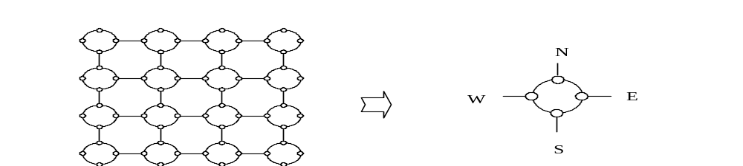
The Reconfigurable Enhanced Mesh RM
For all reconfigurable bus models, buses are created dynamically during execution
Best known example:
  General Reconfigurable Mesh (RM)
  Each PE has four ports called N,S, E, W (often called “NEWS”)
  In one step, each PE can set the connections of its ports, based on local data
  At most two disjoint pairs of ports can be connected at any time
  One such connection is the adjacent pairs,
  {{N,E}, {W,S}}.

Slide 53


Simulation Preliminaries
Reasons to simulate other models using MASC
  Allows a better understanding of the power of MASC
  Provides a simulation algorithm that can be used to convert algorithms designed for the other model to MASC
Basic Assumption Used in the Simulations
  MASC(n, ) has a mesh PE network with row-major ordering
  The enhanced meshes have a 2D mesh with the same size and ordering
  Each PE in MASC has the same computational power as an enhanced mesh PE
  The MASC buses and the buses of the enhanced mesh have the same characteristics
  The word lengths of both models are the same and at least ⎡lg(n)⎤.
  Each PE in MASC knows its position in the 2D mesh.
    Words can store the positions of various PEs

Slide 54
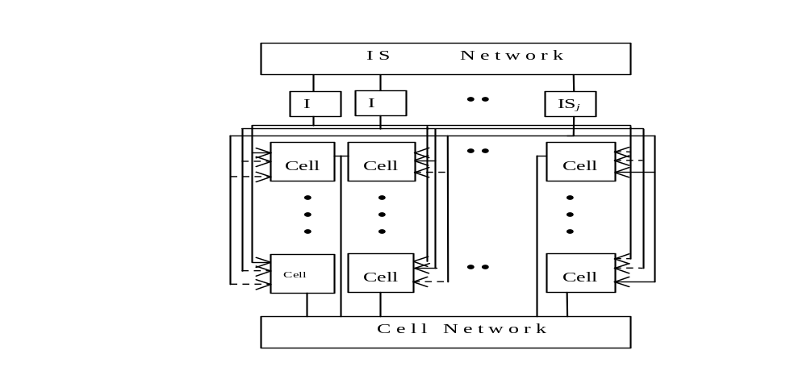
Simulation Mappings between MASC & the Enhanced Mesh MMB
The mapping is between MASC(n, ) and Enhanced meshes of size
The mapping assigns a PE in one model to the PE that is in the same position in the 2D mesh in the other model
The ith IS in MASC simulates both the ith row and the ith column buses

Slide 55
Simulation of MMB with MASC
Since both models have identical 2D meshes, these do not need to be simulated
Since the power of PEs in respective models are identical, their local computations are not simulated
To simulate a MMB row broadcast on the MASC,
  All PEs switch to their assigned row IS
  The IS for each row checks to see if there is a PE that wishes to broadcast
  If true, the IS broadcasts this value to all of its PEs (i.e., the ones on its assigned row).
Simulation of a MMB column broadcast is similar
The running time is O(1)
There are examples that show the MASC model is strictly more powerful than the MMB model
Theorem 1.
MASC(n, j) with a 2-D mesh is strictly more powerful than a MMB for j = Ω( ).
An algorithm for a MMB can be executed on MASC(n, j) with j=Ω( ) and a 2-D mesh with a running time at least fast as the MMB time.

Slide 56



Simulation of MASC by MMB
PE(1,1) stores a copy of the program and simulates the ISs sequentially.
Each instruction stream command or datum is first sent by P(1,1) to the PEs in the first column.
Next, the PEs in the first column broadcast this command or datum along the rows to all PEs.
Each MMB processor uses two registers, channel and status, to decide whether or not to execute the current instruction.
  channel records which IS the processor is assigned to
  status records whether PE is active, inactive, idle
The simulation of simultaneous broadcasts of ISs takes O( ) time.
A local computation, memory access, or a data movement along local links are identical in the two models and require O(1) time.
The execution of a global reduction operator OR, AND, MAX, MIN takes O( ) using an optimal MMB algorithm (details omitted).
Since the global reduction operators may be computed for O( ) ISs, an upper bound is O( ) or O( ).
Theorem 3.
MASC(n, ) with a 2-D mesh can be simulated by a MMB in O( ) time with O( ) extra memory

Slide 57
Simulation Conclusions
MASC is strictly more powerful than an MMB of the same size.
Any algorithm for an MMB can be executed on a MASC of the same size with the same running time. In particular,
  Optimal algorithms for MMB are also optimal when executed on MASC
CLAIM: MASC and RM are very dissimilar and can not simulate each other efficiently.
  Details in Jin’s dissertation.

Slide 58
Suggested Changes
Probably move simulation material to the parallel algorithms course.

