Slide 1
A SIMD MACHINE
ASC
Both a Language and an Architecture

Slide 2
Historical Remarks
Recall that all active processors of a SIMD computer must simultaneously access the same memory location.
These locations can be viewed as components of a vector.
SIMD machines are sometimes called vector computers [Jordan,et.al.] or processor arrays [Quinn 94,04] based on their ability to execute vector and matrix operations efficiently.

Slide 3
Historical Remarks
SIMD computers that focus on vector operations usually
  support some vector and possibly matrix operations in hardware, and
  limit or provide less support for non-vector type operations involving “vector components”.
The inner loops of some sequential algorithms consist only of performing the same operation on a set of disjoint data items.
  Easy to parallelize using a SIMD by assigning each data item to a different processor and having each operation performed simultaneously.

Slide 4
SIMD Execution Style
The traditional (SIMD, vector, processor array) execution style ([Quinn 94, pg 62], [Quinn 2004, pgs 37-43]:
  The sequential processor that broadcasts the commands to the rest of the processors is called the front end or control unit.
  The front end is a general purpose CPU that stores the program and the data that are not manipulated in parallel.
  The front end normally executes the sequential portions of the program.

Slide 5
SIMD Execution Style
  Each processing element has a local memory that can not be directly accessed directly by the host or other processing elements.
  Collectively, the individual memories of the processing elements (PEs) store the vector data that is processed in parallel.
  When the front end encounters an instruction whose operand is a vector, it issues a command to the PEs to perform the instruction in parallel.
  Although the PEs execute in parallel, some units can be allowed to skip any particular instruction.
  SIMDs are also called MPPs (massively parallel processors – although there is a specific machine named MPP. )

Slide 6
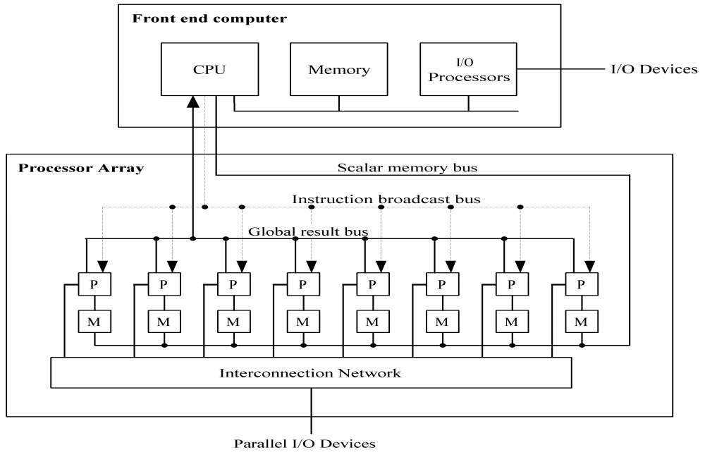
Possible Architecture for a Generic SIMD

Slide 7
Real SIMD Architectures
An early SIMD computer designed for vector and matrix processing was the Illiac IV computer built at the University of Illinois. [Jordan et. al., pg 7].
The CRAY-1 and the Cyber-205 use pipelined arithmetic units to support vector operations and are viewed as pipelined SIMDs ([Jordan, et al, p7], [Quinn 94, pg 61-2], [Quinn 2004, pg37).

Slide 8
Real SIMD Architectures
The MPP, DAP, the Connection Machines CM-1 and CM-2, MasPar MP-1 and MP-2 are examples of SIMD computers given in [Akl, pg 8-12]
  The MP-1 and Connection Machines are briefly discussed there.
Quinn [1994, pg 63-67] discusses the Connection Machine CM-200, a smaller & updated CM-2.
Professor Batcher at Kent State was the chief architect for the STARAN and the MPP (Massively Parallel Processor) and an advisor for the ASPRO (small, second generation STARAN)

Slide 9
Today’s SIMDs
Many SIMDs are being embedded in SISD machines.
Others are being build as part of hybrid architectures.
Others are being build as special purpose machines, although some of them could classify as general purpose.

Slide 10
A Company Trying to Build an Inexpensive SIMD
WorldScape is building a COTS SIMD.
The architecture is changing rapidly as they are in development.
See http://www.wscapeinc.com/

Slide 11
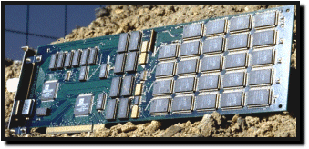
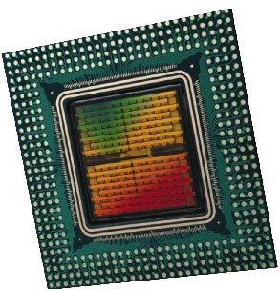
An Example of a Hybrid SIMD
Embedded Massively Parallel Accelerators
  Systola 1024: PC add-on board with 1024 processors
  Fuzion 150: 1536 processors on a single chip
  Other accelerators: Decypher, Biocellerator, GeneMatcher2, Kestrel, SAMBA, P-NAC, Splash-2, BioScan
(Slides 10-12 are due to Prabhakar R. Gudla (U of Maryland) at a CMSC 838T Presentation, 4/23/2003.)

Slide 12

Hybrid Architecture
Systola1024
Systola1024
Systola1024
Systola1024
Systola1024
Systola1024
Systola1024
Systola1024
High speed Myrinet switch
Systola1024
Systola1024
Systola1024
Systola1024
Systola1024
Systola1024
Systola1024
Systola1024
  combines SIMD and MIMD paradigm within a parallel architecture ⇒ Hybrid Computer

Slide 13

Architecture of Systola 1024
Instruction Systolic Array:
  32 × 32 mesh of processing elements
  wavefront instruction execution
RAM NORTH
RAM WEST
program memory
Controller
host computer bus
ISA
Interface processors

Slide 14
SIMDs Embedded in SISDs
Intel's Pentium 4 includes what they call MMX technology to gain a significant performance boost
IBM and Motorola incorporated the technology into their G4 PowerPC chip in what they call their Velocity Engine.
Both MMX technology and the Velocity Engine are the chip manufacturer's name for their proprietary SIMD processors and parallel extensions to their operating code.
This same approach is used by NVidia and Evans & Sutherland to dramatically accelerate graphics rendering.

Slide 15
Special Purpose SIMDs in the
Bioinformatics Market
Paracel, Inc. (acquired by Celera Genomics for $283 million in March of 2000)
  Paracel's systems are based on a proprietary SIMD processor packaged as an integrated system with proprietary software algorithms.
  One of their machines is called GeneMatcher.
TimeLogic, Inc
  Has DeCypher, a reconfigurable SIMD.

Slide 16
MASC
MASC (Massively ASsociative Computing)
Several professors and their graduate students at Kent State University are designing a SIMD machine with special properties.
We will discuss an early version of this machine, the ASC, and program it using a simulator.
That will let you
Dr. Baker is working with theoretical models of the machine.
Dr. Walker is working with the hardware design of the machine.
Advisors involved are Dr. Batcher and Dr. Potter.

Slide 17
Comparisons of SIMD and MIMD
Features
Reference: [Roosta, pg 10]
Less hardware than MIMDs as they have only one control unit.
Less memory needed than MIMD
  Only one copy of the instructions need to be stored
  Allows more data to be stored in memory, which reduces movement of data between primary and secondary storage.

Slide 18
Comparisons of SIMD and MIMD
Features -continued
Less startup time in communicating between PEs.
Single instruction stream and synchronization of PEs make SIMD applications easier to program, understand, & debug.
Control flow operations and scalar operations can be executed on the control unit while PEs are executing other instructions.

Slide 19
Comparisons of SIMD and MIMD
Features -continued
  MIMD architectures require explicit synchronization primitives, which create a substantial amount of additional overhead.
  During a communication operation between PEs,
    PEs send data to a neighboring PE in parallel and in lock step
    the entire communication operation is executed synchronously
  Less complex hardware is needed in a SIMD since no message decoder is needed in PEs
    MIMDs need a message decoder in each PE.

Slide 20
Associative Computing
Overview
Introduction
  The ASC model
  Language designed for the ASC model
  Some ASC Programs
  Introduction to the ASC simulator and how to run ASC programs
  Note: MASC is an extension of the ASC model which allows for multiple instruction streams. We won’t look at this model.

Slide 21
Associative Computing References
Note: KSU papers listed below are available usually on a website which, unfortunately is down right now.
www.cs.kent.edu/~parallel/
Maher Atwah, Johnnie Baker, and Selim Akl, An Associative Implementation of Classical Convex Hull Algorithms, Proc of the IASTED International Conference on Parallel and Distributed Computing and Systems, 1996, 435-438
Johnnie Baker and Mingxian Jin, Simulation of Enhanced Meshes with MASC, a MSIMD Model, Proc. of the Eleventh IASTED International Conference on Parallel and Distributed Computing and Systems, Nov. 1999, 511-516.

Slide 22
Associative Computing References
Mingxian Jin, Johnnie Baker, and Kenneth Batcher, Timings for Associative Operations on the MASC Model, Proc. of the 15th International Parallel and Distributed Processing Symposium, (Workshop on Massively Parallel Processing, San Francisco, April 2001.
Jerry Potter, Johnnie Baker, Stephen Scott, Arvind Bansal, Chokchai Leangsuksun, and Chandra Asthagiri, An Associative Computing Paradigm, Special Issue on Associative Processing, IEEE Computer, 27(11):19-25, Nov. 1994. (Note: MASC is called ‘ASC’ in this article.)
Jerry Potter, Associative Computing - A Programming Paradigm for Massively Parallel Computers, Plenum Publishing Company, 1992

Slide 23
Downloads for ASC Simulator
There is a compiler and a simulator at the following site:
http://zserver.zephyr.cs.kent.edu/PACL/downloads.htm
These will install in a Windows environment.
They are on the C-106 machines.

Slide 24
Associative Computers
Associative Computer: A SIMD computer with certain additional features supported in hardware.
These additional features can be supported (less efficiently) in traditional SIMDs in software.
The name “associative” is due to its ability to locate items in the memory of PEs by content rather than location.

Slide 25
ASC
The STARAN Computer (Goodyear Aerospace, early 1970’s) provided an architectural model for associative computing embodied in the ASC model.
Associative computing extends the data parallel paradigm to a complete computational model.
Provides a practical model that supports massive parallelism.

Slide 26
The Associative Search
On
lot
Busy-
idle
Make
Color
Year
Model
Price
PE1
Dodge
red
1994
1
1
PE2
0
0
PE3
Ford
blue
1996
1
1
IS
PE4
0
Ford
white
1998
1
PE5
0
0
PE6
0
0
PE7
Subaru
red
1997
1
1

