Slide 1
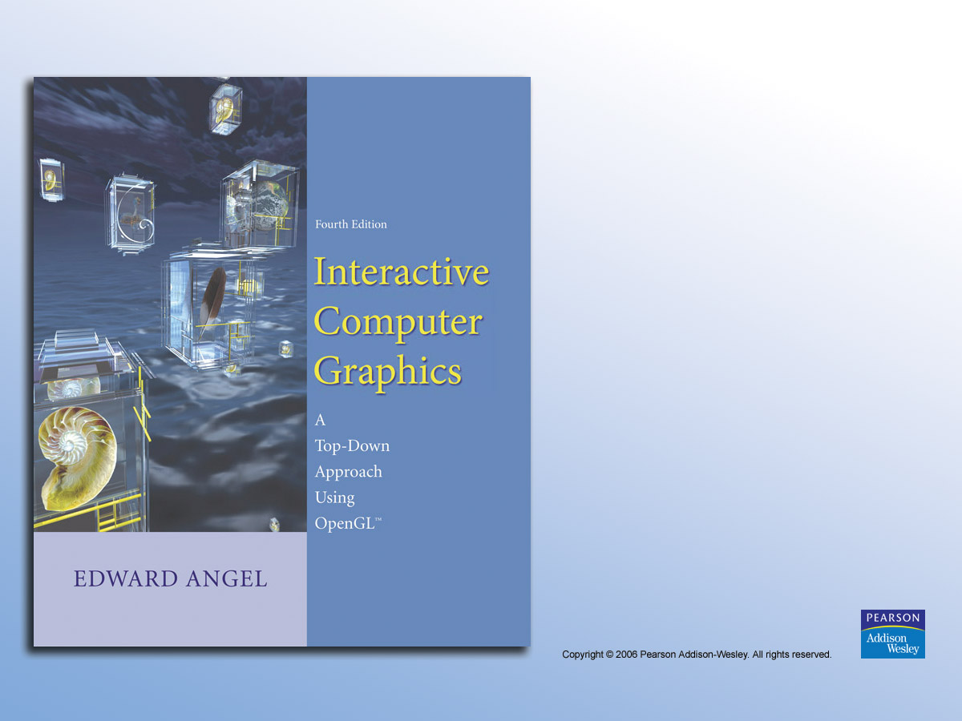
Chapter 4
Geometric Objects And Transformations

Slide 2

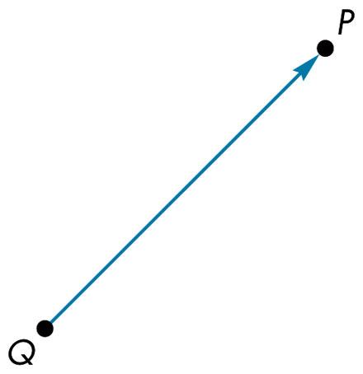
FIGURE 4.1 Directed line segment that connects points.

Slide 3
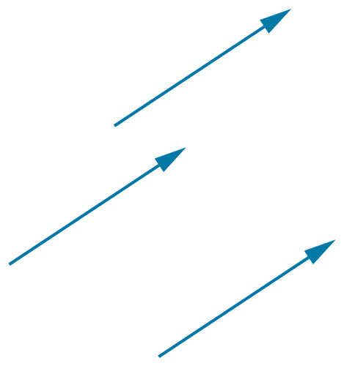
FIGURE 4.2 Identical vectors.

Slide 4
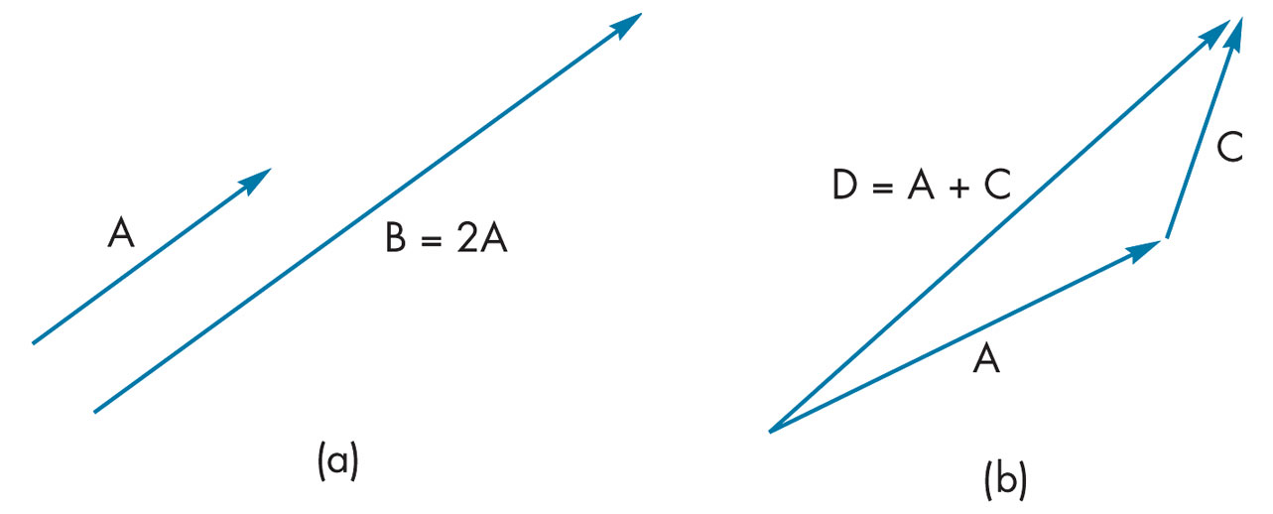
FIGURE 4.3 (a) Parallel line segments. (b) Addition of line segments.

Slide 5
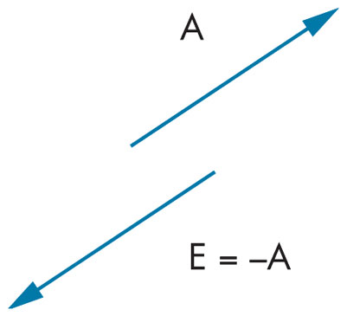
FIGURE 4.4 Inverse vectors.

Slide 6
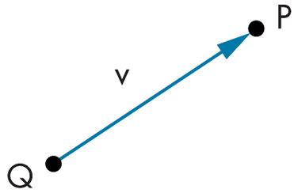
FIGURE 4.5 Point-vector addition.

Slide 7
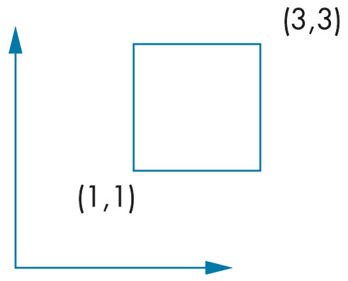
FIGURE 4.6
Object and coordinate system.

Slide 8
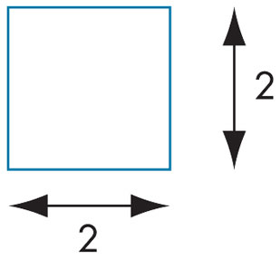
FIGURE 4.7
Object without coordinate system.

Slide 9
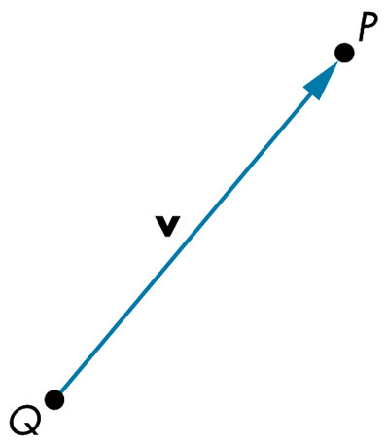
FIGURE 4.8 Point–point subtraction.

Slide 10
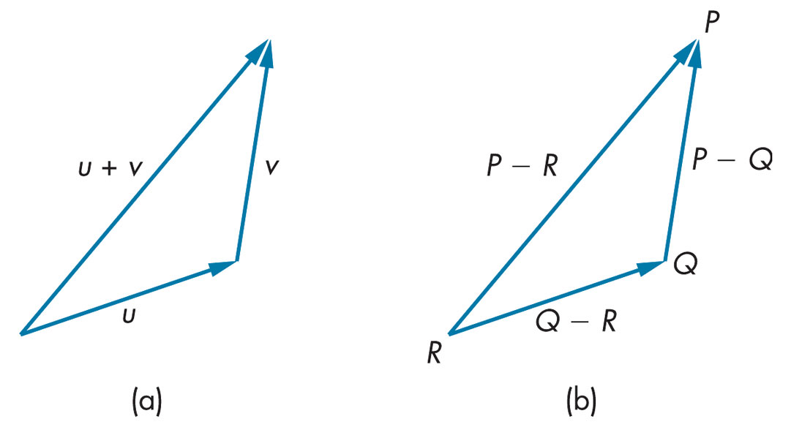
FIGURE 4.9 Use of the head-to-tail rule. (a) For vectors. (b) For points.

Slide 11
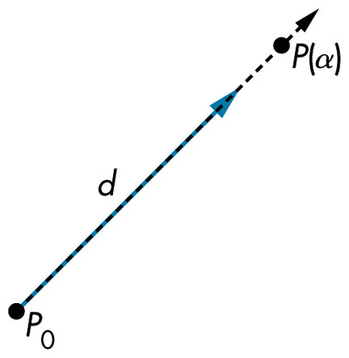
FIGURE 4.10 Line in an affine space.

Slide 12
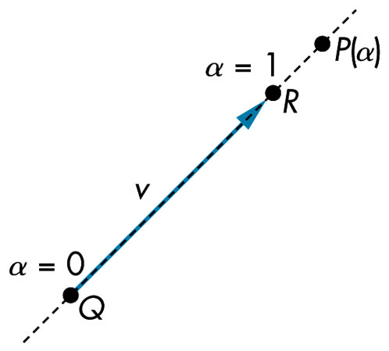
FIGURE 4.11 Affine addition.

Slide 13
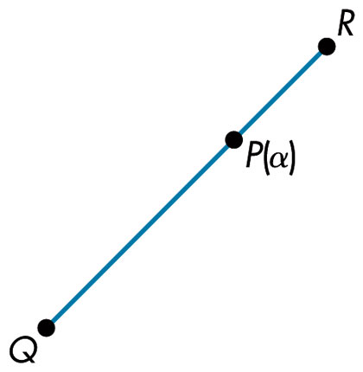
FIGURE 4.12
Line segment that connects two points.

Slide 14
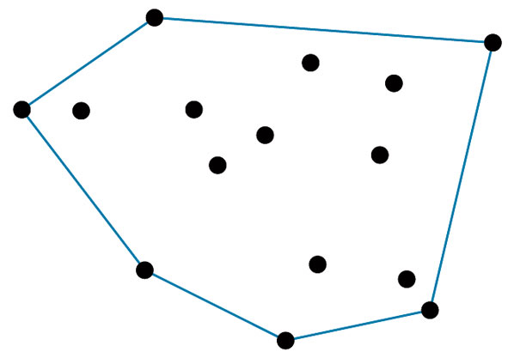
FIGURE 4.13 Convex hull.

Slide 15
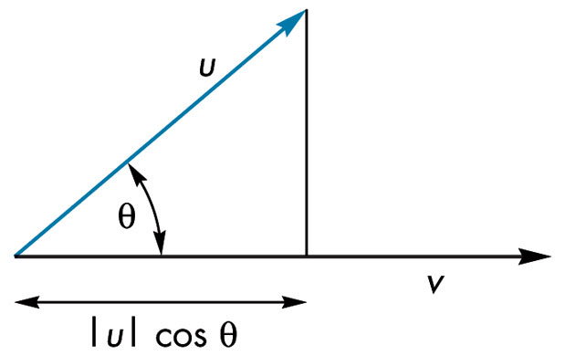
FIGURE 4.14
Dot product and projection.

Slide 16
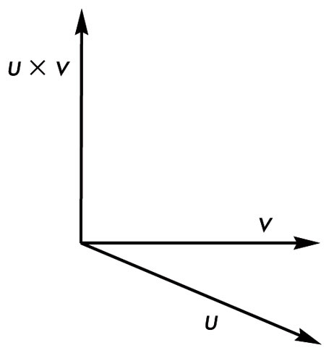
FIGURE 4.15 Cross product.

Slide 17
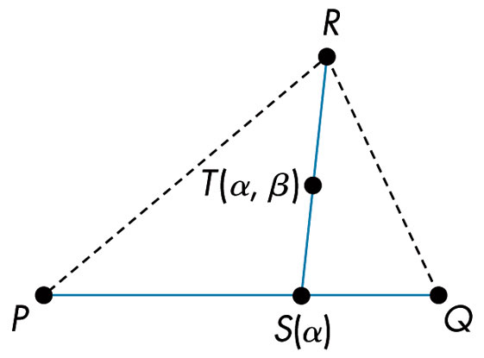
FIGURE 4.16 Formation of a plane.

Slide 18
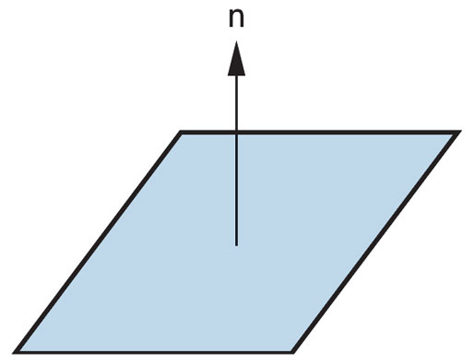
FIGURE 4.17 Normal to a plane.

Slide 19
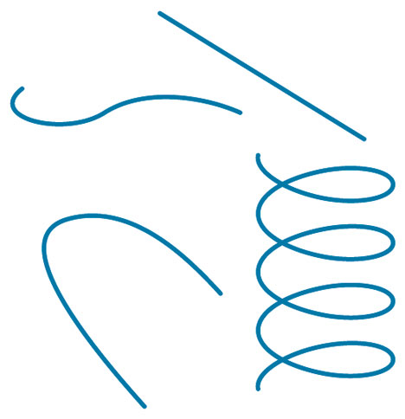
FIGURE 4.18
Curves in three dimensions.

Slide 20
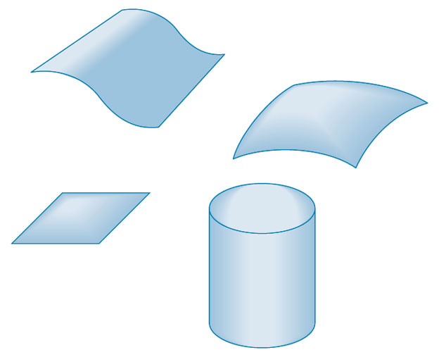
FIGURE 4.19
Surfaces in three dimensions.

Slide 21
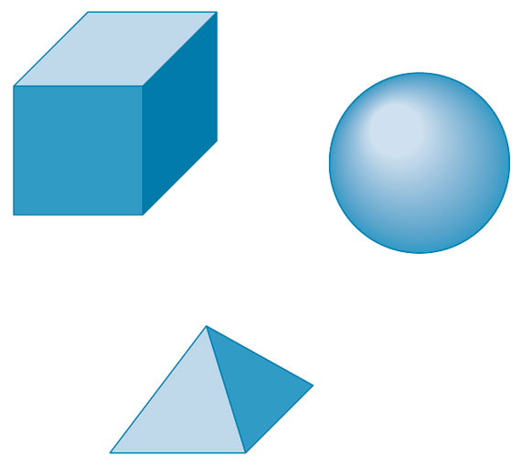
FIGURE 4.20 Volumetric objects.

Slide 22
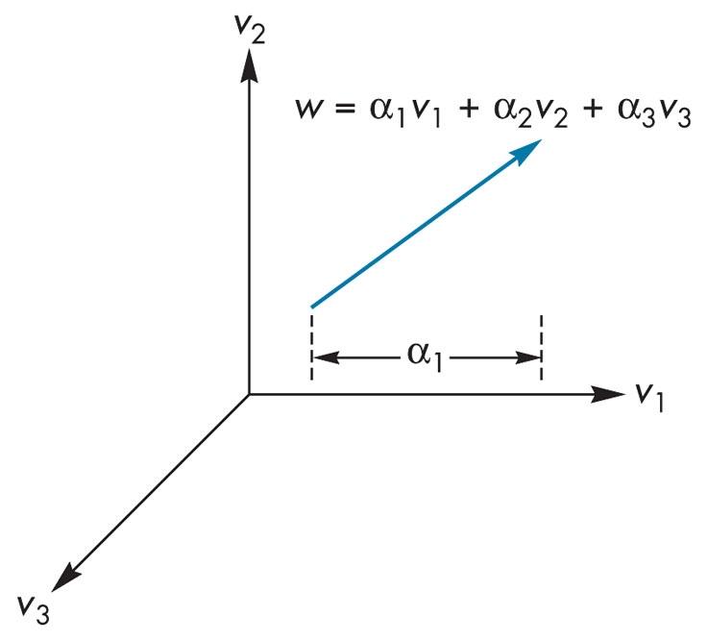
FIGURE 4.21 Vector derived from three basis vectors

Slide 23
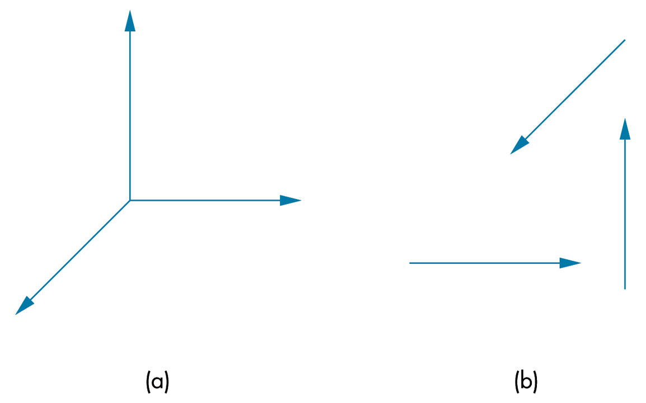
FIGURE 4.22 Coordinate systems.
(a) Vectors emerging from a common point. (b) Vectors moved.

Slide 24
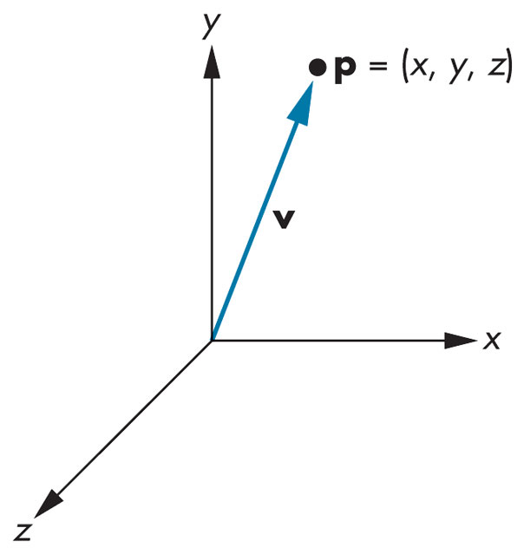
FIGURE 4.23
A dangerous representation of a vector.

Slide 25
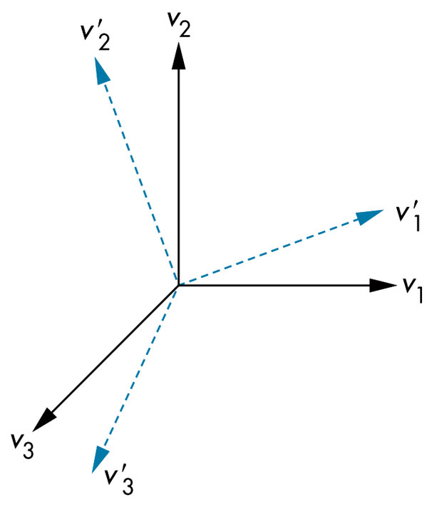
FIGURE 4.24
Rotation and scaling of a basis.

Slide 26
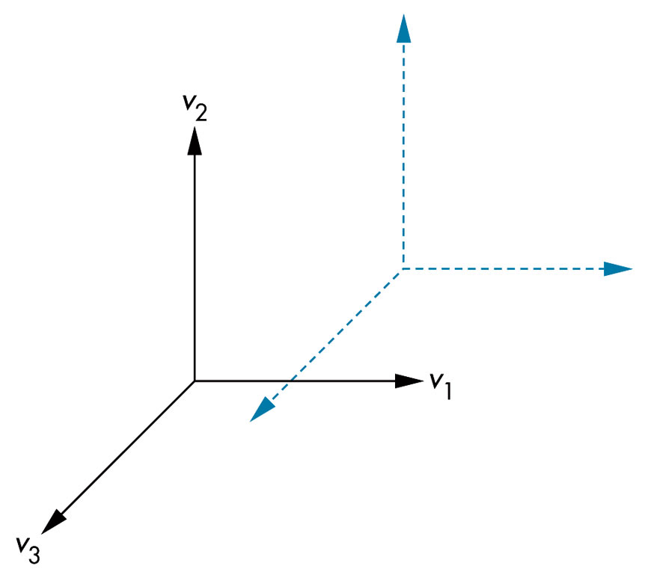
FIGURE 4.25 Translation of a basis.

Slide 27
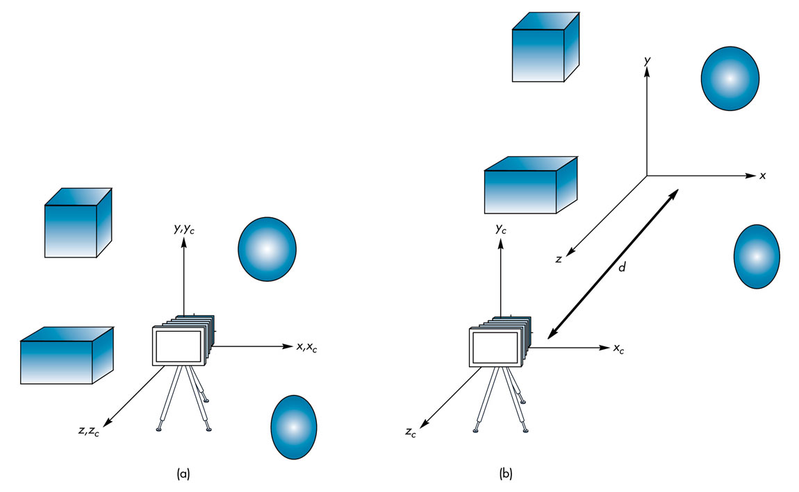
FIGURE 4.26 Camera and object frames.
(a) In default positions. (b) After applying model-view matrix.

Slide 28
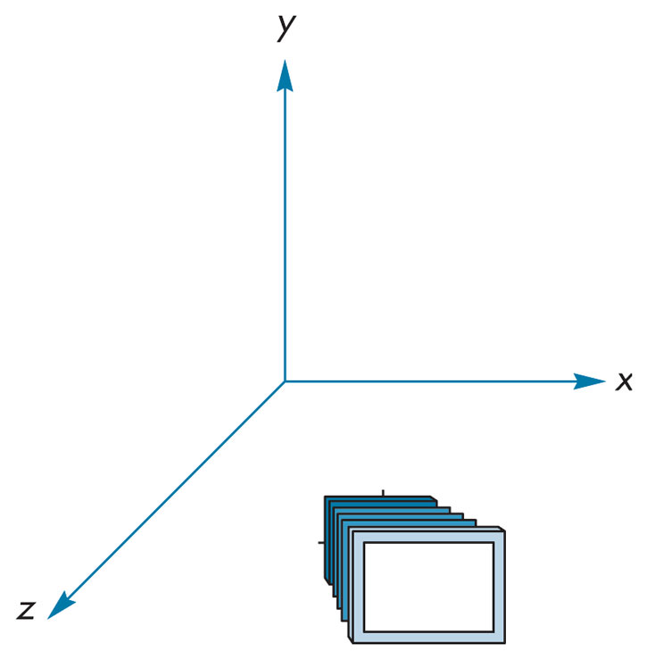
FIGURE 4.27 Camera at (1,0,1) pointing toward the origin.

Slide 29
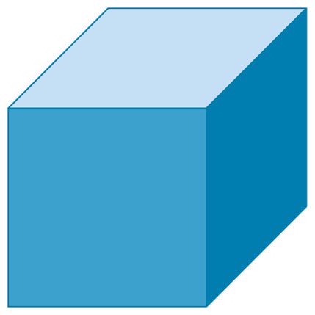
FIGURE 4.28
One frame of cube animation.

Slide 30
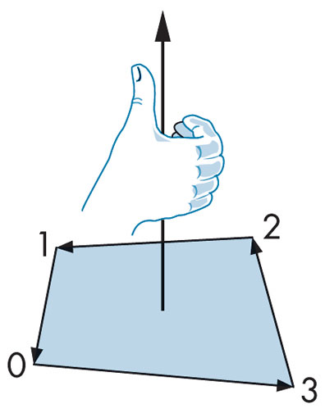
FIGURE 4.29
Traversal of the edges of a polygon.

Slide 31
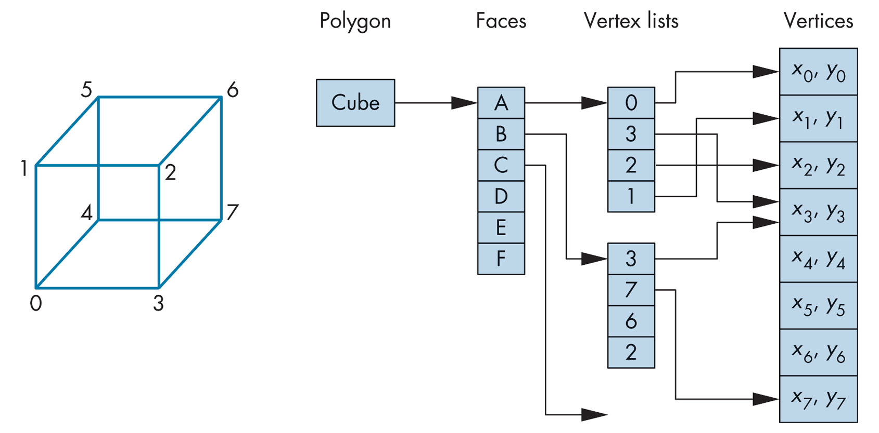
FIGURE 4.30
Vertex-list representation of a cube.

Slide 32
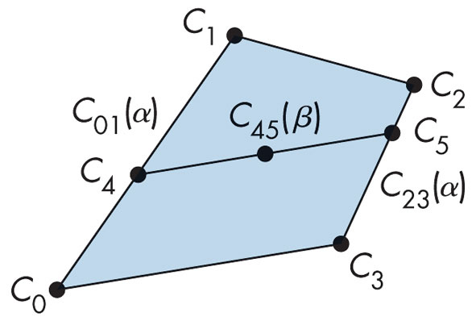
FIGURE 4.31 Bilinear interpolation.

Slide 33
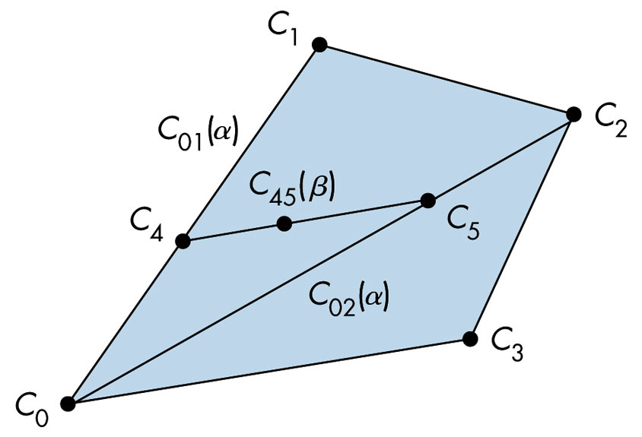
FIGURE 4.32
Bilinear interpolation of a triangle.

Slide 34
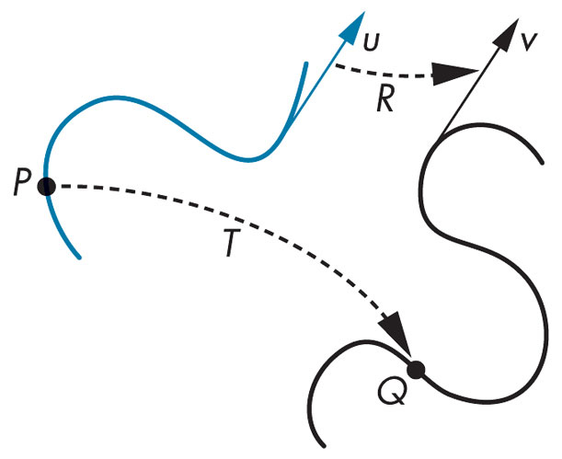
FIGURE 4.33 Transformation.

Slide 35
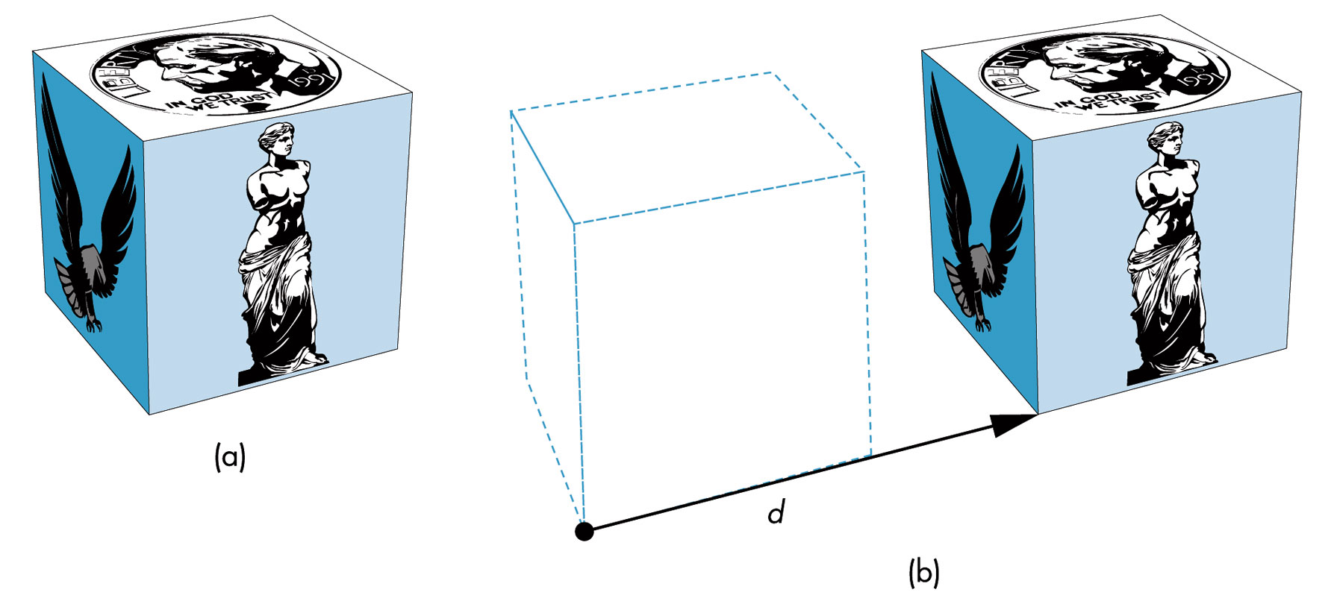
FIGURE 4.34 Translation. (a) Object in original position. (b) Object translated.

Slide 36
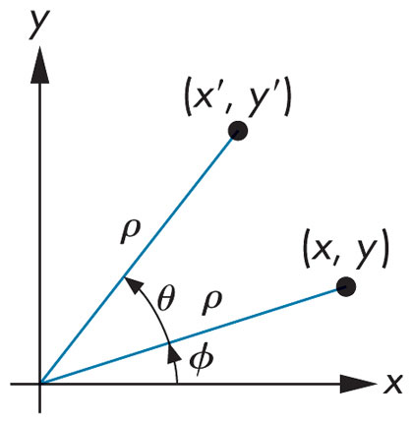
FIGURE 4.35
Two-dimensional rotation.

Slide 37
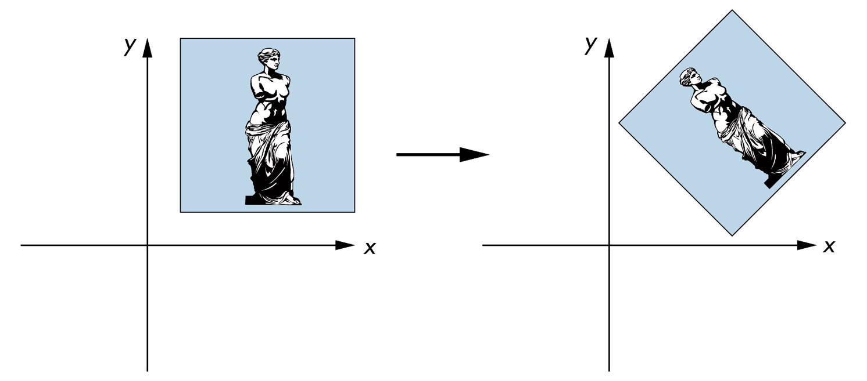
FIGURE 4.36
Rotation about a fixed point.

Slide 38
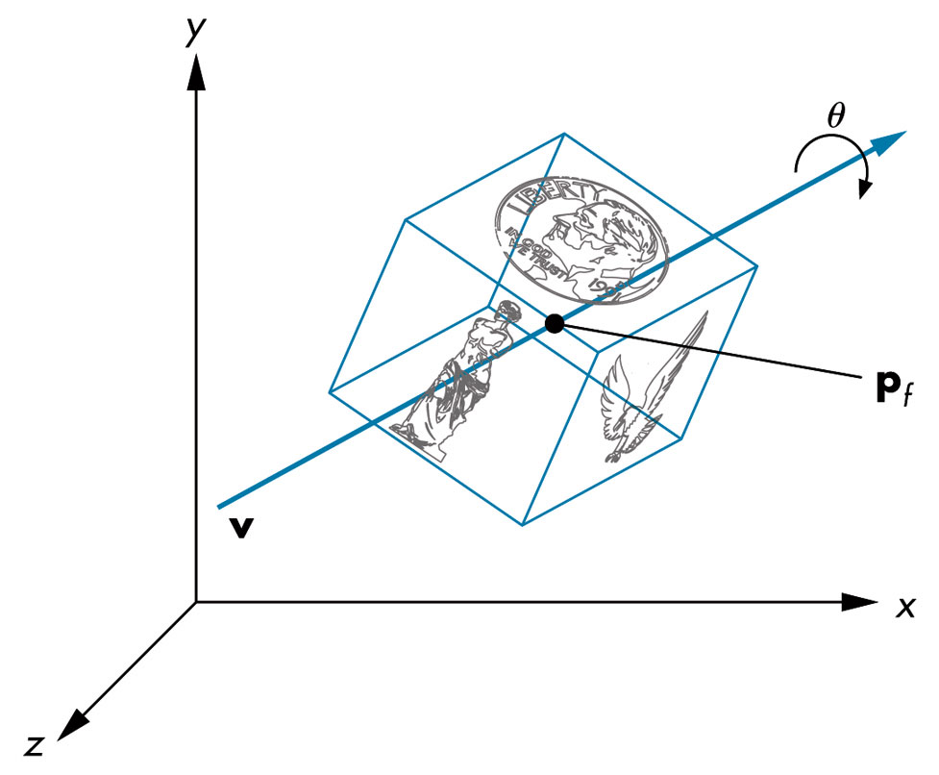
FIGURE 4.37
Three-dimensional rotation.

Slide 39
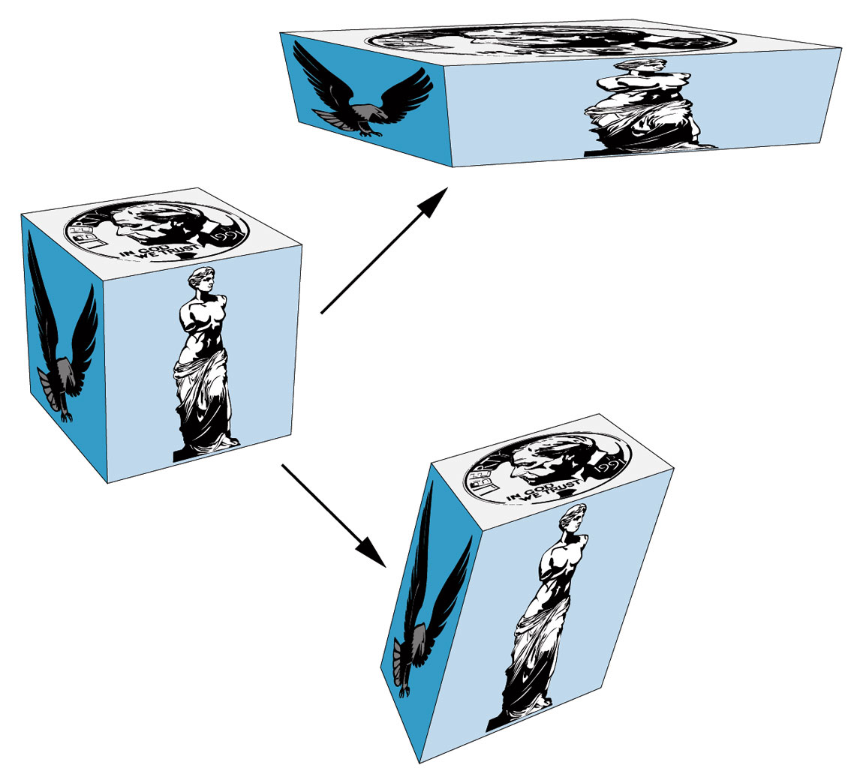
FIGURE 4.38
Non–rigid-body transformations.

Slide 40
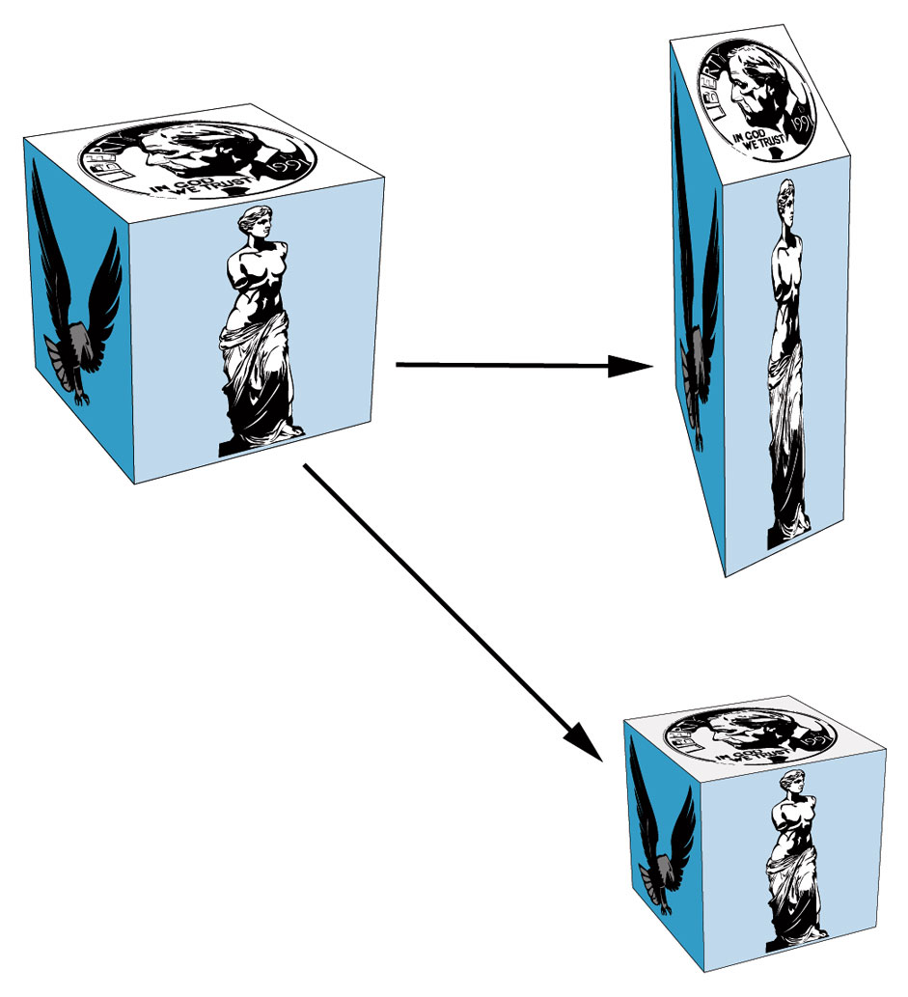
FIGURE 4.39
Uniform and nonuniform scaling.

Slide 41
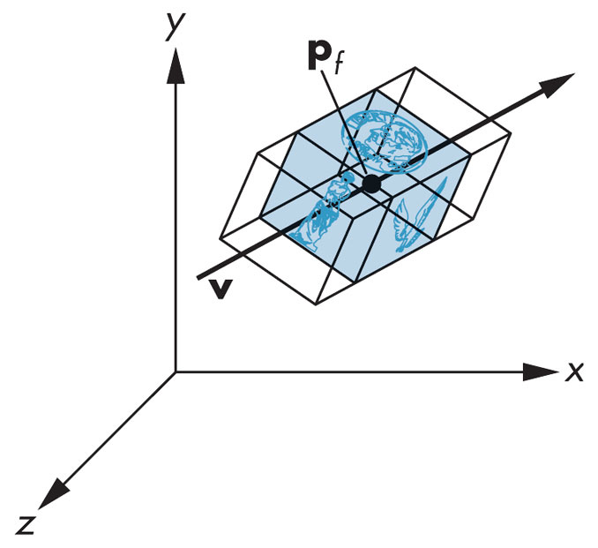
FIGURE 4.40 Effect of scale factor.

Slide 42
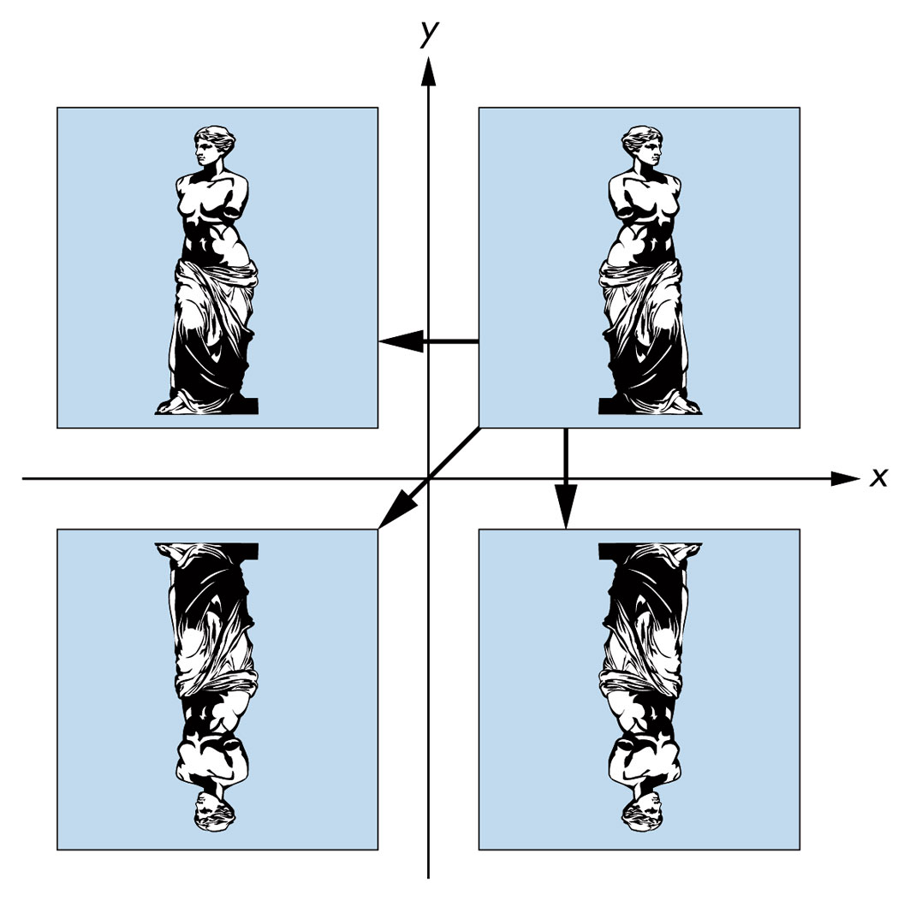
FIGURE 4.41 Reflection.

Slide 43
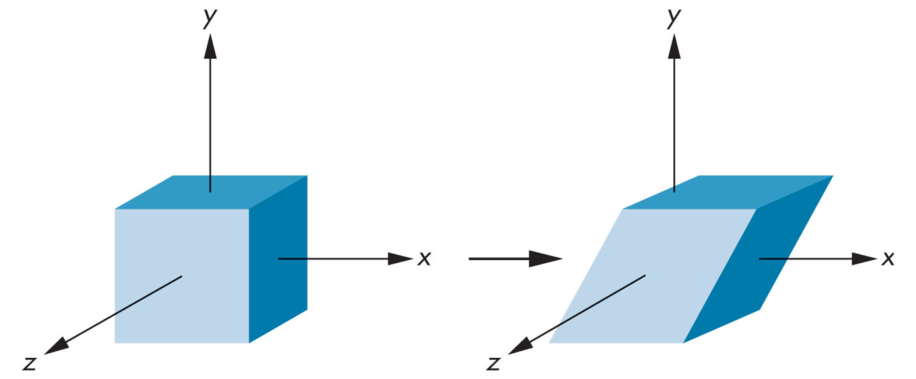
FIGURE 4.42 Shear.

Slide 44
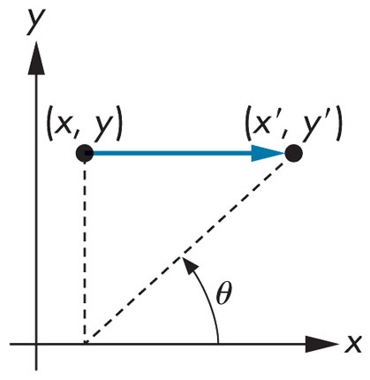
FIGURE 4.43
Computation of the shear matrix.

Slide 45
FIGURE 4.44 Application of transformations one at a time.

Slide 46
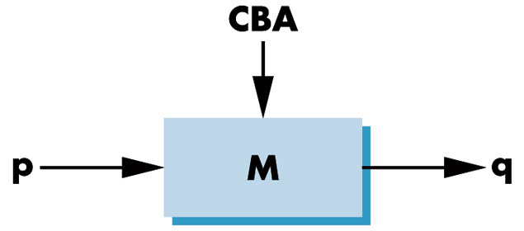
FIGURE 4.45 Pipeline transformation.

Slide 47
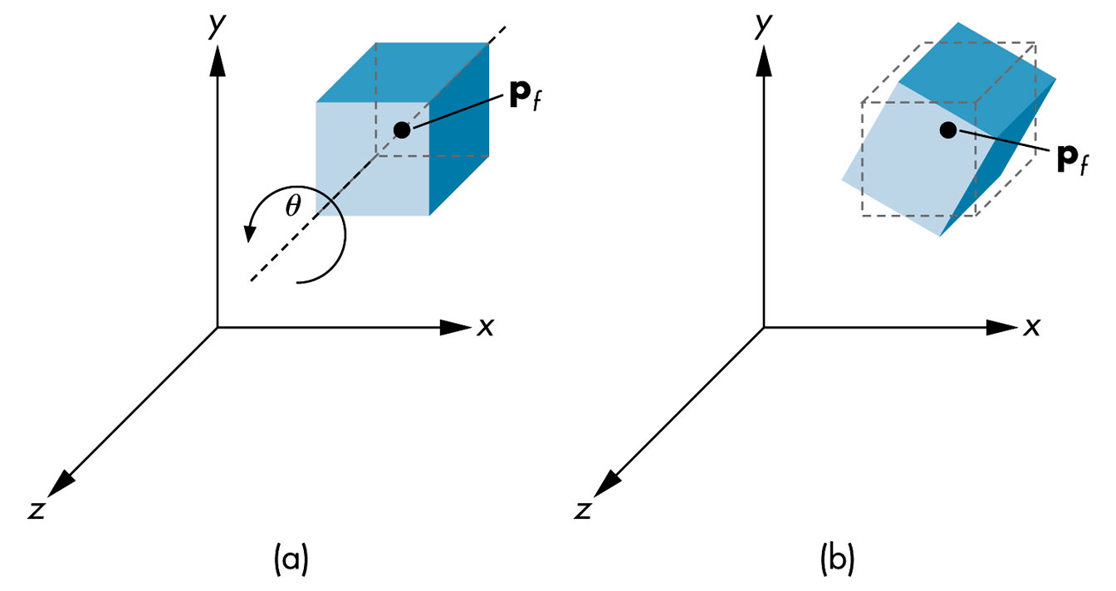
FIGURE 4.46
Rotation of a cube about its center.

Slide 48
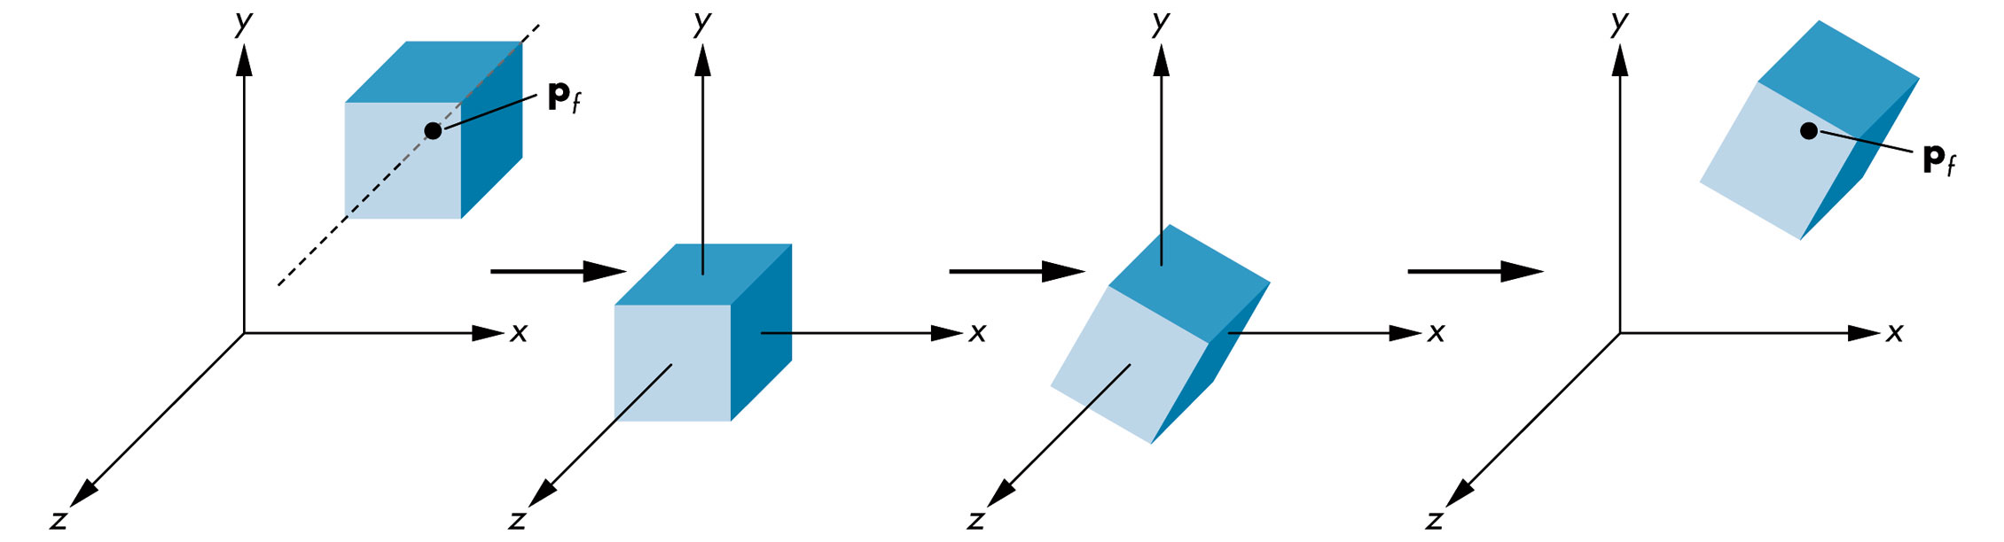
FIGURE 4.47
Sequence of transformations.

Slide 49
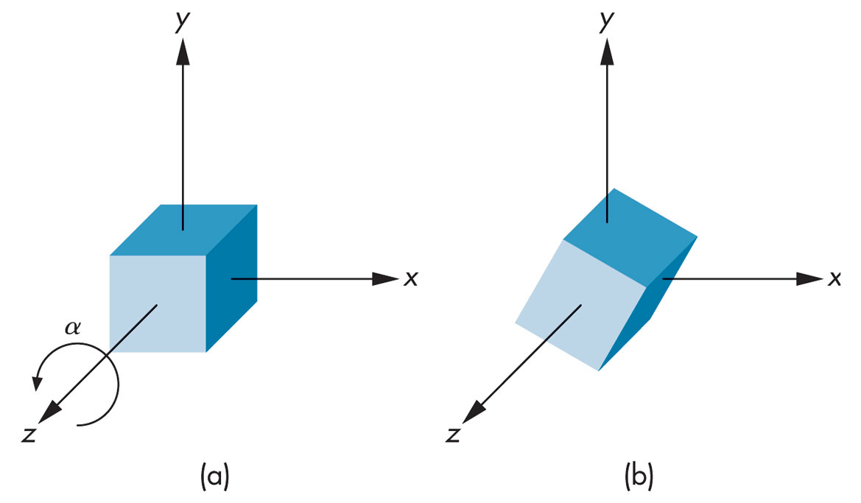
FIGURE 4.48 Rotation of a cube about the z-axis. (a) Cube before rotation.
(b) Cube after rotation.

Slide 50
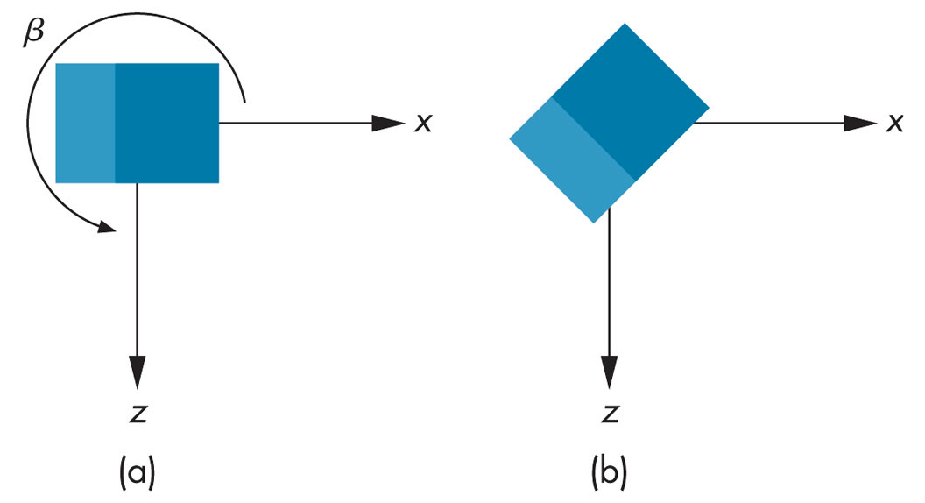
FIGURE 4.49
Rotation of a cube about the y-axis.

Slide 51
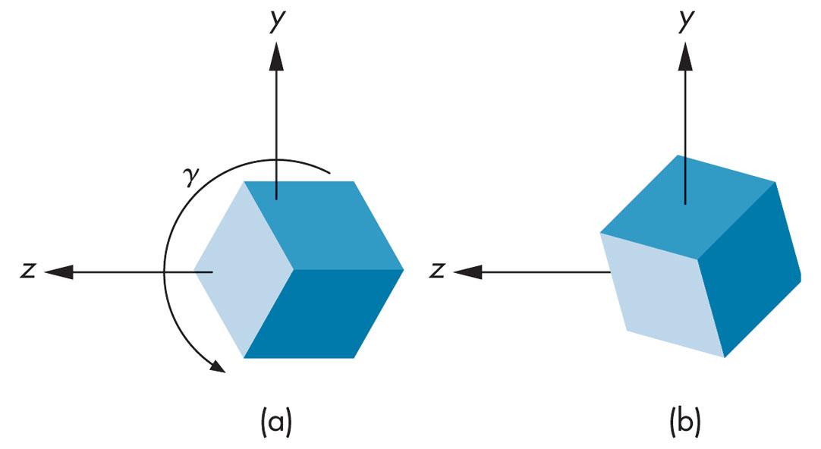
FIGURE 4.50
Rotation of a cube about the x-axis.

Slide 52

FIGURE 4.51 Scene of simple objects.

Slide 53

FIGURE 4.52 Instance transformation.

Slide 54

FIGURE 4.53 Rotation of a cube about an arbitrary axis.

Slide 55

FIGURE 4.54
Movement of the fixed point to the origin.

Slide 56

FIGURE 4.55 Sequence of rotations.

Slide 57

FIGURE 4.56 Direction angles.

Slide 58

FIGURE 4.57
Computation of the x rotation.

Slide 59

FIGURE 4.58
Computation of the y rotation.

Slide 60
FIGURE 4.59
Current transformation matrix (CTM).

Slide 61

FIGURE 4.60
Model-view and projection matrices.

Slide 62

FIGURE 4.61 Trackball frame.

Slide 63

FIGURE 4.62 Projection of the trackball position to the plane.

Slide 64

FIGURE 4.63
Computation of the plane of rotation.

Slide 65

FIGURE 4.64
Symmetric orientation of cube.

