Slide 1
Chapter 11
More 3D Object Representations
Spline Curves and Surfaces

Slide 2
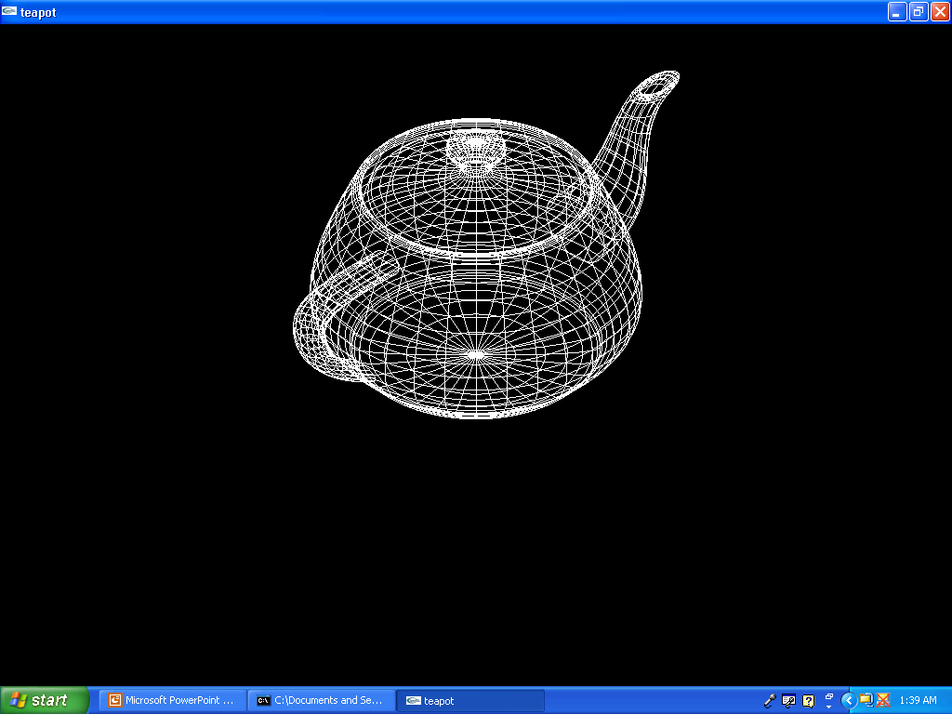
An Example of an Object Drawn with Splines

Slide 3
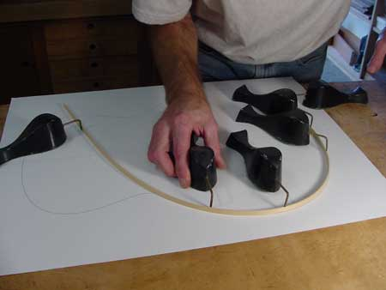
What is a Spline?
Term came from drafting – it is a flexible strip used to produce a smooth curve through a designated set of points.
Small weights were distributed along the spline to hold it to the drafting table when the curve was being drawn.

Slide 4
What is a Spline Curve?
Originally-
  It was any curve drawn with a spline and weights.
  Such curves can be described mathematically as piecewise cubic polynomials whose first and second derivatives are continuous over the various curve sections.
  We’ll see what each of these terms imply even if you haven’t had calculus.
  If you have had calculus, the above sentence should be completely understandable!

Slide 5
What is a Spline Curve?
In computer graphics, the term refers to any composite curve formed with polynomial sections satisfying some specified continuity conditions at the boundary of the pieces.
There are many different types of spline curves and we will investigate only a few of them here.
We’ll look at those listed in yellow in the next slide ---

Slide 6
What is a Spline Curve?
Natural cubic splines
Hermite splines
Cardinal splines
Kochanek-Bartels splines
Bezier Splines
B-splines
Rational splines
The B-splines have different characteristics
Uniform
Periodic
Open Uniform
Non-unifrom

Slide 7
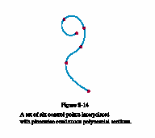
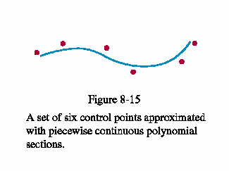
Interpolating and Approximating Splines
We specify a spline curve by giving a set of coordinate positions in 2D.
The coordinates are either interpolated or approximated using points called control points.

Slide 8
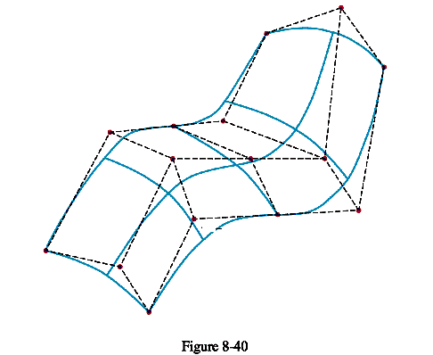
Interpolating and Approximating
Interpolation is often used to digitize drawings or specify animation paths.
Approximation is used predominately as a design tool to create object shapes.
Although we are talking about curves right now, these curves can be used to create 3D surfaces such as

Slide 9
Working with Splines
Spline curves (and surfaces) are defined, modified, and manipulated with operations on the control points.
The designer selects (often interactively) locations for the control points and these influence the position and shape of the curve.
By repositioning the control points, the curve can be shaped by eyeballing it and adjusting its shape until it is what is desired.

Slide 10
Splines Have Many Nice Characteristics for Graphics
Geometric transformations only must be applied to the control points and then the curve can be regenerated – i.e splines can be manipulated easily just like polygons.
Given a set of points, the convex hull of the points (in 2D) is the smallest set containing all the points that is convex.
Intuitively, think of a rubber band being stretched to include all the points – that would define the convex hull.

Slide 11
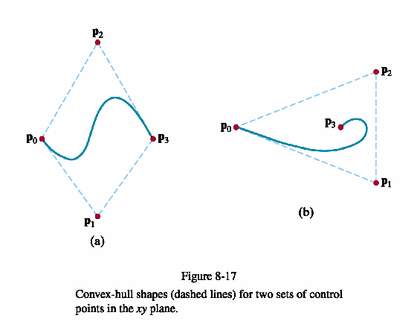
Splines Have Many Nice Characteristics for Graphics
For most splines, the curve lies in the convex hull of the control points
This property means the curve will not deviate too far from the control points.
In particular, wild oscillations won’t occur.

Slide 12
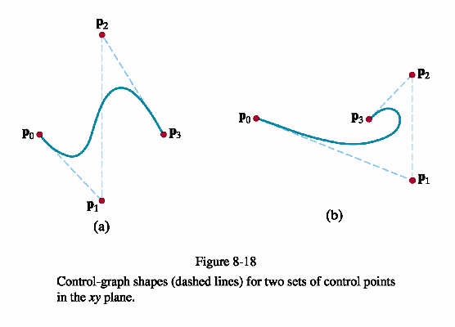
Splines Have Many Nice Characteristics for Graphics
The set of polylines connecting the sequence of control points for an approximation spline curve is called its control graph.

Slide 13
Parametric Equations Define the Curves
Each section of a spline curve is described by a set of parametric coordinate functions of the form:
  x = x(u)
  y = y(u)
  z = z(u) where u₁ ≤ u ≤ u₂, for some u₁ and u₂
  We often view these as defining a point generator given by
  P(u) = (x(u), y(u), z(u)) in 3D space.
  Note that this generates a curve in 3D space.

Slide 14
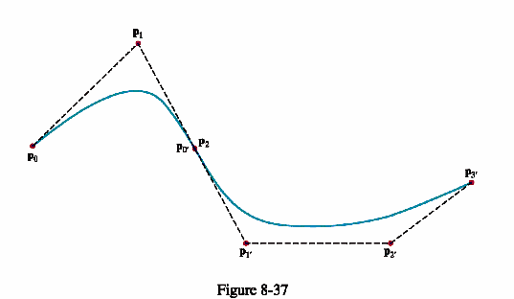
The Joins of Sections
Spline curves are generated in pieces or sections:
First section is generated by P₀, P₁, and P₂
The second section by P₀’, P₁’, and P₂’ where P₂ = P₀’

Slide 15
How We Join the Sections is Critical
The derivative at a point on a curve is the slope of a tangent line to the curve at the point, if the tangent line exists.
Examples:
No derivative at red point.
But, one-sided derivatives exist meaning as you approach the point from one side, you do have a tangent line.
It’s slope is rise/run.
Here, the left-handed derivative is 1 and
right-handed derivative is -1.

Slide 16
Continuity Conditions at the Joins of Sections
Different spline curves provide different continuity conditions that are useful.
Parametric continuity is determined by how the derivatives for the parametric curve sections are related when adjoining curve sections meet at a common boundary or point.
We will always assume that the last control point of one section is the same as the first control point of the next section.

Slide 17
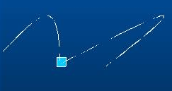
Continuity Conditions at the Joins of Sections
Zero-order parametric continuity (denoted by C⁰) just means the point generated for one section at u₂ is the same point as generated for the next section at u₁.
All splines we’ll generate will have zero-order parametric continuity because of the last condition we assumed.

Slide 18
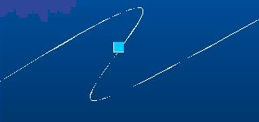
Continuity Conditions at the Joins of Sections
First-order parametric continuity (denoted by C¹) means the one-sided derivatives at the point joining two sections are equal.
This is the minimum amount needed for graphics if we want to digitize images or do any design work at all.

Slide 19
Continuity Conditions at the Joins of Sections
But C¹ continuity is not enough for some graphics work.
Can anyone with a calculus background say why?
What does the second derivative at a point measure?
  Rate of change of the tangent lines at point.
What will you see if the second derivatives are not the same at a join?
When animating, the two parts will change at different rates and the curve will seem to jerk at the joins!

Slide 20
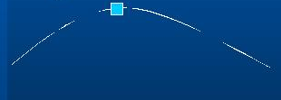
Continuity Conditions at the Joins of Sections
Second-order parametric continuity (denoted by C²) means the one-sided second derivatives at the point joining two sections are equal.
This is the minimum amount needed for animation and some high precision CAD systems.
Only some spline curves will have this property.

Slide 21
Continuity Conditions at the Joins of Sections
There is another kind of continuity condition called a geometric continuity condition.
This only requires that the parametric derivatives of the two sections be proportional to each other.
We won’t worry about these here.

Slide 22
How are Splines Specified?
First, the degree of the polynomials to be used for each section must be specified.
  Many are cubic (or degree 3) polynomials as we will see.
Second, the control points must be specified.
Third, one of three different ways (all equivalent) are used to generate the curve:
1) State the boundary conditions imposed on the curve.
2) State the matrix that characterizes the spline.
3) State the set of blending functions or basis functions for the curve.
Some methods are easier to understand than others, but we’ll illustrate each one.

Slide 23
Natural Cubic Splines
The original spline used in graphics was this one which models the drafting spline.
One problem with these is that no local control is possible.
See the applet:
http://www.cse.unsw.edu.au/~lambert/splines/natcubic.html

Slide 24
Hermite Splines
We’ll use these to illustrate the different specification methods.
Named after a French mathematician.
They are interpolating piecewise cubic splines which can be adjusted locally since each curve section only depends on properties at its endpoints.
Local control is desirable because you don’t want to have one control point move and affect the entire curve.

Slide 25
Hermite Spline Applet
See the following Hermite spline (as well as others) drawing applet at
http://www.siggraph.org/education/materials/HyperGraph/modeling/splines/demoprog/curve.html
and note how moving one section (defined by 4 control points) does not affect the rest of the curve.
Now we will look at three different ways to define Hermite splines.
I do NOT expect you to reproduce this – just get a feeling for the different procedures.

Slide 26
1) State the boundary conditions imposed on the curve
Between control points p_{k} and p_{k+1}, let P(u) represent a parametric cubic function that generates points on the curve between these two control points.
The boundary conditions are
  P(0) = p_{k}
  P(1) = p_{k+1}
  P’(0) is the desired parametric derivative at p_{k}
  denoted by Dp_{k}
  P’(1) is the desired parametric derivative at p_{k+1} denoted by Dp_{k+1}
This is sufficient to generate the curve as we will see.

Slide 27
Try to Follow the Basic Ideas
We need to solve for a, b, c, and d for this curve section in the parametric equation
P(u) = au³ + bu² + cu + d, for 0 ≤ u ≤ 1
Writing this as a matrix equation we have
P(u) = [u³ u² u + 1] [a b c d]^{T}
and taking the derivative we have
P’(u) = [3u² 2u 1 0] [a b c d]^{T}
Now, if we evaluate these at u = 0 and
u = 1, we will have 4 equations and 4 unknowns so we can solve for a, b, c, and d.

Slide 28
1) State the boundary conditions imposed on the curve
So, if we state the boundary conditions for the curve over a section between two control points, we have enough information to solve
P(u) = au³ + bu² + cu + d, for 0 ≤ u ≤ 1
for a, b, c, and d.
We will actually do this so we can obtain our 2nd way of specifying a spline – i.e. by its defining matrix.

Slide 29
Continuing to Obtain the Matrix
Making those substitutions we can express the Hermite boundary conditions in matrix form:
[P(0) P(1) P’(0) P’(1) ]^{T} =
[p_{k} p_{k+1} Dp_{k} Dp_{k+1}]^{T} =
P(0)
0 0 0 1
1 1 1
0 0 1 0
3 2 1 0
[a b c d]^{T}
P(1)
P’(0)
P’(1)
Recall the p_{k} are the control points and Dp_{k} is the derivative at the point.

Slide 30
Continuing
The next step requires us to solve the matrix equation for [a b c d]^{T}
This is not hard, but it does require us to find the inverse of the 4 X 4 matrix in the equation.
We will assume this can be done (and it isn’t hard if you have had matrix algebra), we obtain the final equation on the next slide by simple manipulation.
Note:
For matrix equations, just like real number equations, to solve X = Y*Z for Z we compute Y⁻¹X, where Y⁻¹ is the inverse of Y, assuming it exists. But, you have to multiply on the correct side as matrices don’t commute necessarily!

Slide 31
Continuing We Obtain Our Defining Matrix
The final result solution is
[a b c d]^{T} = M_{H} [p_{k} p_{k+1} Dp_{k} Dp_{k+1}]^{T}
where M_{H} is the Hermite matrix
-2 1 1
-3 3 -2 -1
0 0 1 0
1 0 0 0
This is the inverse of the
4 X 4 matrix
Note: This matrix is the same for any Hermite spline section.
This gives us our second way of defining a curve:
2) State the matrix that characterizes the spline.

Slide 32
3) State the set of blending functions (or basis functions) for the curve.
We use the last matrix equation we found, carry out the matrix multiplications and collecting coefficients:
P(u) = p_{k} (2u³ -3u²+1) +
p_{k+1}(-2u³ +3u²) +
Dp_{k} (u³ -2u²+u) +
Dp_{k+1}(u³ -u²) for 0 ≤ u ≤ 1.
The polynomials in rows 0,1,2,and 3 above are defined to be the blending functions H₀(u), H₁(u), H₂(u), and H₃(u).

Slide 33
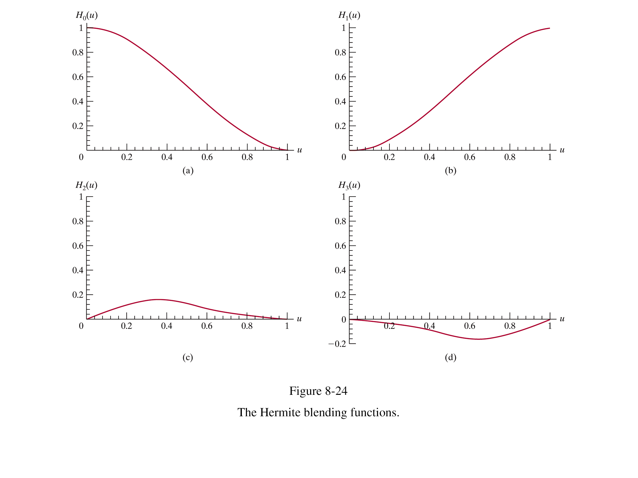
Graphs of the Blending Functions

Slide 34
Summary on How to Specify a Spline
Need:
  Degree(s) of polynomials to be used
  Control points
  One of the following:
    Boundary conditions
    Matrix form of the generating equation
    Blending function form of the generating equation
Most prefer one of the last two methods.

Slide 35
Some Properties of Hermite Splines
They are interpolating splines.
Use piecewise cubic polynomials.
A tangent must be specified at each control point – this is a disadvantage of this type of spline
Hermite splines can be adjusted locally without affecting the entire curve.
There is a generating function for plotting the points.

Slide 36
Generate the Curve Between p_{k} and p_{k+1}
P(u) = p_{k} (2u³ -3u²+1) +
p_{k+1}(-2u³ +3u²) +
Dp_{k} (u³ -2u²+u) +
Dp_{k+1}(u³ -u²)
Plot at some predefined values for u, say u = 0.0, 0.1, 0.2, ...., 0.9, 1.0
i.e. P(0) = p_{k},
p(0.5) = p_{k}(2/8-3/4+1) +
p_{k+1}(-2/8+3/4) +
Dp_{k} (1/8-2/4+1/2) +
Dp_{k+1}(1/8-1/4)
...
p(1) = p_{k+1}
Note that each calculation calculates a 3D point as the control points, p_{k}, are 3D points.

Slide 37
To Speed Up These Polynomial Calculations – Horner’s Rule Could Be Used
If P(u) = au³ + bu² + cu +d, then calculating this as is requires:
  6 multiplications and 3 additions.
But, by simple factoring, these can be reduced to:
P(u) = ((au + b)u + c)u + d requires
  3 multiplications and 3 additions

Slide 38
But, Faster Techniques Exist
Forward-Difference Calculations
Basically, once we know the increment being used, we can just add it to obtain the next value.
Subdivision Method
Useful particularly with Bezier curves.
Repeatedly divide a curve in half increasing the control points at each step.

Slide 39
Bézier Spline Curves

Slide 40
The Formal Definition Of A Bezier Curve
Let p_{k} = (x_{k}, y_{k}, z_{k}) be a control point
for k = 0, 1, ...,n
n
P(u) = Σ C(n,k) u^{k} (1-u)^{n-k}p_{k} (0 ≤ u ≤ 1)
k=0
where C(n,k) = n!/ (k! (n-k)!)
C(n,k) are the binomial coefficients.
n
More simply, P(u) = Σ B_{k,n}(u) p_{k}
k=0
where B_{k,n}(u) are called the
blending functions or
Bernstein polynomials

Slide 41
The Bezier Matrix Equation Form for n = 3
P(u) = [u³ u² u 1]M_{BEZ} [p₀ p₁ p₂ p₃]^{T}
for M_{BEZ} (the Bezier Matrix) defined by
Note- this assumes 4 control points
-1 3 -3 1
-6 3 0
-3 3 0 0
1 0 0 0

Slide 42
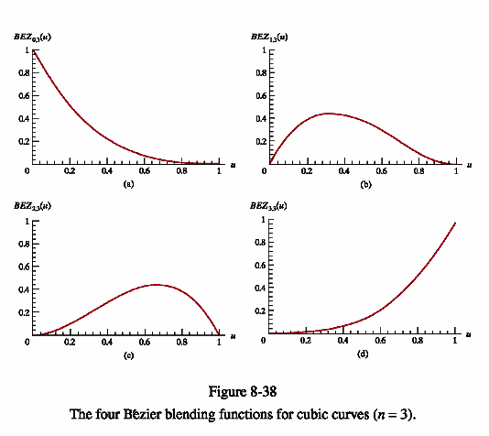

Slide 43
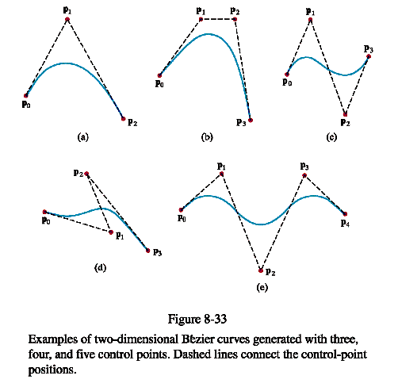

Slide 44
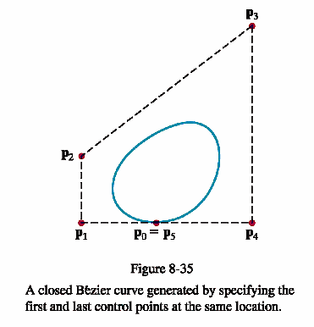
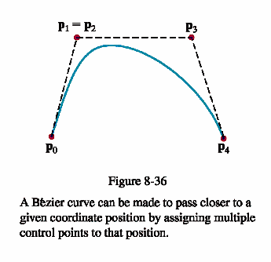

Slide 45
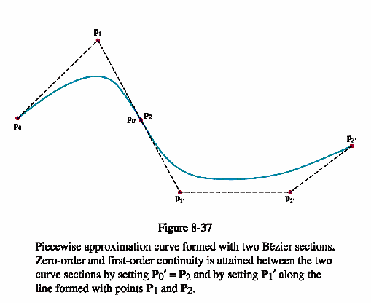
If we try for C² continuity at joins, we restrict the curve unnecessarily. In particular, for cubic curves, this fixes the curve for 3 of the 4 control points (as 3 points must lie on a line to achieve this type of continuity.)

Slide 46
Bezier Curves - Properties
The number n, determines the type of curve. (n = 3 is cubic, n= 4 the curve is of degree 4).
The curve lies in the convex hull of the control points. The curve interpolates at the endpoints.
C¹ continuity at the joins is easy to achieve, but achieving C² continuity is highly restrictive. So animation can be jerky with Bezier curves.
Local control is not available – moving a control point affects the entire curve.

Slide 47
Bezier Curves - Properties
They are affine invariant --- i.e. mapping the control points and then generating points is equivalent pictorially to mapping each point individually.
We can piece the curves or surfaces together and obtain smoothness at the joins (provided we place the endpoints properly).
Rendering is no more computationally expensive than we would expect with the requirement to plot points. Horner's method allows for a quick polynomial evaluation. The recursive spline subdivision method works well for efficient computation.

Slide 48
Bezier Curves - Properties
We can visualize the shape of the curve enough that we can place the control points and have some idea where the curve will lie--- and, of course, we can tinker with it to obtain the shape we want.
Compared to other curve-surface computational methods, Bezier curves are fairly simple to understand.
Try the interactive site:
http://www.doc.ic.ac.uk/~dfg/AndysSplineTutorial/Beziers.html

Slide 49
Bezier Surfaces
Technically, a surface is formed as the Cartesian product of the Bezier blending functions:
p_{j,k} are (m+1) by (n+1) control points.
Then,
m n
P(u,v) = Σ Σ p_{j,k}BEZ_{j,m}(v) BEZ_{k,n}(u)
j=0 k=0
0 ≤ u, v ≤ 1

Slide 50
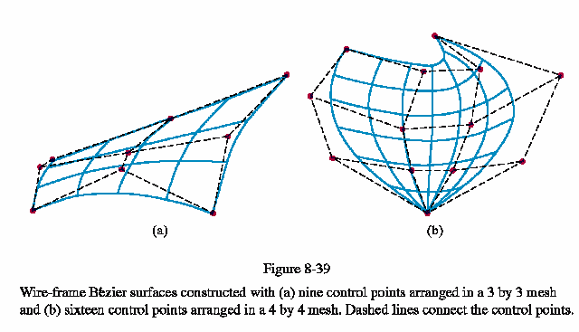

Slide 51
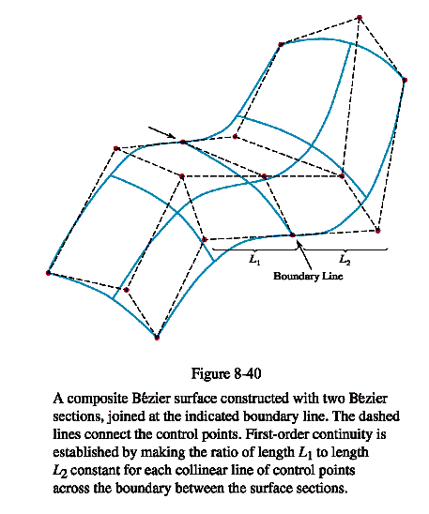

Slide 52
Example of Bezier Surface Generation
http://www.css.tayloru.edu/~btoll/f02/350/res/bezpatch/
Scroll down to see a very nice applet for generating various patches.
OpenGL provides nice functions for generating Bezier curves and surfaces.

Slide 53
Generating Bezier Curves and Surfaces in OpenGL
OpenGL uses evaluators to draw these objects.
The evaluators can compute a user-specified number of points on the curve or surface of any degree.
OpenGL uses these points on the curve or surface to generate standard OpenGL primitives such as line segments or polygons that approximate the curve or the surface.
As we can specify as many points as we wish for the curve, we can achieve as much accuracy as we need for an application.

Slide 54
glMap1*() – One-dimensional Evaluator
void glMap1{fd} (GLenum entity, TYPE u₀, TYPE u₁, GLint stride, GLint order, TYPE* data)
sets up a 1D evaluator for entity over the range [u₀,u₁] using a Bernstein polynomial of degree order - 1. There are stride points of type f (GLfloat) or d (GLdouble) between successive control points in the array *ctrlPts.
The entity can be many different things ...

Slide 55
Specifying entity in glMap1
If set to GL_MAP1_VERTEX_3
  then we will get a curve
  Every time we use the evaluator through functions such as glEvalcoord1*() and glMapGrid1*(), an [x,y,z] point is evaluated.
If set to GL_MAP1_NORMAL
  then we generate normals.
We can also generate colors, GL_MAP1_COLOR, and texture coordinates, GL_MAP1_TEXTURE_COORD_1. (There are 3 other texture coordinate specifications. See the blue book documentation on the use of these.)
All need to be enabled with
glEnable(entity);

Slide 56
Choosing the Order of Curve
The order of the curve is one greater than the degree of the polynomial and is equal to the number of control points it takes to determine the curve.
Any range can be given as the range (u₀,u₁) can be scaled to [0,1] by using
u’ = (u – u₀)/(u₁-u₀)
Examples follow illustrating the range selection ...

Slide 57
Example 1
Enable an evaluator for vertices using 4 control points, u over the range [0,1] where 21 points will be generated on a cubic (4-1) Bezier curve and polylines will connect these points:
  glMap1f(GL_MAP1_VERTEX_3, 0,1,3,4,*ctrlPts);
  glEnable(GL_MAP1_VERTEX_3);
  glBegin(GL_LINE_STRIP);
  for (i=0; i <= 20; glEvalCoord1f(i/20.0);
  glEnd;
  Note: the glEvalCoordlf(i/20.0) replaces the glVertex*() calls you would normally expect.

Slide 58
Example 2
Enable an evaluator for vertices using u over the range [u₀,u₁] where 21 points will be generated on a cubic Bezier curve and polylines will connect these points:
  glMap1f(GL_MAP1_VERTEX_3, u₀, u₁, 3, 4, *ctrlPts);
  glEnable(GL_MAP1_VERTEX_3);
  glBegin(GL_LINE_STRIP);
  for (i=0; i <= 20; i++)
  glEvalCoord1f(u₀ +i*(u₁-u₀)/20.0);
  glEnd;

Slide 59
Example 3
Enable a color evaluator:
glMap1f(GL_MAP1_COLOR_4, u₀, u₁, 3, 4, colors);
glEnable(GL_MAP1_COLOR_4);
The array colors[] would have four RGBA colors in it.
Then if we would generate the curve as before, each vertex would be the specified color.
If GL_SMOOTH were enabled, the colors would blend between the vertices by interpolation.

Slide 60
1. Define The Control Points
Example: A Bezier Curve (Draws one section)
GLint nNumPoints= 4;
/*This will produce cubic polynomials
You may use more control points by adjusting the numbers below */
GLfloat ctrlPoints [4][3] =
{{-4.0f, 0.0f, 0.0f},
//one endpoint ---i.e. the value at u = 0
{-6.0f, 4.0f, 0.0f},
{6.0f, -4.0f, 0.0f},
{4.0f, 0.0f, 0.0f}};
//the other endpoint---i.e. the value at u= 1

Slide 61
1. Define The Control Points (cont)
If you want to see the control points, you will need code like
void DrawPoints(void) {
int i;
glPointSize(5.0f);
glBegin(GL_POINTS);
for (i=0; i <nNumPoints; i++)
glVertex2fv(CtrlPoints[i];
glEnd();
}

Slide 62
2. Drawing the Curve
//Draw Curve
void Draw (void) {
int i;
glClear (GL_COLOR_BUFFER_BIT); //usual clear
//if the above is called only once, put this in Init:
glMap1f(GL_MAP1_VERTEX_3, //says generates 3-tuple *
0.0f, //start of parameter range
100.0f, //ending parameter
3, //stride
nNumPoints, //number of control points
&CtrlPoints[0][0]); //array of control points
//enable evaluator
glEnable(GL_MAP1_VERTEX_3);

Slide 63
2. Drawing the Curve (Con't)
//Use line strip to connect the data that is generated
glBegin(GL_LINE_STRIP);
for (i=0; i <= 100; i++)
{glEvalCoord1f((GLfloat) i);} //generate point
glEnd();
//If you want the control points shown:
DrawPoints();
//Flush drawing commands
glFlush();
} //end Draw
Note: glEvalCoord1*() allows us to use any values of u, not just equally spaced values as we did in our example. But, if we want 21 evenly spaced intervals, we need to make 21 calls to this function.

Slide 64
Another Drawing Function for Evenly Spaced Intervals
Set up an equally spaced grid of n partitions between u₀ and u₁:
void glMapGrid1{fd}( (GLint n, TYPE u₀, TYPE u₁)
Then render in mode (GL_LINE, GL_POINT) all enabled evaluators from the first to the last values of u defined by glMapGrid():
void glEvalMesh1(GLenum mode, GLint first, GLint last)

Slide 65
Example 4
//Set up the grid
glMap1f(GL_MAP1_VERTEX_3, U₀, U₁, 3, 4, ctrlpts);
glEnable(GL_MAP1_VERTEX_3);
glMapGridf(20,u₀,u₁);
//Draw the line strip
glEvalMesh1(GL_LINE,0,20);

Slide 66
Drawing Surfaces --- Similar Commands
GLint nNumPoints =3; //define the control points
GLfloat ctrlPoints [3][3][3] =
{{{-4.0f, 0.0f, 4.0f}, //for v = 0
{-2.0f, 4.0f. 4.0f},
{4.0f, 0.0f,4.0f}},
etc. -4,0,0 -2,4,0 4,00 for v = 1
-4,0,-4 -2,4,-2 4,0,-4 for v = 2
The surface is given by control points p_{j,k} which are being specified above.
2 2
P(u,v) = Σ Σ p_{j,k} B_{j,2}(v)B_{k,2}(u) and the B_{i,2} are the polynomials defined
j=0 k=0 earlier

Slide 67
Drawing Surfaces --- Similar Commands
The command similar to the glMap1f command is:
glMap2f(GL_MAP2_VERTEX_3,
// says there are 2 parameters
0.0f, 10.0f, //lower value of u and upper value of u
3,3, //stride and number of control points in u
0,0f, 10.0f, //lower value of v and upper value of v
9,3, //stride and number of control points in v
&ctrlPoints[0][0][0]); //control point array location
Evaluators are objects so you can manipulate them just like other primitives...

Slide 68
Example Of A Surface Render Function
void Render(void) {
int i;
glClear(GL_COLOR_BUFFER_BIT);
glMatrixMode(GL_MODELVIEW);
glPushMatrix();
//rotate so easier to see
glRotatef(45.0f, 0.0f, 1.0f, 0.0f);
glRotatef(60.0f, 1.0f, 0.0f, 0.0f);
//enable evaluator
glEnable(GL_MAP2_VERTEX_3);

Slide 69
Surface Render Function
//map to a grid and evaluate 100 points
glMapGrid2f(10, 0.0f, 10.0f, 10, 0.0f, 10.0f);
//evaluate grid using lines
glEvalMesh2(GL_LINE, 0,10, 0, 10); //see note *
glPopMatrix();
glFlush();}
*By replacing this line with the 2 below, you can automatically generate normals
glEvalMesh2(GL_FILL, 0,10,0,10);
Surface Render Function glEnable(GL_AUTO_NORMAL);

Slide 70
Excellent Reference
The “OpenGL Programming Guide” (known as the red book) is one of the best sources for this material. There is an official online copy at:
http://fly.cc.fer.hr/~unreal/theredbook/
See Chapter 11: Evaluators and NURBS for the material being discussed here. Complete coding examples are provided there!
This book is also available in book form.

Slide 71
B-Splines

Slide 72
DEFINITIONS FOR B-SPLINES
Now, in addition to control points we have knots.
The knots, u₀, u₁, ..., u_{n} are the endpoints of intervals between u_{min} and u_{max}, where the curve is being defined.
The knots have the property that u_{min}= u₀<= u₁ <= ....<= u_{n}= u_{max}
Again, there are blending functions, B_{i,d}
These are defined by the Cox-deBoor recursion formulas.

Slide 73
PROPERTIES OF THE BLENDING FUNCTIONS- B_{i,d}
The B_{k,0} functions are constant over one interval and zero elsewhere.
The B_{k,1} functions are linear over each of two intervals and zero elsewhere.
The B_{k,2} functions are quadratic over each of three intervals and zero elsewhere.
In general, the B_{k,d} functions are nonzero over the d+1 intervals between u_{k} and u_{k+d+1} and is a polynomial of degree d in each of those intervals.

Slide 74
The Definition Of A B-spline
Looks sort of like the Bezier definition, but remember the B_{i,d} functions are defined differently.
n
P(u) = Σ p_{k} B_{k,d}(u) for u_{min} <= u <= u_{max},
k=0 2 <=d <=n+1,
p_{k} are n+1 control points
Again, as with Bezier curves, the definition of B-splines
can be used to prove that certain important properties exist.
These properties tell us intuitively how curves are rendered, after we specify the control points and the knots

Slide 75
Properties Of B-splines
The polynomial curve has degree d-1. Why is that important?
The curve has continuous d-2 derivatives over the range of u. Why is that important?
Any one control point can affect the shape of at most d curve sections. Why is that important?
The curve lies in the convex hull of at most d+1 control points so the curves are tightly bound to the control points --- i.e. it comes close to the control points.
We can choose the number of control points independent of the degree of the polynomial.
In fact, Bezier curves are just special cases of B-splines!

Slide 76
There are Many Kind of B-Splines
Uniform B-splines – the spacing between the knot values is constant.
Non-uniform B-splines are splines that are not uniform
Rational B-splines –
  A rational function is the ratio of two polynomials.
  Consequently, a rational B-spline is just the ratio of two spline functions.
NURBS are Non-Uniform Rational B-Splines

Slide 77
NURBS
NURBS are a very flexible curve and surfaces that are supported by the GLU library.
A NURB is based on using 4D parametric polynomials (x(u), y(u), z(u), w(u)), where each component can be obtained by OpenGL evaluators.
The desired 3D points are then obtained by dividing the first three components by w(u) forming a 3D vertex
(x(u)/w(u), y(u)/w(u), z(u)/w(u)) for each value of u.

Slide 78
Playing with NURBS
These are the hardest ones to visualize, but they can form many interesting curves.
See: NURBS

Slide 79
Reminder
By all means, explore these using the red book referenced earlier.
The examples are excellent and very detailed.
Sample programs are in the book as well.

Slide 80
GLU NURBS Functions
Although these are are called NURBS, they can be used to generate B-splines that are neither non-uniform nor rational.
In fact, they can be used to produce Bezier curves also.
Procedure to follow is:
  Define a name for the spline
  Activate the GLU B-spline renderer
  Define the spline parameters
Details are available in section in text.

