Slide 1
Chapter 2
Graphics Programming
OpenGL and GLUT

Slide 2
Objectives
Development of the OpenGL API
OpenGL Architecture
  OpenGL as a state machine
Functions
  Types
  Formats
Simple programs

Slide 3
OpenGL
OpenGL is an API (application programmer’s interface)
Many APIs exist
Forerunner of OpenGL was GL from Silicon Graphics, Inc.(SGI) designed for high end IRIS workstations which is optimized for display, has ultrafast matrix transformations, and support for depth buffering.
OpenGL was SGI’s attempt to improve graphics portability.

Slide 4
Early History of APIs
IFIPS (1973) formed two committees to come up with a standard graphics API
  Graphical Kernel System (GKS)
    2D but contained good workstation model
  Core
    Both 2D and 3D
  GKS adopted as IS0 and later ANSI standard (1980s)
GKS not easily extended to 3D (GKS-3D)
Far behind hardware development

Slide 5
PHIGS and X
Programmers Hierarchical Graphics System (PHIGS)
  Arose from CAD community
  Database model with retained graphics (structures)
X Window System
  DEC/MIT effort
  Client-server architecture with graphics
PEX combined the two
  Not easy to use (all the defects of each)

Slide 6
SGI and GL
Silicon Graphics (SGI) revolutionized the graphics workstation by implementing the pipeline in hardware (1982)
To use the system, application programmers used a library called GL
With GL, it was relatively simple to program three dimensional interactive applications

Slide 7
OpenGL
Introduced July 1, 1992 at first Win32 developers conference.
SGI demonstrated how OpenGL had been used for Terminator2 and medical imaging.
Although Microsoft distributes OpenGL with Windows version, it does not control it. There is an OpenGL Architecture Review Board which includes SGI, IBM, Intel, and Microsoft. Meetings are open, but you must obtain attendance approval in advance.
Version1.1 was released in Dec, 1995

Slide 8
DESCRIPTIVE vs PROCEDURAL
GRAPHICS LANGUAGE
Descriptive
  Describe the scene and how it should appear
Procedural
  Programmer actually describes the steps necessary to achieve a certain appearance or effect
OpenGL is a procedural graphics language
The steps involve calls to various commands and functions
These draw graphical primitives such as points, lines, and polygons in 3D

Slide 9
OPENGL
Can add lighting, shading, texture mapping, animation, curve drawing, and other special effects
As OpenGL is procedural, these additions must be specified by the programmer.
OpenGL does NOT include functions for window management, user interaction, I/0.
Each host environment has its own way of handing over to OpenGL the drawing and control of a window or bitmap.

Slide 10
OpenGL Evolution
Controlled by an Architectural Review Board (ARB)
  Members include SGI, Microsoft, Nvidia, HP, 3DLabs,IBM,…….
  Relatively stable (working on version 3.0, but not adopted yet)
    Evolution reflects new hardware capabilities
      3D texture mapping and texture objects
      Vertex programs
  Allows for platform specific features through extensions

Slide 11
OpenGL Libraries
OpenGL core library
  OpenGL32 on Windows
  GL on most unix/linux systems
OpenGL Utility Library (GLU)
  Provides functionality in OpenGL core but avoids having to rewrite code
Links with window system
  GLX for X window systems
  WGL for Widows
  AGL for Macintosh

Slide 12
GLUT
OpenGL Utility Library (GLUT)
  Provides functionality common to all window systems
    Open a window
    Get input from mouse and keyboard
    Menus
    Event-driven
    Slide bars
  Code is portable but GLUT lacks the functionality of a good toolkit for a specific platform

Slide 13

THE POSITIONING OF A GRAPHICS SYSTEM

Slide 14
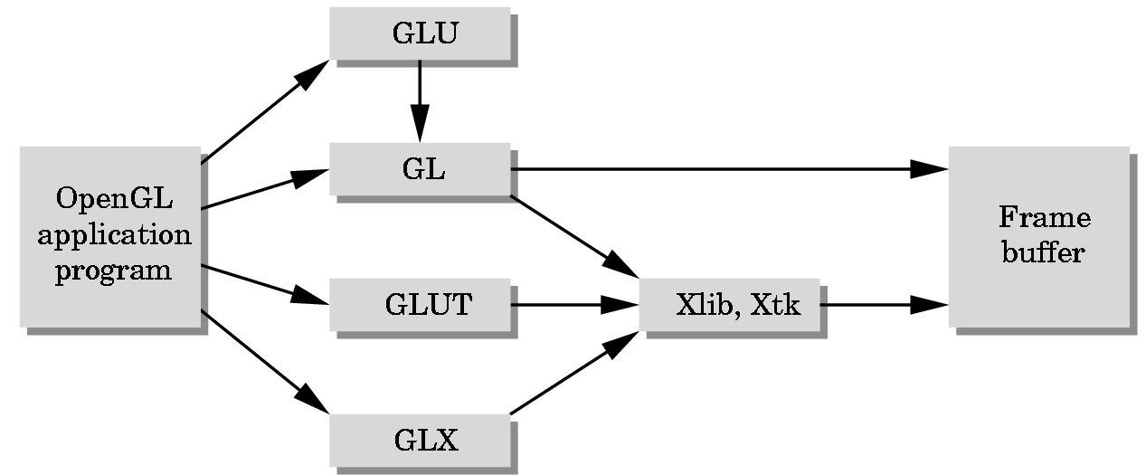
GLUT = GL Utility Toolkit
A library that acts as a common interface to different versions of
windowing environments such as
Microsoft’s
SIGs
X-windows etc.

Slide 15
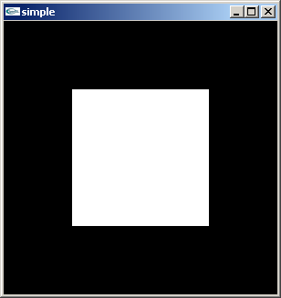
A Very Simple Program
Generate a square on a solid background

Slide 16
simple.cpp
#include <GL/glut.h>
void mydisplay(){
glClear(GL_COLOR_BUFFER_BIT);
glBegin(GL_POLYGON);
glVertex2f(-0.5, -0.5);
glVertex2f(-0.5, 0.5);
glVertex2f(0.5, 0.5);
glVertex2f(0.5, -0.5);
glEnd();
glFlush();
}
void main(int argc, char** argv){
glutCreateWindow("simple");
glutDisplayFunc(mydisplay);
glutMainLoop();
}

Slide 17
Build a Visual C++ 6.0 Application
C++ > Win32 Console Application
  Choose name of Simple
  Folder where to create
  Be sure Create New Workshop is checked and Win 32
  Create empty project
File > New > C++ Source File
  Code (or in this case just copy and paste)
Build all and run.
Investigate folder contents.

Slide 18
Event Loop
Note that the program defines a display callback function named mydisplay
  Every glut program must have a display callback
  The display callback is executed whenever OpenGL decides the display must be refreshed, for example when the window is opened
  The main function ends with the program entering an event loop

Slide 19
2D vs 3D GRAPHICS
Until very recently, APIs (Application Programmer Interface) were predominately 2D-oriented with small extensions for 3D graphics:
  1977 CORE
  1985 GKS, GKS-3D
  1988 PHIGS, PHIGS+, X-Windows
  1992 OpenGL
    Windows NT 3.1 was in beta testing
    Silicon Graphics (SGI) developed OpenGL
    Marriage between the two to incorporate OpenGL in Windows NT 3.5
  Other APIs exist

Slide 20
Defaults
simple.c is too simple
Makes heavy use of state variable default values for
  Viewing
  Colors
  Window parameters
Using defaults is not a good programming practice.
Next version will make the defaults more explicit

Slide 21
Our Objectives
Refine the first program
  Alter the default values
  Introduce a standard program structure
Investigate simple viewing
  Two-dimensional viewing as a special case of three-dimensional viewing
Investigate the fundamental OpenGL primitives
Investigate attributes

Slide 22
Program Structure
Most OpenGL programs have a similar structure that consists of the following functions
  main():
    defines the callback functions
    opens one or more windows with the required properties
    enters event loop (last executable statement)
  init(): sets the state variables
    viewing
    Attributes
  callbacks
    Display function
    Input and window functions

Slide 23
Simple.cpp revisited
In this version, we will see the same output but have defined all the relevant state values through function calls with the default values
In particular, we set
  Colors
  Viewing conditions
  Window properties

Slide 24
MySimple.cpp
#include <GL/glut.h>
void main(int argc, char** argv)
{
glutInit(&argc,argv);
glutInitDisplayMode(GLUT_SINGLE|GLUT_RGB);
glutInitWindowSize(500,500);
glutInitWindowPosition(0,0);
glutCreateWindow("simple");
glutDisplayFunc(mydisplay);
init();
glutMainLoop();
}
define window properties
display callback
set OpenGL state
enter event loop

Slide 25
GLUT functions
glutInit allows application to get command line arguments and initializes system
gluInitDisplayMode requests properties of the window (the rendering context)
  RGB color
  Single buffering
  Properties logically ORed together
glutWindowSize in pixels
glutWindowPosition from top-left corner of display
glutCreateWindow create window with title “simple”
glutDisplayFunc display callback
glutMainLoop enter infinite event loop

Slide 26
Function: init
black clear color
void init()
{
glClearColor (0.0, 0.0, 0.0, 1.0);
glColor3f(1.0, 1.0, 1.0);
glMatrixMode (GL_PROJECTION);
glLoadIdentity ();
glOrtho(-1.0, 1.0, -1.0, 1.0, -1.0, 1.0);
}
opaque window
fill with white
viewing volume
parallel projection

Slide 27
Putting it Together
Create a project called MySimple.
In one file, put in order the code for
  init
  mydisplay (from earlier simple.cpp)
  main
Compile and run
Ordering above is important as init and mydisplay are used by main.
init and mydisplay can be interchanged.

Slide 28
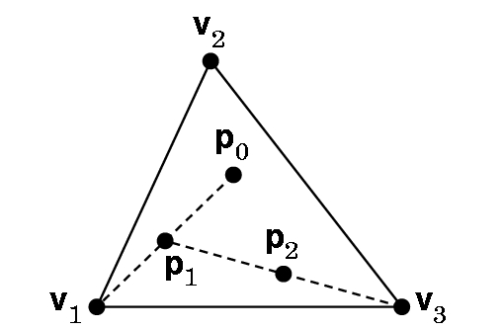
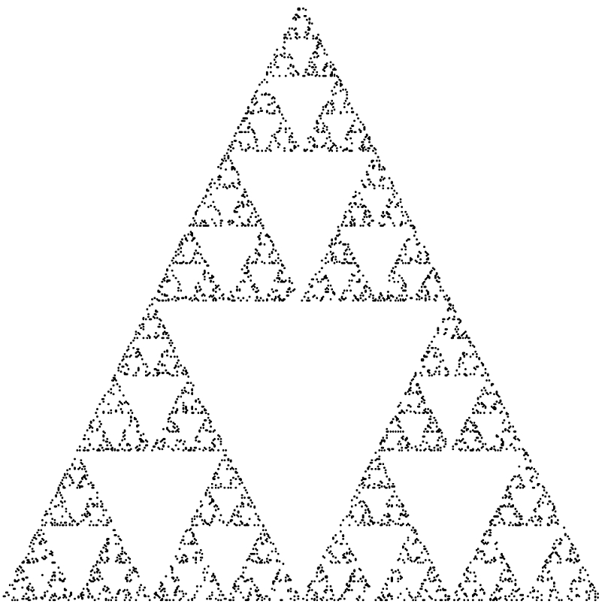
A Bigger Example
2D---but viewed in a 3D world
Construction: Start with 3 points forming vertices of an equilateral triangle.
Continue for a chosen number of points:
1. Randomly pick a point inside triangle
2. Randomly pick a vertex.
3. Find midpoint of the line segment between the vertex and point.
4. Display the new point.
5. Replace the initial point with the new point.
6. Return to 2 if the specified number of points have not been plotted,
2D Sierpinski Gasket

Slide 29
Waclaw Sierpinski
1882-1969
Famous Polish mathematician
For material on his life see:
http://wwwgap.dcs.stand.ac.uk/~history/Mathematicians/
Sierpinski.html
For material on the Sierpinski gasket see:
http://astronomy.swin.edu.au/~pbourke/fractals/gasket/

Slide 30
BEFORE WE CAN DEVELOP A
PROGRAM WE NEED TO ANSWER SOME QUESTIONS
How are points specified?
How are colors specified?
Where on the screen will the image appear?
How will the image be sized?
How is a window created for the image?
How much of the 2D drawing surface which represents the image will be displayed?
How long will the image remain on the screen?
What happens if another window is moved over the drawing window and then moved away from it?

Slide 31
Want a program … main()
{initialize_the_system(); for (some_number_of_points)
{ generate_a_point(); display_the_point();
} cleanup();
}

Slide 32
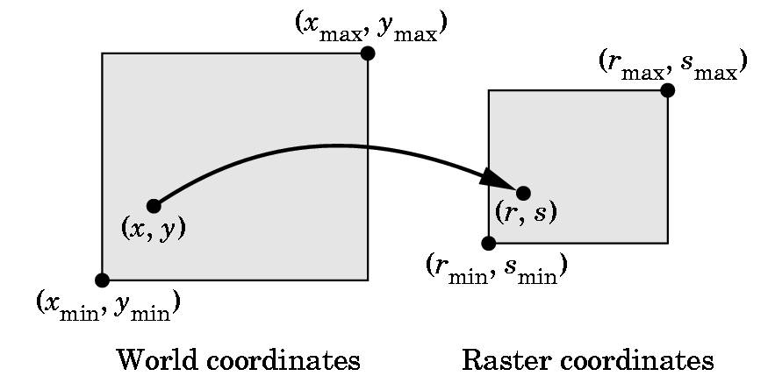
HOW DO WE SPECIFY POINTS?
What coordinates do we use?

Slide 33
VERTICES---i.e. Points
Logically, a point is a triple:
x
y
z
On the slides. I’ll use the notation [ x y z ], since it is easier to write, until we need some matrix calculations.
A vertex command specifies a data structure for a point:
Basic Format: glVertex*( arguments)
gl - specifies library GL
* - is nt or ntv where
n = 2,3, or 4 and specifies the number of argumetns
t = type and specifies i= integer
f = float
d = double
v = says we are defining as a pointer to an array

Slide 34
EXAMPLES
glVertex3f(a,b,c) specifies [a,b,c], where a,b, and c are float values
glVertex2i(x,y) specifies [x,y],where x and y are integers
Given
Glfloat vertex[3]; // an array with 3 elements
glVertex3fv(vertex) specifies
[vertex[0], vertex[1], vertex[2]]
glBegin and glEnd group points and, after setting up the necessary environment, they are used to plot various simple primitives.
The glBegin is a function call with glEnd closing it.

Slide 35
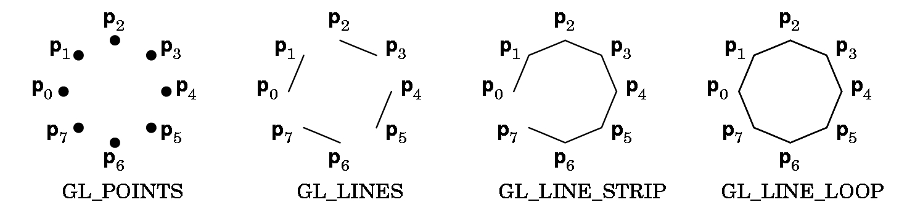
Example:
glBegin(GL-POINTS);
glVertex2f(2.0, 3.0);
glVertex2f(1.0,3.5);
glVertex2f(3.4, 5.4);
glEnd();
Plots 3 points (which may or may not be seen) as their display depends on the view.
The points are specified in world coordinates.

Slide 36
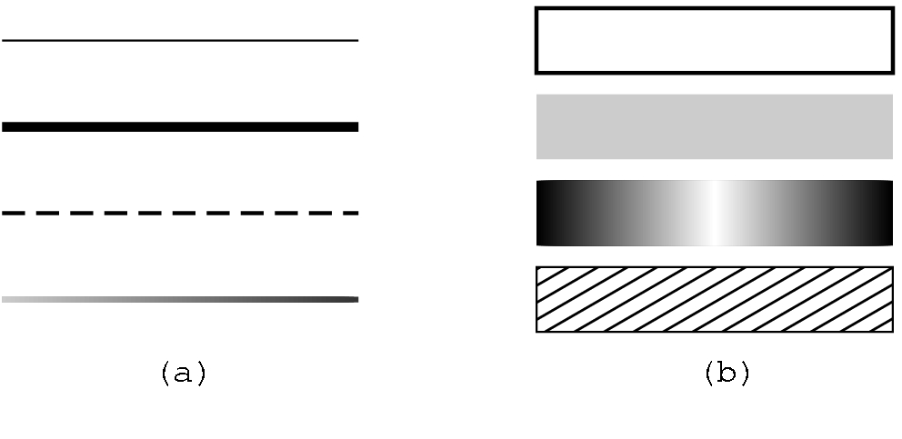
glBegin(Z);
glVertex2f(x1,y1);
glVertex2f(x2,y2);
glVertex2f(x3,y3);
glEnd();
Z is GL_POINTS: 3 points
Z is GL_LINES: one line segment as the points are chosen pairwise
Add a fourth point to the above,
glVertex2f(x4,y4);
Z is GL_LINE_STRIP: a polyline
Z is GL_LINE_LOOP: closes the loop in the polyline
Various line sizes and patterns can be specified.
glPointSize(2.0);
glLineWidth(2.0);

Slide 37
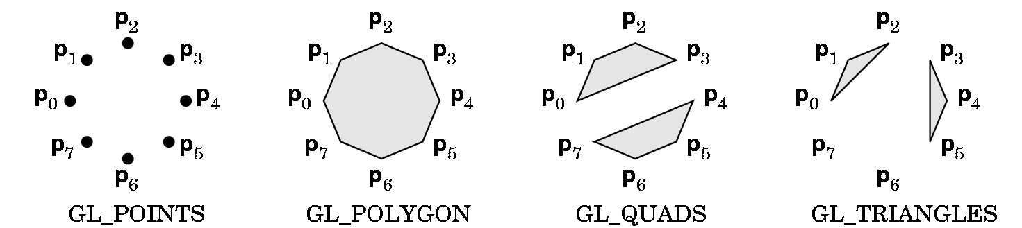
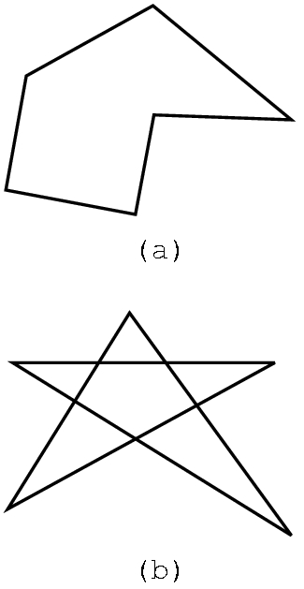
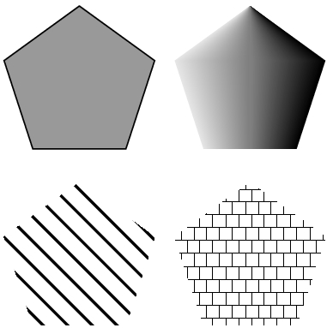
POLYGONS: Defined in a similar fashion.
GL_QUADS and GL_TRIANGLES are special cases.
Polygons play a special role in graphics as they can be
displayed rapidly
used to approximate curved lines
These can be filled with color or patterns.
But, results can be unpredictable for
polygons that are not simple.

Slide 38
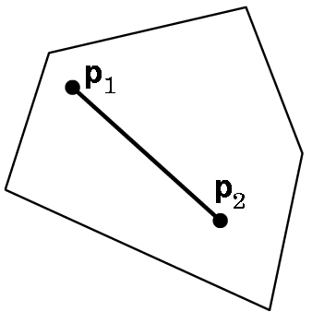
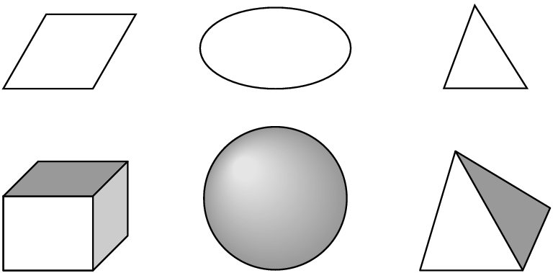
Most APIs work best with convex objects:
Definition: An object is convex if given any two
points p1 and p2 in the object, all points on a
line segment connecting p1 and p2 are in the
object.
Convex objects can be 2-dimensional,
3-dimensional (or, in fact, n-dimensional).

Slide 39

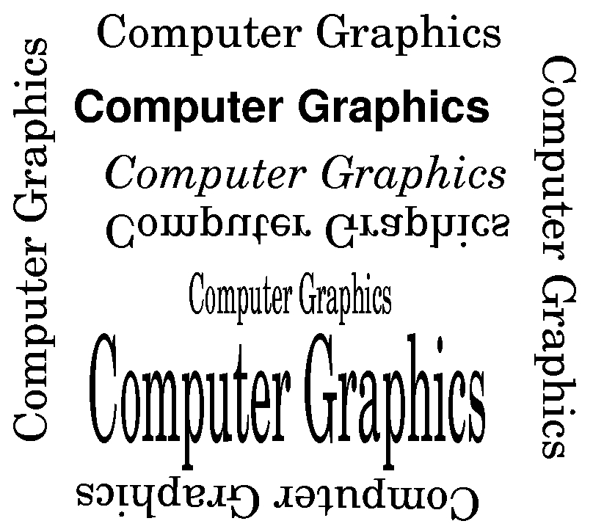
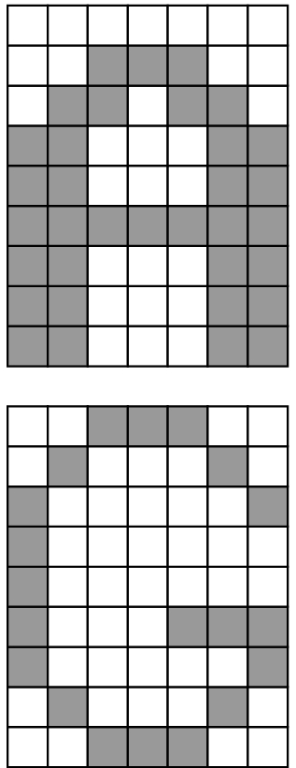
Text can be specified in multiple fonts and with various orientations:
Stroke text
Raster text
OpenGL does not have a text primitive.
GLUT provides several bitmap and stroke sets that can be used.

Slide 40
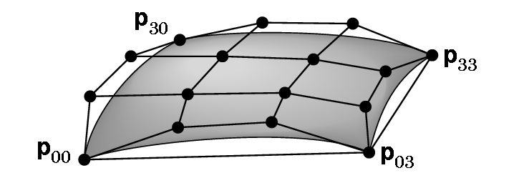
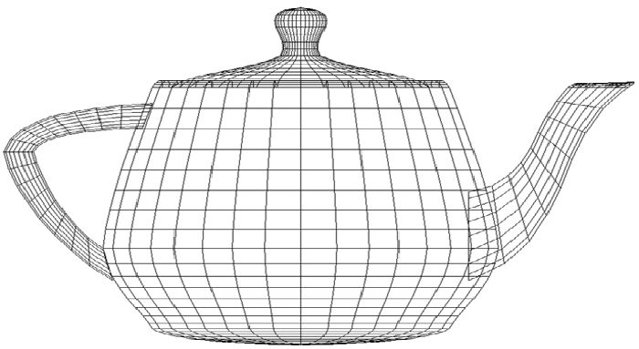

CURVES CAN BE GENERATED BY MATHEMATICAL FUNCTIONS USING POINTS TO CONTROL THE SURFACES
We will consider these later, but be aware they exist.
An example of a Bezier patch
Famous
Utah
teapot

Slide 41
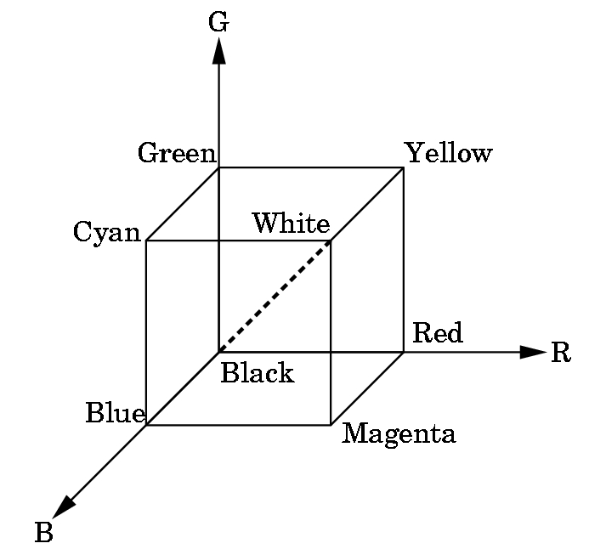
RGB & RGBA SYSTEMS in OpenGL
RGB uses the color cube as a model with intensities between 0.0 and 1.0.
Clear the window to white:
glClearColor(1.0, 1.0, 1.0, 0.0)
Produces white
Alpha component
Alpha component allows blending for special effects
such as translucence.
0.0 = opaque, no light through
1.0 = transparent
glColor3f(1.0,0.0,0.0)
Sets the drawing color to red, until changed.

Slide 42
SOME OTHER EXAMPLES OF RGB COLOR SETTINGS
R G B
dark gray .25 .25 .25
light gray .75 .75 .75
brown .60 .40 .12
pumpkin orange .98 .625 .12
pastel pink .98 .04 .70
purple .6 .4 .7
There are lists of these available (search web)
However, it suffices to just guess and see what you get!

Slide 43
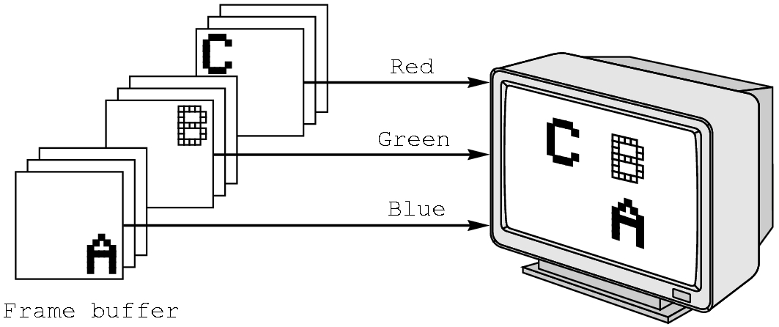
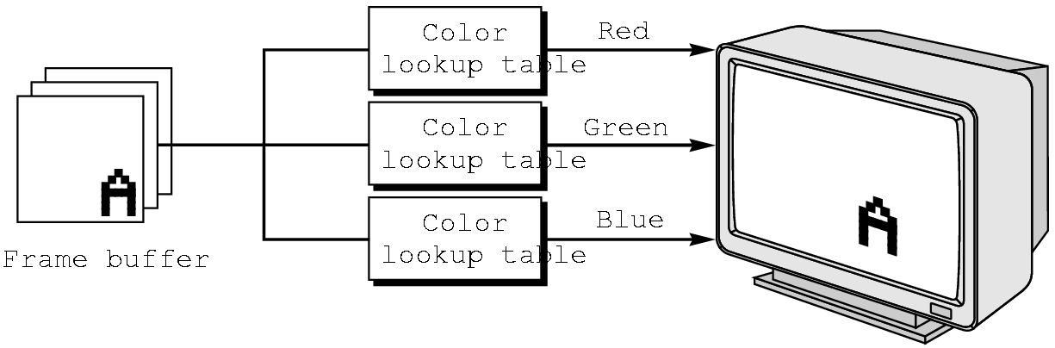
RGB vs INDEXED COLOR
RGB color is harder to support in some hardware due to the size needed in the frame buffer.
OpenGL favors RGB color, although exact reproduction across platforms or results for more color depth than the frame buffer supports are not guaranteed.
GLUT allows indexed color to be specified.

Slide 44
MORE ON COLOR
Low end displays were typically 8-plane devices, i.e. could display only 256 colors simultaneously.
But, palettes typically exist for 8 bits/gun---i.e. have a palette of 2²⁴= 2⁴ * 2²⁰ = 16M of colors (what is called true color in Windows system)
Note: Number of bits/gun is what determines the size needed for the frame buffer as the frame buffer must hold a copy of the image internally

Slide 45
RGB color
Each color component stored separately in the frame buffer
Usually 8 bits per component in buffer
Note in glColor3f the color intensity values range from 0.0 (none) to 1.0 (all), while in glColor3ub the values range from 0 to 255

Slide 46
Indexed Color
Colors are indices into tables of RGB values
Requires less memory
  indices usually 8 bits
  not as important now
    Memory inexpensive
    Need more colors for shading

Slide 47
Color and State
The color as set by glColor becomes part of the state and will be used until changed
  Colors and other attributes are not part of the object but are assigned when the object is rendered
We can create conceptual vertex colors by code such as
glColor
glVertex
glColor
glVertex

Slide 48
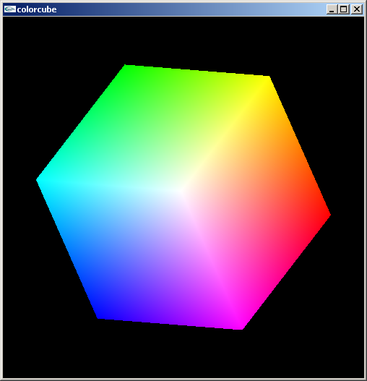
Smooth Color
Default is smooth shading
  OpenGL interpolates vertex colors across visible polygons
Alternative is flat shading
  Color of first vertex
  determines fill color
glShadeModel
  (GL_SMOOTH)
  or GL_FLAT

Slide 49
FRAME BUFFER SIZES
Let
  r = number of rows in display
  c = number of columns in display
  b = number of bits/pixel
Then need frame buffer size of r * c * b
i.e.,
  For r = c = 1024 and b = 24, need
  24 * 2¹⁰ * 2¹⁰ = 3 * 8 * 2²⁰ = 3 M bytes per picture
Most systems are at least double buffered for speed
High end workstations have higher numbers for r, c, and the number of frame buffers

Slide 50
HOW IS THE FRAME BUFFER USED?
Picture is created in frame buffer and scanned to the screen by deflection circuitry:
Refresh rate is given in hertz (Hz)
50-75 Hz required to avoid flicker
i.e. 50-75 scans per second
Inexpensive screens are interlaced on scan--- scan every other row for each refresh.

Slide 51
Coordinate Systems
The units of in glVertex are determined by the application and are called world or problem coordinates
The viewing specifications are also in world coordinates and it is the size of the viewing volume that determines what will appear in the image
Internally, OpenGL will convert to camera coordinates and later to screen coordinates

Slide 52
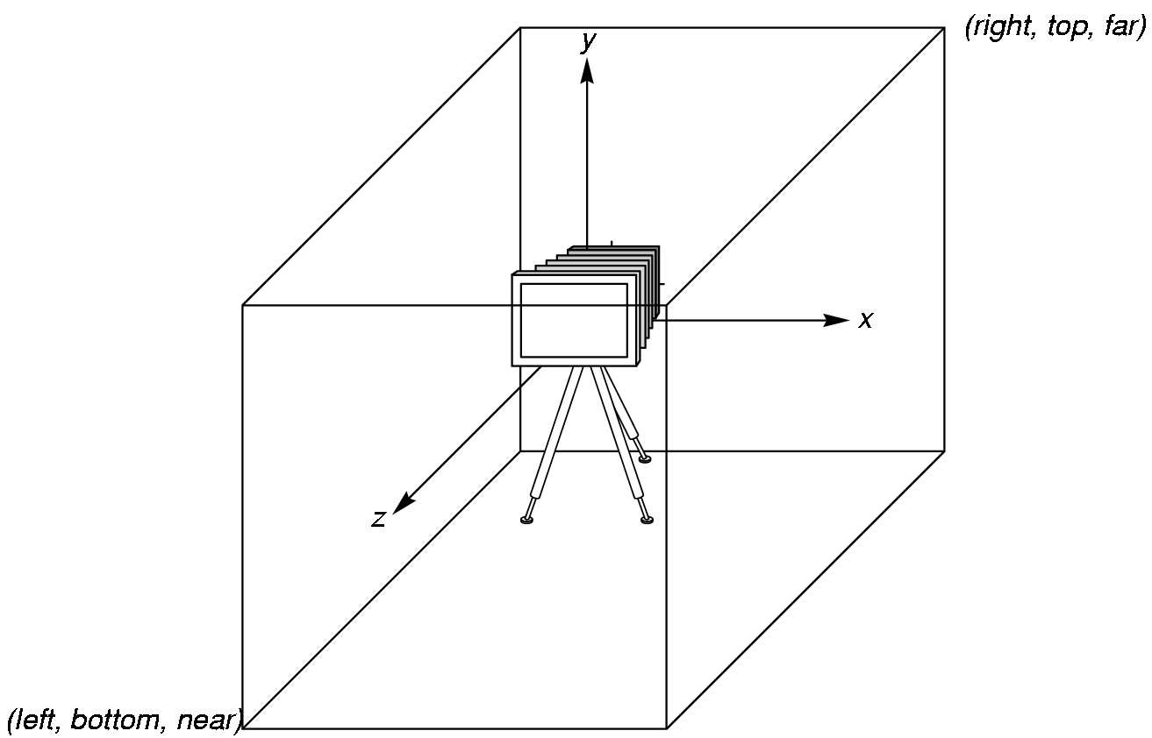
OpenGL Camera
OpenGL places a camera at the origin pointing in the negative z direction
The default viewing volume is a box centered at the origin with a side of
length 2

Slide 53
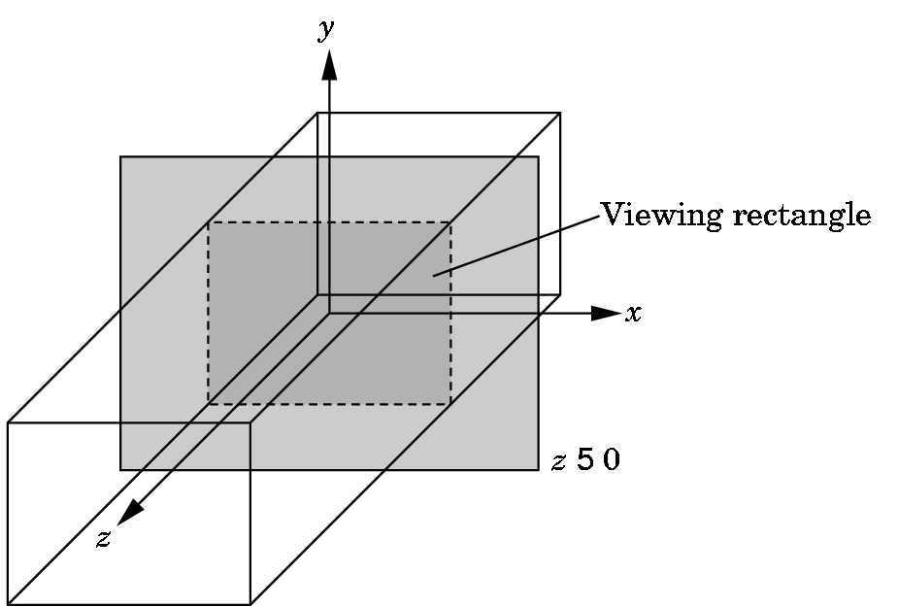
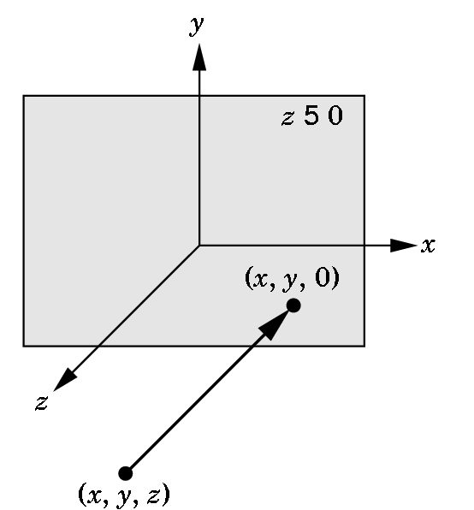
Orthographic Viewing
In the default orthographic view, points are
projected forward along the z axis onto the
plane z=0
z=0
z=0

Slide 54
Transformations and Viewing
In OpenGL, the projection is carried out by a projection matrix (transformation)
There is only one set of transformation functions so we must set the matrix mode first
glMatrixMode (GL_PROJECTION)
Transformation functions are incremental so we start with an identity matrix and alter it with a projection matrix that gives the view volume
glLoadIdentity ();
glOrtho(-1.0, 1.0, -1.0, 1.0, -1.0, 1.0);

Slide 55
Two- and three-dimensional viewing
In glOrtho(left, right, bottom, top, near, far) the near and far distances are measured from the camera
Two-dimensional vertex commands place all vertices in the plane z=0
If the application is in two dimensions, we can use the function
gluOrtho2D(left, right,bottom,top)
In two dimensions, the view or clipping volume becomes a clipping window

Slide 56
mydisplay again
void mydisplay()
{
glClear(GL_COLOR_BUFFER_BIT);
glBegin(GL_POLYGON);
glVertex2f(-0.5, -0.5);
glVertex2f(-0.5, 0.5);
glVertex2f(0.5, 0.5);
glVertex2f(0.5, -0.5);
glEnd();
glFlush();
}

Slide 57
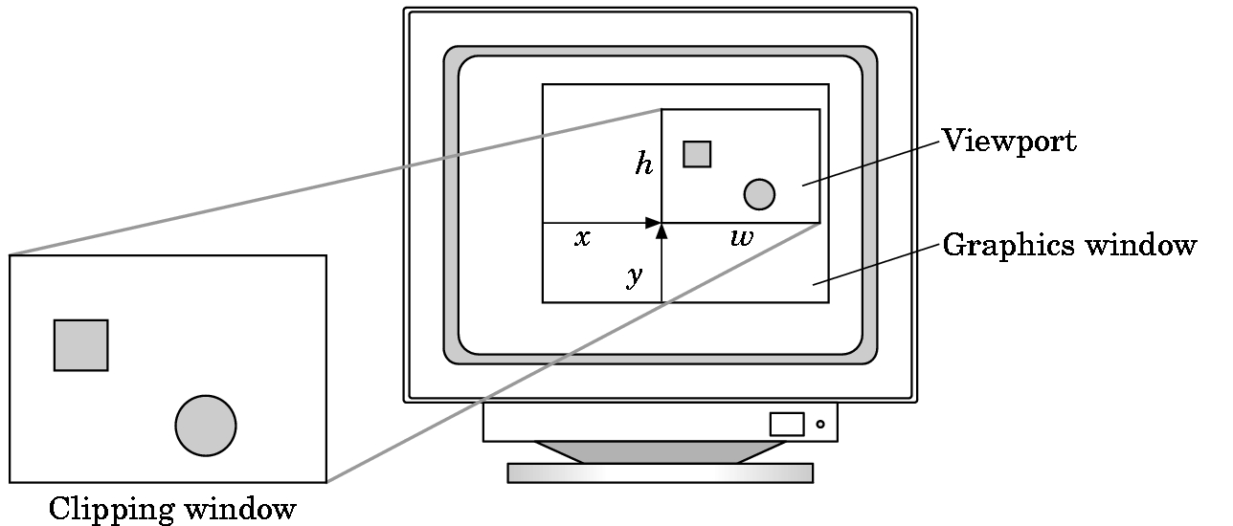
Viewports
Do not have use the entire window for the image: glViewport(x,y,w,h)
Values in pixels (screen coordinates)

Slide 58
First Steps
We now have the means of building a simple program.
We can choose any coordinates we wish as our viewing choices will specify what is seen.
So we can build the 3 points for the 2D triangle as:
typedef Glfloat point2[2];
point2 vertices[3]={{0.0,0.0}, {250.0,500.0}, {500.0,0.0}}; // triangle
Why use these values for the points? No reason---they just make a
nice equilateral triangle. You can choose any world coordinates you wish.
Glfloat (and Glint) are special data structures in OpenGL. Use these instead of the usual C or C++ types. Watch the capitalization!

Slide 59
The algorithm will be coded basically as you would any algorithm with only a few OpenGL commands:
void display( void )
{/* define a point data type */
typedef GLfloat point2[2];
point2 vertices[3] = {{0.0,0.0}, {250.0,500.0}, {500.0,0.0}}; /* A triangle */
/* standard random number generator */
int i, j, k; int rand();
/* An arbitrary initial point inside traingle */
point2 p ={75.0,50.0};
glClear(GL_COLOR_BUFFER_BIT); /*clear the window */

Slide 60
/* compute and plots 5000 new points */
for( k=0; k<5000; k++)
{ j=rand()%3; /* pick a vertex at random */ /* Compute point halfway between selected vertex and old point */
p[0] = (p[0]+vertices[j][0])/2.0;
p[1] = (p[1]+vertices[j][1])/2.0;
/* plot new point */ glBegin(GL_POINTS); glVertex2fv(p);
glEnd();
} //end for loop
glFlush(); /* clear buffers */
}//end display

Slide 61
PROJECTION AND VIEWING
We now have our world defined, but we have no display information.
Note that while our points seem to be 2D points, OpenGL views them as 3D points with the z axis settings as 0.
We must specify projection and viewing information (or defaults will be chosen by OpenGL and results will not be what we expect).
If we were just working with a 2D graphics system, we would only have to worry about viewing information.
But, a 3D world must be projected to a 2D plane.

Slide 62
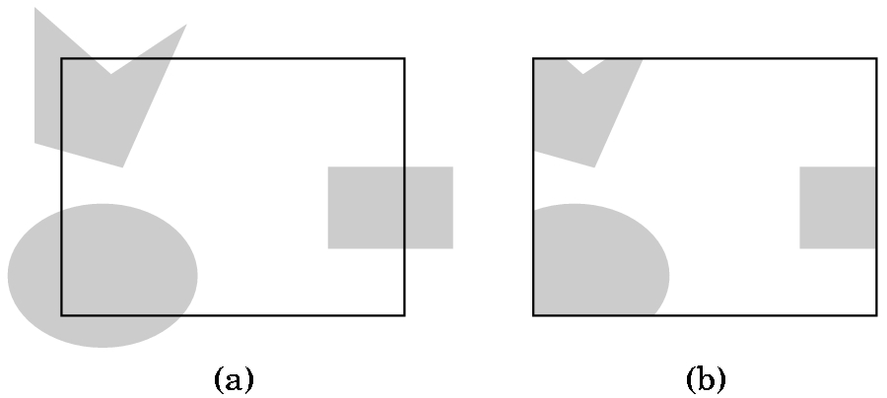
VIEWING AND CLIPPING, IF IN A 2D-GRAPHICS WORLD, IS SIMPLE
A) Shows the world with a 2D viewport outlined
B) Shows the world after clipping to the viewport
But, OpenGL views 2D graphics as
a special case of 3D graphics.
If we do nothing, OpenGL uses
a 2 x 2 x 2 viewing cube with
the origin at the center.
So, we must choose a projection
and then pick a viewing volume.

Slide 63
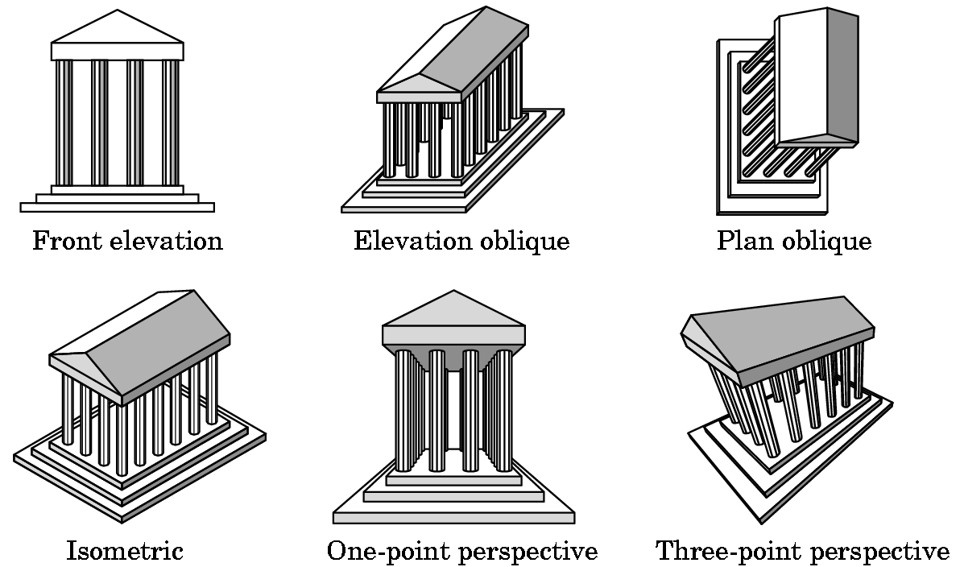
PROJECTIONS
There are many kinds which we will survey later.
Don't worry about definitions now.

Slide 64
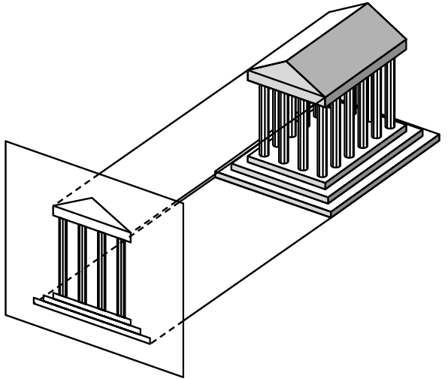

PROJECTION WE WILL USE INITIALLY
The simplest to use is orthographic although the results may look
strange to you as you are not used to looking at orthographic
projections.
3 views
How the projection
is obtained
Orthographic projection

Slide 65
SPECIFYING THE VIEWING VOLUME FOR AN ORTHOGRAPHIC PROJECTION IN OPENGL
near
We need to specify a right
parallelepiped viewing volume. Only objects inside the volume can be seen.
Normally, set 6 bounds- left, right, top
bottom, top, near, and far using an
OpenGL function glOrtho.
far
There is a special version of glOrtho that automatically sets near to -1.0 and far to 1.0. We'll use
gluOrtho2D(0.0,500.0,0.0,500.0);
which will allow us to see all of the triangle defined by
point2 vertices[3]={{0.0,0.0}, {250.0,500.0}, {500.0,0.0}};

Slide 66
THE CODE FOR SETTING THE VIEWING VOLUME
The shifting of coordinate systems (from world, to eye, etc.) is
done using linear algebra techniques that involve matrix multiplication. OpenGL maintains various matrices as part of its internal state. We will study how these work later and, for now, we just will use the necessary commands to manipulate the matrices:
//switch from default MODELVIEW
glMatrixMode(GL_PROJECTION);
glLoadIdentity(); //start with identity matrix
gluOrtho2D(0.0,500.0,0.0,500.0); //form projection matrix
glMatrixMode(GL_MODELVIEW); //switch mode back
Note: 3 of these functions start with gl and 1 starts with glu.

Slide 67
WINDOWS
Define window:
1) (graphics) A rectangular area of our display measured in 2D screen or window coordinates in pixel units.
2) (workstation world) Part of a multiwindow enviroment managed and produced by an operating system (such as Microsoft 2000) or a windowing system (such as X-Windows).
A window in which the graphics window appears is one of the windows managed by the workstation world.
We use GLUT to specify information about our graphics window which will be used by the windowing system for the platform on which we are running ...

Slide 68
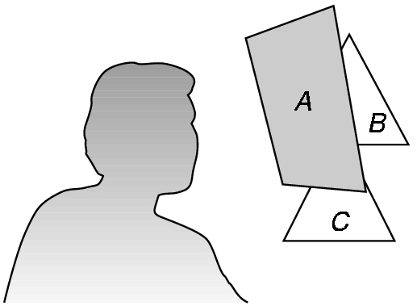
The Standard GLUT Initialization
(at least for now)
#include <glut.h>
void main(int argc, char** argv) {
glutInit(&argc,argv); //required, but not used now
glutInitDisplayMode(GLUT_SINGLE | GLUT_RGB); //actually, default
glutInitWindowSize(500,500); //500 x 500 pixel window
glutInitWindowPosition(0,0); //place anchored at top left
glutCreateWindow("Sierpeinski Gasket"); //window title
glutDisplayFunc(display); /*display callback invoked when window opened,
when window is moved, or when front window is removed */
myinit(); //calls code to set attributes and viewing information
glutMainLoop(); //enter event loop- everything else invoked by events!
}
Some variations for the display mode:
GLUT_DOUBLE- double buffer for hidden-surface removal
GLUT_DEPTH- hidden surface removal
GLUT_INDEX - for indexed color

Slide 69
Now have the complete program (after adding a few commands to the computational part for windows): (see code on web site)
Organization:
1) Header files and usual documentation of purpose of program, your name, class, and date
2) myinit function--- sets attributes and viewing parameters
3) display callback function--- automatically invoked when an event happens. Does the computational part.
4) main function--- standard GLUT initialization

Slide 70
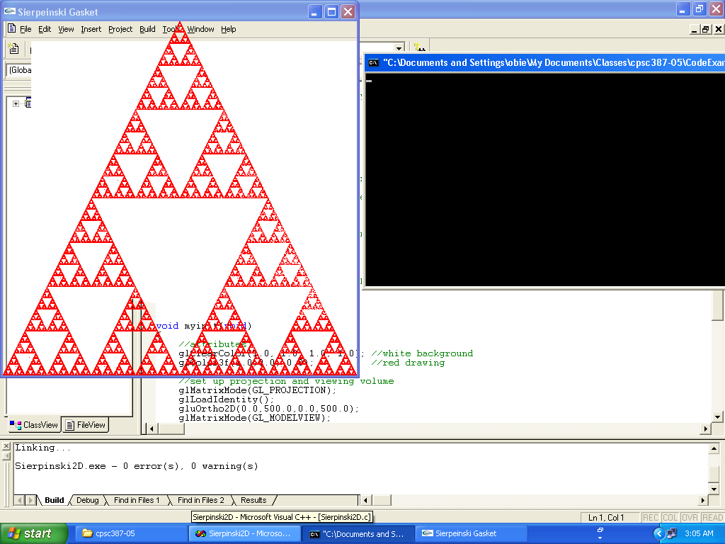
The Result of Running the Code

Slide 71
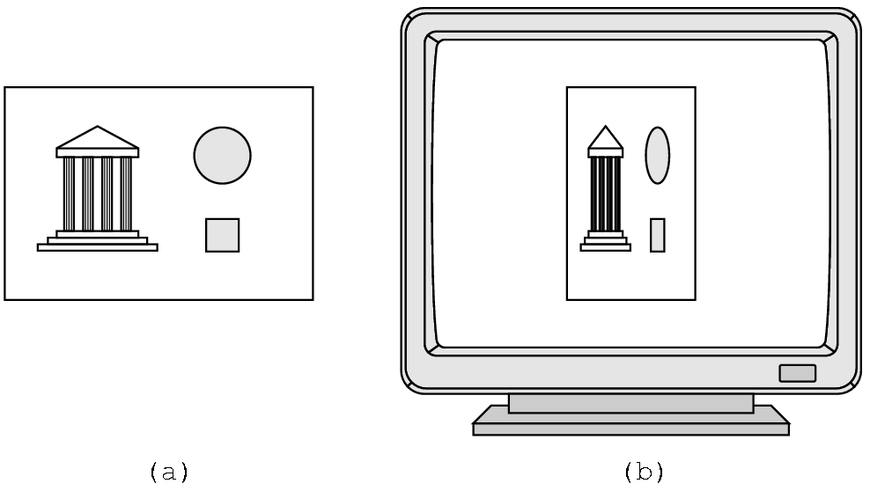
SOME CAUTIONS
Watch the aspect ratio
Can choose a viewport
that is not the entire
window
We'll look at this further later

Slide 72
3D Sierpinski Gasket
Direct Generalization of 2D version
Easy to extend if just generalize from 2D:
  Need an equivalent 3D model--- a tetrahedron
  point3 vertices [4] = { {0.0, 0.0, 0.0},
  {250.0, 500.0,100.0}, {500.0, 250.0, 250.0},
  {250.0, 100.0, 250.0}}
  A tetrahedron is convex. Therefore, same algorithm works as before
  point3 p = {250.0, 100.0, 250.0};
  Pick a random vertex using j = rand() % 4;
  For midpoint, same idea as before but add
  p[2] = (p[2] + vertices[j][2])/2.0;

Slide 73
1st Programming Assignment
Generalize Sierpinski2D.c to a 3D version.
You will need the 3D version of glOrtho. Try something like
glOrtho(0.0, 500.0, 0.0, 500.0, -500.0, 500.0);
for a tetrahedron defined by the 4 points
(0,0,0),(250,500,100),(500,250,250),(250,100,250)
Were the results what you expected?
Send to cpscgrader@hiram.edu with a header
  Program 1- Sierpinski3D.c, your username
  Attach your .c source code

