Slide 1
INPUT AND INTERACTION
Recall: GLUT Handles Input and Interaction, NOT OpenGL

Slide 2
INPUT PHYSICAL DEVICES vs
INPUT LOGICAL DEVICES
physical devices: read in text (pg 101-103) on features and characteristics of each
  2D: mouse, trackball, data tablet, lightpen, joystick, pressure sensors, keyboard
  3D: spaceball, datagloves, laser-based structured lighting, virtual reality sensors
We will be concerned with two kinds:
  pointing device- indicates a screen position and sends an interrupt to computer
  keyboard device- sends character codes to computer

Slide 3
INPUT PHYSICAL DEVICES vs
INPUT LOGICAL DEVICES
Introduced in GKS and continued in PHIGS.
Viewed as the "collective wisdom" of graphics experts as to what should be supported in a graphics environment.
OpenGL doesn't take this approach.
The mouse and keyboard, which OpenGL supports, can be used to simulate various input devices.
We will see that there is NOT a 1-1 correspondence (or pairing) between physical devices and logical devices.
One logical device can be simulated by multiple physical devices and one physical device can simulate multiple logical devices.

Slide 4
INPUT LOGICAL DEVICES
string- provides ASCII strings to a program
  Obviously, keyboard can do this
locator- provides a position in world coordinates to the user program
  Mouse returns (x,y)- a screen coordinate
  Software can convert to world coordinates, although the calculations are not trivial
pick-when the user picks an object, the identifier of the object is returned to the user program
  Can click with a mouse and determine with software which object is the closest.

Slide 5
INPUT LOGICAL DEVICES
choice - user selects one of a discrete number of options
  Use widgets (menus, scrollbars, graphical buttons) provided by the windowing environment
dial- provide analog input to user program
  Again, use widgets (slidebars, rotating dials)
stroke-returns an array of locations. Acts like a multiple locator.
  Can handle by depressing a button or mouse (drag)

Slide 6
ENTITIES DESCRIBING INPUT FROM DEVICES
measure of device- what is returned to a program when the device is activated
trigger of device-signal sent to the computer to do something
input mode-the relationship between the delivery of the measure and the trigger
  request mode- don't deliver measure until trigger occurs
  sample mode- immediate input
  event mode- each trigger places measure in an event queue. It is up to the user program to decide how to handle the events.
    Most APIs today, including GLUT, use a callback function approach

Slide 7
SOME CALLBACK FUNCTIONS IN GLUT
We’ve already seen and explored some:
1) glutDisplayFunc(display); //registers our name choice , //display, for the display function in main
Defined as void display () { … }
Triggers: Open the window, uncover by moving a front window off of the window, resize the window
Measure: None
2) glutReshapeFunc(myReshape); //registration in main
Defined as void myReshape(int w, int h) { … }
Trigger: Window is resized ( It overrides Display for this event)
Measure: Returns the width and height in pixel to the program and passes them to the myReshape function as parameters w and h.

Slide 8
OTHER CALLBACK FUNCTIONS
glutMouseFunc(mymouse); //registration
Trigger: Mouse event---one or more mouse buttons are depressed or released
Measure: Which button was involved, state of button (up or down) after the event, screen coordinates of mouse position
Definition:
void mymouse
(int button, //ex. GLUT_LEFT_BUTTON
int state, //ex. GLUT_DOWN
int x, int y); //screen coordinates

Slide 9
EXAMPLE:
if (button == GLUT_LEFT_BUTTON &&
state == GLUT_DOWN) exit(0); //note parameter for exit
if (button == MIDDLE_BUTTON &&
state == GLUT_DOWN) drawSquare(x,y); //need to define drawSquare
Some other useful callbacks (for the full range see SGI site although some like a spaceball won't be particularly useful):
glutMotionFunc(drawSquare); //invoked when a mouse motion is // //detected when dragging the mouse
glutIdleFunc(myIdle); //invoked when no events are happening //often used to refresh something like a clock or to //toggle between two states //we'll see some examples of this //Note that NULL must be defined as 0

Slide 10
NOTE THAT INTERACTION CAN BE TRICKY!
Normally the display function should handle the noninteractive output, at least initially.
If you change output, you need to hang onto the changes for window displays.
For example, if we write a program to print a square every time a mouse button is clicked,
  If we don't hang onto all of the positions, we can't reconstruct the entire sequence, only the current event.
  We will see how this is can be done shortly, but think about what is needed --- a data structure to record all the positions.

Slide 11
ANOTHER USEFUL CALLBACK
glutKeyboardFunc(myKeyboard);
Trigger: Mouse is in window and key is depressed
Measures: ASCII code of depressed key and (x,y), the screen coordinates of the mouse location
Definition form:
void myKeyboard(unsigned char key, //ASCII code int x, int y) //mouse location
Note: For every callback function, these are the 4 things you need to know (the 4 items in yellow above).
See functions discussed in text and at the OpenGL site.

Slide 12
EXAMPLE: Square Drawing Program
A5, pg 674
A window is cleared to black on every reshape call, which will include the initial display.
Each time the left button of the mouse is depressed and dragged,a series of boxes are drawn. Releasing the button stops output.
The right button of the mouse exits the program.

Slide 13
Globals for program:
GLsizei wh = 500, ww=500; //pixel count with predefined //global of initial window size
GLfloat size = 3.0
//length of side of square to //draw will be 6 pixels ---i.e. this is
//half the side
We often use globals in graphics- but be careful!

Slide 14
A5, continued, pg 674
drawSquare(int x, int y)
    (x,y) is the center of the square to draw
    The function will be registered as a glutMotionFunc for the mouse and (x,y) will be the screen coordinates of the mouse when clicked
    y = wh -y; //flips from screen coordinates to //OpenGL coordinates
+x
⎨
wh
OpenGL
+y
screen

Slide 15
Continuing
glColor3ub( (char) rand() % 256, …);
  Uses discrete values between 0 and 255 instead of intensities as with glColor3f. Remove the (char). It isn't needed.
Recall that GL_POLYGON fills
myReshape- just clears the window by setting everything to black. The clipping window and viewport are set to the same size.
myinit-
  Not a callback function
  Sets viewport, clipping window, and color
  Registering reshape here doesn't seem to be necessary as it is done in main. Deleting it doesn't seem to cause a problem
mouse-
  Should be obvious, but may need a parameter in exit--- try exit(0)

Slide 16
display-
  needed by GLUT 3.0+
  doesn't do anything except keep GLUT happy
main-
  standard stuff
    command line information, needed even if don't use
    single buffering and RGB color
    create window with a title
    call initialization routine
    register callbacks: reshape, mouse, motion, display
    start event loop

Slide 17
AN EXAMPLE OF POOR DOCUMENTATION- square.c
/* This program illustrates the use of the glut library for interfacing
with a Window System */
/* The program opens a window, clears it to black,then draws a box
at the location of the mouse each time the left button is clicked. The
right button exits the program. The program also reacts correctly
when the window is moved or resized by clearing the new window to
black*/
What do you think you should do during the run?
If you repeatedly click, you see often nothing happens and your screen looks funny...

Slide 18
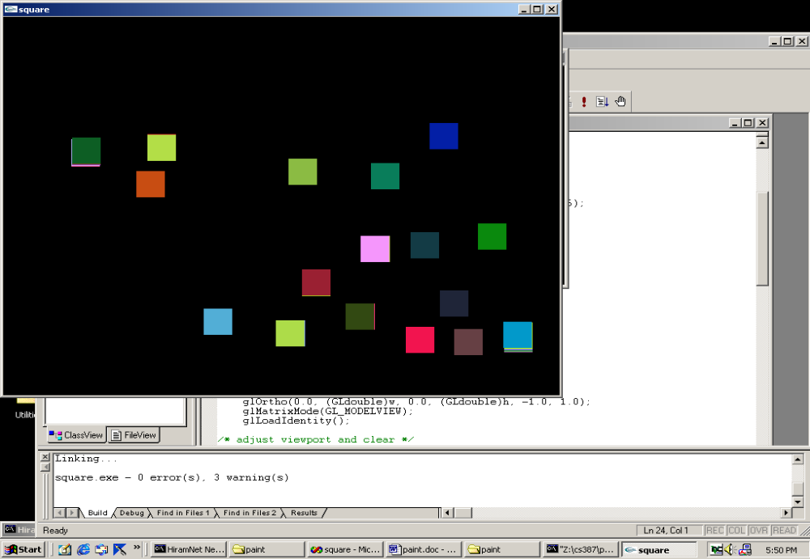
This is what happens each time the left button is clicked-
sometimes nothing is produced
sometimes these slightly multiple squares are produced

Slide 19
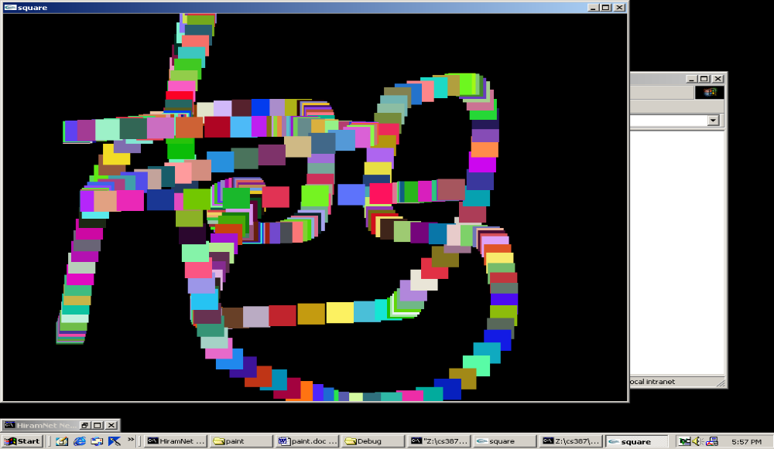
But, if you read the code, not the documentation:
glutMouseFunc (mouse);
glutMotionFunc(drawSquare);
this says you must click and drag the mouse!
Then you can produce:

Slide 20
MENUS
Most windowing systems provide a toolkit allowing the construction of widgets-
  slide bars
  dials
  buttons
  menus
OpenGL directly supports only menus--- i.e. to get the others, you have to create your own or use the the window-specific widgets of the operating system being used.
Menus act as CHOICE logical devices.

Slide 21
MENUS
Easy to define ---usually in main
Register the menu callback function with an int id
    c_menu = glutCreateMenu(myMenu);
Define entries in menu- All subsequent adds are assigned to the menu just created. The adds terminate with the attach command shown below or a new registration. (We'll see in a minute why this approach is taken).
    glutAddMenuEntry("Quit", 1);
    glutAddMenuEntry("Increase size", 2);
Link menu to a specific button
    glutAttachMenu(GLUT_RIGHT_BUTTON);
passed to callback
function if clicked

Slide 22
MENUS
Define the menu callback function:
void myMenu (int id)
{ if (id == 1) exit(0); //menu said "Quit"
else if (id == 2) size = 2* size; //menu said "Increase size"
…
glutPostRedisplay(); //request a redisplay event so the display
//function will be called
It is easy to create hierarchical menus, but you need to plan carefully, especially if you don’t use a middle button for the mouse.

Slide 23
SUBMENUS
Suppose we've defined two menus:
c_menu = glutCreateMenu(color_menu);
glutAddMenuEntry("red", 1);
glutAddMenuEntry("green",2);
…
p_menu = glutCreateMenu(pixel_menu);
glutAddMenuEntry("increase pixel size",1);
glutAddMenuEntry("decrease pixel size", 2);
and attached both to right button:
glutAttachMenu(GLUT_RIGHT_BUTTON);
Now we can make both come off of another menu with another button.
glutAddSubMenu("Colors", c_menu);
glutAddSubMenu("Pixel size", p_menu);
glutAttachMenu(GLUT_MIDDLE_BUTTON);
THE ORDERING OF THE COMMANDS IS IMPORTANT!

Slide 24
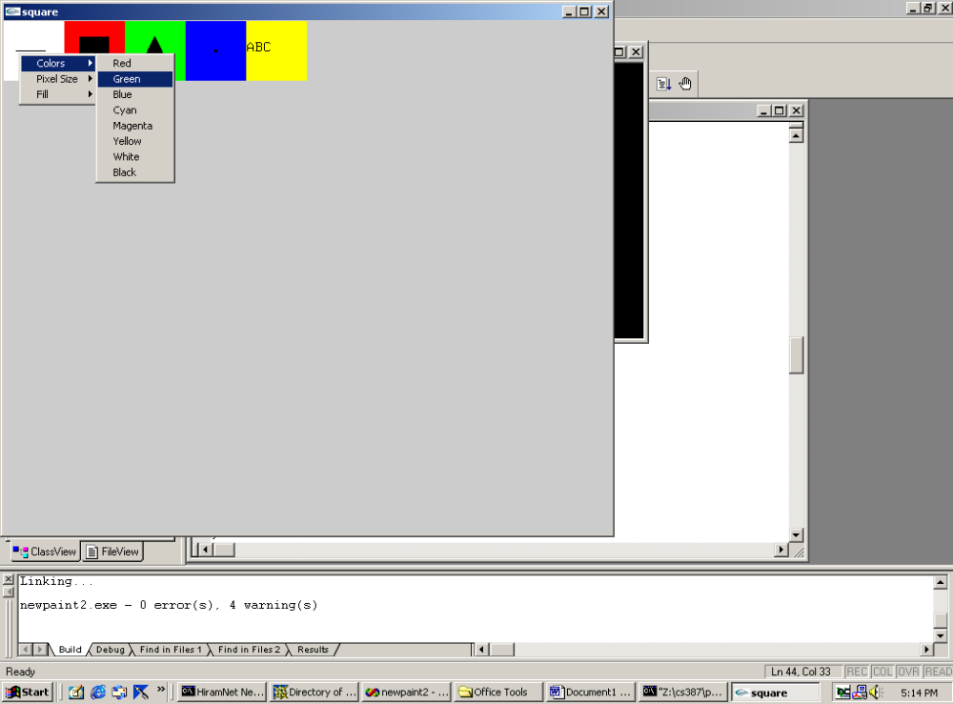

Slide 25
PICKING
In 3D work, this is harder as you have to map (backwards) from screen coordinates to world coordinates in order to identify an object.
In 2D world, often can use the mouse easily as a pick device by determining if the mouse has been clicked in the extent (or bounding rectangle) of an object.
extent- the smallest rectangle aligned with the coordinate axes that contains an object.
Normally an application program maintains a simple data structure to relate objects and their extents.
Note: This can be done in 3D also where a bounding box is used. The extent can be used for collision detection when animating objects.

Slide 26
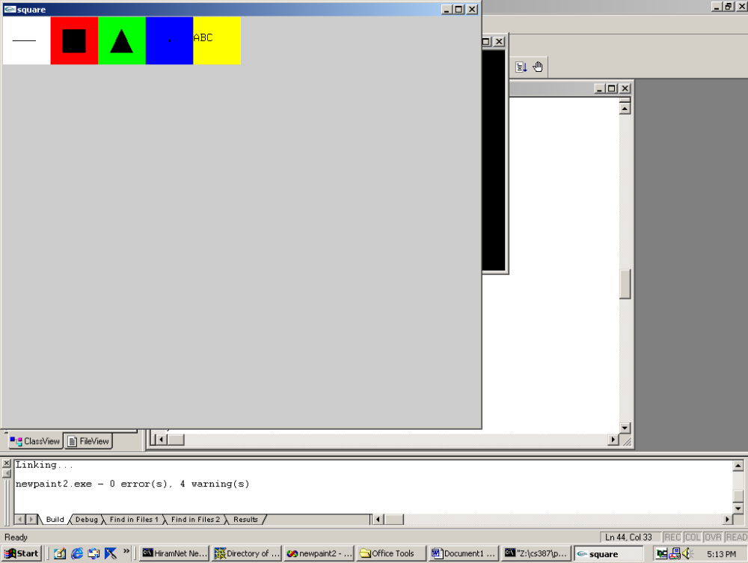
PAINT PROGRAM – see A6, pg 677+
Initial screen with 5 pick areas:
Choose to draw line, box, triangle, random boxes, text by clicking in the box which is labeled. Then ..
Line: 2 clicks
Box: 2 clicks on diagonal
Triangle: 3 clicks
Random boxes: any number of clicks
Text: Click and then start typing

Slide 27
PAINT PROGRAM, MENUS AS CHOICE DEVICES
Menus are used to select:
drawing color
fill or not
increase or decrease pixel size
If resize, the screen is cleared.

Slide 28
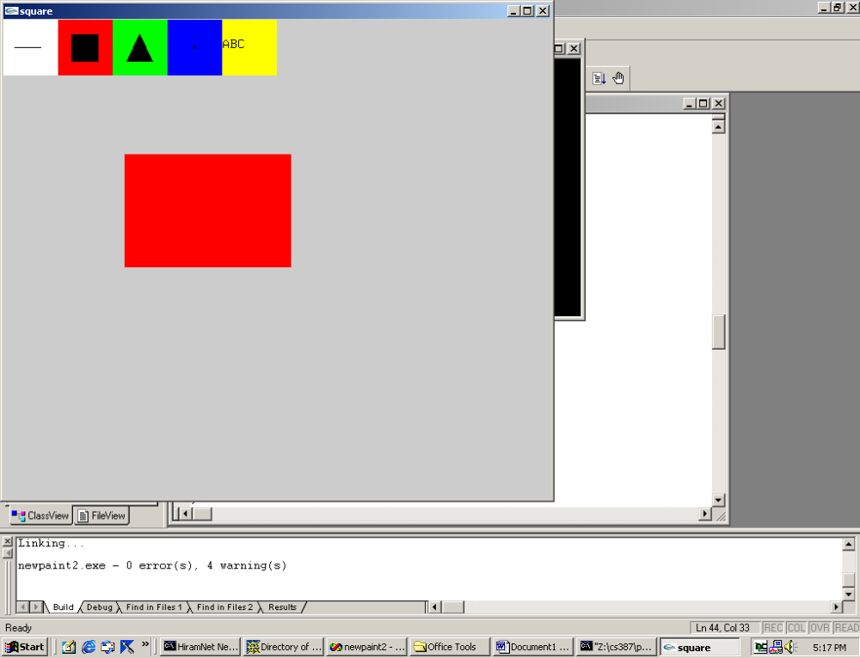
PAINT PROGRAM
More than one square (actually a rectangle) could be drawn.

Slide 29
DESIGN NOTES FOR Paint.c, A6
Menus are defined in main
These are attached to the right mouse button:
  color_menu: Has 8 choices, the colors
  pixel_menu: Has 2 choices, increasing or decreasing size
  fill_menu: Has 2 choice, on or off
  right_menu: Has 2 choices, quit or clear
This is attached to the middle mouse button:
  middle_menu: Has 3 choices, colors, pixel, fill
The left mouse button will be used to pick the drawing choices and the drawing locations.
If only use two mouse buttons, you have to reorganize or use keyboard for choices ...

Slide 30
USING THE KEYBOARD AS A CHOICE INPUT DEVICE
glutKeyboardFunc(keyex); //register in main
void keyex (unsigned char key, int x, int y) {
if (key == 'r') …; //code to set red as drawing color
if (key =='g') …; //code to set green as drawing color
etc.
}
To do this, you will need to provide the user with instructions.
Now, we need to note we are in a graphics window provided by
operating system's windowing system as requested by GLUT.
We are not in a normal console window where text requested by
the executing C (or C++) program would be placed.

Slide 31
CONCEPTS POSTPONED FOR NOW
Textual output in a graphics window
  Stroke and raster text
  Not hard, but a lot of code to explain and at this point I want to move into animation material
Display lists
  Similar in concept to ordinary files and can be used to define geometric primitives
  We'll use these shortly, but they do add overhead that is not desirable in simple programs.
  Right now, just read "lightly" the sections on these. We’ll return to these sections shortly.

Slide 32
Let's Walk Through a Modified Version of paint.c. pg 677+
See the link under Demos for Chpt 3 on web site for modified code
Changed to a 2 button mouse
Text displays not covered here
Display lists not covered as used for textual display

Slide 33
/* Paint.c */
/* This program illustrates the use of the GLUT library for interfacing with a window system using menus and a 2-button mouse */
#define NULL 0 //Aliases for constants
#define LINE 1
#define RECTANGLE 2
#define TRIANGLE 3
#define POINTS 4
#include <stdlib.h> //Should always include in .c code
#include <GL/glut.h> // and this one
start on pg 677

Slide 34
//Declare functions to avoid ordering problems
//These tell the compiler what is needed for compiling
void mouse(int, int, int, int);
void display(void);
void drawSquare(int, int);
void myReshape(GLsizei, GLsizei);
void myinit(void);
void screen_box(int, int, int);
void right_menu(int);
void top_menu(int);
void color_menu(int);
void square_menu(int);
void fill_menu(int);
int pick(int, int);

Slide 35
/* globals */
GLsizei wh = 500, ww = 500; /* initial window size */
GLfloat size = 3.0; /* half side length of square */
int draw_mode = 0; /* drawing mode */
int rx, ry; /*raster position*/
GLfloat r = 1.0, g = 1.0, b = 1.0;/* drawing color */
int fill = 0; /* fill flag */
draw_mode will be returned by the pick function as LINE, RECTANGLE, TRIANGLE, POINTS, TEXT, or an error flag if a valid box wasn't selected by a click.

Slide 36
Now skip ahead to the main function on pg 683
int main(int argc, char** argv)
{
int c_menu, p_menu, f_menu, r_menu;
glutInit(&argc,argv); /*Include even though we
won' t use command line calls*/
//Usual setup of window and register display function
glutInitDisplayMode (GLUT_SINGLE | GLUT_RGB);
glutInitWindowSize(500, 500);
glutCreateWindow("square");
glutDisplayFunc(display);

Slide 37
/* Create 4 menus each of which will be controlled by another menu, top_menu.
The textbook code only uses 3 menus as the middle button of the mouse is used. */
c_menu = glutCreateMenu(color_menu);
//color_menu is a function with id a parameter
glutAddMenuEntry("Red",1);
glutAddMenuEntry("Green",2);
glutAddMenuEntry("Blue",3);
glutAddMenuEntry("Cyan",4);
glutAddMenuEntry("Magenta",5);
glutAddMenuEntry("Yellow",6);
glutAddMenuEntry("White",7);
glutAddMenuEntry("Black",8);

Slide 38
p_menu = glutCreateMenu(square_menu);
//same concept as color_menu
glutAddMenuEntry("increase randomly- colored square size", 1);
glutAddMenuEntry("decrease randomly- colored square size", 2);
f_menu = glutCreateMenu(fill_menu);
//same concept as color_menu
glutAddMenuEntry("fill on", 1);
glutAddMenuEntry("fill off", 2);
r_menu = glutCreateMenu(right_menu);
//same concept as color_menu
glutAddMenuEntry("quit",1);
glutAddMenuEntry("clear",2);

Slide 39
/* Create the controlling menu, top_menu, which allows the invoking of the various submenus.*/
glutCreateMenu(top_menu);
glutAddSubMenu("Colors", c_menu);
glutAddSubMenu("Square Size", p_menu);
glutAddSubMenu("Fill", f_menu);
glutAddSubMenu("Clear/quit", r_menu);
glutAttachMenu(GLUT_RIGHT_BUTTON);
/*With only two buttons, the right will make the
menu selections and the left will pick from the
boxed selections on the screen to determine what
is to be drawn. */

Slide 40
myinit (); //usual initialization stuff
glutReshapeFunc (myReshape); /* To be invoked when reshaping a window */
glutMouseFunc (mouse); /* To be invoked on a mouse movement */
glutMainLoop(); /*Start event loop */
} //end main
Now we write the other functions. Because they were declared initially, the ordering is irrelevant.

Slide 41
void drawSquare(int x, int y) /* When selected, draws a randomly-colored square centered at (x,y) on the screen. The original x and y are screen coordinates returned by the mouse from a mouse click. The adjusted y (and the original x) are the window coordinates.*/
{
y=wh-y; /*wh is the window height. */
glColor3ub( (unsigned char) rand()%256, rand()%256, rand()%256); /*Select 0-255*/
glBegin(GL_POLYGON);
glVertex2f(x+size, y+size);
glVertex2f(x-size, y+size);
glVertex2f(x-size, y-size);
glVertex2f(x+size, y-size);
glEnd();
}

Slide 42
// If window is resized or moved, w and h are set
void myReshape(GLsizei w, GLsizei h)
{ // adjust clipping box
glMatrixMode(GL_PROJECTION);
glLoadIdentity();
glOrtho(0.0, (GLdouble)w, 0.0, (GLdouble)h, -1.0, 1.0);
glMatrixMode(GL_MODELVIEW);
glLoadIdentity();
// adjust viewport and clear
glViewport(0,0,w,h);
glClearColor (0.8, 0.8, 0.8, 1.0);
glClear(GL_COLOR_BUFFER_BIT);
display(); //needed to redraw the pick boxes
glFlush();
// set global size for use by drawing routine
ww = w;
wh = h; }

Slide 43
void myinit(void)
{ glViewport(0,0,ww,wh);
/* Pick 2D clipping window to match size of window This choice avoids having to scale object coordinates each time window is resized */
glMatrixMode(GL_PROJECTION);
glLoadIdentity();
glOrtho(0.0, (GLdouble) ww , 0.0, (GLdouble) wh , -1.0, 1.0);
/* set clear color to black and clear window */
glClearColor (0.8, 0.8, 0.8, 1.0);
glClear(GL_COLOR_BUFFER_BIT);
glFlush();
}

Slide 44
void mouse(int btn, int state, int x, int y) /*Determine which box is chosen by mouse and draw the appropriate item.
The x and y are screen coordinates of mouse click. */
{ static int count; /*static holds value over function calls*/
int where;
static int xp[2],yp[2];
if( btn==GLUT_LEFT_BUTTON
&& state==GLUT_DOWN)
{ glPushAttrib(GL_ALL_ATTRIB_BITS);
where = pick(x,y); /*pick returns 0, LINE,
RECTANGLE, TRIANGLE, or POINTS*/
glColor3f(r, g, b);
if (where != 0) /*0 indicates no box chosen*/
{ count = 0;
draw_mode = where;
}

Slide 45
else switch(draw_mode)
{ case(LINE):
if (count==0)
{ count++;
xp[0] = x; /*xp and yp are static variables*/
yp[0] = y;
}
else
{ glBegin(GL_LINES);
glVertex2i(x,wh-y);
glVertex2i(xp[0],wh-yp[0]);
glEnd();
draw_mode=0;
count=0;
}
break;

Slide 46
case(RECTANGLE):
if(count == 0)
{ count++;
xp[0] = x;
yp[0] = y;
}
else
{ if (fill) glBegin(GL_POLYGON);
else glBegin(GL_LINE_LOOP);
glVertex2i(x,wh-y);
glVertex2i(x,wh-yp[0]);
glVertex2i(xp[0],wh-yp[0]);
glVertex2i(xp[0],wh-y);
glEnd();
draw_mode=0;
count=0;
}
break;

Slide 47
case (TRIANGLE):
switch(count)
{ case(0):
count++; xp[0] = x; yp[0] = y;
break;
case(1):
count++; xp[1] = x; yp[1] = y;
break;
case(2):
if(fill) glBegin(GL_POLYGON);
else glBegin(GL_LINE_LOOP);
glVertex2i(xp[0],wh-yp[0]);
glVertex2i(xp[1],wh-yp[1]);
glVertex2i(x,wh-y);
glEnd();
draw_mode=0;
count=0;
}
break;

Slide 48
case(POINTS):
{
drawSquare(x,y);
count++;
}
break;
}
glPopAttrib();
glFlush();
}
}

Slide 49
int pick(int x, int y)
/*Called by mouse callback. Returns the box in which the mouse is clicked (or an error flag of 0 */
{ y = wh - y;
{if(y < wh-ww/10) return 0; /* This is outside of the squares at the top */
else if(x < ww/10) return LINE;
else if(x < ww/5) return RECTANGLE;
else if(x < 3*ww/10) return TRIANGLE;
else if(x < 2*ww/5) return POINTS;
}
}

Slide 50
void screen_box(int x, int y, int s )
/* Draws a pick box at the top of the window for selecting drawing mode */
{
glBegin(GL_QUADS);
glVertex2i(x, y);
glVertex2i(x+s, y);
glVertex2i(x+s, y+s);
glVertex2i(x, y+s);
glEnd();
}

Slide 51
void right_menu(int id)
{ if (id == 1) exit(0);
else display();}
void top_menu(int id)
{ }
void color_menu(int id)
{ if(id == 1) {r = 1.0; g = 0.0; b = 0.0;} //red
else if(id == 2) {r = 0.0; g = 1.0; b = 0.0;} //green
else if(id == 3) {r = 0.0; g = 0.0; b = 1.0;} //blue
else if(id == 4) {r = 0.0; g = 1.0; b = 1.0;} //cyan
else if(id == 5) {r = 1.0; g = 0.0; b = 1.0;} //magenta
else if(id == 6) {r = 1.0; g = 1.0; b = 0.0;} //yellow
else if(id == 7) {r = 1.0; g = 1.0; b = 1.0;} //white
else if(id == 8) {r = 0.0; g = 0.0; b = 0.0;} //black
}

Slide 52
void square_menu(int id)
/* doubles size of square to increase; half size to decrease */
{
if (id == 1) size = 2 * size;
else if (size > 1) size = size/2;
}
void fill_menu(int id)
{
if (id == 1) fill = 1;
else fill = 0;
}

Slide 53
void display(void) //draws pick boxes on the screen
{ int shift=0;
glPushAttrib(GL_ALL_ATTRIB_BITS);
glClearColor (0.8, 0.8, 0.8, 1.0);
glClear(GL_COLOR_BUFFER_BIT);
glColor3f(1.0, 1.0, 1.0); /*Box for line*/
screen_box(0,wh-ww/10,ww/10);
glColor3f(1.0, 0.0, 0.0); /*Box for rectangle*/
screen_box(ww/10,wh-ww/10,ww/10);
glColor3f(0.0, 1.0, 0.0); /*Box for triangle*/
screen_box(ww/5,wh-ww/10,ww/10);
glColor3f(0.0, 0.0, 1.0); /*Box for colored squares*/
screen_box(3*ww/10,wh-ww/10,ww/10);

Slide 54
glColor3f(1.0,1.0,1.0); //Draw figures in black
glBegin(GL_LINES);
glVertex2i(wh/40,wh-ww/20);
glVertex2i(wh/40+ww/20,wh-ww/20);
glEnd();
glBegin(GL_TRIANGLES);
glVertex2i(ww/5+ww/40,wh-ww/10+ww/40);
glVertex2i(ww/5+ww/20,wh-ww/40);
glVertex2i(ww/5+3*ww/40,wh-ww/10+ww/40);
glEnd();
glPointSize(3.0);
glBegin(GL_POINTS);
glVertex2i(3*ww/10+ww/20, wh-ww/20);
glEnd();
glFlush();
glPopAttrib();
}//end display

Slide 55
Suppose We Wish to Do Simple Animation
Consider A7 – the Double-Buffering Example
Basically, we will draw our white square and then spin it.
We want this to be interactive so the user can turn on or turn off the spin.
To keep flicker down, we will use double buffering – i.e. draw into one frame buffer while the other is being used for refreshing
Then swap the buffers.

Slide 56
/* double.c
This program demonstrates double buffering for flicker-free animation.
It creates two windows- one labeled "single buffering" and one labeled "double buffering". This allows you to see what happens with the two types of buffering.
The left and right mouse buttons start and stop the spinning motion of the square.*/
#include <GL/glut.h>
#include <stdlib.h>
#include <math.h>
#define DEGREES_TO_RADIANS 3.14159/180.0
static GLfloat spin = 0.0;
GLfloat x, y;
int singleb, doubleb;

Slide 57
int main(int argc, char** argv)
{ glutInit(&argc,argv);
glutInitDisplayMode (GLUT_SINGLE | GLUT_RGB);
singleb=glutCreateWindow("single buffered");
myinit (); //register callbacks for 1st window
glutDisplayFunc(displays);
glutReshapeFunc (myReshape);
glutIdleFunc (spinDisplay);
glutMouseFunc (mouse);
glutInitDisplayMode (GLUT_DOUBLE | GLUT_RGB);
doubleb=glutCreateWindow("double buffered");
myinit (); //and callbacks for 2nd window
glutDisplayFunc(displayd);
glutReshapeFunc (myReshape);
glutIdleFunc (spinDisplay);
glutMouseFunc (mouse);
glutMainLoop();}

Slide 58
void square() //just draw a square
{ glBegin(GL_QUADS);
glVertex2f(x,y);
glVertex2f(-y,x);
glVertex2f(-x,-y);
glVertex2f(y,-x);
glEnd();}
void displayd() //display function for double buffering
{ glClear (GL_COLOR_BUFFER_BIT);
square();
glutSwapBuffers ();}
void displays() //display function for single buffering
{ glClear (GL_COLOR_BUFFER_BIT);
square();
glFlush();}

Slide 59
void spinDisplay ()
/* Called by the mouse function to start spin */
{ spin = spin + 2.0;
if (spin > 360.0) spin = spin - 360.0;
x= 25.0*cos(DEGREES_TO_RADIANS * spin);
y= 25.0*sin(DEGREES_TO_RADIANS * spin);
glutSetWindow(singleb);
glutPostRedisplay(); //explictly call for display
glutSetWindow(doubleb);
glutPostRedisplay();
}
void myinit ()
{ glClearColor (0.0, 0.0, 0.0, 1.0);
glColor3f (1.0, 1.0, 1.0);
glShadeModel (GL_FLAT);}

Slide 60
void mouse(int btn, int state, int x, int y) //handle spin
{ if (btn==GLUT_LEFT_BUTTON && state==GLUT_DOWN) glutIdleFunc(spinDisplay);
if(btn==GLUT_RIGHT_BUTTON && state==GLUT_DOWN) glutIdleFunc(NULL);}
void myReshape(int w, int h) //called if window changed
{ glViewport(0, 0, w, h);
glMatrixMode(GL_PROJECTION);
glLoadIdentity();
if (w <= h)
glOrtho (-50.0, 50.0, -50.0*(GLfloat)h/(GLfloat)w,
50.0*(GLfloat)h/(GLfloat)w, -1.0, 1.0);
else glOrtho (-50.0*(GLfloat)w/(GLfloat)h,
50.0*(GLfloat)w/(GLfloat)h, -50.0, 50.0, -1.0, 1.0);
glMatrixMode(GL_MODELVIEW);
glLoadIdentity ();}

Slide 61
Compile and Run
single_double.c is on web under Demos
Note the code is slightly different than A7's which uses the middle mouse.
This code uses the right mouse instead.

