Slide 1
Chapter 4 and
Appendix B
Geometric Objects, Transformations, and Spaces

Slide 2
IDEAL BACKGROUND FOR ANIMATION IN GRAPHICS
Need concepts from
  analytical geometry
  trigonometry
  linear algebra
  vector analysis
Don't need memorized formulas, but intuitive concepts and a few basic formulas that can be understood visually.
We'll take a very pragmatic and utilitarian approach.
Approach will be similar to what we do all the time in computer science---deal with abstract data types

Slide 3
ABSTRACT DATA TYPE (ADT) APPROACH
Initially, don't worry about internal representations of these objects ---i.e. in computer science, we capture concepts using the notions of
  a class
  objects that are instantiated from the class
Concerned about attributes of class
Concerned about functions defined for the class
(Note: although many of you were introduced to these concepts while learning C++ or Java, the above notions existed before these languages were designed.)
REMEMBER- "class" here is not a C++ class!!!

Slide 4
MOTIVATION FOR ALL THIS
  We require a knowledge of vectors and matrices in order to understand animation, in particular:
    Motion
    Camera placement
    How to change between the different coordinate systems
  We require a knowledge of the representation of lines, planes, and normals in order to understand
    Rendering algorithms
    Lighting models

Slide 5
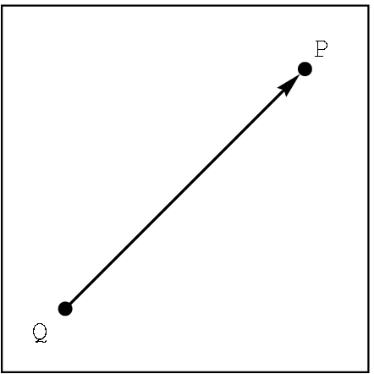
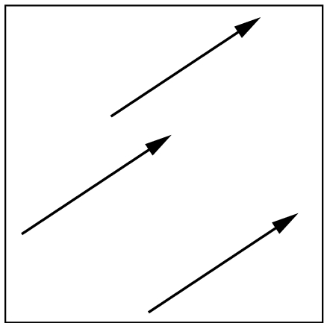
CLASSES- not defined, only described for our setting
scalar Notation: α, β, γ
  For this class, we will use real numbers.
    Define equality: just real number equality
point Notation: P, Q, R
  For this class, we just will use a location in 3D space.
    Define equality: identical locations
vector Notation: u, v , w or A, B, C
Two attributes: length- a scalar denoted by |v| direction in 3D space
Define equality: same length and direction

Slide 6
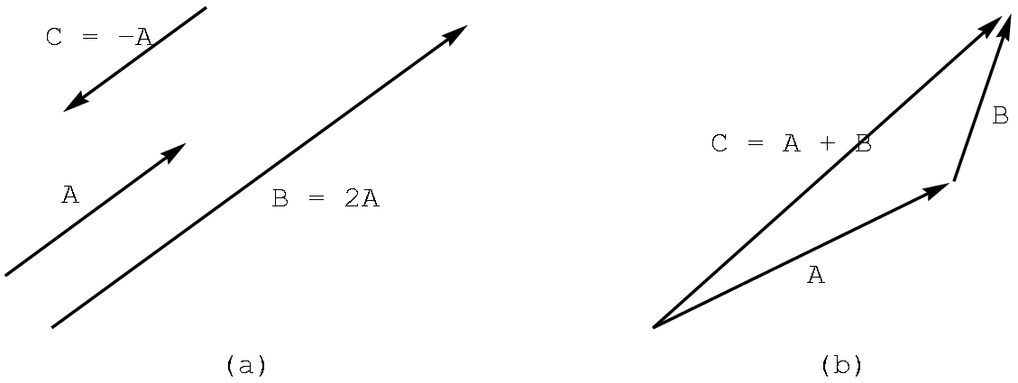
OPERATIONS ON CLASSES
Scalars: Assume the usual real number operations of +, - , *, /
Vectors: Defined in 3D space (as well as 2D)
scalar times vector
-A (i.e. -1A)
2A
vector plus vector
A + B

Slide 7
VECTOR OPERATIONS
Perform addition by the head-to-tail rule.
u
Note that u + v = v + u.
v
v+u
u+v
u
To perform subtraction, we need the zero vector- i.e. vector with zero length and no direction.
Note that v + (-v) = 0
v
-v

Slide 8
VECTOR OPERATIONS
To perform subtraction, given u and v, we define
u - v to be u + (-v):
u
u
-v
v
u - v
As you might suspect, u - v <> v - u
Note: We are NOT "computing"anything with numbers yet. Concentrate on the geometry.
For the moment, we are not using any reference system or coordinate system.

Slide 9
VECTOR OPERATIONS:A bit of trigonometry
There are two ways to measure the size of an angle:
degrees and radian measure
180º = Π radians
(cos θ, sin θ)
θ
Define u• v, the dot product, to be the scalar
|u| |v| cos Θ , 0 <= Θ < Π
and Θ is the angle between u and v
circle with radius 1
We are most often concerned with the sign of u• v as it tells us about the angle between two vectors:
u• v > 0 iff 0 <= Θ < 90º
u• v = 0 iff Θ = 90º
u• v < 0 iff Θ > 90º
Some useful trigonometric values:
Θ cos Θ sin Θ
0 1 0
Π /2 0 1
Π -1 0

Slide 10
VECTOR OPERATIONS:A bit of trigonometry
Define u X v, the cross product, to be the vector whose length is |u||v| sin Θ, 0 <= Θ < Π with Θ is the angle between u and v and whose direction is given by the right hand rule.
(cos θ, sin θ)
θ
Right hand rule:
1. With your right hand, make a gun with your index finger as the barrel, your thumb upright where the hammer would be, and your middle finger extended perpendicular to your palm.
2. Freeze those positions.
3. With u and v joined at the tail, lay the index finger along u and then the middle finger along v.
4. Your thumb will be in the direction of u X v.
circle with radius 1
u
u
v
u X v
Note that u X v <> v X u .
We are often only interested in the direction of u X v.

Slide 11
VECTOR OPERATIONS
Scalar times a vector( more details): Let α be a scalar and u a vector.
Define
αu to be the vector with length | α ||u|
with the direction
of u if α > 0
the opposite of u if α < 0
and, of course, if α = 0, the vector is the zero vector or a point.
u
2u
-3u

Slide 12
POINT OPERATIONS
Many operations are not defined, but a few are and they are useful:
1) We already know a vector + vector CAN be a point. (How?)
2) Given points P and Q, we can define P-Q as the vector given by
P
P-Q
Q
3) Consequently, given a vector v and a point Q there is a unique point P such that
P = v + Q
We can define addition between a vector and a point as above i.e, given Q and v "anchored" at Q, P is the point at the head of v.

Slide 13
SOME IMPORTANT 3D FORMULAS
We won't prove these, but you should understand them intuitively.
1) P(α) = αv + Q
Defines all points on a line through Q in the direction of v.
Also called a parametric equation of a line.
If the points are in 2D space, the line is in 2D space.
If the points are in 3D space, the line is in 3D space.
P(2)
Recall that the line segment between
Q and P(1) is defined by choosing
0 <= α <= 1
v
P(1)
Q = P(0)
P(-1)

Slide 14
DEFINING A RESTRICTED FORM OF POINT ADDITION
Start with
P= P(α) = αv + Q
Let v = R - Q for points R and Q, Then,
P = α (R-Q) + Q //substitute R-Q for v
= αR - αQ + Q //distribute α
= αR + (1- α)Q //regroup
So, we can define a restricted point addition as
P = α₁R +α₂Q , when α₁ + α₂= 1
P(α)
R
R-Q
Q

Slide 15
SOME IMPORTANT 3D FORMULAS
2) P(α) = αR + (1- α)Q
Defines all points on a line through Q and R.
We just derived this formula from (1). You should read the derivation, but I will not ask you to reproduce it!
Again, to obtain the line segment between R and Q, restrict α so that 0 <= α <= 1
P(2)
R = P(1)
R-Q
Q = P(0)
P(-1)

Slide 16
SOME IMPORTANT 3D FORMULAS
T(α,β) = P + β(1- α)(Q-P) + (1- β)(R-P)
defines all points on a plane, provided P, Q, and R are not collinear. But, this formula is not as useful as the next one.
3) T(α,β) = P + αu + βv , defines all points on the plane as a parametric equation.
R
u and v cannot be parallel vectors
v
Q
P
u

Slide 17
Intuitively, T(α,β) = P + αu + βv , defines all points on the plane
P + 1.25 u + 1.5v
(approximately)
.
R
v
P
u
Q

Slide 18
Intuitively, T(α,β) = P + αu + βv , defines all points on the plane
P + (-0.33) u + -v
(approximately)
R
v
Q
P
u
.
What happens if we restrict α and β to be
between 0 and 1?

Slide 19
SOME IMPORTANT 3D FORMULAS
4) Another useful equation of a plane is given by
(u X v) • (P - P₀) = 0 where P is a point on the plane
v
P_{o}
u
The vector u X v is perpendicular, or orthogonal, to the plane and is called the normal to the plane.

Slide 20
REVIEW
We have defined the following as abstract objects
  scalars
  points
  vectors
And we have defined
  dot product
  cross product
  parametric equation of line
  parametric equation of plane
  normal to plane
  plane equation using the normal

Slide 21
NOTE THAT WE HAVEN'T
Seen how to “compute” anything
Haven't had a coordinate system involved.
These concepts are NOT required in order to visualize what is happening with scalars, points, and vectors.
Now, we have to add a coordinate system, but first we need some basic concepts from analytical geometry.

Slide 22
MATRICES
Definition: A matrix is an n X m array of scalars, arranged conceptually in n rows and m columns, where n and m are positive integers.
If n = m, we say the matrix is a square matrix.
We often refer to a matrix with the notation
A = [a(i,j)]
where a(i,j) denotes the scalar in the ith row and the jth column
We'll use A, B, and C to denote matrices.
Note that the text uses the typical mathematical notation
where the i and j are subscripts. We'll use this alternative form as it is easier to type and it is more familiar to computer scientists.

Slide 23
MATRIX OPERATIONS
Definitions
Scalar-matrix multiplication:
αA = [α a(i,j)]
Matrix-matrix addition: A and B are both n X m
C = A + B = [a(i,j) + b(i,j)]
Matrix-matrix multiplication: A is n X r and B is r X m
r
C = AB = [c(i,j)] where c(i,j) = ∑ a(i,k) b(k,j)
k=1
Examples...

Slide 24
MATRIX OPERATIONS
Examples
Scalar-matrix multiplication:
αA = [α a(i,j)]
⎡ 3 -1 ⎤ ⎡ 15 -5 ⎤
5 ⎢ 7 2 ⎥ = ⎢ 35 10 ⎥
⎣ -1 6 ⎦ ⎣ -5 30 ⎦
Matrix-matrix addition: A and B must both be n X m
C = A + B = [a(i,j) + b(i,j)]
⎡ 3 -1 ⎤ ⎡ 5 2 ⎤ ⎡ 8 1 ⎤
⎢ 7 2 ⎥ + ⎢ 3 -1 ⎥ = ⎢ 10 1 ⎥
⎣ -1 6 ⎦ ⎣ 4 0 ⎦ ⎣ 3 6 ⎦

Slide 25
MATRIX OPERATIONS
Examples
Matrix-matrix multiplication: A is n X r and B is r X m
r
C = AB = [c(i,j)] where c(i,j) = ∑ a(i,k) b(k,j)
k=1
For example,
⎡ 3 -1⎤ ⎡1 2 1 -1⎤ ⎡ 0 5 3 -1⎤ c(2,3)= a(2,1)b(1,3) +
⎢ 1 2⎥ ⎣3 1 0 -2⎦ = ⎢ 7 4 1 -5⎥ a(2,2)b(2,3)=
⎣ 0 1⎦ ⎣ 3 1 0 -2⎦ 1*1 + 2*0 = 1
must be the same
Note that the following is undefined:
⎡1 2 1 -1⎤ ⎡ 3 -1⎤ because a 2 X 4 matrix can't be
⎣3 1 0 -2⎦ ⎢ 1 2⎥ multiplied by a 3 X 2 matrix.
⎣ 0 1⎦ A 4 X m matrix is required.

Slide 26
MATRIX OPERATIONS
Definitions (Continued)
Transpose: A is n X m. Its transpose, A^{T}, is the m X n matrix
with the rows and columns reversed.
Inverse: Assume A is a square matrix, i.e. n X n.
The identity matrix, I_{n} has 1s down the diagonal and 0s elsewhere
The inverse A⁻¹ does not always exist. If it does, then
A⁻¹ A = A A⁻¹ = I
There are many algorithms for finding A⁻¹, but we won't worry
about them as the software will find the values.
However, given a matrix A and another matrix B, we can check
whether or not B is the inverse of A by computing AB and BA and seeing that AB = BA = I_{n}
More examples ...

Slide 27
MATRIX OPERATIONS
Examples
Transpose: A is n X m. Its transpose, A^{T}, is the m X n matrix
with the rows and columns reversed.
⎡1 2 1 4⎤^{T} = ⎡1 3⎤
⎣3 1 0 5⎦ ⎢2 1 ⎢
⎢1 0 ⎢
⎣4 5⎦
Inverse: Assume A is a square matrix, i.e. n X n. If A⁻¹ exists, then A⁻¹ A = A A⁻¹ = I
⎡1 0⎤⁻¹ ⎡ 1 0⎤
⎣2 3⎦ = ⎣-2/3 1/3⎦
because ⎡1 0⎤ ⎡ 1 0⎤ ⎡ 1 0⎤ ⎡1 0⎤ ⎡1 0⎤
⎣2 3⎦ ⎣-2/3 1/3⎦ = ⎣-2/3 1/3⎦ ⎣2 3⎦ = ⎣0 1⎦
THIS DOES NOT SHOW HOW TO FIND THE INVERSE!

Slide 28
BASIS
Definition: Any 3 vectors v₁, v₂, and v₃ that satisfy the two properties:
1) (linearly independence)
α₁v₁ + α₂v₂ + α₃v₃ = 0 if and only if α₁ = α₂ = α₃ = 0
2) (spanning)
Any vector v in the space can be represented uniquely as the linear combination of the basis vectors, i.e.
v =β ₁v₁ + β ₂v₂ + β ₃v₃
is called a basis for the space.
FACT: In 2D space, any basis needs 2 vectors.
In 3D space, any basis needs 3 vectors.

Slide 29
BASIS
Example:
1)
Linear independence:
the zero vector
αu + βv = 0 can happen only if α and β are 0
u
v
w
Any vector w can be written as a linear combination of u and v:
u
w = αu + βv
for some α and β
w
v

Slide 30
BASIS- Don't think the basis vectors must be perpendicular to each other
Example:
2)
Linear independence:
a point
αu + βv = 0 can happen only if α and β are 0
u
v
w
The vector w can be written as a linear combination of u and v:
w
u
w = αu + βv
for some α and β
v

Slide 31
FRAMES
Definition: A frame is
a point P₀ and
a basis v₁, v₂, and v₃
in 3D space. We can specify a frame as (v₁, v₂, v₃, P₀)
Given a frame, any point P can be represented in the frame as
P = α₁v₁ + α₂v₂ + α₃v₃ + P₀
and any vector v can be written as
v = β₁v₁ + β₂v₂ + β₃v₃ + 0·P₀
In the previous slides, the P₀ is just the point where the vectors are joined--- i.e. what we often call the origin (or the reference point) of the coordinate system.
We will now use matrices to represent some of these concepts.

Slide 32
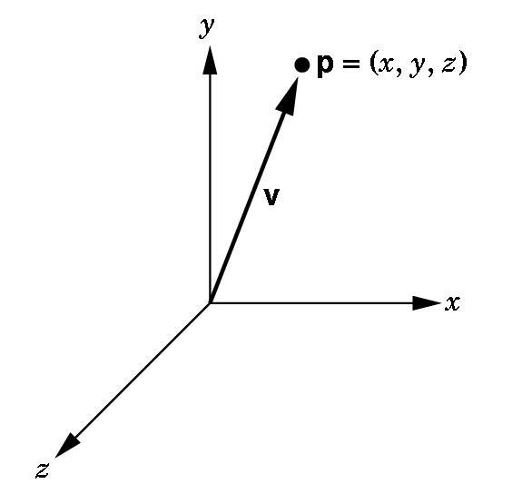
HOMOGENEOUS COORDINATES
In many textbooks, a vector is associated with a point (x, y, z) where the x, y, and z represent the coordinates in the standard coordinate system.
This only works if we assume the frame we are using has the point (0,0,0) as the origin and the vector is positioned at the origin:
This causes confusion as the
vector from (1,1,1) to (2,3,4)
is the same vector as the one from
(0,0,0) to (1,2,3) because the
vectors have the same length
and their directions are the same.

Slide 33
HOMOGENEOUS COORDINATES
In graphics,
  we wish to keep points and vectors as separate entities
  we wish to maintain frame information.
We use homogeneous coordinates to represent points and vectors.
A homogeneous coordinate is a 4D column or row matrix
(This can be defined in projective geometry, but we don't need the definition here- only the properties of a homogeneous coordinate--- it acts like any other matrix.)

Slide 34
HOMOGENEOUS COORDINATE REPRESENTATION OF A 3D POINT
We assume a frame is specified, (v₁, v₂, v₃, P₀), and, consequently any point P can be written uniquely as
P = α₁v₁ + α₂v₂ + α₃v₃ + P₀
If we agree to define 1 • P = P, we can write this formally as the matrix product:
P=[ α₁ α₂ α₃ 1]⎡v₁⎤. ⎢v₂ ⎢
⎢v₃ ⎢
⎣P₀⎦
So, we choose to represents a point P in a frame (v₁, v₂, v₃, P₀) as
column matrix:
[ α₁ α₂ α₃ 1]^{T}

Slide 35
HOMOGENEOUS COORDINATE REPRESENTATION OF A 3D POINT
We assume a frame is specified, (v₁, v₂, v₃, P₀), and, consequently any vector v can be written uniquely as
v = β₁v₁ + β₂v₂ + β₃v₃ + 0·P₀
If we agree to define 0• P₀ = 0, we can write this formally as the matrix product:
v=[ β₁ β₂ β₃ 0]⎡v₁ ⎤. ⎢v₂ ⎢
⎢v₃ ⎢
⎣P₀⎦
So, we choose to represents a point v in a frame (v₁, v₂, v₃, P₀) as
column matrix:
[ β₁ β₂ β₃ 0]^{T}

Slide 36
SO, POINTS AND VECTORS HAVE SIMILAR, BUT DIFFERENT REPRESENTATIONS!
Note the simplicity and similarity of the representations, given some frame:
  2 3 4 1]^{T} is a point in the frame.
  1 4 5 0]^{T} is a vector in the frame.
  Only the 4th component, the 1 or the 0, tells us whether we have a point or a vector.

Slide 37
WHY WORRY ABOUT ALL OF THIS?
We will define our objects in a physical frame.
The camera can be expressed in this frame, but it is more useful to switch to a camera frame where the origin is at the center of a projection.
Moreover,
it will be most useful if we can define our
objects in a frame that is handy to use for computational purposes
and then SWITCH frames to a more natural one.

Slide 38
MOTION OR ANIMATION IS JUST
A FRAME CHANGE.
You can think of motion as
holding the frame still
and moving the object
or
holding the object still
and moving the frame!

Slide 39
CHANGING FRAMES
Problem: Given a frame (v₁, v₂, v₃, P₀) and another frame (u₁, u₂, u₃, Q₀) ,
we need an easy way to
transfer the representation of a point or a vector in one frame
to the appropriate representation of the point or the vector in the other frame.
Recall: In the frame (v₁, v₂, v₃, P₀),
any point P can be written as α₁v₁ + α₂v₂ + α₃v₃ + P₀
and any vector v can be written as β₁v₁ + β ₂v₂ + β ₃v₃

Slide 40
CHANGING FRAME ALGORITHM
(A VERY, VERY IMPORTANT ALGORITHM!)
We will revisit this so don’t sweat the details now
Given a frame X = (v₁, v₂, v₃, P₀)
and another frame Y= (u₁, u₂, u₃, Q₀)
1) Represent the basis vectors u_{i} and the point Q₀ of Y
in the frame X:
u₁ = γ₁₁v₁ + γ₁₂v₂ + γ₁₃v₃ + 0•P₀ where γ_{ij} is the scalar
u₂ = γ₂₁v₁ + γ₂₂v₂ + γ₂₃v₃ + 0•P₀ in the ith row
u₃ = γ₃₁v₁ + γ₃₂v₂ + γ₃₃v₃ + 0•P₀ and jth column.
Q₀ = γ₄₁v₁ + γ₄₂v₂ + γ₄₃v₃ + 1•P₀

Slide 41
2) Represent the equations as a matrix equation.
⎡u₁⎤ ⎡v₁⎤
⎢u₂⎥ ⎢v₂⎥
⎢u₃⎥ = M ⎢v₃⎥ where M is the matrix
⎣Q₀⎦ ⎣P₀⎦
⎡ γ₁₁ γ₁₂ γ₁₃ 0 ⎤
⎢ γ₂₁ γ₂₂ γ₂₃ 0 ⎢
⎢ γ₃₁ γ₃₂ γ₃₃ 0 ⎢
⎣ γ₄₁ γ₄₂ γ₄₃ 1 ⎦
This 4 X 4 matrix M is called the frame change matrix.
Note that it is unique.

Slide 42
3) We can use the matrix M to compute for any point or vector its new representation in frame Y or conversely.
Let a be either a point or vector in X. Then
a = M^{T} b (convert Y frame to X frame)
or
b= (M^{T})⁻¹ a (convert X frame to Y frame)
where b is the corresponding point or vector in Y.
Thus, M allows us to move back and forth between frames!

Slide 43
THE DERIVATION OF THE FORMULAS ON LAST SLIDE
⎡u₁⎤ ⎡v₁⎤ ⎡ γ₁₁ γ₁₂ γ₁₃ 0⎤
⎢u₂⎥ ⎢v₂⎥ ⎢ γ₂₁ γ₂₂ γ₂₃ 0 ⎢
⎢u₃⎥ = M ⎢v₃⎥ where M is the matrix ⎢ γ₃₁ γ₃₂ γ₃₃ 0 ⎢
⎣Q₀⎦ ⎣P₀⎦ ⎣ γ₄₁ γ₄₂ γ₄₃ 1⎦
Let a and b be homogeneous coordinate representations of either a point or a vector in X = (v₁, v₂, v₃, P₀) and Y= (u₁, u₂, u₃, Q₀) respectively. Then,
(All the transpose below does is write the point or vector so it can be multiplied by the column vectors.)
b^{T}⎡u₁⎤ = b^{T}M ⎡v₁⎤ = a^{T}⎡v₁⎤
⎢u₂⎥ ⎢v₂⎥ ⎢v₂⎥ b^{T}M = a^{T} (b^{T}M)^{T} = (a^{T})^{T}
⎢u₃⎥ ⎢v₃⎥ ⎢v₃⎥
⎣Q₀⎦ ⎣P₀⎦ ⎣P₀⎦
a = M^{T}b (formula to convert Y to X)
(M^{T})⁻¹ a = (M^{T})⁻¹ M^{T}b = I_{n} b
b = (M^{T})⁻¹ a (formula to convert
X to Y)

Slide 44
Example of Changing Frames
– Section 4.3.5
Suppose we have vectors v_{i} and u_{i} (i=1,2,3) where
u₁ = v₁
u₂ = v₁ + v₂
u₃ = v₁ + v₂ + v₃
and Q₀ = P₀ + v₁ + 2v₂ + 3v₃
Assume (v₁, v₂, v₃, P₀) is Frame 1.
Then (u₁, u₂, u₃, Q₀) is a frame, Frame 2, and the change matrix, M, is
⎡ 1 0 0 0 ⎤
| 1 1 0 0 |
| 1 1 1 0 |
⎣ 1 2 3 1⎦
To change between the two basis, we need (M^{T})⁻¹ and M^{T}.
Finding M^{T} is easy. We'll assume (M^{T})⁻¹ is calculated for us.

Slide 45
Change Matrix
However, if you want to find the inverse, one way is to solve the matrix equation for a, b, …, p
⎡ 1 1 1 1 ⎤ ⎡a b c d ⎤ ⎡ 1 0 0 0 ⎤
| 0 1 1 2 | | e f g h | = | 0 1 0 0 |
| 0 0 1 3 | | i j k l | | 0 0 1 0 |
⎣ 0 0 0 1⎦ ⎣m n o p⎦ ⎣ 0 0 0 1⎦
After solving the simultaneous equations, we get that (M^{T})⁻¹ is
A = ⎡ 1 -1 0 1 ⎤
| 0 1 -1 1 |
| 0 0 1 -3|
⎣ 0 0 0 1⎦
We can move back and forth between the frames by calculating
b = (M^{T})⁻¹a
and a = M^{T}b
where and b are points or vectors in two frames.

Slide 46
Examples
Consider the point (1,2,3) in Frame 1.
In Frame 1, it's representation is
      p = [1 2 3 1]^{T}
To find its representation in Frame 2, we compute
    p' = (M^{T})⁻¹p
    i.e. p' = [0 0 0 1]^{T}, the origin or reference point in Frame 2.
The vector (1,2,3) in Frame 1 has representation
a = [1 2 3 0]^{T}
    which, in Frame 2 is
    (M^{T})⁻¹a =[-1 -1 3 0]
Similar considerations allow you to move from Frame 2 to Frame 1 representations.

Slide 47
Frames and Affine Transformations

Slide 48
FRAMES IN OPENGL
We've seen that the representation of points and vectors are tied to frames.
OpenGL maintains two frames
  Camera frame
  World frame
Initially, the two frames are the same with the following orientation:
y
x
Camera is pointing along the
negative z axis.
This is a right-handed system.
z

Slide 49
BUT, WE WISH TO BE ABLE TO MOVE OBJECTS (OR MOVE FRAMES)
Hint: Imagine you are sitting so your eye is looking in the negative
z direction towards the origin (reference point) in each frame. Where
do you see the cube? To your left? In front of you? Does it appear
when you switch frames that the cube has moved?
y
y
new frame
x
z
x
z
original frame
Although each activity is the same, it is often easier to think that
you are moving objects. BUT, either visualization is fine!

Slide 50
THE USUAL SCENARIO IN OPENGL
Define objects around the origin in the default setting.
We want the viewing conditions to be such that the camera sees only those objects we wish it to see.
So, we need to move
  1) the camera away from the objects or
  2) the objects away from the camera.
Or, equivalently, we move
  1)' the camera frame relative to the world frame or
  2)' the world frame relative to the camera frame.
Normally, we view the camera as fixed and move the objects.

Slide 51
THE IMPORTANT MODEL-VIEW MATRIX
This is the 4 X 4 frame change matrix that is required to transform between camera frame representations and world frame representations.
We can change the matrix by loading the necessary 16 scalars using glLoadMatrix.
But, computing the 16 scalars is not an easy task as we have seen.
It is easier, to equivalently move objects, using affine transformations.

Slide 52
AFFINE TRANSFORMATIONS
A transformation is a function that maps a point (or vector) into another point (or vector).
An affine transformation is a transformation that maps lines to lines.
Why are affine transformations "nice"?
  We can define a polygon using only points and
  the line segments joining the points.
  To move the polygon, if we use affine transformations,
  we only must map the points defining the polygon
  as the edges will be mapped to edges!
We can model many objects with polygons---
and should--- for the above reason in many cases.

Slide 53
AFFINE TRANSFORMATIONS
VERY IMPORTANT FACT: Any affine transformation can be obtained by applying, in sequence, transformations of the form
  Translate
  Scale
  Rotate- 3 different types in 3D space
So, to move an object all we have to do is determine the sequence of transformations we want using the 3 types of affine transformations above.

Slide 54
FOR EACH AFFINE TRANSFORMATION WE NEED TO KNOW:
What does the transformation do?
What matrix can be used to transform the original points to the new points?
Recall--- moving an object is the same as changing a frame so we know we need a 4 X 4 matrix
It is important to remember the form of these matrices!!!

Slide 55
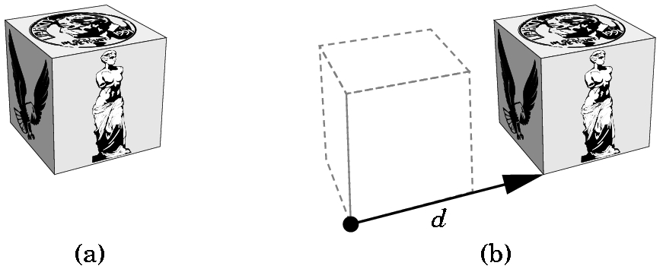
TRANSLATIONS
Each point p in the original frame becomes p' where
p'= p + d
p' = Tp where T = ⎡ 1 0 0 α_{x} ⎤
⎢ 0 1 0 α_{y} ⎢
⎢ 0 0 1 α_{z} ⎢
⎣ 0 0 0 1 ⎦
where α_{x} is the displacement in the x direction,
α_{y} is the displacement in the y direction, and
α_{z} is the displacement in the z direction.
Write T as T(α_{x}, α_{y}, α_{z})
Called the
translation
matrix

Slide 56
TRANSLATIONS
y
y
x
x
z
z
Keep the basis vectors the same, but move the reference point.
Keep remembering, frame changes can be viewed as moving the
frame or moving the object!
Note that a translation clearly has an inverse,
T(α_{x}, α_{y}, α_{z})⁻¹ = T(-α_{x}, - α_{y}, -α_{z})

Slide 57
TRANSLATIONS- 2D
2D translations just require the obvious 3 X 3 matrix:
Example:
What does T(2,-1) do to the line segment shown below if we map the points and then draw the line segment?
(-1,2) ---> (1,1)
(3,1) ---> (5,0) because
⎡ 1 0 2 ⎤⎡ x ⎤ ⎡x + 2⎤
⎢ 0 1 -1⎢⎢ y ⎢ = ⎢y - 1 ⎢
⎣ 0 0 1 ⎦⎣ 1⎦ ⎣ 1 ⎦
Old frame is in red.
New frame is in green.
View this as moving the frame or
moving the line segment!
(-1,2)
•
(3,1)
v₂
•
Q₀
v₁
v₂
P₀
v₁
Note the new origin was at (-2,1) before the translation T(2,-1)

Slide 58
TRANSLATIONS- 2D or 3D
Note that the mapping T(a,b) followed by the mapping
T(c,d) is the same as the mapping defined by the product of
the two matrices: T(a,b) T(c,d)
For example:
⎡1 0 2⎤ ⎡1 0 3⎤ ⎡x⎤ ⎡1 0 2⎤ ⎡x + 3⎤ ⎡x + 5⎤
⎢0 1 -1 ⎢ ⎢0 1 2 ⎢ ⎢y ⎢ = ⎢0 1 -1 ⎢ ⎢y + 2 ⎢ = ⎢y + 1 ⎢
⎣0 0 1⎦ ⎣0 0 1⎦ ⎣1⎦ ⎣0 0 1⎦ ⎣ 1 ⎦ ⎣ 1 ⎦
will yield the same result as multiplying the matrices first:
⎡1 0 2⎤ ⎡1 0 3⎤ ⎡x⎤ ⎡1 0 5⎤ ⎡x⎤ ⎡x + 5⎤
⎢0 1 -1 ⎢⎢0 1 2 ⎢ ⎢y ⎢ = ⎢0 1 1 ⎢ ⎢y ⎢ = ⎢y + 1 ⎢
⎣0 0 1⎦ ⎣0 0 1 ⎦ ⎣1⎦ ⎣0 0 1⎦ ⎣1⎦ ⎣ 1 ⎦
Moreover, geometrically it should be clear that
T(a,b) T(c,d) = T(c,d) T(a,b)

Slide 59
ROTATIONS- 2D
INITIALLY AROUND THE ORIGIN
y
If we rotate through angle ϕ, the point (x,y) is mapped to
x' = x cos ϕ - y sin ϕ
y' = x sin ϕ + y cos ϕ
(x',y')
•
ϕ
•
(x,y)
x
To derive these, all you must do is use trigonometric identities for the
sum of two angles.
We will accept the formulas as correct although those of you with
backgrounds in trigonometry should see that these are correct.
With a rotation, the reference point remains fixed.

Slide 60
ROTATIONS- 2D
INITIALLY AROUND THE ORIGIN
For the rotation through angle ϕ, centered at the origin, the point (x,y) is mapped to
x' = x cos ϕ - y sin ϕ
y' = x sin ϕ + y cos ϕ
so the 2D rotation matrix R(ϕ ) is
⎡ cos ϕ -sin ϕ 0 ⎤
⎢ sin ϕ cos ϕ 0 ⎢
⎣ 0 0 1 ⎦
Using the fact that cos(- ϕ) = cos ϕ and
sin(- ϕ) = - sin ϕ
we can show that R⁻¹(ϕ) = R^{T}(ϕ) = R(- ϕ)

Slide 61
ROTATIONS- 2D
AROUND AN ARBITRARY POINT
Problem: We wish to rotate a polygon φ degrees around an arbitrary point , say (α, β), in some frame. How can we do this when we only know the matrix for rotating about the origin?
Get used to thinking of moving things around!
Move the point (α, β) to the origin by changing the frame.
Rotate around the new origin, changing the frame again.
Move the point (α, β) back to its original place by changing the frame.
i.e. For each vertex of the polygon, p, compute the matrix product:
T (α, β) R(φ) T (-α, -β) p
where p is the homogeneous representation of a point p.

Slide 62
IF SOMETHING ISN'T WHERE YOU WANT IT ….
MOVE THE FRAME
OR MOVE THE OBJECT

Slide 63
ROTATIONS- 3D
INITIALLY AROUND THE ORIGIN
3D rotations are a bit more complicated as there is not just one basic rotation around the origin.
There are 3 basic rotations:
1) Around the x axis.
2) Around the y axis.
3) Around the z axis.
We need to establish some conventions, however, that were ignored in the 2D case as the picture implied the answers to these questions:
1) How do we distinguish a positive angle from a negative angle?
2) How do we measure the angle?

Slide 64
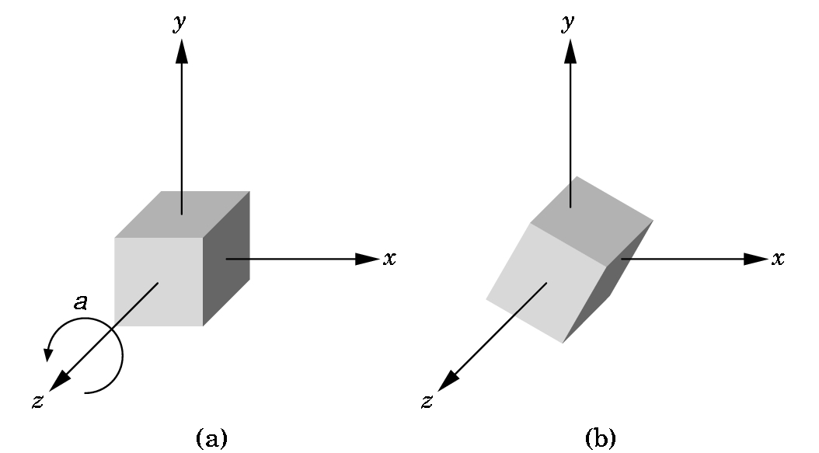
3D z-AXIS ROTATION AROUND ORIGIN
The picture shows a z-axis rotation around the origin in a positive angle, a, direction.
i.e. counterclockwise as you look down the z-axis towards the origin.
The angle is measured in the xy-plane from the x-axis, just as the 2D angle was measured.
It can be shown that a point (x,y,z)
is computed using the same formulas
for x' and y'.
Since z is not changed,
z' = z.
Thus, this rotation matrix is
computed in the same way as the 2D
matrix ...

Slide 65
3D z-AXIS ROTATION AROUND ORIGIN
a is the angle of rotation.
Shows the z-axis is
not moved
R_{z}(a) = ⎡ cos a -sin a 0 0 ⎤
⎢ sin a cos a 0 0 ⎢
⎢ 0 0 1 0 ⎢
⎣ 0 0 0 1 ⎦

Slide 66
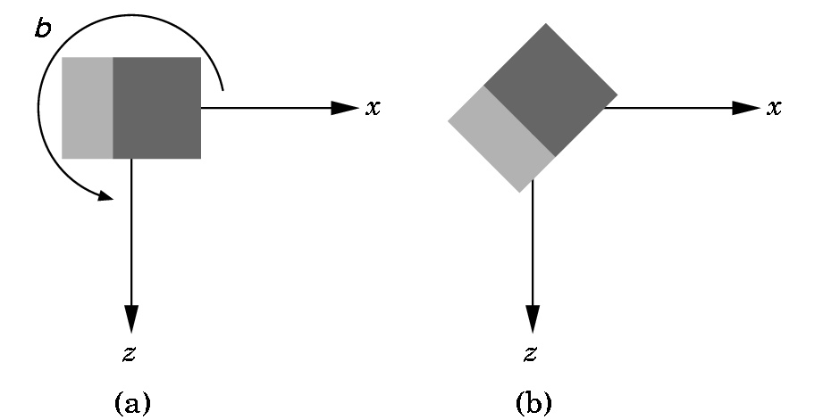
3D y-AXIS ROTATION AROUND ORIGIN
You are looking down the y-axis which is not shown.
A positive (counter-clockwise) angle is shown.
Again, the necessary rotation matrix can be defined:
R_{Y}(b) = ⎡ cos b 0 sin b 0 ⎤
⎢ 0 1 0 0 ⎢
⎢ -sin b 0 cos b 0 ⎢
⎣ 0 0 0 1 ⎦

Slide 67
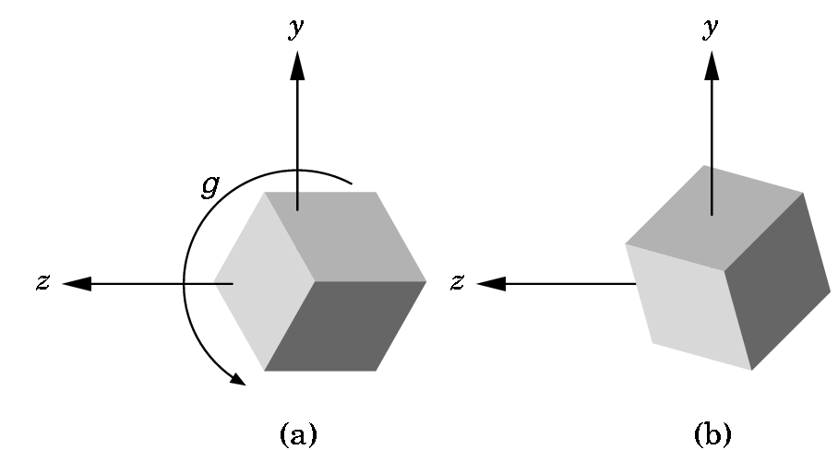
3D x-AXIS ROTATION AROUND ORIGIN
You are looking down the
x-axis which is not shown.
A positive (counter-
clockwise) angle is shown.
Again, the necessary rotation matrix can be defined:
R_{X}(g) = ⎡ 1 0 0 0 ⎤
⎢ 0 cos g -sin g 0 ⎢
⎢ 0 sin g cos g 0 ⎢
⎣ 0 0 0 1⎦

Slide 68
ARBITRARY ROTATIONS IN 3D SPACE
Some can be difficult to determine, but some aren't:
An easy example:
Rotate around the z-axis with P as a fixed point---
Very similar to the 2D situation:
Translate P to the origin T(-P)
Rotate around the z-axis. R_{Z}(Θ)
Translate P back. T(P)
and form the matrix product
T(P) R_{Z}(Θ) T(-P)
Note that the ordering is important.

Slide 69
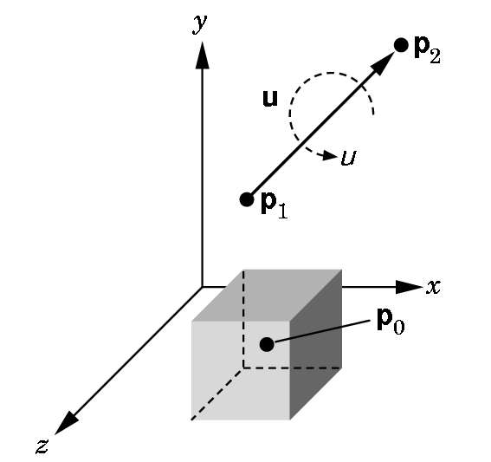
ARBITRARY ROTATIONS IN 3D SPACE
A harder example:
Rotate around an arbitrary axis with an arbitrary fixed point.
Basic idea is simple, but determining the angles can be hard:
1) Translate P₀ to the origin.
2) Align the vector with the z-axis (z is always used) by rotating around the x-axis and then the y-axis.
3) Rotate around the z-axis by the angle desired.
4) Undo (2) and then (1).

Slide 70
ARBITRARY ROTATIONS IN 3D SPACE
1) Translate P₀ to the origin.
--- Form T(- P₀ )
2) Align the vector with the z-axis (z is always used) by rotating around the x-axis and then the y-axis
---Determine the angle ϕ and form R_{X}(ϕ ) ---Determine the angle χ and form R_{Y}(χ). Determining the angles is the hard part.
3) Rotate around the z-axis by the angle desired.
---Form R_{Z}(μ) using the given angle μ.
Form the matrix to be used--- note how we undo the operations---WATCH THE ORDER!
M= T(P₀ ) R_{X} (-ϕ ) R_{Y}(-χ) R_{Z}(μ) R_{Y}(χ) R_{X}(ϕ ) T(- P₀ )

Slide 71
ARBITRARY ROTATIONS IN 3D SPACE
Several different ways of deriving the specific formulas for arbitrary rotation in 3D space:
  a) The method presented here . (See pgs 207-213)
  b) The use of the vector dot product to establish the sine of angle and the use of the vector cross product to determine the cosine of the angle.
  c) The use of quaternions. (See pgs 224-227)
You should be comfortable with using (a) to conceptually establish the formulas. I will not ask you to actually calculate the necessary angles.

Slide 72
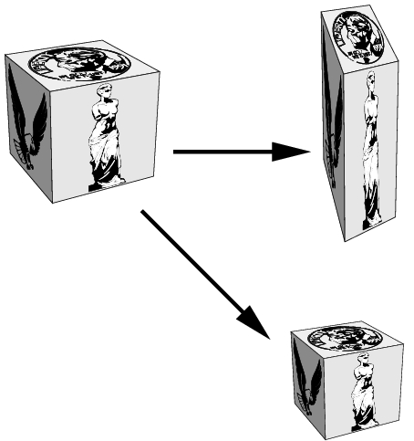
SCALING
Translations and rotations are rigid motions. Our third basic motion is not a rigid motion.
Scaling with respect to a fixed point can stretch or shrink an object and move it relative to that fixed point.

Slide 73
SCALING
The 3D scaling matrix with the origin as the fixed point is given by
S(α_{x,}, α_{y}, α_{z}) = ⎡ α_{x} 0 0 0⎤
⎢ 0 α_{y} 0 0 ⎢
⎢ 0 0 α_{z} 0 ⎢
⎣ 0 0 0 1⎦
The scaling is uniform if all the α are the same.
Each α can be different.
The inverse always exists:
S⁻¹(α_{x,}, α_{y}, α_{z}) = S(1/α_{x,}, 1/α_{y}, 1/α_{z}) unless α = 0. Then just use 0
instead.

Slide 74
2D SCALING EXAMPLES
Vertices are
(4,2), (10,2), (4,4), (10,4)
Uniformly scale by 1/2:
Vertices are
(2,1), (5,1), (2,2), (5,2)
Not only has the rectangle shrunk,
but it has moved closer to the origin.
What happens if you uniformly scale by 2?
What happens if a vertex is on an axis?

Slide 75
2D SCALING EXAMPLES
Vertices are
(4,2), (10,2), (4,4), (10,4)
Scale x by 1/2 and y by 1:
Vertices are
(2,2), (5,2),(2,4),(5,4)
Not only has the rectangle shrunk in the x direction, but it has moved closer to the origin. The y dimension hasn't changed.

Slide 76
SCALING EXAMPLES
As before, to scale with an arbitrary point as a fixed point (x₀,y₀,z₀) we
1) Translate the fixed point to the origin.
2) Scale with respect to the origin
3) Translate the origin back to the original fixed point.
i.e. multiply every point p as below:
T(x₀,y₀,z₀)S(α_{X},α_{Y},α_{Z})T(-x₀,-y₀,-z₀)p

Slide 77
Other 3D Transformations
Only translations, rotations, and scales are required to describe any motion in 3D space. These are called the primitive or basic 3D (or 2D) motions. There are 5 in 3D space and 3 in 2D space.
However, several others are useful to single out.
  3D Reflections
  3D Shears
These are all affine transformations, although they are not the basic (or primitive) affine transformations.

Slide 78
3D Reflections
We can perform reflections relative to a selected reflection axis or with respect to a reflection plane.
Reflections relative to a given axis are equivalent to 180° rotations about that axis.
Reflections with respect to a plane are equivalent to 180° rotations in 4D space.
Rotations around the coordinate planes xy, xz, or yz are the easiest to visualize.
For example, a useful reflection relative to a plane is the conversion of a right-handed coordinate system into a left-handed coordinate system. (See next slide)

Slide 79
A Simple Reflection Relative to a Plane
y
y
Reflection relative to the xy plane
z
x
x
z
M_{zreflect} =
Reflections about other planes can be obtained as a combination of rotations and coordinate-plane reflections.
⎡ 1 0 0 0⎤
⎢ 0 1 0 0 ⎢
⎢ 0 0 -1 0 ⎢
⎣ 0 0 0 1⎦

Slide 80
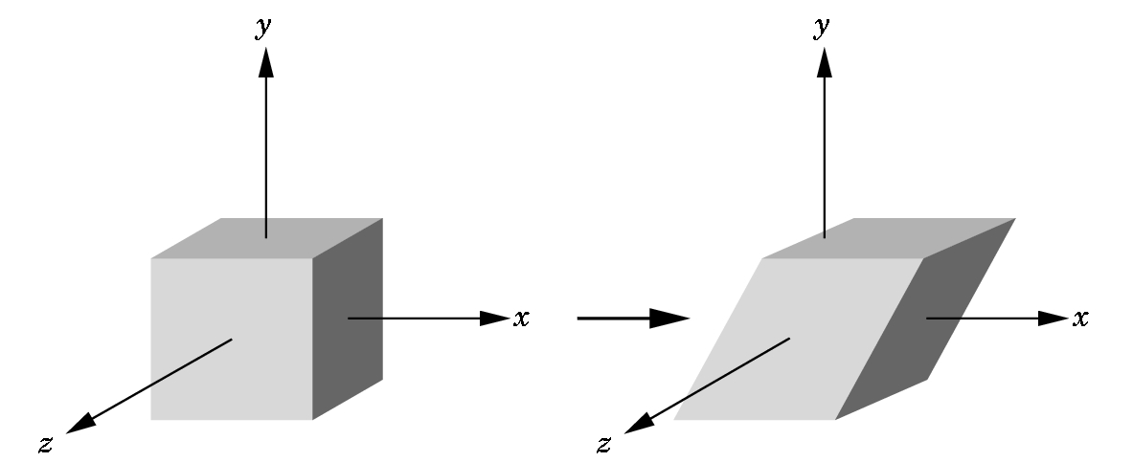
3D Shears
These are not basic affine transformations, but they are important so we deal with them separately:
Each shear is characterized by a single angle Θ which is the angle formed with the axis used for the shear.
In this case, we have an
x-shear. The x-shear matrix is:
x'= x + y cot Θ
y' = y
z' = z
⎡ 1 cot Θ 0 0⎤
H_{X}(Θ) = ⎢ 0 1 0 0⎢
⎢ 0 0 1 0 ⎢
⎣ 0 0 0 1⎦

Slide 81
A BETTER APPROACH TO SHEARS
The general shearing matrix is
⎡ 1 h_{YX} h_{ZX} 0⎤
⎢ h_{XY} 1 h_{ZY} 0 ⎢ where each h_{IJ} is a percentage
⎢ h_{XZ} h_{YZ} 1 0 ⎢
⎣ 0 0 0 1⎦
It can be shown that the matrix above can be obtained as a sequence of affine transformations, but it is usually simpler to load this in GL_MODELVIEW mode directly with
glMultMatrixf(m);
where we have predefined the matrix m using
glFloat m[] = {1.0, h_{YX} , h_{ZX} , 0.0, //row 1
h_{XY}, 1.0, h_{ZY}, 0.0, //row 2
…}
It is interesting to play with the different shears.

Slide 82
Summary – Affine Transformations
Affine transformations preserve lines – i.e. if the endpoints of a line are transformed by an affine transformation and then the line segment between them is drawn, then, equivalently, we could transform all points between and including the endpoints and obtain the same results.
Thus, to transform a polygon, it suffices to transform each of its vertices and then draw the line segments between them.

Slide 83
Summary - Affine Transformations
Translations
Rotations
Scales
Reflections
Shears
The first three suffice to mimic ANY 3D (or 2D) motion as a finite sequence of these three transformations that are composited (i.e. function multiplied.)

Slide 84
Summary - Affine Transformations
Affine transformations transform parallel line segments into parallel line segments and a finite number of points into a finite number of points.
An affine transformation involving only translations, rotations, and reflections preserves angles, lengths, and parallel line segments.

Slide 85
DOING ALL THESE NEAT THINGS IN OPENGL
Modeling a Rotating Cube
3
2
The simplest object we can model is a cube.
We number the vertices so we can refer to them.
There are several decisions we must make.
7
0
1
4
5
1) Will we view this as a primitive object that we manipulate?
2) Will we view this as only a collection of 8 vertices that the hardware manipulates?
OpenGL programming tends to encourage a middle ground- we view this as made up of the six polygons that define the faces , or facets, of the cube.

Slide 86
Modeling a Rotating Cube
3
2
We usually build objects in OpenGL initially at the origin.
So, this cube will be centered at the origin.
The coordinates are chosen to be simple as we can scale in the future.
7
6
0
1
4
5
GLfloat vertices[][3] = {{-1.0,-1.0,-1.0},{1.0,-1.0,-1.0}, {1.0,1.0,-1.0}, {-1.0,1.0,-1.0}, {-1.0,-1.0,1.0}, {1.0,-1.0,1.0}, {1.0,1.0,1.0}, {-1.0,1.0,1.0}};
But, we want to view this as more than a collection of vertices. We want to include the faces.

Slide 87
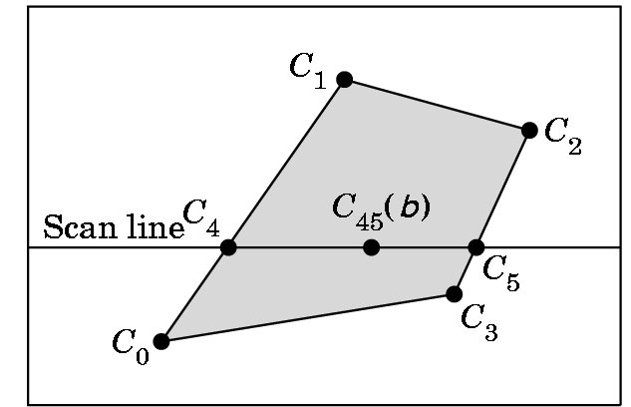
Modeling a Rotating Cube
3
2
7
6
0
1
We model the color cube by selecting colors for the vertices:
4
5
GLfloat colors[][3] = {{0.0,0.0,0.0},{1.0,0.0,0.0},{1.0,1.0,0.0}, {0.0,1.0,0.0}, {0.0,0.0,1.0}, {1.0,0.0,1.0}, {1.0,1.0,1.0}, {0.0,1.0,1.0}};
vertex 0 is black 4 is blue
1 is red 5 is magenta
2 is yellow 6 is white
3 is green 7 is cyan
OpenGL will interpolate the color between the vertices if we model the faces as polygons using a scan-line interpolation algorithm when it draws the polygon.

Slide 88
Modeling a Rotating Cube
3
2
7
We want to capture not only the geometry of the cube, but characteristics of it being a cube (i.e. its topology). So, we wish to convey what is inside and what is outside of the cube.
6
0
1
4
5
For each face, we could traverse the edges in one of two directions.
We will specify the outside of a face by a right hand rule:
7
6
7
6
Curl your right hand in the direction of the arrow. If your thumb is pointing out, you want that traversal in the definition.
4
5
4
5
So, 4,5,6,7 defines the correct side of the face as the outside face. (Or, 5,6,7,4 or 6,7,4,5 or 7,4,5,6 --- any of these will do.)

Slide 89
Modeling a Rotating Cube
Vertex normals (or Gouraud normals) are needed for shading or the interpolation of color.
Gouraud normals are defined as the sum of the normals of the polygons intersecting at a point.
For the cube centered at the origin, they are easy to calculate:
Each vertex normal is positioned from the origin to the vertex of the cube---i.e.
GLfloat normals[][3] = {{-1.0,-1.0,-1.0},{1.0,-1.0,-1.0}, {1.0,1.0,-1.0}, {-1.0,1.0,-1.0}, {-1.0,-1.0,1.0}, {1.0,-1.0,1.0}, {1.0,1.0,1.0}, {-1.0,1.0,1.0}};
glNormal3f(pointer_to_normal) associates the normal with a vertex.

Slide 90
Modeling a Rotating Cube
Now we write a function to define each face and incorporate color into the face:
void polygon(int a, int b, int c , int d)
/* draw a polygon via list of vertices */
{glBegin(GL_POLYGON);
glColor3fv(colors[a]); //change color for vertex a
glNormal3fv(normals[a]); //associate normal with vertex glVertex3fv(vertices[a]); //draw the point

Slide 91
Continuing, we do the other vertices in a similar fashion
glColor3fv(colors[b]);
glNormal3fv(normals[b]);
glVertex3fv(vertices[b]);
glColor3fv(colors[c]);
glNormal3fv(normals[c]);
glVertex3fv(vertices[c]);
glColor3fv(colors[d]);
glNormal3fv(normals[d]);
glVertex3fv(vertices[d]);
glEnd();
}
Note: If you omit the normal code for this example, it will still run correctly as the defaults will be the normals we defined.

Slide 92
Modeling a Rotating Cube
Now we can create the cube as a collection of faces. The ordering
of the vertices in the polygon calls forces the inside-outside orientation on the cube.
void colorcube(void){ /* map vertices to faces */
polygon(0,3,2,1);
polygon(2,3,7,6);
polygon(0,4,7,3);
polygon(1,2,6,5);
polygon(4,5,6,7);
polygon(0,1,5,4);}

Slide 93
Modeling a Rotating Cube
We are only interested in rotation for this program, but the OpenGL affine transformation commands have the form:
  glTranslatef(Xdis, Ydis, Zdis);
  glScalef(Xscale, Yscale, Zscale);
  glRotatef(angle, x, y, z);
    This rotates the angle specified around the vector from the origin to the point (x,y,z) .Positive is counterclockwise as you look from the vector to the origin.
    Although sin and cos are given in radians, glRotatef’s angle is given in degrees.

Slide 94
So, why did we do all that translate-rotate-undo mess when this last command is so simple?
Because, OpenGL performs the calculation as we saw it specified, even though these commands look simple.

Slide 95
Modeling a Rotating Cube
Recall that OpenGL begins with the world frame and the camera frame the same.
Although you will write points as triples and vectors as triples (assuming the tail is at the origin), OpenGL will maintain them as homogeneous coordinates.
Frame changes are made by modifying the current transformation matrix (CTM), a 4 X 4 matrix in OpenGL that represents the cumulative effects of post-multiplying by frame change matrices.
Each affine transformation when invoked, forms the appropriate matrix and post-multiplies the CTM by that matrix ...

Slide 96
A Critical Example
Assume we want to do the actions below in the following order with a box centered at the origin:
scale with respect to the origin by 2 in each direction.
rotate by 90.0 around y-axis
translate by +20, 0, +0
Describe what the result is.

Slide 97
Suppose We Write the Code Below Like This:
drawbox() //draw a box at the origin
glScalef(2.0,2.0,2.0);
glRotatef(90.0,0.0,1.0,0.0);
glTranslatef(20.0,0.0, 0.0);
drawbox(5) //draw a box
What happens if we assume we are in Modelview mode with the matrix originally equal to the identity?
The above commands do not move the box. First a box is drawn at the origin.
Each affine transformation command forms the appropriate matrix and post-multiples the Modelview matrix.
Thus, the following matrix is formed:
I*S(2,2,2)R_{y}(90,0,1,0)T(20,0,0) = M
When each vertex of the second box is to be rendered, it is first multiplied by M.
So, in what order are the motions made?

Slide 98
Code Correctly Doing the Desired Motions
glMatrixMode(GL_MODELVIEW); //select mode
glLoadIdentity(); //start with identity
glTranslatef(20,0,0); //Start with the LAST one
glRotatef(90.0,0.0,1.0,0.0);
glScalef(2.0,2.0,2.0); //End with the FIRST one
drawbox();
The matrix formed will be
M = I*T(20,0,0) R(90,0,1,0) S(2,2,2)
Any vertex p specified after M is formed will be transformed to
q = Mp

Slide 99
MOVING MORE THAN ONE OBJECT TO DIFFERENT LOCATIONS
The last matrix loaded into the current transformation matrix determines what is applied to subsequent points.
Example: Two objects are centered at the origin. Move one 10 units along the positive x-axis and one independently of the other 15 units along the negative y-axis.
Klutzy way:
translate 10 units in x
draw 1st object
translate back to origin
translate 15 in y
draw 2nd object
Better way: Use a stack
A stack is a data structure logically viewed as a list with a distinguished end called a top and several operations:
Push something- inserts something at the top into the stack
Pop- removes the top something from the stack and makes it the current transformation matrix

Slide 100
MOVING MORE THAN ONE OBJECT TO DIFFERENT LOCATIONS
The type of code needed:
glMatrixMode(GL_MODELVIEW); //Get in right mode
glPushMatrix(); //store old Modelview matrix
glLoadIdentity(); //Start with identity matrix
glTranslatef(10.0,0.0,0.0);
//code to draw 1st object here
//glPushMatrix(); optional- only if want to use later
glLoadIdentity();
glTranslatef(0.0,15.0,0.0); //Can do more than one
//code to draw 2nd object here
glPopMatrix(); //May need more than one
//if you pushed the optional one
//Now you are back to the old matrix

Slide 101
Return to Modeling a Rotating Cube
The frame buffer is called the color buffer in OpenGL.
It's used to hold the image being displayed if single buffering is being used.
The depth buffer (or z-buffer) in OpenGL is used to store information needed to allow for hidden surface removal. (We'll see how this is done later).
With animation, we want double buffering and automatic depth
handling. So, we need in main:
glutInitDisplayMode(GLUT_DOUBLE | GLUT_RGB | GLUT_DEPTH);
glEnable(GL_DEPTH_TEST); // Enable hidden--surface--removal
and before drawing we need to clear the frames:
glClear(GL_COLOR_BUFFER_BIT | GL_DEPTH_BUFFER_BIT);

Slide 102
Modeling a Rotating Cube
Actual spin - at last!
Mouse click chooses axis of rotation:
void mouse(int btn, int state, int x, int y){
/* mouse callback, selects an axis about which to rotate */
if(btn==GLUT_LEFT_BUTTON && state == GLUT_DOWN) axis = 0; //x
if(btn==GLUT_MIDDLE_BUTTON && state == GLUT_DOWN) axis = 1; //y
if(btn==GLUT_RIGHT_BUTTON && state == GLUT_DOWN) axis = 2; //z
}
If you have only two buttons, you can change to keyboard control:
void keys(unsigned char key, int x, int y)
//Change so middle button is not needed
{
if (key == 'x') axis = 0; // select x axis
if (key == 'y') axis = 1; // select y axis
if (key == 'z') axis = 2; // select z axis
display();
} //and don't forget to register keys

Slide 103
Modeling a Rotating Cube
The idle callback, spincube, sets
theta[axis] += 2.0;
and adjusts this if the angle becomes greater than 360 degrees.
Then the idle callback calls display which does the drawing.
Note that a callback function CAN be invoked ….
void spinCube(){
/* Idle callback, spin cube 2 degrees about selected axis */
theta[axis] += 2.0;
if( theta[axis] > 360.0 ) theta[axis] -= 360.0;
display(); }

Slide 104
Modeling a Rotating Cube
All that remains is the reshape function which we have seen before:
void myReshape(int w, int h){
glViewport(0, 0, w, h);
glMatrixMode(GL_PROJECTION);
glLoadIdentity();
if (w <= h)
glOrtho(-2.0, 2.0, -2.0 * (GLfloat) h / (GLfloat) w,
2.0 * (GLfloat) h / (GLfloat) w, -10.0, 10.0);
else
glOrtho(-2.0 * (GLfloat) w / (GLfloat) h,
2.0 * (GLfloat) w / (GLfloat) h, -2.0, 2.0, -10.0, 10.0);
glMatrixMode(GL_MODELVIEW);
}
Note- this is still an orthographic projection which looks fine.

