Slide 1
Chapter 5
Classical and Computer Viewing

Slide 2
MATRICES ALL OVER
Most OpenGL programmers quickly become familiar with the modelview and projection matrices.
The modelview matrix controls the viewing and modeling transformations for your scene.
The projection matrix defines the view frustum and controls how the 3D scene is projected into a 2D image.
Another matrix, the texture matrix allows you to transform texture coordinates to accomplish effects such as projected textures or sliding a texture image across a geometric surface. We will look at it later.
A single set of matrix manipulation commands controls all of the OpenGL matrices: glScalef, glTranslatef, glRotatef, glLoadIdentity, glMultMatrixf, and several other commands.

Slide 3
MATRICES ALL OVER
For the efficient saving and restoring of a matrix state, OpenGL provides the glPushMatrix and glPopMatrix commands; each matrix type has its own stack of matrices.
None of the matrix manipulation commands have an explicit parameter to control which matrix they affect. Instead, OpenGL maintains a current matrix mode that determines which matrix type the previously mentioned matrix manipulation commands actually affects.
To change the matrix mode, use the glMatrixMode command.

Slide 4
MODEL TO SCREEN
All of the phases in moving from the model to the screen involve matrices, some of which the programmer specifies without realizing matrices are involved.
Many of the matrices are developed mathematically in the text, but we will not develop them right now.
Be aware, however, that they exist at each stage of the viewing pipeline .
Different graphics packages use different pipelines. We’ll investigate why and how later.

Slide 5
THE TRUE VIEWING PIPELINE
Each phase is represented by a matrix:
p_{MC} --------------------> Modeling-----------> p_{WC}-----------
(original vertex) Transformation (world coordinate)
-----> Viewing----------------> p_{VC}----------------> Projection------
Transformation (viewing coordinates) Transformation
-----> p_{PC} ----------------> Normalized --------------> p_{NC}--------
(projection Transformation ( normalized
coordinates) and Clipping coordinates)
----> Viewport ---------> p_{DC}
Transformation (device coordinates)

Slide 6
The Various Coordinate Systems
Modeling coordinates (MC): The coordinate system around the origin, typically, that the modeler uses to first define an object.
Modeling Transformations (i.e. scales, translates, and rotates) change these into:
World coordinates (WC): The coordinate system in which the user and programmer models objects and scenes.
Viewing Transformations place the camera (or eye) in the desired location, decide what parts of the scene are to be seen, and, consequently, change these into:

Slide 7
Viewing coordinates (VC) : Also called camera coordinates or eye coordinates. The coordinate system with the eye or camera at the origin and a viewing volume defined with a projection plane (the camera view plane) selected.
A Projection Transformation maps the viewing coordinates into :
Projection Coordinates (PC) : After the projection, these are the 2D coordinates on the projection plane.

Slide 8
Normalization Transformation and Clipping maps the projection coordinates to normalized coordinates and clips the scene.
Normalized Coordinates (NC) are 2D coordinates with
0.0 <= x,y <= 1.0
This intermediate step allows us to achieve device independence in our software.
Last, we finish out the pipeline by
Viewport Transformations which map normalized coordinates to the specific display device to obtain
Device Coordinates (also called screen coordinates).

Slide 9
Don't assume, however, that a point is actually transformed one step at a time. Some of these matrices are multiplied into the current state matrix as they are specified. Some transformations can be performed in hardware on some machines.
Although this is a general 3D transformation pipeline, there are other orderings that can be done.
We will explore the issues with different orderings later.

Slide 10
THE TRUE VIEWING PIPELINE - review
Each phase is represented by a matrix:
p_{MC} --------------------> Modeling-----------> p_{WC}-----------
(original vertex) Transformation (world coordinate)
-----> Viewing----------------> p_{VC}----------------> Projection------
Transformation (viewing coordinates) Transformation
-----> p_{PC} ----------------> Normalized --------------> p_{NC}--------
(projection Transformation ( normalized
coordinates) and Clipping coordinates)
----> Viewport ---------> p_{DC}
Transformation (device coordinates)

Slide 11
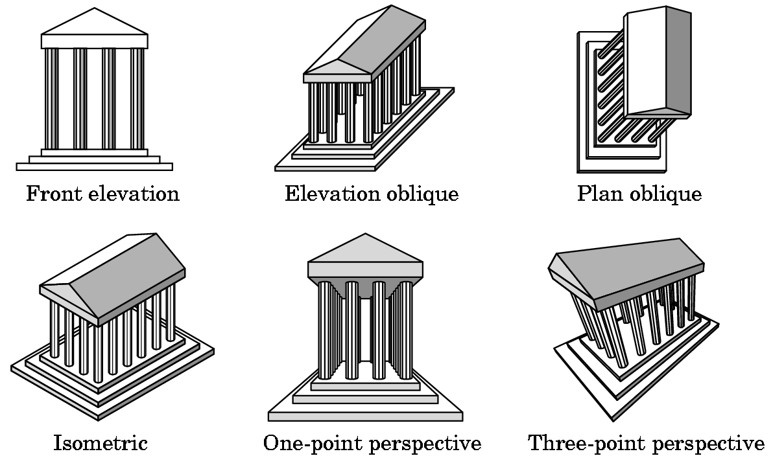
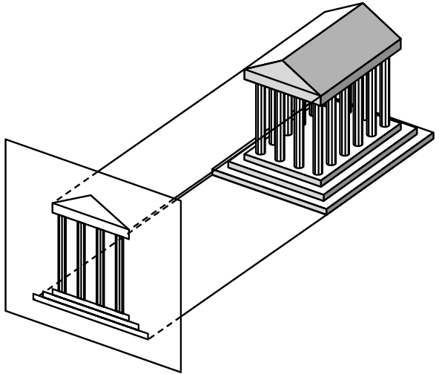
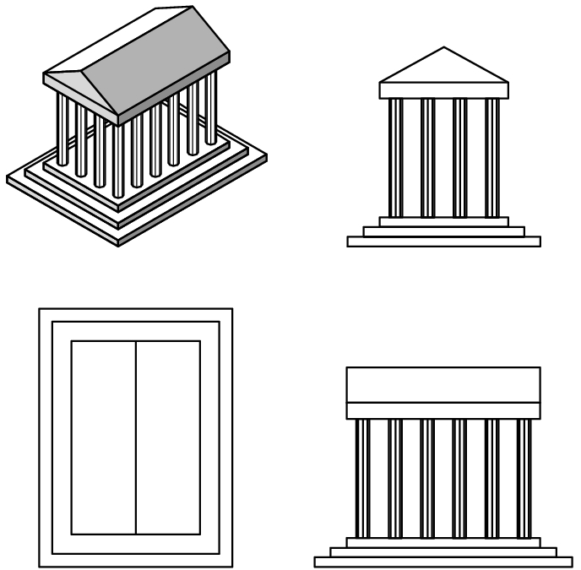
PROJECTION
Many kinds of projections exist. These can be developed in OpenGL, but only two kinds are supported directly:
orthographic
1-point perspective
We have been using the orthographic projection:

Slide 12
OpenGL Defaults
OpenGL starts with the camera at the origin with it pointing in the negative z direction –(i.e. in this initial setting, its as if you were looking into the screen.)
The camera is set up for an orthogonal view and has a viewing volume that is a cube centered at the origin and with sides of length 2.
The default projection plane is the z = 0 plane and the direction of the projection is along the z-axis.
Thus, anything in this box will be projected and made visible if the orientation of the object is OK.
In this case, the model-view and projection matrices are both the identity.
To obtain other views, we manipulate these matrices.

Slide 13
Creating a World
We will build our world as follows:
  Define an object at the origin and align it with the x,y, and z axis.
  Use the scale, rotate, and translate matrices to "move" the object to where we wish it to reside.
  Create the viewing volume we desire by setting the projection matrix we desire.
  Render.
Note- for debugging sake, it is often useful to use an orthographic projection as it is easy to define.

Slide 14
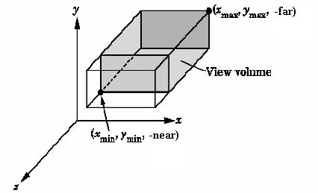
VIEWING VOLUME FOR ORTHOGRAPHIC PROJECTION
There is no restriction
on far and near other
than that far > near.
Normally far and near
are positive.
You can view them as
distances from the eye.
Set using
glOrtho(xmin, xmax,ymin,ymax,near,far);

Slide 15
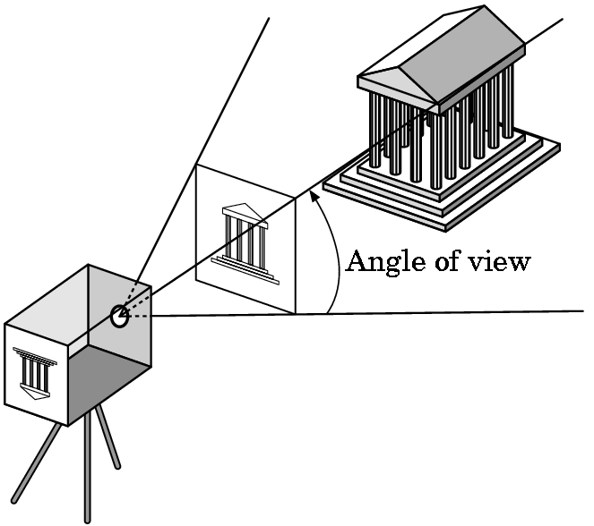
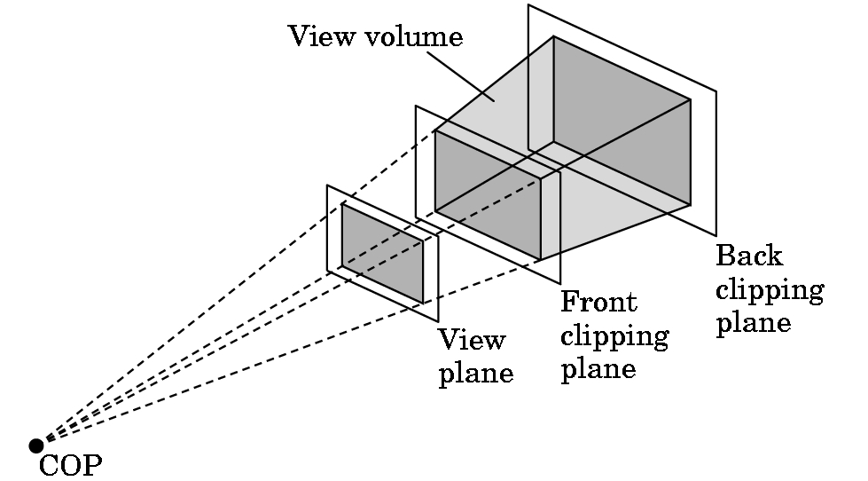
(1-point) PERSPECTIVE PROJECTION
Basic idea for defining the view volume:
Again, we have a front and back clipping plane:
COP = center of projection

Slide 16
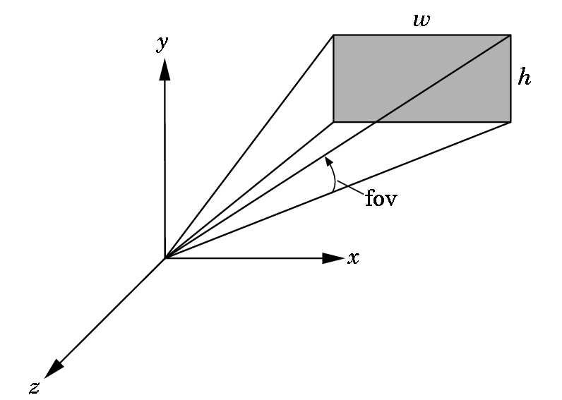
PERSPECTIVE PROJECTION
OpenGL has two functions for specifying perspective views.
The simplest one to use specifies the field of view (fov) as the angle between the top and bottom planes:
The function is:
gluPerspective(fov, aspect, near, far);
Near and far are as with glOrtho.
The aspect ratio is the value of w/h.

Slide 17
gluPerspective(fov, aspect, near, far);
Typical values for field of view are between 60 to 30 degrees.
The larger the value, the greater the apparent depth effect.
Try experimenting with the value, however, as you can achieve some interesting effects with it---like changing the lens on a camera. A wide angle lens is the same as a wide field of view.
Note that when the window is resized, the new width and height are provided so this function can easily be used to maintain the correct aspect ratio.

Slide 18
gluPerspective(fov, aspect, near, far);
Choosing values for near and far:
Don't choose these too far apart. Why?
The values in the depth buffer are normalized to the range 0.0 to 1.0.
The smaller the values that must be represented, the better differentiation that will occur in the calculated depth of objects.
If the far/near ratio isn't small, you might see round-off errors in the z-values. This produces z-fighting where pixels from various polygons that are close to the same depth are intermixed in the image.
But, if you don't see anything, spread your near and far apart. It is easy to choose poor values.

Slide 19
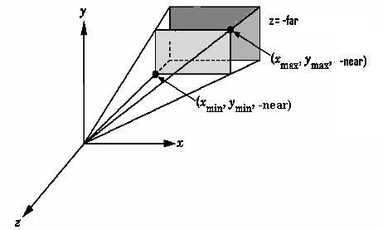
THE OTHER PERSPECTIVE COMMAND
The more powerful and more difficult to use command:
glFrustrum(xmin,xmax,ymin,ymax,near,far);
The near and far distances must be positive and are
measured from the COP to these planes, both of which must be parallel to the plane z = 0.

Slide 20
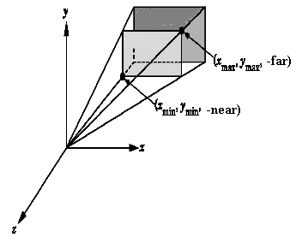
glFrustrum(xmin,xmax,ymin,ymax,near,far);
This is more powerful as you can have nonsymmetric viewing volumes.
Why is this useful?
For example, you might have the interior of a cockpit modeled, with two cockpit windows split by a vertical support.
Then you could have the left frustrum specify a distance -x as the left parameter and 0 as the right. The right frustrum could specify 0 as the left and x as the right. Then use two viewports to obtain the view.

Slide 21
WHEN DO WE SET THE PERSPECTIVE?
Changes to the model-view matrix move the world frame relative to the camera.
These changes affect the camera's view of all objects defined afterwards as their vertices are specified relative to the repositioned world frame.
The projection and model-view matrices are part of the state.
When an object is drawn, the system uses the present state to obtain the matrices to apply to it.
Thus, in reality, we change the state and then draw an object even though we might be imagining we are moving the object!

Slide 22
A TYPICAL SEQUENCE
glMatrixMode(GL_PROJECTION);
/* Now update the projection matrix. */
glLoadIdentity();
glFrustum(-3.0, 3.0, -3.0, 3.0, 1.0, 40.0);
glMatrixMode(GL_MODELVIEW);
/* Now update the modelview matrix. */
glPushMatrix(); //save old one
glLoadIdentity();
glTranslate(0.0, 0.0, -2.0);
//recall the next transformation is done first
glRotatef(-90.0, 0.0, 1.0, 0.0); //rotate around y-axis //negative 90 degrees
render(); //a drawing routine
glPopMatrix(); //restore old Modelview matrix

Slide 23
MASTERING THE MODELVIEW MATRIX
Individually the transformations are easy to visualize.
Visualizing their interactions takes some practice.
Standard Example: Introduced in the original OpenGL Programming Guide:
  We want to model part of the solar system.
  Place sun in the center.
  The earth will rotate around the sun in a circular orbit in 365 days.
  The earth will rotate around its own axis in 24 hours.
  The moon will rotate around the earth in a circular orbit in 1/12 of year.
  The moon will rotate around its own axis, but it keeps its same side to the earth.
  We want the plane of the elliptic to be tilted slightly.

Slide 24
Handling Motion Successfully
Understanding the solar system example will help you immensely in programming animation in OpenGL!!
Observe that several objects are being positioned independently.
The earth is rotating around the sun; the moon is rotating around the earth; and, of course, the moon is rotating around the sun, also.
Rotations are taking place in the elliptic plane as well as self-rotations of the moon and earth around their own axis.

Slide 25
A Simple Example – A Flying Sphere
void display(void)
/* Orbit starts at 0 and day at 0. By hitting 'r' key,
the rotation is increased by 5 (mod 360). By hitting 'o'
key, the orbit is increased by 10 (mod 360) */
{glClear(GL_COLOR_BUFFER_BIT);
glColor3f(1.0,1.0,0.0);
glPushMatrix();
glRotatef(45.0,1.0,0.0,0.0); //rotate center sphere to
//show better
glutWireSphere(1.0,10,12); //draw center sphere

Slide 26
Continued - display
glRotatef((GLfloat) orbit,0.0,1.0,0.0);
glTranslatef(2.0,0.0,0.0);
glRotatef((GLfloat) rotation,0.0,1.0,0.0);
glColor3f(0.0, 1.0,1.0);
glutWireSphere(0.5,10,8); //draw second sphere
glPopMatrix();
glutSwapBuffers();
}

Slide 27
Reshape code
void reshape (int w, int h)
{
glViewport(0,0,(GLsizei) w, (GLsizei) h);
glMatrixMode(GL_PROJECTION);
glLoadIdentity();
gluPerspective(60.0, (GLfloat) w/ (GLfloat)h, 1.0, 10.0);
glMatrixMode(GL_MODELVIEW); //restore default
glLoadIdentity();
gluLookAt(0.0, 0.0, 5.0, 0.0, 0.0, 0.0, 0.0, 1.0, 0.0);
}

Slide 28
SOLAR SYSTEM PROGRAM LAYOUT
Main- as usual
  Double buffer
  Set up window on screen with title
  Call the initialization routine
  Register callback functions
  Enter main event loop.
Initialization Routine
  Set shading model (which we haven't talked about yet)
  Set background color
  Set depth buffer
  Enable depth testing

Slide 29
SOLAR SYSTEM PROGRAM LAYOUT
RESHAPE
  Set viewport
  Set perspective
For example:
h = (h==0) ? 1 : h; //set defaults
w= (w==0) ? 1 : w;
glViewport(0,0,w,h); //display in entire window
glMatrixMode(GL_PROJECTION);
glLoadIdentity();
gluPerspective(45.0f,(GLfloat)w/(GLfloat)h, 1.0f, 20.0f);
glMatrixMode(GL_MODELVIEW); //good idea to do here
//before you forget!
need gluLookAt set here also.

Slide 30
SOLAR SYSTEM PROGRAM
//animation values
static int HourOfDay=0, DayOfYear = 0;
static int AnimateIncrement = 24;
// can be sped up or slowed down by mouse buttons
void mouse(int btn, int state, int x, int y)
{
// Changes animation speed
if(btn==GLUT_LEFT_BUTTON && state == GLUT_DOWN)
{ AnimateIncrement *=2;
if (0 == AnimateIncrement) AnimateIncrement = 1;
}
if(btn==GLUT_RIGHT_BUTTON && state == GLUT_DOWN)
AnimateIncrement /=2;
}

Slide 31
SOLAR SYSTEM PROGRAM---display
// clear the frame and depth buffers
glClear(GL_COLOR_BUFFER_BIT | GL_DEPTH_BUFFER_BIT);
//update animation parameters
HourOfDay += AnimateIncrement;
//see previous slide for values and use
DayOfYear += HourOfDay/24;
HourOfDay = HourOfDay % 24; //keep in bounds
DayOfYear = DayOfYear % 365;
// tilt the elliptic plane and back the camera off the origin
glLoadIdentity();
glTranslatef(0.0f, 0.0f,-5.0f); //watch the order
glRotatef(5.0f, 1.0f, 0.0f, 0.0f); //5° around x-axis

Slide 32
Display - Continued
// select color for sun and draw the sun as wireframe
glColor3f(1.0f, 1.0f, 1.0f); //assuming white sun
draw(1.0f); //a routine for drawing a sphere with radius 1
// move coordinate system to the location of earth
//and rotate in orbit
glRotatef( (GLfloat) (360.0*DayOfYear/365.0, 0.0f, 1.0f, 0.0f);
glTranslate(4.0f, 0.0f, 0.0f); //again, watch order
glPushMatrix(); //save so we can handle moon later
//but, modelview matrix stays same
//rotate the earth - note this will be done first, then the above
glRotatef((GLfloat) 360.0*HourOfDay/24.0, 0.0f, 1.0f, 0.0f);

Slide 33
Display- continued
//select color and draw earth
glColor3f(0.2f, 0.2f, 1.0f); //predominately blue- touch of yellow
draw(0.2f);
glPopMatrix(); //restore coordinate system for moon
//translate moon relative to earth and rotate it before drawing
glRotatef((GLfloat) 360.0*12.5*DayOfYear/365.0, 0.0f, 1.0f, 0.0f);
glTranslate(0.5f, 0.0f, 0.0f);
glColor3f(0.3f, 0.3f, 0.3f); //grey color
draw(0.05f);
//then flush pipeline and swap buffers //NOW all goes on screen

Slide 34
Handling Motion Successfully
Understanding the solar system example will help you immensely in programming animation in OpenGL!!
Observe that several objects are being positioned independently.
The earth is rotating around the sun; the moon is rotating around the earth; and, of course, the moon is rotating around the sun, also.
Rotations are taking place in the elliptic plane as well as self-rotations of the moon and earth around their own axis.

Slide 35
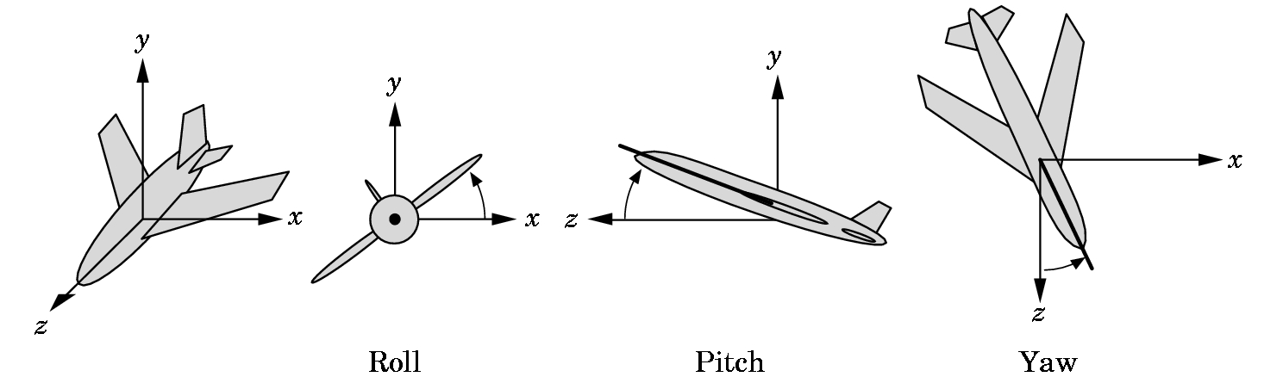
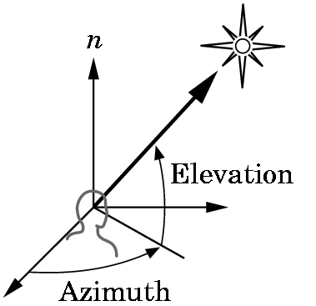
POSITIONING THE CAMERA
There are several ways to do this.
  Solar system example- an example of instance transformations that we discussed
  LookAt vector method- more on this shortly
  Two other methods we won’t explore:
    Motion in terms of roll, pitch, and yaw of an airplane
    Motion in terms of polar coordinates

Slide 36
POSITIONING THE CAMERA
OpenGL directly supports only some of the methods.
Other methods can be obtained if the programmer wishes to load the necessary matrices directly.
We must be careful when doing animation. Where in a program we define the position of the camera depends on which of the following we choose:
  Do we want to place the camera in a fixed position in a scene?
  Do we want the camera attached to a particular object?

Slide 37
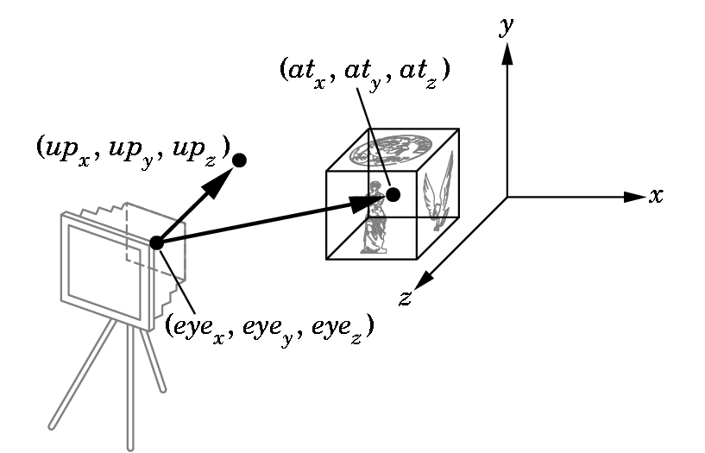
POSITIONING THE CAMERA with gluLookAt
The concept is simple and allows us to move our camera relative to an object:
gluLookAt(eyex, eyey, eyez, atx, aty, atz, upx, upy, upz);
Alters the modelview matrix for a camera pointed along the
given line.

Slide 38
Changing gluLookAt Allows Us to Have Camera Motion
To pan along a scene:
  Take the At point to be in a particular place.
  Calculate the eye to be a distance from that point.
  Then vary the At point to produce the pan.
To walk through a scene:
  Vary the gluLookAt function allowing the at vector to center on different objects.

Slide 39
What We Are Skipping in Chapter 5 Now
The derivation of the 4 X 4 matrices for doing orthographic or 1-point perspective projections. Parts of Section 5.4, 5.8, and 5.9 dealing with the derivations
Hidden-surface removal – we'll do this in Chapter 8 along with other algorithms - Section 5.6
Interactive Mesh Displays – Section 5.7.1, 5.73
Projections and shadows – we'll do this in Chapter 6 - Section 5.10

