Slide 1
Shading

Slide 2
Warnings
Shading in OpenGL and other graphics languages is hard because you have to get all of the following correct:
  Light sources
  Materials
  Surface normals
If any one of them is wrong, things do not look right.
The key is to keep things simple and experiment with one thing at a time.

Slide 3
Warnings
Another complication is that when you use transformations to place objects or move them, you also can affect
  The positions of your lights
  The normals you have defined.
The shading model you choose also affects the final rendering.
And, when you introduce texturing, everything can become messed up again!

Slide 4
LIGHT SOURCES

Slide 5
Lights
How is light scattered or reflected from a surface?
In graphics, we typical use several kinds of lights:
  ambient light - light reflecting off of other surfaces
  point light sources - lights that shine on objects
  emissive light sources – materials that self-glow
The amount of light reaching the synthetic camera must be calculated.

Slide 6
OpenGL Provides Two Types of Light Sources Although Others Can Be Simulated
Directional –
  Considered to be an infinite distance away from the objects in the scene.
  Its rays are considered parallel by the time they reach the object.
Positional –
  Is near or within the scene
  The direction of its rays are taken into account in lighting calculations.
  These lights have a greater performance cost than directional lights due to additional calculation required.

Slide 7
Light In Real World
Overview
RGB values for a pixel are not enough to give realistic pictures.
Need to handle light.
An object either
  emits light --- for example, a taillight
  or is illuminated by one of the different kinds of light
    ambient light
    diffuse light
    specular light

Slide 8
AMBIENT LIGHT
Doesn't come from a particular direction.
Has a source, but has bounced around so much it is directionless.
The intensity is the same at every point on the surface.
Often achieved through large sources that shine through a diffuser that scatters light in all directions.
Affects all polygons independent of their position, orientation, or viewing angle.
Typical examples are light from:
a cloudy day
moonlight
sunlight scattered by fog or haze

Slide 9
DIFFUSE LIGHT
Comes from a particular direction, but it is reflected evenly off of a surface.
Although the reflection is even, the surface is brighter if the light is pointed directly onto the surface rather than on an angle.
Thus, the position and incident angle of a polygon affects the light.
Examples are:
all area lights
fluorescent lighting
noon sunlight streaming in a side window

Slide 10
Specular Light
Directional like diffuse light, but it is reflected sharply and in a particular direction.
A high specular light often leaves a highlight on an object called the specular highlight.
Examples of producing specular light:
spotlight
sun beam
Although diffuse and ambient lights are independent of the material, the specular light depends strongly on the material and especially its shininess.

Slide 11
Emissive Light
Materials may have an emissive color which simulates light originating from an object.
In the OpenGL lighting model, the emissive color of a surface adds intensity to the object.
However, the emissive color is unaffected by any light sources and is present even with no other light.
Nor does the emissive color introduce any additional light into the overall scene.
Examples:
  taillights
  fireflies

Slide 12
Lighting- some facts
When light strikes an object, some of it is reflected and the rest is absorbed as heat.
For example, a red surface absorbs all of the light components except the red ones which are what your eye sees. Color is really a reflection property.
Moreover, light is made up of different parts of the
3 types:
specular
diffuse
ambient

Slide 13
An Example
Consider: A Red Laser Beam In A Laboratory
Composed almost entirely of a pure red specular component of the light.
• But, smoke or dust particles scatter the beam so it
can be seen traveling across the room. Scattering
represents the diffuse component of the light.
• If the beam is bright and no other light sources are
present, you might notice objects in the room
taking on a red hue. This would be a very small
ambient component of the light.

Slide 14
An Example
A Red Laser Beam In A Laboratory
In OpenGL, and many graphics packages, we can specify the different components of light for each gun by specifying a number in the range of 0.0 (none) to 1.0.
For the red laser beam in a laboratory, the laser light
source may be specified as:
  green and blue guns have components of 0.0
  the red gun might be:
    specular 0.99 - pure red for gun
    diffuse 0 .10 - scattering due to dust and smoke
    ambient 0.05 - red hue on other objects

Slide 15
Specifying Light Sources In Opengl
You can specify 8 light sources named GL_LIGHT0 to GL_LIGHT7.
Properties of the light sources are specified using: glLightfv(sourcename, propertyname, vectorsettings);
After setting the properties you must enable each light: glEnable(GL_LIGHT0);
Each light source you use requires both commands.

Slide 16
Specifying Light Sources In Opengl
glLightfv(sourcename, propertyname, vectorsettings)
Some of the property names and values to specify are:
  GL_AMBIENT R,G,B,alpha components as GLfloats
  GL_DIFFUSE “
  GL_SPECULAR “
  Use 1.0 for alpha component for now

Slide 17
Specifying Light Sources In Opengl
glLightfv(sourcename, propertyname, vectorsettings)
  GL_POSITION A homogeneous coordinate. Use 0 in last slot for a true position; use 1 for infinitely far away. GL_SPOT_DIRECTION vertex of vector
  GL_SPOT_CUTOFF angle cutoff to allow a true spot. If not used, it defaults to 180 degrees.

Slide 18
Good Sources Of Examples You Can Run And Look At The Code
On web site: lightlab.c and spots.c
Example in lightlab:
Glfloat ambient[] ={0.3f, 0.3f, 0.3f, 1.0f};
Glfloat diffuse[] ={0.7f, 0.7f, 0.7f, 1.0f};
Glfloat pos[] ={ -50.0f, 50.0f, 100.0f, 1.0f};
glLightfv(G L_LIGHT0, GL_AMBIENT, ambient);
glLightfv(GL_LIGHT0, GL_DIFFUSE, diffuse);
glLightfv(GL_LIGHT0, GL_POSITION, pos);
glEnable(GL_LIGHT0);
Gives a moderately white light, upper left, slightly behind
the viewer (at origin looking down the -z axis)
To model bright sunlight,
add a specular component of 1,1,1,1.

Slide 19
Material Properties

Slide 20
Material Properties
Light Properties Are Not Enough
Given a light, different materials reflect the light differently.
Material settings are set as with light settings:
  glMaterialfv(whichfaces, property, settings);
Properties are GL_DIFFUSE, etc.
plus GL_SHININESS in the range 1 to 128.
Which faces are GL_FRONT, GL_BACK,
GL_FRONT_AND_BACK
As with all OpenGL commands, before you draw an
object, set its material properties and be sure your
light properties are set.

Slide 21
Diffuse Reflector
Brightness Depends Upon:
The components of white light it reflects.
The strength of the ambient and direct light striking the surface.
The position of the direct light sources.
The orientation of the reflecting surface relative to the direct light source.
The type of surface.
Note: Reflected light is scattered in all directions for a
diffuse surface.
Matte surfaces such as flat paint and ordinary paper
are predominately diffuse reflectors.

Slide 22
SPECULAR REFLECTOR
BRIGHTNESS DEPENDS UPON:
The strength of directional light sources.
The position of directional light sources.
The orientation of the surface with respect to the light sources.
The position of the viewer.
The surface roughness.
Note: Highlights are the result of light being scattering in a narrow range of angles close to angle of reflection.
A mirror is an example of a perfect specular reflector.
Shiny plastic exhibits both diffuse and specular reflection,
but the specular component is high.

Slide 23
Translucent Surfaces
Allow some light to penetrate the surface and emerge from another location on the light.
Some light might be reflected at the surface.
Water and glass are translucent surfaces.
Translucent properties are set somewhat with the alpha channel, the fourth component in the color settings. We'll discuss details of these settings shortly.

Slide 24
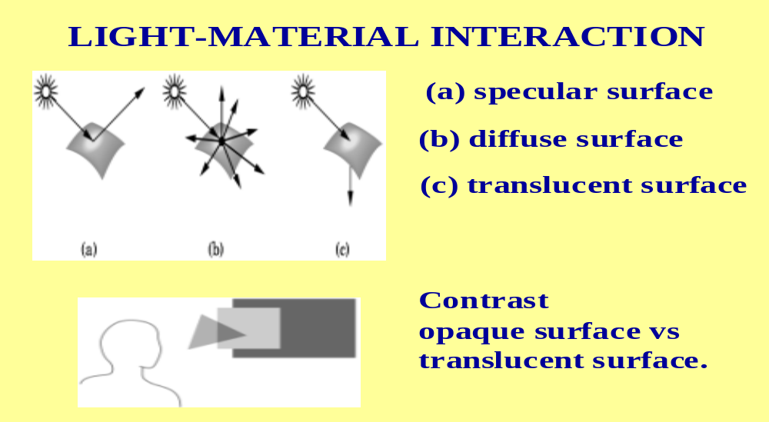
Interactions Of The Settings

Slide 25
Choosing Values For Light And Materials
Light:
    1.0 brightest
    0.5 half intensity
    0.0 none
Material:
    1.0 reflects the color completely
    0.5 reflects half the color
    0.0 reflects none of the color

Slide 26
Material Settings Determine Whether An Object "Looks Right" Or Not
Brass:
    0.33, 0.22, 0.03, 1.0 ambient
    0.78, 0.57, 0.11, 1.0 diffuse
    0.99, 0.91, 0.81, 1.0 specular
    27.8 shininess
Red plastic:
    0.0, 0.0, 0.0 ambient
    0.5, 0.0, 0.0 diffuse
    0.7, 0.6, 0.6 specular
    32 shininess

Slide 27
Selecting Material Properties
Ambient light: Defines the dominant color when no direct light is on that part of the surface.
Diffuse light: Defines the dominant color when the surface is illuminated.
For most physically-based materials or real-world materials these are similar values.

Slide 28
Selecting Material Properties
Specular light: Determines the color of the highlights shown.
Colored glass with white light on it has highlights the same color as the glass. So, set this to the same as the object's ambient and diffuse light.
But, highlights for chrome reflect the color of the light shining on it. So set this to the same as the light's color.
Shininess: Controls the focus of the highlight. A low value spreads the reflection over the surface while a high value concentrates the highlight making it smaller and brighter.

Slide 29
Shading Models

Slide 30
Shading Model
A shading model dictates how light is scattered or reflected from a surface.
The amount of light that reaches the eye is dependent upon many things:
  geometry of the surface specified, for example, by
    normal n to surface at a point p
    vector from p to viewer's eye
    vector s from p to light surface
  nature of the material
  the components of the light
  the shading model chosen

Slide 31
Shading Models
Many have been proposed over the years.
Some are not supported in OpenGL:
  ray tracing
  radiosity - works with diffuse reflections only. Considers the radiant-energy interactions between all surfaces in scene. This is very computationally intensive.
Others are involved with the ways in which polygons are rendered:
    Constant shading
    Faceted shading
    Gouraud shading
    Phong shading
Shading models dictate how often the color computation is performed.

Slide 32
SHADING ALGORITHMS
Constant shading
  simplest, but not realistic
  give same color to every polygon
Faceted shading
  determine orientation
  do one color computation per polygon
Gouraud shading
  averages color over intersecting polygons
  blends color along the edges of polygons by interpolation
Phong shading
  does a color calculation for every pixel based on the lighting model used

Slide 33
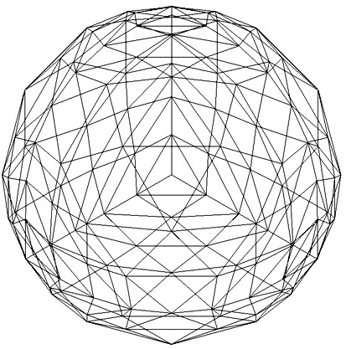
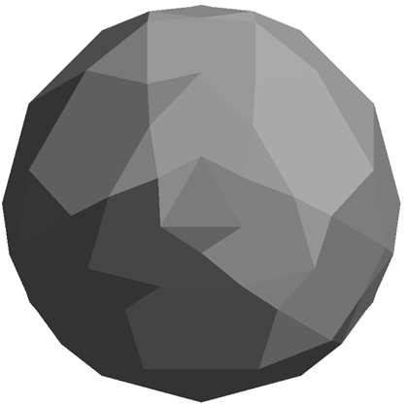
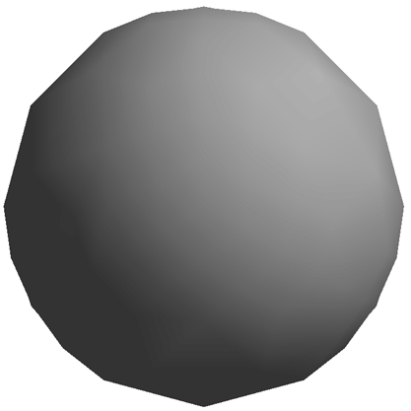
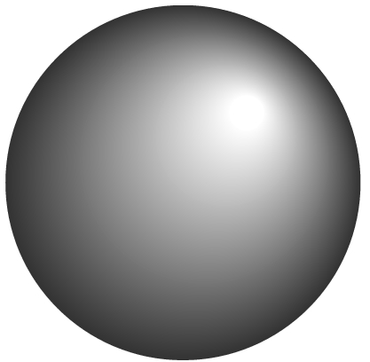
SHADING ALGORITHMS
wireframe
faceted
Phong
Gouraud

Slide 34
Faceted (Or Flat) Shading
For a given polygon, use the normal of one vertex to do the color calculations.
In OpenGL, specify with
glShadeModel(GL_FLAT);
OpenGL uses the first vertex encountered on the polygon for the calculation.

Slide 35
Gouraud Shading
x
Setting at
a is the average of settings at x and y;
b is the average of settings at y and z
w is the average of settings at a and b
a
w
•
b
y
z
Algorithm:
Compute the vertex normals (average of normals
of the intersecting faces).
Apply the model to each vertex to get the settings.
Linearly interpolate over the scan lines.
Specified in OpenGL by
glShadeModel(GL_SMOOTH);

Slide 36
Phong Shading
x
Algorithm:
1. Linearly interpolate the vertex
normals over the surface --i.e. normal calculations are done for each point.
2. Apply model along each scan line.
w
a
•
b
y
z
Equivalent to a point-by-point calculation.
More expensive, but more realistic.
Usually done off line.
Over the years, many modifications have been proposed to speed up the algorithm. For example, one approximates the calculations by Taylor series expansions.

Slide 37
Normals
Up to This Point You Can Experiment to See What Works

Slide 38
Normals
Recall that a normal is a vector perpendicular to a plane.
We also require it to be of length 1 (normalized – i.e. a unit vector)
A Gouraund or vertex normal is a unit vector that is the average of all the normals of polygons intersecting at the vertex.
Normals are used by OpenGL to calculate the amount of light that's hitting the surface of a polygon.

Slide 39
Normals
If the normal vector is pointing directly at the light source, then the full value of the light is hitting the surface.
As the angle between the light source and the normal increases, the amount of light striking the surface decreases.
We often are forced to approximate normals in graphics as the calculations, particularly for multi-surfaces, can be difficult.

Slide 40
What Normals Are Needed?
To use one of the shading models, you need to define normals:
flat shading:
      single polygon- last vertex determines
other primitives-last specified vertex
in each polygon
smooth shading: each vertex is used

Slide 41
The Advantage of Using Predefined GLUT Shapes
The normals are provided for you!
However, sometimes the predefined shapes just won’t work.
In those cases, you must handle the normals yourself by
  Calculating the vector perpendicular to the surface you are using.
  Normalizing the vector.
  Averaging the vectors to obtain vertex normals.
Using predefined shapes CAN help you see if you have your lighting right!

Slide 42
If Things Don’t Look Right When You Add Lighting
Try the same lighting commands with predefined solid GLUT shapes.
You know the normals are correct there (well almost – more on this later)
If everything looks right with the predefined shapes, you know the problem is with the normals in your other scene.

Slide 43
Calculating Normals – Overview First
For flat surface:
1. Choose 3 non-collinear points on outside face, oriented as before by using a curl on your right hand.
2. Generate two vectors with a common origin that lie in the plane.
3. Calculate the cross product of the vectors.
4. Normalize the cross product (or have OpenGL do it for you.) To normalize a vector, divide the vector by its length so the final vector has length 1.

Slide 44
Calculating Normals- an example
1. Choose 3 non-collinear points on outside face, oriented as before by using a curl on your right hand.
Let p0, p1, and p2 be the points.
p1
p0
In which direction will "the" normal go?
p2
2. Generate two vectors with a common origin that lie in the plane.
p2 - p0 and p1 - p0 are vectors lying in the plane with a common origin of p0.
(Recall from that earlier we defined P-Q as the vector from the point Q to the point P.)

Slide 45
Calculating Normals
Now, we must calculate p2- p0 and p1 - p0 . Before,
we did not use any actual numbers.
The calculation is easy, but just watch the order:
Example:
Suppose p0 is (1,2,3)
p1 is (-1,-1,4)
p2 is (0,-2,5)
p2 - p0 is the vector from (0,0,0) to
(0-1, -2-2,5-3) or (-1,-4,2)
p1 - p0 is the vector from (0,0,0) to (-2, -3, 1)
i.e., pk - p0 is the vector from (0,0,0) to
(pk[0]-p0[0], pk[1]-p0[1], pk[2]-p0[2])

Slide 46
Calculating Normals
3. Calculate the cross product of the vectors.
The cross product of p1-p0 and p2-p0
(be careful of the order--- why?)
is calculated as the determinant of a matrix:
| i j k |
| p1[0]-p0[0] p1[1]-p0[1] p1[2]-p0[2] |
| p2[0]-p0[0] p2[1]-p0[1] p2[2]-p0[2] |
where i, j, and k are basis vectors.
This is easier to calculate than it looks at first...

Slide 47
Calculating Normals
Continuing the previous example:
p2 - p0 is the vector from (0,0,0) to (-1,-4,2)
p1 - p0 is the vector from (0,0,0) to (-2, -3, 1)
So we must calculate:
| i j k | basis vectors
| -2 -3 1 | p1 - p0
| -1 -4 2 | p2 - p0
By definition, a determinant is calculated as follows:
| a b c |
| d e f | = + |e f | * a - | d f | * b + | d e | * c
| g h j | |h j | | g j | | g h |
and | x y | is x*w - z*y.
| z w|

Slide 48
The Definition Looks Worst Than It Is!
| i j k |
| -2 -3 1 | =
| -1 -4 2 |
to remember the smaller determinants:
+ ((-3)(2) - (-4)(1))i //cross out row 1, column 1
- ((-2)(2) - (-1)(1)) j //cross out row 1, column 2
+ ((-2)(-4) - (-1)(-3))k //cross out row 1, column 3
= (-6-(-4))i - (-4 -(-1))j + (8- 3)k
= -2i + 3j + 5k
i.e. the normal to the face in the outward direction

Slide 49
Defining The Normals In Your Code
When you define your object, define the normals as GLfloat type:
GLfloat normals[][3] = {{-2.0,3.0,5.0},…..};
and associate with a vertex as
void polygon(int a, int b, int c , int d)
{ /* draw a polygon via list of vertices */
glBegin(GL_POLYGON);
glNormal3fv(normals[a]);
….
Only problem--- these are not unit vectors--- i.e. they haven't been normalized and the shading models require unit vectors.
You can calculate them directly: Divide each component by
sqrt(x² + y² + z² ) which is the length of the vector.

Slide 50
Do Normalized Vectors Stay Normalized After Transformations?
Yes, if you use only rigid transformations-
rotations or translations
If you supply unit vectors and you use only uniform scaling, you can have OpenGL automatically normalize them after transformations by calling
glEnable(GL_RESCALE_NORMAL);

Slide 51
Normalizing vectors
If you use shears, non-uniform scaling, or don't supply unit vectors, use
glEnable(GL_NORMALIZE);
There is a cost to doing this which is fine unless you are gaming.
It is best for development work that you include the above command in your init() routine.
Then you don’t have to worry about normalizing.

Slide 52
If Your Shading Looks Funny In Opengl- Tips on Lighting
1. You must specify normals along with your geometry, or you must generate them automatically with evaluators (which are used to draw curves or predefined objects such as spheres), in order for lighting to work as expected.
2. Lighting does not work with the current color as set by glColor*().
It works with material colors. Set the material colors with glMaterial*().

Slide 53
If Your Shading Looks Funny In Opengl- Tips on Lighting
3. Lighting is computed at each vertex (and interpolated across the primitive, when glShadeModel() is set to GL_SMOOTH). This may cause large surfaces to appear too dark, even though a light is centered over the primitive.
  You can obtain more correct lighting with a higher surface approximation ---i.e. more polygons.
4. To achieve a smooth shading effect, generally you need to specify a different normal at each vertex. If you have set the same normal at each vertex, the result, in most cases, will be a flat shading.

Slide 54
If Your Shading Looks Funny In Opengl- Tips on Lighting
5. If your application doesn't call glNormal*(), then it uses the default normal of (0.0, 0.0, 1.0) at every vertex.
OpenGL will then compute the same, or nearly the same, lighting result at each vertex. This will cause your model to look flat and lack shading. That is often ok for development work initially!
6. If your shading is flat, be sure glShadeModel() is set to GL_SMOOTH, which is the default value. If you haven't called glShadeModel() at all, it's probably already set to GL_SMOOTH, and something else is wrong.

Slide 55
If Your Shading Looks Funny In Opengl- Tips on Lighting
7. Remember that a typical surface normal is perpendicular to the surface that you're attempting to approximate. You may just have done the arithmetic incorrectly. It is safer to write a program to do the normal calculation!
8. A light's position is transformed by the current ModelView matrix at the time the position is specified with a call to glLight*().
This is done in the same way that geometric vertices are transformed by the current ModelView matrix when they are specified with a call to glVertex*().

Slide 56
If Your Shading Looks Funny In Opengl- Tips on Lighting
9. If you later change the ModelView matrix, such as when the view changes for the next frame, the light position isn't automatically re-transformed by the new contents of the ModelView matrix.
If you want to update the light’s position, you must again specify the
light position with a call to glLightfv(GL_LIGHT_POSITION,…).
10. When lighting is on, the color of a vertex is the cumulative effect of the material color AND the light that's shining on that vertex. When lighting is off, the color of a vertex is the effect of the color setting --- that is different from the material color.

Slide 57
If Your Shading Looks Funny In Opengl- Tips on Lighting
11. Shading calculations are expensive and will affect the run-time of your application. Increasing the number of polygons and using flat shading might increase speed although there reaches a point of diminishing returns. You can toggle between flat and smooth shading.
12. Perhaps you should provide a default. Set a global light using
glLightModel*()
which can be set to a RGBA value for the global ambient light that is present independent of the other lights.

Slide 58
If Your Shading Looks Funny In Opengl- Tips on Lighting
13. For the few of you who are already doing texturing in projects:
By default, texture mapping is applied AFTER lighting calculations.
This can result in specular highlights that are muted or the texturing may look funny.
Try using
glLightModel(GL_LIGHT_MODEL_COLOR_CONTROL,
GL_SEPARATE_SPECULAR_COLOR);
which will separate the two.
To restore the default, call the above with
GL_SINGLE_COLOR
as the second parameter.
(I'll explain when we discuss texturing why this should help.)

Slide 59
If Your Shading Looks Funny In Opengl- Tips on Lighting
14. If colors are not a linear function of space, which they aren't in OpenGL, quads and polygons will shade differently depending on how OpenGL splits them into triangles. This causes trouble when part of the quad or polygon is off screen and clipping occurs. So, it is best to use triangles when modeling if you want better color results.
15. Color shifts can occur due to roundoff error if you are rotating an image or, sometimes, by just the clipping process!

Slide 60
If Your Shading Looks Funny In Opengl- Tips on Lighting
16. Don’t go crazy with lights. Most scenes can be rendered very nicely with just one light.
17. Start with one light and make sure it is being handled correctly. Then increase the number if you feel they are necessary.

Slide 61
Opinions on Light Settings
1. Ambient light can be either global or your primary light source. Intensity in the 0.1 – 0.3 range is usually good. Don’t have multiple ambient lights.
2. Diffuse lighting is what photographers call “soft lighting”. Some programmers think it should always be present with an intensity of 1.
3. Specular light is “hard lighting” and creates highlights. The primary light source should have specular intensity 1. Secondary lights are what photographers use for backlighting or extra flash. Set their specular component to 0.

Slide 62
Opinions on Light Settings
4. Lights have a position given as (x,y,z,1) or a direction (x,y,z,0). The direction is the vector from (0,0,0) to (x,y,z). Directional lights are viewed as easier to work with.
5. Using the vectors (0,1,0) and (0,0,1) provide good values for directional lighting.

Slide 63
Opinions on Material Settings
1. Ambient and diffuse material values are usually identical. That is why you can specify both together in OpenGL:
Possible values are GL_AMBIENT, GL_DIFFUSE, GL_SPECULAR, GL_EMISSION, GL_SHININESS, GL_AMBIENT_AND_DIFFUSE.
2. There is a command glColorMaterial. Experienced programmers can find this useful, but it should be avoided at first as you still have to set up material properties and just one more complication is added. (See the last two slides.)

Slide 64
Opinions on Material Settings
3. Something will appear yellow if
  You color it yellow and shine a white light on it or
  You color it white and shine a yellow light on it.
  The first approach is easier as lights are set up once and not altered.
  Consequently, most of your work goes into getting material settings correct.

Slide 65
Opinions on Material Settings
4. A rough classification of materials is:
matte – high diffuse color and low specular
plastic – high diffuse color and white specular
metal – low diffuse color and high specular
5. When we describe something as having a certain color, it usually means for matte or plastic surfaces that we see the diffuse color and for metal surfaces we see the specular color.

Slide 66
Some Material Settings
The following table from a graphics book is very useful for choosing material settings.
Of course, you can always play with them in lightlab.c also.
http://acc6.its.brooklyn.cuny.edu/~lscarlat/graphics/SurfMats.html
There are other such tables available on the web and, of course, you can play with the settings inside some software such as lightlab.c and spots.c.

Slide 67
Opinions on Normals
1. If you aren’t using predefined objects where the normals are provided, write a routine to do the calculations!
2. Surface and vertex normals are essential for lighting. Be sure you have them available and that they are normalized! Otherwise, the lighting looks weird.
If you do texturing, realize things will get loused up.

Slide 68
The Basics in OpenGL – Very Important to Understand the Interactions Here
Is OpenGL lighting enabled? glEnable(GL_LIGHTING;
  glDisable (...)
If no, the final polygon color is determined by glColor*(...) as we have been doing before this section.
If yes, a check is made:
See next slide ...

Slide 69
The Basics – Very Important to Understand
Is GL_COLOR_MATERIAL enabled?
glEnable(GL_COLOR_MATERIAL);
glDisable (...)
If no, the final polygon colors are determined by GLMaterial*(...) and the settings for the ambient, diffuse, specular, and emission components.
If yes, (not recommended for beginners)
there is an interaction between the glColor*(...) and glColorMaterial(...) settings which will NOT be explored here.

