Slide 1
Chapter 10
Illumination Models and Surface-Rendering Methods

Slide 2
SOME SPECTACULAR EXAMPLES
Pictures are from student projects at the web sites
http://www.depaul.edu/~rwolfe/539/hmwk1gallery/gallery.html
http://www.depaul.edu/~rwolfe/469/w99demos/index.html

Slide 3
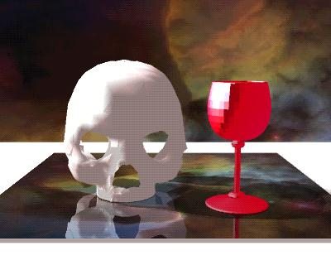

Slide 4


Slide 5
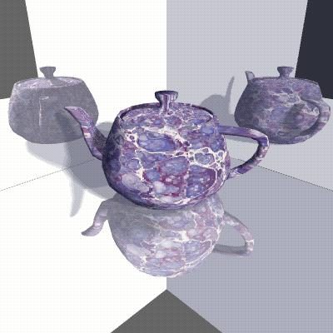

Slide 6
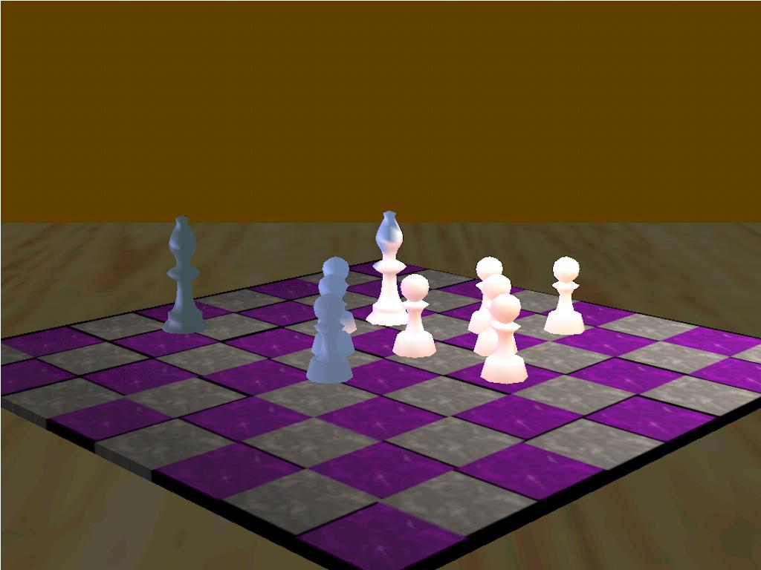

Slide 7
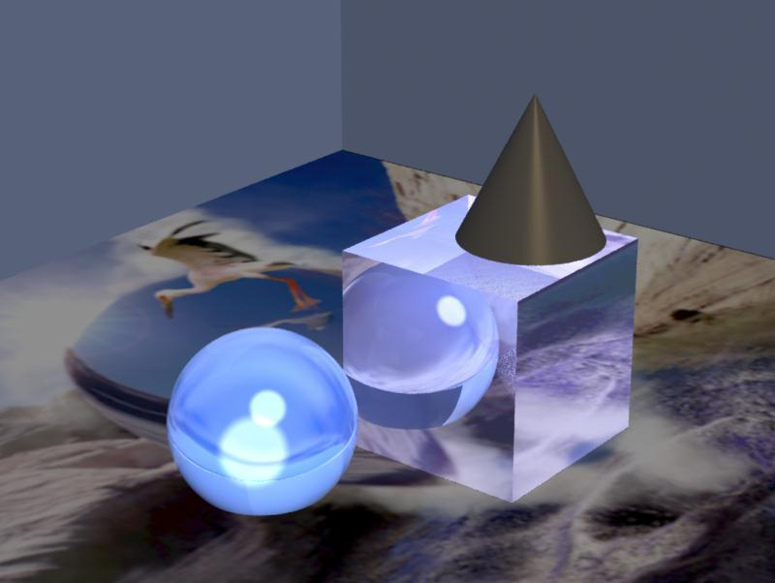

Slide 8
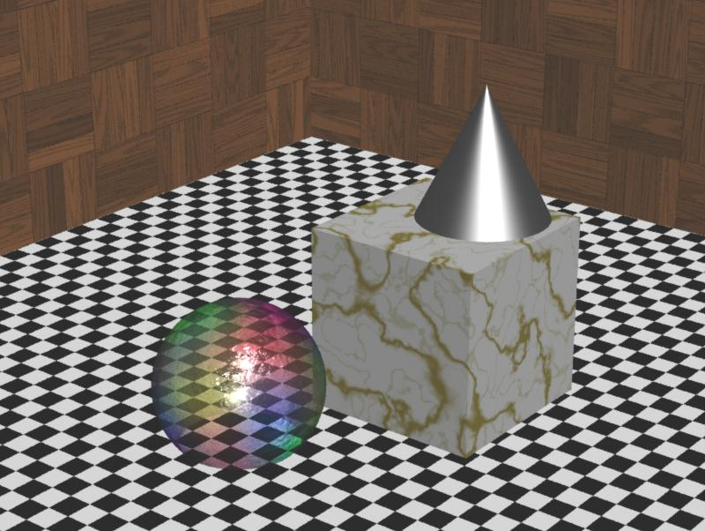
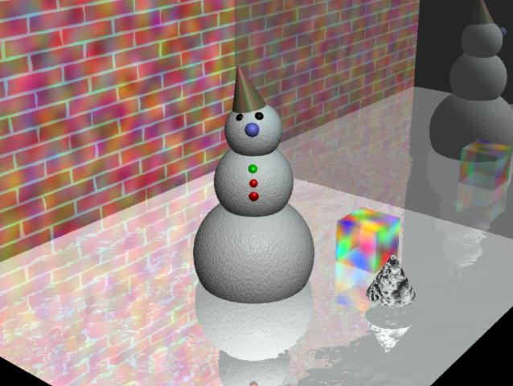

Slide 9
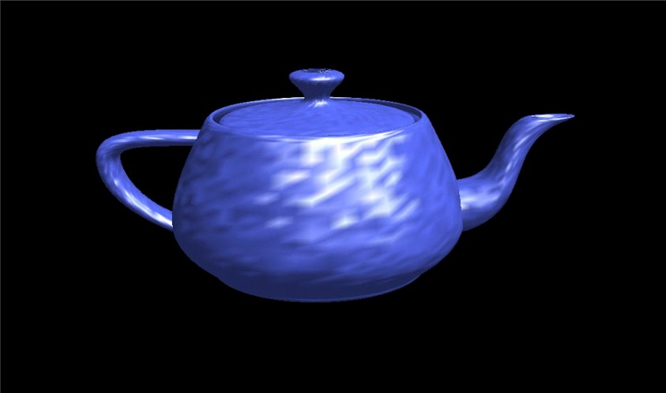

Slide 10
Shading and Lighting
An Overview-1

Slide 11
3D Modeling Depth Cues
Definition: Processes used to create an object that appears to be 3 dimensional in a computer application
These processes provide an illusion that the image is 3 dimensional.The processes have been known for years to artists.
Examples include the use of :
  reflections shading
  lighting highlights
  fogging effects size
  various projections shadows

Slide 12
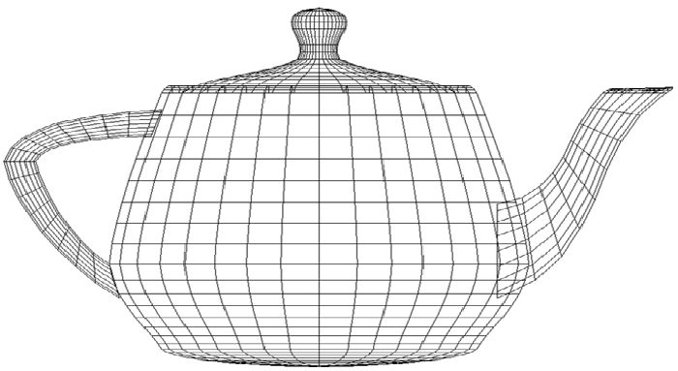
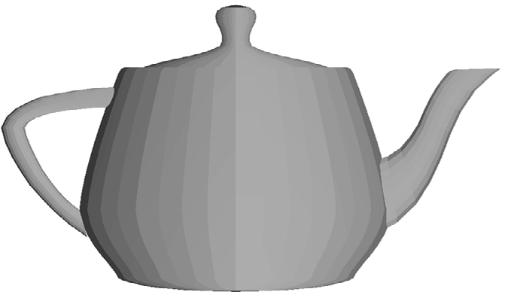
Visibility
As we know, most objects are modeled with polygons as polygons are easier to generate with a computer than curves. Recall the teapot.
Obtaining depth cues via visibility requires hidden surface algorithms that eliminate lines and surfaces.
A wireframe teapot
shows limited depth.
A filled in image provides
better depth cues.

Slide 13
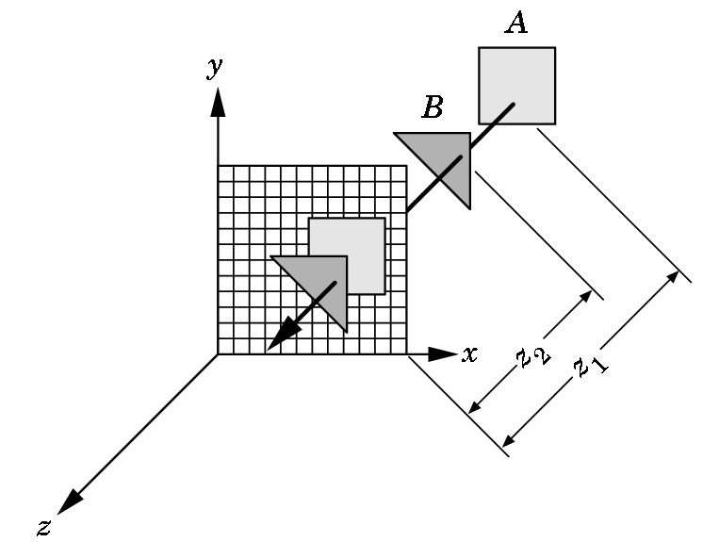
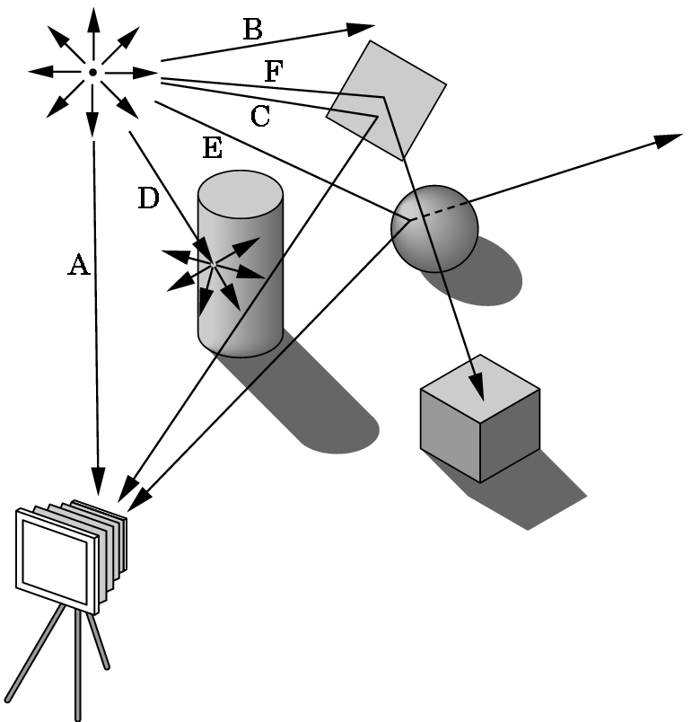
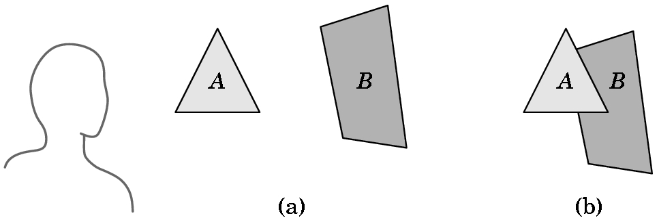
The Objects That Are Visible Are a Function Of the Rendering Algorithm Used
z-buffer painter's ray-tracing
3 COMMONLY USED ALGORITHMS

Slide 14
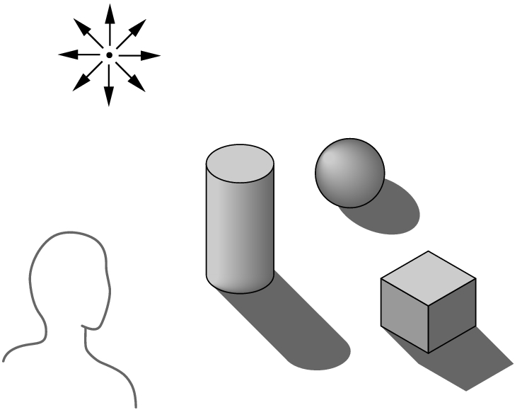
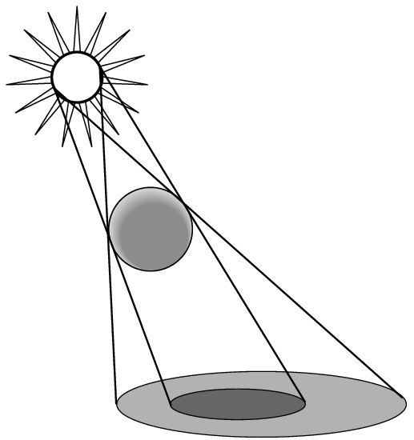
An Example
The algorithm used determines how easy it is to do realistic modeling and how costly the rendering process is. For example, consider shadows.
Without shadows, objects seem to float above their supporting surface.
Shadows add realism to an image as well as depth cues.
The difficulty (or ease) of providing shadows depends upon which algorithms are used to render the scene.

Slide 15
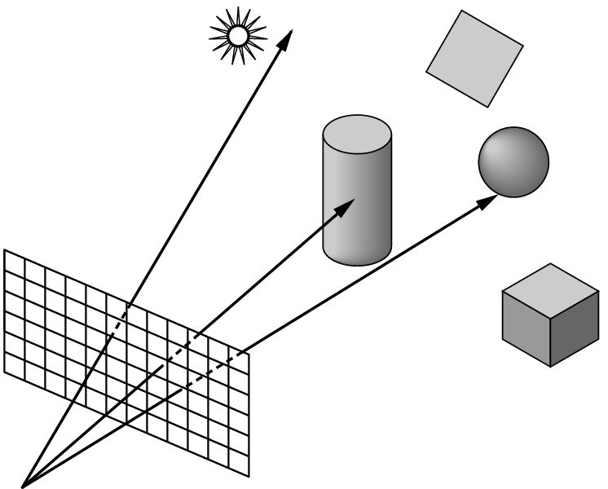
Ray Tracing Can Easily Produce Shadows
But, casting rays from a light source can be a waste of computing power.
Most rays don't ever reach the eye.
Instead, from the eye, we cast one ray for each pixel. Each ray either intersects an object, hits the light source, or goes to infinity.

Slide 16
RAY TRACING- Basic idea of the algorithm
If the ray goes to infinity, it should receive a background color.
If the ray intersects an object
then we must calculate a shade for the point of intersection.
But what is seen, depends upon the relationship between the object and the light source so we use shadow rays...

Slide 17
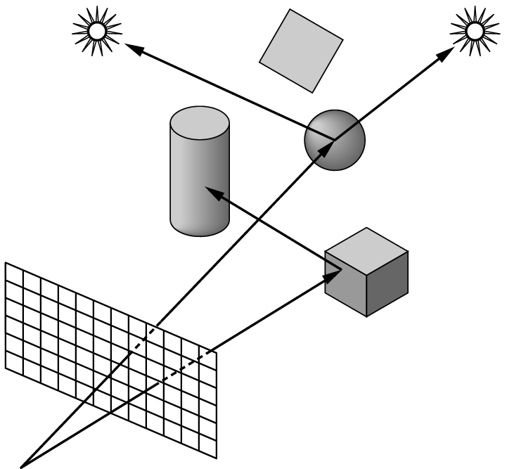
SHADOW RAYS
If a shadow ray intersects an object before it hits a light source, then the light is blocked and the point is in shadow from that source.
If the surface is opaque and doesn't scatter light, we have our shadow areas identified.
Shadow rays are also called feeler rays.

Slide 18
Z-buffer Algorithm
Requires extra memory in addition to the usual frame buffer.
Normally a frame buffer stores only
(x,y) - location information for the screen
and color information for the screen.
With this algorithm, the depth (z-value) is stored. If z2 is closer to the eye than z1, B’s information is stored in the frame buffer.

Slide 19
Ray Tracing vs Z-buffer Algorithm
Normally ray-tracing is the best for exciting visual effects such as shadows, transparency, and reflection.
An unmodified z-buffer algorithm produces images that may appear dull by comparison as it can’t handle shadows, transparency, or reflections directly.
The 114,240 frames of Disney's "Toy Story" were imaged with a z-buffer algorithm as ray-tracing requires too much time to render an image.

Slide 20
Toy Story
But, weren't there shadows in "Toy Story"?
But, wasn't Buzz Lightyear's helmet transparent?
But, couldn't you see Slinky Dog's reflection on the floor?
Yes, because the developers of "Toy Story" modified the original z-buffer algorithm.
This is where computer scientists come into the scene to change existing algorithms without sacrificing speed.

Slide 21
Modified Z-buffer Algorithm
Rendering Shadows: Adds a shadow buffer (i.e. extra memory) which draws a version of the scene from the viewpoint of the light before it appears on the screen.
When a point is determined to be visible from the observer (via usual z-buffer algorithm), the shadow buffer is checked to see if the point is also visible to the light. If yes, it is in direct line. If no, it is in shadow,

Slide 22
Modified Z-buffer Algorithm
Handling Transparency: Does several renderings in order to build the image in multiple frame buffers.
For example, if an opaque object is inside a transparent one, such as a fish in a fishbowl,
1) Renders opaque objects in background as usual.
2) Splits the transparent object into two parts:
one part behind the opaque object
one part in front of the opaque object
3) Thus, there are 3 renderings:
the back half of the transparent object
the opaque object
render front half of transparent object

Slide 23
Modified Z-buffer Algorithm
The z-buffer modified algorithm can't simulate refraction.
If a transparent object bends the light passing through it (i.e. it refracts the light), you can be sure it a ray-tracing algorithm and not a z-buffer algorithm is being used..

Slide 24
Modified Z-buffer Algorithm
Handling Reflections: Uses environment mapping.
Multiple versions of a scene are rendered with the camera placed in slightly different positions.
These are mapped onto the surface which is showing a reflection.
This works best when only one reflective object is in a scene and the object is convex or flat.

Slide 25
Cost And Effect Of All Of This
As computer scientists, we must examine the underlying algorithms in order to predict performance.
Although machines are becoming faster, a bad algorithm will still be a poor choice.
Memory and time are both important.
Note that the modified z-buffer algorithm sacrificed memory for time --- a typical tradeoff.
Still, "time is money".
Let's informally analyze the costs.

Slide 26
Factors Influencing Rendering Speed
Scene composition
Resolution and antialiasing
Lighting choices
Computer speed
Surface algorithm
Shader used
    These are discussed further in the next few slides.

Slide 27
SCENE COMPOSITION
Independent of all other considerations, the number and complexity of the objects will have a major effect.
Except for raytracing, all objects are described as a group of polygons.
The more polygons, the longer the time needed to render the object.
A sphere is typically made from at least 500 triangles--- otherwise it looks jagged.
Some manufactures describe their graphics hardware by how many polygons it can draw per second.

Slide 28
Resolution And Antialiasing
The higher the resolution, the higher the rendering time.
  Example: Going from a 100 X 100 pixel image to one with double the width and double the height
    increases the size by a factor of 4 (not 2)!
Aliasing - occurs when resolution errors occur in the image. Examples are
  jaggies
  staircasing
  missing or malformed polygons
  disintegrated textures
Antialiasing techniques are techniques to remove these problems

Slide 29
Antialiasing Techniques
When these are invoked, you lose rendering speed.
Typically, each pixel is divided into regions and color is averaged over all the regions.
Most renderers allow you to turn antialiasing on or off.
Often with high-speed animation, you won't see the problems--- this is why video games can do some things that are difficult to do in real time, especially for images projected on a large movie screen. The speed masks the problems that could be seen otherwise.

Slide 30
Lighting Choices
One lighting model, the Phong model, that we will study must compute the color based on ambient light and then on the point light source.
Multiple light sources complicate the process.
Each light source adds a new calculation to the process.
Thus, adding 1 direct light source nearly doubles the cost of determining the color of a pixel.
Spotlights are a little more costly than point sources.
Area lights are the most expensive.
Adding radiosity incurs a huge additional expense. This is usually added last during the development process. Again, we will define radiosity later.

Slide 31
Computer Speed
Obviously, the faster the better.
But, speed is not just a function of the MHz of the processor.
For graphics, you need a lot of RAM and a large hard disk for storing images.
The graphics card (or graphics accelerator) is a critical enhancement.

Slide 32
Computer Speed
And Graphics Cards
Unfortunately, rendering software is often sensitive to which graphics card is used.
Some do well with some rendering software and not with others.
The market changes so rapidly, you really need to stay on top of it constantly.
Even the sides to check change constantly.

Slide 33
SURFACE ALGORITHMS
Determining color and visibility of pixels are the two most time-consuming things done when rendering an image.
The surface algorithm determines what is visible at this pixel on thee screen.
The most commonly used algorithms are
  wireframe
  hidden line
  z-buffer
  ray-tracing

Slide 34
Surface Algorithms
Wireframe- quickest
  Doesn't bother checking visibility. Just draw it
Hidden line- next in line for speed
  Draws only outlines. Doesn't deal with fills.
Z-buffer - slower than above
  Has to process both the interior and perimeter of a polygon.
  But, discards a polygon after determining its visibility
Ray-tracing- slowest of all
  Each and every object and polygon is processed many, many times.

Slide 35
SHADER USED (For Non Ray-tracing)
Constant -
  1 color calculation per object
Faceted-
  1 color calculation per polygon
Gouraud-
  1 color calculation per vertex
Phong-
  1 color calculation per pixel
Relative costs are obvious for a given scene when we count objects, polygons, vertices, and pixels

Slide 36
Shader Used (For Non-ray-tracing)
Enhancements such as
  texture mapping- the cheapest
  bump mapping- a bit more expensive
  environment mapping- requires multiple renderings
Are usually done as enhancements to Phong shading
Doing all of these obviously slows the rendering down extensively.

Slide 37
Shader Used (with ray-tracing)
Ray tracing always determines visibility and color for each pixel.
But, there are added costs depending upon the type of calculation done:
  shiny, plastic objects need specular calculations
  reflections are expensive because the rays have to be traced that bounce off the surface
  transparent objects are very timeconsuming as rays are generated that exit the object

Slide 38
WHAT KIND OF NUMBERS ?
Relative numbers are the important thing.
These benchmarks were run on a single scene of
  3409 polygons forming a teapot
  lighting was single point with constant ambient component
  no radiosity
  no antialiasing
  750 X 500 resolution
100 MHz Pentium-based PC with 32 MB of RAM, no graphics accelerator, running Linux OS

Slide 39
Surface algorithm: (time in minutes) ray tracer z-buffer
transparent 54.8
reflection & bump 23.1
reflection 22.3
texture & bump 16.2
bump 16.1
texture 15.6
diffuse, specular 14.5
diffuse only 14.3
environment map 5.3
bump 2.5
spherical texture 1.3
planar texture 1.1
Phong 0.68
Gouraud 0.17
Faceted 0.16
Constant 0.15
hidden line 0.07 wireframe 0.06
Now think in terms of animation with 30+ images needed for 1 second!

