Slide 1
Chapter 7
From Vertices to Fragments
Part 1

Slide 2
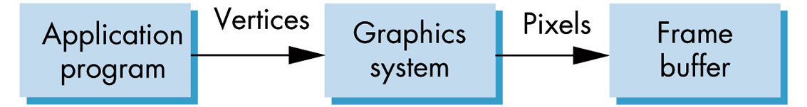
FIGURE 7.1
High-level view of the graphics process.
Inputs are the vertices and states defined in the program – i.e. geometric objects, attributes, camera specifications
Output is an array of colored pixels in the frame buffer.
Within this pipeline we must do many tasks including transformations, clipping, shading, hidden surface removal, and rasterization of primitives.

Slide 3
Organization of These Tasks
There are basically two different strategies for organizing these tasks:
1) Object-oriented
2) Image-oriented
Because the program that carries out these tasks must assign a value to every pixel and must process every geometric primitive and light source, the program must contain at least two loops that iterate over the basic variables.

Slide 4
Object-Oriented Strategy
Here the outer loop is over the objects.
Think of the program as controlled by a loop of the form:
for(each_object) render(object);
A pipeline renderer fits this description.
Vertices are defined in the program and flow through a sequence of modules that transforms them, colors them, and determines which are visible.

Slide 5
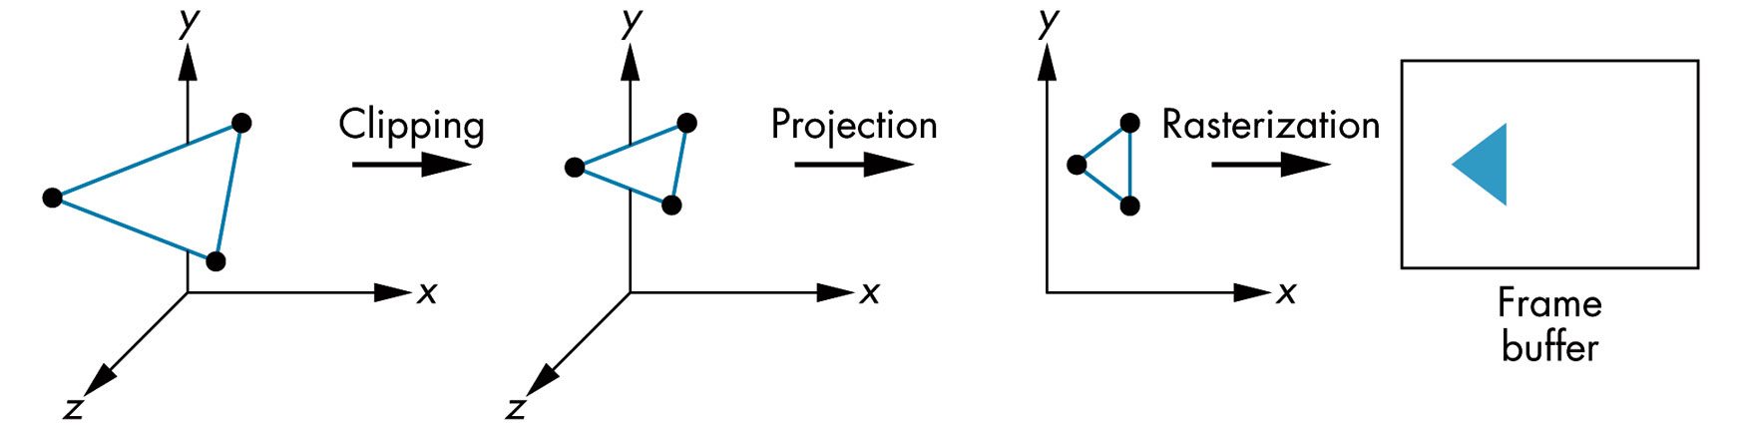
FIGURE 7.2 Object-oriented approach.
This shows a polygon flowing though the various modules.
Most implementations that follow this approach use a rendering pipeline containing hardware or software modules for each of the tasks.

Slide 6
Limitations of the Object-Oriented Approach
A large amount of memory is required.
There is a high cost of processing each object independently.
Any geometric primitive that emerges from the geometric processing potentially can affect any set of pixels in the frame buffer.
Consequently, the entire color buffer and other buffers such as the depth buffer used for hidden surface removal need to be the size of the display buffer.
The limitations above are no longer a problem as memory has become very inexpensive.
Moreover, customized chips now perform many of the operations which allow us to obtain processing speeds of tens of millions of polygons per second.

Slide 7
Limitations of the Object-Oriented Approach Today
The main problem today is that object-oriented implementations cannot handle global calculations .
Because each geometric primitive is processed independently and in an arbitrary order, complex shading effects that involve multiple geometric objects, such as reflections, cannot be handled except by approximation methods.
There is an exception to this, however. Hidden-surface removal can use global calculations because the z-buffer is used to store global information.

Slide 8
Image-oriented Approach
Here the program loops over pixels or rows of pixels called scanlines.
Such a program would look like:
for(each_pixel) assign_a_color(pixel);
For each pixel we work backward, trying to determine which geometric primitives can contribute to its color.
One advantage of this approach is that we need only limited display memory and we can obtain fast processing speeds.

Slide 9
Pros and Cons of the Image-oriented Approach
The results of most calculations don't change much from pixel to pixel or scanline to scanline so we can take advantage of this coherence in our algorithms by using incremental forms for many of the steps.
The main disadvantage of this approach is we must first build a data structure from the geometric data before we know which primitive contribute to a particular pixel.

Slide 10
Pros and Cons of the Image-oriented Approach
However, by having a data structure storing information we can have the geometric data available at all times during the rendering process.
Thus, we can handle global effects such as shadows and reflections better.
Ray-tracing is good example of a method that is completely image-oriented.

Slide 11
Algorithms for Implementing the Synthetic Camera Pipeline
When we looked at the various tasks provided by the pipeline (projection, viewport transformation, etc.) , we skipped over the details about how these are carried out.
In this section we'll start looking at some of these algorithms in order to see what goes on "under the hoods".

Slide 12
FIGURE 7.3 The Implementation Tasks.
Modeling:
We have discussed this task a lot.
The end result of modeling is the specification of vertices that define a group of geometric objects to be supported by the system.
This is usually done by a user program.
Some of the later implementation tasks, such as clipping, can be done by the modeler, but they are not required to be.

Slide 13
FIGURE 7.3 The Implementation Tasks.
Geometric Processing:
The goal of this processor is to determine which geometric objects can appear on the display and to assign shades or colors to the vertices of these object.
Four processes are required:
Projection
Primitive assembly
Clipping
Shading

Slide 14
Geometric Processing
1) Normally the first step in geometric processing is to change models from object coordinates to the camera or eye coordinates using the model-view transformation.
2) The next step is to transform vertices using the projection transformation to a normalized view volume in which objects that might be visible are contained in a cube centered at the origin.
Vertices at this point are in clip coordinates. This normalization converts simplifies the clipping process as we will see.

Slide 15
Geometric Processing
3) Geometric objects are transformed by a sequence of transformations that may reshape and move them or may change their representations.
4) Eventually, only those primitives that fit within a specified volume (the view volume) can appear on the display after rasterization are retained.
Some objects will not appear because they are hidden behind other objects.
This is where hidden-surface removal and visible-surface determination algorithms are executed.
It is important to remove objects that won't be seen from the pipeline as soon as possible to save processing time.

Slide 16
Geometric Processing
5) Colors must be assigned to each vertex.
These are determined by the current color or, if lighting is enabled, by one of the shading models.
6) After clipping takes place, the remaining vertices are still in 4-dimensional homogeneous coordinate.
Perspective division converts them to 3-dimensional representations in normalized device coordinate.

Slide 17
Geometric Processing
All of these operation require what is called front-end processing. They involve
  3-dimensional calculations
  floating point arithmetic
  calculations on a vertex-to-vertex basis
  We'll discuss some of these shortly as I skipped over some of the processing details the first time through some of the chapters.
  Some of the algorithms, such as the clipping algorithms and the line drawing algorithms are in this chapter.

Slide 18
.
Rasterization (or scan conversion):
Even after geometric processing, we need to retain depth information in order to do hidden surface removal.
Next we have to determine fragments which give the locations of the pixels in the frame buffer that correspond to the vertices.
For line segments, rasterization determines which fragments should be used to approximate a line segment between the projected vertices.
For polygons, rasterization determines which pixels lie inside the 2D polygon determined by the projected vertices.

Slide 19
Rasterization
The rasterizer starts with vertices in normalized device coordinates and outputs fragments whose locations are in units of the display – i.e. window coordinates.
The projection of the clipping volume must appear in the viewport that the user chooses.
In OpenGL this final transromation is done after the projection and, consequently, is 2 dimensional.
Previous transformations have normalized the view volume so its sides are of length 2 and these are lined up with the side of the viewport.

Slide 20
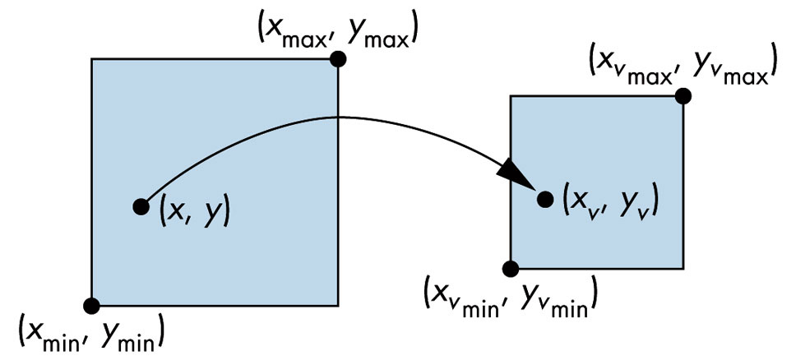
FIGURE 7.4 Viewport transformation.
We'll look at details of this mapping after we look at the projection process.
With the above transformation, the z values retain their original depth order and can be used for hidden surface removal.
Normally we use the term screen coordinate to refer to the 2D system that is the same as the window coordinate but lacks the depth coordinate.

Slide 21
.
Fragment Processing:
In the simplest situations, fragments are assigned colors by the rasterizer and these colors are the ones placed in the frame buffer at the locations corresponding to the fragments' locations.
However, there are many other possibilities:
OpenGL and similar architectures uses a separate pixel pipeline and merges the results of the geometric pipeline at the rasterization stage.

Slide 22
Example
Suppose a shaded and texture-mapped polygon is processed. What happens in the pipleline?
Vertex lighting is computed as part of the geometric processing.
Texture values are not needed until after rasterization when the renderer has generated fragments that correspond to location inside the polygon.
Now interpolation of per-vertex colors and texture coordinates takes place the texture parameters determine how to combine texture colors and fragment colors to determine the final colors in the texture buffer.
This is why colors can be loused up when using lighting and texture maps.

Slide 23
More on Fragment Processing
Objects in the view volume will not be visible if they are blocked by any opaque object closer to the viewer.
The required hidden-surface removal process is typically carried out on a fragment-by-fragment basis.
If, in addition, we have translucent objects, fragment colors have to be blended with the colors of pixels already in the frame buffer.

Slide 24
Going From the Frame Buffer to the Monitor
Normally this is automatic and is not of concern to the application program.
However, the quality of the display may be undesirable (i.e. the jaggies) and the application program will want to execute antialiasing algorithms.
We'll consider antialiasing algorithms shortly.

Slide 25
Various Algorithms
We'll now begin studying various algorithms that are used to move an object through the pipeline to a monitor.
First we'll consider clipping algorithms.

Slide 26
The Clipping Window
The section of a 2D scene selected for display is called a clipping window because all parts outside of it are “clipped” away.
Sometimes it is called the world window or the viewing window.
At one time, it was just called “the window”, but then operating systems starting referring to windows and the term was changed in graphics to the clipping window.

Slide 27
The Viewport
The section of a display window where scene is to be mapped is called a viewport.
The clipping window selects what we want to see; the viewport indicates where it is to be viewed on the output device.
Multiple viewports can be used to display different parts of a scene.
Although we didn’t look at multiple viewports, they are supported in OpenGL.
By changing the position of a viewport, we can view objects at different postions on the display area of an output device.
By varying the size of viewports, we can change the size and proportions of displayed objects.

Slide 28
The Viewport-Clipping Window Interaction
We achieve zooming effects by successively mapping different sized clipping windows onto a fixed-sized viewport.
As the clipping windows are made smaller, we zoom in on some part of a scene to view details that are not shown with the larger clipping windows.
More overview is obtained by zooming out from a section of a scene with successively larger clipping windows.
Panning effects are achieved by moving a fixed-size clipping window across the various objects in a scene.

Slide 29
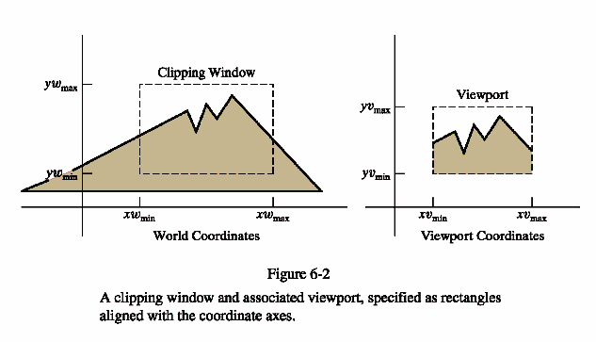

Slide 30
The Window to Viewport Mapping
Mapping a 2D, world-coordinate scene to device coordinates is called a 2D viewing transformation (or the window-viewport transformation or the windowing transformation.)
Although we are mainly interested in the pipeline for 3D scenes, the part we will do here will provide us with some of the background needed for the 3D work.

Slide 31
The 2D Viewing-Transformation Pipeline
World coordinate scene constructed from modeling coordinates
World coordinates converted to viewing coordinates
MC
WC
VC
NC
DC
Viewing coordinates converted to normalized coordinates
Map normalized coordinates to device coordinates

Slide 32
Clipping Window Characteristics
Technically, they can be of any size, shape, or orientation.
However, as you might suspect, clipping using a concave polygon as a clipping window or using nonlinear boundaries for the clipping window adds quite a bit of overhead to the process.
Consequently, most graphics packages support only clipping to a rectangle with the sides parallel to the x and y axis.
Any other clipping must be programmer implemented.

Slide 33
Various Methods Can Be Used to Handle the Window to Viewport Transformation
Once a world-coordinate scene is constructed, we could set up a separate 2D, viewing coordinate reference frame for specifying the clipping window.
But, the clipping window is often just defined in world coordinates, so that viewing coordinates for 2D applications are the same as world coordinates.
For a 3D scene, however, we need a separate viewing frame to specify the parameters for the viewing position, direction, and orientation.

Slide 34
Making the Viewing Process Independent of the Output Device
Most graphics packages convert objects to normalized coordinates in the range from 0 to 1 or -1 to 1.
Depending on the package, the viewport is defined either in normalized coordinates or in screen coordinate after the normalization process.
As the final step of the viewing transformation, the contents of the viewport are transferred to positions within the display window.

Slide 35
Clipping
Clipping is usually performed in normalized coordinates.
This allows us to reduce computations by first concatenating the various transformation matrices.
Clipping algorithms are of fundamental importance in graphics.
They are used not only in viewing transformations, but also in window-manager systems, in painting and drawing packages to erase picture sections, and in many other applications.
As you may be beginning to suspect, several different approaches are possible for the normalization and viewing transformations.

Slide 36
Various Approaches
With some graphics packages, the normalization and window-to-viewport transformations are combined into one operation.
In this case, the viewport coordinates are often given in the range from 0 to 1 so that the viewport is positioned within a unit square.
After clipping, the unit square containing the viewport is mapped to the output display device.
In other systems, the normalization and clipping routines are applied before the viewport transformation.
For these systems, the viewport boundaries are specified in screen coordinate relative to the display-window position.

Slide 37
Mapping the Clipping Window Into a Normalized Viewport – Approach 1
Assume the viewport is defined with normalized coordinate values between 0 and 1.
Object descriptions are transferred to this normalized space using a transformation that maintains the same relative placement of a point in the viewport as it had in the clipping window.
  i.e. if a coordinate position is at the center of the clipping window, it would be mapped to the center of the viewport.

Slide 38
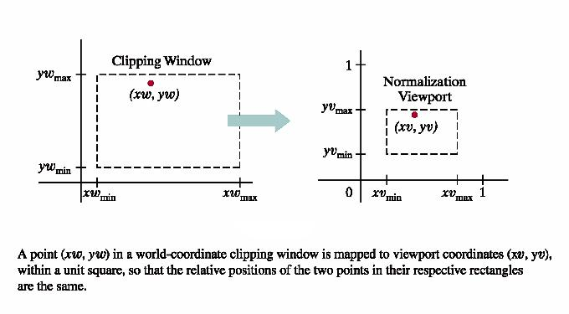
Scale the clipping window to the size of the viewport using a fixed point position of (xw_{min}, yw_{min})
Translate (xw_{min},yw_{min}) to (xv_{min},yv_{min})
We'll do these with the usual transformations we developed earlier but we'll write the points as xw[min], yw[min] etc.
Source:Hearn & Baker, Computer Graphics with OpenGL, 3rd ed, pg.302

Slide 39
The Transformations for Approach 1
The scaling factors are
s_{x} = (xv[max]- xv[min])/
(xw[max]- xw[min])
and s_{y} = (yv[max]- yv[min])/
(yw[max]- yw[min])
The translation factors are
t_{x} = (xw[max]*xv[min]- xw[min]*xv[max])/
(xw[max]- xw[min])
t_{y} = (yw[max]*yv[min]- yw[min]*yv[max])/
(yw[max]- yw[min])

Slide 40
The Matrices for the Transformation
The scaling matrix is
  S = s_{x} 0 xw[min](1- s_{x})
  0 s_{y} yw[min](1- s_{y})
  0 0 1
The translation matrix is
T = 1 0 xv[min]- xw[min]
0 1 yv[min]- yw[min]
0 0 1
Multiplying these together we get
TS = s_{x} 0 t_{x}
0 s_{y} t_{y}
0 0 1
which maps the window to a normalized viewport.

Slide 41
Some Observations on This Approach
Any other clipping window reference point such as the top-right corner or the window center could be used for the scale-translation operations.
Or, we could first translate any clipping-window position to the corresponding location in the viewport and then scale relative to that viewport location.
The window-to-viewport transformation maintains the relative placement of objects – i.e. objects inside the clipping window are mapped inside the viewport and objects outside the clipping window are mapped outside the viewport and don't appear in it.

Slide 42
Some Observations on This Approach
Relative proportions of objects, however, are maintained only if the aspect ration of the viewport and the clipping window are the same.
One disadvantage of this approach is that a lot of time can be spent on mapping objects outside the clipping window as they are not distinguished in any way from ones inside the window.
It is desirable to do clipping to eliminate this extra work.
Clipping can be applied using either the clipping window boundaries or the viewport boundaries.

Slide 43
Some Observations on This Approach
After clipping, the normalized coordinates are transferred to device coordinates.
The unit square can be mapped onto the output device using the same procedures as in the window-to-viewport transformation with the area inside the unit square transferred to the total display area of the output device.

Slide 44
Mapping the Clipping Window Into a Normalized Viewport – Approach 2
Here we transform the clipping window into a normalized square, clip in normalized coordinates, and then transfer the scene description to a viewport specified in screen coordinates.
Here we assume the normalized coordinates are in the range from -1 to 1.

Slide 45
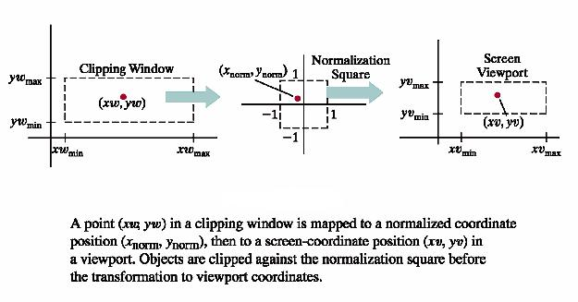
Approach 2
This has the advantage that everything outside of the normalized coordinates ± 1 are detected and removed from the scene.
Source:Hearn & Baker, Computer Graphics with OpenGL, 3rd ed, pg.304

Slide 46
Developing the Matrices
These are developed in the same manner as those earlier, but using the following steps:
1) Map the contents of the clipping window into the normalization square.
2) Apply clipping algorithms that we will study next.
3) Transform the normalized square with edge length 2 to the specified viewport.

Slide 47
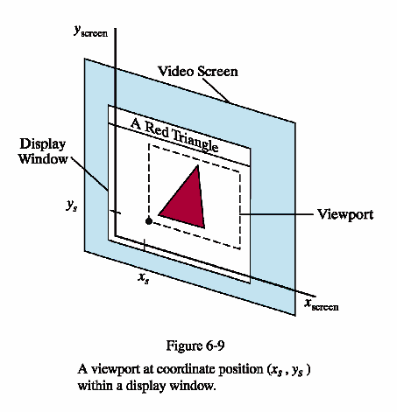
This shows the end result.
Source:Hearn & Baker, Computer Graphics with OpenGL, 3rd ed, pg.305

Slide 48
Clipping Objects

Slide 49
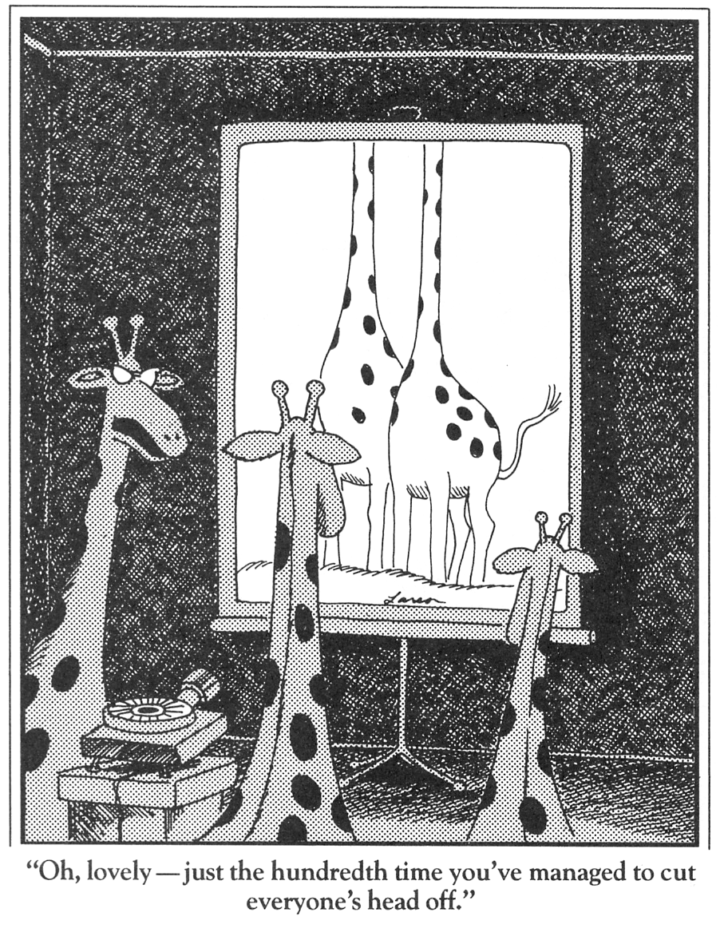
Clipping is Important!

Slide 50
Clipping
Apart from clipping in graphics packages, clipping is a basic operation in many other algorithms
  Breaking space up into chunks
  2D drawing and windowing
  Modelling
May require more complex geometry than rectangular boxes

Slide 51
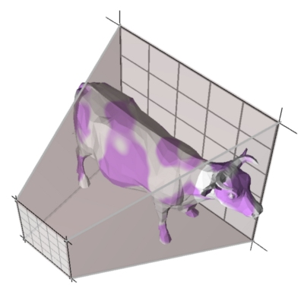
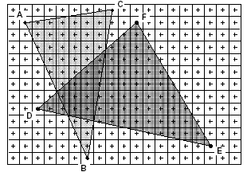
Concentrating on These Parts of Pipeline
Modeling
Transformations
Portions of the
object outside
the view frustum
are removed
Rasterize
objects
into pixels
Illumination
(Shading)
Viewing Transformation
(Perspective / Orthographic)
Clipping
Projection
(to Screen Space)
Scan Conversion
(Rasterization)
Visibility / Display

Slide 52
The Graphics Pipeline
Modeling
Transformations
Former hardware relied on full clipping
Modern hardware mostly avoids clipping
  Only with respect to
  plane z=0
In general, it is useful to learn clipping because it is similar to many geometric algorithms
Illumination
(Shading)
Viewing Transformation
(Perspective / Orthographic)
Clipping
Projection
(to Screen Space)
Scan Conversion
(Rasterization)
Visibility / Display

Slide 53
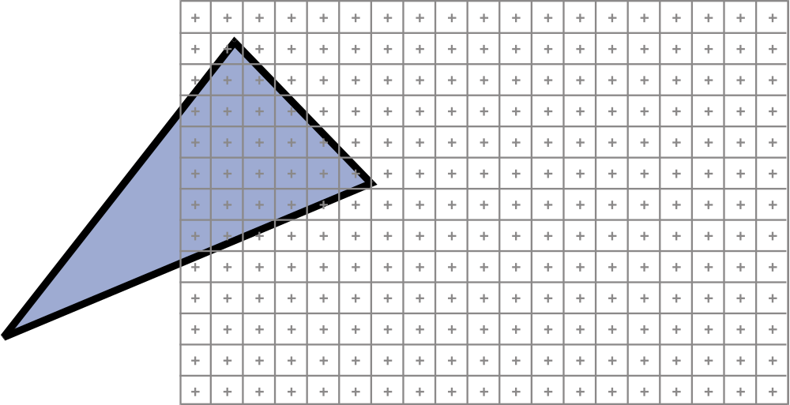
Clipping problem
How do we clip parts outside window?

Slide 54
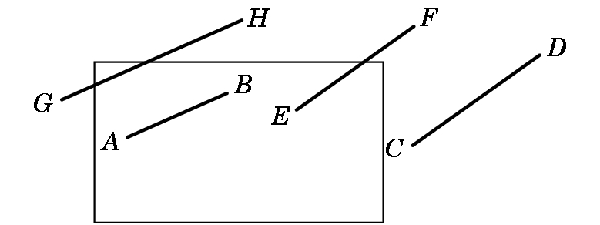
Line-Segment Clipping
Task: Decide which primitives will appear on the display
Clipping relationship between primitive and view volume:
  Accept if fits entirely inside
  Reject (cull) if falls entirely outside
  Clip if crosses the boundary

Slide 55
Placing Clipping in the Pipeline:
  Many possibilities –
    during modeling,
    in 3-D before projection,
    in 2-D after projection
  OpenGL clips in 3-D Normalized Device Coordinates before a final orthographic projection

Slide 56
Clipping Algorithms
Again, the wrong way to do this is the first way you would think to do it manually:
Calculate the equations for each line
Calculate the intersection with the window
Problems:
  Costly to do the calculations
  These are floating point number intersections

Slide 57
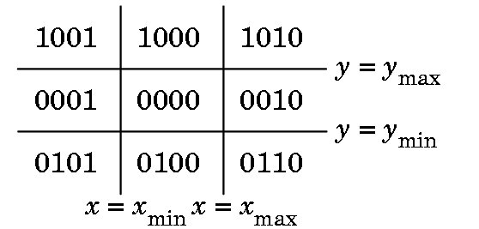
Cohen-Sutherland Clipping – 2D Version
Motivation:
  Many line segments can be trivially accepted/rejected. Want to avoid intersection calculation in these cases
  Seek to replace floating point division with cheaper operations
  Create algorithm extensible to 3-D
  We define outcodes for each region of the plane:

Slide 58
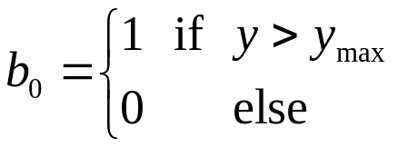
Cohen-Sutherland Clipping
Outcode:
  Extend clipping edges to divide space in and around the clipping rectangle into nine regions
  Each region has a unique 4-bit binary number o = b₀b₁b₂b₃
  If P = (x,y) then
  Likewise b₁ is y < y_{min}, b₂ is x > x_{max}, b₃ is x < x_{min}

Slide 59
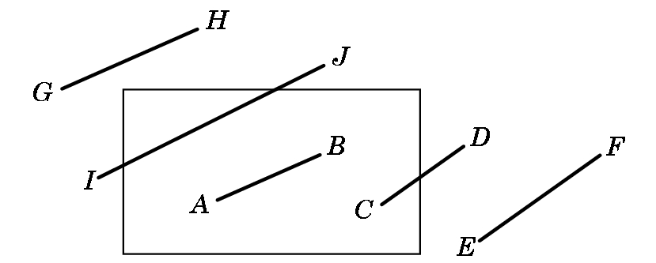
Cohen-Sutherland Clipping
Exercise: What are the outcodes for these points
Use Top, Bottom, Right, Left
  A = 0000; B = 0000
  C = 0000; D = 0010
  E = 0010; F = 0010
  G = 1001; H = 1000
  I = 0001; J = 1000

Slide 60
Case 1
Cases (line segment with endpoint outcodes o₁, o₂):
  (o₁ = o₂ = 0) Both endpoints inside the window and no clipping occurs.

Slide 61
Case 2
  (o₁ ≠ 0, o₂ = 0; or vice versa) One endpoint inside, the other out. Nonzero outcode indicates endpoint that will require shortening of the line

Slide 62
Case 3
  (o₁ && o₂ ≠ 0) Do bitwise AND. If nonzero, both endpoints lie outside the same side → discard

Slide 63
Case 4
  (o₁ && o₂ = 0) Both endpoints outside but on different clipping edges. Cannot tell from outcodes alone whether to shorten or discard
But, only in this case do we have to do intersection calculations.

Slide 64
Cohen-Sutherland Clipping
Exercise: What action is taken for each pair?
Use Top, Bottom, Right, Left Action
  A = 0000; B = 0000 Keep
  C = 0000; D = 0010 Find intersection
  E = 0010; F = 0010 Discard
  G = 1001; H = 1000 Discard
  I = 0001; J = 1000 Find intersections

Slide 65
Calculating the Intersections
In the one case, we must find the intersection points or determine that the line is outside the region.
Consider the following Case 4 situation
P2
P1

Slide 66
Calculating the Intersections
We recursively clip to each side. (Clip L, T, R, B)
P2
1
2
4
P1
3

Slide 67
Calculating the Intersections
We recursively clipped each side by clipping L, T, R, B. Any ordering is possible, but the same ordering is used for each situation.
Note this is a worst case where 4 calculations are needed.
P2
1
2
4
P1
3
The intersection calculations are easy – why?

Slide 68
Finding the Intersections
Let (x1,y1) be one point and (x2,y2) the other with (x1,y1) outside the window.
Let m = (y2-y1)/(x2-x1) be the slope provided x2 ≠ x1, a case which is handled separately.
Clip to left boundary:
  y1 = y1 + (xmin – x1)*m;
  x1 = xmin
Clip to right boundary:
  Substitute xmax for xmin above.
Clip to top boundary:
  x1 = x1 + (ymax = y1)/m
  y1 = ymax
Clip to bottom boundary
  Substitute ymin for ymax above.

Slide 69
Another Example
Consider the following Case 4 situation which requires only one intersection calculation.
P2
P1
We recursively clip each side. (LTRB)

Slide 70
An Interactive Cohen Sutherland Clipping Demo
http://www.cs.princeton.edu/~min/cs426/jar/clip.html
Note that the algorithm can be slightly adjusted to handle the removal of individual points from the clipping area.

Slide 71
Liang-Barsky Clipping
By using the parametric form of a line equation we can clip differently and more efficiently.
Assume the line segment is defined by two endpoints p1 = [x1,y1]^{T} and p2 = [x2,y2]^{T}.
The parametric form of the line segment, as seen earlier, through these points is:
p(a) = (1-a)*p1 + a*p2, for 0 <= a <= 1
One advantage of using this equation over the explicit form we used for the Cohen Sutherland Clipping Algorithm is the equation is robust – it is the same for horizontal or vertical lines.
Note- p(a) is a matrix equation and yields two equations, x(a) and y(a).

Slide 72
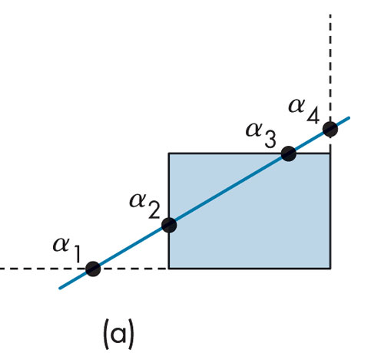
Consider the Following Example
Here 4 points intersect the extended window lines.
a1 is bottom intersect
a2 the left intersect
a3 the top intersect
a4 the right intersect
In this example, the parameters are ordered as
1 > a4 > a3 > a2 > a1 > 0
Note the two inner parameters, a3 and a2, determine the endpoints of the clipped line.
One corresponds to the line entering the window and one to the line exiting the window.

Slide 73
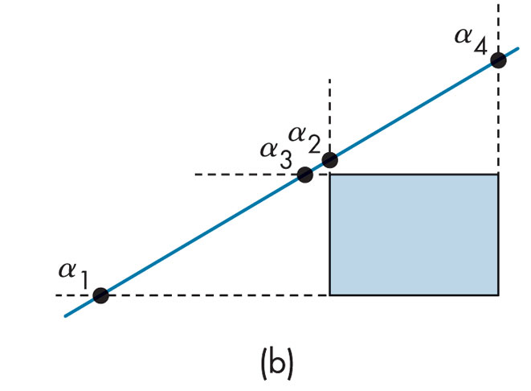
Contrast the Previous Case with This One
As before,4 points intersect the extended window lines.
a1 is bottom intersect
a2 the left intersect
a3 the top intersect
a4 the right intersect
But here the ordering is
1 > a4 > a2 > a3 > a1 > 0
This says the line intersects both the top and the bottom before it intersects the left or the right.
Thus, the entire line can be rejected.

Slide 74
The Other Cases
These can be argued in a similar manner.
Many lines can be rejected before all four intersections are known.
Moreover, the intersection calculations for the parametric equation of a line are efficient as we'll see.
In particular, we want to avoid floating point division.

Slide 75
The Intersection Calculations for Liang-Barsky Line Clipping
The intersection at the top of the window is found at a = (ymax – y1)/(y2-y1)
Similar equations can be stated for each side.
But, instead of using these where we have a floating point divide (and even potentially a zero divide), we instead write the equation as
a(y2-y1) = aΔy = ymax – y1 = Δymax
All the tests required now can be restated in terms of Δymax, Δy , and similar terms computed for the other sides of the windows.

Slide 76
Liang-Barsky vs Cohen-Sutherland
Consequently, all decisions about clipping can be made without floating point division.
This is more efficient than Cohen-Sutherland because we avoid multiple shortenings of line segments and repeated executions of the clipping algorithm.
To see an implementation of the algorithm, look for the Liang-Barsky code at
http://cs-people.bu.edu/jalon/cs480/Oct11Lab/Oct11Lab.html

Slide 77
Other Line Clipping Algorithms in 2D
Over the years, many different algorithms have been proposed, all trying to be more efficient than previous ones.
For example, there is a Nicholl-Lee-Nicholl algorithm which is interesting.
But, Liang-Barksy and Cohen-Sutherland have a very important property –
Each can be extended to work in 3D without blowing up.
The Nicholl-Lee-Nicholl algorithm and many others can't.

