Slide 1
Chapter 7
From Vertices to Fragments
Part 2

Slide 2
3D Clipping

Slide 3
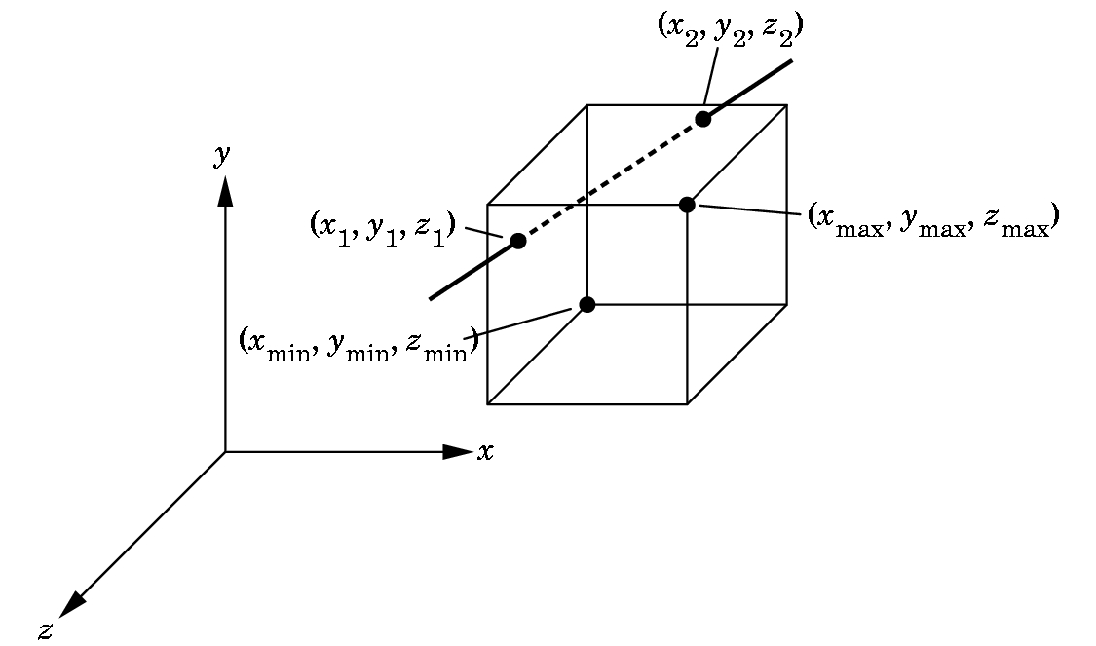
Clipping in 3-D
Cohen-Sutherland 2D clipping extends to 3-D quite easily.
Perspective Viewing:
  Clip against the view frustum
  BUT, easier to clip against a parallelepiped aligned with the axes
  OpenGL: projects to normalized orthographic view then clips
  Lesson: in pipelining, always consider the process as a whole
  Now the intersections are
  simple.

Slide 4
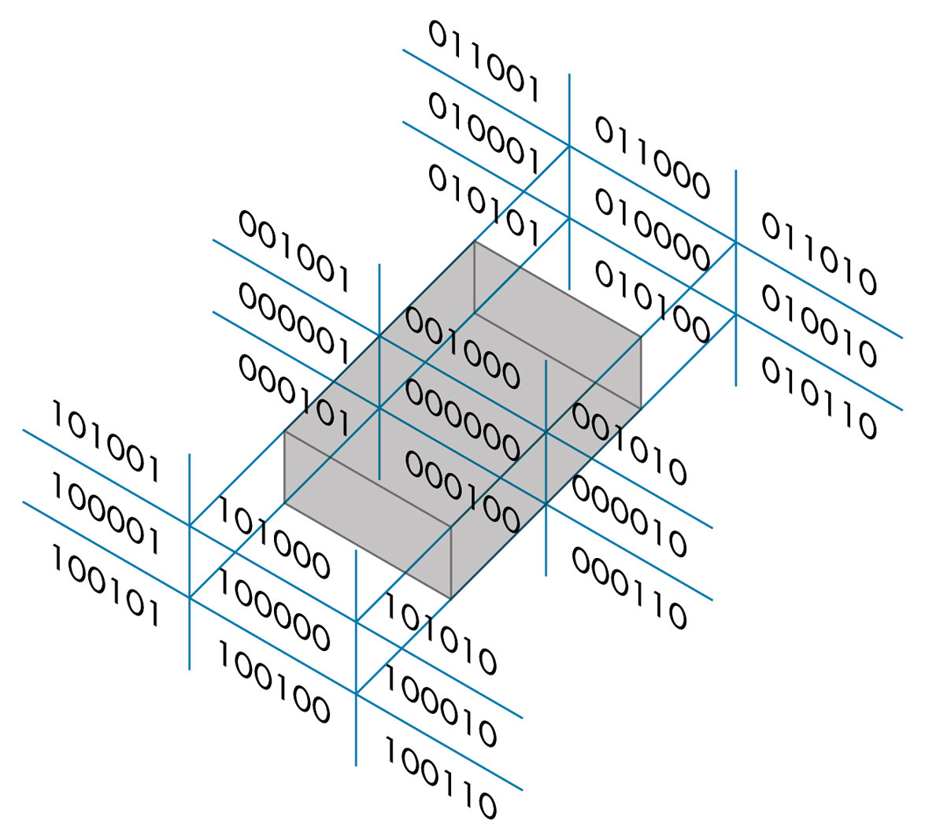
Outcodes in 3D Cohen-Sutherland Line Clipping Algorithm
Now we use a 6 bit outcode to handle the near and far plane.
The testing strategy is virtually identical to the 2D case.

Slide 5
3D Liang-Barsky
We now add a third equation
z(a) = (1-a)z1 + a*z2
to obtain the 3D parametric representation of the line segment.
We now have to consider six intersections with the surfaces that form the clipping volume, but we can use the same logic we used in the 2D case.
Clippers constructed as a pipeline just add two modules for either algorithm to clip against the near and far planes of the clipping volume.

Slide 6
Calculating Intersections in 3D
For both algorithms, the intersection calculations are more complex.
In 2D, you are clipping lines against lines.
In 3D, you are clipping lines against planes.
If the planes are not parallel to the axis, this complicates things.
So many graphics packages move even a perspective view into an orthographic view first so the clipping planes are parallel to the axis.
An orthographic view is a right parallelepiped and each intersection calculation reduces to a single division.
We'll see how this transformation is made when we look at projection calculations.

Slide 7
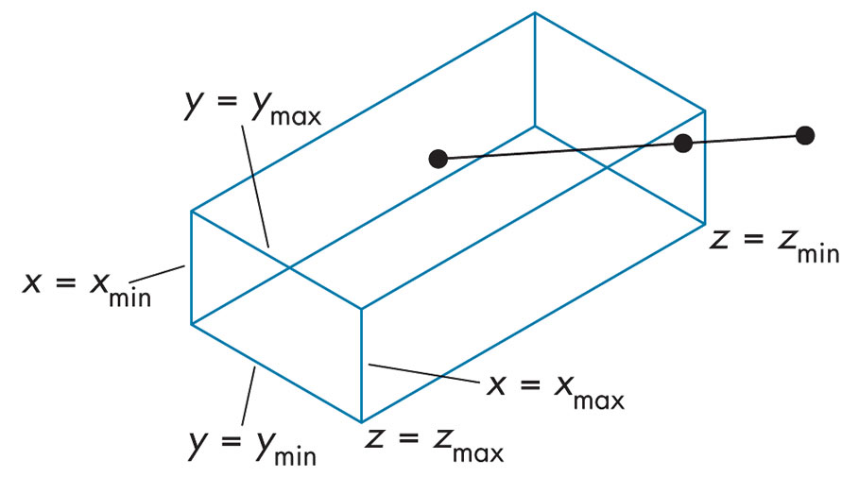
FIGURE 7.24
Clipping for orthographic viewing.

Slide 8
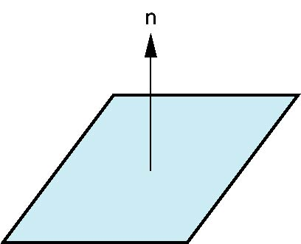
Recall
Every plane has a vector n normal (perpendicular, orthogonal) to it
From point-two vector form P(α,β)=R+αu+βv, we know we can use the cross product to find n = u × v and the plane equation:
(P(α)-P) ⋅ n=0
v
u
P

Slide 9
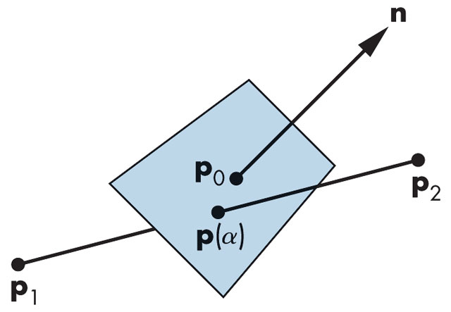
FIGURE 7.23 Plane–line intersection.
We use the matrix forms of the equations of a 3D line and a 3D plane:
p(a) = (1-1)p1 + ap2
n·(p(a) –p0) = 0 where n is the normal to the plane and pi are in figure.
Recall, the · operator is the dot product.
Solving this we get
a = n·(p0 –p1)/ n·(p2 –p1)
If we have a right parallelepiped for the viewing volume, this reduces to a single division per side.

Slide 10
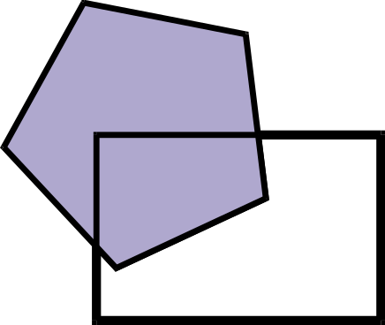
Polygon Clipping

Slide 11
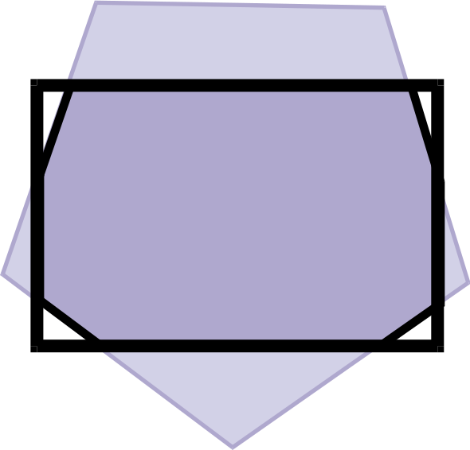
Polygon Clipping is Complex
Even when the polygons are convex

Slide 12
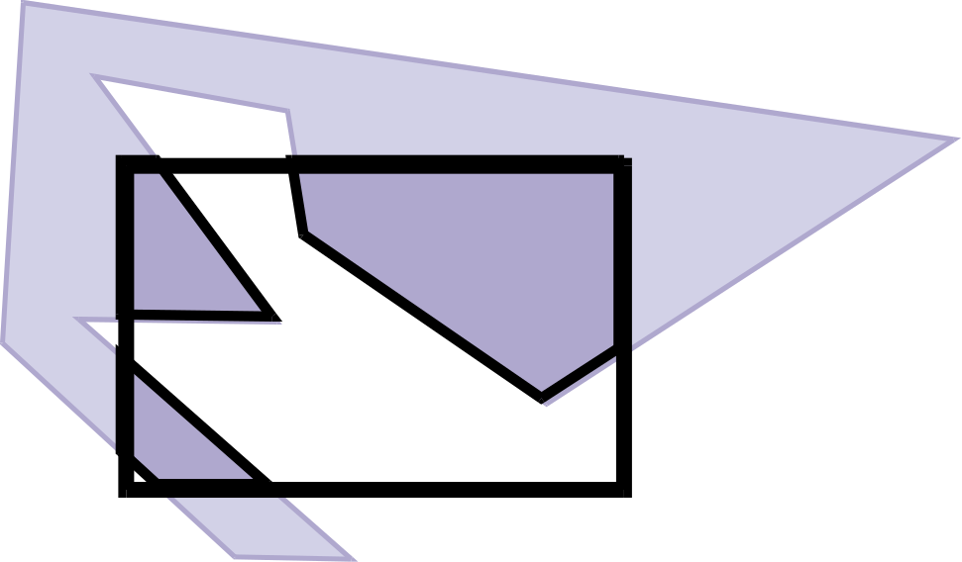
Polygon Clipping is Nasty
But, also need to deal with polygons that are concave
Polygon clipping is an important task and appears in places other than window clipping:
  Shadow generation, hidden-surface removal, and antialiasing techniques may require polygon clipping.

Slide 13
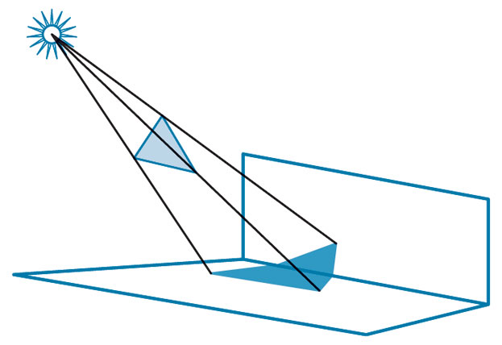
FIGURE 7.9
Polygon Clipping Is Used In Shadow Generation.

Slide 14
Naïve Polygon Clipping?
We could clip a polygon as a collection of line segments.
Then must link all segments
Not efficient and not even easy
The polygon is a 2D object, not just a collection of line segments.
Not easy if the polygon must be filled with color.

Slide 15
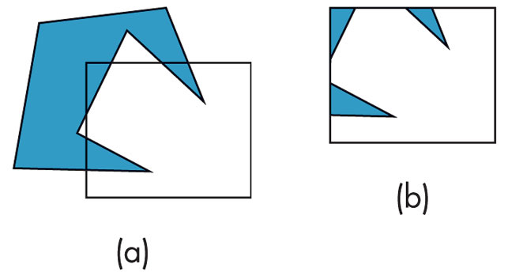
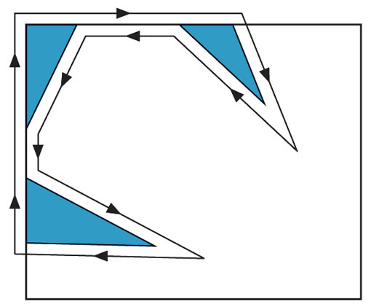
FIGURE 7.10 Clipping of a concave polygon. (a) Before clipping. (b) After clipping.
If we clip a concave polygon even against a rectangular window, we appear to get 3 polygons.
FIGURE 7.11
Creation of a single polygon.
We'd really like to treat this as a single polygon so we can handle the fill properly.

Slide 16
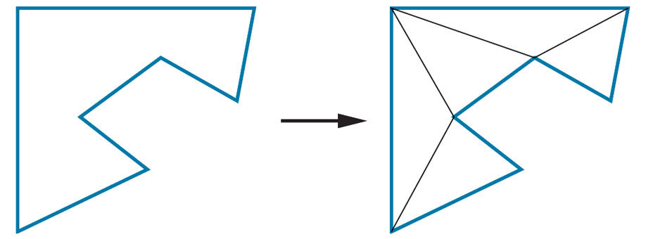
Convex Polygons
These don't cause problems as the result of clipping against a rectangular window produces a single convex polygon.
So, a graphics system might forbid the use of concave polygons.
Another approach may be to tessellate a given polygon into a set of convex polygons:
FIGURE 7.12
Tessellation of a concave
polygon.
OpenGL includes tessellation functions in the GLU library.

Slide 17
Sutherland-Hodgeman Polygon Clipping Algorithm
For rectangular regions, both the Cohen-Sutherland and the Liang-Barsky algorithms can be applied to polygons by applying the algorithms to each edge.
But, Sutherland and Hodgeman developed another algorithm that fits well in a pipelined architecture.
We view the line segment clipper as a black box that receives as input a pair of vertices from the segment to be tested and clipped and whose output is a pair of vertices corresponding to the clipped line segment or is nothing if the line segment is outside the window,

Slide 18
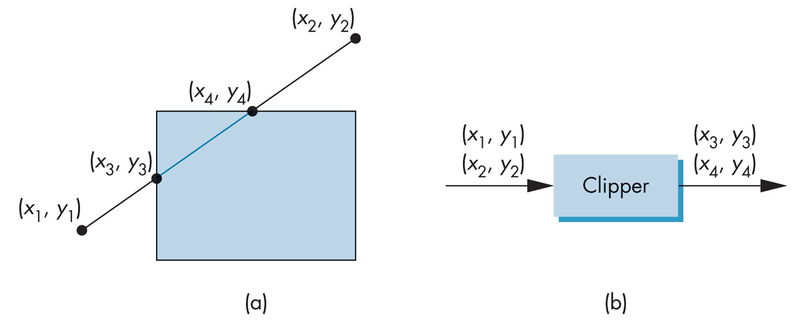
FIGURE 7.13 Two views of clipping. (a) Clipping against a rectangle. (b) Clipper as a black box.

Slide 19
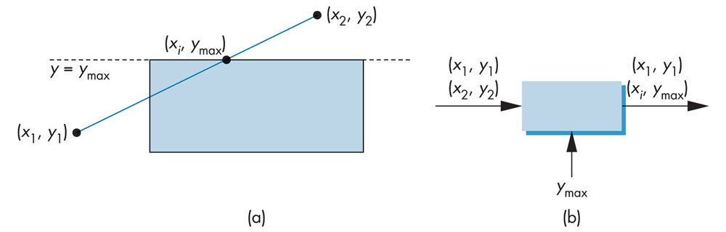
FIGURE 7.14 Clipping against top.
(a) Graphically. (b) Black-box view.

Slide 20
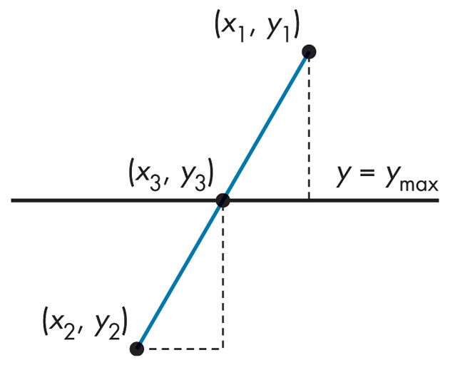
FIGURE 7.15
Intersection with the top of the window.
Using similar triangles, if there is an intersection, it lies at
x3 = x1 + (ymax – y1) (x2-x1)/
(y2-y1)
y3 = ymax
So, the clipper returns one of three pairs:
(x1,y1), (x2,y2)
(x1,y1), (x1,ymax) or
(x1,ymax), (x2,y2)

Slide 21
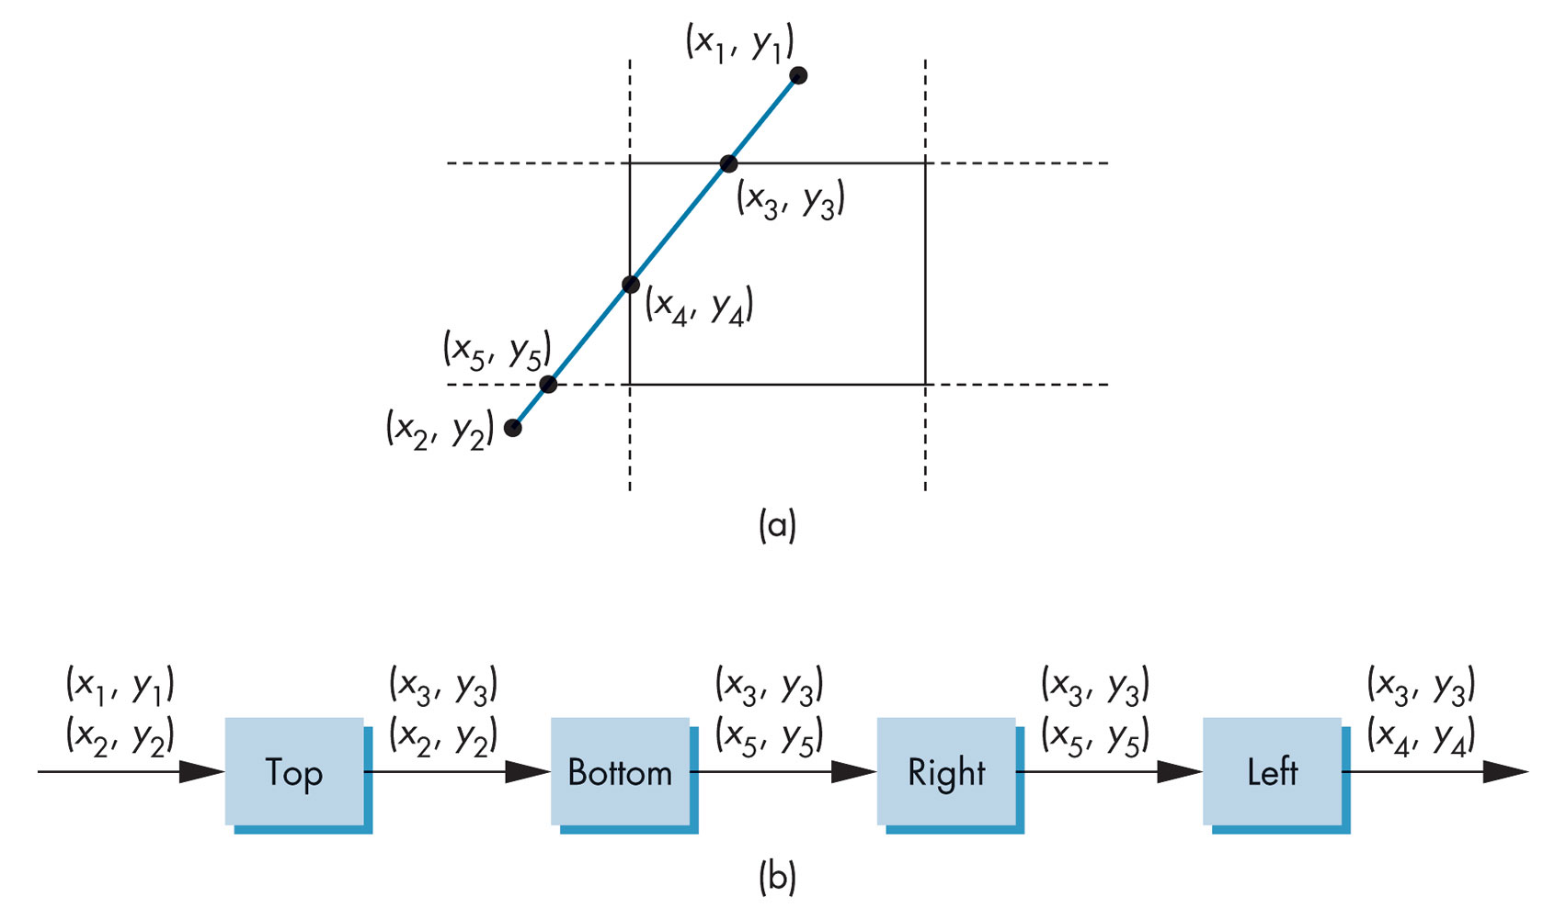
Sutherland-Hodgeman Polygon Clipping Algorithm
We can now clip against the bottom, right, and left lines independently, using the same expressions but interchanging the roles of x and y and the values for sides of windows.
We now arrange the 4 clippers in a pipeline:

Slide 22
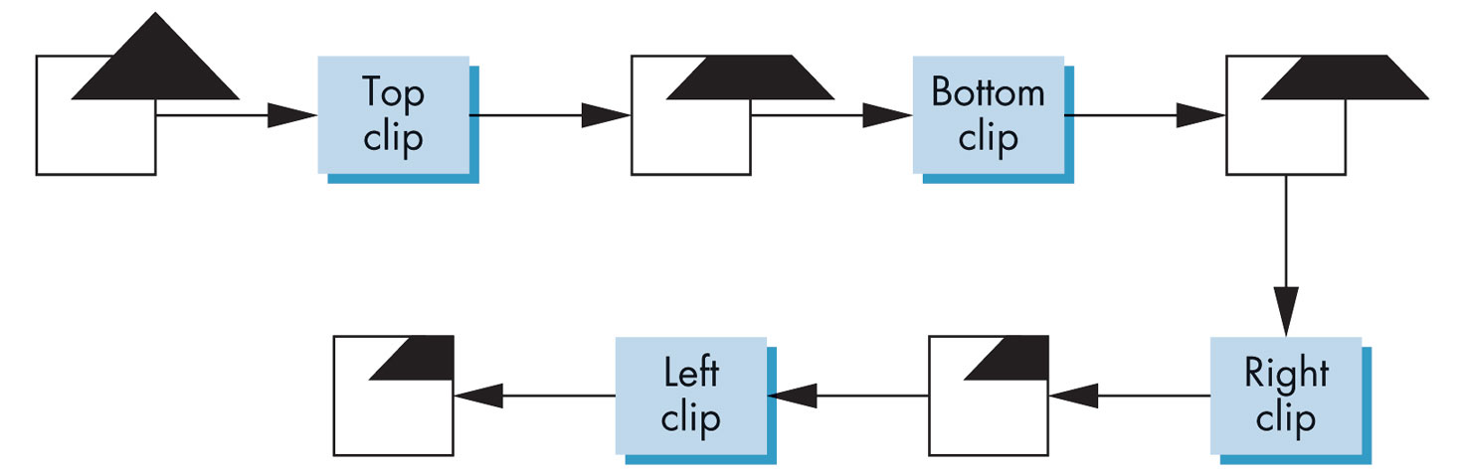
Sutherland-Hodgeman Polygon Clipping Algorithm
Now if we build the clipper in hardware, we have a clipper that can work on four vertices concurrently.
This shows how those clippers could work:

Slide 23
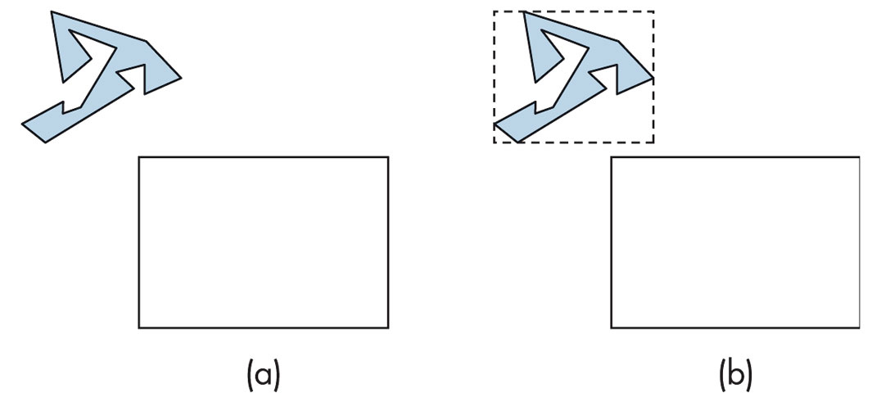
Another Approach That Works With Concave Polygons – Use Bounding Boxes
FIGURE 7.18 Using bounding boxes.
(a) Polygon and clipping window. (b) Polygon, bounding box, and clipping window.

Slide 24
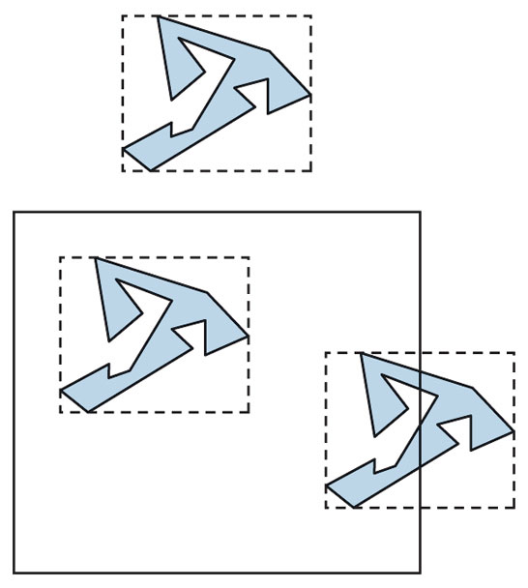
Other Examples With Bounding Boxes
Obviously this idea works with bounding volumes.
But, what about non-rectangular clipping windows?
Can we handle that?
FIGURE 7.19
Clipping with bounding boxes.

Slide 25
Weiler-Atherton Polygon Clipping
Not described in the text.
See Hearn-Baker, "Computer Graphics with OpenGL", 3rd edition pg 335-337.
This is a general polygon-clipping approach that can be used to clip a fill area that is either a convex or concave polygon.
The method was developed as a means of identifying visible surfaces in a 3D scenes.
Thus, we could use this approach to clip any polygon fill area against a clipping window with any polygon shape.
The illustrations will use a rectangular window, but that is not required.

Slide 26
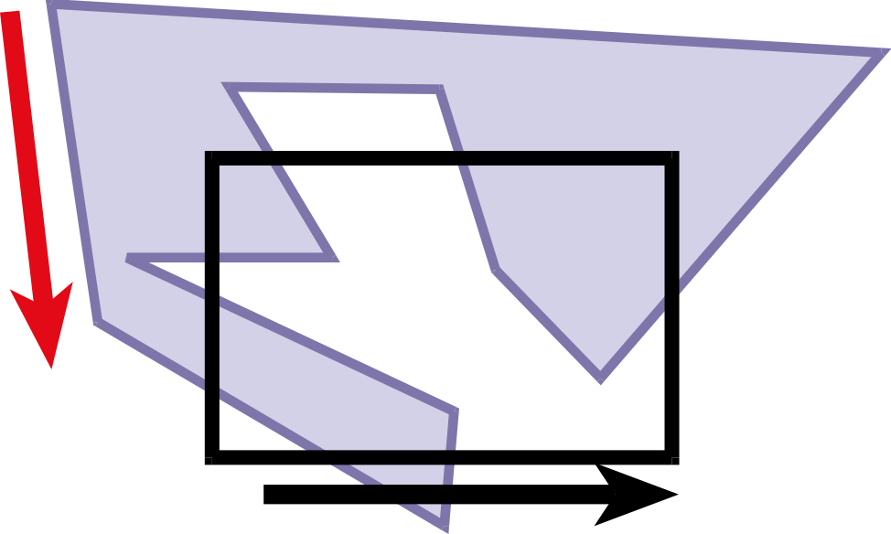
Weiler-Atherton Clipping
Strategy: “Walk" polygon/window boundary counterclockwise
Black is the clipping window which need not be a rectangle.
Normally the vertex list is ordered in a counterclockwise fashion in order to specify the front face of a polygon.

Slide 27
Finding a Counterclockwise Walk If Vertices Are Not Stored That Way
There are many inside-outside tests for polygons.
We want to "walk" so the inside is always on our left.
Thus, we have to be able to identify the inside of a polygon.
Two commonly used methods for finding the inside of a polygon are
  The odd-parity test (or odd-even test)
  The winding test
Reference: Section 7.10.1, pgs 349-350

Slide 28
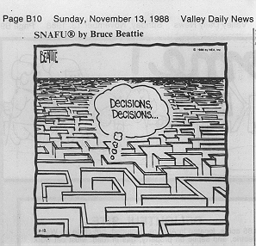
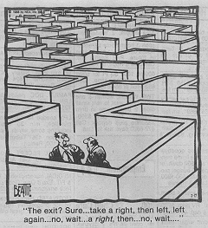
Inside-Outside Tests
Often we need to identify the interior regions of objects.
With simple objects, this is often not a problem.
But, with a complex collection of objects, how do we determine what is inside the object and what is outside?

Slide 29
Inside-Outside Tests
Odd-even rule (or odd-parity rule or even-odd rule): Determine if a point P is inside or outside a closed polyline.
  Draw a horizontal line from P to a point outside the coordinate extents of the closed polyline.
  Displace the figure if necessary so as to be sure the line does not go through any vertices.
  Count the number of segments crossed by this line.
  If the count is odd, P is considered an interior point. Otherwise, it is an exterior point.

Slide 30
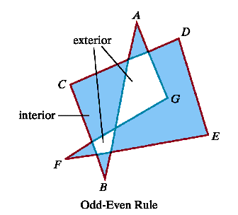
Odd-Even Rule
odd: interior
even: exterior

Slide 31
Nonzero Winding-Number Rule
The winding-number is defined for polygons with directional edges:
  Draw a horizontal line from P to a point outside the coordinate extents of the closed polyline.
  Displace the figure if necessary so as to be sure the line does not go through any vertices.
  Set the winding-number to 0. As we move along the line from P to the point outside, add 1 if we cross a line oriented from right to left. Subtract 1 otherwise.
  At the end, if the winding-number is nonzero, P is considered interior. Otherwise, it is exterior.

Slide 32
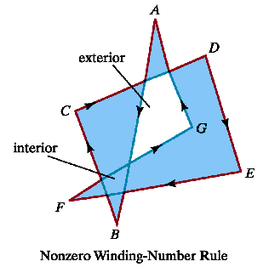
Winding-Number
+1: left to right
-1: right to left
nonzero: interior
zero: exterior
Note: the part marked interior here is designated differently for the Odd-Even Rule.

Slide 33
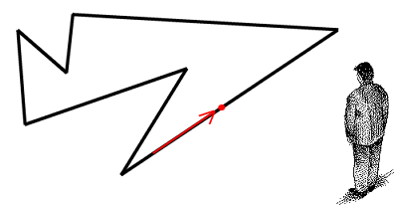
Another Way to Look at This
Imagine yourself watching a point traverse the boundary of the polygon in a counter-clockwise direction and pivoting so that you are always facing at it.
Your winding number is the number of full revolutions that you complete. If you winding number is 0 then you are outside of the polygon, otherwise you are inside.

Slide 34
Determining Which Type of Crossing (left to right or right to left) Occurs
Assume we are in the xy plane – otherwise move.
One method:
  Let E be the edge vector (as determined by the orientation) and u be the vector from the point P to the distant point.
  If u X E is in the direction of + z, the line crosses from right to left and add 1 to the winding number. Otherwise, subtract 1 from the winding number.
Another method: Uses the dot product of a vector perpendicular to u (and oriented a certain way) and the vector E, but the above method is the best for raster displays.

Slide 35
Other Uses of the Winding Number
In programs such as Bryce, boolean operations are defined on positive and negative objects.
For example, given an intersecting positive object A and a negative object B, the difference A – B is the object A with the part of b removed.
For 2D objects, the winding number can be used to define the union, intersection, and difference of two objects and what part of two 2D objects should be filled to represent the set.
There are many situations when we are doing rasterization, where we need to know where the inside of a polygon is.

Slide 36
Boolean Operations on 3D Primitives
A Boolean object in graphics is an object created by combining two or more objects to form a single object.
Boolean objects are created by performing Boolean operations on a number of objects.
Typically, the three types of Boolean operations are union, subtraction, and intersection.
These are available in Bryce.
Bryce uses Object properties to perform Boolean operations. Objects can be Neutral, Positive, Negative, or Intersecting. When you combine these objects in a group, the result is a Boolean object.

Slide 37
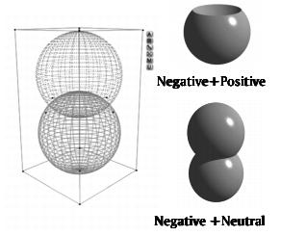
Boolean Operations – Simple Examples
Top: A Negative on top and a Positive on bottom produces a Subtraction.
Bottom: a Neutral object is not affected by any other object.
Source: Bryce Help files

Slide 38
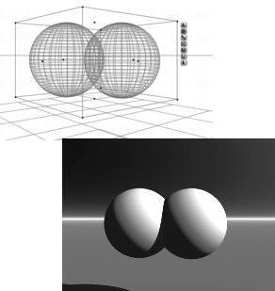
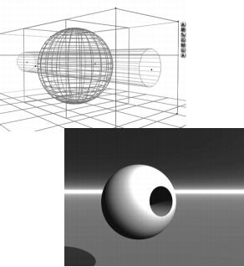
More Boolean Operations
Both positive produces a Union.
A more interesting Subtraction.
Source: Ibid

Slide 39
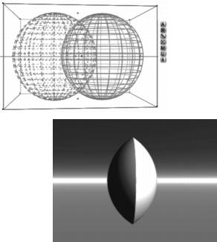
More on Boolean Operations
Group a Positive object with an Intersecting object to form an Intersection.
Note: Negative or Intersecting objects must share space with at least one Positive object in the group to exhibit a Boolean operation. If there is no common space, Negative objects are invisible when rendered.
Source: Ibid

Slide 40
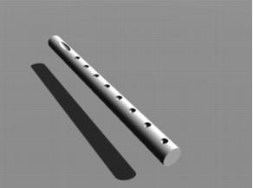
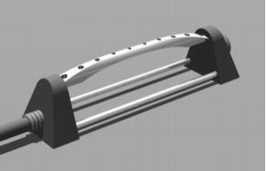
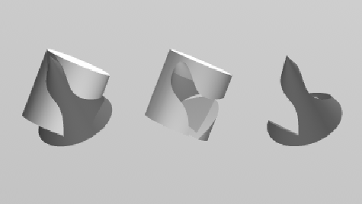
How Can Boolean Operations Be Used to Produce These?
A flute
A lawn sprinkler

Slide 41
Boolean Operations – Note the Orientations
Fill region with a positive value winding number = union
Fill region with a winding number greater than 1 = intersection
Fill region with a positive value for the winding number = difference

Slide 42
Back to Weiler-Atherton Clipping
Process the edges of the polygon fill area in a counterclockwise order until an inside-outside pair of vertices is encountered for one of the clipping boundaries – i.e. the first vertex of the polygon edge is inside the clip region and the second vertex is outside the clip region.
Follow the window boundaries in a counterclockwise fashion from the exit-intersection point to another intersection point with the polygon.
If this is a previously processed point, form the vertex list. Otherwise, continue processing polygon edges until a previously processed vertex is found.
Form the vertex list for this section of the filled area.
Return to the exit-intersection point and continue processing the polygon edges in counterclockwise order.
Source: Hearn-Baker, Computer Graphics, 3rd ed, pg 337

Slide 43
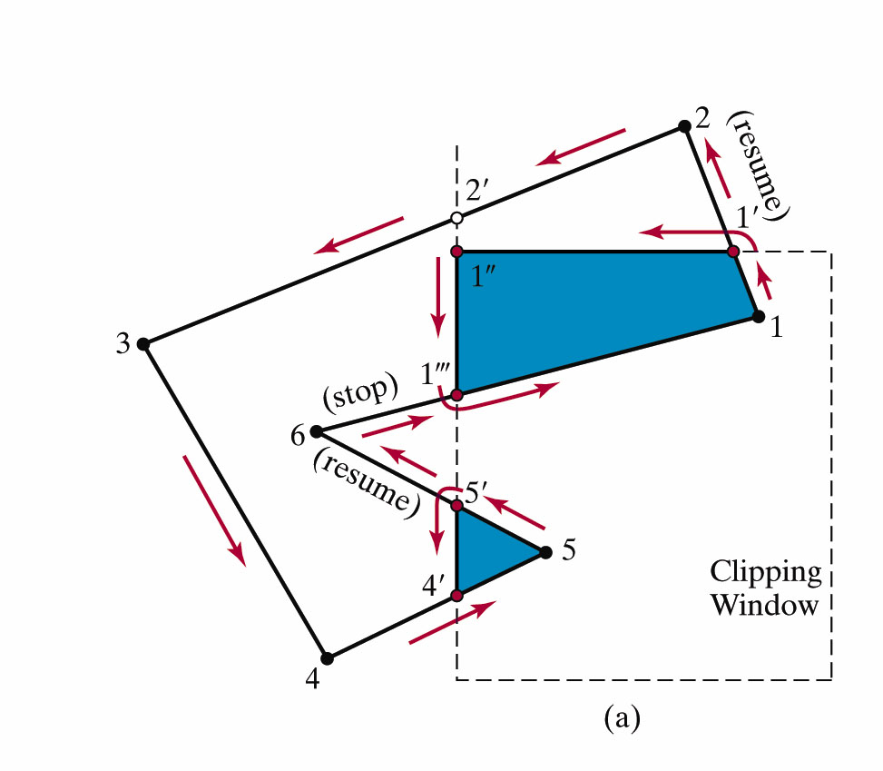
An Example
Process the edges of the polygon fill area in a counterclockwise order until an inside-outside pair of vertices is encountered for one of the clipping boundaries – i.e. the first vertex of the polygon edge is inside the clip region and the second vertex is outside the clip region.
This first occurs for points 1 and 2.
Calculate the intersection point 1' and turn left at that point.
Source: Hearn-Baker, Computer Graphics, 3rd ed, pg 337

Slide 44
Weiler-Atherton Clipping
Follow the window boundaries in a counterclockwise fashion from the exit-intersection point to another intersection point with the polygon.
If this is a previously processed point, form the vertex list. Otherwise, continue processing polygon edges until a previously processed vertex is found.
Move along the window boundary until encountering 1''' and calculate it.
Source: Hearn-Baker, Computer Graphics, 3rd ed, pg 337

Slide 45
Weiler-Atherton Clipping
Turn left and walk the polygon until encountering 1 again.
This completes a circuit and identifies the vertex list {1, 1', 1'', 1'''} as a clipped region of the original area.
Resume at 1'.
The edge from 2 to 3 crosses to the outside of the left boundary.
But points 2' and 3 are to the left of the clipping region.
Also, the edge with endpoints 3 and 4 is outside the left clipping region.
Source: Hearn-Baker, Computer Graphics, 3rd ed, pg 337

Slide 46
Weiler-Atherton Clipping
But, the next edge from 4 to 5 reenters the clipping region and we pick up intersection point 4'.
The edge with endpoints 5 and 6 exits the window at intersection point 5' so we detour down the left clipping boundary to obtain the closed vertex list of {4',5,5'}
Resume at vertex 5'.
This brings us back to the previously processed point 1'''.
All polygon vertices and edges are processed so we are done.
Source: Hearn-Baker, Computer Graphics, 3rd ed, pg 337

Slide 47
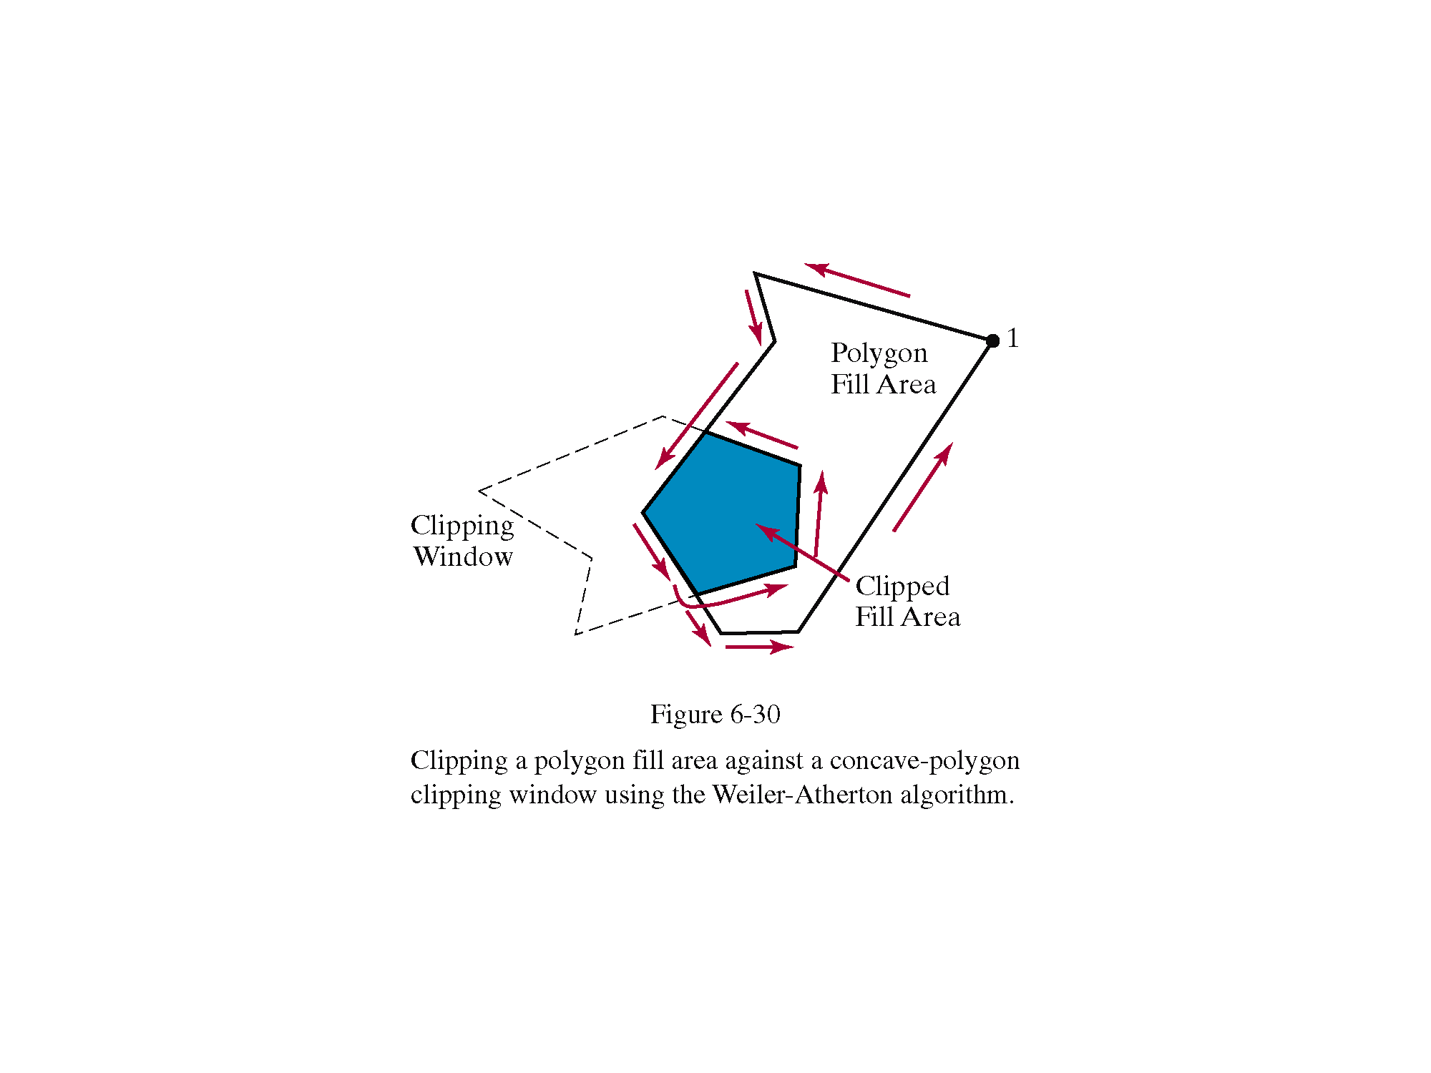

Slide 48
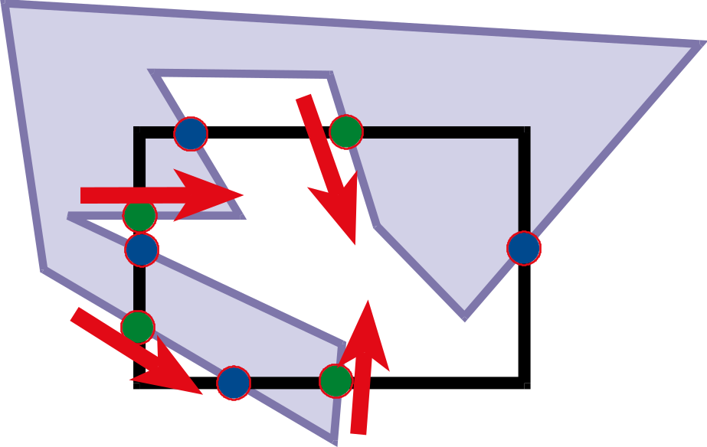
Weiler-Atherton Clipping – Overview-Summary
Walk polygon/window and compute intersection points
Mark points where polygon enters clipping window (green here) as the walk is taken along the polygon

Slide 49
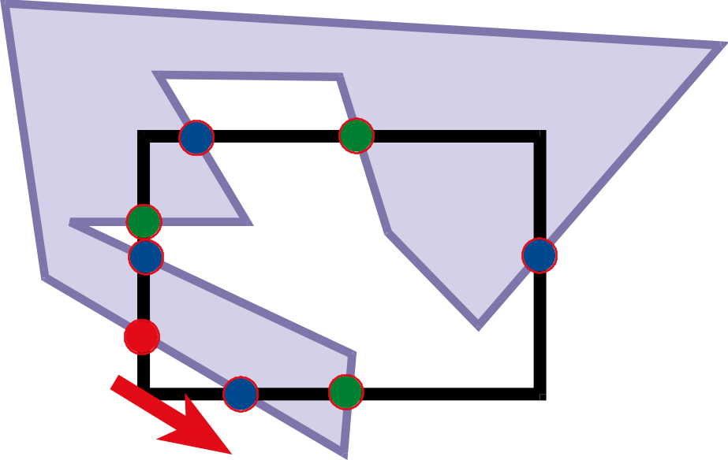
Clipping
While there is still an unprocessed entering intersection
Walk polygon/window boundary

Slide 50
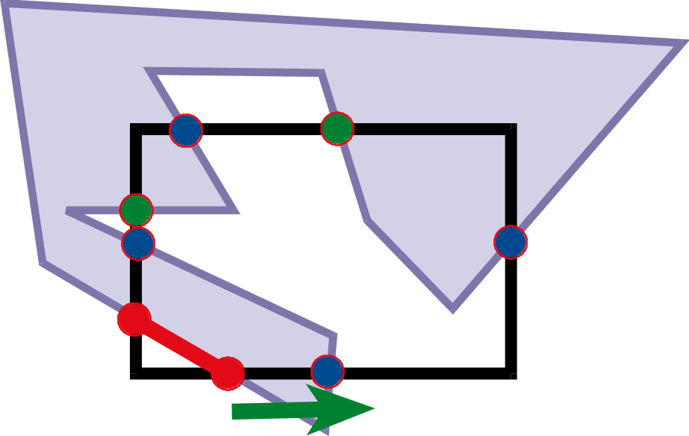
Walking Rules – Another example
Move along polygon from a towards b
At (1) Outside the window to inside the window:
  Record clipped point
  Follow polygon boundary
At (2) Inside the window to outside the window:
  Record clipped point
  Follow window boundary
a
(1)
b
(2)
b

Slide 51
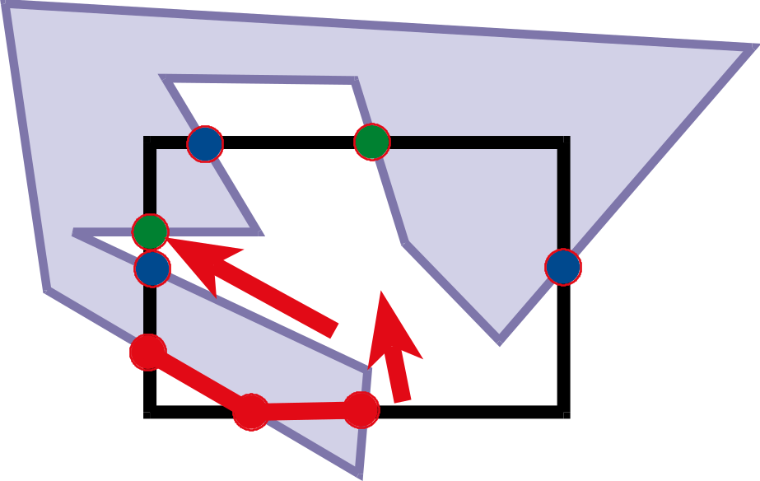
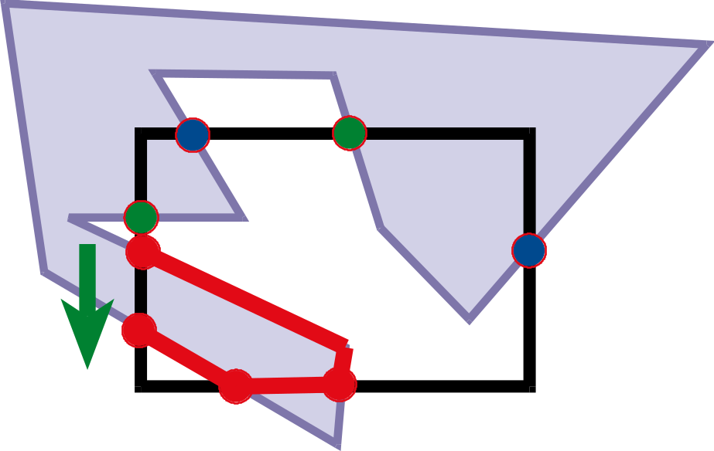
Walking Rules
At (3) Outside the window to inside the wondow:
  Record clipped point
  Follow polygon boundary
At (4) In the window to outside the window:
  Record clipped point
  Follow window boundary
(4)
(3)

Slide 52
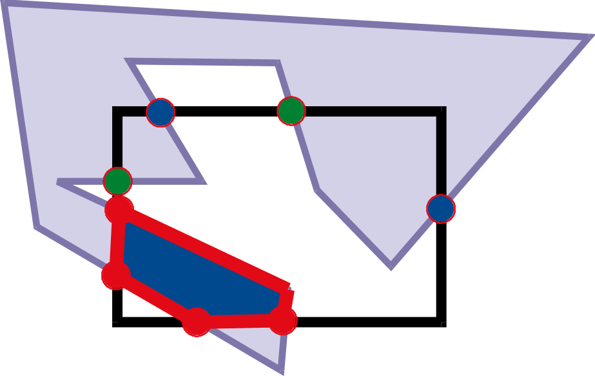
Walking Rules
We encounter a previously processed point so we have a vertex list forming a circuit inside the window.

Slide 53
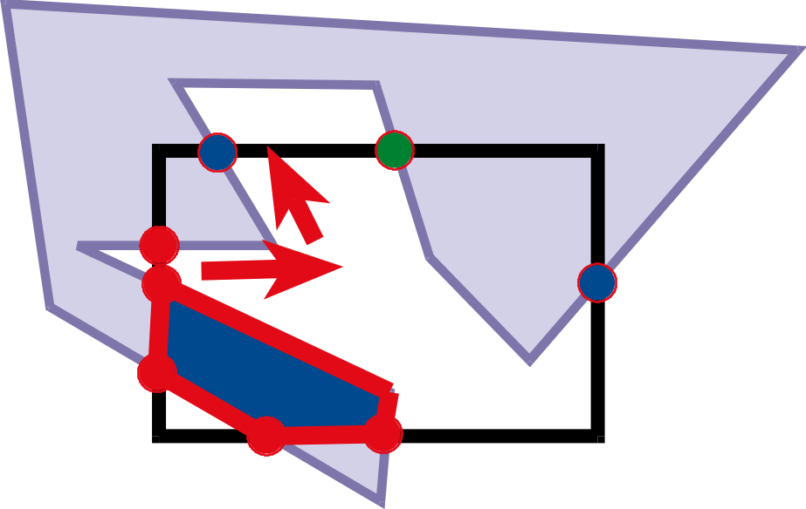
Walking Rules
While there is still an unprocessed entering intersection
Walk polygon/window boundary following rules similar to those shown earlier on the lower circuit.

Slide 54
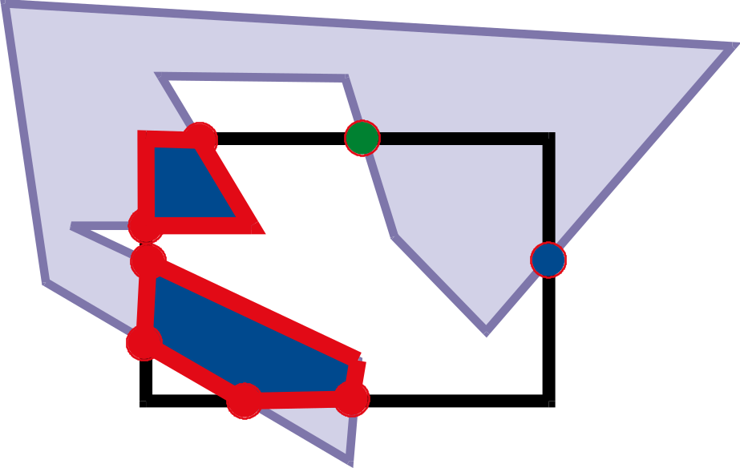
Walking rules
We end up with the next vertex list that forms a circuit.

Slide 55
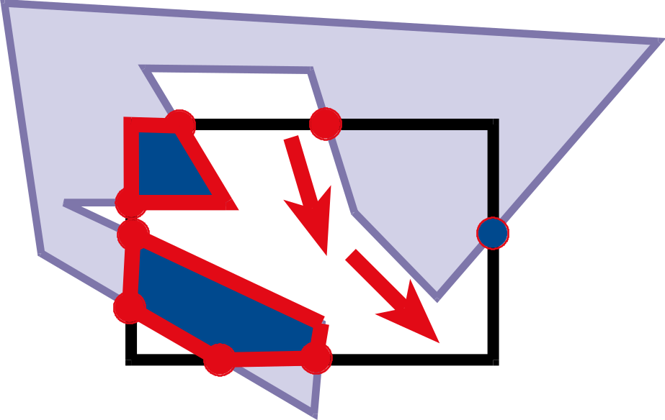
Walking rules
While there is still an unprocessed entering intersection
Walk polygon/window boundary

Slide 56
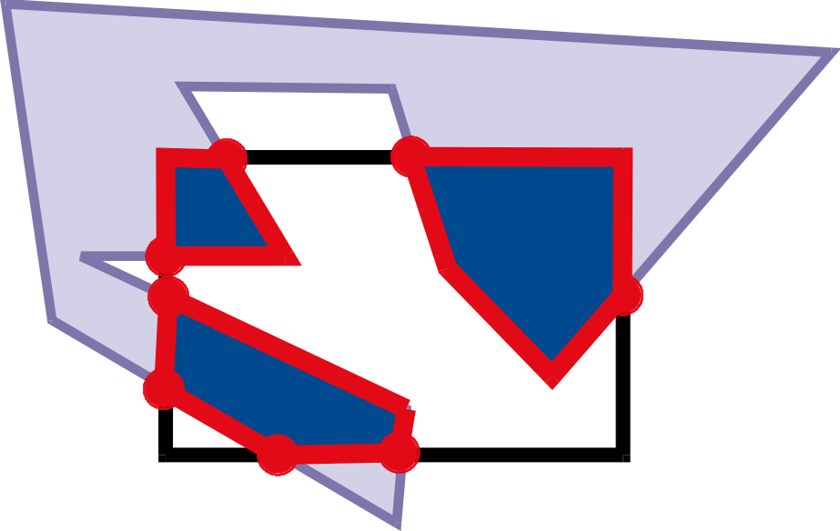
Walking rules
We obtain the final circuit and we have the clipped polygon inside the window.
Note that nowhere did we use the fact that the clipping window was a convex polygon and clearly the other polygon is concave.

Slide 57
Weiler-Atherton Clipping
Importance of good adjacency data structure
(Here we can simply list the oriented edges)

Slide 58
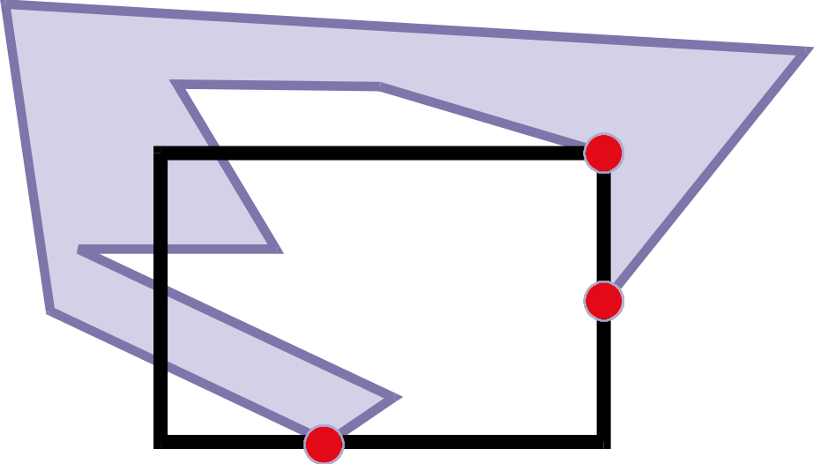
Robustness, Precision, Degenerate Cases
What if a vertex is on the boundary?
What happens if it is “almost” on the boundary?
  Problem with floating point precision
Welcome to the real world of geometry!

Slide 59
Some Observations
This algorithm works with convex or concave polygons for both the clipping window and the polygon.
The method was originally developed to identify visible surfaces in a 3D scene.
You need to know a few things however:
  How do you walk counterclockwise?
  Note: We usually store edges this way for lighting purposes.
  When are you inside a polygon?
  We saw the odd-even rule or a nonzero winding number rule can be used to answer that question.

Slide 60
Clipping
There are many other clipping algorithms:
  Cyrus and Beck Line Clipping
  Liang-Barsky Line Clipping
  Nicholl-Lee-Nicholl Line Clipping
  Polygon Fill-area Clipping
  Sutherland-Hodgman Polygon Clipping
  Clipping against nonrectangular polygons
  Curve clipping
  Text clipping
Each has different characteristics and is used in different situations.

