Slide 1
Chapter 7
From Vertices to Fragments
Part 3

Slide 2
Overview of Algorithms in Chapter 7 We Will Examine for Rasterization
Line Drawing
Setting Frame-Buffer Values
Circle Drawing
Fill Primitives
Hidden Surface Removal
  Scanline Algorithms
  Back-Face Removal
  The z-Buffer Algorithm
  Scan Conversion with z-Buffer
  Depth Sort and the Painter's Algorithm
  Antialiasing

Slide 3
Line Drawing
The best algorithms for this are not what you would first expect to use.
The most common form of the equation of a line is
  y = mx + b
where m = slope of line and b is the y-intercept.
For hand sketching a line, this is an easy formula to use.
For example,
to draw y = 2x + 3:
(0,3)

Slide 4
But, This is Not a Good Formula For Generating a Line on a Raster Device
First, y = mx +b is not the equation for all lines. Why not?
Second, depending on the slope, this may not generate a nice looking line. Let’s see why.
On raster devices, lines are plotted by changing the color of pixels.
We must sample a line at discrete positions and then determine the pixel that is nearest to the line at the sampled point.

Slide 5
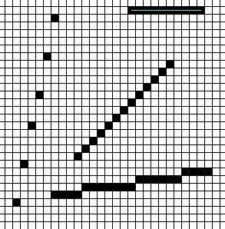
Let’s See What Happens With Different Slopes
Plot y = mx + b by sampling values for x
And this assumes square pixels!

Slide 6
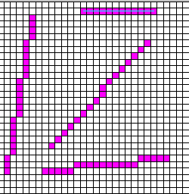
One Simple Improvement
If 0 <= m <=1, draw as before sampling with x changing.
If m >1, use the equation
x = (y-b)/m
and sample with y.
Negative slopes are handled in the obvious way.

Slide 7
Digital Differential Analyzer (DDA) Algorithm
Basically like the simple improvement algorithm, but gains speed by doing additions/subtractions instead of multiplications/divisions.
The basic idea is to step along the x-axis (or the y-axis) and instead of recalculating everything, just determine what needs to be incremented (or decremented) to get the next point.
For example, if 0 <= m <= 1, we sample at integer x intervals (x₀, x₁ = x₀ + 1, x₂ = x₁ + 1, ....) and compute successive y values as
y_{k+1} = y_{k} + m and round this to the nearest integer.
The pixel that will be drawn will be (x_{k+1}, round(y_{k+1})).

Slide 8
DDA
If 0 <= m and m > 1, we sample on integer y values, increasing by 1 each time, and calculate
x_{k+1} = x_{k} + 1/m, where 1/m is computed once.
Obviously, the algorithm has to be adjusted for negative slopes.
Each of the algorithms seen so far assumes that the line is going to be generated from left to the right, otherwise adjustments must be made.
With the DDA algorithm, there is a danger of rounding error causing drifting off the “true” calculated line.
Still, even with this algorithm, the algorithm is time consuming to run.

Slide 9
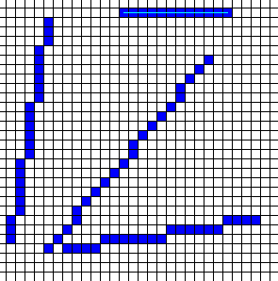
The DDA Algorithm Produces Results Similar to the Last Algorithm

Slide 10
Bresenham’s Line Drawing Algorithm
Jack Bresenham, an IBM employee, developed many nice algorithms for generating raster displays. He is particularly known for his line drawing and circle drawing algorithms.
The challenge was to produce a sequence of pixels
  That gave the best possible appearance of a line on a raster device.
  That worked for all possible lines.
  That worked quickly.
A major bottleneck in many graphics displays is the time required to scan-convert straight line segments. Most manufacturers use hardware based on Bresenham's line algorithm.

Slide 11
Bresenham’s Line Drawing Algorithm
Start with the left endpoint (red one) and assume a positive slope for now.
The goal is to determine quickly for the next sample position whether to plot the point adjacent to the current one (yellow one) or the next one up (pink one):

Slide 12
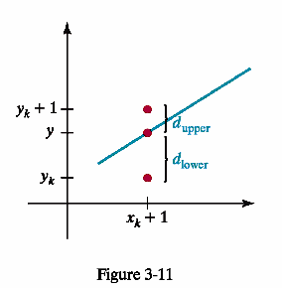
Bresenham’s Line Drawing Algorithm
Assume a positive slope with slope less than 1.0 for now and that we have determined that point (x_{k},y_{k}) is to be displayed.
Since y = m(x_{k}+1) + b for the next sample point on the x-axis, define
d_{lower} = y – y_{k}
= m(x_{k}+1) + b –y_{k}
and
d_{upper} = (y_{k}+1) – y
= u_{k} +1 –m(x_{k}+1) -b

Slide 13
Bresenham’s Line Drawing Algorithm
We set up an efficient test for which screen point to choose next.
First compute the difference:
d_{lower} - d_{upper} = 2m(x_{k}+1) – 2y_{k} + 2b -1
by substituting the previous expressions for the d values and rearranging.
Next, we manipulate the above calculation so it involves only integer calculations by substituting for m = Δy/Δx where Δy and Δx are the vertical and horizontal separations of the endpoint positions and we define:
p_{k} = Δx(d_{lower} – d_{upper})
=2(Δy)x_{k} – 2(Δx)y_{k} + c
where c is the constant 2Δy + Δx(2b-1)

Slide 14
Bresenham’s Line Drawing Algorithm
Some useful observations:
  1. The parameter c is a constant and has no influence on which point to choose next.
  2. For this case with Δx > 0, the value of p_{k} and d_{lower} - d_{upper} have the same sign.
  3. If the pixel at y_{k} is closer to the line path than the pixel at y_{k} + 1, then d_{lower} < d_{upper} and p_{k} is negative. In that case we plot the upper pixel. Otherwise, we plot the adjacent pixel!
  So, all we need to know is the sign of p_{k} (called the decision parameter) to know what to plot.
  Moreover, we can obtain the values of successive decision parameters by using only incremental integer calculations as we see next.

Slide 15
Bresenham’s Line Drawing Algorithm
At step k+1, the decision parameter is
p_{k+1} = 2(Δy)x_{k+1} – 2(Δx)y_{k+1} + c
Computing,
p_{k+1} - p_{k} = 2Δy(x_{k+1} – x_{k}) - 2Δx(y_{k+1} –y_{k})
Now, y_{k+1} – y_{k}is either 0 or 1, depending on the sign of p_{k} and x_{k+1} – x_{k} is always 1 in the case we are considering with positive, less than 1.0 slope.
Therefore,
p_{k+1} = p_{k} + 2Δy (when p_{k} < 0) or
p_{k+1} = p_{k} + 2Δy - 2Δx (otherwise)
Moreover, the parts in yellow are constants that only need be calculated once for the line being drawn!!!

Slide 16
Bresenham’s Line Drawing Algorithm
For |m| < 1.0 through points (x₀,y₀) and (x₁,y₁) with (x₀,y₀) the left endpoint.
Plot (x₀,y₀).
Calculate the constants
  Δx = x₁-x₀ , Δy = y₁ – y₀, 2Δy, and 2Δy – 2Δ and the starting position for the decision parameter as
  p₀ = 2Δy – Δx
Perform the following for each k = 1,2,... (Δx -1) times to plot (x_{k+1},y_{k+1}) where x_{k+1} = x_{k} + 1:
  If p_{k} < 0, set y_{k+1} = y_{k} and set p_{k+1} = p_{k} + 2Δy
  otherwise set y_{k+1} = y_{k} + 1 and set
  p_{k+1} = p_{k} + 2Δy - 2Δx

Slide 17
Bresenham’s Line Drawing Algorithm
The algorithm has to be generalized to lines with an arbitrary slope by using the symmetry of the various octants and quadrants of xy plane.
We step along the y direction as with the simple improved algorithm when m > 1.
The special cases of horizontal or vertical lines can be loaded directly into the frame buffer as these are detected when the constants are calculated.

Slide 18
Example
Given points (20,10) and (30,18), plot the line segment between them.
Δx = 30-20=10 and Δy = 18-10 = 8
The slope is Δy/Δx = 8/10 = 0.8 so the case outlined applies.
p₀ = 2Δy – Δx = 16-10=6 and the increment for calculating the various decision parameters are
2Δy = 16 and 2Δy -2Δx = -4
Next, fill out a table for k, p_{k}, x_{k+1} and y_{k+1} using the sign of p_{k} to determine the value of y_{k+1} and p_{k+1}

Slide 19
Example - Starts at (20,10)
k | p_{k} | x_{k+1} | y_{k+1}
0 | 6 | 21 | 11
1 | 2 | 22 | 12
2 | -2 | 23 | 12
3 | 14 | 24 | 13
4 | 10 | 25 | 14
5 | 6 | 26 | 15
6 | 2 | 27 | 16
7 | -1 | 28 | 16
8 | 14 | 29 | 17
9 | 10 | 30 | 18

Slide 20
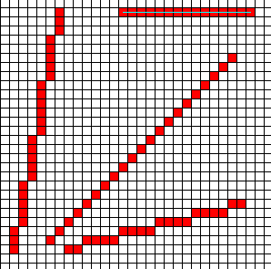
Bresenham’s Line Drawing Algorithm
DDA Draws as well – the power of this algorithm is its speed.
Again, with algorithms, to gain speed, we need a more complex algorithm than the usual ones we think to use first!

Slide 21
Line Drawing Algorithm Development Did Not Stop with Bresenham
For example, there is an excellent algorithm, developed in 1990 by J.G. Rokne, Brian Wyvill, and Xiaolin Wu.
http://portal.acm.org/citation.cfm?id=88572
In this paper an algorithm is developed based on the original Bresenham scan-conversion together with the symmetry first noted by Gardner and a recent double-step technique. This results in a speed-up of scan-conversion by a factor of approximately 4 as compared to the original Bresenham algorithm. Hardware implementations are simple and efficient since the property of using only shift and increment operations is preserved.

Slide 22
Circle-Generating Algorithms
The formula for a circle centered at (x_{c},y_{c}) with radius r in the plane is:
(x – x_{c})² + (y – y_{c})² = r²
By solving for r, we could try to use the formula for generating a circle:
____________
r = y_{c} ± √ r² – (x_{c} – x)²
but, obviously, there are some problems with this such as:
There is a lot of computation at each step.
The spacing between plotted positions is not uniform
There is a danger of undefined calculations being attempted.

Slide 23
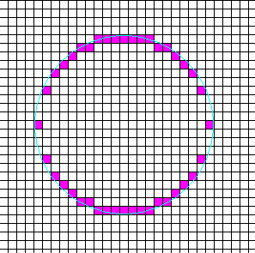
Simple Plotting Results

Slide 24
Circle-Generating Algorithms
Another approach: Use polar coordinates and a parametric equation in r and Θ, where r is the radius of the circle and Θ is the angle formed with the x-axis.
The equations to use are then:
x = x_{c} + r cosΘ
y = y_{c} + r sinΘ
where we step through Θ with a fixed size.
This handles the problem of unequal spacing, but the calculations are time consuming because of the trig calculations.

Slide 25
Circle-Generating Algorithms
Bresenham took the same basic ideas for his line drawing algorithm and modified it for circle drawing.
Again, a decision parameter is used to determine which pixel should be chosen next.
His algorithm compares pixel distances from a circular path by comparing the squares of the pixel separation distances.
But, his algorithm can be modified to form the midpoint circle algorithm which provides an even faster technique for drawing circles.

Slide 26
Midpoint Circle Algorithm
Sample at unit intervals and determine the closest pixel position to the specified circle path at each step.
We assume the circle is at the origin when we are plotting it.
After a point to plot is determined, we move it to its specified position for the circle centered off the origin by translating with x_{c} and y_{c}.
We take advantage of symmetry and develop the algorithm first for the one octant and then adjust it for the other seven octants.
As with Bresenham’s line drawing algorithm, we will define a decision parameter that will help us choose the next point to plot.

Slide 27
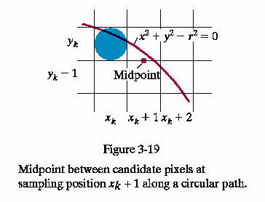
Midpoint Circle Algorithm
Define f_{circ}(x,y) = x² + y² – r²
Any point (x,y) on the boundary of the circle satisfies the equation
f_{circ}(x,y) = 0.
If the point is in the interior of the circle, the circle function is negative. If it it outside the circle, the function is positive.
This circle function is the
decision parameter we will
use and we will test midpoints
between two candidate pixels

Slide 28
We have plotted (x_{k},y_{k}).
We evaluate the circle function at the midpoint of the possible candidate pixels, (x_{k} + 1, y_{k} - 1/2).
If this is negative, the midpoint is inside the circle and the pixel at y_{k} is closer to the circle boundary. Therefore, let y_{k+1} = y_{k}. Otherwise, choose the pixel with y being y_{k} – 1.
As with the line drawing algorithm, successive decision parameters can be calculated easily. In fact, it is not necessary to square the radius!

Slide 29
Derivation Details are Skipped
Generation of the pixel positions in the first octant using the Midpoint Circle Drawing Algorithm for a circle centered at (0,0) with radius r:
Plot (x₀,y₀) = (0,r) and set p₀ = 5/4 – r. If r is an integer, use 1 – r.
At each x_{k} starting at k = 0, test sign of p_{k}.
If p_{k} < 0, y_{k+1}= y_{k} and
p_{k+1} = p_{k} + 2x_{k+1} + 1.
Otherwise, y_{k+1} = y_{k} -1 and
p_{k+1} = p_{k} + 2x_{k+1} + 1 – 2y_{k+1}
where 2x_{k+1} = 2x_{k} + 2 and 2y_{k+1} = 2y_{k} -2.
After generating these for the first octant, the others are done by symmetry.

Slide 30
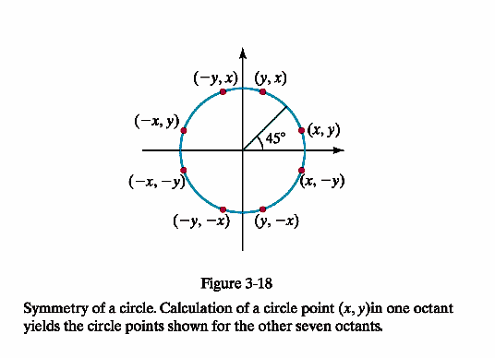
Using Symmetry for Other Octants

Slide 31
Example
Plot the circle with r = 10 using the midpoint circle algorithm for the first and second octants.
p0 = 1- r = -9 (since r is an integer)
Plot (0,10). The initial increment terms for calculating the decision parameters are 2x₀ = 0 and 2y₀ = 20. (Note: these must be recalculated for each step.)
We set up a table, just as for the line drawing algorithm, for each of the needed values.

Slide 32
Midpoint Circle Algorithm Example
k | p_{k} | x_{k+1} | y_{k+1} | 2x_{k+1} | 2y_{k+1}
0 | -9 | 1 | 10 | 2 | 20
1 | -6 | 2 | 10 | 4 | 20
2 | -1 | 3 | 10 | 6 | 20
3 | 6 | 4 | 9 | 8 | 19
4 | -3 | 5 | 9 | 10 | 18
5 | 8 | 6 | 8 | 12 | 16
6 | 5 | 7 | 7 | 14 | 14
Red is plotted from initial point and above table. Yellow is plotted by symmetry.

Slide 33
Other Curves
As an ellipse is an elongated circle, it should be obvious that efficient algorithms can be designed for generating ellipses.
Other interesting curves are the conics where various properties of A, B, C, D, E, and F determine the curve specified by
  Ax² + By² + Cxy + Dx + Ey + F = 0
In fact, algorithms similar to the midpoint circle algorithm can be derived for each of the curves and allow for efficient generation.
And, of course, we have already looked at splines and some of the methods used to generate them.

Slide 34
Fill-Area Primitives
A fill area is a picture component which can be filled with some solid color or a pattern.
Most graphics packages allow fill regions, but often restrict them to polygons.
Of course, in 3D graphics, a set of designated polygon vertices may not lie exactly in one plane due to rounding errors, errors in selecting coordinate positions, or because they were generated as approximations to curves.
Moreover, as we have seen, convex polygons are often the only ones supported for fill operations, so many graphics packages automatically tessellate polygons into triangles.
OpenGL requires all fill polygons to be convex.

Slide 35
Identifying Concave Polygons
We can use the vector cross product to identify concave polygons.
Recall when we defined the cross product of two vectors – we did it intuitively, but the formula below was given also:
  V1 X V2 = |v1| |v2| sinΘ u, where u is the vector given by the right hand rule, and Θ is the angle between the vectors.
  |v1| and |v2| are the magnitudes of the vectors so they are always positive.
When dealing with polygon algorithms, we always assume that we do not have a degenerate polygon – i.e. some of the points are not collinear.

Slide 36
V1 X V2 = |v1| |v2] sinΘ u
A concave polygon has at least one interior angle greater than 180 degrees.
If we walk around a polygon and form vectors of each of its edges, a concave polygon will have at least two of the pairwise cross products of opposite signs.
sign (E3 X E4) is negative
while all the other cross products are positive.
We can use this information to split the polygon into convex regions.

Slide 37
Determining If a Polygon is Concave or Convex
Assume polygon is in the xy plane. If not, move it there.
Assume the polygon is not degenerate.
Form the edge vectors between two consecutive vertex positions : E_{k} = V_{k+1} – V_{k}
Calculate the cross products of successive edge vectors in order around the polygon perimeter. Process in counterclockwise order (to have the calculations available for splitting a concave polygon later.)
If the cross products are all of the same sign, the polygon is convex; otherwise, it is concave.

Slide 38
Splitting a Concave Polygon Into Convex Polygons
Given a concave polygon determined by the method on the last slide, examine each cross product with a negative value.
If E_{i} X E_{i+1} is negative, extend the line segment E_{i} to split the polygon.
To do this computationally, we compute the slope of the green line segment, its y-intercept and determine its intersection with the polygon. (Assuming the slope exists – otherwise, handle as a special case.)

Slide 39
Other Methods For Splitting Polygons
Rotational method:
  Move counterclockwise around polygon edges, shift each vertex V_{k} onto the origin.
  Rotate the polygon in a clockwise direction so the next vertex V_{k+1}is on the x-axis.
  If V_{k+2} is below the x axis, the polygon is concave and should be split along the x-axis to form two new polygons.
  Repeat the test on the new polygons.

Slide 40
Rotational Example
Both polygons are now convex so we quit.
Note: The axis are displaced slightly so the work can be seen.
Another algorithm easily splits a convex polygon into a set of triangles which provides a nice tessellation algorithm.

Slide 41
Drawing and Filling Polygons

Slide 42
Fill-area Attributes
Most graphics packages limit fill areas to polygons because they are described by linear functions.
Moreover, they are further restricted to convex polygons.
There are basically two techniques used:
  Determine the overlap intervals for scan lines that cross the area and set these to the fill color (We'll do this later)
  From an interior position, start painting and continue outward, pixel by pixel, until a boundary is encountered. (These are called flood fill algorithms.)

Slide 43
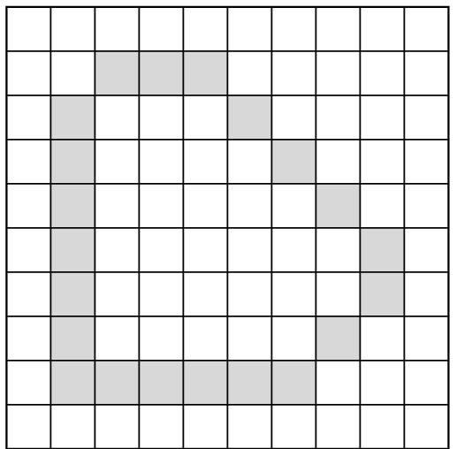
Drawing Polygons: Flood Fill
Draw edges of polygons into frame buffer
Assume background is WHITE and drawing colour is GREY
Grow coloring out from a seed point inside the polygon until an edge is encountered
Recursive Algorithm:
  flood_fill(int x, int y)
  { if(read_pixel(x, y) == WHITE)
  { write_pixel(x, y, GREY);
  flood_fill(x-1, y);
  flood_fill(x+1, y);
  flood_fill(x, y-1);
  flood_fill(x, y+1);
  } }

Slide 44
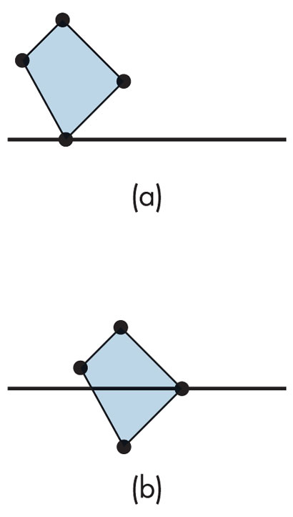
Singularities
Polygons have an advantage over other shapes as the locations of their edges are known exactly.
However, even polygons can cause problems.
Consider:
If we are using an odd-even fill definition, these have to be counted differently.
We can make sure all integer-valued vertices are displaced slightly to avoid this problem.
OpenGL considers a virtual frame buffer with twice the resolution of the real frame buffer.
Then pixels are located only at even values of y and all vertices are located only on odd values of y. This fixes the problem.

Slide 45
Hidden Surface Removal

Slide 46
Hidden Surface Removal
This is also known as visible surface determination.
Every fragment generated by rasterization corresponds to a location in the frame buffer, but we do not want to display the fragment if it is behind another opaque object.
Hidden surface removal algorithms locate what part, if any, of each object in the view volume will be visible to the viewer.
As usual, there are several different algorithms for doing this.
As usual, each has its strengths and weaknesses.
As usual, these algorithms can be used for doing things other than hidden surface removal.

Slide 47
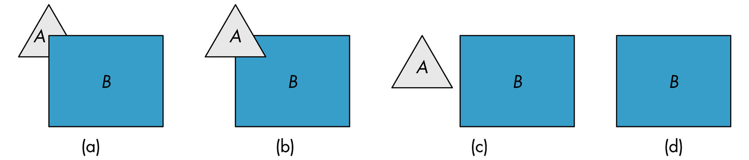
Object-Space and Image-Space Approaches
Consider the following situations:
For an object space algorithm we could do:
Pick one of the k polygons and compare it pairwise with the remaining k-1 polygons.
Determine the visible part and render it for each of the k-1 polygons.
Without deriving any details of this algorithm, it should be clear the complexity is Θ(k²) in the worst case.
So, we can see that object-space algorithms work well when there are few polygons.

Slide 48
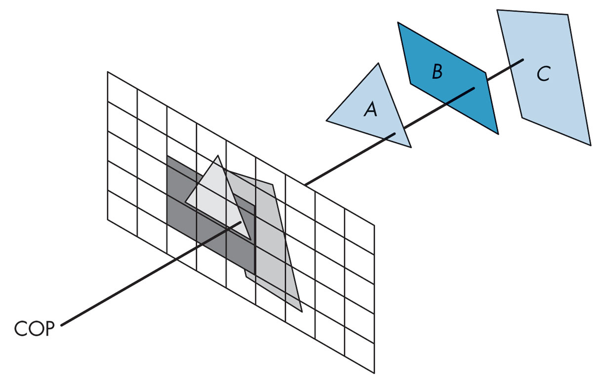
Object-Space and Image-Space Approaches
The image-space approach follows the ray casting model.
Consider:
Now we find the the point that is closest to COP-the center of projection.
The fundamental operation is the intersection of the rays with the objects.
For an n X m display, we must do nmk operations so we have a complexity of Θ(k) in worst case.

Slide 49
Sorting
For the object-oriented algorithms, we could sort objects by their distance from the camera.
But, as we know, this would give us, at best, a Θ(k logk) algorithm.
As it turns out, we can often do object-oriented hidden surface removal and achieve this complexity.
Moreover, there are some situations where collision detection algorithms are needed and although they initially look bad, they can be reduced to a Θ(k logk) algorithm.
We'll look at several of these although realize there are many more possiblities.

Slide 50
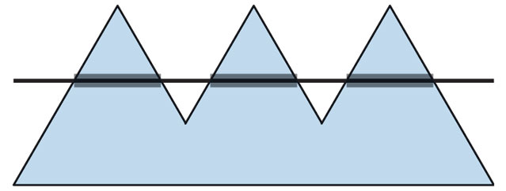
Scanline Algorithms
These algorithms potentially generate pixels as they are displayed.
Recall a scan line is one row of the frame buffer which is displayed on a monitor in one sweep of the electron guns.
Consider:
If we use the odd-even rule, there are 3 spans in this example.
Note that each span can be processed independently for lighting and depth calculations.
This is exploited in some hardware that has parallel span processors.

Slide 51
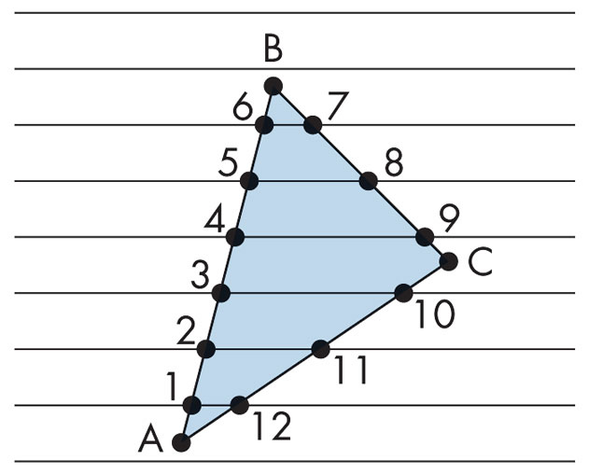
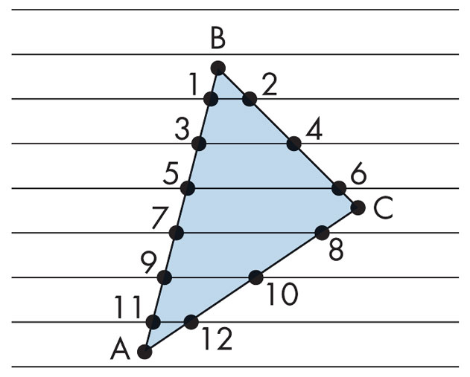
Scanline Algorithms
The ease of doing scanline work depends on the way we store the vertices.
Consider the two cases:
Obviously the ordering on the right is better as it allows us to exploit the ordering when generating the scan lines.

Slide 52
Scanline Algorithms
A brute force approach would sort all the intersections into the desired order.
But, a large or jagged polygon might intersect so many edges that the n intersections can be large enough that the Θ(n logn) complexity of the sort makes the calculation too slow for real-time implementations.
An example of this would be when a polygon spans half of the scan lines.
Several methods have been developed to avoid this poor complexity.
We'll look briefly at the yx algorithm that creates bucket for each scanline.
This algorithm is often implemented in hardware.

Slide 53
Scan Line Algorithms
A scan line is a row of pixels on a screen.
When the frame buffer is output, the output starts in the upper left corner.
The electron gun then moves across the row (or scan line) outputting the necessary settings, and then returns to the left side for the second scan line.
Fill algorithms that determine the properties of a pixel while it is being output on the scan line are called scan line algorithms.
Flood algorithms determine the properties of a pixel in the frame buffer.

Slide 54
Basic Ideas Behind Scan Conversion Algorithms
If a scan line doesn’t pass through a vertex, it intersects a polygon an even number of times (or none at all).
For non-convex polygons, this observation assumes inside-outside is defined the same way – i.e. in the star, the point is outside the star.
A

Slide 55
Most Scan Conversion Algorithms Work as Follows
Given a point on one scan line, determine the point on the next scan line when we know the edge of the polygon:
Most produce the polygon in the order:
scan line 1
scan line 2
scan line 3

Slide 56
The Integer Coordinates Used on the Screen Cause Some Problems
Example: Define a rectangle with vertices (1,1), (5,1), (5,4), and (1,4). This is a 4 X 3 polygon with area 12.
But when we plot pixels the area is 20!
Note: The pixel is addressed by its lower left corner
 | 1,4 |  |  |  | 5,4
 | 1,1 |  |  |  | 5,1

Slide 57
One Approach to Correcting the Last Problem (Somewhat)
When plotting (x,y),
plot (round(x) , round(trunc(y) + 0.5))
This effectively rounds in the y direction and gives an area of 15.
 | 1,4 |  |  |  | 5,4
 | 1,2 |  |  |  | 5,2

Slide 58
Simple Ordered Edge List Algorithm for Scan Converting a Polygon
Example: Define a polygon by
P1:(1,1)
P2:(8,1)
P3:(8,6)
P4:(5,3)
P5:(1,7)
P5
P3
P4
P1
P2
1) Displace each vertex to remove them from the scan lines by adding 0.5 to y value.
2) Scan from y = 7 down to y = 2.
3) Given each line segment, calculate the intersections of each scan line with the line segment.

Slide 59
Calculate the Intersections of Each Scan Line With the Line Segment.
For P5:(1,7.5) to P4:(5,3.5)
The slope is 4/-4 = -1
For the first intersection,
y is y - 0.5 and x is x + ½|1/m|
Afterwards, y is y-1 and x is x+ |1/m|
So, the intersections are
(1.5,7), (2.5,6), (3.5,5), (4.5,4)
The significance of the yellow point will become clear later.

Slide 60
Calculate the Intersections of Each Scan Line With the Line Segment.
For P4:(5,3.5) and P3:(8,6.5)
The slope is 3/3 = 1
For the first intersection,
y is y – 0.5 and x is x -1/2|1/m|
Afterwards, y is y-1 and x is x - |1/m|
So the intersections are
(7.5,6), (6.5,5), and (5.5,4)
Note: As we will generate pixels as scan lines are encountered, we generate these from the highest point to the lowest point.

Slide 61
Calculate the Intersections of Each Scan Line With the Line Segment.
P1:(1,1) to P5:(1,7) is easy as Δx =0. Therefore, the intersections are
(1,7), (1,6), (1,5) , (1,4) , (1,3), (1,2).
P1:(1,1) to P2:(8,1) has Δy = 0 so there are no intersections (recall the scan line is displaced and not an integer).
P3:(8,5) to P2:(8,1) is easy also: Intersections are (8,6), (8,5), (8,4) ,(8,3),(8,2)

Slide 62
Store the Intersections in Buckets, One for Each Scan Line
In each bucket, the intersections are sorted by ascending values of the x.
This is easy to do by doing an insertion sort as the values are stored.
For example, at scan line 5, the bucket would look like:
1
3.5
6.5
8
because the points (1,5), (3.5,5), (6.5,5), and (8,5) are intersections with the line segments
P1-P5, P5-P4, P3-P4, and P3-P2 respectively. (To see this, go back to the previous slides and look at the yellow highlighted points).

Slide 63
To Turn On Pixels
Each scan line will have an even number of entries in the bucket.
Starting at the head of the bucket (on the left), select in pairs and turn on the pixels between and including the two entries.
The pairs for scan line 5 are
  1 and 3.5
  6.5 and 8
So, on scan line 5, we would turn on pixels
(1,5), (2,5), (3,5), (4,5) and (7,5),(8,5) rounding up on each of the numbers.

Slide 64
The Entire Bucket List For This Simple Polygon Is
1
8
1
8
1
4.5
5.5
8
1
3.5
6.5
8
1
2.5
7.5
8
1
1.5
This starts at scan line 2 in the upper bucket and goes through scan line 7. The scan lines are read out 7, 6, 5, ...

Slide 65
This Would Produce the Polygon Below
The “true” polygon is shown outlined in yellow.

Slide 66
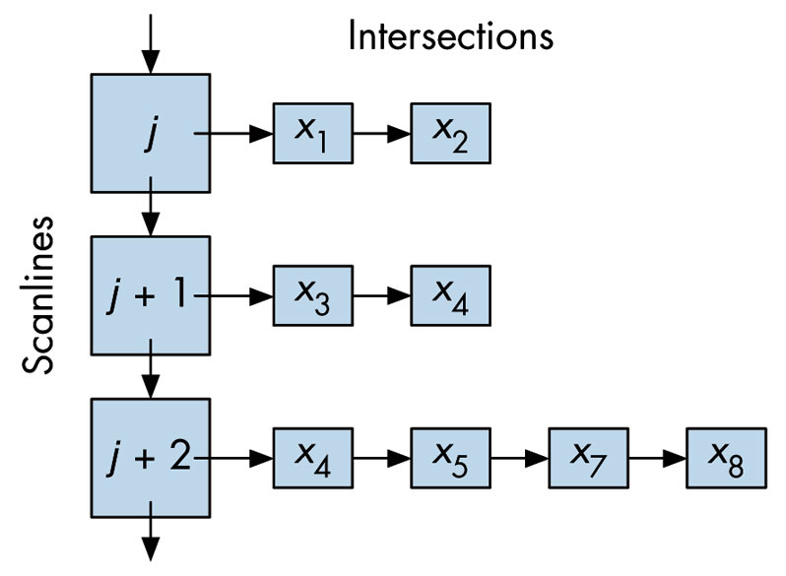
The Data Structure for yx Algorithm.
Each scan line is represented as a linked list (or bucket) showing the x values of the intersections – i.e. (x1, j) is one intersection.
As edges are processed, the intersections with scanlines are placed in the proper bucket.
Within each bucket, an insertion sort orders the x values along each scanline.

Slide 67
YX-Scan Algorithm
The algorithm just used is called the YX-scan algorithm because you sort on y and then sort on x.
It is simple to code.
However, it is a space hog as it maintains a bucket for each scan line.
If the picture is complex, there are a lot of intersections and the space used in prohibitive.
Another algorithm, the Active Edge List Algorithm, does a similar thing, but generates the intersections as the scan line is readied to be output, not in advance like the YX-algorithm.

Slide 68
Active Edge List Algorithm
Basic idea: If we just scanned one line and we have generated a pixel at (x_{i}, y_{i}), then we can calculate the next intersection
(x_{i} -1/m, y_{i}-1) if we know the previous x-intercept, previous scan line, the value -1/m (if it is defined) and if the edge intersects the new scan line.
Therefore, we create a record for each edge:
x | -1/m | Δy | link
where x = previous x-intercept; initially x for largest y,
-1/m (vertical lines are 0 and horizontal lines are ignored), Δy – count of number of scan lines that intersect edge

Slide 69
The Edge Table
We store these records in buckets by scan line, but we don’t sort them. The idea is that there are fewer edges than intersections.
Using the previous example on slide 9,
for scan line 6 we have the edges P3-P4 and P4-P2:
P5
8 | -1 | 3
8 | 0 | 5
P3
and for scan line 7 we have the edges P5-P1 and P5-P4:
P4
P1
P2
1 | 0 | 6
1.5 | -1 | 4

Slide 70
We Use an Active Edge List to Scan Convert the Polygon
1. Start with the active edge list (AEL) of the top scan line, y = 7:
1 | 0 | 6
1.5 | -1 | 4
2. Turn on pixels (1,7) and (2,7)
3. Update and merge with next edges from edge table sorted by x:
At y = 6, the AEL is
P5
P3
P4
1 | 0 | 5
2.5 | 1 | 3
P1
P2
8 | -1 | 3
8 | 0 | 5
So, turn on (1,6), (2,6), (3,6), (8,6)

Slide 71
Continuing
For scan lines 5 and 4, only the updates occur- no new edges are added and no edges are dropped.
At scan line 3, we have AEL as
1 | 0 | 2
5.5 | 1 | 0
5 | -1 | 0
8 | 0 | 2
and the edges with Δy = 0 (see yellow entries) are deleted.
This works well although when the new edge is inserted and after each update, the x values need to be checked to see if they are still in increasing order.

Slide 72
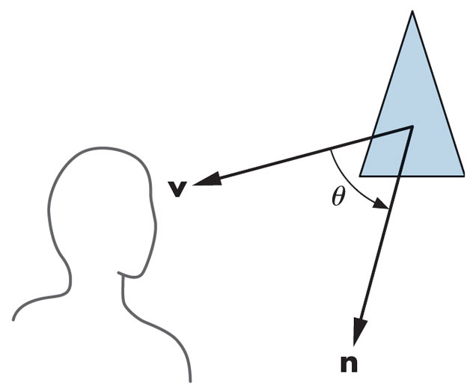
Back-Face Removal
OpenGL allows the application programmer to render only front-facing polygons.
When we can't see back faces we can reduce the work needed for hidden surface removal.
The following shows the test for culling a back-facing polygon:
n is the normal and v is the lookat vector.
We see the face if and only if
-90 <= Θ <= 90
or, equivalently,
cos Θ >= 0

Slide 73
Back-Face Removal
The second condition is easier to test as all we need to do is a dot product calculation – i.e.
n · v >= 0
Moreover, we can do even better if we apply the test after transformation to normalized device coordinate.
In that case, all views are orthographic with the direction of projection along the z-axis.
The homogeneous coordinates are then
v = [0 0 1 0]^{T}
So, if the polygon is on the surface
ax + by + cz + d = 0
we need to only check the sign of c to see if it is front or back facing.

Slide 74
Back-Face Removal
This test can be done in either software or hardware.
OpenGL uses the function glCullFace which allows us to turn on back face determination.
The test it uses is based on computing the area of the polygon in screen coordinates.
If it is negative, it is a back-facing polygon.

Slide 75
The z-Buffer Algorithm
This is the most widely used hidden-surface removal algorithm today.
It's easy to implement in either hardware or software.
It is comparable with pipeline architectures.
It operates at speeds at which the fragments pass through the pipeline.
The algorithm technically is an image space algorithm, but it loops over the polygons rather than over pixels.
Consequently, it is really part of the scan conversion process that we discussed earlier.

Slide 76
The z-Buffer Algorithm
Depth information is kept with each fragment in a buffer other than the frame buffer called the z buffer or depth buffer.
We rasterize polygon by polygon and for each fragment corresponding to an intersection of the ray through a pixel, we calculate the z-value.
If the z-value is less than the one in the depth buffer, we replace it and place the calculate color for that pixel in the color buffer.
See the illustration on the next page.

Slide 77
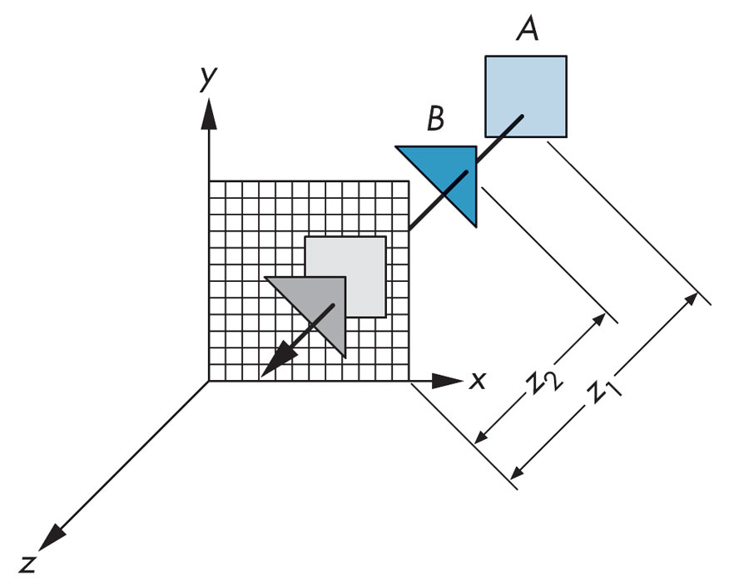
FIGURE 7.47 The z-buffer algorithm.

Slide 78
The z-Buffer Algorithm
For perspective views, the depth we are using is the distance that have been altered by a normalization transformation.
That transformation, as we will see, is nonlinear, but it preserves relative distances.
Some numerical inaccuracies can result, however, if the distance to the near clipping plane is small.
OpenGL uses the z-buffer algorithm for hidden-surface removal.
As noted earlier, in "Toy Story", this algorithm was modified in order to allow a transparent face helmet.

Slide 79
The z-Buffer Algorithm
This algorithm works well with image-oriented approaches to the implementation because the amount of incremental work is small.
For details see the text.
Normally the worst case performance of an image space algorithm is proportional to the number of primitives, the z-buffer algorithm's performance is proportional to the number of fragments generated by rasterization.
This latter value depends on the area occupied by the polgons.

Slide 80
Scan Conversion with z-Buffer
We won't walk through this here, but, basically, this section follows a polygon down through the pipeline and shows how the various parts come into play.
The critical point is that while a polygon is being sent down the pipeline, we can manipulate it to to do hidden-surface removal, coloring, and various other tasks such as applying bit patterns (called strippling) and texturing.
Thus, the timing for the rendering process is just as fast as we can move a polygon down through the pipeline.

Slide 81
Depth Sort and the Painter's Algorithm
Image-space methods are dominant in hardware as they can be efficiently implement by the z-buffer algorithm.
Often object-space methods are coupled with this to lower the polygon count.
Depth sort is a direct implementation of the object space approach to hidden surface removal.
We will only look at the algorithm for a scene composed of planar polygons although the algorithm can be extended to other classes of objects.

Slide 82
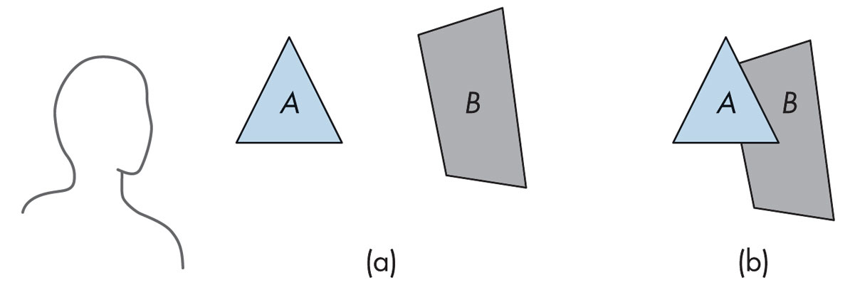
Depth Sort and Painter's Algorithm
The depth sort is a variant of a simpler algorithm known as the painter's algorithm.
In (a), suppose we have a collection of polygons that are sorted based on how far from the viewer the polygons are.
For a viewer, they appear as (b).

Slide 83
Painter's Algorithm
Render the far polygon into the frame buffer (i.e. paint it in), then render the near polygon similarly.
Both of these polygons would be rendered correctly with the hidden surface being automatically calculated.
But, there's two problems – (1) How to sort efficiently
(2) What do you do when the polygons overlap.

Slide 84
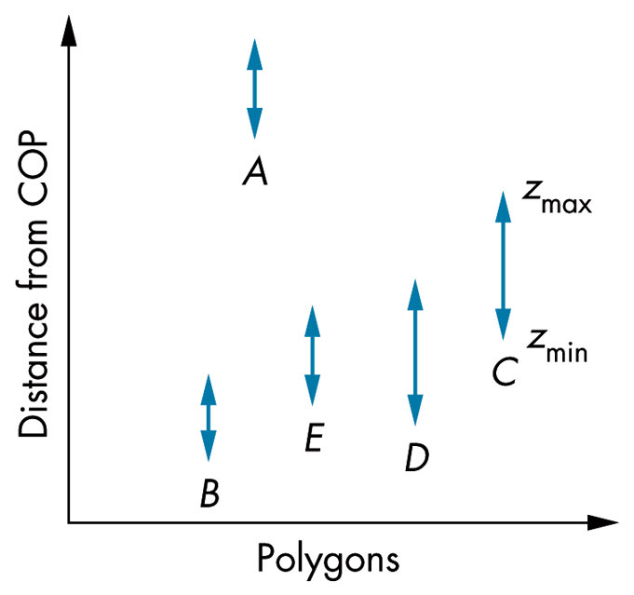
Depth Sort
This algorithm addresses both of these questions although in specific applications more efficient methods can be found.
We calculate the z- extents of the sorted polygons.
We order the polygons by how far from the viewer their maximum x value is.
If the minimum value of a polygon is greater than the maximum depth of the polygon behind the one of interest, we paint the polygons back to front and we're done.

Slide 85
Depth Sort Algorithm
For example, polygon A is behind all the other polygons and can be painted first.
However, we can't handle the others based solely on their z-extents.

Slide 86
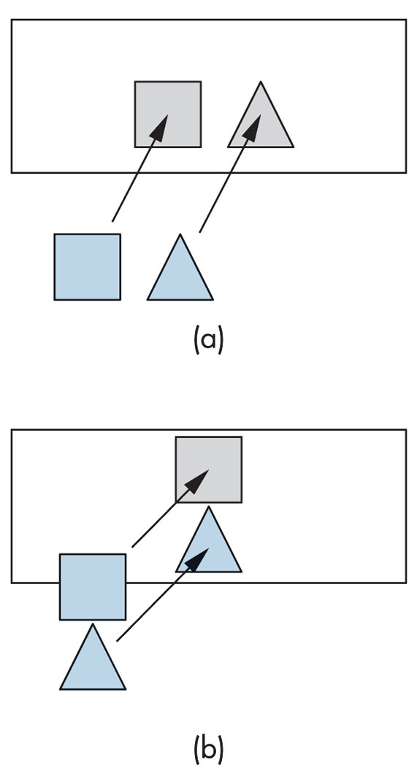
Handling Polygons That Don't Yield Quickly to the Depth Sort
The algorithm runs increasingly more difficult tests, attempting to find a satisfactory ordering.
The simplest test is to check their x and y extents:
Nonoverlapping x extents.
(b) Nonoverlapping y extents.
If either do not overlap, neither polygon can obscure the other and they can be painted in either order.
Note: This is assuming a parallel view!

Slide 87
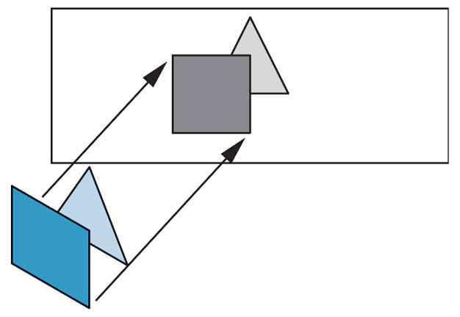
Handling Polygons That Don't Yield Quickly to the Depth Sort
Even if these tests fail, it might still be possible to find an ordering so the polygons can be painted individually.
One possible case is when one polygon lies completely on one side of the plane determined by the other:
As you might expect, there are many special cases to consider with this algorithm.

Slide 88
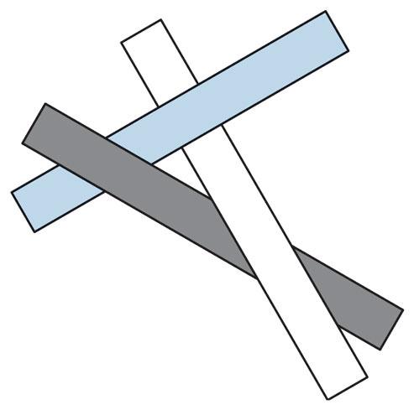
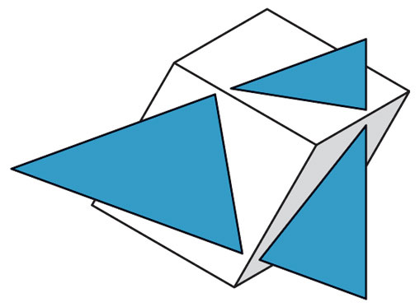
Some Cases That Are Still Difficult to Handle With This Algorithm
Cyclic overlapping polygons and piercing polygons.

Slide 89
Antialiasing

Slide 90
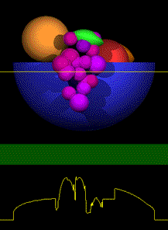
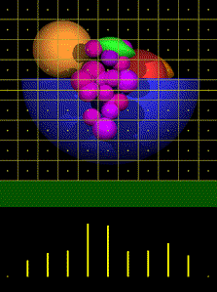
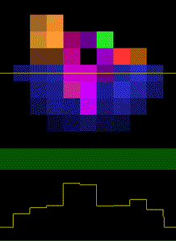
Aliasing
Occurs when the sampling inherent in rendering does not contain enough information for an accurate image.
Original Scene
Sampling Pixel Centers
Rendered Image
Scanline Luminosity
Sampled Signal
Luminosity Signal

Slide 91
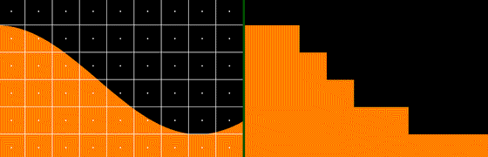
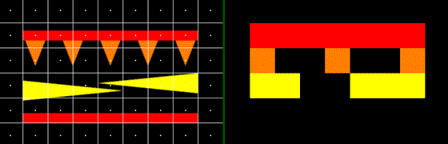
Effects of Aliasing
  Common aliasing errors (called artifacts) are: jagged profiles, disappearing or improper fine detail, and disintegrating textures.
Jagged Profiles
Loss of Detail

Slide 92
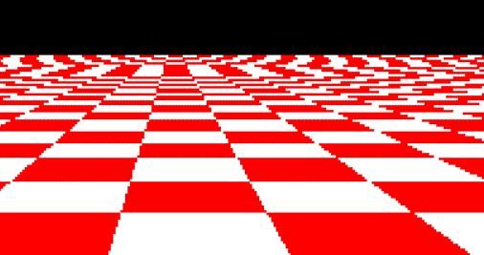
Disintegrating Textures
  The checkers on a plane should become smaller with distance.
  But aliasing causes them to become larger and/or irregular.
  Increasing resolution only moves the artifact closer to the horizon.

Slide 93
Antialiasing
Developed to combat aliasing
Applies to all types of aliasing
Prefiltering:
  Treat a pixel as an area. Calculate overlap of polygon with pixel.
  Color based on which color contributes most to the pixel.
  Costly

Slide 94
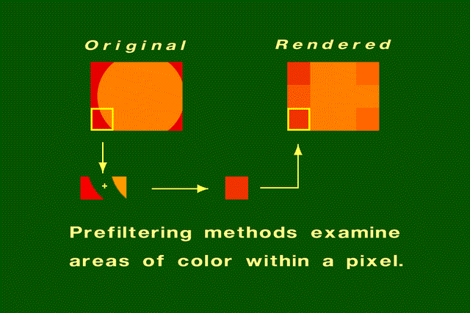
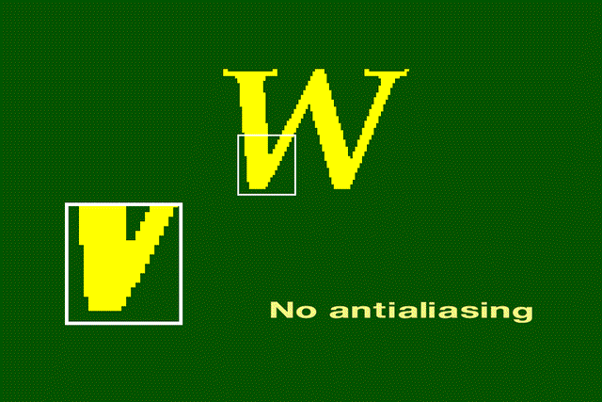
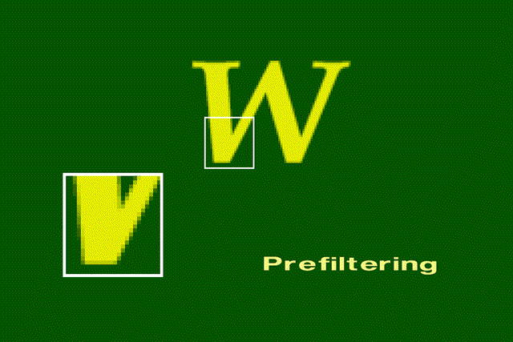
Prefiltering
No Antialiasing
Prefiltering

Slide 95
Antialiasing
Postfiltering (supersampling):
  Compute pixel color by averaging multiple samples. Preferred Method
  Sample the scene at n times the display resolution.
  For example, suppose the display resolution is 512x512. Sampling at three times the width and three times the height of the display resolution would yield 1536x1536 samples
  A filter provides the weights used to compute the average

Slide 96
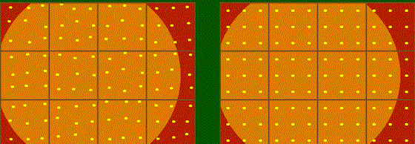
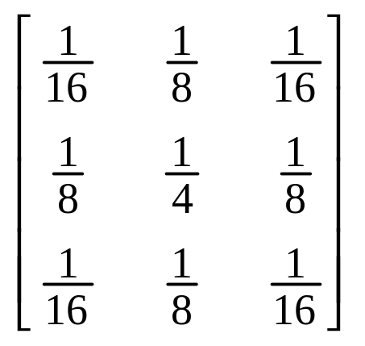
Postfiltering
Sampling: take n X n jittered, regular or random samples.
Averaging: use an n X n
filter to assign weights to
each sample. Sum all the
weighted samples to obtain
a pixel.
Jittered
Regular

Slide 97
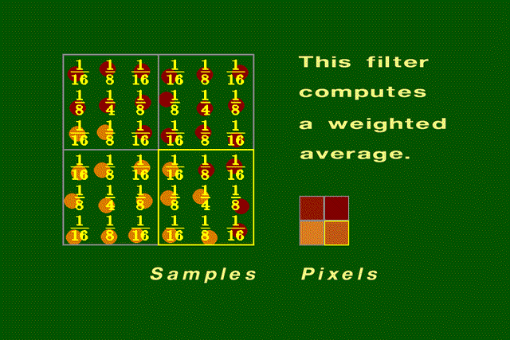
Filtering Example

Slide 98
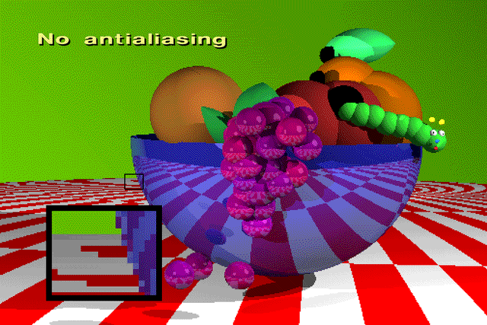
Antialiasing Examples

Slide 99
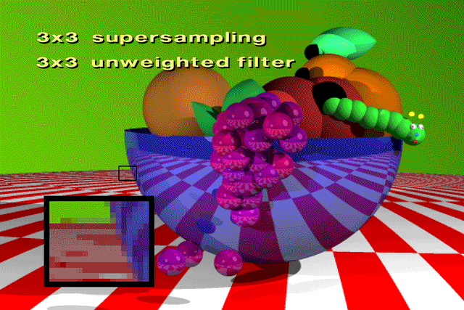

Slide 100


Slide 101


