Slide 1
Chapter 10
More Modeling

Slide 2
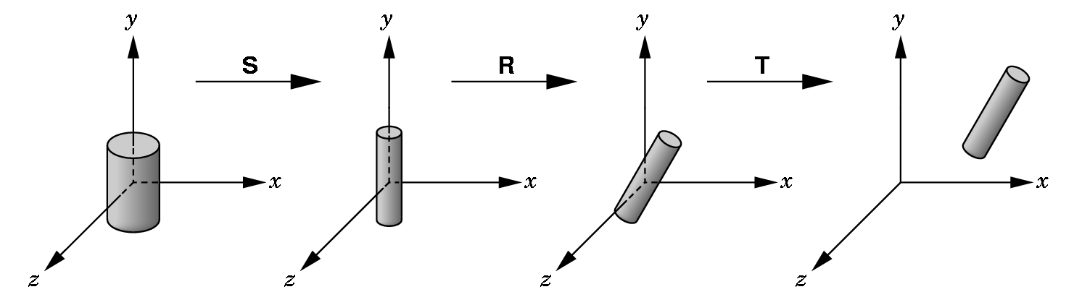
Already We Have Seen We Can Model With Objects
And we move the objects into the proper place with
  scale
  rotate
  translate

Slide 3
SO WE OFTEN SEE CODE SUCH AS
glMatrixMode(GL_MODELVIEW);
glLoadIdentity();
glTranslatef(…);
glRotatef(…);
glScalef(…);
glutSolidCylinder(…);
These are called instance transformations.
But, what if we wish to build hierarchical models--- i.e. models composed of different components that work together?

Slide 4
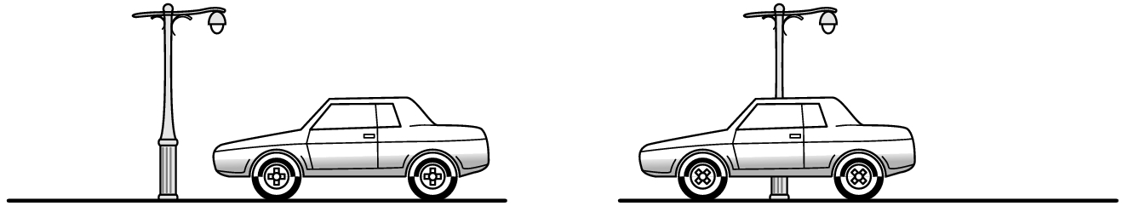
An Example Of A Hierarchical Model- A Car
When doing animation, we DON'T want to write code such as:
calculate speed s
calculate direction d
draw right front wheel using s and d
draw right back wheel using s and d
draw left front wheel using s and d
draw left back wheel using s and d
draw chassis using s and d
THE PROBLEM IS WE ARE NOT EXPLOITING THE RELATIONSHIPS INHERENT IN THE MODEL!

Slide 5

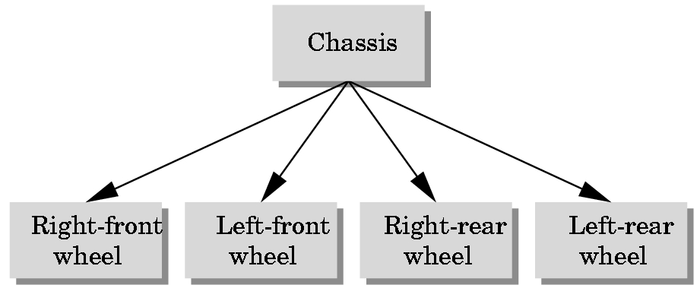
RELATIONSHIPS IN THE MODEL
The motion of the wheels and the motion of the chassis are tied together.
The 4 wheels are all the same--- they are just in different positions and orientations
We use the concepts of graph theory to represent the relationships between different elements in the physical world:
One possible representations: A tree structure.

Slide 6
Recall Graph Theory Definitions
A graph is a set of nodes (or vertices) and a set of edges.
Edges connect pairs of nodes or a node to itself.
Edges can have a direction associated with them; such graphs are called directed graphs. An undirect graph assumes no orientation on the edges:
directed graph
undirected graph

Slide 7
GRAPH THEORY DEFINITIONS
A (connected) tree is a directed graph without closed paths or loops.
Each node, except one which is called the root node has one edge entering it.
Thus, every node, except the root node, has a unique parent node.
Each parent node can have one or more child nodes.
A node without a child is a terminal node or a leaf node.

Slide 8
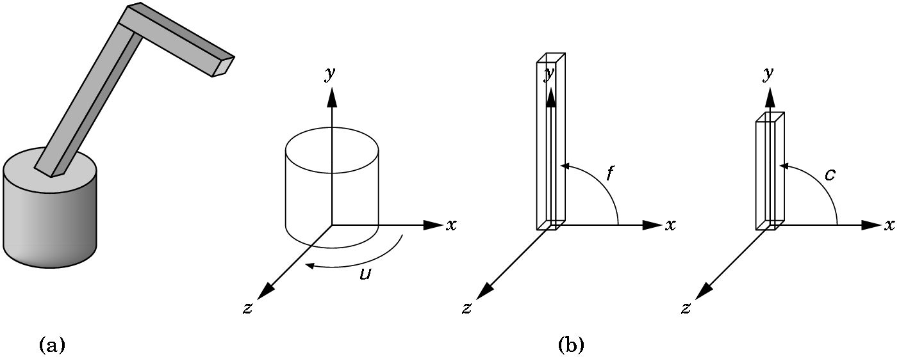
MODELING A ROBOT ARM
(a) The complete model
(b) The component parts modeled from a cylinder and two parallelepipeds (i.e. scaled cubes!).
The arm has 3 degrees of freedom which can be described by the 3 angles shown. By varying the angles, we can position the arm in 3 dimensional space.

Slide 9
MODELING A ROBOT ARM
BASE: Sits on xz-plane with y = 0.
Can rotate by angle μ from the x-axis to some point on base around y-axis.
When we choose μ ,we'll use R _{Y}(μ) for positioning.

Slide 10
LOWER ARM:
Parallelepiped sitting on top of the base.
To place it in the proper place, we must translate it using T(0,h,0), where h is the height off of the base.
Then we must position it using R _{Z}(f).
Note: If the base moves by R_{Y}(μ), then the lower arm moves by
R_{Y}(μ)*T(0,h,0)
So, every time we move the lower arm by an angle f, we must use the following matrix to control the lower arm:
R _{Y}(μ)*T(0,h,0)*R _{Z}(f)

Slide 11
Modeling A Robot Arm
UPPER ARM: The same ideas apply. It's motion matrix is R_{Z}(c), but relative to the others, we must use
R _{Y}(μ)*T(0,h₁,0)*R _{Z}(f)*T(0,h_{2,}0)* R _{Z}(c)
where h₁ and h₂ are the necessary heights. Note that h₁ was the h in the last slide.

Slide 12
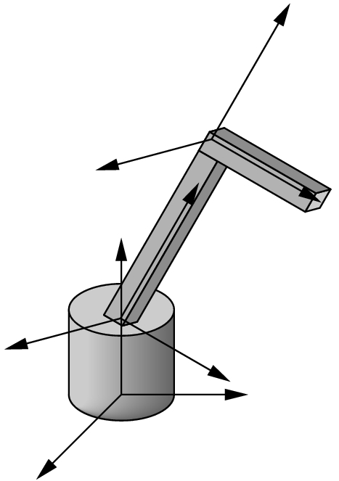
Modeling A Robot Arm
Note that we are thinking of different frames initially. Then the frames are moved.
To form the matrix
R_{Y}(μ)*T(0,h₁,0)*R_{Z}(f)*T(0,h_{2,}0) *R_{Z}(c)
we could use the following drawing code:
display() {
glRotate(theta[0], 0.0,1.0, 0.0); //y rotation of angle μ
base();
glTranslate(0.0,h1,0.0);
glRotate(theta[1],0.0,0.0,1.0); //z rotation of angle f
lower_arm();
glTranslate(0.0,h2,0.0);
glRotatef(theta[2],0.0,0.0,1.0); //z rotation of angle c
upper_arm();}

Slide 13
The Question Is...
How do we write the code for base, lower_arm, and upper_arm so any transformations we need to position them does not interfere with the transformations needed to position the parts correctly?
i.e. What if we use pre-defined functions and we need to position them first?

Slide 14
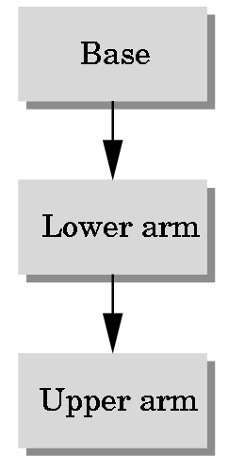
Modeling the Robot Arm as a Tree
Provides an Easy Approach
Using a tree structure, we can easily determine when to push and pop the modelview matrix to draw the robot arm.
We do all the instance transformations in code named base(), lower-arm(), and upper_arm().
As we enter the code, we push the modelview matrix and then pop as we exit.
For this, just to introduce you to some additional pre-defined figures, we’ll use the GLU library instead of the GLUT library.

Slide 15
The Glu Library
Other pre-defined quadric objects are available in the GLU library. Check the OpenGL documentation. They all have a similar form:
In your init routine declare an object and allocate space:
p=gluNewQuadric(); // allocate quadric object gluQuadricDrawStyle(p, GLU_LINE); // render it as wireframe
Each drawing object has a different format
gluCylinder(GLUquadricObj *obj, //this would be the p above
GLdouble baseRadius,
GLdouble topRadius, //if same, have true cylinder
GLdouble height,
GLint slices, //number of sides
GLint stacks) //number of chunks shown
Runs along z-axis with (0,0,0) center of base and (0,0,height) as center of top.

Slide 16
/* Define the three functions. Note the use of push/pop to return the modelview matrix to its state before functions are entered. Rotation, translation, and scaling are used to create instances of objects (cube and cylinder) */
void base(){
glPushMatrix();
//We now transform an instance into a fixed position
/* rotate cylinder to align with y axis */
glRotatef(-90.0, 1.0, 0.0, 0.0);
/* cylinder aligned with z axis, render with 5 slices for base and 5 along length */
gluCylinder(p, BASE_RADIUS, BASE_RADIUS, BASE_HEIGHT, 5, 5);
glPopMatrix();}

Slide 17
void upper_arm(){
glPushMatrix();
glTranslatef(0.0, 0.5*UPPER_ARM_HEIGHT, 0.0);
glScalef(UPPER_ARM_WIDTH, UPPER_ARM_HEIGHT,
UPPER_ARM_WIDTH);
glutWireCube(1.0);
glPopMatrix();}
void lower_arm(){
glPushMatrix();
glTranslatef(0.0, 0.5*LOWER_ARM_HEIGHT, 0.0);
glScalef(LOWER_ARM_WIDTH, LOWER_ARM_HEIGHT,
LOWER_ARM_WIDTH);
glutWireCube(1.0);
glPopMatrix();}

Slide 18
Here is the entire display function:
void display(void){
/* Accumulate ModelView Matrix as we traverse tree */
glClear(GL_COLOR_BUFFER_BIT);
glLoadIdentity(); //M= I
glColor3f(1.0, 0.0, 0.0);
glRotatef(theta[0], 0.0, 1.0, 0.0); //M I*R_{y}(theta[0])
base();
/*Recall that base() does the following :
push matrix M above
define instance rotation--- M is I*R_{y} (theta[0])*R_{x}(-90)
draw base using M
pop matrix -------- M becomes I*R_{y}(theta[0]) */

Slide 19
// At this point, // M= I*Ry(theta[0])
//Position the lower arm
glTranslatef(0.0, BASE_HEIGHT, 0.0);
glRotatef(theta[1], 0.0, 0.0, 1.0);
lower_arm(); //be sure you see how this is done
//Position the lower arm
glTranslatef(0.0, LOWER_ARM_HEIGHT, 0.0);
glRotatef(theta[2], 0.0, 0.0, 1.0);
upper_arm(); //be sure to see how this is done
glFlush();
glutSwapBuffers();}

Slide 20
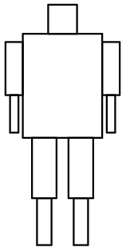
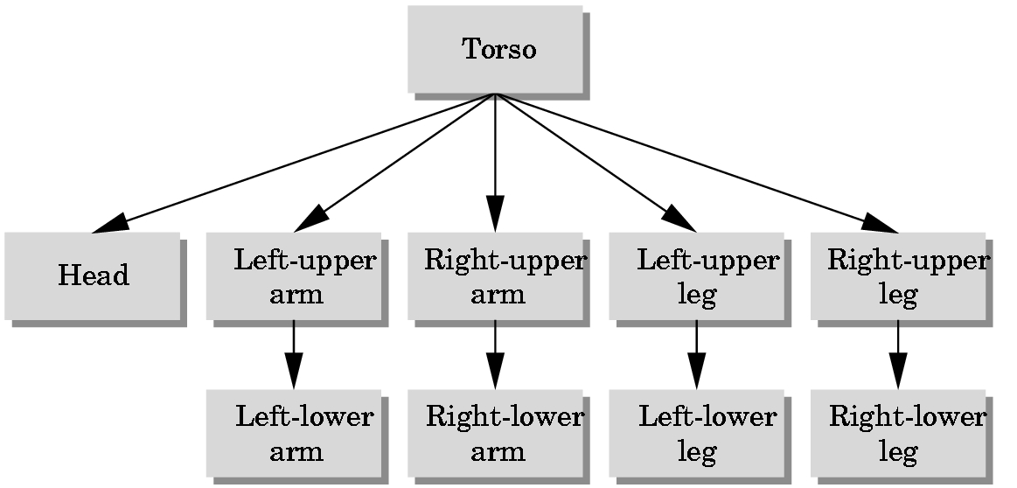
More Complex Scenes
With Articulated Figures
Once you understand the basic idea, it is easy to model complex interrelated objects. For example.
figure
a tree representation of the figure

Slide 21
ROBOT :
  Head is sphere
    Use gluSphere
  All other parts will be cylinders.
    Use gluCylinder
  As before, write code for producing instances of each part:
  Define each part:
  GLUquadricObj *t, *h, *lua, *lla, *rua, *rla, *lll, *rll, *rul, *lul;
For example, t = torso, h = head, lua = left upper arm, etc.

Slide 22
SAMPLE INSTANCE CODE FOR ROBOT
These are solid. Ignore lighting stuff now
void head(){
glPushMatrix();
glTranslatef(0.0, 0.5*HEAD_HEIGHT,0.0);
glScalef(HEAD_RADIUS, HEAD_HEIGHT, HEAD_RADIUS);
gluSphere(h,1.0,10,10);
//recall h is object. 1.0 is radius
glPopMatrix();}
The first 10 in gluSphere is the number of slices (like longitude) and
second 10 is the number of stacks (like latitude).
All limbs are just handled by setting the cylinders upright.

Slide 23
Recall – Need Functions for Each Part
void left_upper_arm(){
glPushMatrix();
glRotatef(-90.0, 1.0, 0.0, 0.0);
gluCylinder(lua,UPPER_ARM_RADIUS, UPPER_ARM_RADIUS,
UPPER_ARM_HEIGHT,10,10);
glPopMatrix();}
Obviously, you must define all these constants such as UPPER_ARM_RADIUS, etc.

Slide 24
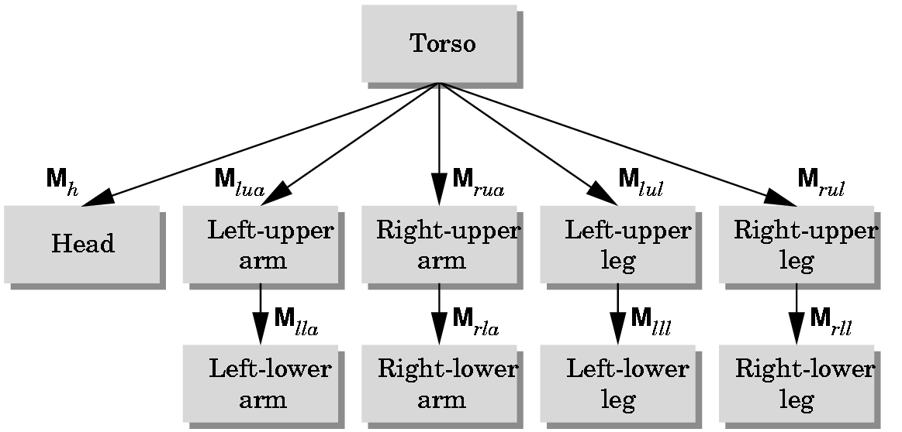
Now We Have To Draw The Figure Itself
Consider the model's tree structure:
We will traverse the tree using a preorder traversal - pushing the Modelview matrix as we start down the tree and popping the matrix as we move back to the root.
Each matrix M_{abc} is formed and post multiplied into the current Modelview matrix before the instance is drawn at the
node.

Slide 25
Preorder Traversal Of A Tree
Recursive:
Process node
Process tree with the leftmost child as the root
Process tree with the next to leftmost child as the root. ...
Process tree with the rightmost child as the root
For example, a preorder traversal of the robot representation would process the nodes in the order:
t, h, lua, lla, rua, rla, lul, lll, rul, rll

Slide 26
void display(void){ //we'll do a preorder traversal of the tree
glClear(GL_COLOR_BUFFER_BIT|GL_DEPTH_BUFFER_BIT);
glLoadIdentity();
glColor3f(1.0, 0.0, 0.0);
glRotatef(theta[0], 0.0, 1.0, 0.0); //left-right torso motion
torso(); //draw torso instance
glPushMatrix(); //save torso matrix as go down tree
//form M_{h} and draw head instance
glTranslatef(0.0, TORSO_HEIGHT+0.5*HEAD_HEIGHT, 0.0);
glRotatef(theta[1], 1.0, 0.0, 0.0); //up-down head motion
glRotatef(theta[2], 0.0, 1.0, 0.0); //right-left head motion
glTranslatef(0.0, -0.5*HEAD_HEIGHT, 0.0);
head();
glPopMatrix(); //restore matrix for torso
Above processes
Torso and
Head

Slide 27
glPushMatrix(); //save torso matrix
glTranslatef(-(TORSO_RADIUS+UPPER_ARM_RADIUS),
0.9*TORSO_HEIGHT, 0.0);
glRotatef(theta[3], 1.0, 0.0, 0.0); //up-down arm motion
left_upper_arm(); //draw
form
M_{lua}
glTranslatef(0.0, UPPER_ARM_HEIGHT, 0.0);
glRotatef(theta[4], 1.0, 0.0, 0.0);
left_lower_arm(); //draw
form
M_{lla}
glPopMatrix(); //restore matrix for torso
glPushMatrix(); //save it again
glTranslatef(TORSO_RADIUS+UPPER_ARM_RADIUS,
0.9*TORSO_HEIGHT, 0.0);
glRotatef(theta[5], 1.0, 0.0, 0.0);
right_upper_arm(); //draw
form
M_{ruaa}
etc for the rest of the tree

