Slide 1
Chapter 8- Section 8.6- 8.10
Texture Mappings

Slide 2
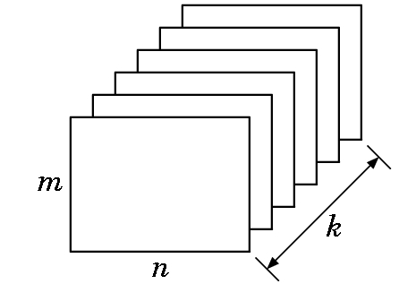
BUFFERS
Buffer: - A block of memory with a spatial resolution of n X m k-bit elements:
Bitplane: Any of planes
Pixel: All k elements at
given spatial location.
For the frame buffer,
n and m are screen resolution values
k is color depth.
For the depth buffer,
n and m are screen resolution values
k is the depth resolution that the system will support.

Slide 3
MAPPINGS
If we model an orange by only using a sphere and distorting it, it may not look right since an orange has
  imperfections
  bumps
  a slightly irregular shape
One approach is to try to model it exactly with curves (which we’ll look at shortly).
But, a simpler means is to use
  a simple model (such as the sphere) plus
  a mapping of an image to the surface

Slide 4
MAPPINGS
Some of the types of mappings are:
Texture mapping
  Uses a pattern (called a texture) to determine the color of part of an image
Bump mapping
  Distorts the shape of a surface to create variations
Reflection or environmental mapping
  Allows us to create images that look like ray traced examples (almost).

Slide 5
MAPPINGS
All 3 methods have some common concepts:
  Alter shading of individual pixels
  Implemented as part of the shading process
  Rely on the map being stored as a 1D, 2D, or 3D image
  All are subject to aliasing errors
  All cause lighting to change in somewhat strange ways.
  None are simple 1-2-3 step processes as the images being used for texturing can be in many different formats and each is handled differently.

Slide 6
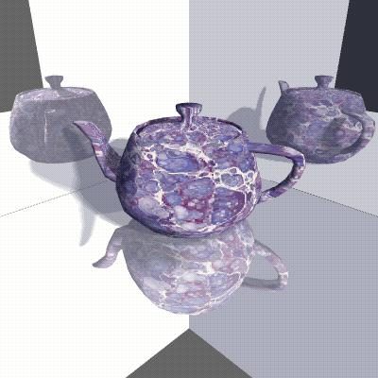
Teapot is a texture mapped image.
The reflections are reflection or environmental mapped images.

Slide 7
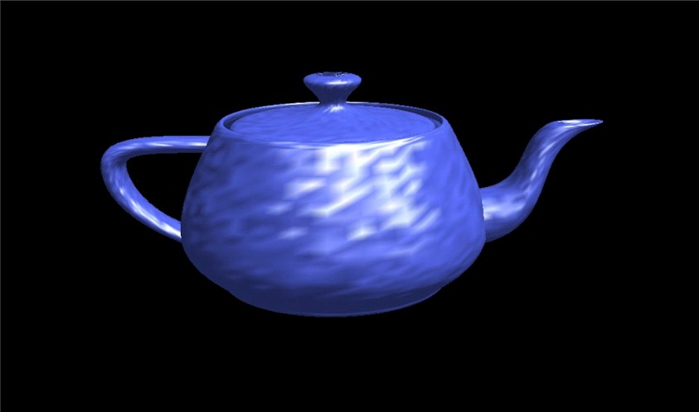
A bumped mapped image.

Slide 8
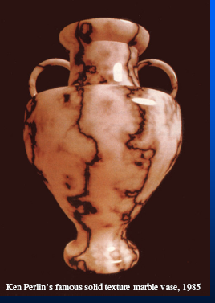

Slide 9
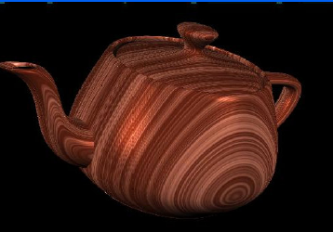
A spectacular texturing of the teapot.

Slide 10
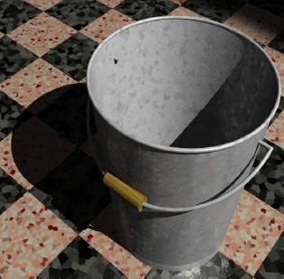
Multiple textures in one image.

Slide 11
OPENGL AND TEXTURE MAPS
Texture mapping is one of OpenGL's most productive features, and one of the reasons why many of today's games use OpenGL for 3D drawing.
Catmull produced the first textured image in 1974.
Blinn and Newell produced the first environmental image in 1976.
Once one loads an RGB or RGBA texture from an image file or other source, OpenGL makes it somewhat simple to filter, scale, and manage 2D texture maps.
The difficult part is really the loading of the image!

Slide 12
TEXTURING TASKS
Obtain an image- this is often easy
Load image- this can be a pain since there are so many possible formats
Generate texture coordinates- rather straightforward
Filter- can become complicated if you want very unusual effects, but for flat maps, this is not hard
Apply image to application
Adjust coloring

Slide 13
2D TEXTURE MAPPING-
Obtain the image
You can do texture mapping in any dimension (even 4D!), but the 3D methods require high-end hardware.
So, we'll concentrate on 2D mappings.
Ultimately we need a pattern stored in an n X m array of what are called texture elements or texels.
The pattern can be either
generated
or read in from a file

Slide 14
IN THE BOUNCING DINOSAUR
/* Nice floor texture tiling pattern. */
static char *circles[] = {
"....xxxx........",
"..xxxxxxxx......",
".xxxxxxxxxx.....",
".xxx....xxx.....",
"xxx......xxx....",
"xxx......xxx....",
"xxx......xxx....",
"xxx......xxx....",
".xxx....xxx.....",
".xxxxxxxxxx.....",
"..xxxxxxxx......",
"....xxxx........",
"................",
"................",
"................",
"................",
};
The pattern was generated.
See the code for details.

Slide 15
USING AN EXISTING IMAGE
Clearly the most common approach.
Sources of images:
  Many sites on the nets contain images that are free to use
  Or, you can scan your own picture
  Or, use a digital camera.
Be sure, however, that you are not violating copyrights. Some examples of sites:
  http://members.aol.com/slpryfox/textures/page2.html
  http://textures.forrest.cz/
  http://mayang.com/textures/
  There are many of these--- you can find almost any texture you might desire.

Slide 16
LOADING THE IMAGE
Images can be stored in a bewildering number of formats:
JPEG- Joint Photographic Experts Group
  Supports high color and image resolution
  Consumes little file space
  Offers a choice of the percentage of full quality in which you want to store the image
  Very good file compression --- i.e. small file usually results
  Lossy compression --- i.e. some quality is lost
  Used by many web applications
BMP- Windows Bitmap
  Not a compression format so full quality.
  Just an image displayed as an array of colored dots or pixels in the Windows environment.

Slide 17
FILE FORMATS
TIFF-Tagged Image File Format
  Used by both Windows and Macs
  Another non-compressed, full quality format
  Good for maintaining the fidelity of an image when doing a scan, for example.
GIF- Graphics Image Format
  Defined by Compuserve
  A compression format that uses the LZW (Lempel-Ziv-Welch) compression algorithm that is quite sophisticated.
  Has been the center of a lot of lawsuits.
Specs say GIF is pronounced "jif" as in "jiffy"; but many pronounce it with the hard "g" as in "graphics"!

Slide 18
FILE FORMATS
TGA- Targa
  One I will use for texturing
  It is cross platform
  It can be generated from other formats by photoshop
  A free format converter is available at
  http://www.irfanview.com/
Other formats could be used, but you need an operative loading program.
Don't get the idea that these are the only file formats around !

Slide 19
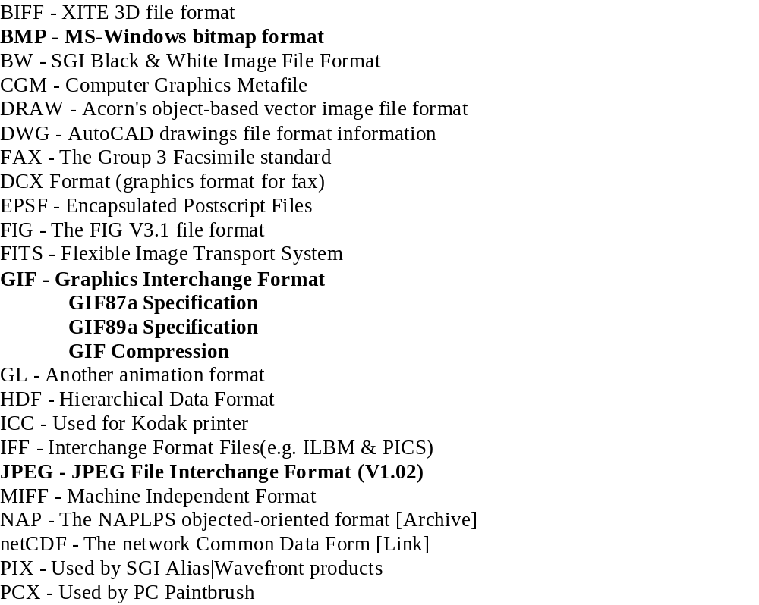
SOME FILE FORMATS

Slide 20
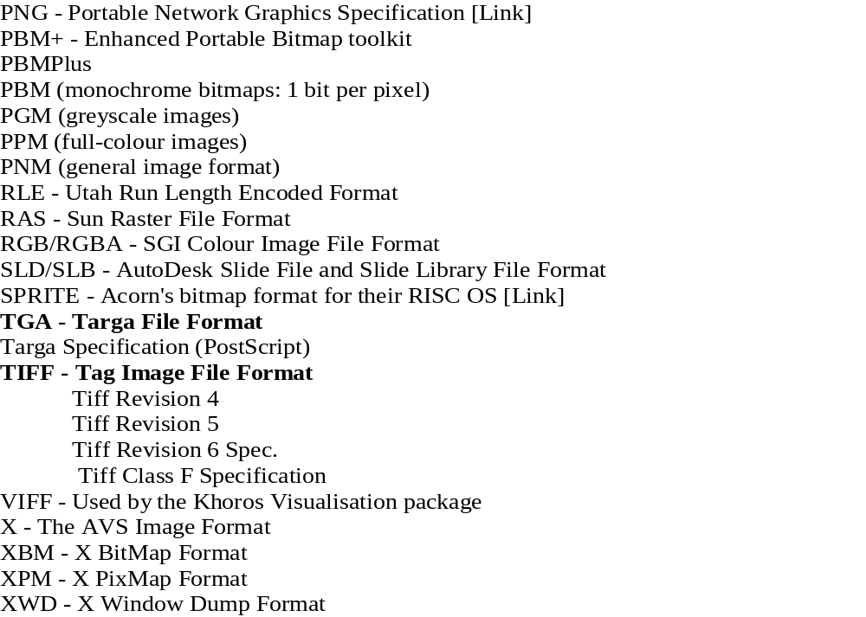
AND SOME MORE FILE FORMATS!

Slide 21
TARGA FORMAT
Type: Bitmap Extension: .tga
Color Depth: 1- to 32-bits (8, 16, 24, and 32 typical)
Maintainer: Truevision Inc.
Specification:
  The TGA format is one of the most widely used bitmap file formats for the storage of 24- and 32-bit truecolor images.
  TGA supports colormaps, alpha channel, gamma value, postage stamp image, textual information, and developer-definable data.
To write your own loader for an image format, you need to know the header information for that format. For example, with tga ....

Slide 22
Header Information for TGA
The header (18 bytes) might be defined as on the next slide for C/C++.
You should be careful with this since it has byte values which some compilers will align to natural
boundaries.
This is checked by printing the sizeof(HEADER).
If it greater than 18,then byte alignment is taking effect and a fread() using the struct on the next slide will not give the right results.
In that case you either need to read your compiler manual and turn off boundary alignment or read the components one at a time.

Slide 23
Header Information for TGA Formatted Images
typedef struct {
char idlength; // length of a string located after the header
char colormaptype;
char datatypecode; //targa format code- see next slide
short int colormaporigin;
short int colormaplength;
char colormapdepth;
short int x_origin;
short int y_origin;
short width;
short height;
char bitsperpixel; //size of each color value
char imagedescriptor;
} HEADER;

Slide 24
All Targa formats are identified by a Data Type field, which is a one byte binary
integer located in byte three of the file. These data types are:
0 - No image data included.
1 - Uncompressed, color-mapped images.
2 - Uncompressed, RGB images.
3 - Uncompressed, black and white images.
9 - Runlength encoded color-mapped images.
10 - Runlength encoded RGB images.
11 - Compressed, black and white images.
32 - Compressed color-mapped data, using Huffman, Delta, and
runlength encoding.
33 - Compressed color-mapped data, using Huffman, Delta, and
runlength encoding. 4-pass quadtree-type process.
For the bitsperpixel: When 24 or 32 the normal conventions apply. For 16 bits
each color component is stored as 5 bits and the remaining bit is a binary alpha
value. The color components are converted into single byte components by
simply shifting each component up by 3 bits (multiply by 8).

Slide 25
CONVERTING OTHER FORMATS TO TGA FORMAT
Write your own conversion program.
Find a conversion program on the nets and use that.
Use some existing software such as Adobe Photoshop. Even old versions do quite well.
  For example, if Photoshop can open the file, you can save it in Targa format by using
    file => save as => other => select Targa
If Photoshop isn’t available, use something like Irfanview which is free.

Slide 26
ONE OF THE FIRST HURDLES--- THE INPUT OF THE IMAGE TO MEMORY IN YOUR PROGRAM
Too often you see:
"This article will cover the basics of texture mapping in OpenGL. This includes the uploading of the texture to the video memory and the application of the texture onto
geometry. This article will not cover the actual loading of the texture data itself. That is left up to the reader."

Slide 27
OPENGL TEXTURING
Some Issues

Slide 28
USING MULTIPLE TEXTURES-
PRETTY, BUT EXPENSIVE
The line below tells OpenGL we want to build three textures, and we want the textures to be stored in texture[0], texture[1] and texture[2].
// Create Three Textures
glGenTextures(3, &texture[0]);
Unfortunately, multiple textures chew time and space.
There are techniques that help, but they are complicated.

Slide 29
THE TYPICAL SCENARIO
Load texture image bits from a disk file.
Set the OpenGL texture parameters and environment (filters, border modes, and so on).
Call glTexImage2D (for 2D textures) to load the texture into OpenGL.
Draw some geometry with texture coordinates.

Slide 30
However, you wouldn't want to perform each of these steps
for every frame of an animated scene especially with multiple textures.
Repeatedly accessing a disk file can be pretty expensive.
If you are using a single texture, as we saw, you load the disk
file and call glTexImage2D() after creating the rendering
context.
Then you'd render the geometry or scene while repeatedly
changing the viewer's position or the object's orientation
(whichever is appropriate).
With a run-of-the-mill 3D card with OpenGL acceleration,
you would get a reasonably good frame rate and thus a
smooth animation.

Slide 31
Suppose a scene contains multiple textured objects,
each using one or more textures.
Or perhaps we have a single object with multiple textures.
An example might be a spinning cube with a different texture
on each face, plus a marble texture for a floor beneath this
cube.
This scene has a total of seven textures that need to be
loaded.
Naturally, we don't want to access the disk seven times for
every frame of our animation, as this would slow our
rendering considerably.

Slide 32
One popular technique is to combine all seven textures into one
large texture that is loaded once.
Then, by tweaking the texture coordinates, you can put different
portions of the same texture on each side of the cube.
The problem with this technique is that texture filtering will often
introduce unsightly artifacts along the edges of the polygons.
Another practical consideration is that most hardware imposes some
limit on the maximum texture size for a single texture. You could
quickly exhaust your available texture space.
So it's better to keep textures separate.
How then do we avoid a texture load every time textures need to be changed?

Slide 33
First thought: use display lists!
Each display list would contain a call to glTexture2D()
with a pointer for the given texture.
This approach saves considerable time because it only
accesses the disk seven times to read the textures and it does
so before the animation loop.
Saving seven or more disk accesses per frame seems is a
substantial optimization.
Unfortunately, little performance gain is seen when this is done.

Slide 34
The purpose of a display list is to encapsulate a group of OpenGL commands into a preprocessed batch that can be sent to hardware quickly or even invoked remotely via a client/server interface.
Since display lists pre-compile a set of OpenGL commands into hardware commands, they can be very difficult for hardware vendors to optimize when they contain important state changes, such as loading a new texture.
Display lists are inherently inefficient for texture loads.
Texture objects were introduced to act somewhat like display lists, but to be geared to the demands of texturing.

Slide 35
OTHER THINGS TO WORRY ABOUT WITH TEXTURING-Thrashing
You could have one very large texture and several smaller textures in your scene. Suppose you keep swapping the large texture back and forth to make room for some little texture.
If your graphics card has limited texture memory available, all the swapping back and forth could kill your frame rate.
It would be nice if you could tell OpenGL that your bigger textures are going to be used for every frame, and that if it needs to make room for more textures on board, to discard the smaller textures first.
You can if you do your own performance tuning.
OpenGL's answer to this situation is texture priorities. A single function call, glPrioritizeTextures(), is all that is required, but you need to be using texture objects.

Slide 36
OTHER THINGS TO WORRY ABOUT WITH TEXTURING-Filter Choice
The MIN_FILTER is the filter used when an image is drawn smaller than the original texture size.
The MAG_FILTER is used when the image is bigger than the original texture size.
Using GL_NEAREST turns off filtering. It takes very little processing power, but it looks really bad.
If you've ever played a game where the textures look all blocky, it's probably using this type of filtering.

Slide 37
OTHER THINGS TO WORRY ABOUT WITH TEXTURING-Filter Choice
The only benefit of using GL_NEAREST filtering is that projects made using this type of texturing will usually run fairly well on slow computers.
You can mix GL_NEAREST with GL_LINEAR, and the texture will look a bit better, but if you want speed, use low quality for both.

Slide 38
OTHER THINGS TO WORRY ABOUT WITH TEXTURING-Filter Choice
Linear filtered texture maps use the filter GL_LINEAR
They require a hefty amount of processing power, but they look nice.
To determine the texture, 4 texture pixels are utilized to determine one pixel.

Slide 39
EXAMPLE OF NEAREST FILTERING
// Create Nearest Filtered Texture
glBindTexture(GL_TEXTURE_2D, texture[0]);
glTexParameteri(GL_TEXTURE_2D,
GL_TEXTURE_MAG_FILTER,GL_NEAREST);
glTexParameteri(GL_TEXTURE_2D,
GL_TEXTURE_MIN_FILTER,GL_NEAREST);
glTexImage2D(GL_TEXTURE_2D, 0, 3,
TextureImage[0]->sizeX, TextureImage[0]->sizeY,
0, GL_RGB, GL_UNSIGNED_BYTE,
TextureImage[0]->data);

Slide 40
OTHER THINGS TO WORRY ABOUT WITH TEXTURING-Sizing Problems
You may notice that when you make an image very tiny on the screen, many of the fine details disappear. Patterns that used to look nice start looking real bad.
When you draw a texture to the screen OpenGL will select the BEST looking texture from the ones it built (texture with the most detail) and draw it to the screen instead of resizing the original image (which causes detail loss).

Slide 41
OTHER THINGS TO WORRY ABOUT WITH TEXTURING-Lighting Problems
Lighting and textures interact in strange ways.
glTexEnvf (GL_TEXTURE_ENV, GL_TEXTURE_ENV_MODE, GL_MODULATE); allows you to apply effects such as lighting and coloring to your texture.
If you do not want lighting and coloring to effect your texture and you would like to display the texture unchanged when coloring is applied replace GL_MODULATE with GL_DECAL.

Slide 42
FINAL CHECK LIST
#1 Make sure that you have enabled texturing. You do this with the glEnable (GL_TEXTURE_2D) call.
#2 Make sure that you bind to a texture before you do any sort of glBegin/glEnd. You cannot bind to a texture in the middle of a begin/end pair.
#3 Make sure that you specify a texture coordinate before each vertex that makes up a face. If you have 3 vertices the pattern for texture mapping the triangle would go like this:
  TexCoord; VertexCoord; TexCoord; VertexCoord; TexCoord; VertexCoord;
#4 Make sure that you store your texture id's in variables, it makes things easier.
#5 Make use of glGenTextures. Its the easy way to get a free texture id.

Slide 43
Chapter 3- Section 3.4
Display Lists

Slide 44
WHAT ARE DISPLAY LISTS?
Concept goes back to the early days of graphics in the 1960's.
Refreshing a display was prohibitive.
Consequently, a special purpose display processor was used connected to a host computer.
The user program was processed on the host computer and a compiled list of instructions were sent to the display processor where the instructions were stored as a display file or display list.

Slide 45
WHAT ARE DISPLAY LISTS?
Thus, the display processor could repeatedly execute the instructions and keep the refresh rate high.
Today the display processor is a graphics server and the user program on the host computer has become a client.
Refresh rate is no longer a problem, but the amount of traffic that passes between aaserver and client is.

Slide 46
We can send graphical entries to a display as follows:
  immediate mode graphics: As soon as a program executes a statement that defines a primitive, send the primitive to the server for display and do not have the system remember it --- i.e. to redisplay, everything must be recalculated.
  retained-mode graphics: Define an object and store it on a list on the server. To display it, issue a function call to just download the predefined object.

Slide 47
WHAT ARE DISPLAY LISTS?
Display lists allow you to cache models so they need not be recalculated every time you wish to display them.
They were introduced in the graphics environment years ago to implement retained-mode graphics.
It is common, in programs, to have either
  speed, at the expense of memory, or
  limited space, at the expense of speed
Thus, display lists use space to store objects that are precomputed.
OpenGL supports display lists as follows ...

Slide 48
DISPLAY LISTS IN OPENGL
Each list is identified by a unique number.
Example:
#define BOX 1
glNewList(BOX, GL_COMPILE);
//send list to server, but don't execute yet
glBegin(GL_POLYGON); glColor3f(1.0,0.0,0.0);
glVertex2f(-1.0, -1.0);
glVertex2f( 1.0, -1.0);
glVertex2f( 1.0, 1.0);
glVertex2f(-1.0, 1.0);
glEnd();
glEndList();

Slide 49
DISPLAY LISTS IN OPENGL
To draw, issue the command
glCallList(BOX):
Cautions:
1. The present state determines the environment for the drawing of the box.
2. If you change a state within the display list, as we did with setting a color for the box, you will be changing the color setting for later.
3. Consequently, it is best to push and pop attributes within the display list code ...

Slide 50
DISPLAY LISTS IN OPENGL
For example, put at the beginning of the display list
definition:
glPushAttrib(GL_ALL_ATTRIB_BITS);
glPushMatrix();
and at the end
glPopAttrib();
glPopMatrix();
Multiple display lists can be called with one call.
There is an automatic generator for identifying
numbers.
Display lists can be deleted and numbers reused.
The fonts for text are handled with display lists.
More later on this.

Slide 51
WILL DISPLAY LISTS SPEED UP MY PROGRAM?
Maybe yes; maybe no! Achieving the highest performance from display lists is highly dependent on the OpenGL implementation and a few other things:
Your program may not be computationally intensive. Slow speeds might just be due to the computer's speed, the graphics card, or the complexity of your scenes.
Make sure that your program size isn't so large that memory thrashing could occur with display lists. Using display lists takes more memory than immediate mode, so it's possible that a program can spend more time thrashing memory blocks than rendering OpenGL calls.

Slide 52
WILL DISPLAY LISTS SPEED UP MY PROGRAM?
Stay away from GL_COMPILE_AND_EXECUTE mode. Instead, create the list using GL_COMPILE mode, then execute it with glCallList().
In some cases if you group your state changes together, the display list can optimize them as a group (i.e., it can remove redundant state changes, concatenate adjacent matrix changes, etc.).
Display lists won't improve the performance of a fill-limited application. Try rendering to a smaller window, and if your application runs faster, it's likely that it's fill-limited.

Slide 53
MORE ON PERFORMANCE
Graphics applications can be slowed in several places.
Generally speaking, bottlenecks fall into three broad categories:
  CPU limited,
  geometry limited
  fill limited

Slide 54
CPU-LIMITED
CPU-limited is a general term.
For a true CPU-limited application, performance will increase with a faster CPU.
Of course other computer characteristics can play a role such as bus bandwidth, cache size, RAM size, characteristics of video card, etc.
Short of a money investment, the best approach in this case to increase performance is to reduce your program’s demand on CPU resources.

Slide 55
GEOMETRY LIMITED
A geometry limited application is bound by how fast the computer or graphics hardware can perform vertex computations, such as
  transformations
  clipping
  lighting
  culling
  other OpenGL operations performed on a per vertex basis.
For many very low-end graphics devices, this processing is performed in the CPU.
Then, the line between CPU limited and geometry limited becomes fuzzy.
In general, CPU limited implies that the bottleneck is CPU processing unrelated to graphics.

Slide 56
FILL-LIMITED
In a fill-limited application, the rendering rate is limited by how fast the graphics hardware can fill pixels.
To go faster, you need to find away to either fill fewer pixels, or simplify how pixels are filled, so they can be filled at a faster rate.

Slide 57
WHICH IS CAUSING THE LACK OF SPEED?
Shrink the window size, and see if rendering speeds up. If it does, you're fill limited.
One way to test for a CPU limitation is to change your code, so it repeatedly renders a static, precalculated scene. If the performance is significantly faster, you're dealing with a CPU limitation.
The part of your code that calculates the scene or does other application-specific processing is causing your performance hit. You need to focus on tuning this part of your code.

Slide 58
WHICH IS CAUSING THE LACK OF SPEED?
If it's not fill limited and not CPU limited, it is probably geometry limited.
The per vertex features you’ve enabled or the shear volume of vertices you're rendering is causing your performance hit.
You need to reduce the geometry processing either by reducing the number of vertices or reducing the calculations OpenGL must use to process each vertex.
Display lists may help in this case if preprocessing will cut down on the run-time calculations. But, there is no guarantee as state calculations are run-time calculations.

Slide 59
TRYING DISPLAY LISTS
Most examples in the book don’t use display lists.
But, it is easy to convert code to use display lists by just encapsulating the code in glNewList and glEndList code.
It’s always worth trying to see if you can gain some speedup AFTER you have developed the basic code.
Watch out for attribute problems, however.

Slide 60
Using Display Lists with Fonts

Slide 61
EXAMPLE- adding text to the Paint program
The following code clears the window, sets up global variables and compiles display lists for 128 characters:
void myinit(void) {
int i;
base = glGenLists(128);
for (i=0; i < 128; i++) {
glNewList(base+i, GL_COMPILE);
glutBitmapCharacter
(GLUT_BITMAP_9_BY_15, i);
glEndList(); }
glListBase(base);
glViewport(0,0,ww,wh); //rest of init stuff
Now we will use a key push to generate a correct display...

Slide 62
void key(unsigned char k, int xx, int xy) {
if (draw_mode != text) return;
glRasterPos2i(rx,ry);
glCallList(k); //display list for character k
rx+ = glutBitmapWidth (GLUT_BITMAP_9_B7_15,k); }
See a complete survey of font work at
http://www.opengl.org/resources/features/fontsurvey/

