Slide 1
Some Predefined Objects to be Used When Programming

Slide 2
Predefined Objects
When you are first playing around with OpenGL, it is nice to use some predefined objects so not everything must be created from scratch.
In fact, in many cases, these objects can be used and even deformed into other shapes that are handy to use.
We will look at wireframe
  Polyhedra
  Quadric Surfaces
  Superquatrics
Later in the course, after handling lighting, we’ll look at Bezier and spline curves plus various solid versions of the above.

Slide 3
Polyhedra
A set of surface polygons that enclose an interior is a polyhedron.
Many graphics systems store all object descriptions as sets of surface polygons.
The reason is that rendering is faster when you are dealing with linear equations defining the objects.
Some systems, like OpenGL, allow Bezier and spline surfaces, but even these are often converted to polygonal representations before going down the pipeline.
Consequently, polyhedra are often referred to as standard graphics objects.

Slide 4
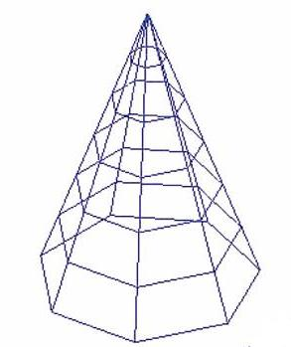
Generating Polyhedra in OpenGL
Method 1 – what we did with the cube
  Define polygon faces and generate the cube from them.
  This can be done for
  curved surfaces, also,
  if we approximate the
  surface with polygon
  patches
  This process is referred
  to as surface tessellation
  or fitting the surface with
  a polygon mesh.

Slide 5
Generating Polyhedra in OpenGL
In fitting polygons to a surface, we are not limited to using GL_POLYGON as we did with the cube.
We can also use
  GL_TRIANGLES
  GL_TRIANGLE-STRIP
  GL_TRIANGLE_FAN
  GL_QUADS
  GL_QUAD_STRIP

Slide 6
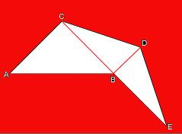
Example: GL_TRIANGLE_STRIP
Makes 5 calls to glVertex for A,B,C,D,E in that order
To initialize the triangle strip you need to specify one initial triangle, ABC above.
Then as you add new vertices (D and E), you add a new triangle to the "strip" with only ONE vertex.
This technique improves the rendering speed of 3D models since with only 5 calls to glVertex you can make 3 triangles.

Slide 7
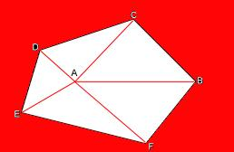
GL_TRIANGLE_FAN
Again, 5 calls to glVertex are made in the order A,B,C,D,E,F
A triangle fan has one origin indicated by the first vertex, and an initial triangle, indicated by the first 3 vertices including the origin.
By adding the 4th and 5th vertices, all the later triangles are tied to one origin point and do not extend into a line (or a strip) of triangles.

Slide 8
Method 2 – Use predefined regular polyhedra from the GLUT and GLU libraries.
We’ll look at the GLUT library functions first.

Slide 9
The Regular Polyhedron Functions
These are called the Platonic solids – all faces of the regular polyhedron are identical regular polygons.
This says –
  All angles between faces are equal.
  All edges are equal in length.
  All edge angles are equal.
There are precisely 5 of these in 3-dimensional space ...

Slide 10
The Platonic Solids
Regular tetrahedron (or triangular pyramid) has 4 faces
Regular hexahedron (or cube) with 6 faces
Regular octahedron with 8 faces
Regular dodecahedron with 12 faces
Regular icosahedron with 20 faces
Interesting trivia: In 4D, there are 6 regular hyperpolyhedron.
In each dimension 5 or greater, there are only 3 in each dimension!

Slide 11
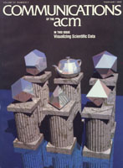
The image used for the February 1988 edition of the CACM is called
The Six Platonic Solids
As you might guess by now, the teapot is special in graphics! So, some call the teapot the
Teapotahedron

Slide 12
Back to GLUT’s Library of Polyhedron Functions
All are defined in model coordinates so they are specified around the origin.
5 functions produce wireframes which you can easily use right now.
Ex: glutWireX(), where X is one of the names Cube, Tetrahedron, Octahedron, Dodecahedron, or Icosahedron (with the first letter capitalized).
5 functions produce polyhedra facets as shaded fill areas - the characteristics of these are determined by material and lighting properties.
  Ex: glutSolidX(), where X is as above.

Slide 13
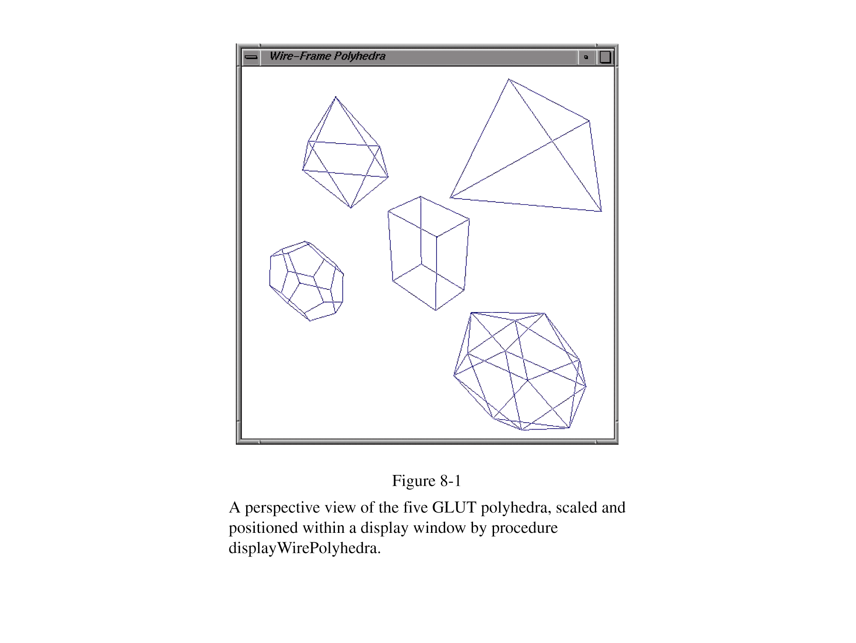

Slide 14
Before Scaling and Translation
Each of the wireframes is defined in modeling coordinates.
In a 500 X 500 window with
  the eye at (5,5,5)
  the look at point at (0,0,0) and
  the up vector at (0,1,0) – i.e. up is parallel to the y-axis
With a perspective projection with a frustum defined by (-1, 1, -1,1,2,20)
  each wireframe looks like the following ...

Slide 15
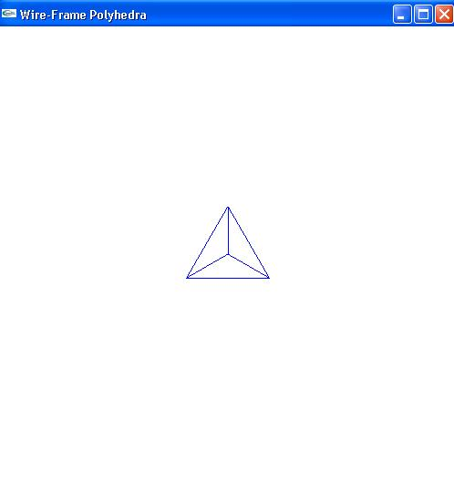
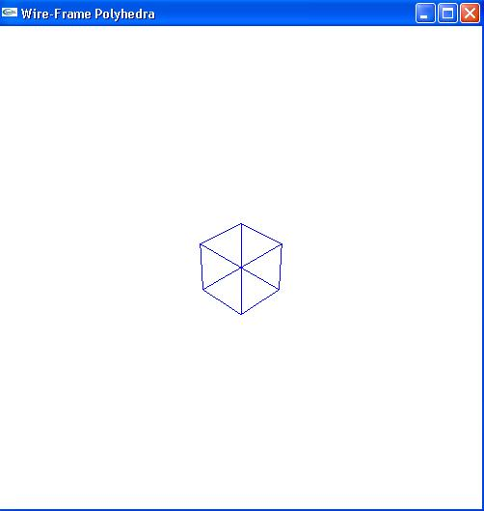
glutWireTetrahedron() and glutWireCube(1.0)
4 faces
6 faces

Slide 16
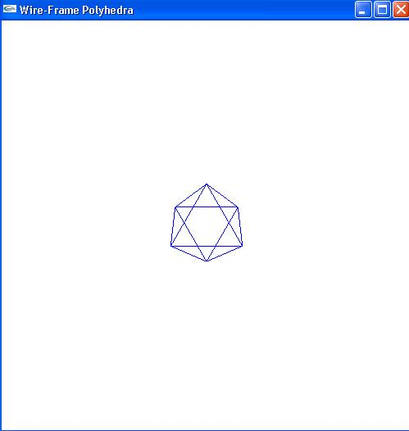
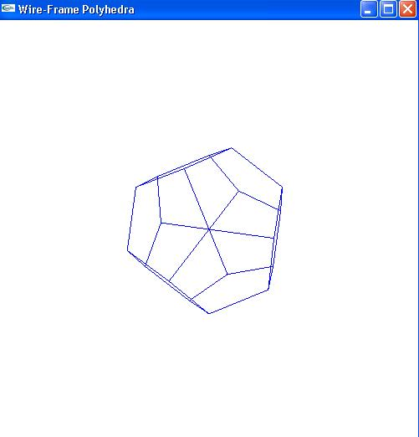
glutWireOctahedron() and glutWireDodecahedron()
8 faces
12 faces

Slide 17
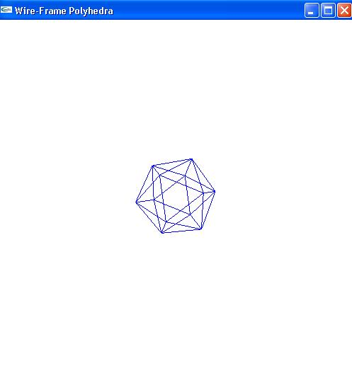
And, glutWireIcosahedron()
20 faces

Slide 18
Quadric Surfaces
Defined by second degree equations or quadratics.
Include
  Spheres
  Ellipsoids
  Tori
  Paraboloids
  Hyperboloids
  Cones
  Cylinders
See http://en.wikipedia.org/wiki/Quadric
for pictures of these.

Slide 19
GLUT Functions – for Solids, Substitute Solid for Wire
glutWireSphere(r,nLongitudes,nLatitudes);
glutWireCone(rBase, height,bLongitudes,nLatitudes);
glutWireTorus(rCrossSection, rAxial, nConcentrics, nRadialSlices);
and the following is provided also!!!!!!
glutWireTeapot(size);

Slide 20
Mundane Objects Become Part of Graphics History
As you have noticed, generating an object from scratch can be tedious if you need to calculate the positions of vertices.
Very early in the history of graphics, many individuals constructed mesh data tables that modeling mundane objects such as a Volkswagen.
The idea for modeling the teapot was brought up over concerns by Martin Newell at the University of Utah that he didn't have enough interesting computer models with unusual surface characteristics.

Slide 21
Birth of the Utah Teapot
Martin Newell’s wife, Sandra, suggested modeling the tea service they had just acquired.
Martin took some graph paper and a pencil, and he modeled the entire tea service freehand.
Then, he went back to the lab and edited Bezier control points on a Tektronix storage tube, again by hand.
Later he also digitized a spoon and a cup and saucer.

Slide 22
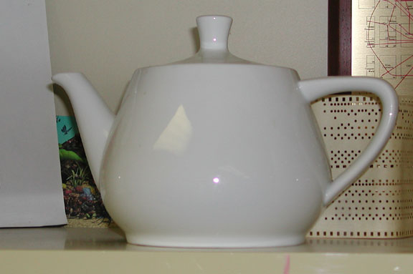
The Utah Teapot
The real teapot---
The teapot was made by Melitta in 1974 and originally belonged to Martin Newell and his wife, Sandra - who purchased it from ZCMI, (a department store in Salt Lake City).
The teapot was donated to the Boston Computer Museum but now resides in the Ephemera collection of the Computer History Museum where it's catalogued as "Teapot used for Computer Graphics rendering" catalogue number X00398.1984.

Slide 23
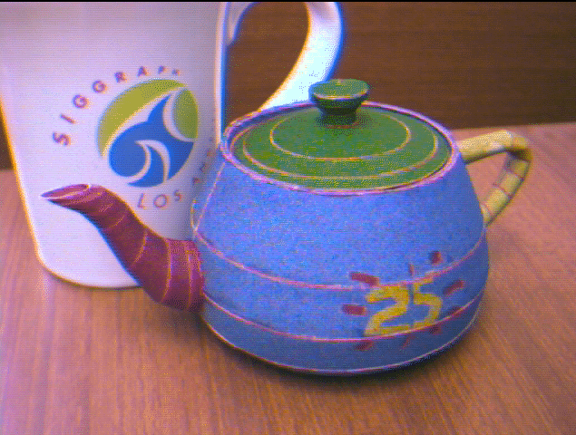
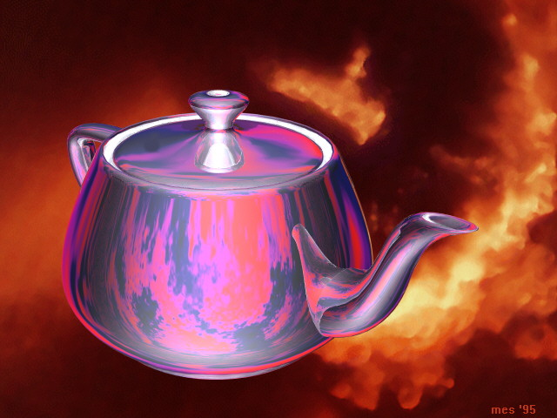
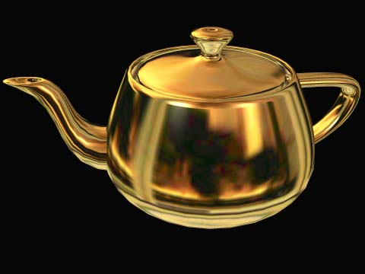
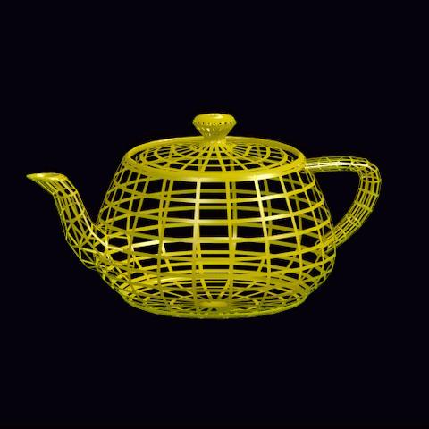
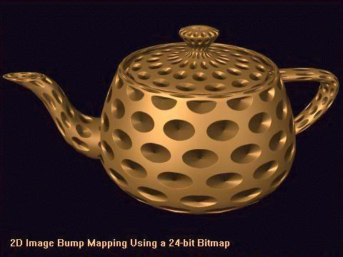
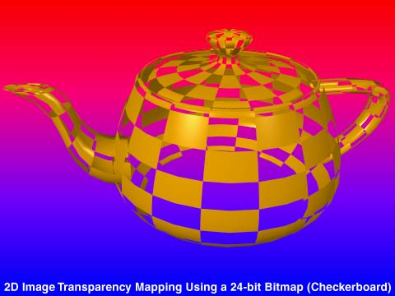
Many Versions of Teapots
From Steve Baker’s History of the Teapot site: http://www.sjbaker.org/teapot/index.html

Slide 24
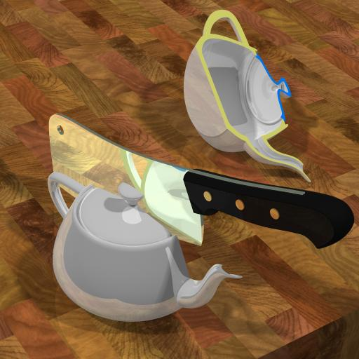
And the One I Like (Reflecting Newell’s View of Why He is Best Remembered for that %^$@ Teapot!)
From Steve Baker’s History of the Teapot site: http://www.sjbaker.org/teapot/index.html.

Slide 25
A FEW FOLKLORE FACTS ABOUT THE ORIGINAL TEAPOT
The real teapot is about 30% taller than the classic computer teapot see. Why?
  Jim Blinn was one of the early users of the Teapot data
    He was rendering on an Evans and Sutherland frame buffer.
    The pixels were not square, so he squashed the model rather than scaling the image.
    He chose to scale all the Z coordinates by dividing them by 1.3. His data was more widely distributed than the original and it has become the standard.
The original teapot data had no bottom.
  Some of the data sets that are out there have added a bottom - but that is definitely 'impure'.
  The one in the GLU and GLUT distributions is impure

Slide 26
WHY IS THE TEAPOT POPULAR?
In the early days, there were no 3D modeling packages
  Everything was digitized by hand or sketched on graph paper and the numbers entered by using a text editor.
  If you were working on texture mapping algorithms, ray tracing, lighting models, etc., then any source of free data was welcome.
Moreover, the teapot is a useful test object to test. It
  Is instantly recognizable
  Has complex topology
  Self-shadows
  There are hidden surface issues
  Has both convex and concave surfaces - as well as saddle points
  Doesn't take much storage space
Folklore says that some of the early pioneers of computer graphics could type the vertex coordinates for the teapot from memory!

Slide 27
Toy Story and the Teapot
In the movie Toy Story, you can spot the teapot in the scene after Buzz loses his arm and has tea with the headless dolls.
Did the graphics folks insert that scene just so that a gratuitous Teapot could be seen?
The graphics folks refuse to answer the question!

Slide 28
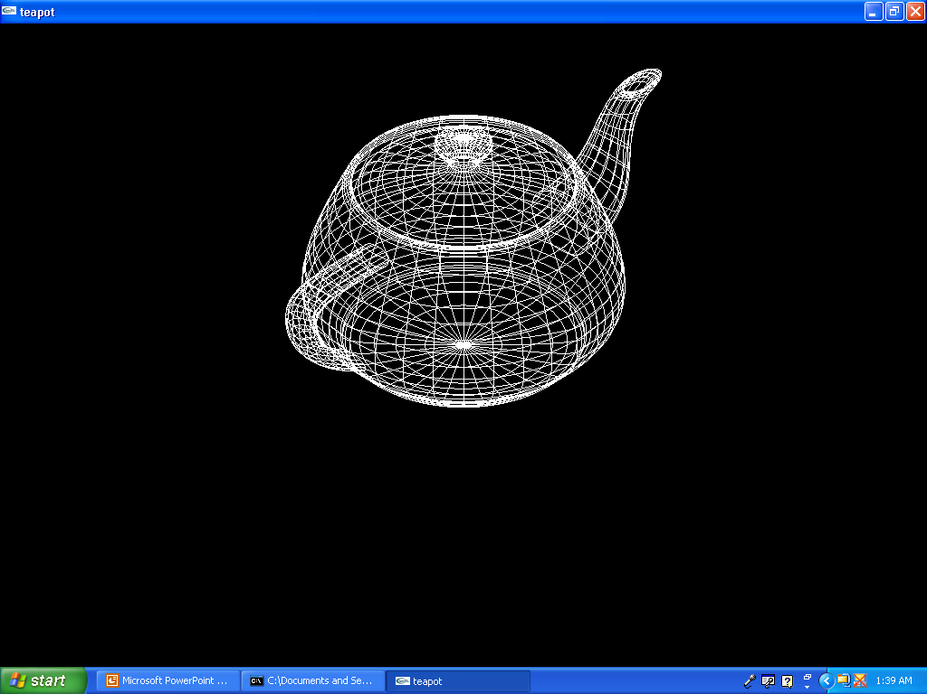
wireframe

Slide 29
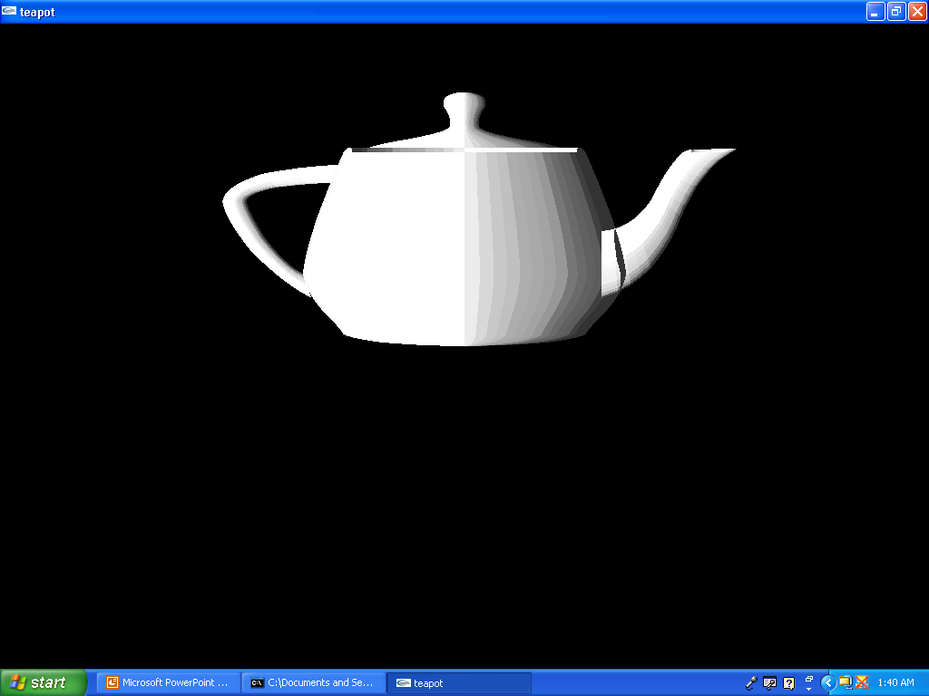
faceted shading

Slide 30
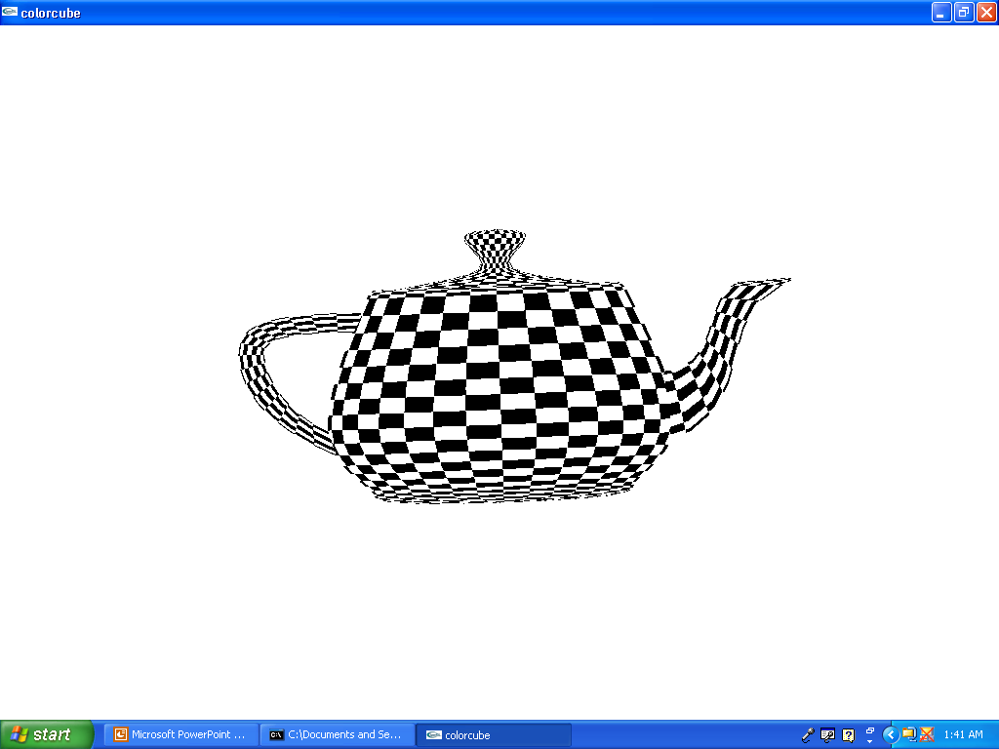
textured and rotating

Slide 31
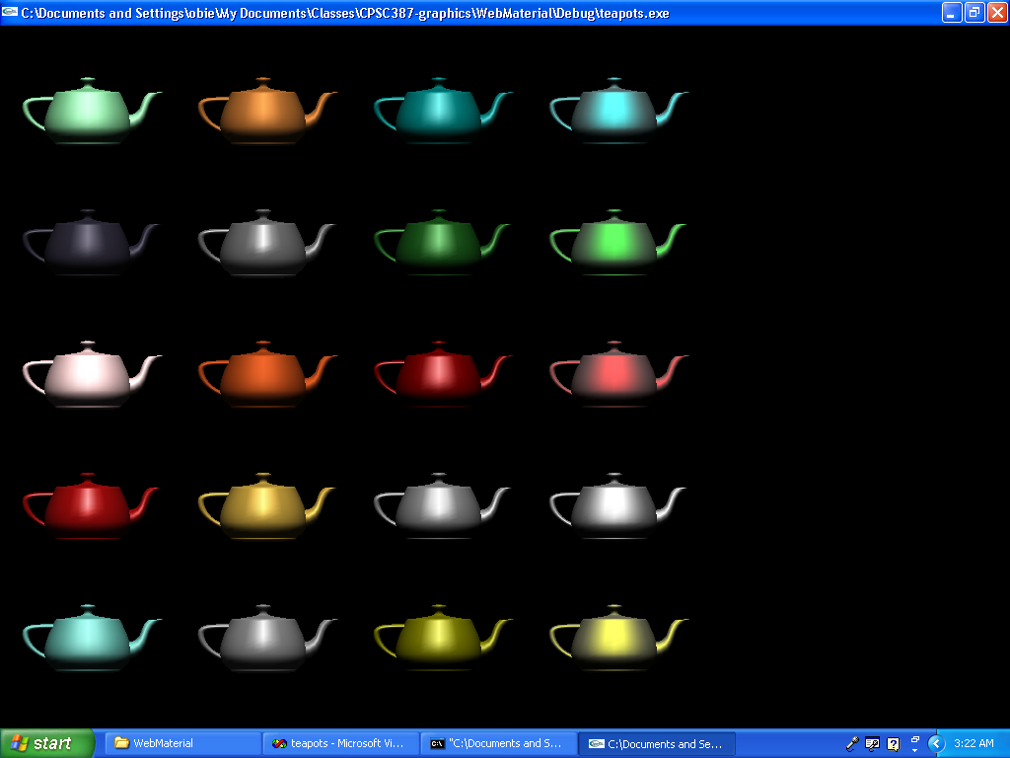
Multiple Teapots of Various Materials

Slide 32
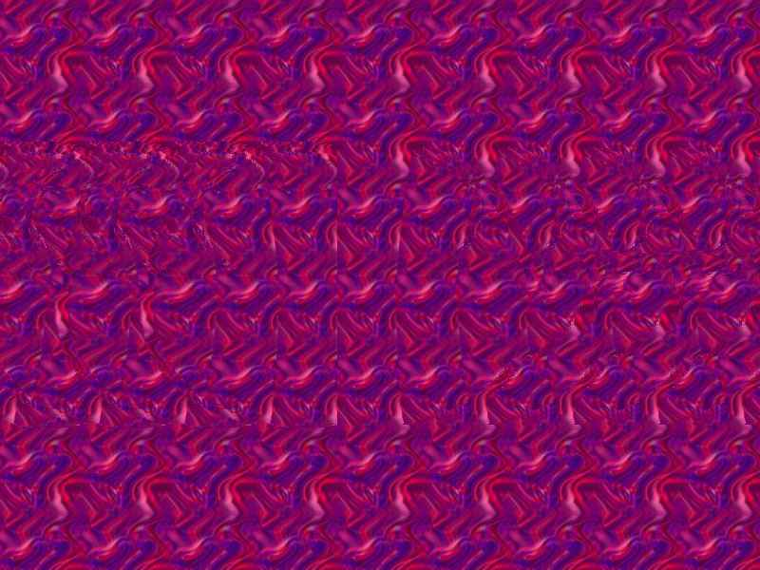

Slide 33
References for GLUT Functions
http://www.opengl.org/resources/libraries/glut/spec3/node80.html

