Slide 1
INTRODUCTION TO GRAPHICS
Part 2

Slide 2
Parts 2 and 3
Approaches in Studying Graphics
Basic OpenGL Architecture
GLUT
Simple Programs in 2 and 3 Dimensions

Slide 3
Approaches to Teaching Computer Graphics
Bottom Up
Survey
Top Down
Really Top Down

Slide 4
One Argument
You don’t need to know what’s under the hood to be literate, but unless you know how to program, you’ll be sitting in the back seat instead of driving.
Bottom up = study the engine
Survey = hire a chauffeur
Top Down = learn to drive

Slide 5
What are Some of the Important Concepts?
Three dimensional concepts
Light-material interactions
Transformations
Modeling
Interaction
Rendering Algorithms
... and others

Slide 6
What Is OpenGL?
Graphics rendering API (Application Programmer’s Interface) which
  Produces high-quality color images composed of geometric and image primitives
  Is window system independent
  Is operating system independent
  Is close to the hardware
    Consequently, it leads to discussions of algorithms and implementation
Notes:
OpenGL is a library for doing computer graphics. By using it, you can create interactive applications which render high-quality color images composed of 3D geometric objects and images.
OpenGL is window and operating system independent. As such, the part of your application which does rendering is platform independent. However, in order for OpenGL to be able to render, it needs a window to draw into. Generally, this is controlled by the windowing system on whatever platform you’re working on.

Slide 7
Other Physical Approaches to Rendering
Ray tracing
  Close to physics for simple models
  Easy to teach
  Easy to start with
  Somewhat limited as we will see
Radiosity
  Closer to rendering equations
  Not suitable for real time graphics
  Not suitable for teaching initially in a first class

Slide 8
Pipeline Model
Close to hardware
Easy to program
Direct implementation of synthetic camera
  Image formation by computer is analogous to image formation by camera (or human)
  Specify viewer, objects, lights
  Let hardware/software form image (via projection)

Slide 9
OpenGL Geometric Pipeline
State
Application
Program
ModelView
Transformation
Frame
Buffer
Projection
Rasterization
Vertices
Pixels
Notes:
This is the most important diagram you will see today, representing the flow of graphical information, as it is processed from CPU to the frame buffer.
There are two pipelines of data flow. The upper pipeline is for geometric, vertex-based primitives. The lower pipeline is for pixel-based, image primitives. Texturing combines the two types of primitives together.
There is a pull-out poster in the back of the OpenGL Reference Manual (“Blue Book”), which shows this diagram in more detail.

Slide 10
OpenGL as a Renderer
Two operations (basically) in OpenGL:
  Draw something
  Change the state of what or how OpenGL draws
Geometric primitives
  Various kinds of points, lines, and polygons
Image Primitives
  Images and bitmaps
  Separate pipeline for images and geometry
    Linked through texture mapping
Rendering depends on the state of
  Colors, materials, light sources, etc.
Notes:
As mentioned, OpenGL is a library for rendering computer graphics. Generally, there are two operations that you do with OpenGL:
draw something
change the state of how OpenGL draws
OpenGL has two types of things that it can render: geometric primitives and image primitives. Geometric primitives are points, lines and polygons. Image primitives are bitmaps and graphics images (i.e. the pixels that you might extract from a JPEG image after you’ve read it into your program.) Additionally, OpenGL links image and geometric primitives together using texture mapping, which is an advanced topic we’ll discuss this afternoon.
The other common operation that you do with OpenGL is setting state. “Setting state” is the process of initializing the internal data that OpenGL uses to render your primitives. It can be as simple as setting up the size of points and color that you want a vertex to be, to initializing multiple mipmap levels for texture mapping.

Slide 11
OpenGL Architecture
Upper pipeline is for geometric,
vector-based primitives.
Per Vertex
Operations &
Primitive
Assembly
Polynomial
Evaluator
CPU
Display
List
Rasterization
Per Fragment
Operations
Frame
Buffer
Texture
Memory
Pixel
Operations
Lower pipeline is for pixel-based, image
primitives.
Notes:
This is the most important diagram you will see today, representing the flow of graphical information, as it is processed from CPU to the frame buffer.
There are two pipelines of data flow. The upper pipeline is for geometric, vertex-based primitives. The lower pipeline is for pixel-based, image primitives. Texturing combines the two types of primitives together.
There is a pull-out poster in the back of the OpenGL Reference Manual (“Blue Book”), which shows this diagram in more detail.

Slide 12
OpenGL and the Windowing System
OpenGL is concerned only with rendering
  It is window system independent
  No input functions
OpenGL must interact with the underlying OS and windowing system
  Need minimal interface which may be system dependent
    Done through additional libraries: AGL, GLX, WGL

Slide 13
GLU and GLUT
GLU (OpenGL Utility Library)
  Part of OpenGL
  Provides NURBS, tessellators, quadric shapes, etc.
GLUT (OpenGL Utility Toolkit)
  A portable windowing API
  Not officially part of OpenGL
  Extremely useful for helping students (and others) create images quickly without worrying about the underlying windowing system being used
Notes:
As mentioned, OpenGL is window and operating system independent. To integrate it into various window systems, additional libraries are used to modify a native window into an OpenGL capable window. Every window system has its own unique library and functions to do this. Some examples are:
GLX for the X Windows system, common on Unix platforms
AGL for the Apple Macintosh
WGL for Microsoft Windows
OpenGL also includes a utility library, GLU, to simplify common tasks such as: rendering quadric surfaces (i.e. spheres, cones, cylinders, etc. ), working with NURBS and curves, and concave polygon tessellation.
Finally to simplify programming and window system dependence, we’ll be using the freeware library, GLUT. GLUT, written by Mark Kilgard, is a public domain window system independent toolkit for making simple OpenGL applications. It simplifies the process of creating windows, working with events in the window system and handling animation.

Slide 14
OpenGL and Related APIs
application program
OpenGL Motif
widget or similar
GLUT
GLX, AGL
or WGL
GLU
X, Win32, Mac O/S
GL
software and/or hardware
Notes:
The above diagram illustrates the relationships of the various libraries and window system components.
Generally, applications which require more user interface support will use a library designed to support those types of features (i.e. buttons, menu and scroll bars, etc.) such as Motif or the Win32 API.
Prototype applications, or one which don’t require all the bells and whistles of a full GUI, may choose to use GLUT instead because of its simplified programming model and window system independence.

Slide 15
Preliminaries- Installing the Software
Mesa is an open source version of OpenGL which can be used on many machines to provide an OpenGL environment. See
http://www.mesa3d.org/
Windows systems come with OpenGL
In either case, you will need GLUT. Version 3.7.6 is available at
http://www.xmission.com/~nate/glut.html
GLUT will have to interact with your C or C++ compiler. I will use Visual C++ 6.0.

Slide 16
Software at Hiram College
C-106 and KC should have Visual C++ and GLUT installed.
Unfortunately, Visual C++ wouldn’t install on dorm computers.
Check the web page for open lab hours.

Slide 17
GLUT FILES FOR YOUR PC
(Windows and Visual C++ easy installation)
From
http://www.xmission.com/~nate/glut.html
download and extract the compiled version
glut-3.7.6-bin.zip (117KB)
You might find glut-3.7.6-src.zip (4.76MB) interesting as it includes the source for the above as well as some demo programs.
The instructions on the next slide are for Visual C++. Otherwise, you need to locate the appropriate directories or folders for your compiler.

Slide 18
GLUT FILES FOR YOUR PC
(Windows XP and Visual C++ instructions)
Install glut32.ddl in the system folder where Opengl32.dll and glu32.dll reside:
  C:\WINDOWS\system32
Install glut32.lib in the Visual C++ folder where Opengl32.lib and glu32.lib reside:
C:\Program Files\Microsoft Visual Studio\
VC98\Lib
Install glut.h in the Visual C++ folder where gl.h and glu.h reside:
C:\Program Files\Microsoft Visual Studio\
VC98\Include\GL
See details for other installations on the OpenGL website.

Slide 19
Preliminaries
On the web site is a link to a quick introduction to C++. READ IT IMMEDIATELY!
Headers Files
    #include <glut.h>
Enumerated Types
  OpenGL defines numerous types for compatibility- the actual representation is chosen by the system
      GLfloat, GLint, GLenum, etc.
Notes:
All of our discussions today will be presented in the C computer language.
For C, there are a few required elements which an application must do:
Header files describe all of the function calls, their parameters and defined constant values to the compiler. OpenGL has header files for GL (the core library), GLU (the utility library), and GLUT (freeware windowing toolkit).
Note: glut.h includes gl.h and glu.h. On Microsoft Windows, including only glut.h is recommended to avoid warnings about redefining Windows macros.
Libraries are the operating system dependent implementation of OpenGL on the system you’re using. Each operating system has its own set of libraries. For Unix systems, the OpenGL library is commonly named libGL.so and for Microsoft Windows, it’s named opengl32.lib.
Finally, enumerated types are definitions for the basic types (i.e. float, double, int, etc.) which your program uses to store variables. To simplify platform independence for OpenGL programs, a complete set of enumerated types are defined. Use them to simplify transferring your programs to other operating systems.

Slide 20
GLUT Basics
Application Structure
  Configure and open a window
  Initialize OpenGL state(s)
  Register input callback¹ functions- i.e.
    render
    resize
    input: keyboard, mouse, etc.
  Enter event processing loop
  ¹ A callback function is a function that is invoked by an event
Notes:
Here’s the basic structure that we’ll be using in our applications. This is generally what you’d do in your own OpenGL applications.
The steps are:
1) Choose the type of window that you need for your application and initialize it.
2) Initialize any OpenGL state that you don’t need to change every frame of your program. This might include things like the background color, light positions and texture maps.
3) Register the callback functions that you’ll need. Callbacks are routines you write that GLUT calls when a certain sequence of events occurs, like the window needing to be refreshed, or the user moving the mouse. The most important callback function is the one to render your scene, which we’ll discuss in a few slides.
4) Enter the main event processing loop. This is where your application receives events, and schedules when callback functions are called.

Slide 21
Sample Program- Basic Ideas
void main( int argc, char** argv )
{
int mode = GLUT_RGB|GLUT_DOUBLE;
glutInitDisplayMode( mode );
glutCreateWindow( argv[0] );
init();
glutDisplayFunc( display );
glutReshapeFunc( resize );
glutKeyboardFunc( key );
glutIdleFunc( idle );
glutMainLoop();
}
Notes:
Here’s an example of the main part of a GLUT based OpenGL application. This is the model that we’ll use for most of our programs in the course.
The glutInitDisplayMode() and glutCreateWindow() functions compose the window configuration step.
We then call the init() routine, which contains our one-time initialization. Here we initialize any OpenGL state and other program variables that we might need to use during our program that remain constant throughout the program’s execution.
Next, we register the callback routines that we’re going to use during our program.
Finally, we enter the event processing loop, which interprets events and calls our respective callback routines.

Slide 22
OpenGL Initialization
Set up whatever state you’re going to use
void init( void )
{
glClearColor( 0.0, 0.0, 0.0, 1.0 );
glClearDepth( 1.0 );
glEnable( GL_LIGHT0 );
glEnable( GL_LIGHTING );
glEnable( GL_DEPTH_TEST );
}
Notes:
Here’s the internals of our initialization routine, init(). Over the course of the day, you’ll learn what each of the above OpenGL calls do.

Slide 23
GLUT Callback Functions
Routine to call when something happens
  window resize or redraw
  user input
  animation
“Register” callbacks with GLUT
    glutDisplayFunc( display );
    glutIdleFunc( idle );
    glutKeyboardFunc( keyboard );
Notes:
GLUT uses a callback mechanism to do its event processing. Callbacks simplify event processing for the application developer. As compared to more traditional event driven programming, where the author must receive and process each event, and call whatever actions are necessary, callbacks simplify the process by defining what actions are supported, and automatically handling the user events. All the author must do is fill in what should happen when.
GLUT supports many different callback actions, including:
glutDisplayFunc() - called when pixels in the window need to be refreshed.
glutReshapeFunc() - called when the window changes size
glutKeyboardFunc() - called when a key is struck on the keyboard
glutMouseFunc() - called when the user presses a mouse button on the mouse
glutMotionFunc() - called when the user moves the mouse while a mouse button is pressed
glutPassiveMouseFunc() - called when the mouse is moved regardless of mouse button state
glutIdleFunc() - a callback function called when nothing else is going on. Very useful for animations.

Slide 24
Rendering Callback
Do all of your drawing here
glutDisplayFunc( display );
void display( void )
{
glClear( GL_COLOR_BUFFER_BIT );
glBegin( GL_TRIANGLE_STRIP );
glVertex3fv( v[0] );
glVertex3fv( v[1] );
glVertex3fv( v[2] );
glVertex3fv( v[3] );
glEnd();
glutSwapBuffers();
}
Display, of course, can call other functions.
Notes:
One of the most important callbacks is the glutDisplayFunc() callback. This callback is called when the window needs to be refreshed. It’s here that you’d do all of your OpenGL rendering.
The above routine merely clears the window, and renders a triangle strip and then swaps the buffers for smooth animation transition. You’ll learn more about what each of these calls do during the day.

Slide 25
Idle Callbacks
Use for animation and continuous update
glutIdleFunc( idle );
void idle( void )
{
t += dt;
glutPostRedisplay();
}
When nothing else is called, do this.
Notes:
Animation requires the ability to draw a sequence of images. The glutIdleFunc()is the mechanism for doing animation. You register a routine which updates your motion variables (usually global variables in your program which control how things move) and then requests that the scene be updated.
glutPostRedisplay() requests that the callback registered with glutDisplayFunc() be called as soon as possible. This is preferred over calling your rendering routine directly, since the user may have interacted with your application and user input events need to be processed.

Slide 26
User Input Callbacks
Process user input
glutKeyboardFunc( keyboard );
void keyboard( char key, int x, int y )
{
switch( key ) {
case ‘q’ : case ‘Q’ :
exit( EXIT_SUCCESS );
break;
case ‘r’ : case ‘R’ :
rotate = GL_TRUE;
break;
}
}
Notes:
Above is a simple example of a user input callback. In this case, the routine was registered to receive keyboard input. GLUT supports user input through a number of devices including the keyboard, mouse, dial and button boxes and spaceballs.

Slide 27
Elementary Rendering
Geometric Primitives
Managing OpenGL State
OpenGL Buffers
Notes:
In this section, we’ll be discussing the basic geometric primitives that OpenGL uses for rendering, as well as how to manage the OpenGL state which controls the appearance of those primitives.
OpenGL also supports the rendering of bitmaps and images, which is discussed in a later section.
Additionally, we’ll discuss the different types of OpenGL buffers, and what each can be used for.

Slide 28
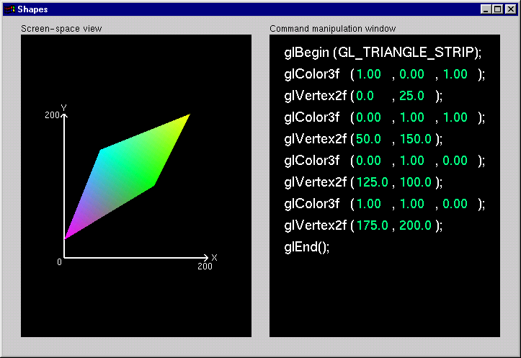
Shapes Tutorial
  Developed by Nate Robbins
  Available on web and in the labs
  Illustrates the principles of rendering geometry, specifying both colors and vertices.
We'll look at several of these tutorials. This one is shapes.exe
I’ll demo a few things and then ask some questions of you as you play with the software.
Notes:
This is the first of the series of Nate Robins’ tutorials. This tutorial illustrates the principles of rendering geometry, specifying both colors and vertices.
The shapes tutorial has two views: a screen-space window and a command manipulation window.
In the command manipulation window, pressing the LEFT mouse while the pointer is over the green parameter numbers allows you to move the mouse in the y-direction (up and down) and change their values. With this action, you can change the appearance of the geometric primitive in the other window. With the RIGHT mouse button, you can bring up a pop-up menu to change the primitive you are rendering. (Note that the parameters have minimum and maximum values in the tutorials, sometimes to prevent you from wandering too far. In an application, you probably don’t want to have floating-point color values less than 0.0 or greater than 1.0, but you are likely to want to position vertices at coordinates outside the boundaries of this tutorial.)
In the screen-space window, the RIGHT mouse button brings up a different pop-up menu, which has menu choices to change the appearance of the geometry in different ways.
The left and right mouse buttons will do similar operations in the other tutorials.

Slide 29
OpenGL Geometric Primitives
All geometric primitives are specified by vertices
GL_LINES
GL_POLYGON
GL_POINTS
GL_LINE_STRIP
GL_LINE_LOOP
GL_TRIANGLES
GL_QUADS
GL_QUAD_STRIP
GL_TRIANGLE_STRIP
GL_TRIANGLE_FAN
Notes:
Every OpenGL geometric primitive is specified by its vertices, which are homogenous coordinates. Homogenous coordinates are of the form
( x, y, z, w ). Depending on how vertices are organized, OpenGL can render any of the shown primitives.

Slide 30
Simple Example
void drawRhombus( GLfloat color[] )
{
  glBegin( GL_QUADS );
  glColor3fv( color );
  glVertex2f( 0.0, 0.0 );
  glVertex2f( 1.0, 0.0 );
  glVertex2f( 1.5, 1.118 );
  glVertex2f( 0.5, 1.118 );
  glEnd();
}
Notes:
The drawRhombus() routine causes OpenGL to render a single quadrilateral in a single color. The rhombus is planar, since the z value is automatically set to 0.0 by glVertex2f().

Slide 31
OpenGL Command Formats
glVertex3fv( v )
Number of
components
Data Type
Vector
b - byte
ub - unsigned byte
s - short
us - unsigned short
i - int
ui - unsigned int
f - float
d - double
omit “v” for
scalar form
glVertex2f( x, y )
2 - (x,y)
3 - (x,y,z)
4 - (x,y,z,w)
Notes:
The OpenGL API calls are designed to accept almost any basic data type, which is reflected in the calls name. Knowing how the calls are structured makes it easy to determine which call should be used for a particular data format and size.
For instance, vertices from most commercial models are stored as three component floating point vectors. As such, the appropriate OpenGL command to use is glVertex3fv( coords ).
As mentioned before, OpenGL uses homogenous coordinates to specify vertices. For glVertex*() calls which don’t specify all the coordinates
( i.e. glVertex2f()), OpenGL will default z = 0.0, and w = 1.0 .

Slide 32
Specifying Geometric Primitives
Primitives are specified using
      glBegin( primType );
      glEnd();
  primType determines how vertices are combined
  GLfloat red, green, blue;
  Glfloat coords[3];
  glBegin( primType );
  for ( i = 0; i < nVerts; ++i ) {
  glColor3f( red, green, blue );
  glVertex3fv( coords );
  }
  glEnd();
Notes:
OpenGL organizes vertices into primitives based upon which type is passed into glBegin(). The possible types are:
GL_POINTS GL_LINE_STRIP
GL_LINES GL_LINE_LOOP
GL_POLYGON GL_TRIANGLE_STRIP
GL_TRIANGLES GL_TRIANGLE_FAN
GL_QUADS GL_QUAD_STRIP

Slide 33
OpenGL Color
Models
RGBA or Color Index
color index mode
Red
Green
Blue
0
1
1
Display
2
2
4
8
3

16


24
123
219
74
25
26

RGBA mode
Notes:
Every OpenGL implementation must support rendering in both RGBA mode,
( sometimes described as TrueColor mode ) and color index ( or colormap ) mode.
For RGBA rendering, vertex colors are specified using the glColor*() call.
For color index rendering, the vertex’s index is specified with glIndex*().
The type of window color model is requested from the windowing system. Using GLUT, the glutInitDisplayMode() call is used to specify either an RGBA window ( using GLUT_RGBA ), or a color indexed window ( using GLUT_INDEX ).

Slide 34
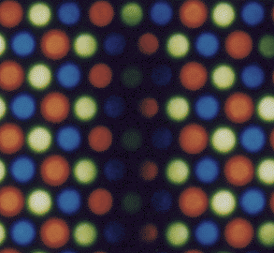
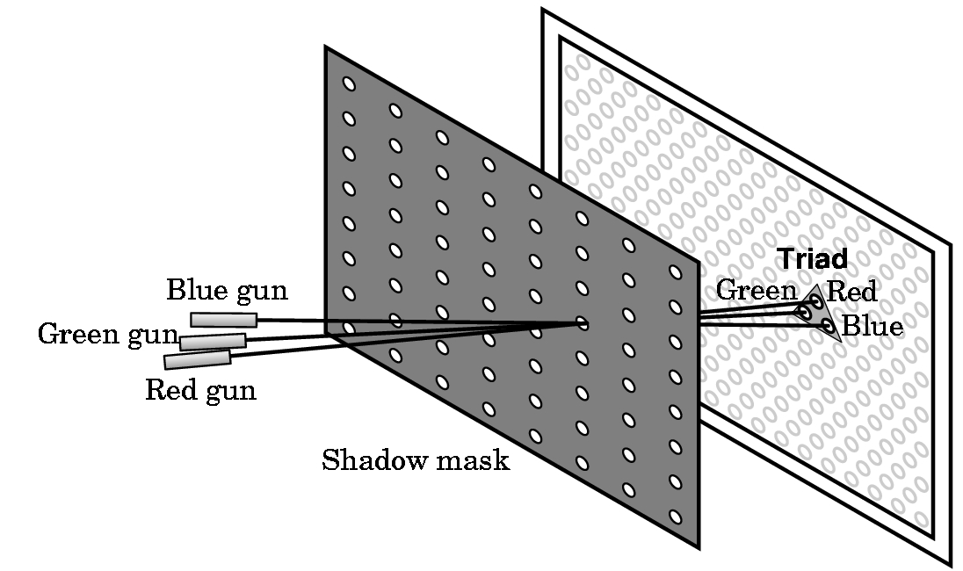
Shadow Mask CRT

Slide 35
Additive and Subtractive Color
Additive color
  Form a color by adding amounts of three primaries
    CRTs, projection systems, positive film
  Primaries are Red (R), Green (G), Blue (B)
Subtractive color
  Form a color by filtering white light with cyan (C), Magenta (M), and Yellow (Y) filters
    Light-material interactions
    Printing
    Negative film

Slide 36
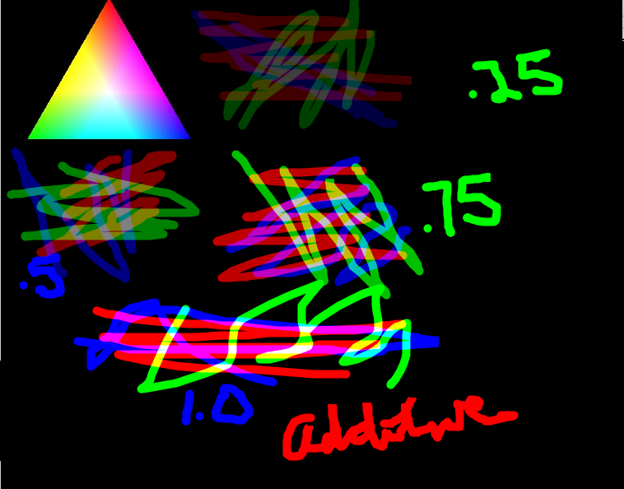
Additive Color by Intensities

Slide 37
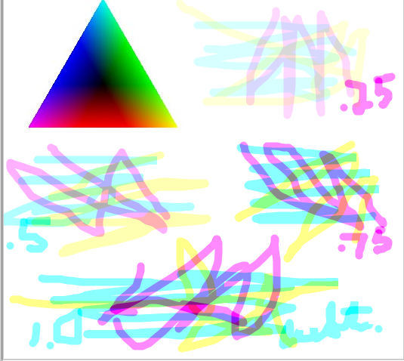
Subtractive Color by Intensities

Slide 38
Sample Program- Basic Ideas
void main( int argc, char** argv )
{
int mode = GLUT_RGB|GLUT_DOUBLE;
glutInitDisplayMode( mode );
glutCreateWindow( argv[0] );
init();
glutDisplayFunc( display );
glutReshapeFunc( resize );
glutKeyboardFunc( key );
glutIdleFunc( idle );
glutMainLoop();
}
Notes:
Here’s an example of the main part of a GLUT based OpenGL application. This is the model that we’ll use for most of our programs in the course.
The glutInitDisplayMode() and glutCreateWindow() functions compose the window configuration step.
We then call the init() routine, which contains our one-time initialization. Here we initialize any OpenGL state and other program variables that we might need to use during our program that remain constant throughout the program’s execution.
Next, we register the callback routines that we’re going to use during our program.
Finally, we enter the event processing loop, which interprets events and calls our respective callback routines.

