Slide 1
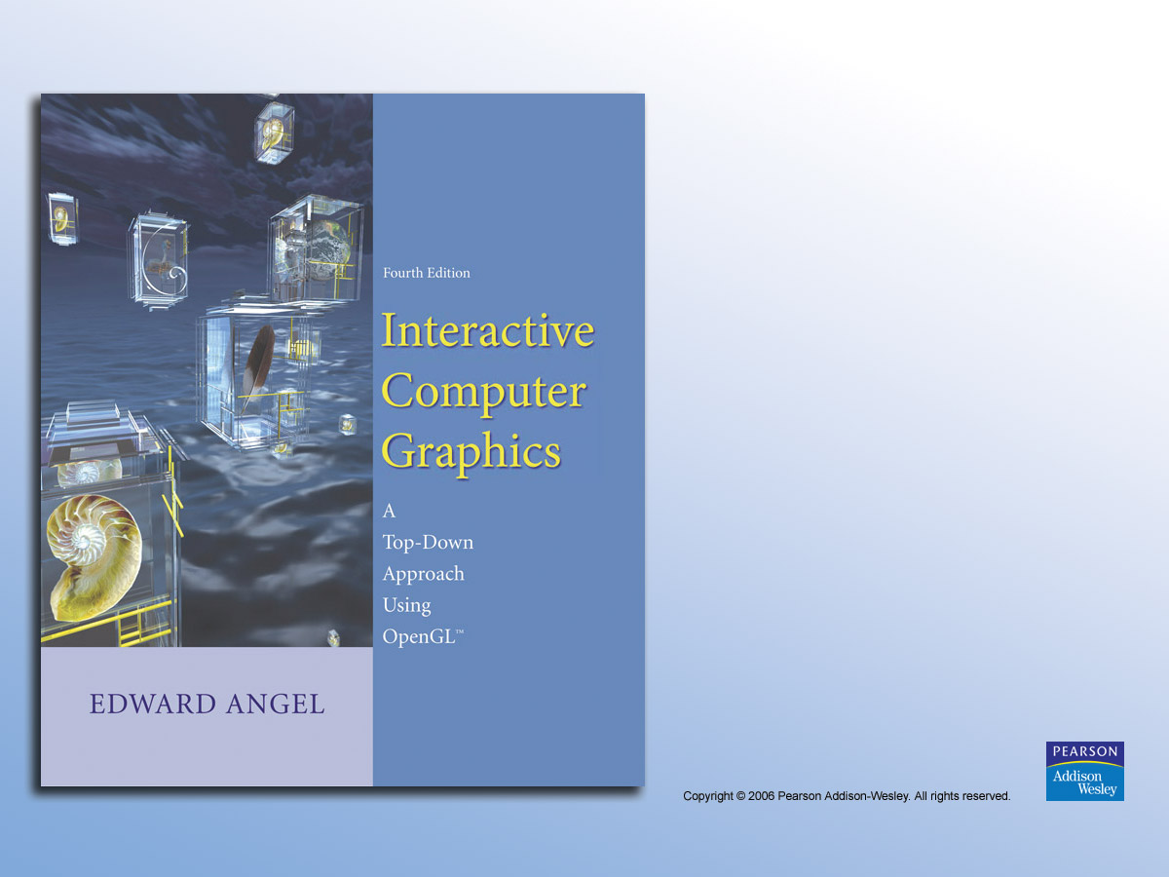
Chapter 7
From Vertices
to Fragments

Slide 2


FIGURE 7.1
High-level view of the graphics process.

Slide 3
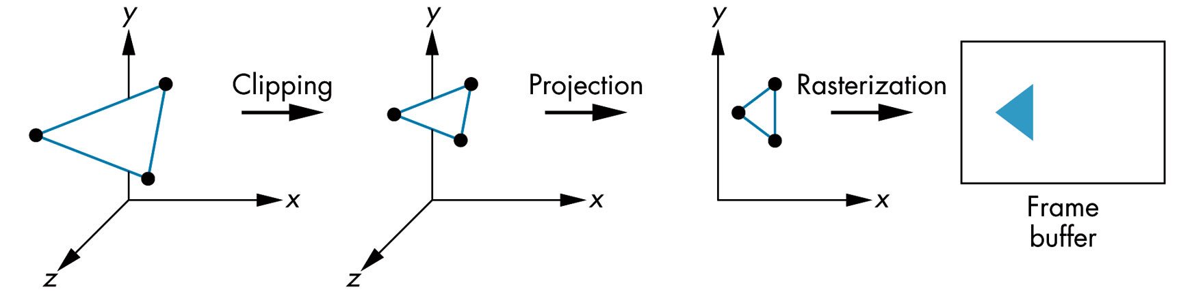
FIGURE 7.2 Object-oriented approach.

Slide 4
FIGURE 7.3 Implementation tasks.

Slide 5
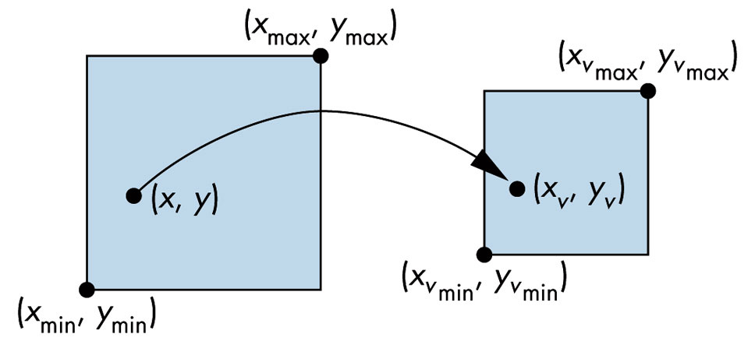
FIGURE 7.4 Viewport transformation.

Slide 6
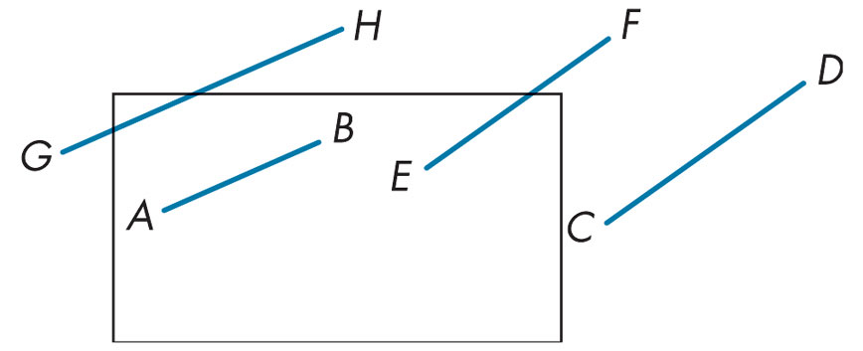
FIGURE 7.5 Two-dimensional clipping.

Slide 7
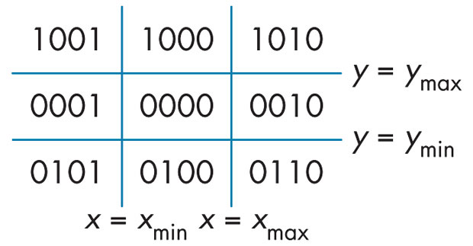
FIGURE 7.6
Breaking up of space and outcodes.

Slide 8
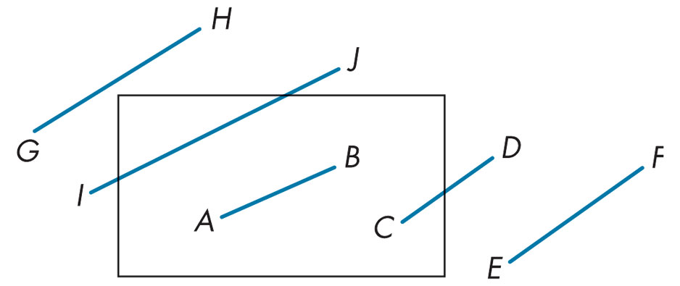
FIGURE 7.7 Cases of outcodes in Cohen-Sutherland algorithm.

Slide 9
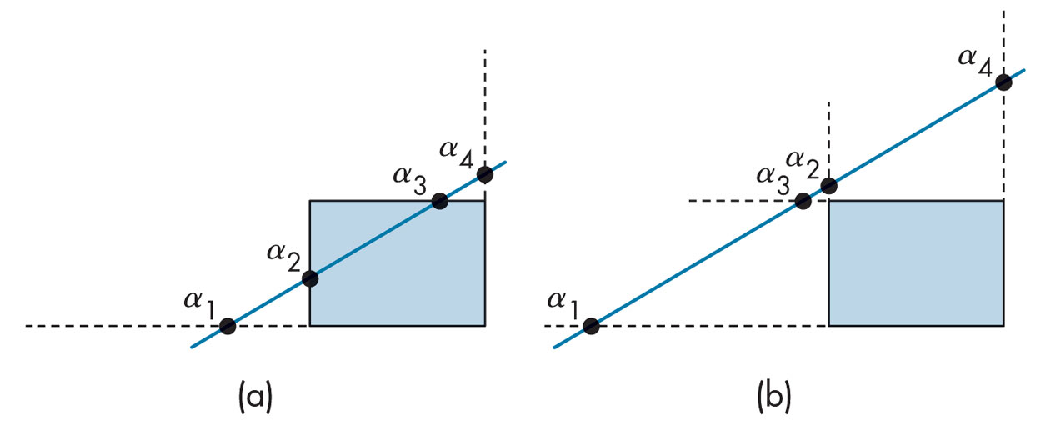
FIGURE 7.8 Two cases of a parametric line and a clipping window.

Slide 10
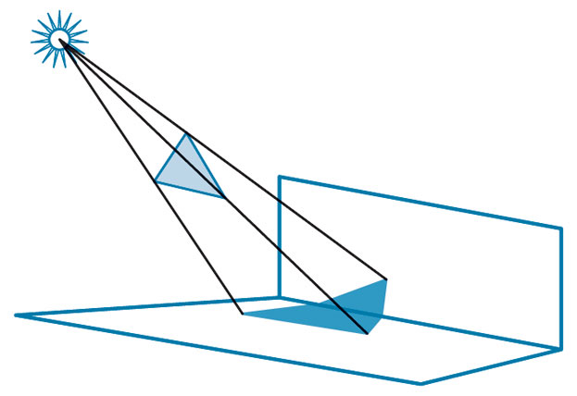
FIGURE 7.9
Polygon clipping in shadow generation.

Slide 11
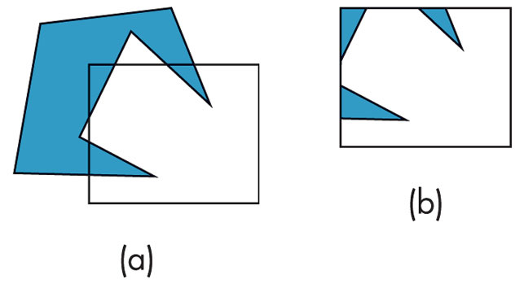
FIGURE 7.10 Clipping of a concave polygon. (a) Before clipping. (b) After clipping.

Slide 12
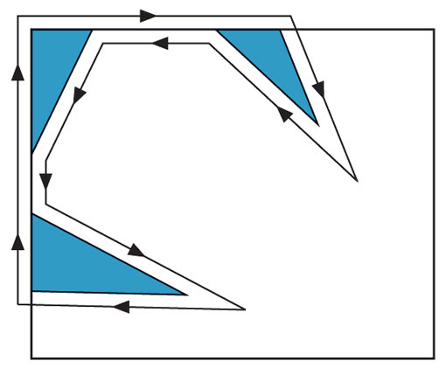
FIGURE 7.11
Creation of a single polygon.

Slide 13

FIGURE 7.12
Tessellation of a concave polygon.

Slide 14
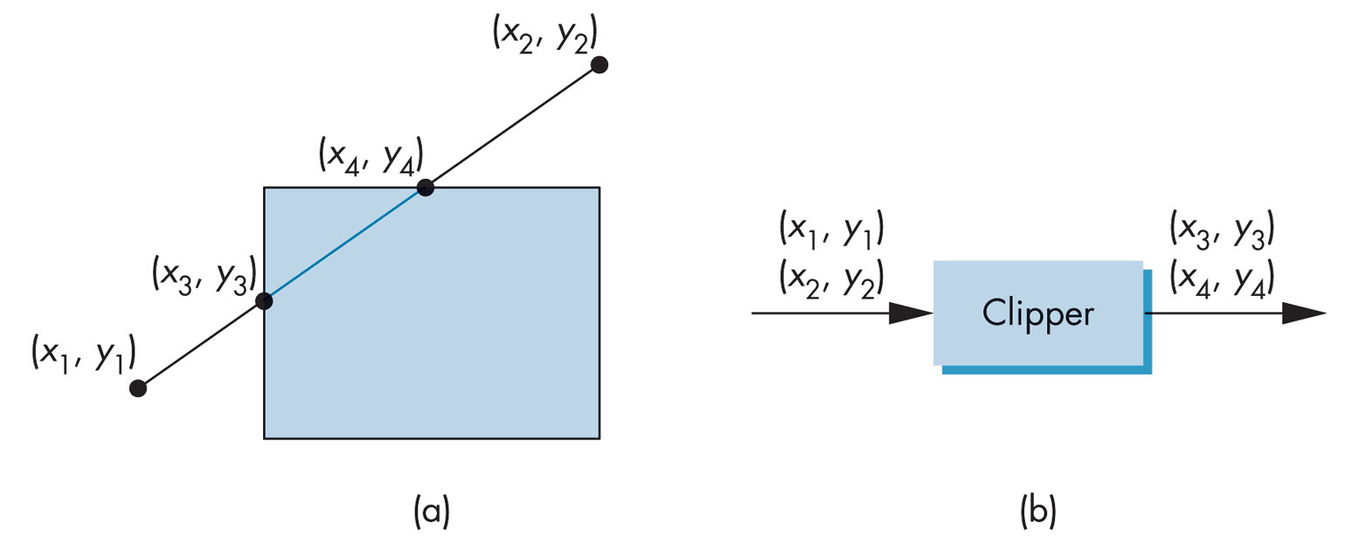
FIGURE 7.13 Two views of clipping. (a) Clipping against a rectangle. (b) Clipper as a black box.

Slide 15
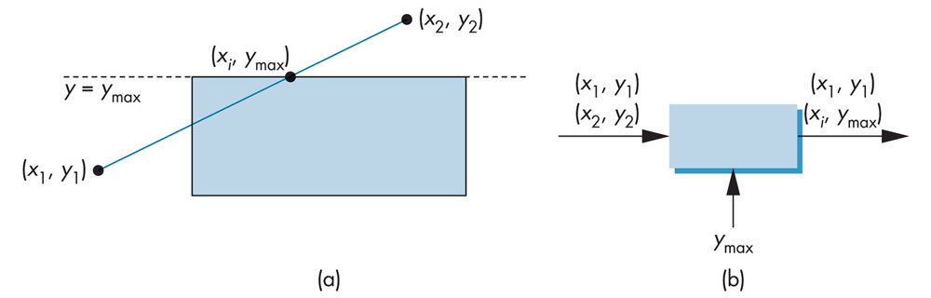
FIGURE 7.14 Clipping against top.
(a) Graphically. (b) Black-box view.

Slide 16
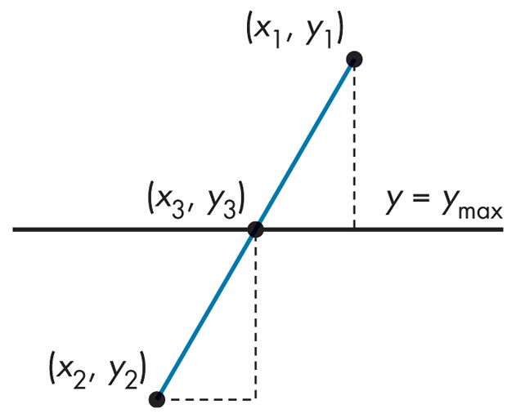
FIGURE 7.15
Intersection with the top of the window.

Slide 17
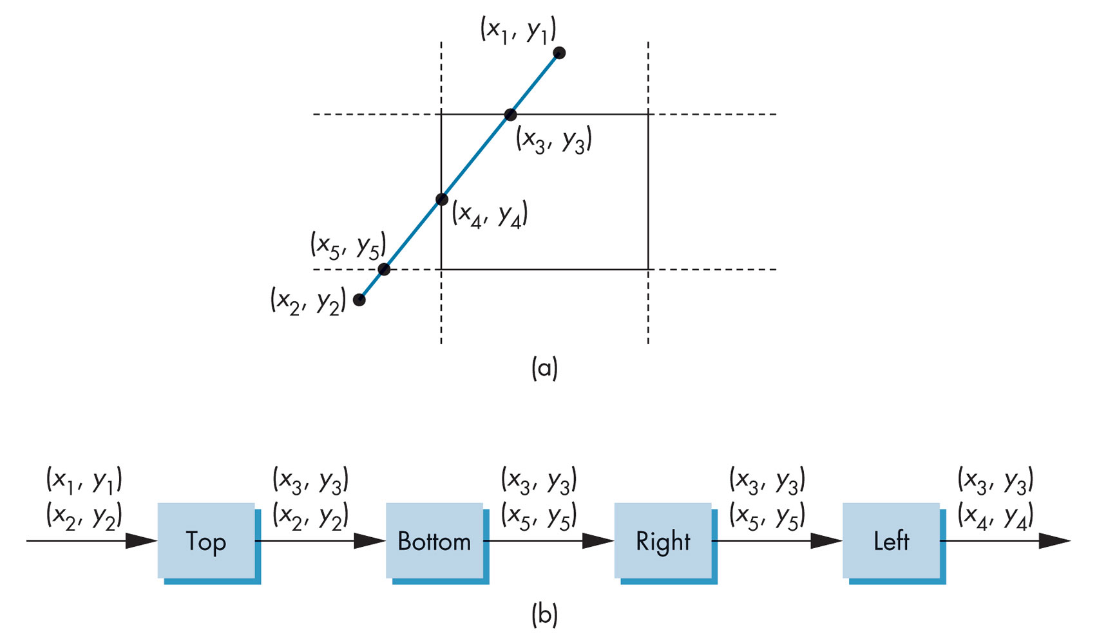
FIGURE 7.16 Pipeline clipping. (a) Clipping problem. (b) Pipeline clippers.

Slide 18
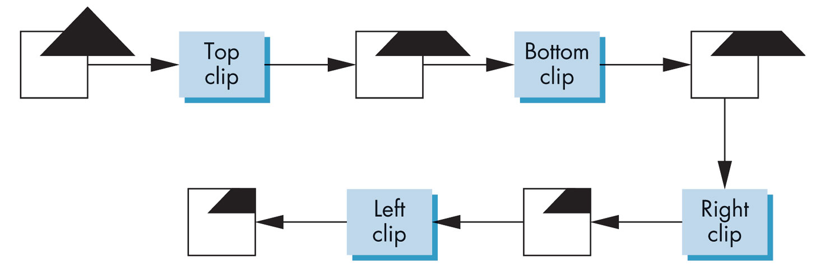
FIGURE 7.17
Example of pipeline clipping.

Slide 19
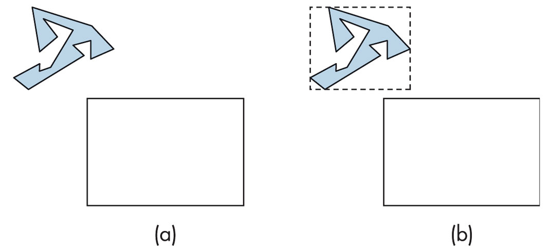
FIGURE 7.18 Using bounding boxes.
(a) Polygon and clipping window. (b) Polygon, bounding box, and clipping window.

Slide 20
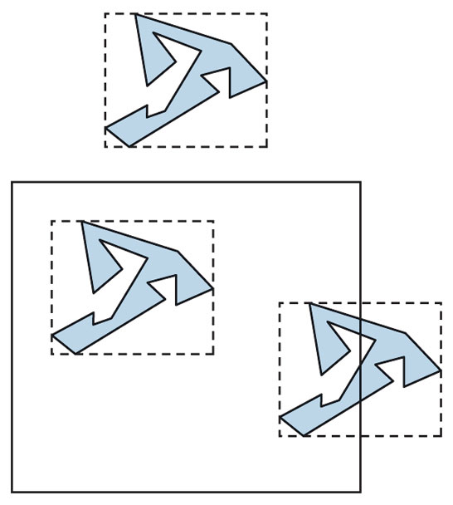
FIGURE 7.19
Clipping with bounding boxes.

Slide 21
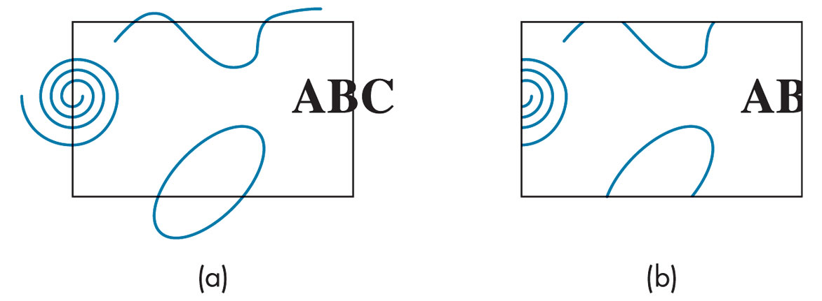
FIGURE 7.20 Curve clipping.

Slide 22
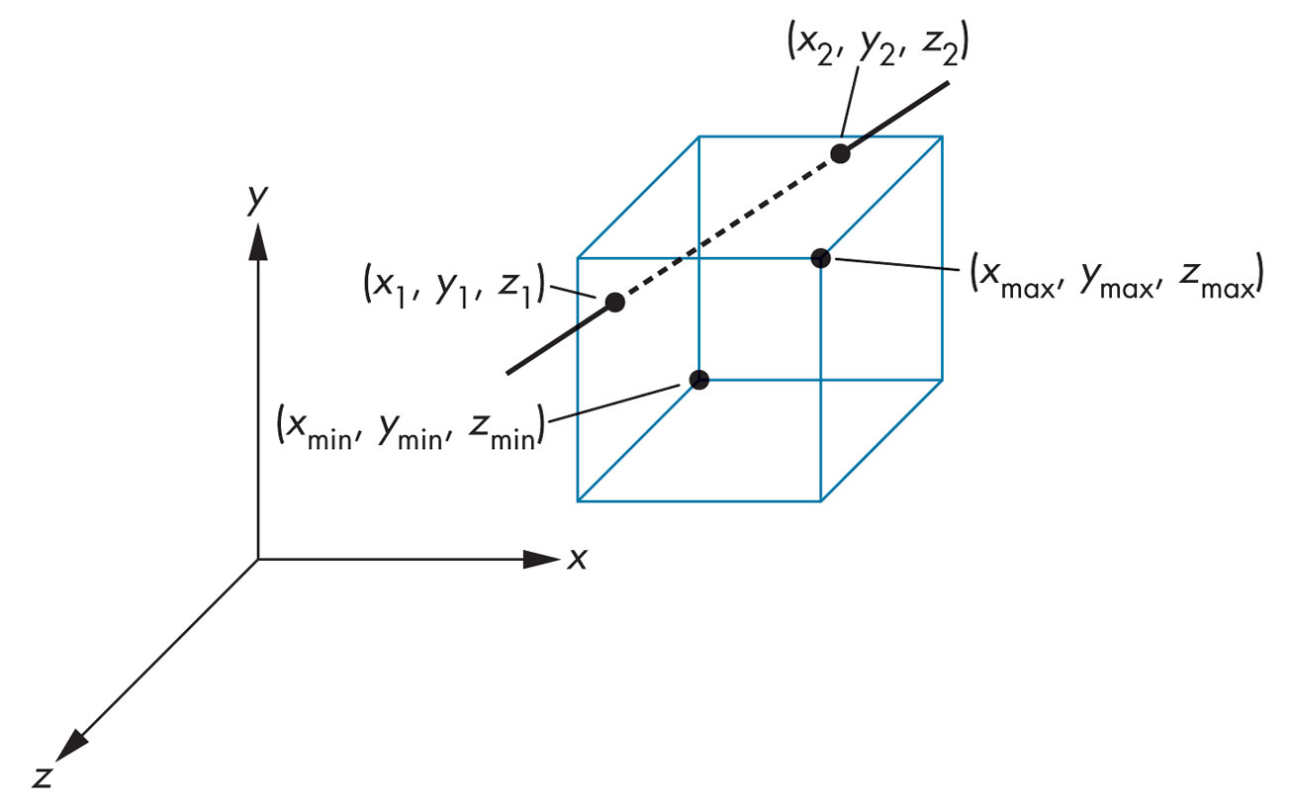
FIGURE 7.21 Three-dimensional clipping against a right parallelepiped.

Slide 23
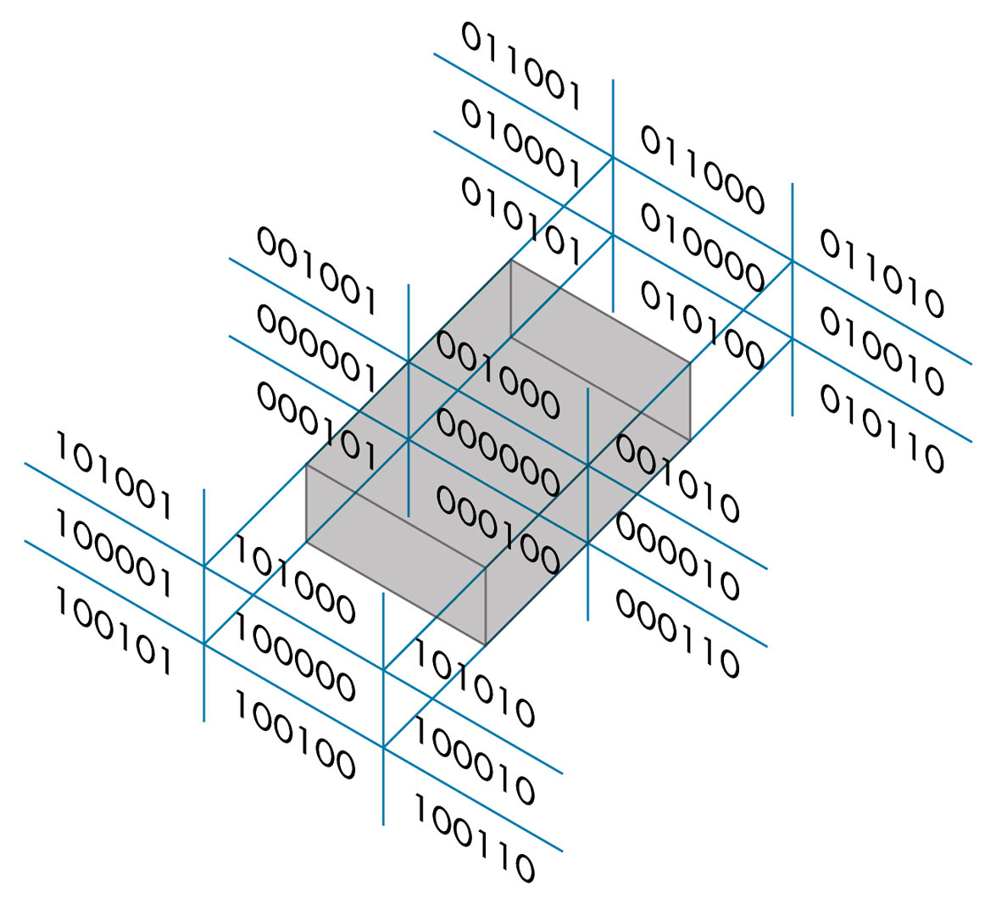
FIGURE 7.22 Cohen-Sutherland regions in three dimensions.

Slide 24
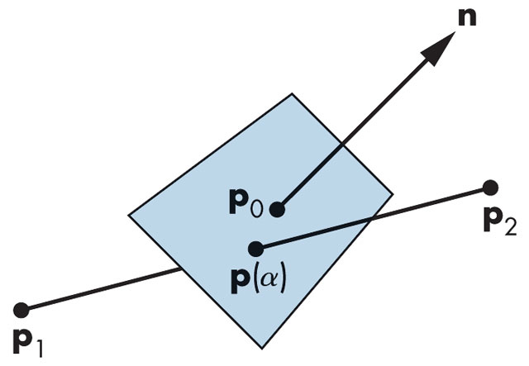
FIGURE 7.23 Plane–line intersection.

Slide 25
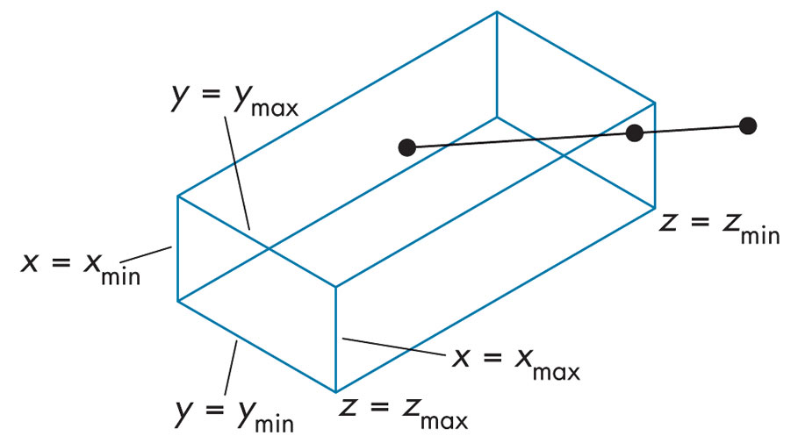
FIGURE 7.24
Clipping for orthographic viewing.

Slide 26
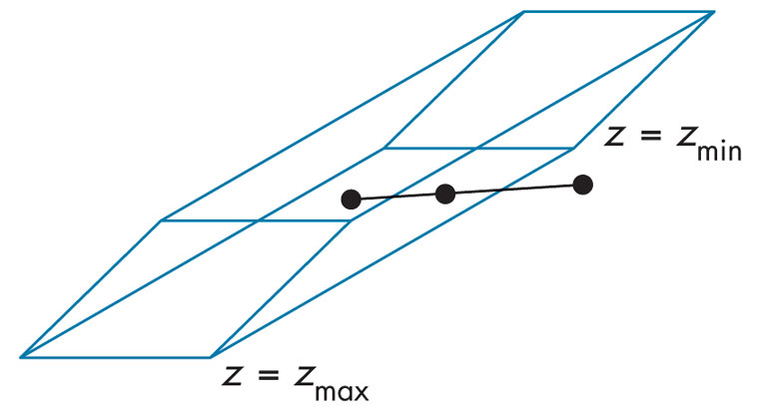
FIGURE 7.25
Clipping for oblique viewing.

Slide 27
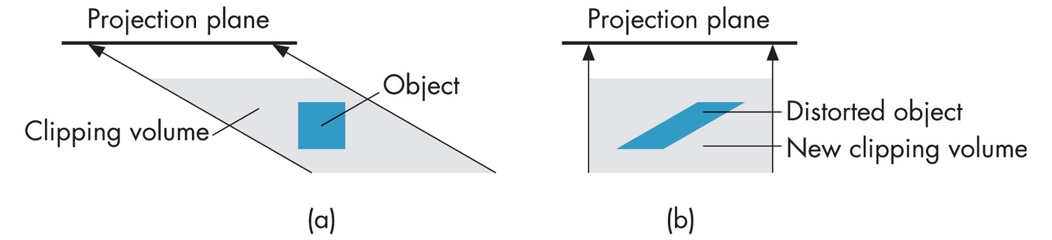
FIGURE 7.26 Distortion of view volume by shear. (a) Top view before shear. (b) Top view after shear.

Slide 28
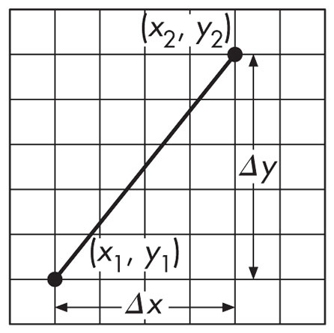
FIGURE 7.27
Line segment in window coordinates.

Slide 29
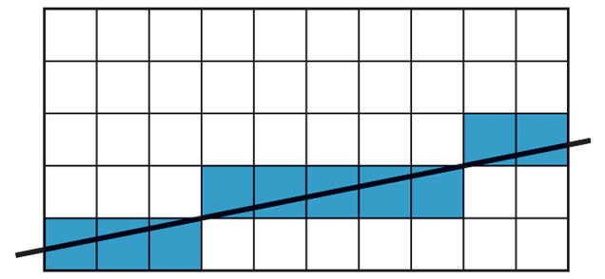
FIGURE 7.28
Pixels generated by DDA algorithm.

Slide 30
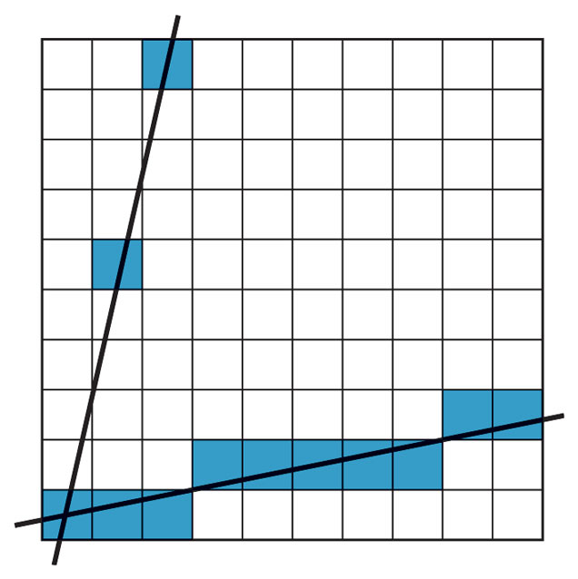
FIGURE 7.29 Pixels generated by high- and low-slope lines.

Slide 31
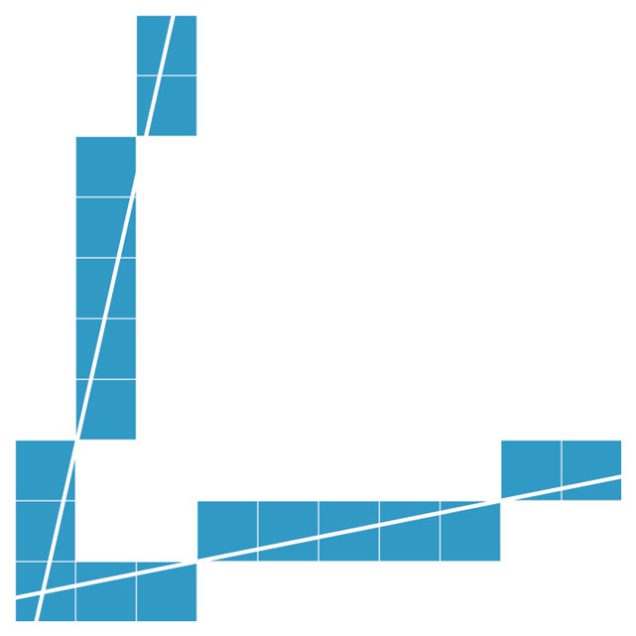
FIGURE 7.30 Pixels generated by revised DDA algorithm.

Slide 32
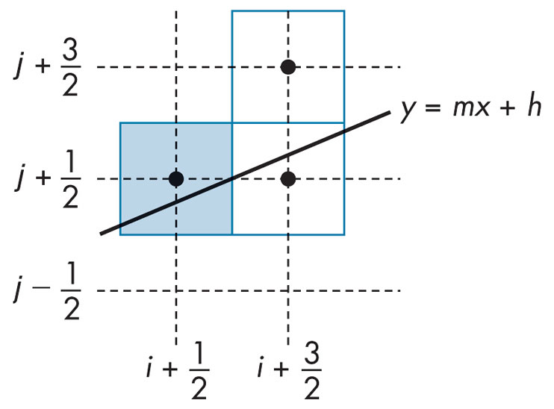
FIGURE 7.31
Conditions for Bresenham’s algorithm.

Slide 33
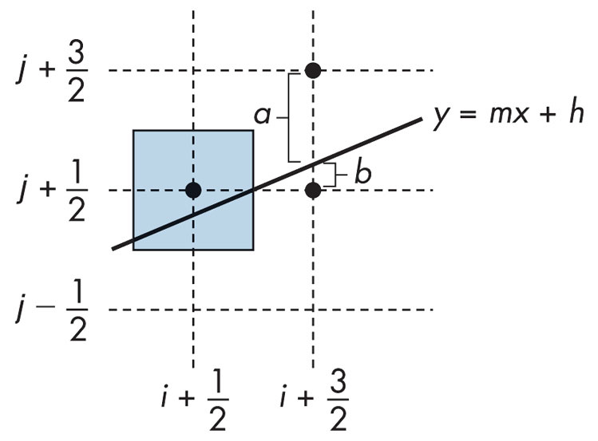
FIGURE 7.32 Decision variable for Bresenham’s algorithm.

Slide 34
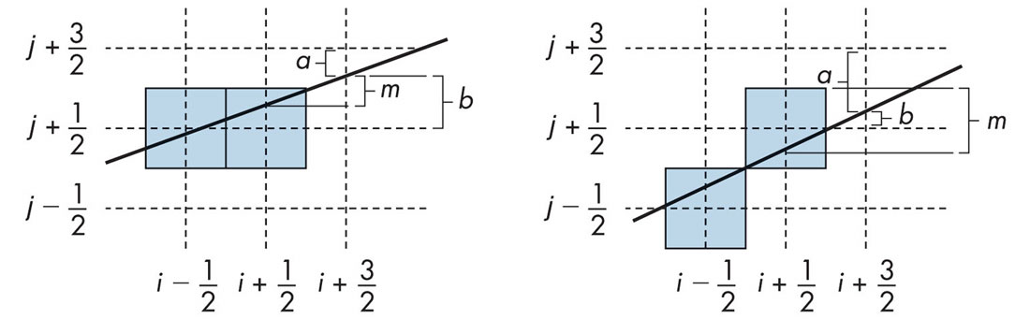
FIGURE 7.33
Incrementing of the values of a and b.

Slide 35

FIGURE 7.34
Filling with the odd-even test.

Slide 36
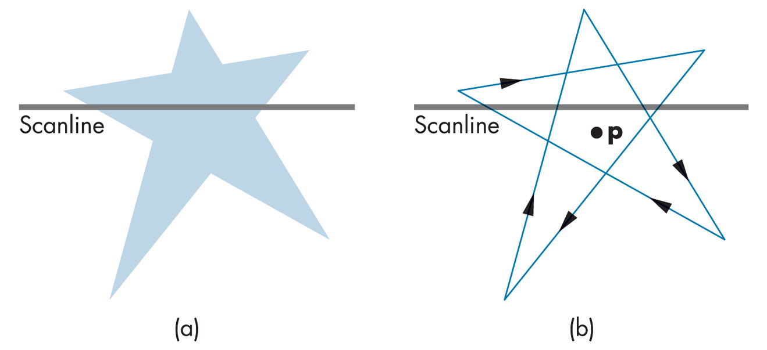
FIGURE 7.35
Fill using the winding number test.

Slide 37

FIGURE 7.36 S-shaped curve.

Slide 38
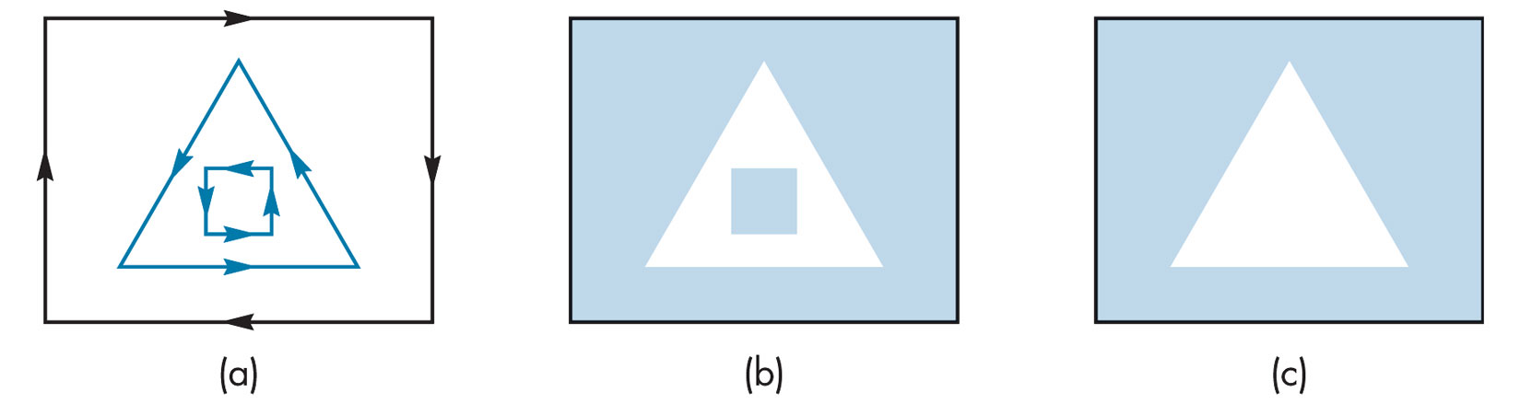
FIGURE 7.37 Polygon tessellations.
(a) Polygon with edges and directions of contours. (b) Tessellation 1. (c) Tessellation 2.

Slide 39
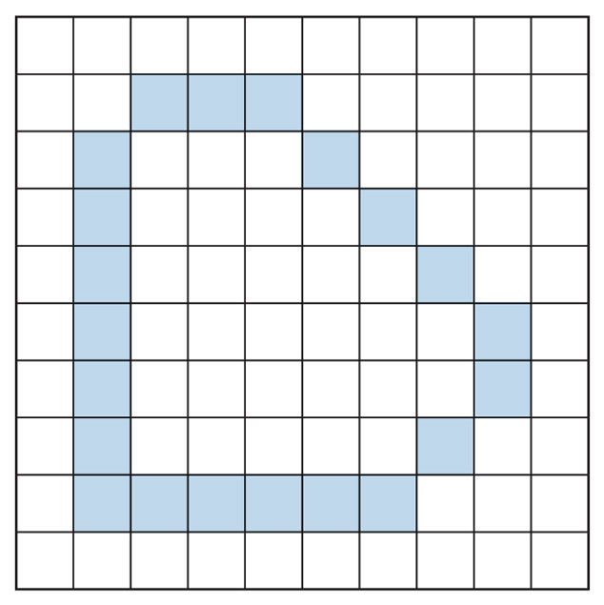
FIGURE 7.38
Polygon displayed by edges.

Slide 40
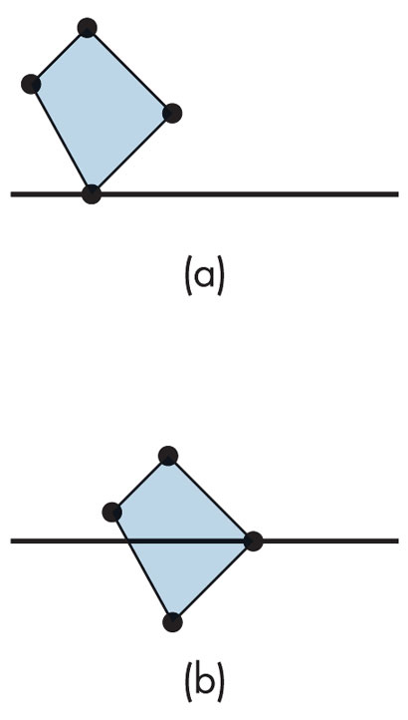
FIGURE 7.39 Singularities. (a) Zero or two edge crossings. (b) One edge crossing.

Slide 41
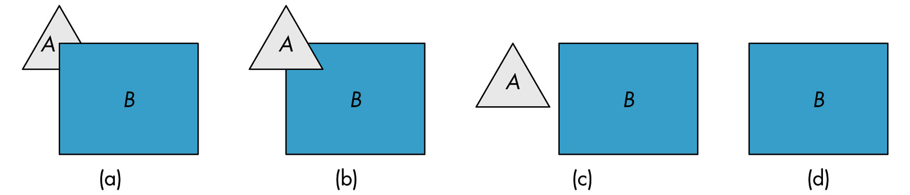
FIGURE 7.40 Two polygons. (a) B partially obscures A. (b) A partially obscures B. (c) Both A and B are visible. (d) B totally obscures A.

Slide 42
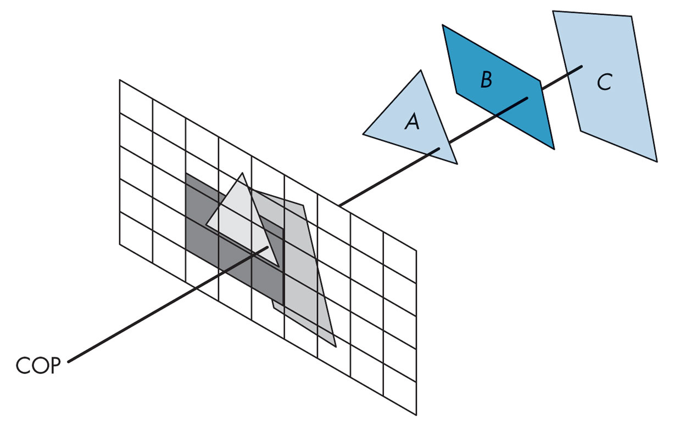
FIGURE 7.41
Image-space hidden-surface removal.

Slide 43
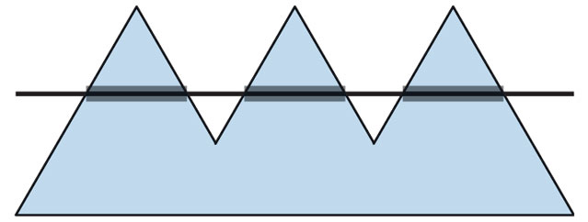
FIGURE 7.42 Polygon with spans.

Slide 44
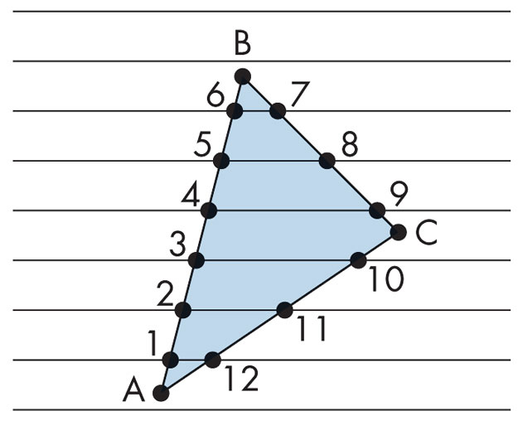
FIGURE 7.43
Polygon generated by vertex list.

Slide 45
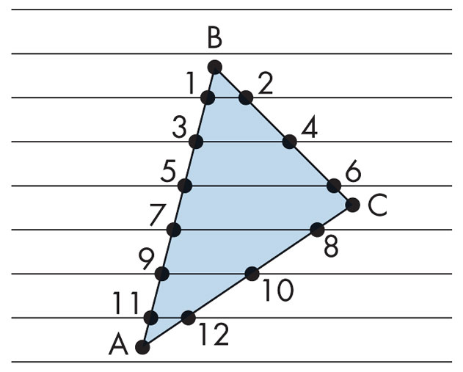
FIGURE 7.44 Desired order of vertices.

Slide 46
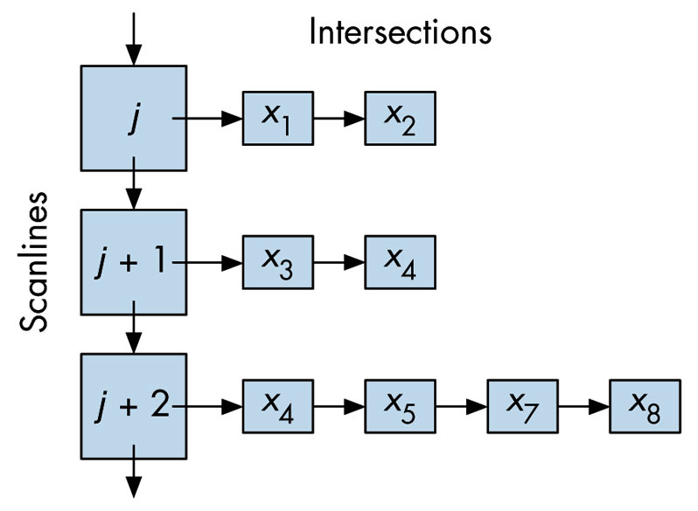
FIGURE 7.45
Data structure for y–x algorithm.

Slide 47
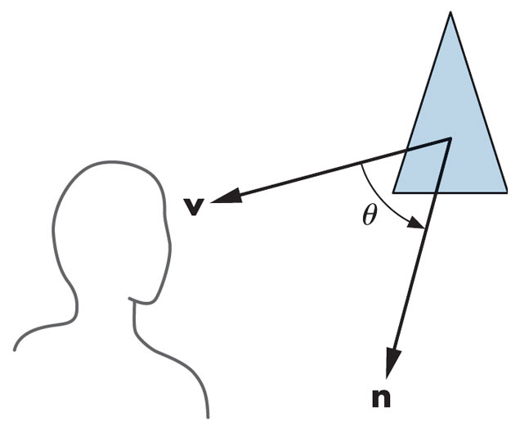
FIGURE 7.46 Back-face test.

Slide 48
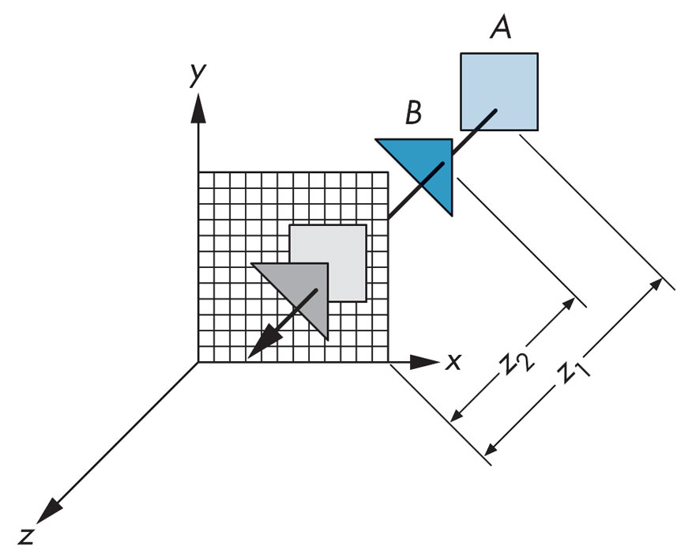
FIGURE 7.47 The z-buffer algorithm.

Slide 49
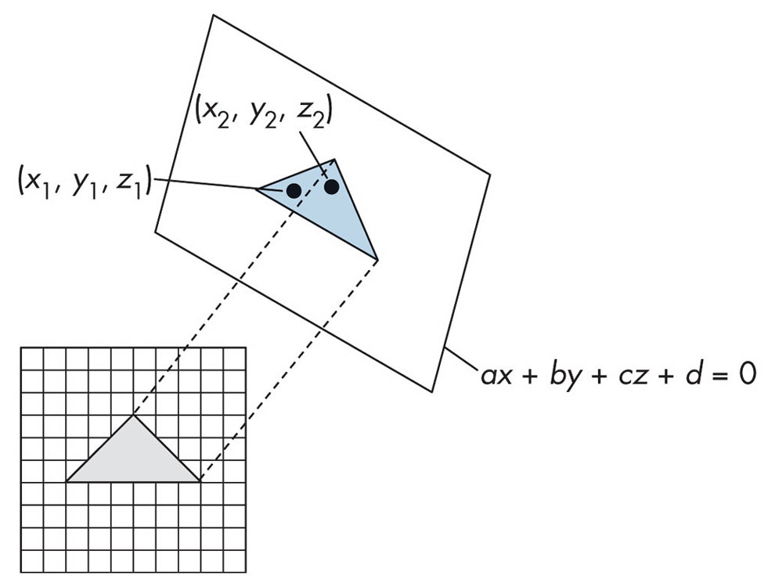
FIGURE 7.48
Incremental z-buffer algorithm.

Slide 50
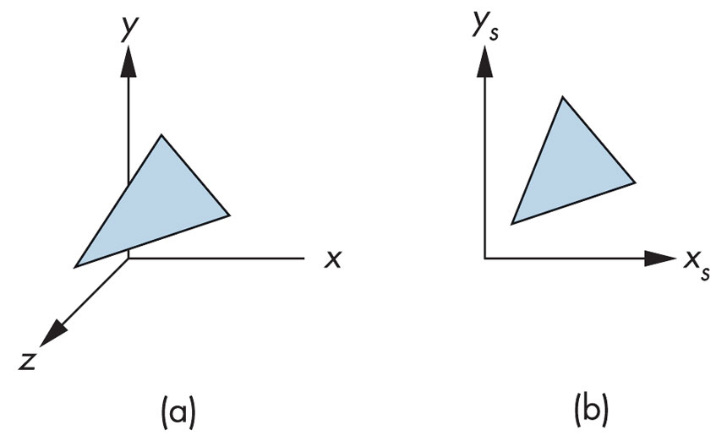
FIGURE 7.49 Dual representations of a polygon. (a) Normalized device coordinates.
(b) Screen coordinates.

Slide 51
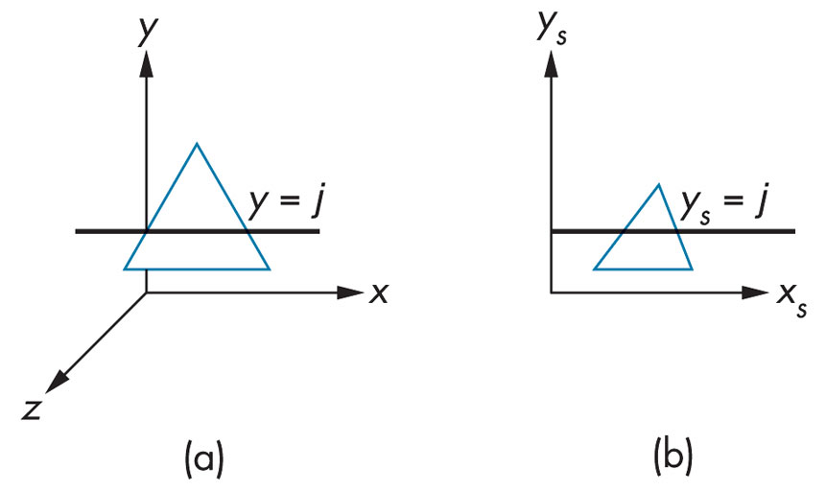
FIGURE 7.50 Dual representations of a scanline. (a) In normalized device coordinates. (b) In screen coordinates.

Slide 52
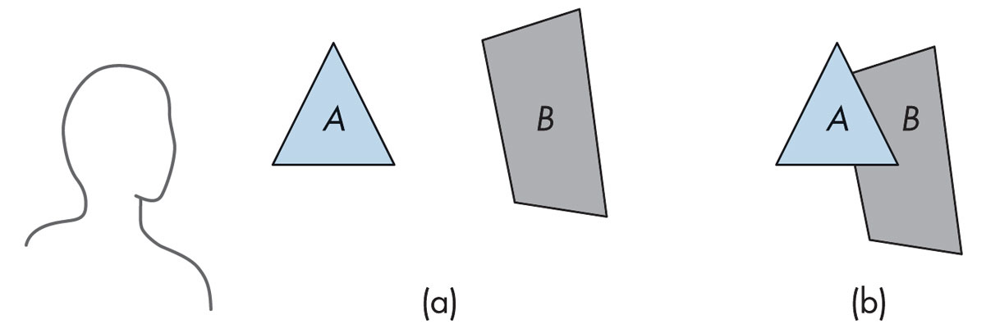
FIGURE 7.51 Painter’s algorithm.
(a) Two polygons and a viewer are shown.
(b) Polygon A partially obscures B when viewed.

Slide 53
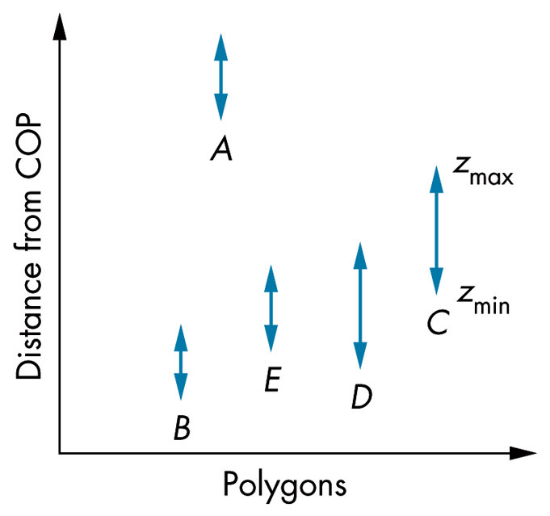
FIGURE 7.52
The z extents of sorted polygons.

Slide 54
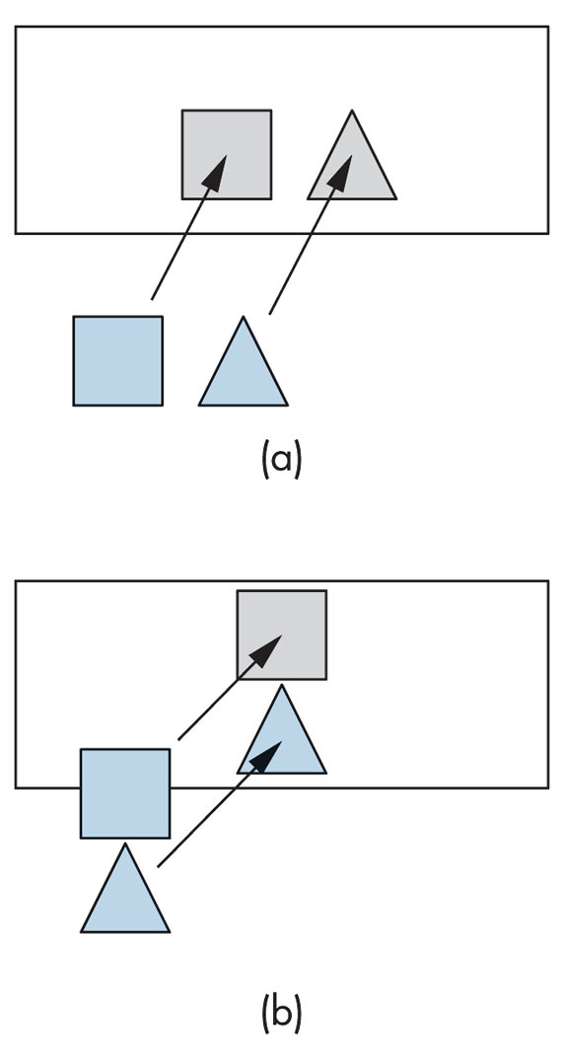
FIGURE 7.53 Test for overlap in x and y extents. (a) Nonoverlapping x extents.
(b) Nonoverlapping y extents.

Slide 55
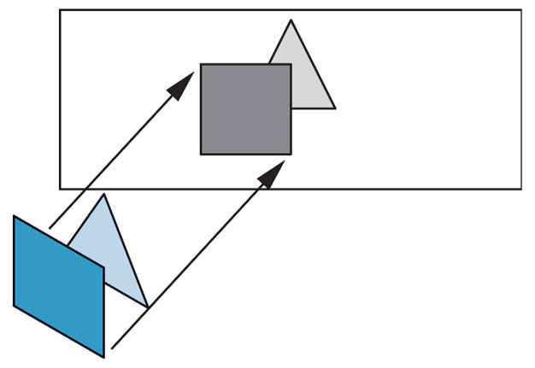
FIGURE 7.54
Polygons with overlapping extents.

Slide 56

FIGURE 7.55 Cyclic overlap.

Slide 57

FIGURE 7.56 Piercing polygons.

Slide 58

FIGURE 7.57 Ideal raster line.

Slide 59

FIGURE 7.58 Aliased versus antialiased line segments. (a) Aliased line segment. (b) Antialiased line segment. (c) Magnified aliased line segment. (d) Magnified antialiased line segment.

Slide 60

FIGURE 7.59
Polygons that share a pixel.

Slide 61

FIGURE 7.60 Time-domain aliasing.

Slide 62

FIGURE 7.61 Color cube.

Slide 63

FIGURE 7.62 Triangle of producible colors in chromaticity coordinates.

Slide 64

FIGURE 7.63 Visible colors and color gamut of a display.

Slide 65

FIGURE 7.64 Hue–lightness–saturation color. (a) Using the RGB color cube.
(b) Using a single cone.

Slide 66

FIGURE 7.65 Logarithmic brightness.

Slide 67

FIGURE 7.66 Digital halftone patterns.

