Slide 1
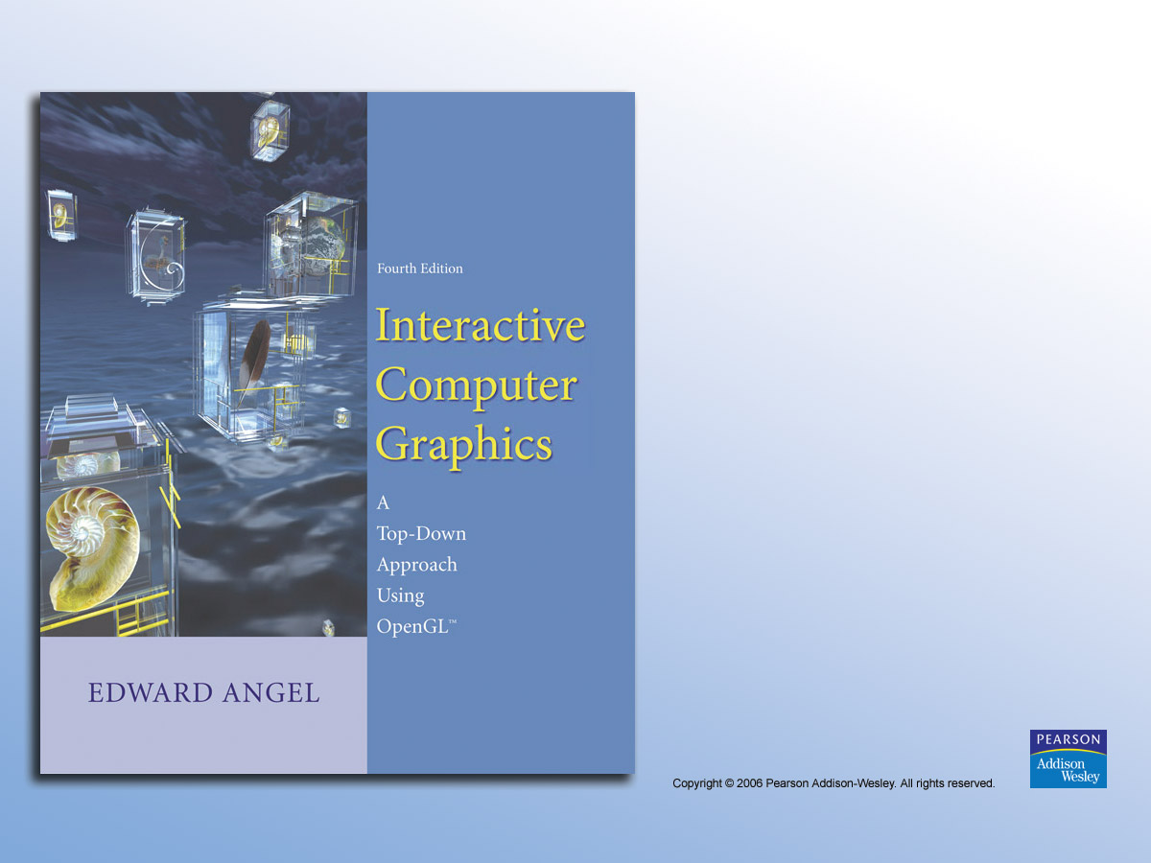
Chapter 8
Discrete Techniques

Slide 2

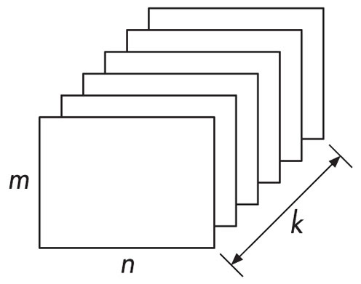
FIGURE 8.1 Buffer.

Slide 3
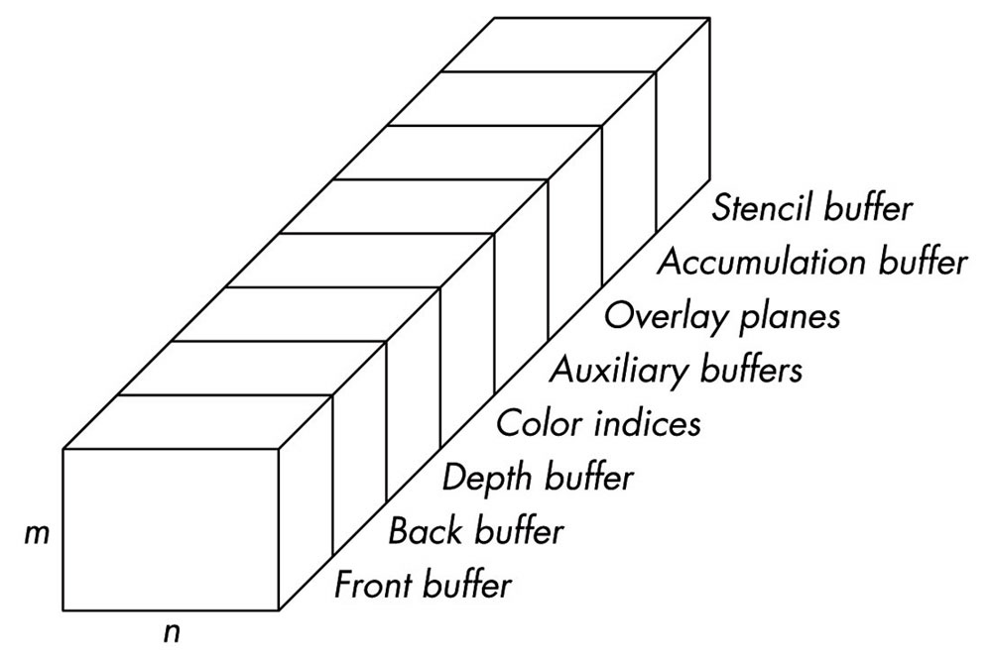
FIGURE 8.2 OpenGL frame buffer.

Slide 4
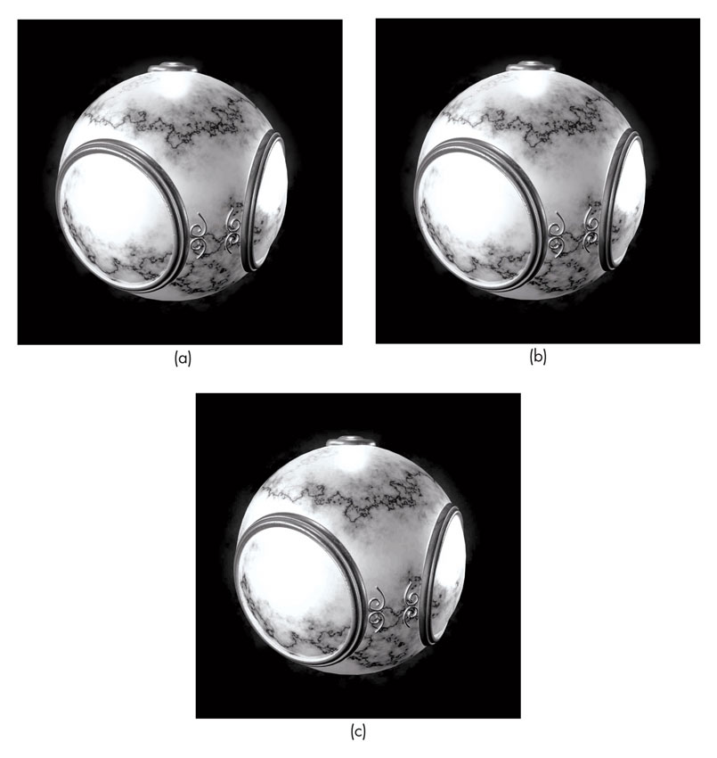
FIGURE 8.3 (a) Original TIFF luminance image. (b) JPEG image compressed by a factor of 18.
(c) JPEG image compressed by a factor of 37.

Slide 5
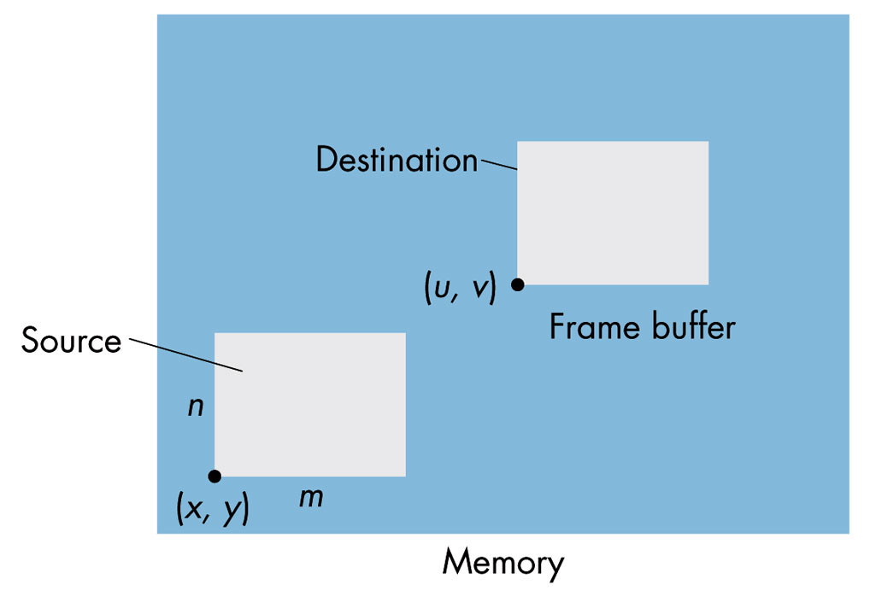
FIGURE 8.4 Writing a block.

Slide 6
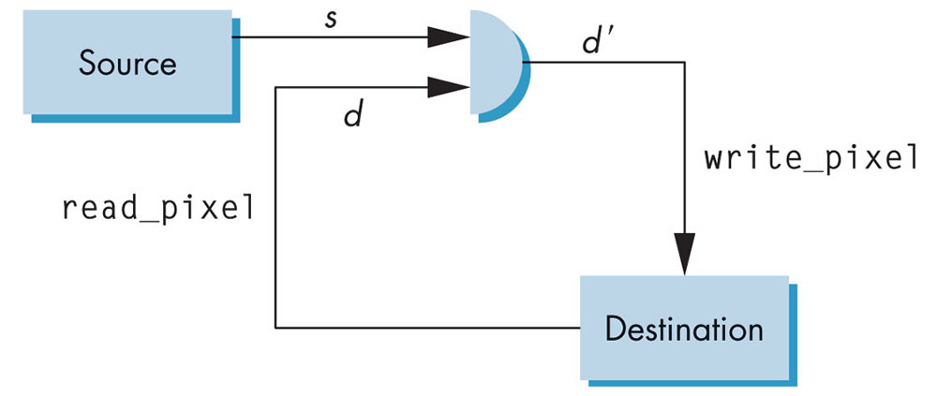
FIGURE 8.5 Writing model.

Slide 7
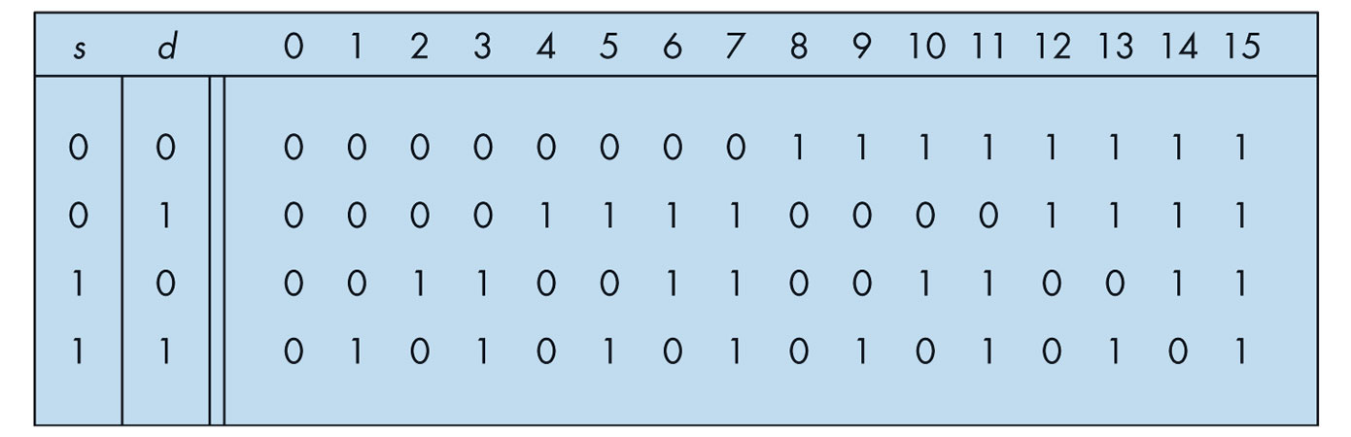
FIGURE 8.6 Writing modes.

Slide 8
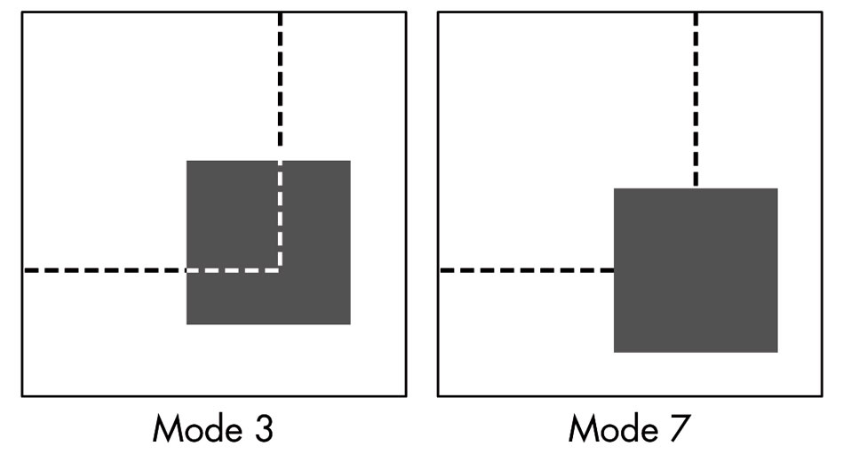
FIGURE 8.7 Writing in modes 3 and 7.

Slide 9
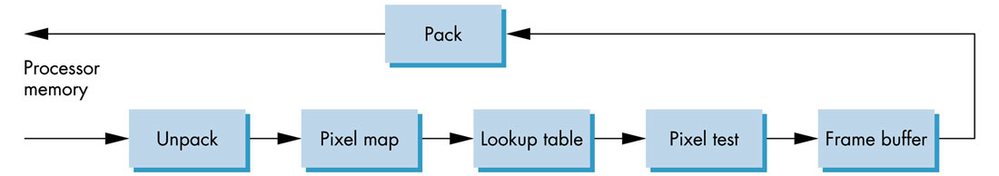
FIGURE 8.8
The OpenGL pixel pipeline.

Slide 10
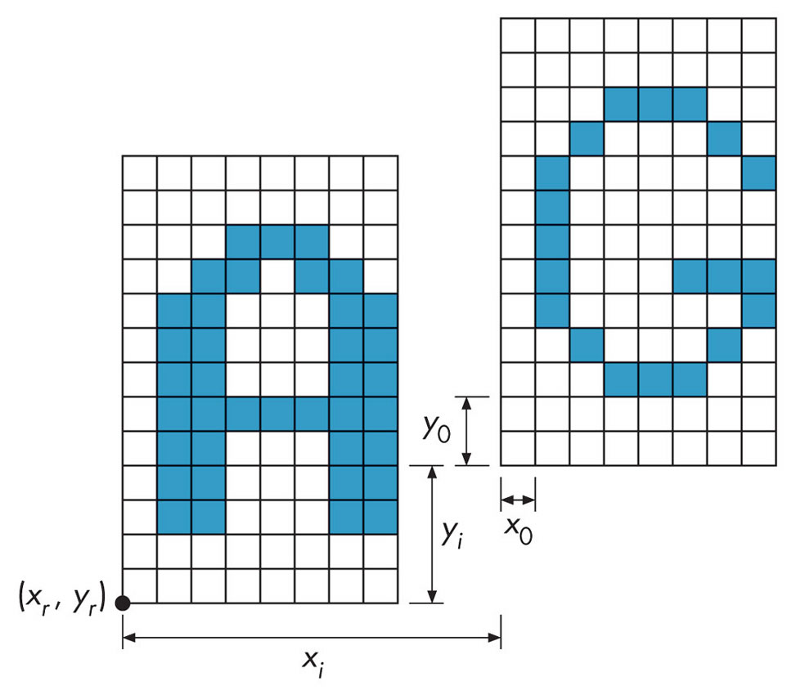
FIGURE 8.9 Outputting a bitmap.

Slide 11
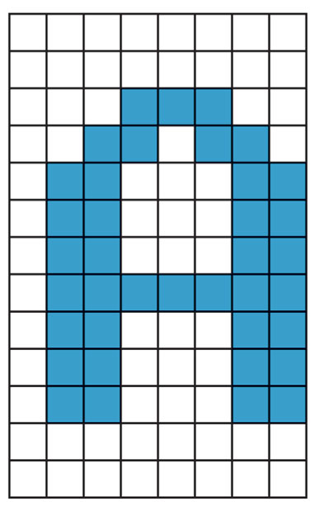
FIGURE 8.10 Definition of a character.

Slide 12
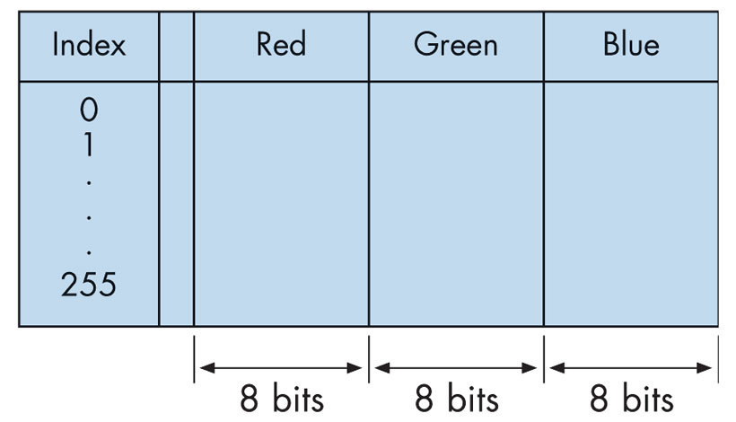
FIGURE 8.11 Lookup table for RGB.

Slide 13
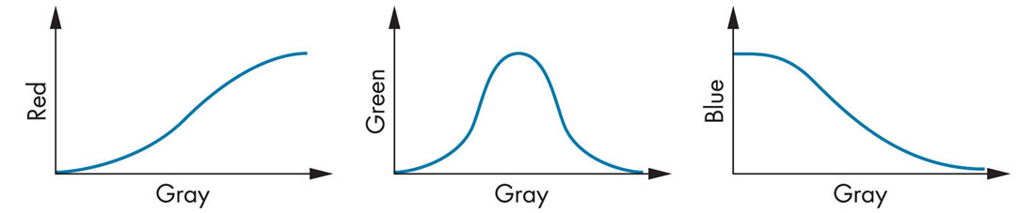
FIGURE 8.12 Thermal color map.

Slide 14
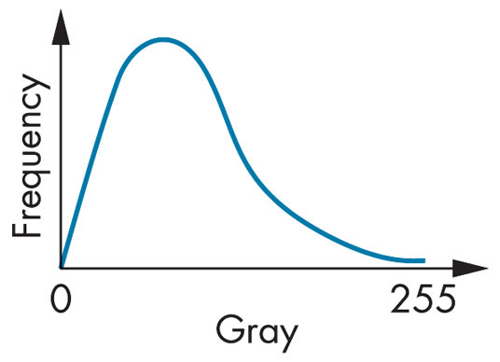
FIGURE 8.13
Histogram of a dark image.

Slide 15
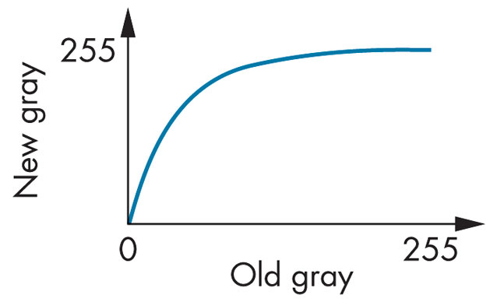
FIGURE 8.14
Lookup table for lightening of an image.

Slide 16
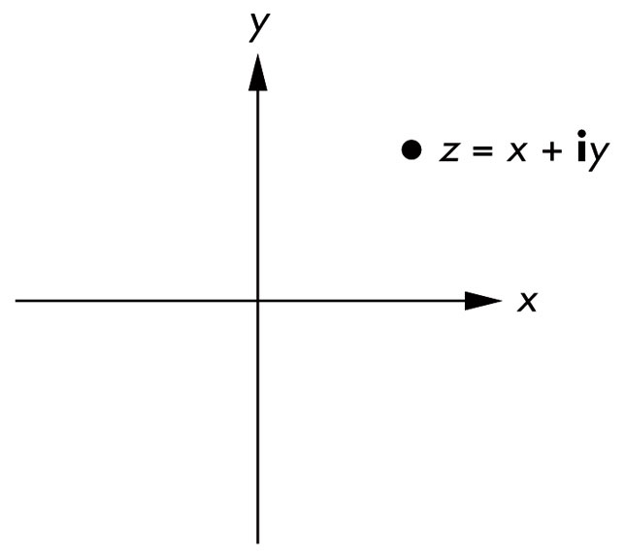
FIGURE 8.15 Complex plane.

Slide 17
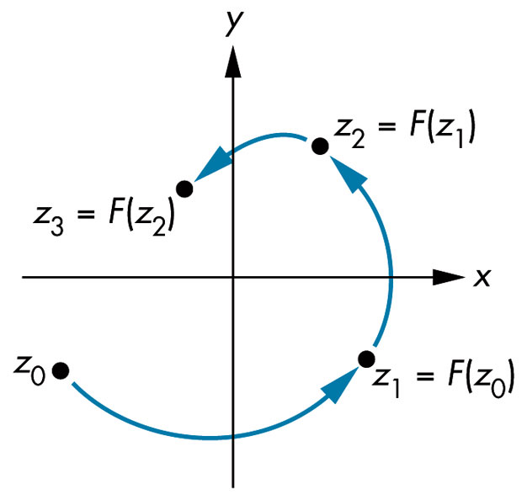
FIGURE 8.16
Paths from complex recurrence.

Slide 18
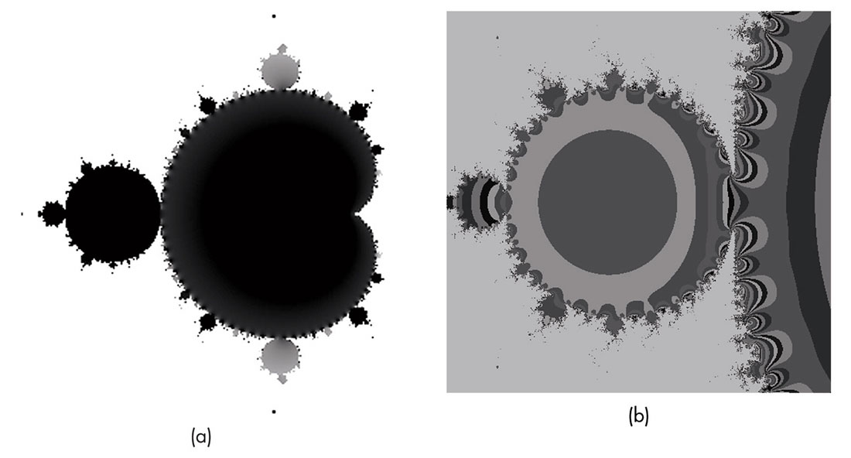
FIGURE 8.17 Mandelbrot set. (a) Black and white coloring. (b) Detail along edges.

Slide 19
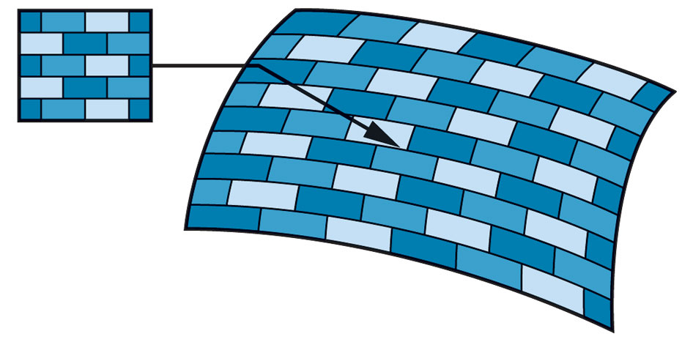
FIGURE 8.18
Texture-mapping a pattern to a surface.

Slide 20
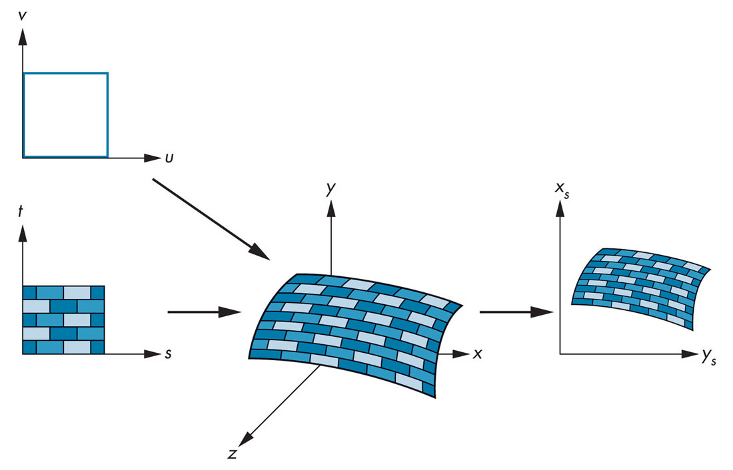
FIGURE 8.19
Texture maps for a parametric surface.

Slide 21
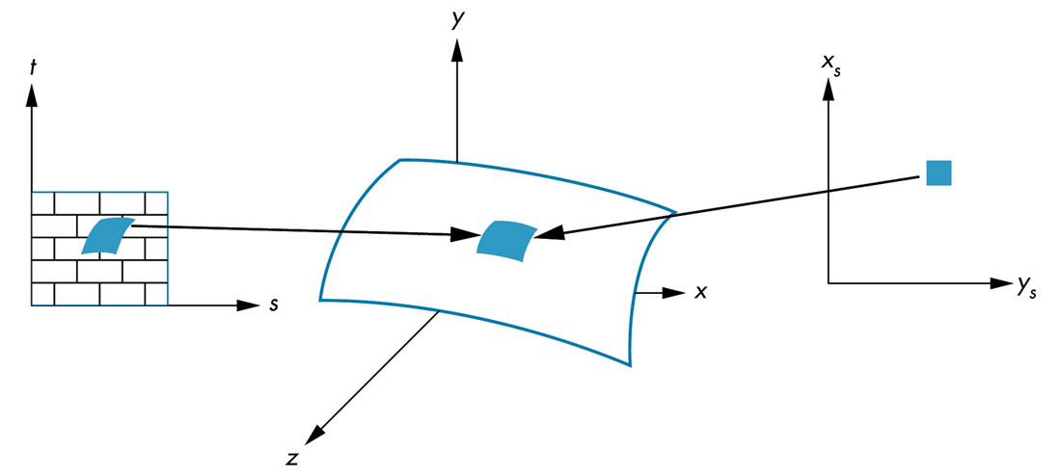
FIGURE 8.20 Preimages of a pixel.

Slide 22
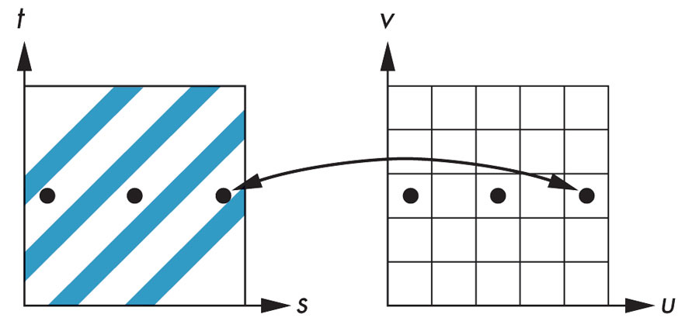
FIGURE 8.21
Aliasing in texture generation.

Slide 23
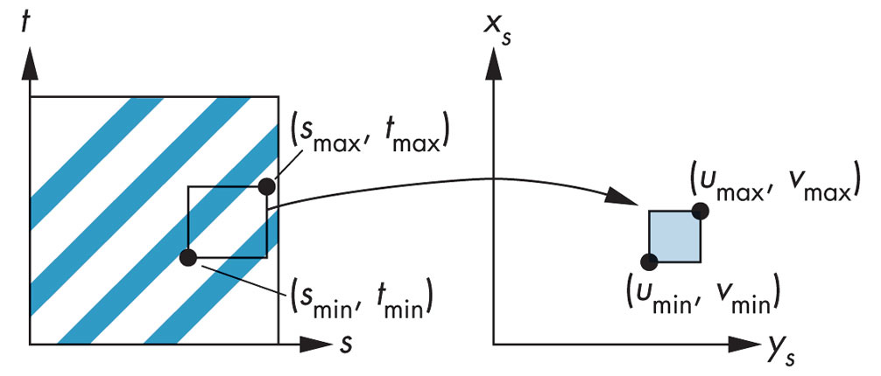
FIGURE 8.22
Linear texture mapping.

Slide 24
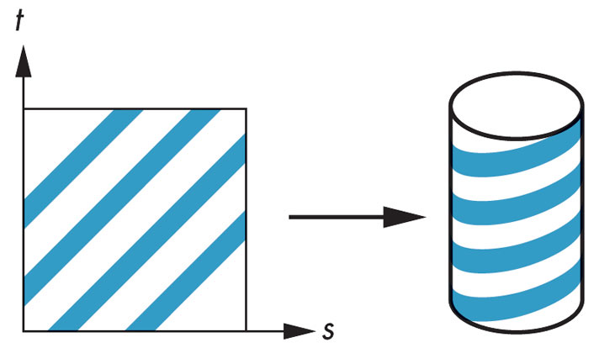
FIGURE 8.23
Texture mapping with a cylinder.

Slide 25
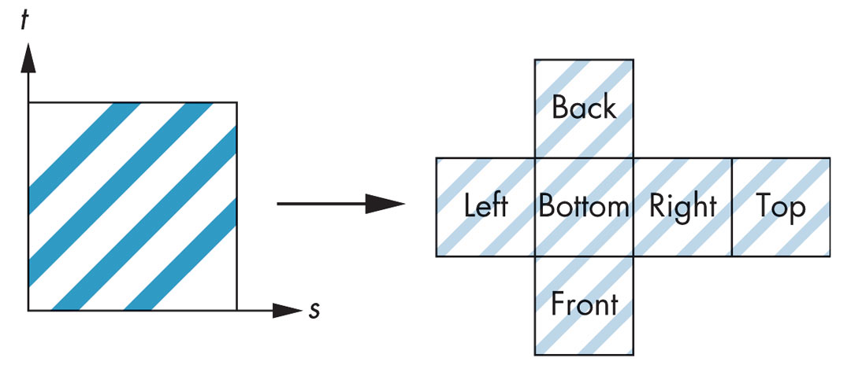
FIGURE 8.24
Texture mapping with a box.

Slide 26
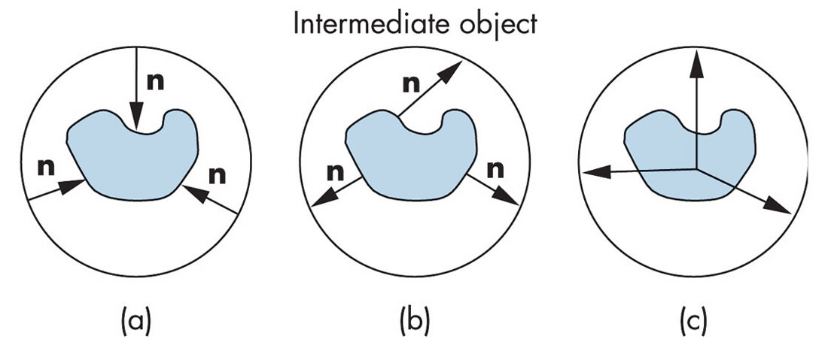
FIGURE 8.25 Second mapping. (a) Using the normal from the intermediate surface. (b) Using the normal from the object surface. (c) Using the center of the object.

Slide 27
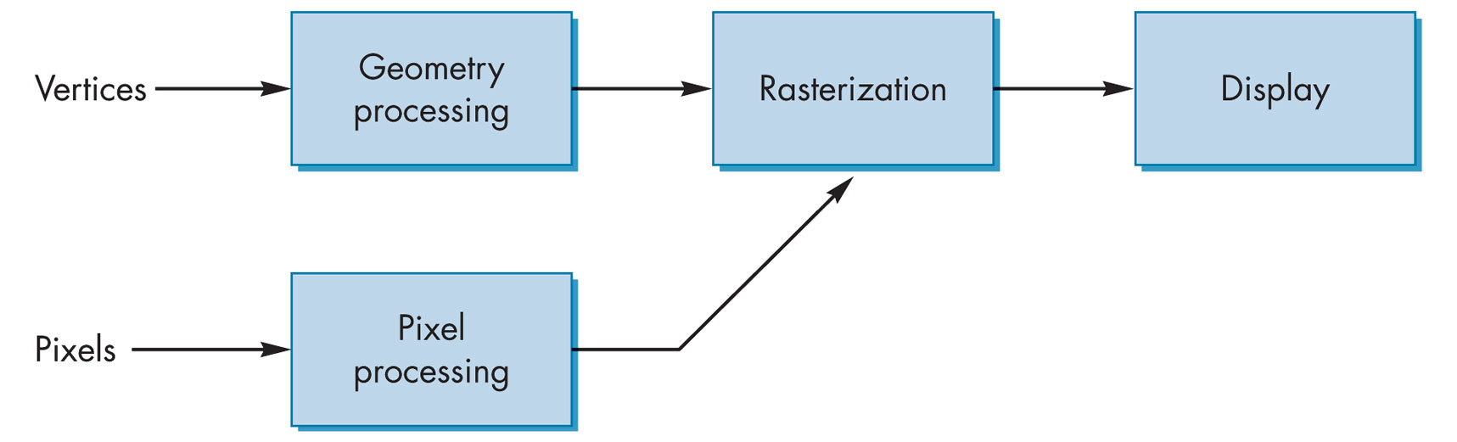
FIGURE 8.26
Pixel and geometry pipelines.

Slide 28
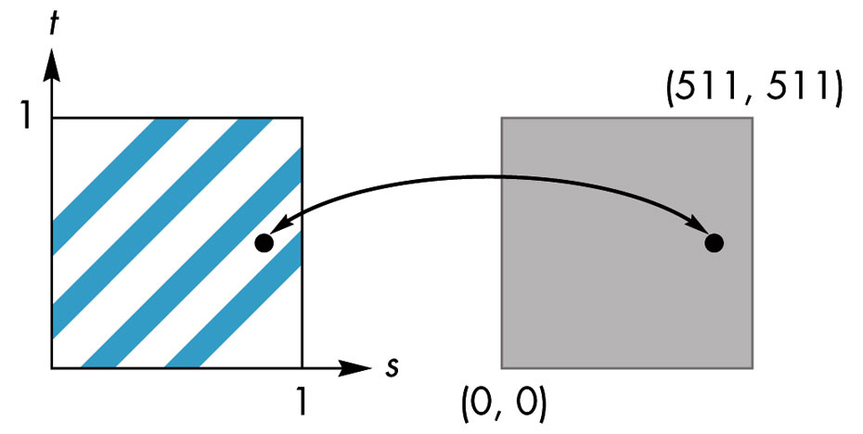
FIGURE 8.27
Mapping to texture coordinates.

Slide 29
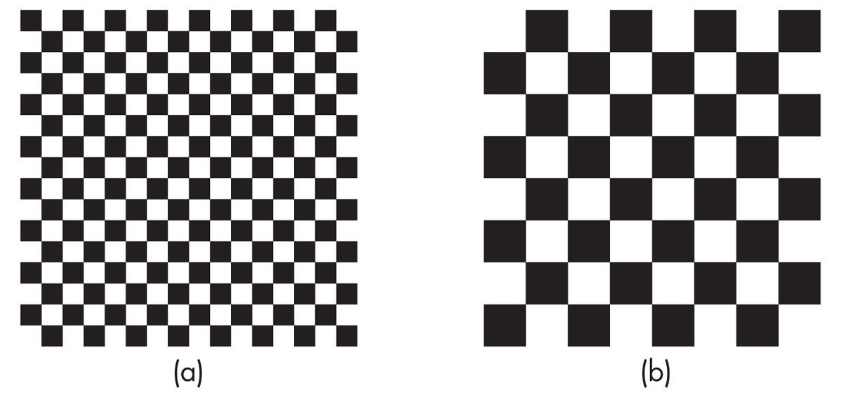
FIGURE 8.28 Mapping of a checkerboard texture to a quadrilateral. (a) Using the entire texel array. (b) Using part of the texel array.

Slide 30
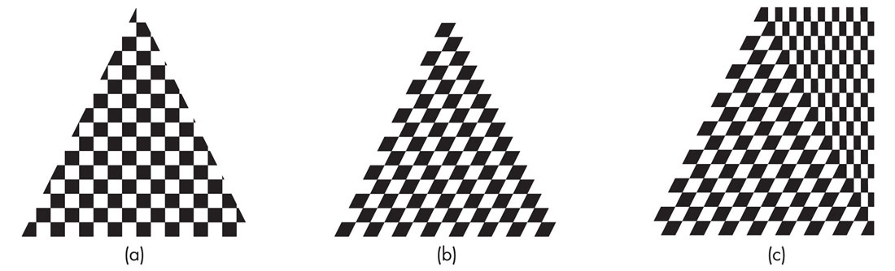
FIGURE 8.29 Mapping of texture to polygons. (a and b) Mapping of a checkerboard texture to a triangle.
(c) Mapping of a checkerboard texture to a trapezoid.

Slide 31
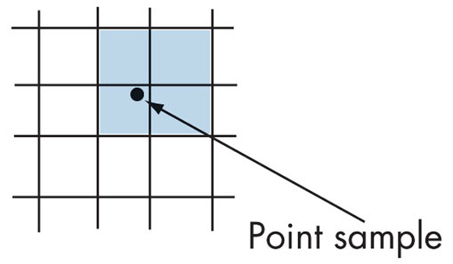
FIGURE 8.30
Texels used with linear filtering.

Slide 32
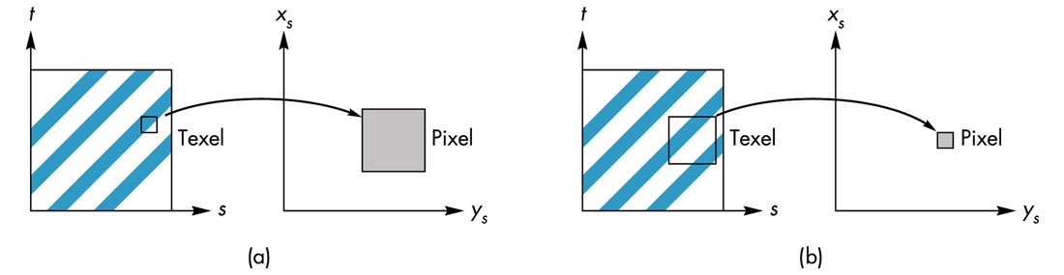
FIGURE 8.31 Mapping texels to pixels. (a) Magnification. (b) Minification.

Slide 33
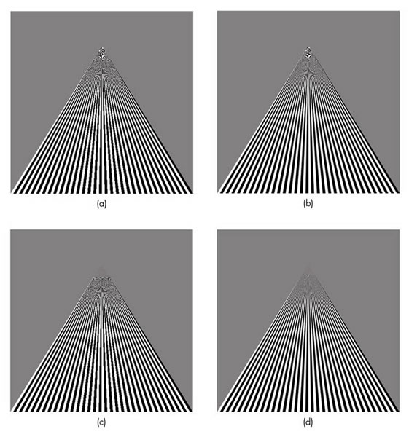
FIGURE 8.32 Texture mapping to a quadrilateral.
(a) Point sampling. (b) Linear filtering. (c) Mipmapping point sampling. (d) Mipmapping linear filtering.

Slide 34
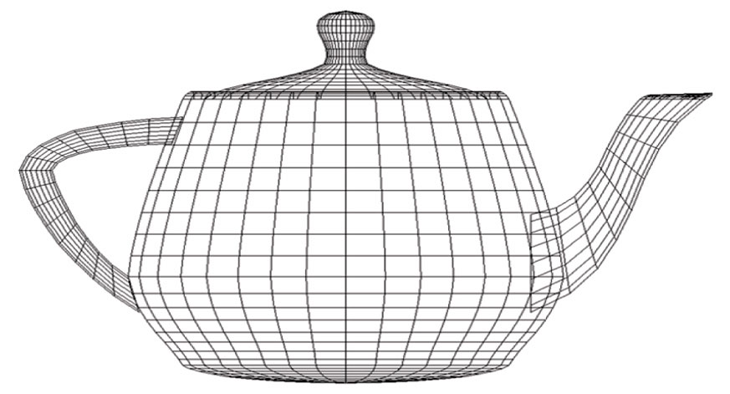
FIGURE 8.33
Polygonal model of Utah teapot.

Slide 35
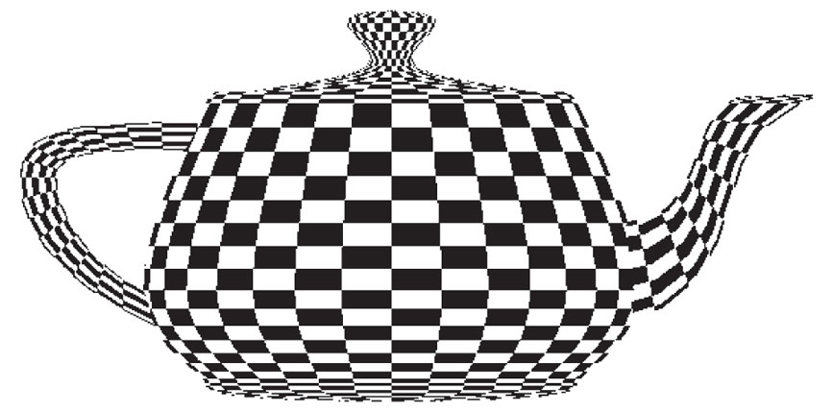
FIGURE 8.34
Texture-mapped Utah teapot.

Slide 36
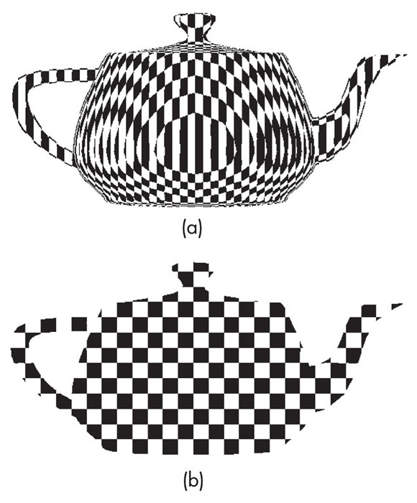
FIGURE 8.35 Teapot using automatic texture coordinate generation. (a) In object coordinates. (b) In eye coordinates.

Slide 37
FIGURE 8.36
Sequence of texture units.

Slide 38
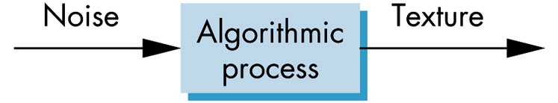
FIGURE 8.37 Texture generation.

Slide 39
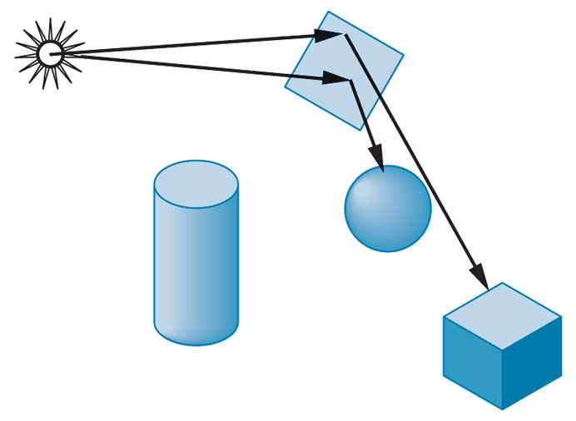
FIGURE 8.38 Scene with a mirror.

Slide 40
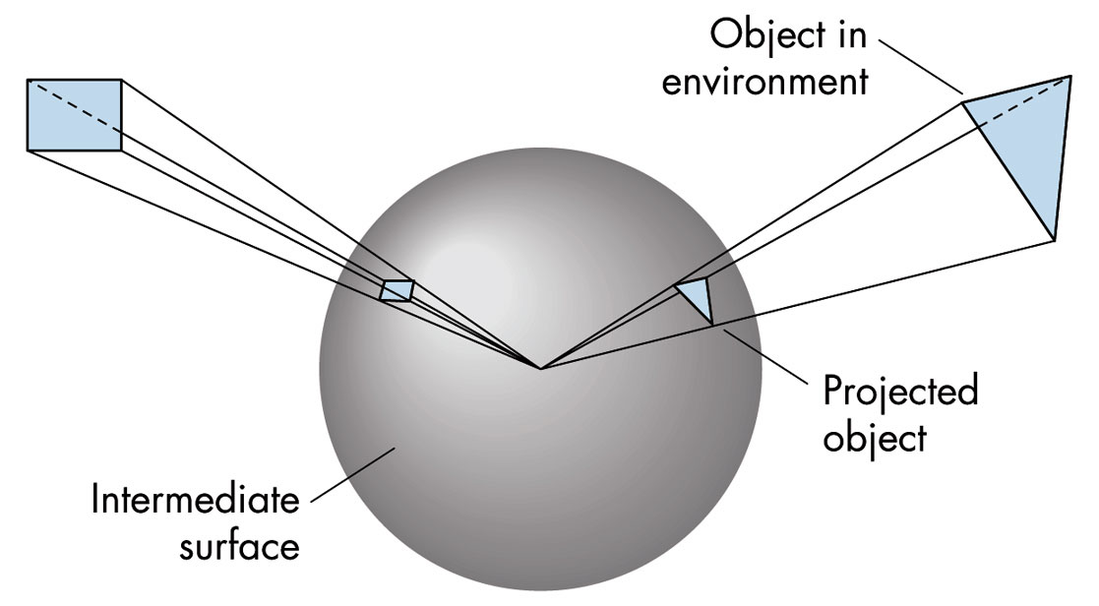
FIGURE 8.39
Mapping of the environment.

Slide 41
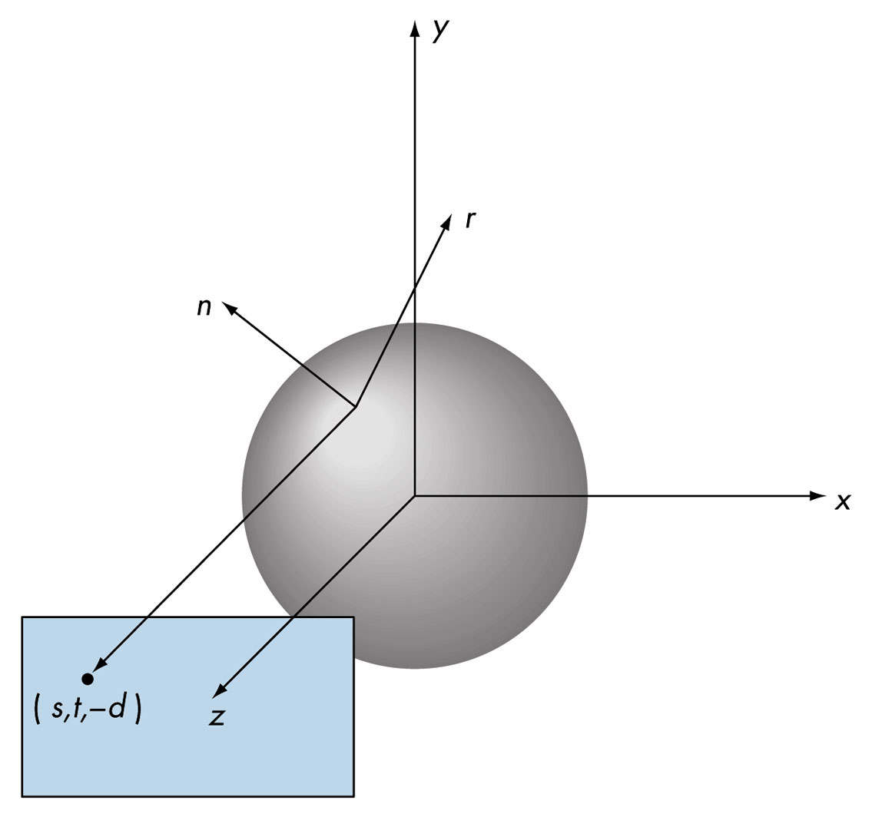
FIGURE 8.40 Reflection map.

Slide 42
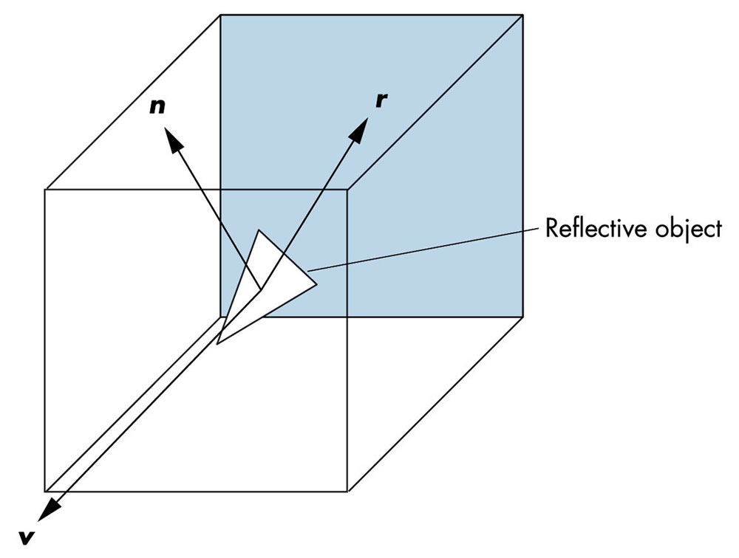
FIGURE 8.41 Reflective cube map.

Slide 43

FIGURE 8.42
Translucent and opaque polygons.

Slide 44

FIGURE 8.43 Raster line.

Slide 45
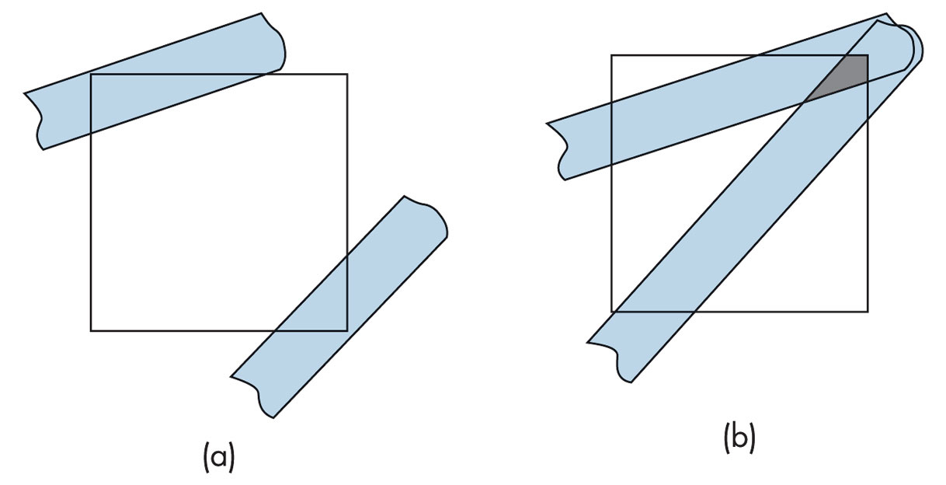
FIGURE 8.44 Fragments.
(a) Nonoverlapping. (b) Overlapping.

Slide 46
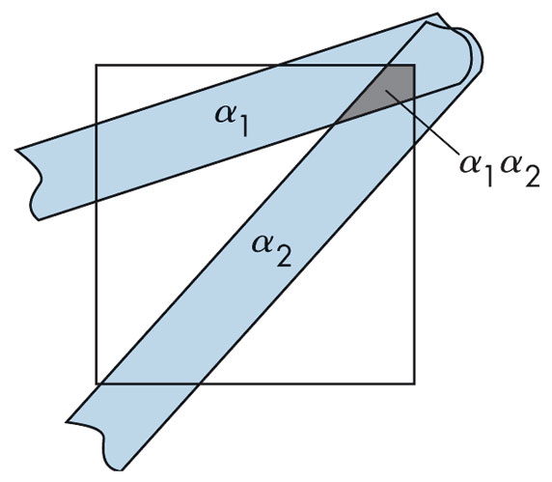
FIGURE 8.45 Average overlap.

Slide 47
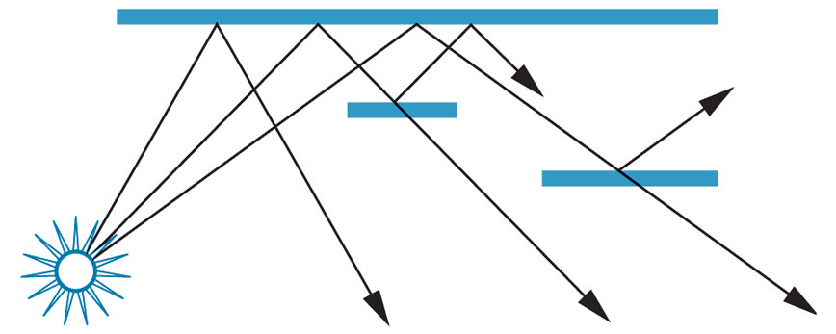
FIGURE 8.46
Scene with translucent objects.

Slide 48
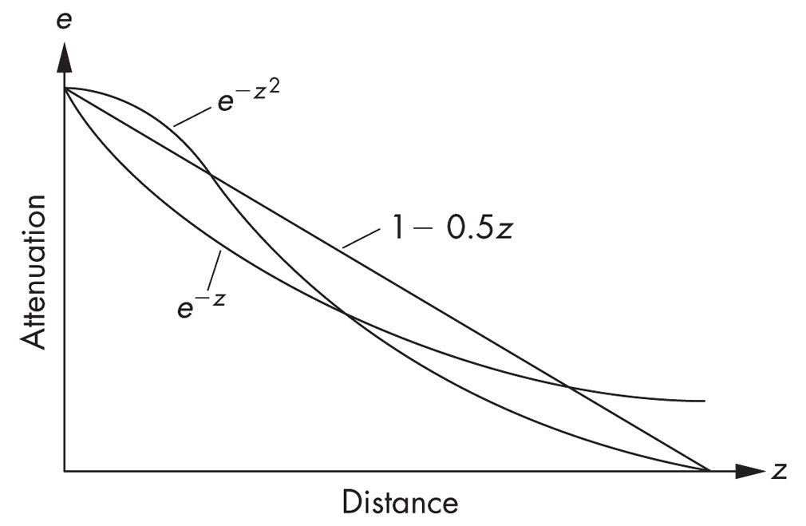
FIGURE 8.47 Fog density.

Slide 49
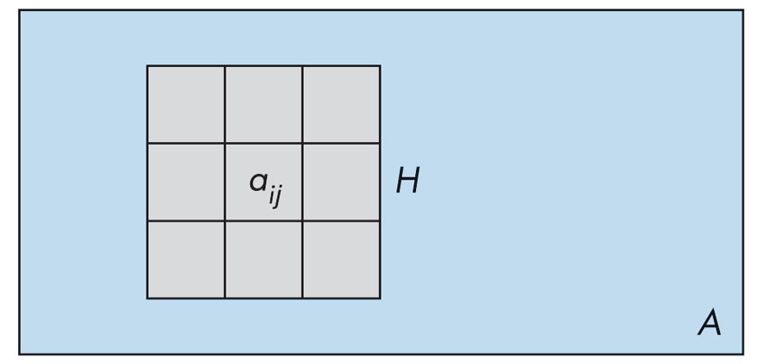
FIGURE 8.48 Filtering and convolution.

Slide 50
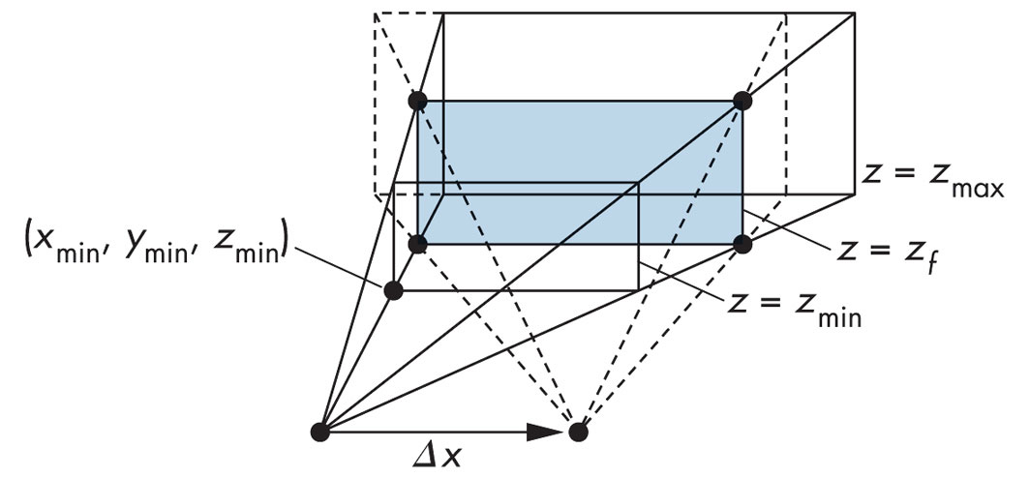
FIGURE 8.49 Depth-of-field jitter.

Slide 51
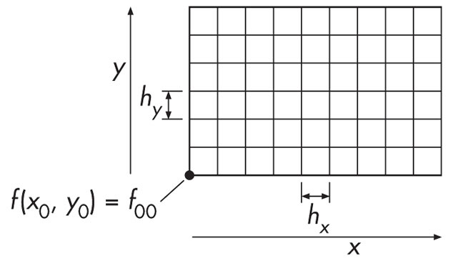
FIGURE 8.50 Sampling grid.

Slide 52
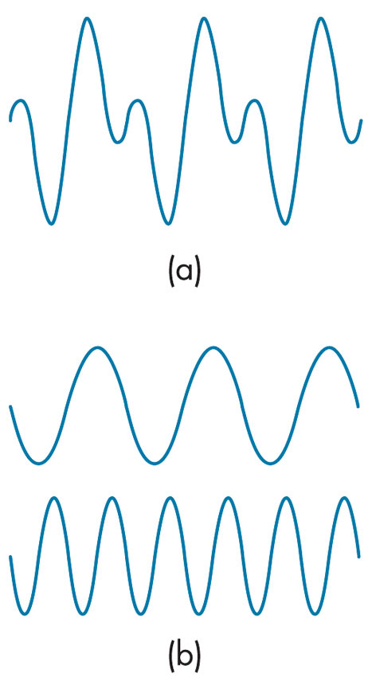
FIGURE 8.51 One-dimensional decomposition. (a) Function. (b) Components.

Slide 53
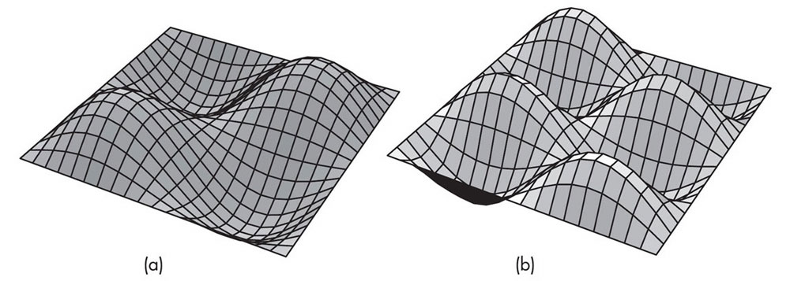
FIGURE 8.52
Two-dimensional periodic functions.

Slide 54

FIGURE 8.53 Band-limited function. (a) Function and its samples in the spatial domain. (b) Spectrum of the function. (c) Spectrum of the samples.

Slide 55

FIGURE 8.54 Overlapping replicas.

Slide 56

FIGURE 8.55 Aliasing.

Slide 57

FIGURE 8.56 Aliasing of a sinusoid.

Slide 58

FIGURE 8.57 Scanning an image.
(a) Point sampling. (b) Area averaging.

Slide 59

FIGURE 8.58 Sinc function.

Slide 60

FIGURE 8.59
One-dimensional reconstruction.

Slide 61

FIGURE 8.60
Two-dimensional sinc function.

Slide 62

FIGURE 8.61
Display of a point on a CRT.

Slide 63

FIGURE 8.62 Display spots. (a) Ideal spot.
(b) Rectangular approximation. (c) Piecewise-linear approximation. (d) Gaussian approximation.

Slide 64

FIGURE 8.63 Quantizer.

