Slide 1
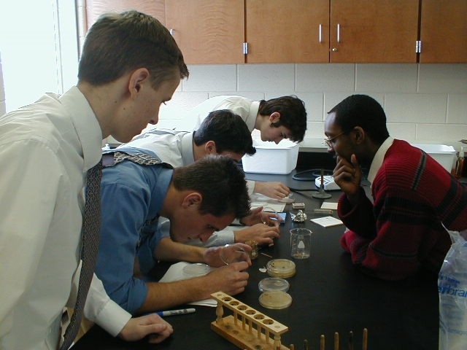
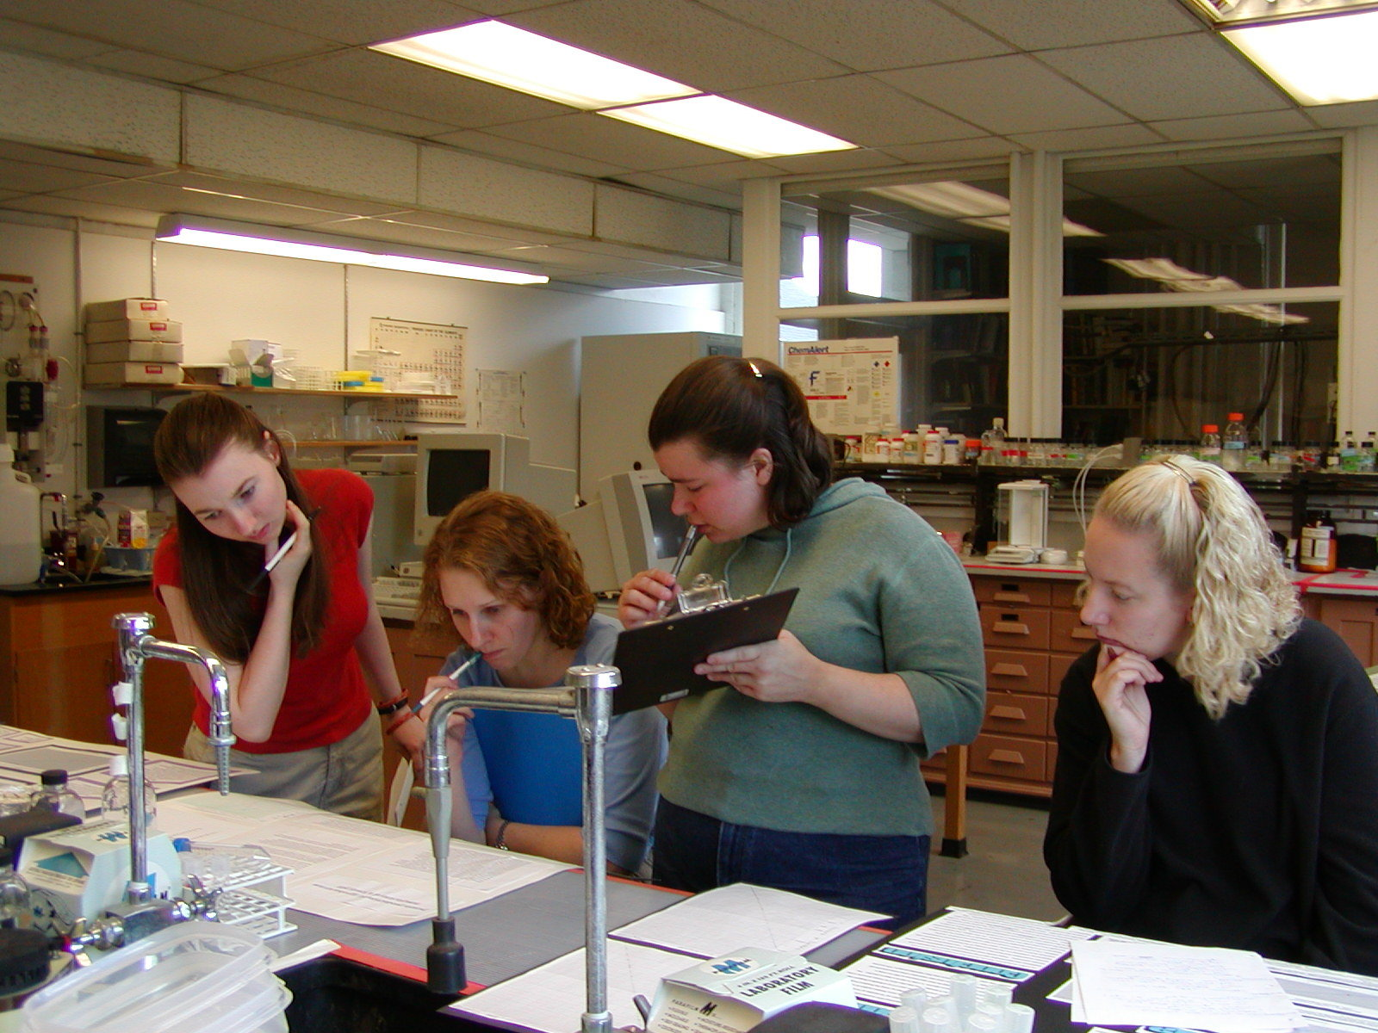
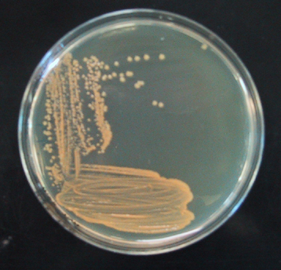
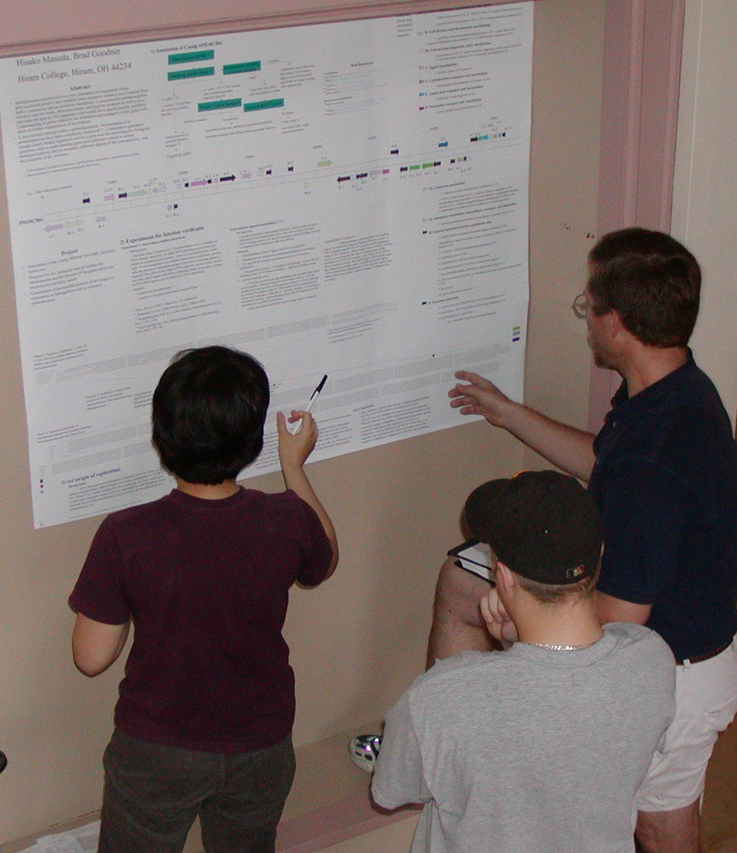
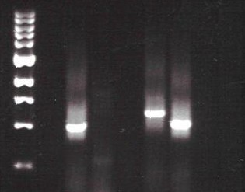
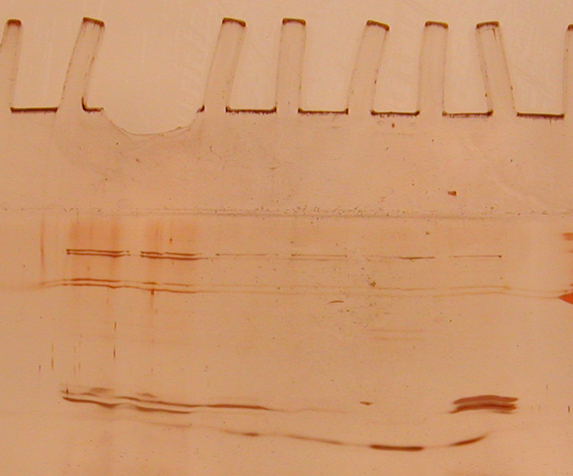
Hiram Genomics Initiative
Integration of Research Throughout Curriculum
“It was unique and interesting to do such an experiment that is normally done only on the graduate level. I got to understand how mutations help to construct a map of the genome.”
Marc Cicora, Benedictine High School
Students from Benedictine and Walsh Jesuit high
schools collaborate on picking S. elodea mutants.
Hiram students in Biochemistry II class decipher gel results on the secreted proteins from A. tumefaciens.
Micrococcus kristinae
(Micro ’03)
Research Areas: (1) Agrobacterium tumefaciens (2) Other Genome Projects (3) Silver Creek Microbial Survey
Genome Project
Sphingomonas Halomonas Xenorhabdus
elodea elongata nematophila
(collaboration (collaboration (collaboration
with Monsanto with Purdue with Monsanto
Integration Co.) Univ. & TIGR) Co., Univ. of
into Wisc., Univ. of
Curriculum: Wisc.-Milwaukee,
Functional Genomes of Strains & Danforth Cntr.) Repeated Sampling
Native Genomics of K84 (bv. 2) & S4 (bv. 3) (Micro)
Tumor Strain C58 (collaboration with Genetic/ Genetic/
Survey (bv. 1) Monsanto Co., Univ. of Physical Physical
(Intro Biol, Washington, Univ. of Map Map Standard Cultivation 16S rRNA
Micro, & Illinois, & Cornell Univ.) (Genetics (Genetics Means of Identification Gene PCR
high schools) & high schools) & high schools) (Micro) (Micro)
Sequence Sequence Sequence Annotation Annotation Annotation
(Adv Mol Biol) (Genetics) (Bioinformatics)
(Independent
Gene Secreted Subgenomic Sequence 16S rRNA Research)
Disruptions Proteins Libraries for Annotation Gene PCR Sequence
(MolCell, (Biochem II) Sequencing (Bioinformatics) (Micro) Analysis
Independent (Adv Mol Biol) (Micro,
Research) (Independent Research) Genetics)
Gap Closure in situ
(Genetics) Quantification
(Micro)
(Independent (Micro) (Biochem II)
Research)
“Two things stand out in my mind. First, the growth curve of bacterial cultures sets your schedule not vice versa. Second, getting a single good result means nothing if you cannot reproduce it!”
Spencer Weeks
Hiram ’03 biology major
Silver stained gel of secreted proteins isolated from A. tumefaciens using various combinations of precipitation and filtration steps (Biochem II ’02)
M B1 B2 A F B1 B2 A F
“I learned that in research, things do not always go as planned, and the protocol must be tested and modified before it goes into effect to find a result. The original way we plated the auxotrophs was not successful so Dr. Goodner and his team found a new way to plate them.”
George Jeney, Benedictine High School
Students in Advanced Molecular Biology course presenting their sequence annotation results in a poster session.
Secreted proteins of unknown function
Flagellar filament subunits (in good agreement with previous work by Lai et al., J. Bact. 182:3705-16)
16S rRNA gene PCR on total DNA from stream samples. M = markers, B1 & B2 = different primer sets for Bacteria domain, A = primer set for Archaea domain, F = primer set for Fungi kingdom (Micro ’03)

