Slide 1
CHAPTER 1
FUNDAMENTAL CONCEPTS-I

Slide 2
MODEL OF A GRAPHICS SYSTEM
Processor
Memory
Frame buffer - only non-standard component
Output devices
Input devices

Slide 3
The Display
Today- raster-based
  pixel = picture element
Previously, vector-refresh displays
  line drawing displays
Raster-based
  pixels stored in frame buffer
  frame buffer implemented in VRAM, DRAM, or memory

Slide 4
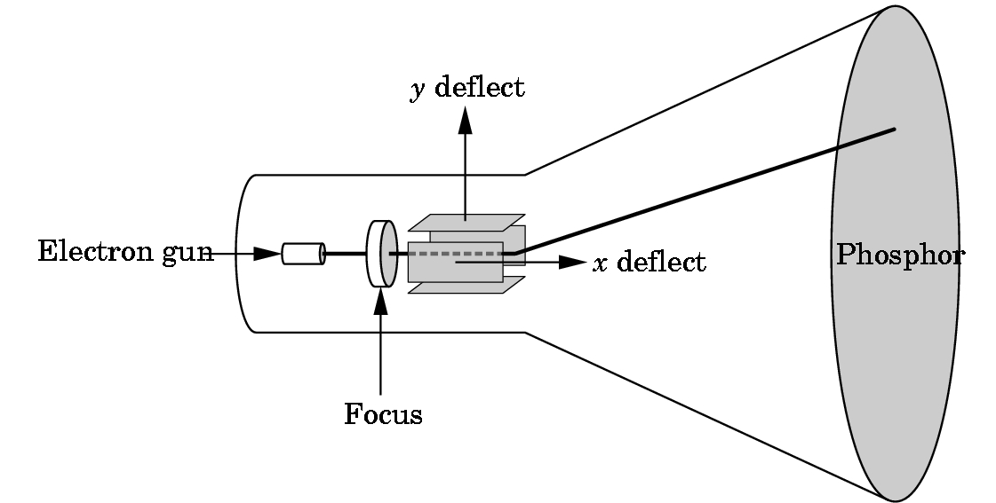
One of most common disply devices- CRT or cathode ray tube

Slide 5
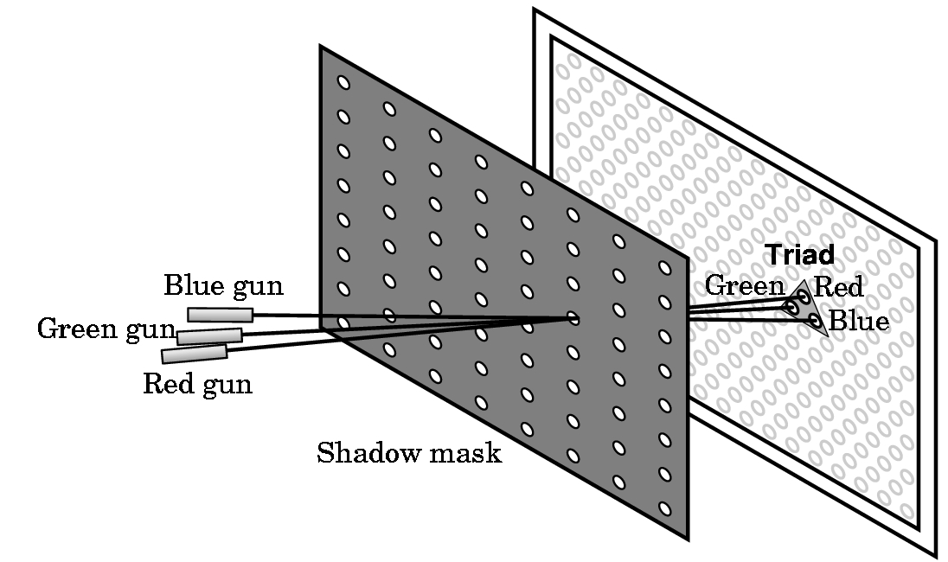
RGB (red-green-blue) shadow mask CRT

Slide 6
SIMPLEST WAY TO REPRESENT COLOR- an example
2 bits per gun
  00 dark or off
  01 dim
  10 2/3 brightness
  11 bright
Thus, a color of 011100 gives
  1/3 red + 1 green + 0 blue
  i.e. bright green and dim red
  i.e. perceived as yellow tint

Slide 7
LUT (or look up table)
If we say a device has 3-plane graphics or a 3-bit deep frame buffer, we are saying it is using a LUT with 2³= 8 entries:
index red green blue result
===============================================
0 00 00 00 black
1 10 00 00 medium red
2 11 00 10 reddish purple
.
.
.
7 11 11 11 white
Note: Different LUTs can be defined

Slide 8
The LUT size determines the number of colors that can be displayed simultaneously
Thus, a 3-plane graphics system has a 2³= 8 LUT size and can display only 8 colors simultaneously.
The palette of a device is the number of colors that can be displayed and is a function of the number of color bits stored per pixel.
In our example, 6 bits were used (2 bits per gun, so the palette is 2⁶= 64 colors.

Slide 9
MORE ON COLOR
Low end displays are typically 8-plane devices, i.e. can display only 256 colors simulataneously.
But, palettes typically exist for 8 bits/gun---i.e. have a palette of 2²⁴= 2⁴ * 2²⁰ = 16M of colors (what is called true color in Windows system)
Note: Number of bits/gun is what determines the size needed for the frame buffer as the frame buffer must hold a copy of the image internally

Slide 10
FRAME BUFFER SIZES
Let
  r = number of rows in display
  c = number of columns in display
  b = number of bits/pixel
Then need frame buffer size of r * c * b
i.e.,
  For r = c = 1024 and b = 24, need
  24 * 2¹⁰ * 2¹⁰ = 3 * 8 * 2²⁰ = 3 M bytes per picture
Most systems are at least double buffered for speed
High end workstations have higher numbers for r, c, and the number of frame buffers

Slide 11
HOW IS THE FRAME BUFFER USED?
Picture is created in frame buffer and scanned out to the screen by deflection circuitry:
Refresh rate is given in hertz (Hz)
50-75 Hz required to avoid flicker
i.e. 50-75 scans per second
Inexpensive screens are interlaced on scan--- scan every other row for each refresh.

Slide 12
2D vs 3D GRAPHICS
Until very recently, APIs (Application Programmer Interface) were predominately 2D-oriented with small extensions for 3D graphics:
  1977 CORE
  1985 GKS, GKS-3D
  1988 PHIGS, PHIGS+, X-Windows
  1992 OpenGL
    Windows NT 3.1 was in beta testing
    Silicon Graphics (SGI) developed OpenGL
    Marriage between the two to incorporate OpenGL in Windows NT 3.5
  Other APIs exist

