Slide 1
CHAPTER 1
FUNDAMENTAL CONCEPTS-II

Slide 2
3 Distinct Image Formation Paradigms
Synthetic camera
Ray tracing
Modeling-Rendering
We’ll discuss each of these although the major emphasis will be on
synthetic camera model.
Each paradigm has its own advantages and disadvantages.
Techniques used for each of the 3 models are not totally distinct and,
consequently, overlap.

Slide 3
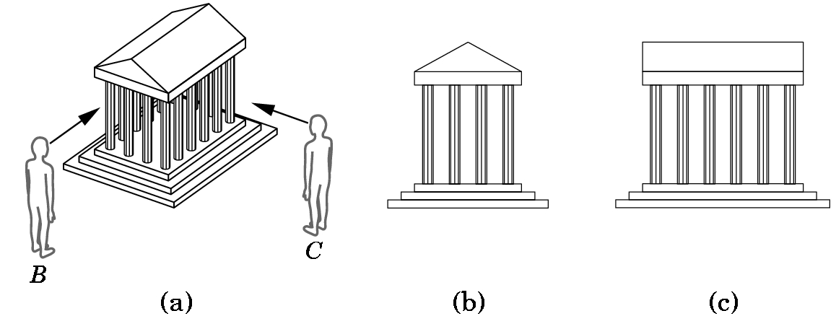
All view the world or problem coordinate system as populated with objects and a viewer can be positioned anywhere to obtain a view of the world
Figure 1.5, page 10
Thus, we can move around objects and see different things.

Slide 4
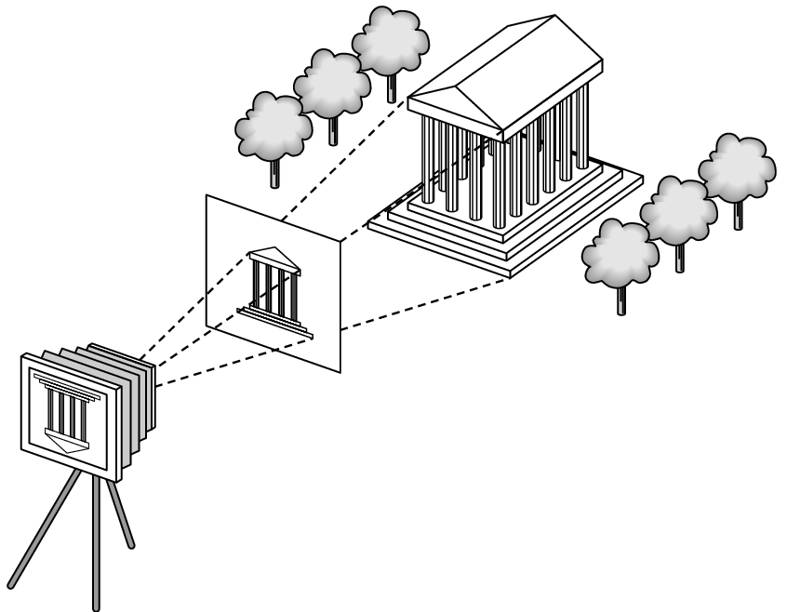
SYNTHETIC CAMERA APPROACH
Figure 1.19, page 20
Identify: world, projector, projection plane, clipping window, image
Note: The frame buffer makes sure the image is displayed right side up

Slide 5
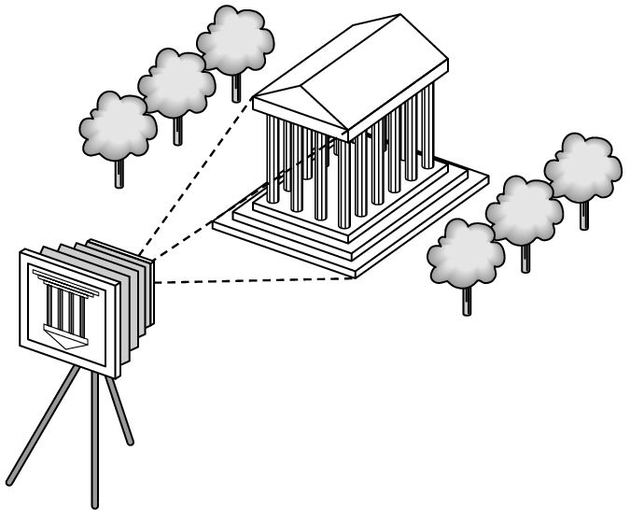
World and Image
Note that not all of the world must be displayed
Figure 1.17, page 19

Slide 6
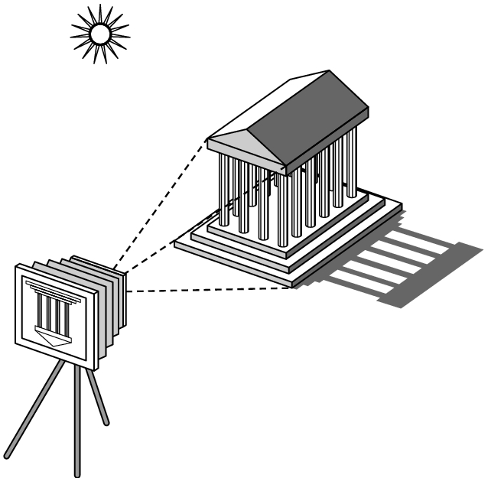
Can add light sources and shadows
Figure 1.7, page 11

Slide 7
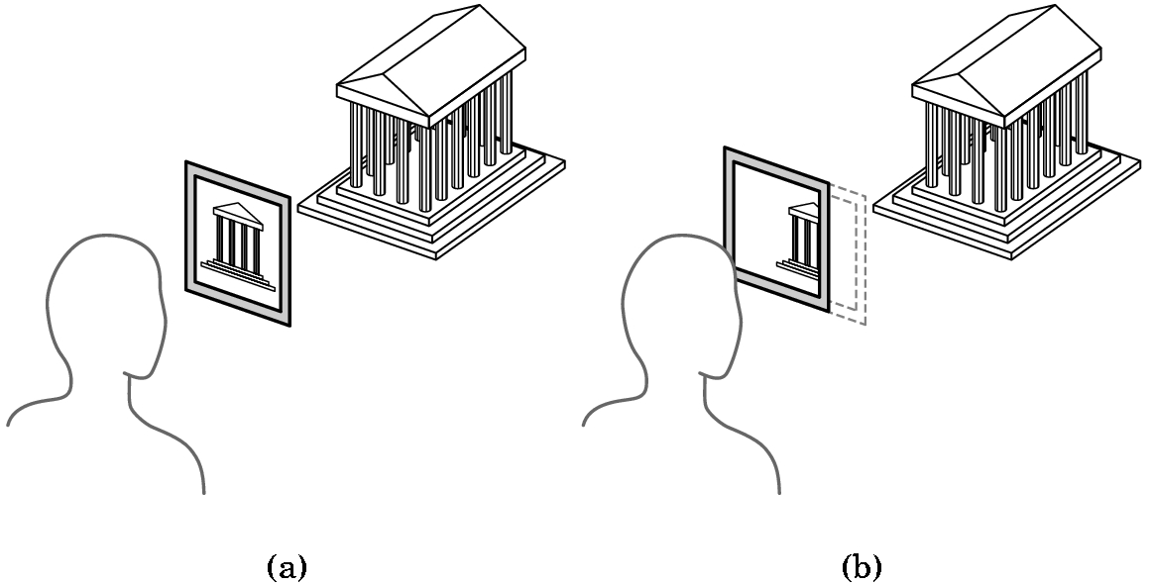
Clipping plane and the clipping window determines what is seen
Figure 1.20, page 21
How can you pan?
How can you rotate the image?
How can you fly around the world?

Slide 8
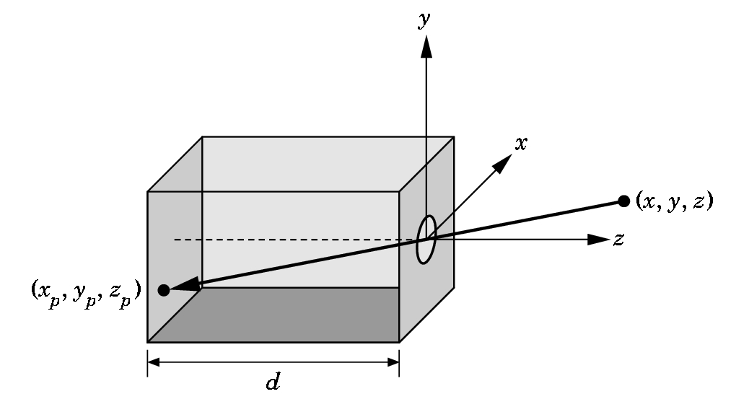
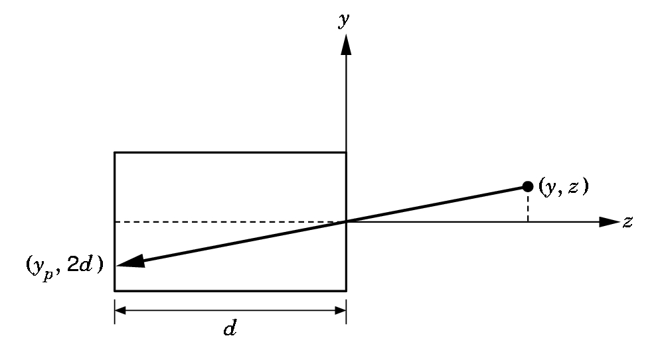
Pinhole camera model uses geometry to calculate pixel coordinates
Want (x_{p}, y_{p} , z_{p}) =
projection of
point (x,y,z)
Figures 1.14 and 1.15m page 17
Using similar triangles,
y_{p} / -d = y/z or
y_{p} is -y divided by z/d
A similar argument yields
x_{p} is -x divided by z/d
Should be -d

Slide 9
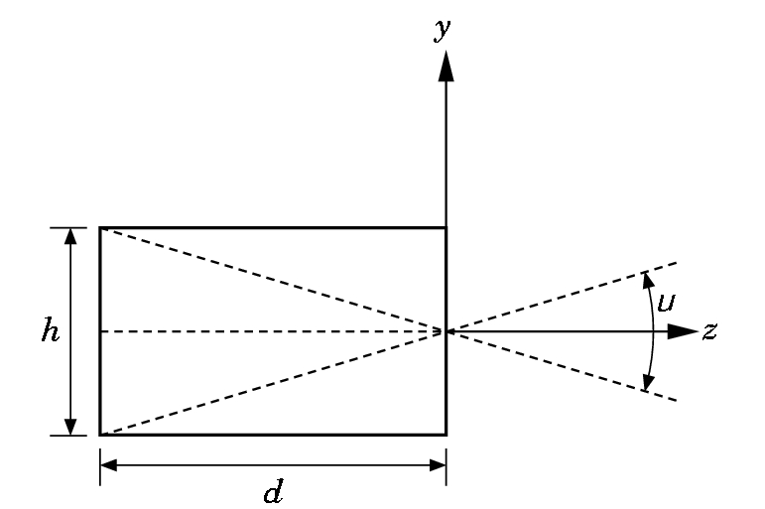
Field or Angle of View= angle formed when the largest object is imaged, μ
Figure 1.16, page 18
Ideally, want every point within the field of view to be in focus.
So, we want to be able to pick any d so that we can ideally achieve
a field of 180 degrees and everything that can be viewed will be
in focus.

Slide 10
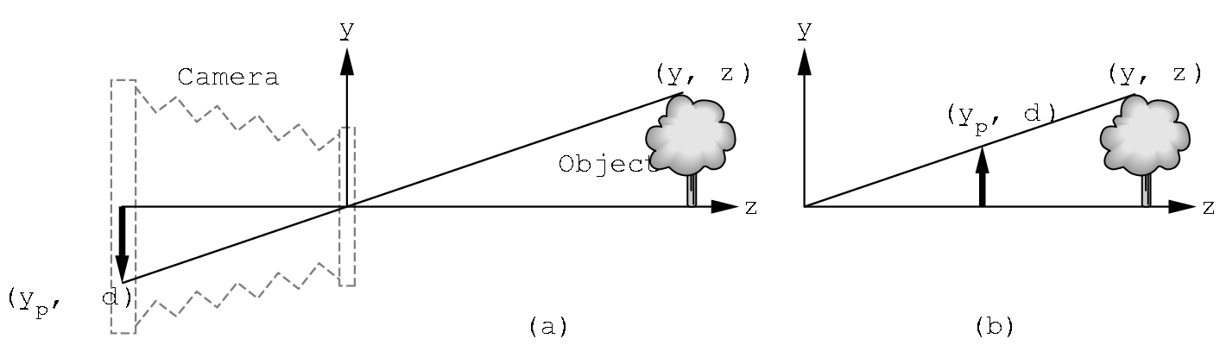
We will achieve this by basically using a lens where we can move the film plane around- i.e. a synthetic camera- later we will see the mathematical formulas that allow that are used
Figure 1.18, page 20

Slide 11
Recall the clipping plane and the clipping window, which is where the image is formed, determines what is seen.
Figure 1.20, page 21

Slide 12
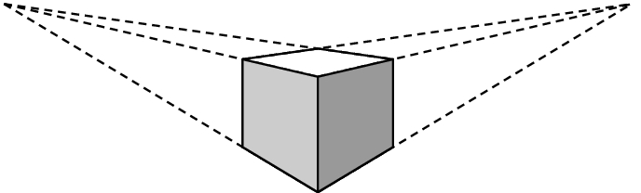
Although OpenGL supports only one-point projection-perspective, interesting effects can be achieved when more than one point is used.
Figure 1.24, page 24

Slide 13
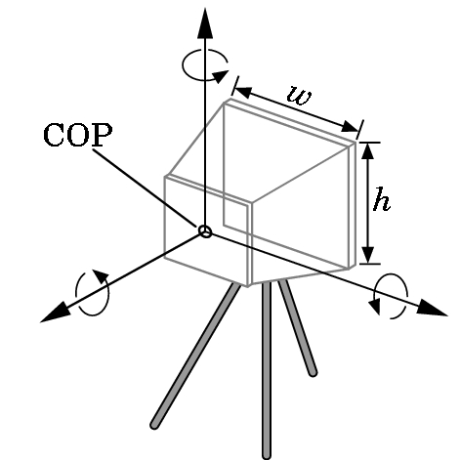
Which API you use, determines how much flexibility you have in setting camera specifications. Want to be able to set
Position
Orientation
Focal length
Film plane
Figure 1.23, page 23

Slide 14
Synthetic camera approach leads to the need to manipulate various coordinate systems and to transform one to another (linear algebra)
World coordinates - where scene is located- 3D
Eye coordinates - where eye of viewer is located- 3D
Normalized device coordinates - coordinates of an idealized screen- 2D
Screen coordinates- actual coordinates on the display device-2D

Slide 15
Consequences of the Using the Synthetic Camera Paradigm
Clear separation of viewer and object
Allows us to use a pipeline architecture for the display process
  Objects built in world
  Transform points into viewing coordinates and clip (order we will worry about later)
  Project onto 2D view plane
  Rasterize onto display device

Slide 16
Advantages of Pipelining
If can multitask, throughput can be increased.
Graphics software can be built in a nice, modular fashion.
If new devices are added, only the software that maps the idealized coordinate system to the device coordinates need be changed.
Useful when new algorithms are incorporated into the graphics software.

Slide 17
Disadvantages of Pipelining
Need to send individual pixels through the pipeline - so 1000 vertices require 1000 traversals of the pipeline.
One reason we often model with wireframes first and then use line drawers and shading algorithms to fill in parts.
But, the synthetic camera approach dominates the
field--- it is the basis of OpenGL, PHIGS, and GKS.

Slide 18
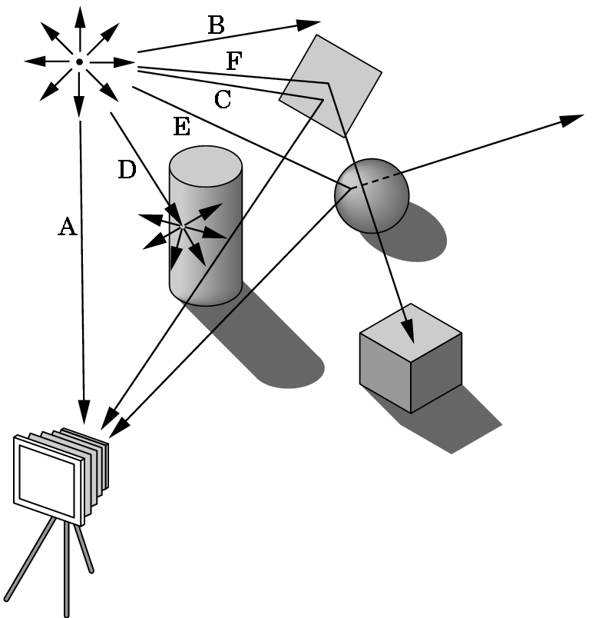
RAY TRACING PARADIGM
Figure 1.10, page 14

Slide 19
MODELING-RENDERING PARADIGM- very computationally intensive
Idea is to separate
  Modeling
    very interactive
    design and place objects
  Rendering
    add light sources
    add texture
    add various effects
    then produce quality image
Becoming increasingly important for CAD and movie production

Slide 20
Homework
Read Chapter 1 (covered today) and Chapter 2
Locate the home page (after tonight) and find the materials for the book
Paper-pencil: page 33-34. Exercises 1.1-1.11. Note that the odd-numbered exercises are available on the web site.
These will be discussed in class at a future (to be announced) date. I will assume you have tried all of the exercises and have at least looked at the odd-number solutions by the announced date.
We will be programming after the next class!

