Slide 1
FRACTALS
Pictures are due to Derek Wills, U of Hull, UK

Slide 2
MODELING DIFFICULTIES
Irregular, non-manufactured objects have been difficult
to model with the standard methods of graphics.
We have already seen in IRC presentations that
texturing can help---
although, in a sense, there is something unsatisfying
about just pasting a scanned image onto an object to
make it look good---not that your first attempts are easy
It is true that texturing adds realism faster than most methods.

Slide 3
MODELING DIFFICULTIES
Other techniques we've seen in IRCs have been the
particle systems for water and fire.
Particle systems are fluid and, consequently, a nice
choice for water and fire.
But, some things are more solid, but still
irregular:
shorelines,
clouds, --- can model with particle systems
mountains,
trees

Slide 4
FRACTALS
Typically are used to model objects with the properties
that they are:
Irregular
Randomly jagged, but constrained
Non-fluid
On zooming in, the shape becomes more irregular
On zooming out, the shape becomes less irregular

Slide 5
FRACTALS
Introduced mathematically to capture the notion that you can have a continuous curve that is nowhere differentiable---i.e. there is no point at which a derivative exists.
Intuitively, this means the curve is unbroken---i.e. smooth---but it is incredibly jagged.
Of course, when we draw a fractal we are drawing it at only one point in its generation, as many of these are defined as the limit of an iterative process.

Slide 6
KOCH CURVE- One of the Simplest Examples
Step 0: length = 1, seg = 1/3
Step 1: length = 4/3, seg = 1/9
This continues iteratively, where at each level, the
segments are divided into thirds and the same pattern is
repeated.
The definition of the curve requires that this be repeated
forever.

Slide 7
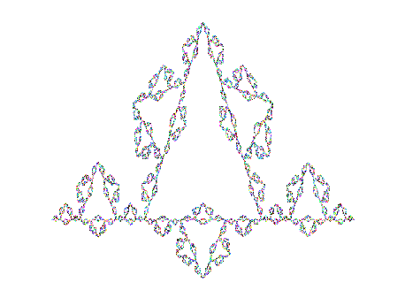
KOCH CURVE
At level k, the length is (4/3)^{k} so in the limit, the
length of the curve approaches infinity.

Slide 8
FRACTALS AND FRACTIONAL DIMENSION
Topological dimension is defined as the number of parameters needed to specify the location of a point on an
object.
For fractals, this is not too useful as the specific location
of a point is difficult to locate. Another definition of dimension is used called the Hausdorff-Bisicovitch dimension.
We will see in a minute how this is defined, but a fractal
is defined to be a set of points whose H-B dimension is strictly larger than its topological dimension.

Slide 9
FRACTALS AND FRACTIONAL DIMENSION
The H-B dimension can be defined formally, but this intuitive approach yields a better understanding for our
purposes.
Suppose you want to measure a shoreline:
If you use a straight edge ruler of length 1 mile, you might find
the length to be 2:
But, if you use a straight edge ruler of length 1/8 mile, you would
find the length to be different as you conform more to the bends
and twists.

Slide 10
FRACTALS AND FRACTIONAL DIMENSION
The Koch curve has the same kind of property:
The length is 1 if you use a ruler of length 1/3.
The length is 4/3 if you use a ruler of length 1/9.
The length is 16/9 if you use a ruler of length 1/27.
The Hausdorff-Besicovitch dimension is defined between
two iterations where you obtain lengths len1 and len2
for rulers of length s1 and s2 as
log(len2/len1) / log(s1/s2)
In graphics, that number is called the ruggedness factor.

Slide 11
FRACTALS AND FRACTIONAL DIMENSION
One property of fractals is self-similarity ---i.e. if the curve is enlarged, it is identical to the entire curve.
Every fractal that "sits" in 2D topological space has a fractional dimension between 1 and 2.
Every fractal that "sits" in 3D topological space has a fractional dimension between 2 and 3.
Natural landscapes - ~2.15
Rugged Alps - ~2.5

Slide 12
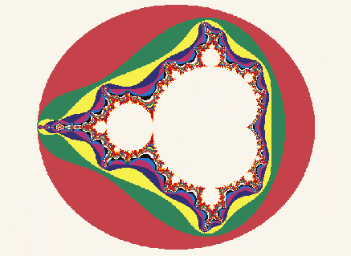
GENERATING FRACTALS
Many methods (see my board work) exist to generate
some of the following kinds of pictures of fractals:
The Mandelbrot set is the best known probably:

Slide 13
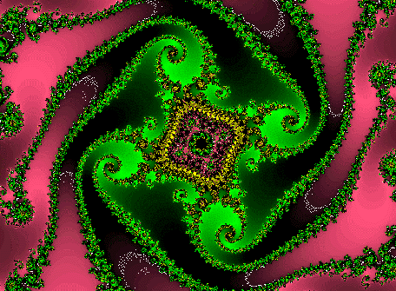
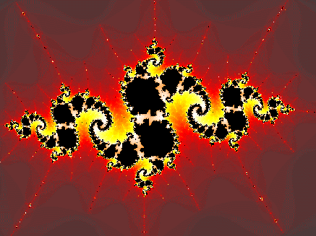
OTHER FRACTAL IMAGES
Each is produced by following a fractal generating algorithm and selecting colors to represent points with certain properties.

Slide 14
COLORING
The Mandelbrot set is really the set of points in the white interior.
Colors are selected to represent points outside of the set that have
different properties.

Slide 15
FRACTAL LIKE METHODS
Shorelines, trees, mountains, etc. aren't really fractals, but we can use fractal like methods to model them.
Mandelbrot first used them in graphics to generate mountainous terrain, but Fournier, Fussell, and Carpenter in 1982 found a faster way to generate terrain.
Since then, the methods have been modified to produce trees, clouds, and ferns as well is mountains...

Slide 16
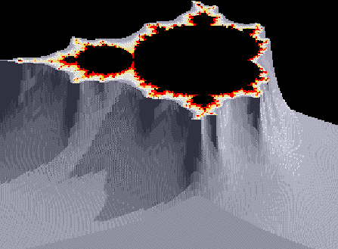
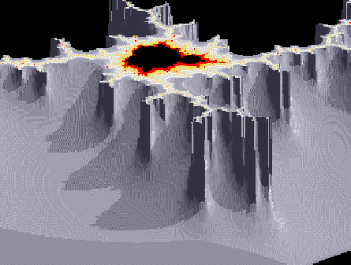
FRACTAL GENERATED GRAPHICS
These are close to the Mandelbrot set, but one of the values generated in the iteration is used to produce a height, and, consequently a rugged terrain.

Slide 17
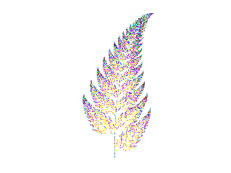

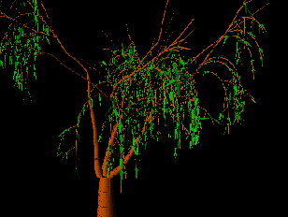
OTHER MODIFICATIONS PRODUCE

Slide 18
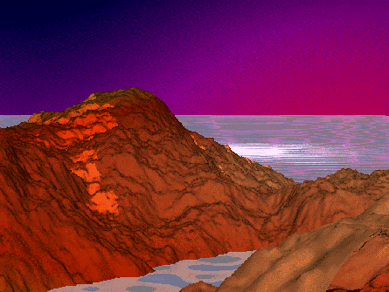
AND OF COURSE ...

Slide 19
ADDITIONAL REFERENCES
There are many references on the web.
Also useful are several books with excellent sections on fractals and graphics in general:
  Hearn and Baker, Computer Graphics, Prentice Hall
  Foley, van Dam, Feiner, and Hughes, Computer Graphics: Principles and Practice, Addison Wesley
  Rogers, Procedural Elements for Computer Graphics, McGraw Hill

