Slide 1
Chapter 2
Graphics Programming
OpenGL and GLUT

Slide 2
OpenGL
OpenGL is an API (application programmer’s interface)
Many APIs exist
Forerunner of OpenGL was GL from Silicon Graphics, Inc.(SGI) designed for highend IRIS workstations which is optimized for display, has ultrafast matrix transformations, and support for depth buffering.
OpenGL was SGI’s attempt to improve graphics portability.

Slide 3
OpenGL
Introduced July 1, 1992 at first Win32 developers conference.
SGI demonstrated how OpenGL had been used for Terminator2 and medical imaging.
Although Microsoft distributes OpenGL with Windows version, it does not control it. There is an OpenGL Architecture Review Board which includes SGI, IBM, Intel, and Microsoft. Meetings are open, but you must obtain attendance approval in advance.
Version1.1 was released in Dec, 1995

Slide 4
DESCRIPTIVE vs PROCEDURAL
GRAPHICS LANGUAGE
Descriptive
  Describe the scene and how it should appear
Procedural
  Programmer actually describes the steps necessary to achieve a certain appearance or effect
OpenGL is a procedural graphics language
The steps involve calls to various commands and functions (120+)
These draw graphical primitives such as points, lines, and polygons in 3D

Slide 5
OPENGL
Can add lighting, shading, texture mapping, animation, curve drawing, and other special effects
As OpenGL is procedural, these additions must be specified by the programmer.
OpenGL does NOT include functions for window management, user interaction, I/0.
Each host environment has its own way of handing over to OpenGL the drawing and control of a window or bitmap.

Slide 6
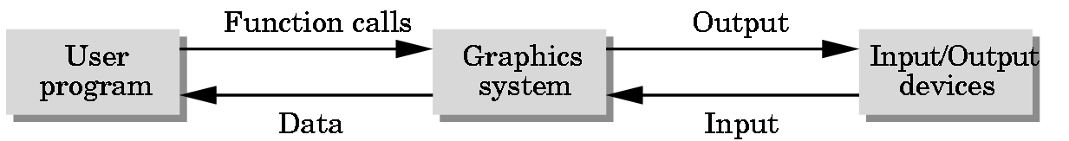
THE POSITIONING OF A GRAPHICS SYSTEM

Slide 7
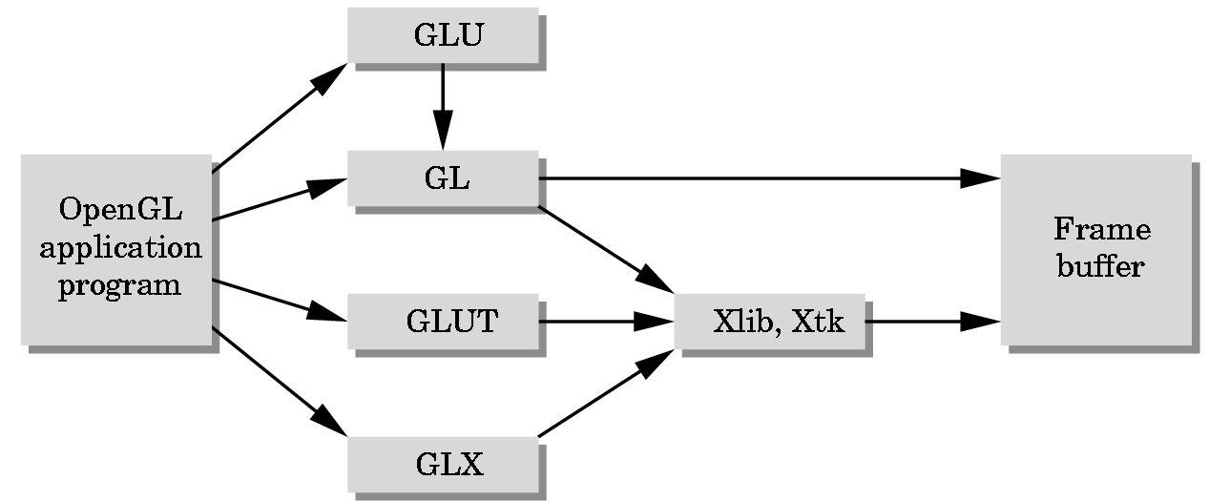
GLUT = GL Utility Toolkit
A library that acts as a common interface to different versions of
windowing environments such as
Microsoft’s
SIGs
X-windows etc.

Slide 8
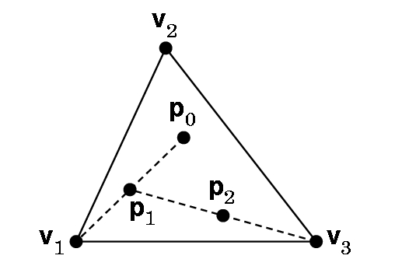
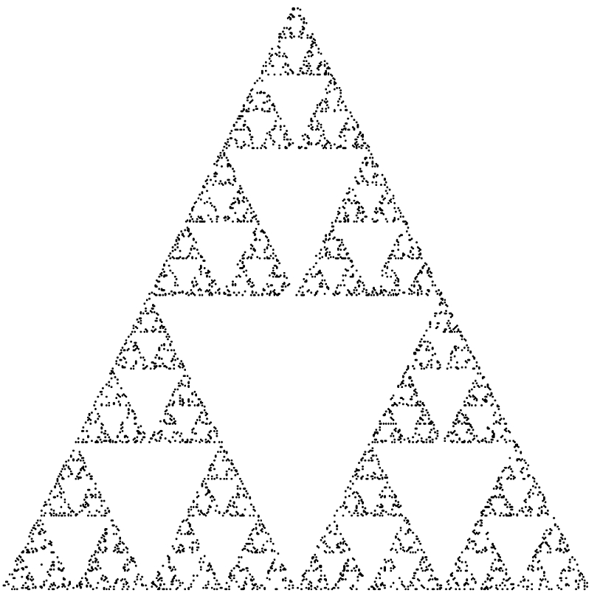
Our First Example
2D---but viewed in a 3D world
Construction: Start with 3 points forming vertices of an equilateral triangle.
Continue for a chosen number of points:
1. Randomly pick a point inside triangle
2. Randomly pick a vertex.
3. Find midpoint of the line segment between the vertex and point.
4. Display the new point.
5. Replace the initial point with the new point.
6. Return to 2 if the specified number of points have not been plotted,
2D Sierpinski Gasket

Slide 9
BEFORE WE CAN DEVELOP A
PROGRAM WE NEED TO ANSWER SOME QUESTIONS
How are points specified?
How are colors specified?
Where on the screen will the image appear?
How will the image be sized?
How is a window created for the image?
How much of the 2D drawing surface which represents the image will be displayed?
How long will the image remain on the screen?
What happens if another window is moved over the drawing window and then moved away from it?

Slide 10
Want a program … main()
{initialize_the_system(); for (some_number_of_points)
{ generate_a_point(); display_the_point();
} cleanup();
}

Slide 11
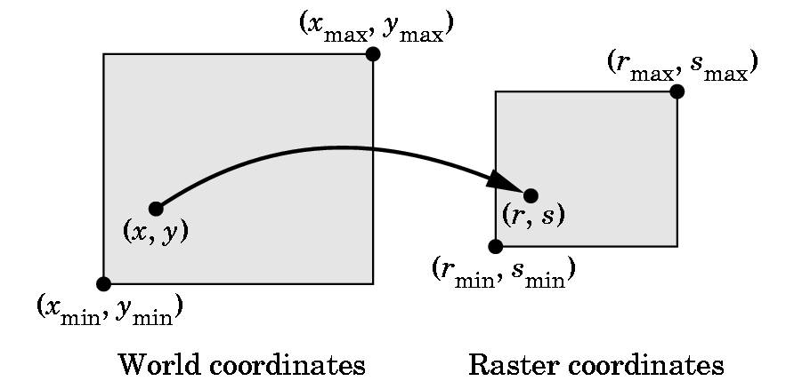
HOW DO WE SPECIFY POINTS?
What coordinates do we use?

