Slide 1
Chapter 2
Graphics Programming
What is Possible

Slide 2
Want a program … main()
{initialize_the_system(); for (some_number_of_points)
{ generate_a_point(); display_the_point();
} cleanup();
}

Slide 3
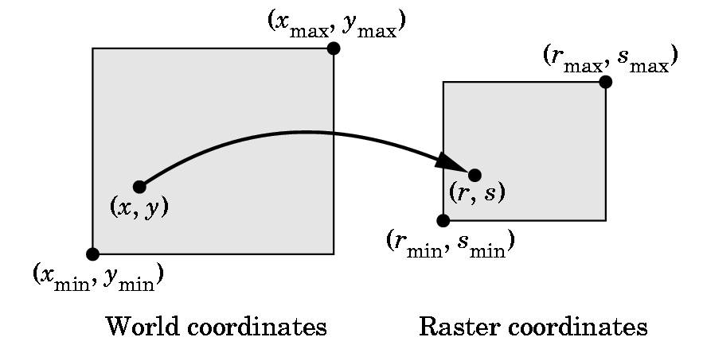
HOW DO WE SPECIFY POINTS?
What coordinates do we use?

Slide 4
VERTICES---i.e. Points
Logically, a point is a triple:
x
y
z
On the slides. I’ll use the notation [ x y z ], since it is easier to write, until we need some matrix formulas.
A vertex command specifies a data structure for a point:
Basic Format: glVertex*( arguments)
gl - specifies library GL
* - is nt or ntv where
n = 2,3, or 4 and specifies the number of argumetns
t = type and specifies i= integer
f = float
d = double
v = says we are defining as a pointer to an array

Slide 5
EXAMPLES
glVertex3f(a,b,c) specifies [a,b,c], where a,b, and c are float values
glVertex2i(x,y) specifies [x,y],where x and y are integers
Given
Glfloat vertex[3];
glVertex3fv(vertex) specifies [vertex[0], vertex[1], vertex[2]]
glBegin and glEnd group points and, after setting up the necessary environment, they are used to plot various simple primitives ...

Slide 6
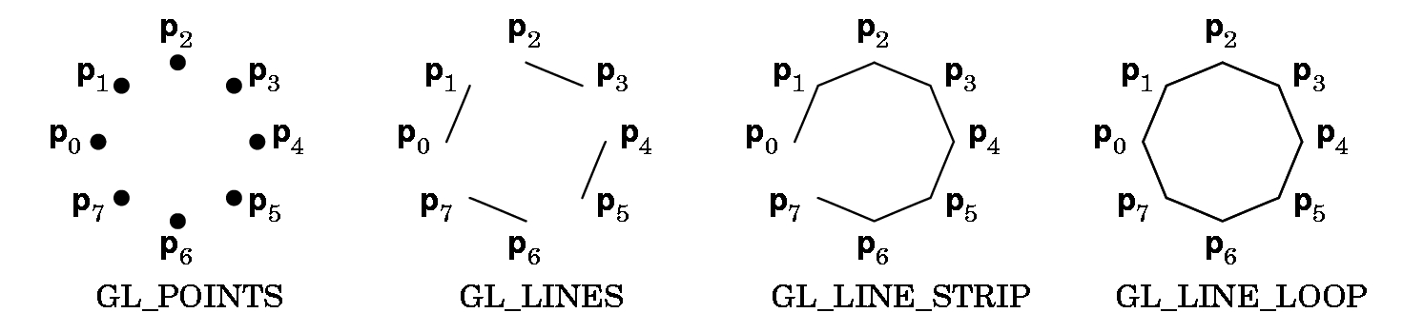
Example:
glBegin(GL-POINTS);
glVertex2f(2.0, 3.0);
glVertex2f(1.0,3.5);
glVertex2f(3.4, 5.4);
glEnd();
Plots 3 points (which may or may not be seen) as their display depends on the view.
The points are in world coordinates.

Slide 7
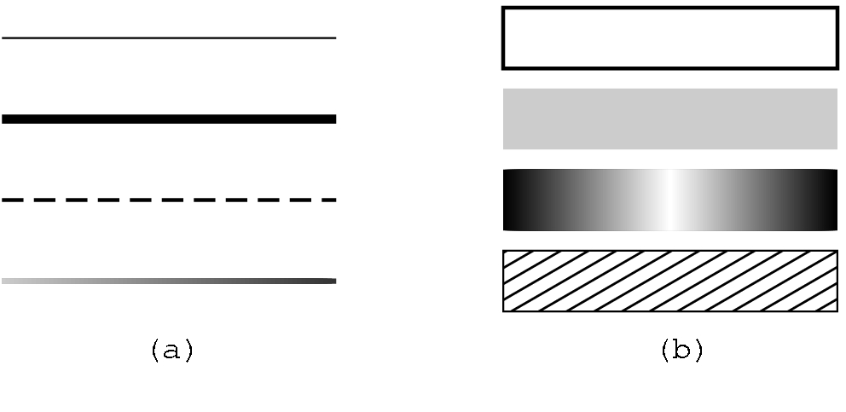
glBegin(Z);
glVertex2f(x1,y1);
glVertex2f(x2,y2);
glVertex2f(x3,y3);
glEnd();
Z is GL_POINTS: 3 points
Z is GL_LINES: one line segment as the points are chosen pairwise
Add a fourth point to the above,
glVertex2f(x4,y4);
Z is GL_STRIP: a polyline
Z is GL_LINE_LOOP: closes the loop in the polyline
Various line sizes and patterns can be specified.
glPointSize(2.0);
glLineWidth(2.0);

Slide 8
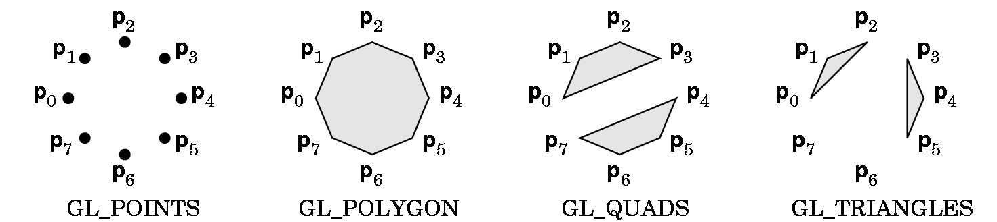
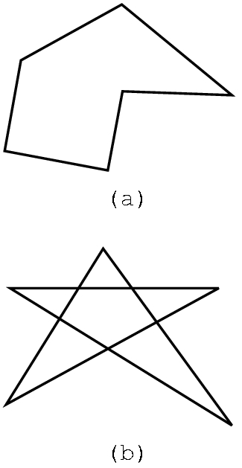
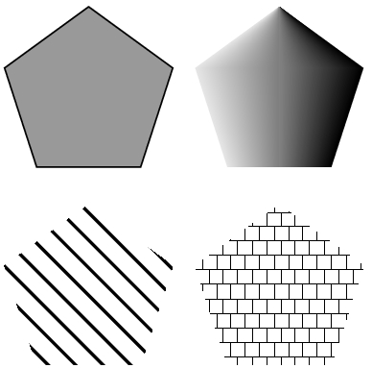
POLYGONS: Defined in a similar fashion.
GL_QUADS and GL_TRIANGLES are special cases.
Polygons play a special role in graphics as they can be
displayed rapidly
used to approximate curved lines
These can be filled with color or patterns.
But, results can be unpredictable for
polygons that are not simple.

Slide 9
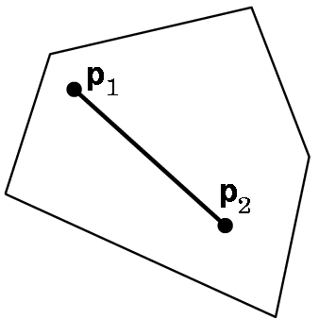
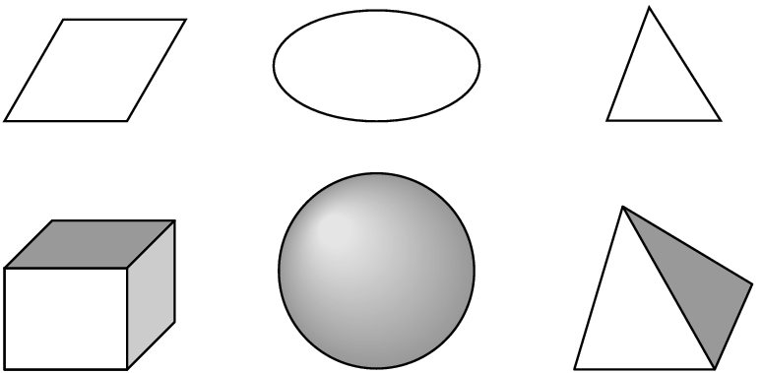
Most APIs work best with convex objects:
Definition: An object is convex if given any two
points p1 and p2 in the object, all points on a
line segment connecting p1 and p2 are in the
object.
Convex objects can be 2-dimensional,
3-dimensional (or, in fact, n-dimensional).

Slide 10
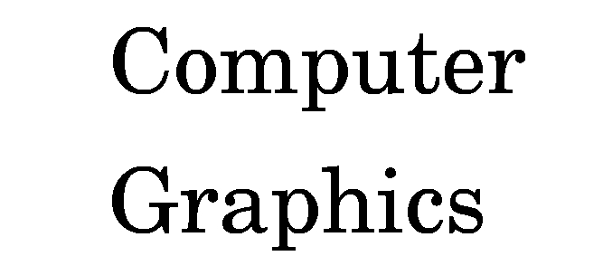
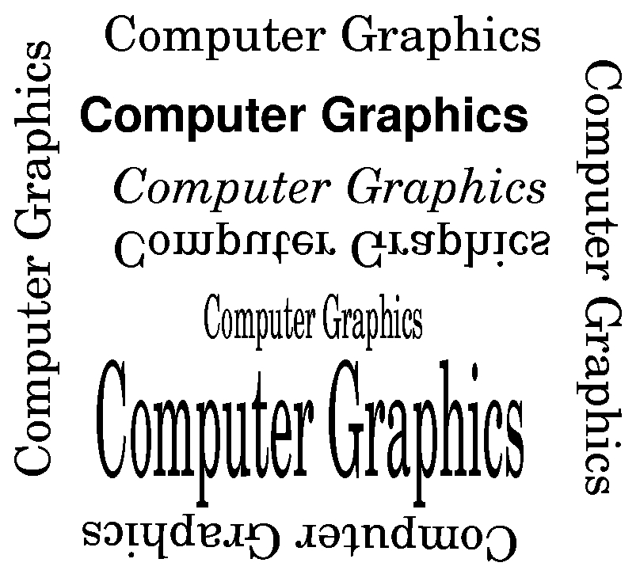
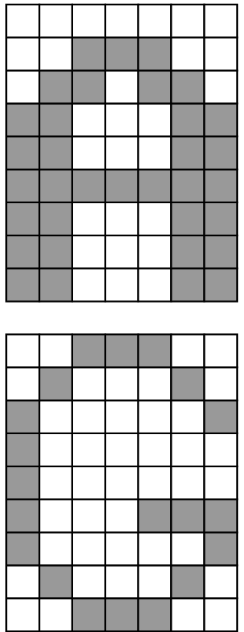
Text can be specified in multiple fonts and with various orientations:
Stroke text
Raster text
OpenGL does not have a text primitive.
GLUT provides several bitmap and stroke sets that can be used.

Slide 11
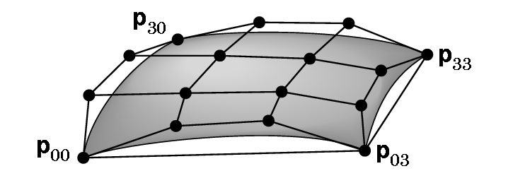
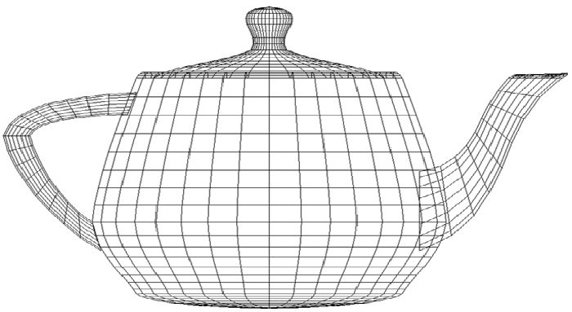
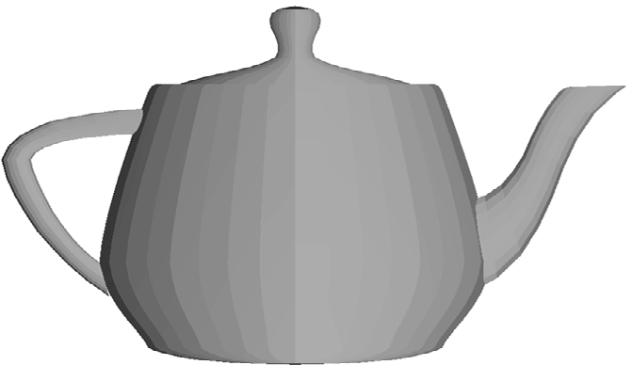
SOME CURVES ARE GENERATED BY MATHEMATICAL FUNCTIONS USING POINTS TO CONTROL THE SURFACES
An example of a Bezier patch
Famous
teapot

Slide 12
Demo in Class of Various Programs Illustrating
2D gasket
Rotating cube and color possibilities
Bouncing dinosaur
Flying paper planes
Rotating spheres- smooth, wireframe, and polygon patches
Various lighting and material attributes on objects
Moving spotlights
Note that none of these programs are more than 5 pages long and
many are of fewer pages.

