Slide 1
Chapter 2
Graphics Programming
Closing on Our First Program

Slide 2
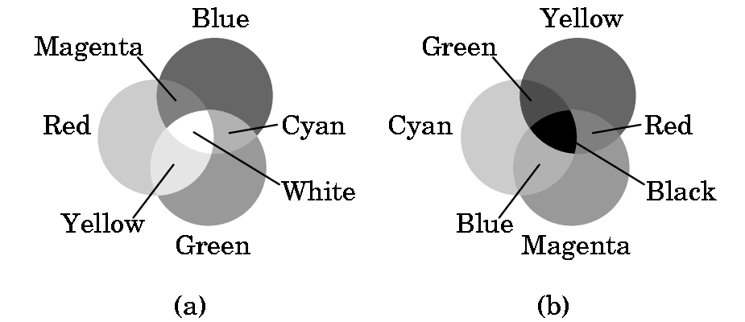
ALREADY TALKED SOME ABOUT COLOR
Color graphics is based on the three-color theory or the additive model of color
This model assumes we add 3 primary colors as if they were spotlights on a dark floor.
Printing uses the subtractive model.

Slide 3
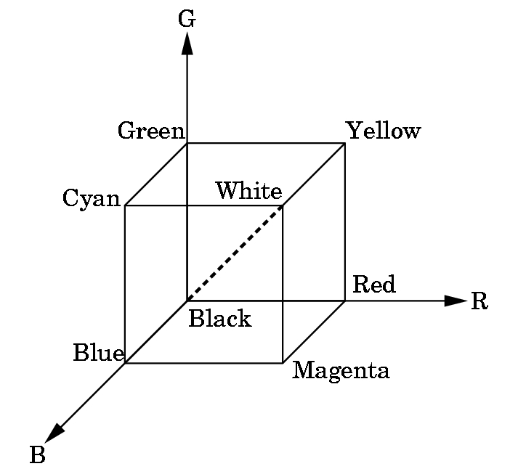
RGB & RGBA SYSTEMS in OpenGL
RGB uses the color cube as a model with intensities between 0.0 and 1.0.
Clear the window to white:
glClearColor(1.0, 1.0, 1.0, 0.0)
Produces white
Alpha component
Alpha component allows blending for special effects
such as translucense.
0.0 = opaque, no light through
1.0 = transparent
glColor3f(1.0,0.0,0.0)
Sets the drawing color to red, until changed.

Slide 4
SOME OTHER EXAMPLES OF RGB COLOR SETTINGS
R G B
dark gray .25 .25 .25
light gray .75 .75 .75
brown .60 .40 .12
pumpkin orange .98 .625 .12
pastel pink .98 .04 .70
purple .6 .4 .7
There are lists of these available (search web) or just guess and see what you get!

Slide 5
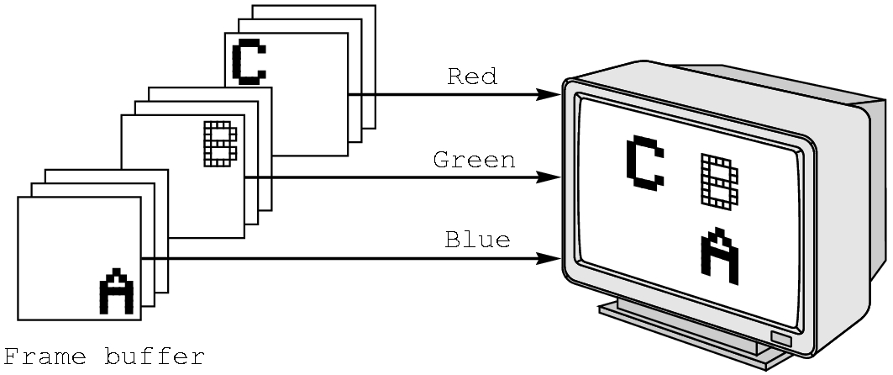
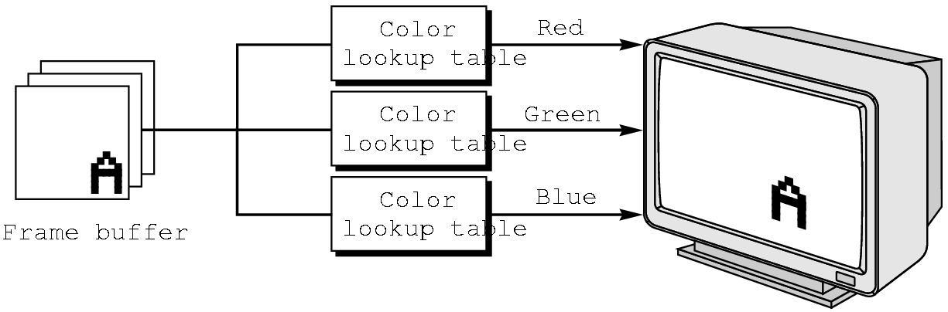
RGB vs INDEXED COLOR
RGB color is harder to support in some hardware due to the size needed in the frame buffer.
OpenGL favors RGB color, although exact reproduction across platforms or results for more color depth than the frame buffer supports are not guaranteed.
GLUT allows indexed color to be specified.

Slide 6
First Steps
We now have the means of building an object.
We can choose any coordinates we wish as our viewing choices will specify what is seen.
So we can build the 3 points for the 2D triangle as:
typedef Glfloat point2[2];
point2 vertices[3]={{0.0,0.0}, {250.0,500.0}, {500.0,0.0}}; // triangle
Glfloat (and Glint) are special data structures in OpenGL. Use these instead of the usual C or C++ types. Watch the capitalization!
Why use these values for the points? No reason---they just make a
nice equilateral triangle. You can choose any you wish.

Slide 7
The algorithm will be coded basically as you would any algorithm with only a few OpenGL commands:
int i, j, k; //i and j are point indices; k is looping variable int rand(); //C++ random number generator point2 p={75.0, 50.0}; //start somewhere
[A OpenGL command will go here in a minute for viewing]
/* compute and plot 5000 points */ for (k=0; k< 5000; k++) { j=rand() %3; // pick a vertex at random
/* Compute a point halfway between vertex and old point */ p[0] = (p[0] + vertices[j][0])/2.0; p[1] = (p[1] + vertices[j][1])/2.0;
/* Plot new point - these are OpenGL commands*/ glBegin(GL_POINTS); glVertex2fv(p); glEnd(); }

Slide 8
PROJECTION AND VIEWING
We now have our world defined, but we have no display information.
Note that while our points seem to be 2D points, OpenGL views them as 3D points with the z axis settings as 0.
We must specify projection and viewing information (or defaults will be chosen by OpenGL and results will not be what we expect).
If we were just working with a 2D graphics system, we would only have to worry about viewing information.
But, a 3D world must be projected to a 2D plane.

Slide 9
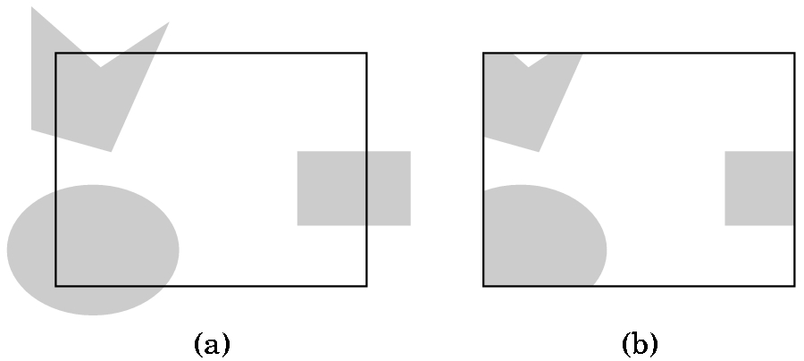
VIEWING AND CLIPPING, IF IN A 2D-GRAPHICS WORLD, IS SIMPLE
A) Shows the world with a 2D viewport outlined
B) Shows the world after clipping to the viewport
But, OpenGL views 2D graphics as
a special case of 3D graphics.
If we do nothing, OpenGL uses
a 2 x 2 x 2 viewing cube with
the origin at the center.
So, we must choose a projection
and then pick a viewing volume.

Slide 10
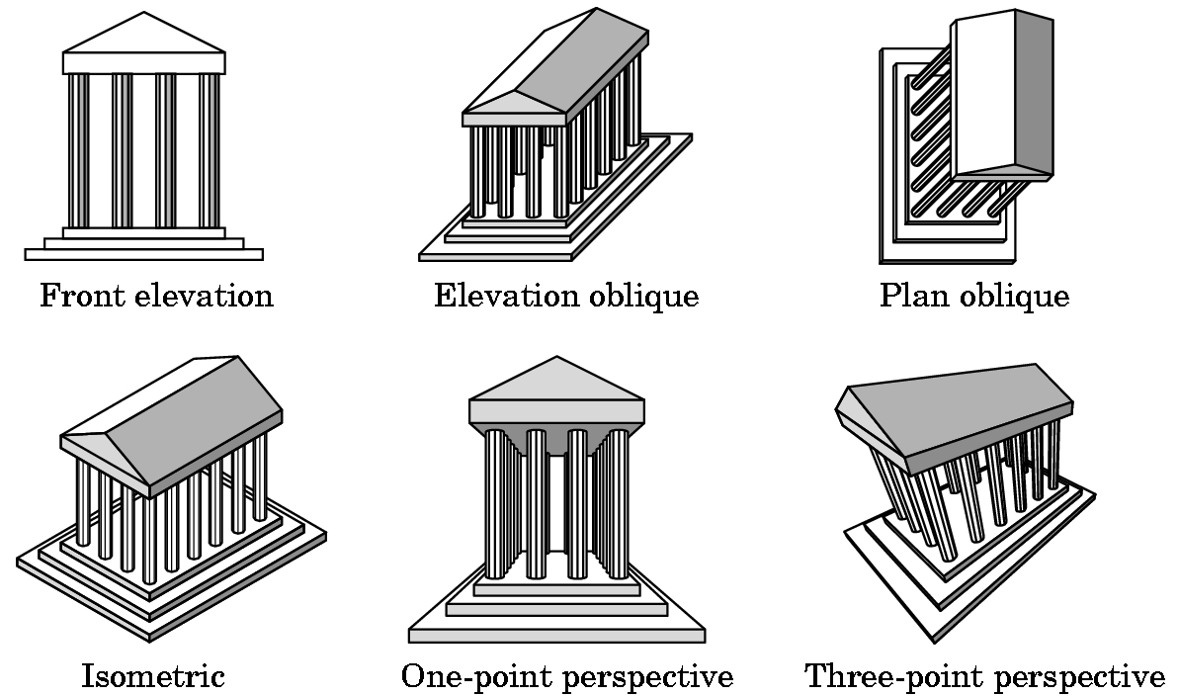
PROJECTIONS
There are many kinds which we will survey in Chapter 5.
Don't worry about definitions now.

Slide 11
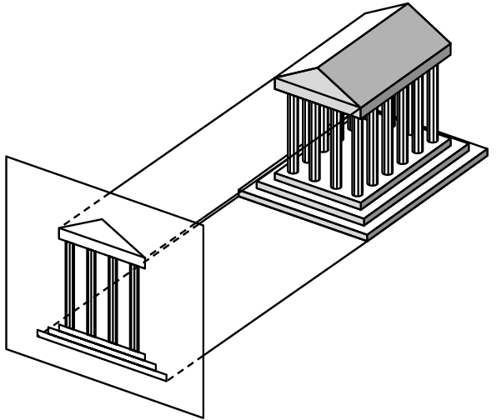

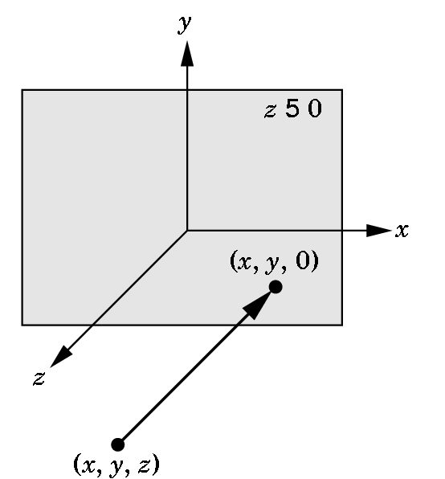
PROJECTION WE WILL USE INITIALLY
The simplest to use is orthographic although the results may look
strange to you as you are not used to looking at orthographic
projections.
3 views
How the projection
is obtained
Orthographic projection

Slide 12
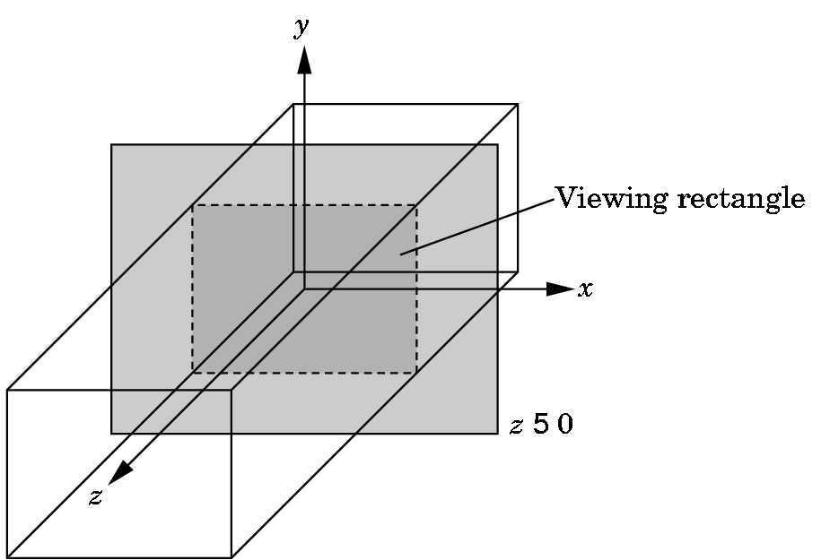
SPECIFYING THE VIEWING VOLUME FOR AN ORTHOGRAPHIC PROJECTION IN OPENGL
near
We need to specify a right
parallelepiped viewing volume. Only objects inside the volume can be seen.
Normally, set 6 bounds- left, right, top
bottom, top, near, and far using an
OpenGL function glOrtho.
far
There is a special version of glOrtho that automatically sets near to -1.0 and far to 1.0. We'll use
gluOrtho2D(0.0,500.0,0.0,500.0);
which will allow us to see all of the triangle defined by
point2 vertices[3]={{0.0,0.0}, {250.0,500.0}, {500.0,0.0}};

Slide 13
THE CODE FOR SETTING THE VIEWING VOLUME
The shifting of coordinate systems (from world, to eye, etc.) is
done using linear algebra techniques that involve matrix multiplication. OpenGL maintains various matrices as part of its internal state. We will study how these work later and, for now, we just will use the necessary commands to manipulate the matrices:
glMatrixMode(GL_PROJECTION); //switch from default MODELVIEW
glLoadIdentity(); //start with identity matrix
gluOrtho2D(0.0,500.0,0.0,500.0); //form projection matrix
glMatrixMode(GL_MODELVIEW); //switch mode back
Note: 3 of these functions start with gl and 1 starts with glu.

Slide 14
WINDOWS
Define window:
1) (graphics) A rectangular area of our display measured in 2D screen or window coordinates in pixel units.
2) (workstation world) Part of a multiwindow enviroment managed and produced by an operating system (such as Microsoft 2000) or a windowing system (such as X-Windows).
A window in which the graphics window appears is one of the windows managed by the workstation world.
We use GLUT to specify information about our graphics window which will be used by the windowing system for the platform on which we are running ...

Slide 15
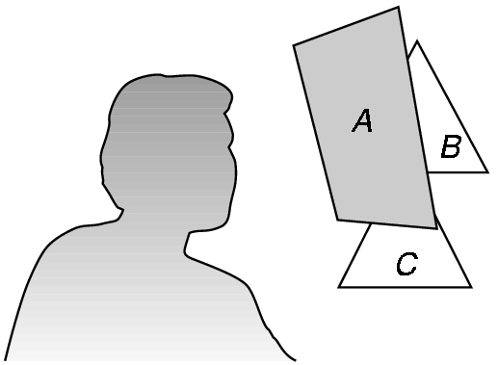
The Standard GLUT Initialization
(at least for now)
void main(int argc, char** argv) {
glutInit(&argc,argv); //required, but not used now
glutInitDisplayMode(GLUT_SINGLE | GLUT_RGB); //actually, default
glutInitWindowsSize(500,500); //500 x 500 pixel window
glutInitWindowPosition(0,0); //place anchored at top left
glutCreateWindow("Sierpeinski Gasket"); //window title
glutDisplayFunc(display); /*display callback invoked when window opened,
when window is moved, or when front window is removed */
myinit(); //calls code to set attributes and viewing information
glutMainLoop(); //enter event loop- everything else invoked by events!
}
Some variations for the display mode:
GLUT_DOUBLE- double buffer for hidden-surface removal
GLUT_DEPTH- hidden surface removal
GLUT_INDEX - for indexed color

Slide 16
Now have the complete program (after adding a few commands to the computational part for windows):
Organization:
1) Header files and usual documentation of purpose of program, your name, class, and date
2) myinit function--- sets attributes and viewing parameters
3) display callback function--- automatically invoked when an event happens. Does the computational part.
4) main function--- standard GLUT initialization

Slide 17
// 2D Sierpinski Gasket---Program in the textbook
// in Appendix A1, page 530
#include <glut.h> //will work in the labs
//varies depending on location of file
void myinit(void) {
//attributes:
glClearColor(1.0, 1.0, 1.0, 1.0); //white background
glColor3f(1.0,0.0, 0.0); //red drawing
//set up projection and viewing volume
glMatrixMode(GL_PROJECTION);
glLoadIdentity();
gluOrtho2D(0.0,500.0,0.0,500.0);
glMatrixMode(GL_MODELVIEW);
}

Slide 18
void display(void) {
//define a point data type
typedef Glfloat point2[2];
//and the triangle
point2 vertices[3]={{0.0,0.0}, {250.0,500.0}, {500.0,0.0}};
//establish structures for the computation
int i, j, k; int rand(); point2 p={75.0, 50.0};
//OpenGL command added to clear the window
glClear(GL_COLOR_BUFFER_BIT);
//Now add all the computation code:

Slide 19
/Computational stuff from an earlier slide
//compute and plot 5000 points for (k=0; k< 5000; k++) { j=rand() %3; // pick a vertex at random
/*Compute a point halfway between vertex and old point */
p[0] = (p[0] + vertices[j][0])/2.0; p[1] = (p[1] + vertices[j][1])/2.0;
//Plot new point
glBegin(GL_POINTS); glVertex2fv(p); glEnd(); }
glFlush(); //added- clear buffers
} //end display callback function

Slide 20
void main(int argc, char** argv) {
glutInit(&argc,argv);
glutInitDisplayMode(GLUT_SINGLE | GLUT_RGB);
glutInitWindowsSize(500,500);
glutInitWindowPosition(0,0);
glutCreateWindow("Sierpeinski Gasket");
glutDisplayFunc(display); //display callback
myinit(); //set attributes and viewing information
glutMainLoop(); //enter event loop- everything else invoked by events!
}

Slide 21
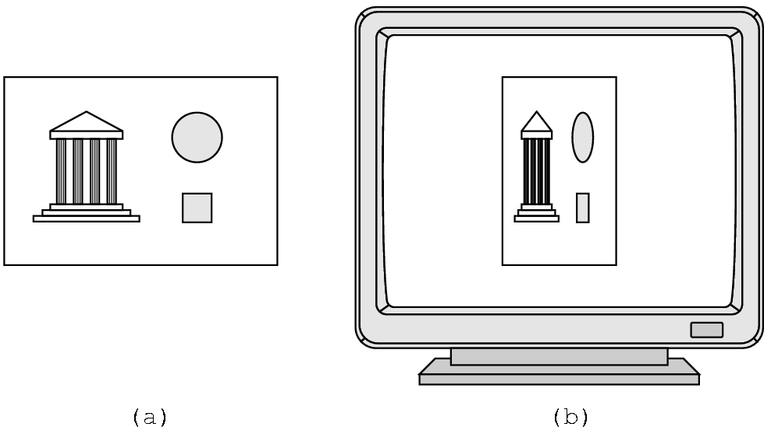
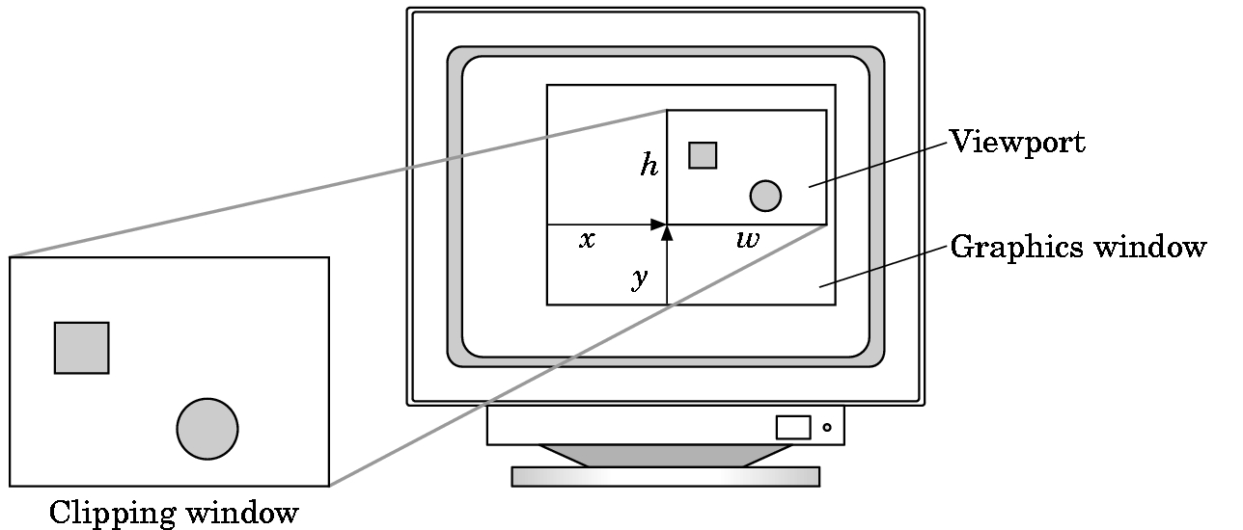
SOME CAUTIONS
Watch the aspect ratio
Can choose a viewport
that is not the entire
window---see page 67
We'll look at this further in chapter 3.

Slide 22
