Slide 1
Chapter 2
And, Finally, 3D

Slide 2
3D Sierpinski Gasket
Direct Generalization of 2D version
Easy to extend if just generalize from 2D:
  Need an equivalent 3D model--- a tetrahedron
  point3 vertices [4] = { {0.0, 0.0, 0.0},
  {250.0, 500.0,100.0}, {500.0, 250.0, 250.0},
  {250.0, 100.0, 250.0}}
  A tetrahedron is convex. Therefore, same algorithm works as before
  point3 p = {250.0, 100.0, 250.0};
  Pick a random vertex using j = rand() % 4;
  For midpoint, same idea as before but add
  p[2] = (p[2] + vertices[j][2])/2.0;

Slide 3
Changing the color of the dots based on the placement in the tetrahedron adds some interest to the drawing:
glBegin(GL_POINTS);
glColor3f(p[0]/250.0, //red component p[1]/250.0, //green component p[2]/250.0); //blue component
glEnd;
Now we need a 3D clipping volume:
glOrtho(0.0, 500.0, 0.0, 500.0, -500.0, 500.0);
which sets the left, right, bottom, top, near, and far planes at
the values specified.
There is a slight variation of this code available as gasket3d.c or A.3 on pg 534. The changes are ...

Slide 4
RUNNING THE CODE FOR A.3 ON PAGE 534 (This is the gasket3d.c code on the author's website)
Use only one include file, glut.h
Comment out the line in mouse that deals with the MIDDLE_BUTTON. The NULL is not recognized.
There are some slight changes from what I presented in class, namely:
  A typedef is used to build a structure so that records are used instead of arrays (hence the notation such as new.x etc.
  Mouse actions are included which we haven't discussed yet (and one won't compile in the lab).
  I set the color using a form of p[i]/250, as in the text discussion, but the code uses other settings (that are not equivalent, but are ok.) The idea is to distinguish locations.

Slide 5
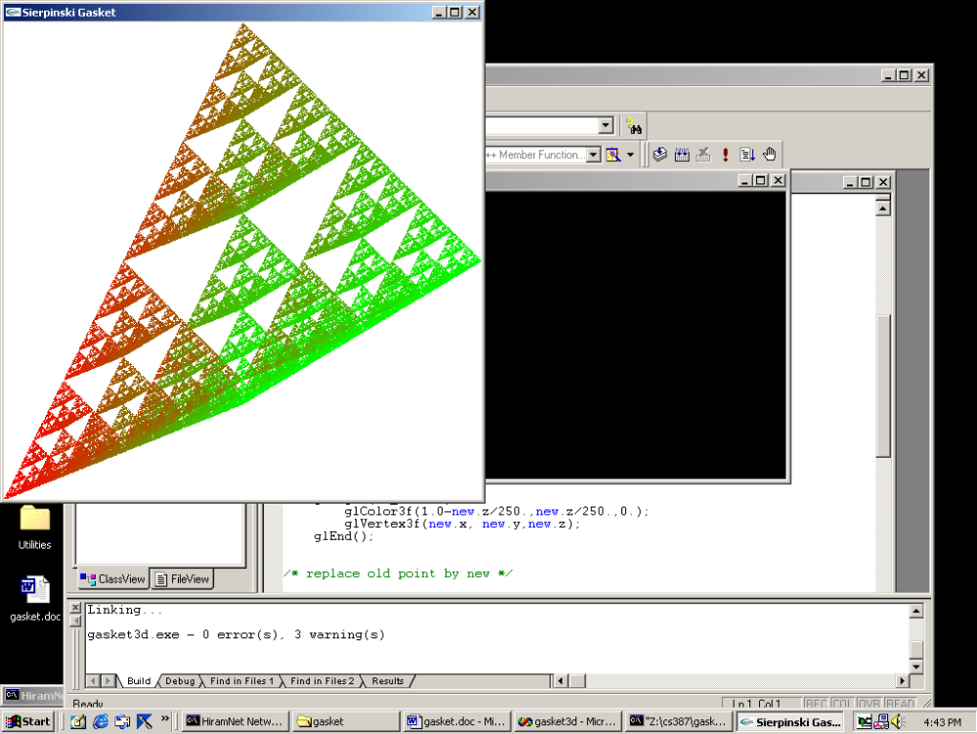
THE RESULT OF RUNNING A3 (or gasket3d.c) AFTER MODIFICATIONS
Note: This plots until the right mouse is clicked.

Slide 6
ANOTHER ALGORITHM FOR THE SIERPINSKI GASKET
Recursively subdivide
Use polygons instead of points:
Recursively subdivide a triangle throwing away the center section each time.
When the triangles are small (the size of a pixel), draw them.
Fix the number of calls to make globally.
Note: with OpenGL we can't pass data to functions and callbacks easily.
Remove from
consideration

Slide 7
Some remarks about the function code in 2D recursive gasket program, A.2, on page 532+ of text:
triangle: Note that GL_TRIANGLES takes 3 points, forms the triangle, and fills the interior with color that is set.
divide_triangle:
  Recursive
  Initial call is in display function
  4th parameter controls the depth of recursive calls
  Called initially with the 3 original vertices.
display: Very simple as just clear color bit, do recursive call, and flush
myinit: As before, but in different order for no reason.
main:Very much as before, but need to change n=atoi(argv[1]) , which is a picking up a command line argument, to n = 5 (or some other small number). This is the number of recursive calls you desire.

Slide 8
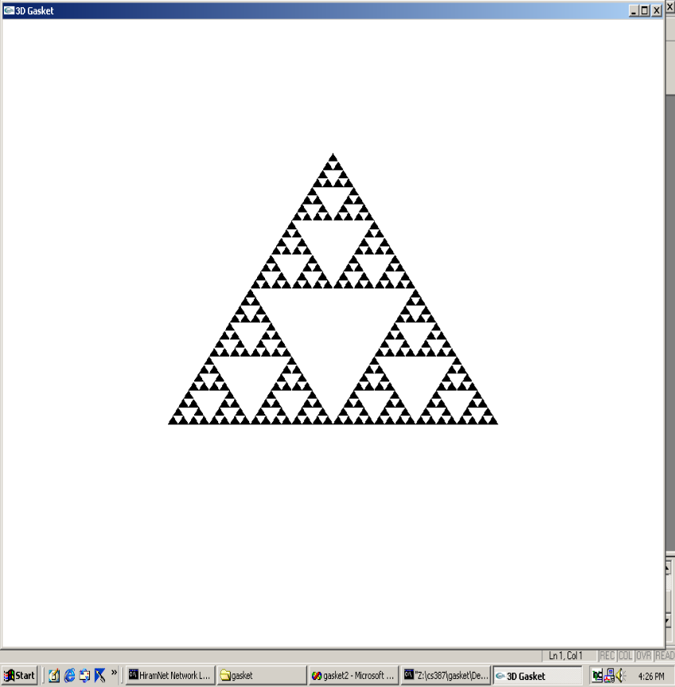
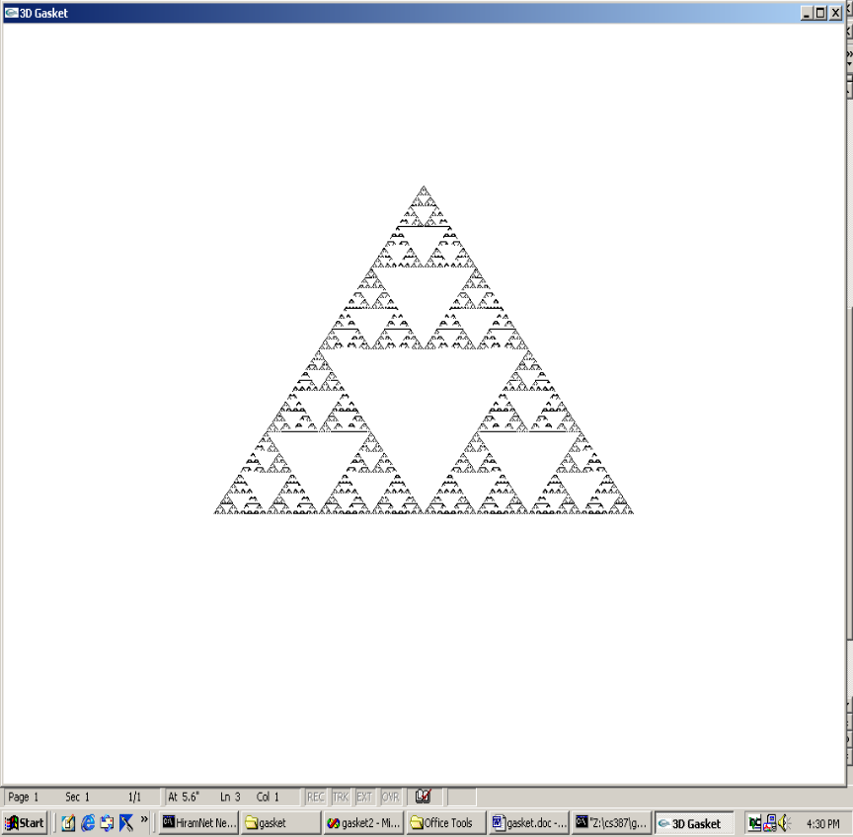
RUNNING A2 IN THE TEXT
AFTER RECURSIVE CALLS
5 CALLS
8 CALLS

Slide 9
3D RECURSIVE GASKET
A4 in appendix, page 536
Available at web site as tetra.c
Not many changes --- some are as we did before
Some of changes are cosmetic--- for example, typedef defining a structure.
Some are changes we will ignore right now:
  glNormal3fv command
  and the myReshape command code I will just handwave for now
Otherwise …
Establish the tetrahedron inside the unit cube (why will become clear in a later chapter).

Slide 10
3D RECURSIVE GASKET
A4 in appendix, page 536
triangle- as before, draws and fills a 3D triangle
  the addition of glNormal3fv(a) establishes constant shading and this will be explained later
divide_triangle- exactly as before
tetrahedron- subdivides each face of tetrahedron into triangles and changes colors for each face (red, green, blue, and black)
display- We now want hidden surface removal using the z-value to determine which point is displayed. This requires more memory for the frame buffer. So,we add
  glClear(GL_COLOR_BUFFER_BIT | GL_DEPTH_BUFFER_BIT);

Slide 11
3D RECURSIVE GASKET
A4 in appendix, page 536
myReshape - the reshape command is called whenever the window is resized. As resizing can mess up the aspect ratio, the calculations here are to preserve the aspect ratio.
  We'll discuss this in a minute, but w is set automatically to the new window width and h to the the new window height.
  In main, glutReshapeFunc(myReshape) registers this function as the reshape function.
main- as before, change atoi code. Also, for depth handling, include GLUT_DEPTH and GL_DEPTH_TEST and the appropriate places.

Slide 12
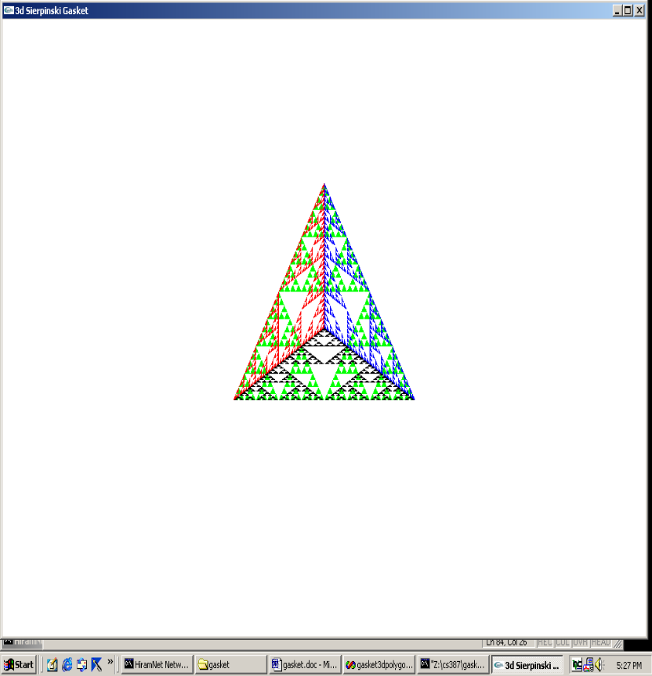
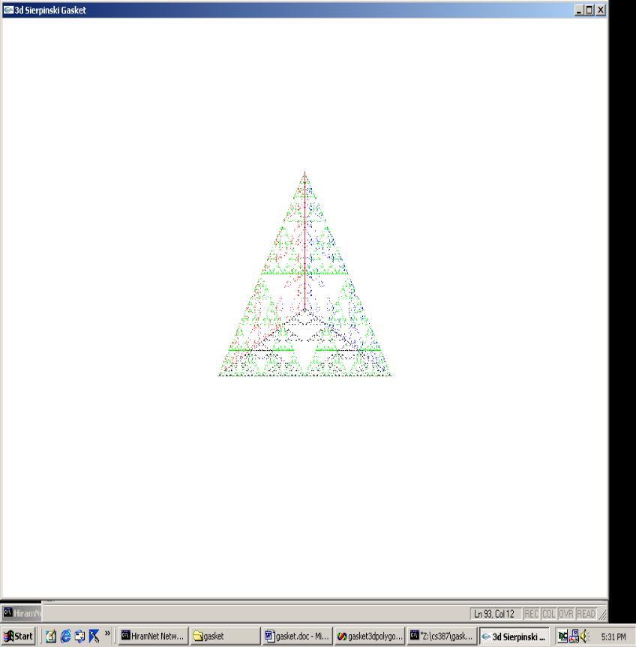
RUNNING A4 IN THE TEXT
AFTER RECURSIVE CALLS
n=5
n=10

Slide 13
THE RESHAPE CODE- pg 538
void myReshape(int w, int h) //w= width of new window and h=height //set automatically when invoked with a new window size //set as the number of pixels
{ glViewport(0,0,w,h); //set a viewport in the display area of proper size
glMatrixMode(GL_PROJECTION); //switch matrices, as before
glLoadIdentity(); //always start fresh
if (w <= h) //choose a clipping rectangle with the same aspect ratio as window
glOrtho(-2.0, 2.0, -2.0 * (GLfloat) h / (GLfloat) w,
2.0 * (GLfloat) h / (GLfloat) w, -10.0, 10.0); else...
EXAMPLE: w= 200 and h = 300 Then setting is
bottom = 3/2 * (-2) = -3 and top is 3/2 *2= 3.
The aspect ratio of the window is 2:3 and the aspect ratio of the clipping rectangle is also 4:6 (which is also 2:3).
Note the w > h case is handled similarly with left and right being scaled appropriately.

Slide 14
Suggestions of things to do to check your understanding
Make the necessary changes to gasket3d.c (A3 in text) and run it with various settings for the color (in glColor3f calls).
Make the necessary changes to tetra.c (A4 in text) and run it with different color settings.
Make changes to glOrtho . See if you can predict the results. Remember, the projection is a parallel one, not a perspective one.
Show me what you did: capture the screens, state what you thought would happen before you ran the modified code, and include all in a DOC file sent to csgrader.

