Slide 1
INPUT AND INTERACTION
Recall: GLUT Handles Input and Interaction, NOT OpenGL

Slide 2
INPUT PHYSICAL DEVICES vs
INPUT LOGICAL DEVICES
physical devices: read in text (pg 87-90) on features and characteristics of each
  2D: mouse, trackball, data tablet, lightpen, joystick, pressure sensors, keyboard
  3D: spaceball, datagloves, laser-based structured lighting, virtual reality sensors
We will be concerned with two kinds:
  pointing device- indicates a screen position and sends an interrupt to computer
  keyboard device- sends character codes to computer

Slide 3
INPUT PHYSICAL DEVICES vs
INPUT LOGICAL DEVICES
Introduced in GKS and continued in PHIGS.
Viewed as the "collective wisdom" of graphics experts as to what should be supported in a graphics environment.
OpenGL doesn't take this approach.
The mouse and keyboard, which OpenGL supports, can be used to simulate various input devices.
We will see that there is NOT a 1-1 correspondence (or pairing) between physical devices and logical devices.
One logical device can be simulated by multiple physical devices and one physical device can simulate multiple logical devices.

Slide 4
INPUT LOGICAL DEVICES
string- provides ASCII strings to a program
  Obviously, keyboard can do this
locator- provides a position in world coordinates to the user program
  Mouse returns (x,y)- a screen coordinate
  Software can convert to world coordinates, although the calculations are not trivial
pick-when the user picks an object, the identifier of the object is returned to the user program
  Can click with a mouse and determine with software which object is the closest.

Slide 5
INPUT LOGICAL DEVICES
choice - user selects one of a discrete number of options
  Use widgets (menus, scrollbars, graphical buttons) provided by the windowing environment
dial- provide analog input to user program
  Again, use widgets (slidebars, rotating dials)
stroke-returns an array of locations. Acts like a multiple locator.
  Can handle by depressing a button or mouse (drag)

Slide 6
ENTITIES DESCRIBING INPUT FROM DEVICES
measure of device- what is returned to a program when the device is activated
trigger of device-signal sent to the computer to do something
input mode-the relationship between the delivery of the measure and the trigger
  request mode- don't deliver measure until trigger occurs
  sample mode- immediate input
  event mode- each trigger places measure in an event queue. It is up to the user program to decide how to handle the events.
    Most APIs today, including GLUT, use a callback function approach

Slide 7
SOME CALLBACK FUNCTIONS IN GLUT
We’ve already seen and explored some:
1) glutDisplayFunc(display); //registers our name choice , //display, for the display function in main
Defined as void display () { … }
Triggers: Open window, uncover by moving a front window off of the window, resize the window
Measure: None
2) glutReshapeFunc(myReshape); //registration in main
Defined as void myReshape(int w, int h) { … }
Trigger: Window is resized ( It overrides Display for this event)
Measure: Returns the width and height in pixel to the program and passes them to the myReshape function as parameters w and h.

Slide 8
OTHER CALLBACK FUNCTIONS
glutMouseFunc(mymouse); //registration
Trigger: Mouse event---one or more mouse buttons are depressed or released
Measure: Which button was involved, state of button (up or down) after the event, screen coordinates of mouse position
Definition:
void mymouse
(int button, //ex. GLUT_LEFT_BUTTON
int state, //ex. GLUT_DOWN
int x, int y); //screen coordinates

Slide 9
EXAMPLE:
if (button == GLUT_LEFT_BUTTON &&
state == GLUT_DOWN) exit(0); //note parameter for exit
if (button == MIDDLE_BUTTON &&
state == GLUT_DOWN) drawSquare(x,y); //need to define drawSquare
Some other useful callbacks (for the full range see SGI site although some like a spaceball won't be particularly useful):
glutMotionFunc(drawSquare); //invoked when a mouse motion is // //detected when dragging the mouse
glutIdleFunc(myIdle); //invoked when no events are happening //often used to refresh something like a clock or to //toggle between two states //we'll see some examples of this //Note that NULL must be defined as 0

Slide 10
NOTE THAT INTERACTION CAN BE TRICKY!
Normally the display function should handle the noninteractive output here, at least initially.
If change output, you need to hang onto the changes for window displays.
For example, if we write a program to print a square every time a mouse button is clicked,
  If we don't hang onto all of the positions, we can't reconstruct the entire sequence, only the current event.
  We will see how this is can be done shortly, but think about what is needed --- a data structure to record all the positions.

Slide 11
ANOTHER USEFUL CALLBACK
glutKeyboardFunc(myKeyboard);
Trigger: Mouse is in window and key is depressed
Measures: ASCII code of depressed key and (x,y), the screen coordinates of the mouse location
Definition form:
void myKeyboard(unsigned char key, //ASCII code int x, int y) //mouse location
Note: For every callback function, these are the 4 things you need to know---these are in red above.
See functions discussed in text ---pg 600
and SIGI site.

Slide 12
EXAMPLE: Square Drawing Program, pg 538 in text, square.c
A window is cleared to black on every reshape call, which will include the initial display.
Each time the left button of the mouse is depressed and dragged,a series of boxes are drawn. Releasing the button stops output.
The right button of the mouse exits the program.
Globals:
GLsizei wh = 500, ww=500; //pixel count with predefined //global of initial window size
GLfloat size = 18.0 //length of side of square to draw will be 36 //pixels--- is 3.0 in text

Slide 13
A5, continued, pg 539
drawSquare(int x, int y)
    (x,y) is the center of the square to draw
    The function will be registered as a glutMotionFunc for the mouse and (x,y) will be the screen coordinates of the mouse when clicked
    y = wh -y; //flips from screen coordinates to //OpenGL ones
+x
⎨
wh
screen
OpenGL
+y

Slide 14
A5, continued, pg 539
glColor3ub( (char) rand() % 256, …);
  Uses discrete values between 0 and 255 instead of intensities as with glColor3f. Remove the (char). It isn't needed.
Recall that GL_POLYGON fills
myReshape- just clears the window by setting everything to black. The clipping window and viewport are set to the same size.
myinit-
  Not a callback function
  Sets viewport, clipping window, and color
  Registering reshape here doesn't seem to be necessary as it is done in main.
  Deleting it doesn't seem to cause a problem
mouse-
  Should be obvious, but need a parameter in exit--- try exit(0)

Slide 15
A5, continued, pg 539
display-
  needed by GLUT 3.0+
  doesn't do anything except keep GLUT happy
main-
  standard stuff
    command line information, needed even if don't use
    single buffering and RGB color
    create window with a title
    call initialization routine
    register callbacks: reshape, mouse, motion, display
    start event loop

Slide 16
AN EXAMPLE OF POOR DOCUMENTATION- square.c
/* This program illustrates the use of the glut library for interfacing
with a Window System */
/* The program opens a window, clears it to black,then draws a box at
the location of the mouse each time the left button is clicked. The right
button exits the program. The program also reacts correctly when the
window is moved or resized by clearing the new window to black*/
What do you think you should do during the run?
If you repeatedly click, you see often nothing happens and your screen looks funny...

Slide 17
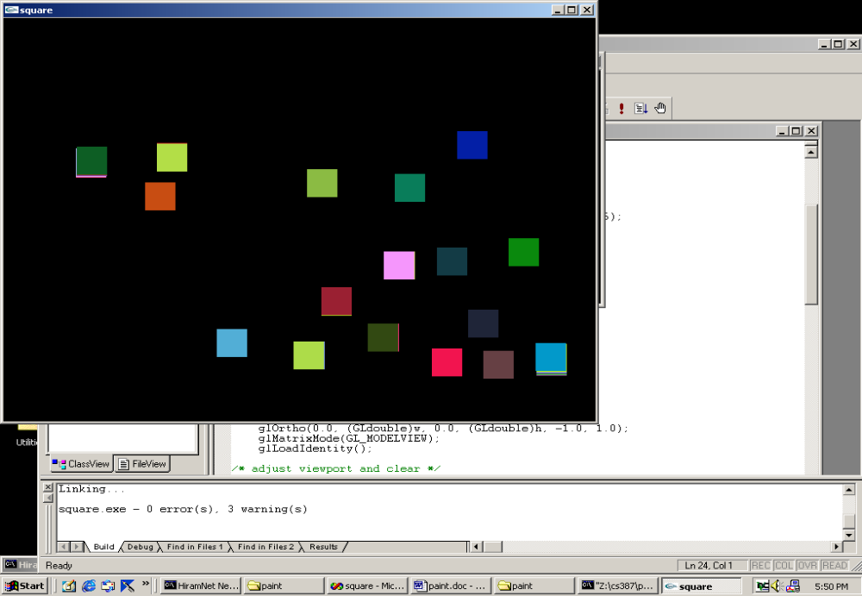
What happens each time the left button is clicked-
sometimes nothing is produced
sometimes these slightly multiple squares are produced

Slide 18
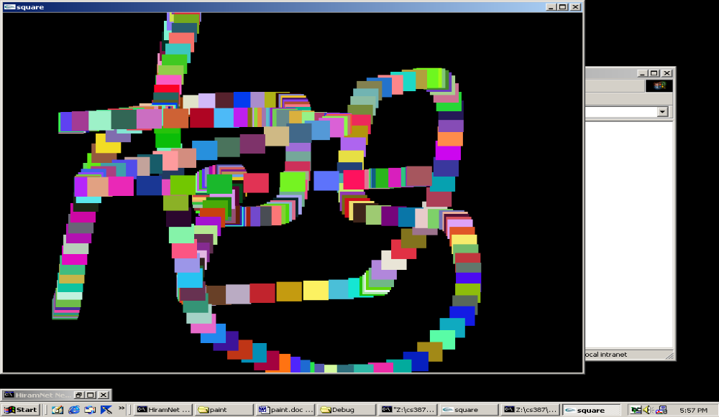
But, if you read the code, not the documentation:
glutMouseFunc (mouse);
glutMotionFunc(drawSquare);
this says you must click and drag the mouse!
Then you can produce:

Slide 19
MENUS
We saw several programs that used menus to control lighting, texturing, etc. (See the dinosaur demo and the lightlab demo)
Most windowing systems provide a toolkit allowing the construction of widgets-
  slide bars
  dials
  buttons
  menus
OpenGL directly supports only menus--- i.e. to get the others, you have to create your own or use the the window-specific widgets of the operating system being used.

Slide 20
MENUS
Easy to define ---usually in main
Register the menu callback function with an int id
    c_menu = glutCreateMenu(myMenu);
Define entries in menu- All subsequent adds are assigned to the menu just created as above. The adds terminate with the attach command shown below or a new registration. (We'll see in a minute why this approach is taken).
    glutAddMenuEntry("Quit", 1);
    glutAddMenuEntry("Increase size", 2);
Link menu to a specific button
    glutAttachMenu(GLUT_RIGHT_BUTTON);
passed to callback
function if clicked

Slide 21
MENUS
Define the menu callback function:
void myMenu (int id)
{ if (id == 1) exit(0); //menu said "Quit"
else if (id == 2) size = 2* size; //menu said "Increase size"
…
glutPostRedisplay(); //request a redisplay event so the display
//function will be called
It is easy to create hierarchical menus, but you need to plan carefully...

Slide 22
SUBMENUS
Suppose we've defined two menus:
c_menu = glutCreateMenu(color_menu);
glutAddMenuEntry("red", 1);
glutAddMenuEntry("green",2);
…
p_menu = glutCreateMenu(pixel_menu);
glutAddMenuEntry("increase pixel size",1);
glutAddMenuEntry("decrease pixel size", 2);
and attached both to right button:
glutAttachMenu(GLUT_RIGHT_BUTTON);
Now we can make both come off of another menu with another button.
glutAddSubMenu("Colors", c_menu);
glutAddSubMenu("Pixel size", p_menu);
glutAttachMenu(GLUT_MIDDLE_BUTTON);
NOTE THAT THE ORDERING OF THE COMMANDS IS IMPORTANT!

Slide 23
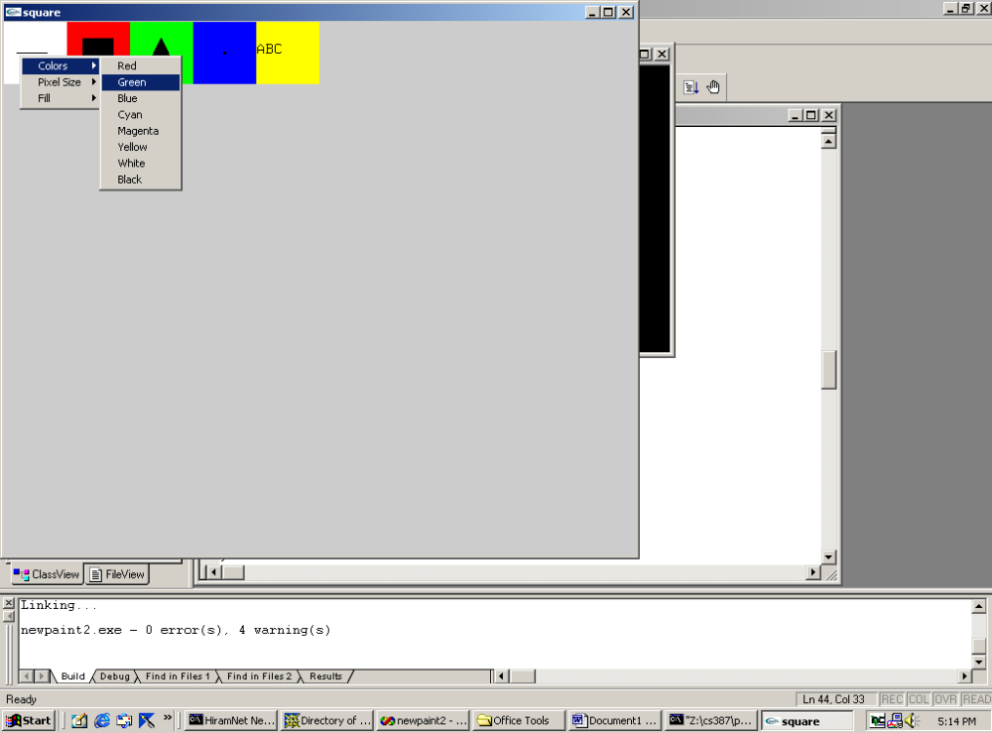

Slide 24
PROGRAMMING ASSIGNMENT #1
Write an OpenGl and GLUT program that opens a graphics window, clears it to white, and draws a 5-pointed star at the cursor location whenever the left button is clicked. Initially the star should be drawn with unfilled line segments in black.
Provide a popup menu, accessible through the right mouse button, that allows for the following interactions:
1) Change the star from an outline to a filled polygon.
2) Change the color of the star from black to at least 6 different colors that the user can choose.
3) Change the background color from white to at least 6 different colors that the user can choose.
4) Increase or decrease the line width. (Look at GLUT documentation.)
Exit the program.
Code should be commented and your own work.
When you have tested successfully, prepare screen shots that show that the various options work correctly and drop them into a Word document with comments about options shown.
I will have you send the code and screen shots to an account that will be announced on the web. Due date will be in one week and announced on the web.

