Slide 1
OTHER INPUT OPTIONS IN GLUT

Slide 2
PICKING
In 3D work, this is harder as you have to map (backwards) from screen coordinates to world coordinates in order to identify an object.
In 2D world, often can use the mouse easily as a pick device by determining if the mouse has been clicked in the extent (or bounding rectangle) of an object.
extent- the smallest rectangle aligned with the coordinate axes that contains an object.
Normally an application program maintains a simple data structure to relate objects and their extents.
Note: This can be done in 3D also where a bounding box is used. The extent is can be used for collision detection when animating objects.

Slide 3
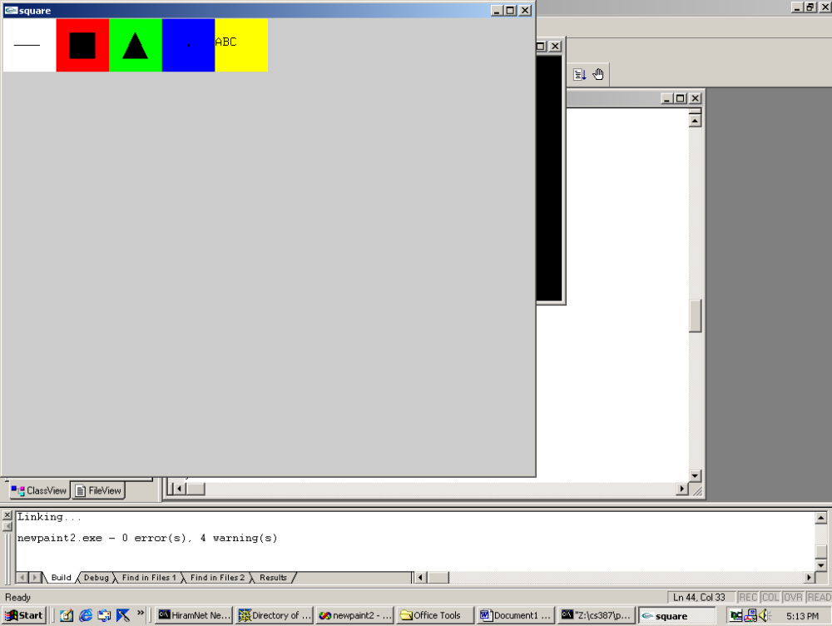
PAINT PROGRAM, A6, pg 541, newpaint2.c
Initial screen with 5 pick areas:
Choose to draw line, box, triangle, random boxes, text by clicking in the box which is labeled. Then ..
Line: 2 clicks
Box: 2 clicks on diagonal
Triangle: 3 clicks
Random boxes: any number of clicks
Text: Click and then start typing

Slide 4
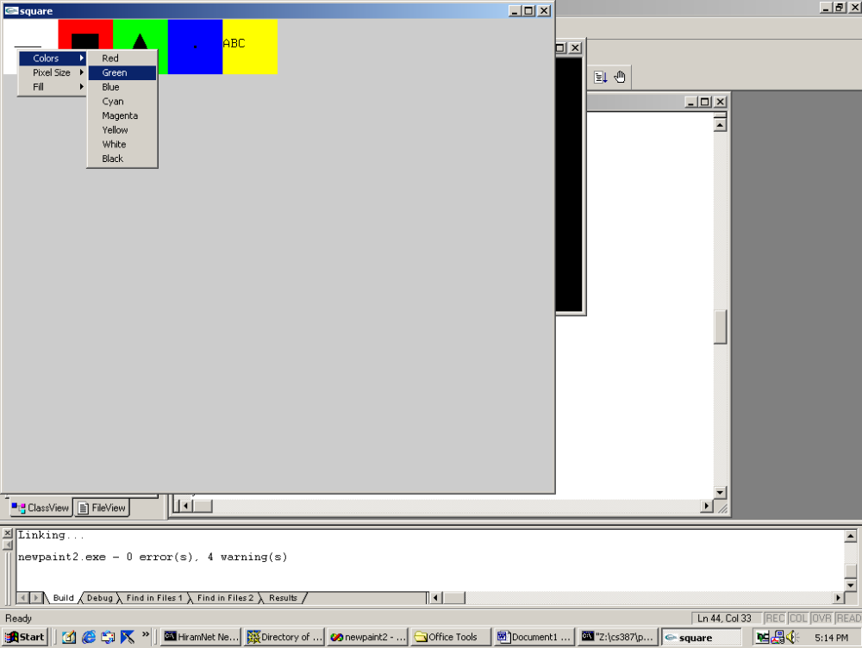
PAINT PROGRAM, A6, pg 541, newpaint2.c MENUS AS CHOICE DEVICES
Menus are used to select:
drawing color
fill or not
increase or decrease pixel size
If resize, the screen is cleared.

Slide 5
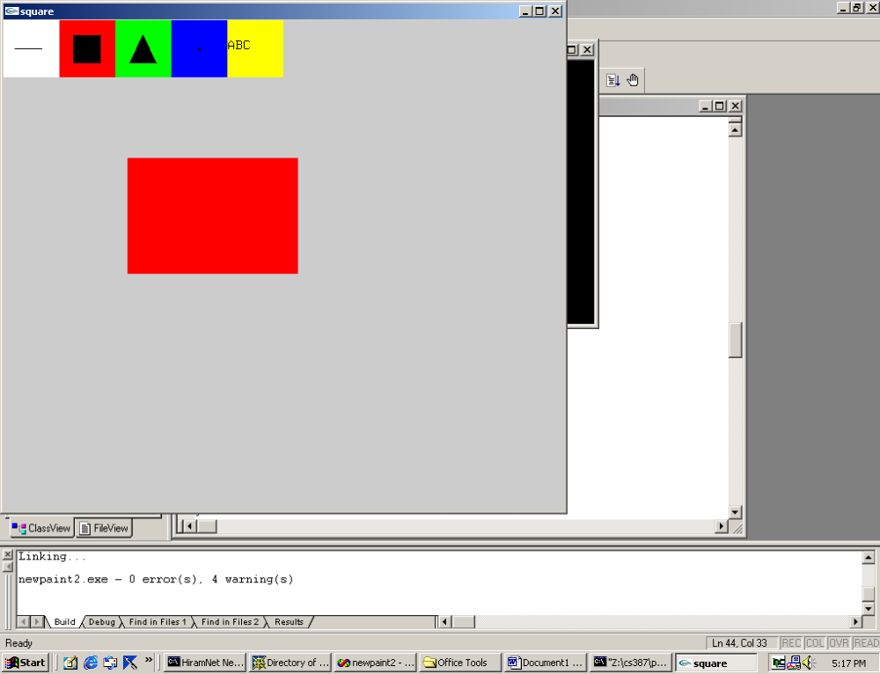
PAINT PROGRAM, A6, pg 541, newpaint2.c
More than one square (actually a rectangle) could be drawn.

Slide 6
DESIGN NOTES FOR A6
Menus are defined in main, pg 549
These are attached to the right mouse button:
  color_menu: Has 8 choices, the colors
  pixel_menu: Has 2 choices, increasing or decreasing size
  fill_menu: Has 2 choice, on or off
  right_menu: Has 2 choices, quit or clear
This is attached to the middle mouse button:
  middle_menu: Has 3 choices, colors, pixel, fill
The left mouse button will be used to pick the drawing choices and the drawing locations.
If only use two mouse buttons, you have to reorganize or use keyboard for choices ...

Slide 7
USING THE KEYBOARD AS CHOICE INPUT DEVICE
glutKeyboardFunc(keyex); //register in main
void keyex (unsigned char key, int x, int y) {
if (key == 'r') …; //code to set red as drawing color
if (key =='g') …; //code to set green as drawing color
etc.
}
To do this, you will need to provide the user with instructions.
Now, we need to note we are in a graphics window provided by
operating system's windowing system as requested by GLUT.
We are not in a normal console window where text requested by
the executing C (or C++) program would be placed.

Slide 8
CONCEPTS POSTPONED FOR NOW
Textual output in a graphics window
  Stroke and raster text
  Not hard, but a lot of code to explain and at this point I want to move into animation material
Display lists
  Similar in concept to ordinary files and can be used to define geometric primitives
  We'll use these shortly, but they do add overhead that is not desirable in simple programs.
  Right now, just read "lightly" the sections (3.3-3.4)

Slide 9
HIGHLIGHTS OF A6 (skipping the font drawing material for now)
pg 541:initial definitions, declarations, and globals
  NULL, LINE, RECTANGLE, … will be used in the code, but they will be interpreted as 0, 1, 2,… etc.
  Declarations like
    void mouse (int, int, int, int); warn the compiler about any forward references to the function (and list the functions defined)

Slide 10
QUESTIONS ON A6
(let's read code together)
1) What is the first programmer-defined function invoked
On what page is its definition? Describe what it does.
2) What is the second programmer-defined function invoked
On what page is its definition? Describe what it does.
3) What is the third programmer-defined function invoked
On what page is its definition? Describe what it does starting with …
glColor3f(1.0, 1.0, 1.0);
glPushAttrib(GL_ALL_ATTRIB_BITS);
glClearColor(0.8,0.8,0.8.1.0);
glClear(GL_COLOR_BUFFER_BIT);
…
glFlush();
glPopAttrib();

Slide 11
QUESTIONS ON A6- continued
4) myReshape, pg 542-3--- rather standard
5) mouse, pg 543--- calls pick initially (pg 544). So look at pick (pg 546) first.
6) Back to mouse, pg 543. What is the purpose of the static command at the bottom of page 543?
7) Rest is quite straightforward.

