Slide 1
THE MATHEMATICS CHAPTER
Scalars, Points, and Vectors
Section 4.1, Appendices B.2 and B.3

Slide 2
IDEAL BACKGROUND FOR ANIMATION IN GRAPHICS
Need concepts from
  analytical geometry
  trigonometry
  linear algebra
  vector analysis
But, don't need memorized formulas, just intuitive concepts and a few basis formulas that are understood intuitively.
We'll take a very pragmatic and utilitarian approach.
Approach will be similar to what we do all the time in computer science---deal with abstract data types

Slide 3
ABSTRACT DATA TYPE (ADT) APPROACH
Initially, don't worry about internal representations of a concept ---i.e. in computer science, we capture concepts using the notions of
  a class
  objects that are instantiated from the class
Concerned about attributes of class
Concerned about functions defined for the class
(Note: although many of you were introduced to these concepts while learning C++, the above notions existed before C++ was designed.)
REMEMBER- "class" here is not a C++ class!!!

Slide 4
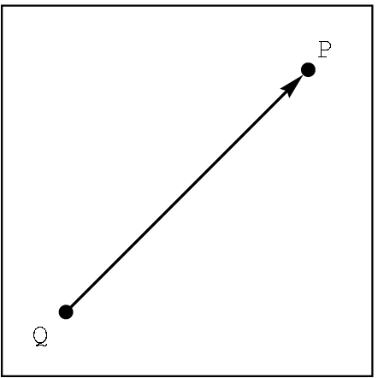
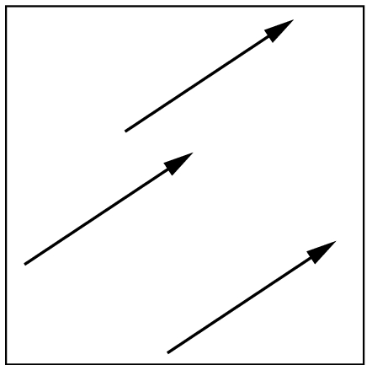
CLASSES- not defined, only described for our setting
scalar Notation: α, β, γ
  For this class, we will use real numbers.
    Define equality: just real number equality
point Notation: P, Q, R
  For this class, we just will use a location in 3D space.
    Define equality: identical locations
vector Notation: u, v , w or A, B, C
Two attributes: length- a scalar denoted by |v| direction in 3D space
Define equality: same length and direction
v

Slide 5
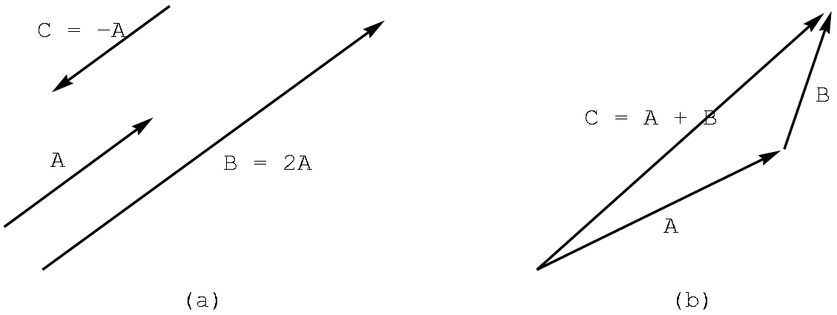
OPERATIONS ON CLASSES
Scalars: Assume the usual real number operations of +, - , *, /
Vectors: Defined in 3D space (as well as 2D)
scalar times vector
-A (i.e. -1A)
2A
vector plus vector
A + B

Slide 6
VECTOR OPERATIONS
Perform addition by the head-to-tail rule.
u
Note that u + v = v + u.
v
v+u
u+v
u
To perform subtraction, we need the zero vector- i.e. vector with zero length and no direction.
Note that v + (-v) = 0
v
-v

Slide 7
VECTOR OPERATIONS
To perform subtraction, given u and v, we define
u - v to be u + (-v):
u
u
-v
v
u - v
As you might suspect, u - v <> v - u
Note: We are NOT "computing"anything with numbers. Concentrate on the geometry.
For the moment, we are not using any reference system or coordinate system.

Slide 8
VECTOR OPERATIONS:A bit of trigonometry
There are two ways to measure the size of an angle:
degrees and radian measure
180º = Π radians
(cos θ, sin θ)
θ
Define u• v, the dot product, to be the scalar
|u| |v| cos Θ , 0 <= Θ < Π
and Θ is the angle between u and v
circle with radius 1
We are often concerned with the sign of u• v as it tells us about the angle between two vectors:
u• v > 0 iff 0 <= Θ < 90º
u• v = 0 iff Θ = 90º
u• v < 0 iff Θ > 90º
Some useful trigonometric values:
Θ cos Θ sin Θ
0 1 0
Π /2 0 1
Π -1 0

Slide 9
VECTOR OPERATIONS:A bit of trigonometry
Define u X v, the cross product, to be the vector whose
length is |u||v| sin Θ, 0 <= Θ < Π with Θ is the angle
between u and v and whose direction is given by the
right hand rule.
(cos θ, sin θ)
θ
Right hand rule:
1. With your right hand, make a gun with your index finger as the barrel, your thumb upright where the hammer would be, and your middle finger extended perpendicular to your palm.
2. Freeze those positions.
3. With u and v joined at the tail, lay the index finger along u and then the middle finger along v.
4. Your thumb will be in the direction of u X v.
circle with radius 1
u
u
v
u X v
Note that u X v <> v X u .
We are often only interested in the direction of u X v.

Slide 10
VECTOR OPERATIONS
Scalar times a vector( more details): Let α be a scalar and u a vector.
Define
αu to be the vector with length | α ||u|
with the direction
of u if α > 0
the opposite of u if α < 0
and, of course, if α = 0, the vector is the zero vector or a point.
u
2u
-3u

Slide 11
POINT OPERATIONS
Many operations are not defined, but a few are and they are useful:
1) We already know a vector + vector CAN be a point. (How?)
2) Given points P and Q, we can define P-Q as the vector given by
P
P-Q
Q
3) Consequently, given a vector v and a point Q there is a unique point P such that
P = v + Q
We can define addition between a vector and a point as above i.e, given Q and v "anchored" at Q, P is the point at the head of v.

Slide 12
SOME IMPORTANT 3D FORMULAS
We won't prove these, but you should understand them intuitively.
1) P(α) = αv + Q
Defines all points on a line through Q in the direction of v.
Also called a parametric equation of a line.
If the points are in 2D space, the line is in 2D space.
If the points are in 3D space, the line is in 3D space.
P(2)
Recall that the line segment between
Q and P(1) is defined by choosing
0 <= α <= 1
v
P(1)
Q = P(0)
P(-1)

Slide 13
DEFINING A RESTRICTED FORM OF POINT ADDITION
Start with
P= P(α) = αv + Q
Let v = R - Q for points R and Q, Then,
P = α (R-Q) + Q //substitute R-Q for v
= αR - αQ + Q //distribute α
= αR + (1- α)Q //regroup
So, we can define a restricted point addition as
P = α₁R +α₂Q , when α₁ + α₂= 1
P(α)
R
R-Q
Q

Slide 14
SOME IMPORTANT 3D FORMULAS
2) P(α) = αR + (1- α)Q
Defines all points on a line through Q and R.
We saw this formula earlier in the term and we just derived it from (1). You should read the derivation, but I will not ask you to reproduce it!
Again, to obtain the line segment between R and Q, restrict α so that 0 <= α <= 1
P(2)
R = P(1)
R-Q
Q = P(0)
P(-1)

Slide 15
SOME IMPORTANT 3D FORMULAS
T(α,β) = P + β(1- α)(Q-P) + (1- β)(R-P)
defines all points on a plane, provided P, Q, and R are not collinear. But, this formula is not as useful as the next one.
3) T(α,β) = P + αu + βv , defines all points on the plane as a parametric equation.
R
u and v cannot be parallel vectors
v
Q
P
u
What happens if we restrict α and β to be between 0 and 1?

Slide 16
SOME IMPORTANT 3D FORMULAS
4) Another important equation of a plane is given by
(u X v) • (P - P₀) = 0 where P is a point on the plane
v
P_{o}
u
The vector u X v is perpendicular, or orthogonal, to the plane and is called the normal to the plane.

Slide 17
REVIEW
We have defined the following as abstract objects
  scalars
  points
  vectors
And we have defined
  dot product
  cross product
  parametric equation of line
  parametric equation of plane
  normal to plane
  plane equation using the normal

Slide 18
NOTE THAT WE HAVEN'T
Seen how to compute anything
Haven't had a coordinate system involved.
These concepts are NOT required in order to visualize what is happening with scalars, points, and vectors.
Now, we have to add a coordinate system, but first we need some basic concepts from analytical geometry.

