Slide 1
THE MATHEMATICS CHAPTER
Frames and Affine Transformations
Sections 4.3.5, 4.3.6, 4.5, 4.6-4.9

Slide 2
FRAMES IN OPENGL
We've seen that the representation of points and vectors are tied to frames.
OpenGL maintains two frames
  Camera frame
  World frame
Initially, the two frames are the same with the following orientation:
y
x
Camera is pointing along the
negative z axis.
This is a right-handed system.
z

Slide 3
BUT, WE WISH TO BE ABLE TO MOVE OBJECTS (OR MOVE FRAMES)
Hint: Imagine you are sitting so your eye is looking in the negative
z direction towards the origin (reference point) in each frame. Where
do you see the cube? To your left? In front of you? Does it appear
when you switch frames that the cube has moved?
y
y
new frame
x
z
x
z
original frame
Although each activity is the same, it is often easier to think that
you are moving objects. BUT, either visualization is fine!

Slide 4
THE USUAL SCENARIO IN OPENGL
Define objects around the origin in the default setting.
We want the viewing conditions to be such that the camera sees only those objects we wish it to see.
So, we need to move
  1) the camera away from the objects or
  2) the objects away from the camera.
Or, equivalently, we move
  1)' the camera frame relative to the world frame or
  2)' the world frame relative to the camera frame.
Normally, we view the camera as fixed and move the objects.

Slide 5
THE IMPORTANT MODEL-VIEW MATRIX
This is the 4 X 4 frame change matrix that is required to transform between camera frame representations and world frame representations.
We can change the matrix by loading the necessary 16 scalars using glLoadMatrix.
But, computing the 16 scalars is not an easy task as we have seen.
It is easier, to equivalently move objects, using affine transformations.

Slide 6
AFFINE TRANSFORMATIONS
A transformation is a function that maps a point (or vector) into another point (or vector).
An affine transformation is a transformation that maps lines to lines.
Why are affine transformations "nice"?
  We can define a polygon using only points and
  the line segments joining the points.
  To move the polygon, if we use affine transformations,
  we only must map the points defining the polygon
  as the edges will be mapped to edges!
We can model many objects with polygons---
and should--- for the above reason in many cases.

Slide 7
AFFINE TRANSFORMATIONS
VERY IMPORTANT FACT: Any affine transformation can be obtained by applying, in sequence, transformations of the form
  Translate
  Scale
  Rotate- 3 different types
So, to move an object all we have to do is determine the sequence of transformations we want using the 3 types of affine transformations above.

Slide 8
FOR EACH AFFINE TRANSFORMATION WE NEED TO KNOW:
What does the transformation do?
What matrix can be used to transform the original points to the new points?
Recall--- moving an object is the same as changing a frame so we know we need a 4 X 4 matrix
It is important to remember the form of these matrices!!!

Slide 9
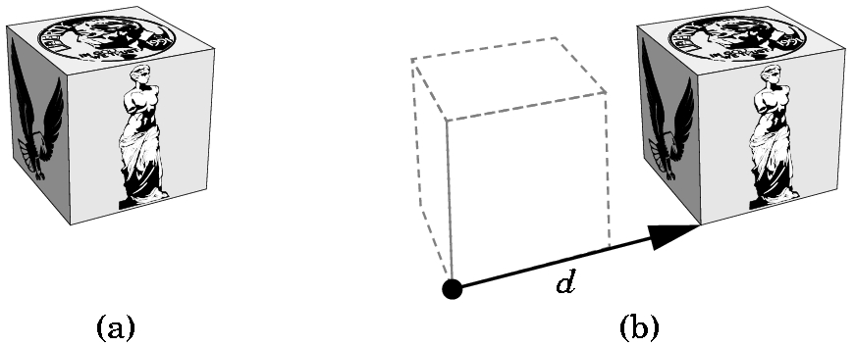
TRANSLATIONS
Each point p in the original frame becomes p' where
p'= p + d
p' = Tp where T = ⎡ 1 0 0 α_{x} ⎤
⎢ 0 1 0 α_{y} ⎢
⎢ 0 0 1 α_{z} ⎢
⎣ 0 0 0 1 ⎦
where α_{x} is the displacement in the x direction,
α_{y} is the displacement in the y direction, and
α_{z} is the displacement in the z direction.
Write T as T(α_{x}, α_{y}, α_{z})
Called the
translation
matrix

Slide 10
TRANSLATIONS
y
y
x
x
z
z
Keep the basis vectors the same, but move the reference point.
Keep remembering, frame changes can be viewed as moving the
frame or moving the object!
Note that a translation clearly has an inverse,
T(α_{x}, α_{y}, α_{z})⁻¹ = T(-α_{x}, - α_{y}, -α_{z})

Slide 11
TRANSLATIONS- 2D
2D translations just require the obvious 3 X 3 matrix:
Example:
What does T(2,-1) do to the line segment shown below if we map the points and then draw the line segment?
(-1,2) ---> (1,1)
(3,1) ---> (5,0) because
⎡ 1 0 2 ⎤⎡ x ⎤ ⎡x + 2⎤
⎢ 0 1 -1⎢⎢ y ⎢ = ⎢y - 1 ⎢
⎣ 0 0 1 ⎦⎣ 1⎦ ⎣ 1 ⎦
Old frame is in red.
New frame is in green.
View this as moving the frame or
moving the line segment!
(-1,2)
•
(3,1)
v₂
•
Q₀
v₁
v₂
P₀
v₁
Note the new origin was at (-2,1) before the translation T(2,-1)

Slide 12
TRANSLATIONS- 2D or 3D
Note that the mapping T(a,b) followed by the mapping
T(c,d) is the same as the mapping defined by the product of
the two matrices: T(a,b) T(c,d)
For example:
⎡1 0 2⎤ ⎡1 0 3⎤ ⎡x⎤ ⎡1 0 2⎤ ⎡x + 3⎤ ⎡x + 5⎤
⎢0 1 -1 ⎢ ⎢0 1 2 ⎢ ⎢y ⎢ = ⎢0 1 -1 ⎢ ⎢y + 2 ⎢ = ⎢y + 1 ⎢
⎣0 0 1⎦ ⎣0 0 1⎦ ⎣1⎦ ⎣0 0 1⎦ ⎣ 1 ⎦ ⎣ 1 ⎦
will yield the same result as multiplying the matrices first:
⎡1 0 2⎤ ⎡1 0 3⎤ ⎡x⎤ ⎡1 0 5⎤ ⎡x⎤ ⎡x + 5⎤
⎢0 1 -1 ⎢⎢0 1 2 ⎢ ⎢y ⎢ = ⎢0 1 1 ⎢ ⎢y ⎢ = ⎢y + 1 ⎢
⎣0 0 1⎦ ⎣0 0 1 ⎦ ⎣1⎦ ⎣0 0 1⎦ ⎣1⎦ ⎣ 1 ⎦
Moreover, geometrically it should be clear that
T(a,b) T(c,d) = T(c,d) T(a,b)

Slide 13
ROTATIONS- 2D
INITIALLY AROUND THE ORIGIN
y
If we rotate through angle ϕ, the point (x,y) is mapped to
x' = x cos ϕ - y sin ϕ
y' = x sin ϕ + y sin ϕ
(x',y')
•
ϕ
•
(x,y)
x
To derive these, you must use trigonometric identities for the
sum of two angles. (See the derivation on page 164).
We will accept the formulas as correct although those of you with
backgrounds in trigonometry should see that these are correct.
With a rotation, the reference point remains fixed.

Slide 14
ROTATIONS- 2D
INITIALLY AROUND THE ORIGIN
For the rotation through angle ϕ, centered at the origin, the point (x,y) is mapped to
x' = x cos ϕ - y sin ϕ
y' = x sin ϕ + y sin ϕ
so the 2D rotation matrix R(ϕ ) is
⎡ cos ϕ -sin ϕ 0 ⎤
⎢ sin ϕ cos ϕ 0 ⎢
⎣ 0 0 1 ⎦
Using the fact that cos(- ϕ) = cos ϕ and
sin(- ϕ) = - sin ϕ
we can show that R⁻¹(ϕ) = R^{T}(ϕ) = R(- ϕ)

Slide 15
ROTATIONS- 2D
AROUND AN ARBITRARY POINT
Problem: We wish to rotate a polygon φ degrees around an arbitrary point , say (α, β), in some frame. How can we do this when we only know the matrix for rotating about the origin?
Think of moving things around!
Move the point (α, β) to the origin by changing the frame.
Rotate around the new origin, changing the frame again.
Move the point (α, β) back to its original place by changing the frame.
i.e. For each vertex of the polygon, p, compute the matrix product:
T (α, β) R(φ) T (-α, -β) p
where p is the homogeneous representation of a point p.

Slide 16
IF SOMETHING ISN'T WHERE YOU WANT IT ….
MOVE THE FRAME
OR MOVE THE OBJECT

Slide 17
ROTATIONS- 3D
INITIALLY AROUND THE ORIGIN
3D rotations are a bit more complicated as there is not just one basic rotation around the origin.
There are 3 basic rotations:
1) Around the x axis.
2) Around the y axis.
3) Around the z axis.
We need to establish some conventions, however, that were ignored in the 2D case as the picture implied the answers to these questions?
1) How do we distinguish a positive angle from a negative angle?
2) How do we measure the angle?

Slide 18
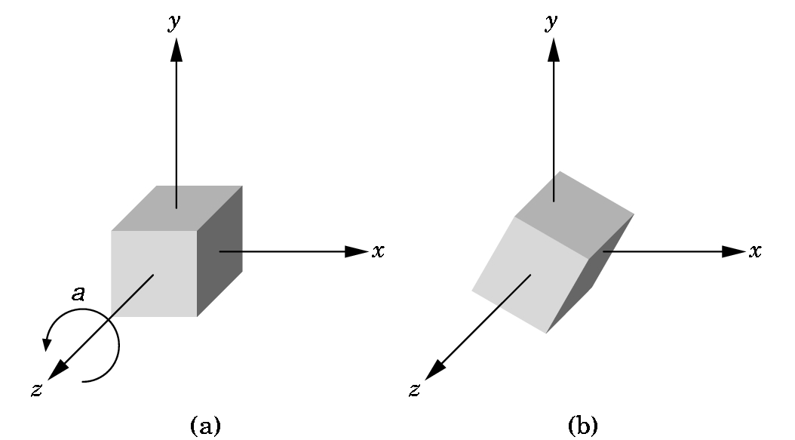
3D z-AXIS ROTATION AROUND ORIGIN
The picture shows a z-axis rotation around the origin in a positive angle, a, direction.
i.e. counterclockwise as you look down the z-axis towards the origin.
The angle is measured in the xy-plane from the x-axis, just as the 2D angle was measured.
It can be shown that a point (x,y,z)
is computed using the same formulas
for x' and y'.
Since z is not changed,
z' = z.
Thus, this rotation matrix is
computed in the same way as the 2D
matrix ...

Slide 19
3D z-AXIS ROTATION AROUND ORIGIN
a is the angle of rotation.
Shows the z-axis is
not moved
R_{z}(a) = ⎡ cos a -sin a 0 0 ⎤
⎢ sin a cos a 0 0 ⎢
⎢ 0 0 1 0 ⎢
⎣ 0 0 0 1 ⎦

Slide 20
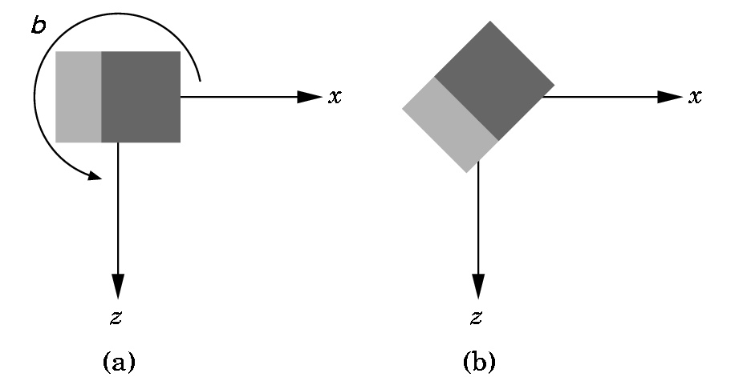
3D y-AXIS ROTATION AROUND ORIGIN
You are looking down the y-axis which is not shown.
A positive (counter-clockwise) angle is shown.
Again, the necessary rotation matrix can be defined:
R_{Y}(b) = ⎡ cos b 0 sin b 0 ⎤
⎢ 0 1 0 0 ⎢
⎢ -sin b 0 cos b 0 ⎢
⎣ 0 0 0 1 ⎦

Slide 21
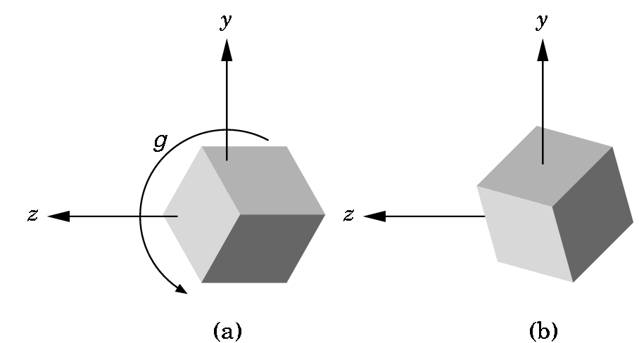
3D x-AXIS ROTATION AROUND ORIGIN
You are looking down the
x-axis which is not shown.
A positive (counter-
clockwise) angle is shown.
Again, the necessary rotation matrix can be defined:
R_{X}(g) = ⎡ 1 0 0 0 ⎤
⎢ 0 cos g -sin g 0 ⎢
⎢ 0 sin g cos g 0 ⎢
⎣ 0 0 0 1⎦

Slide 22
ARBITRARY ROTATIONS IN 3D SPACE
Some can be difficult to determine, but some aren't:
An easy example:
Rotate around the z-axis with P as a fixed point---
Very similar to the 2D situation:
Translate P to the origin T(-P)
Rotate around the z-axis. R_{Z}(Θ)
Translate P back. T(P)
and form the matrix product
T(P) R_{Z}(Θ) T(-P)
Note that the ordering is important.

Slide 23
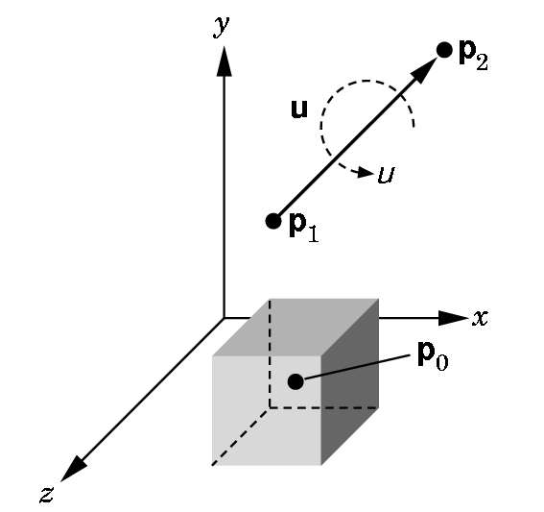
ARBITRARY ROTATIONS IN 3D SPACE
A harder example: (details of derivation are in 4.8.4)
Rotate around an arbitrary axis with an arbitrary fixed point.
Basic idea is simple, but determining the angles can be hard:
1) Translate P₀ to the origin.
2) Align the vector with the z-axis (z is always used) by rotating around the x-axis and then the y-axis.
3) Rotate around the z-axis by the angle desired.
4) Undo (2) and then (1).

Slide 24
ARBITRARY ROTATIONS IN 3D SPACE
1) Translate P₀ to the origin.
--- Form T(- P₀ )
2) Align the vector with the z-axis (z is always used) by rotating around the x-axis and then the y-axis
---Determine the angle ϕ and form R_{X}(ϕ ) ---Determine the angle χ and form R_{Y}(χ). Determining the angles is the hard part.
3) Rotate around the z-axis by the angle desired.
---Form R_{Z}(μ) using the given angle μ.
Form the matrix to be used--- note how we undo the operations---WATCH THE ORDER!
M= T(P₀ ) R_{X} (-ϕ ) R_{Y}(-χ) R_{Z}(μ) R_{Y}(χ) R_{X}(ϕ ) T(- P₀ )

Slide 25
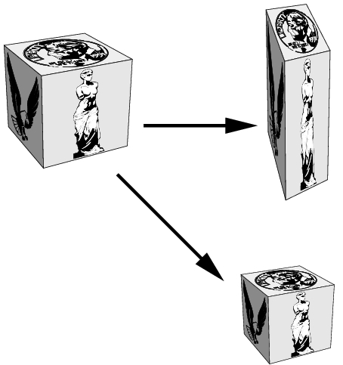
SCALING
Translations and rotations are rigid motions. Our third basic motion is not a rigid motion.
Scaling with respect to a fixed point can stretch or shrink an object and move it relative to that fixed point.

Slide 26
SCALING
The 3D scaling matrix with the origin as the fixed point is given by
S(α_{x,}, α_{y}, α_{z}) = ⎡ α_{x} 0 0 0⎤
⎢ 0 α_{y} 0 0 ⎢
⎢ 0 0 α_{z} 0 ⎢
⎣ 0 0 0 1⎦
The scaling is uniform if all the α are the same.
Each α can be different.
The inverse always exists:
S⁻¹(α_{x,}, α_{y}, α_{z}) = S(1/α_{x,}, 1/α_{y}, 1/α_{z}) unless α = 0. Then just use 0
instead.

Slide 27
2D SCALING EXAMPLES
Vertices are
(4,2), (10,2), (4,4), (10,4)
Uniformly scale by 1/2:
Vertices are
(2,1), (5,1), (2,2), (5,2)
Not only has the rectangle shrunk,
but it has moved closer to the origin.
What happens if you uniformly scale by 2?
What happens if a vertex is on an axis?

Slide 28
2D SCALING EXAMPLES
Vertices are
(4,2), (10,2), (4,4), (10,4)
Scale x by 1/2 and y by 1:
Vertices are
(2,2), (5,2),(2,4),(5,4)
Not only has the rectangle shrunk in the x direction, but it has moved closer to the origin. The y dimension hasn't changed.

Slide 29
SCALING EXAMPLES
As before, to scale with an arbitrary point as a fixed point (x₀,y₀,z₀) we
1) Translate the fixed point to the origin.
2) Scale with respect to the origin
3) Translate the origin back to the original fixed point.
i.e. multiply every point p as below:
T(x₀,y₀,z₀)S(α_{X},α_{Y},α_{Z})T(-x₀,-y₀,-z₀)p

Slide 30
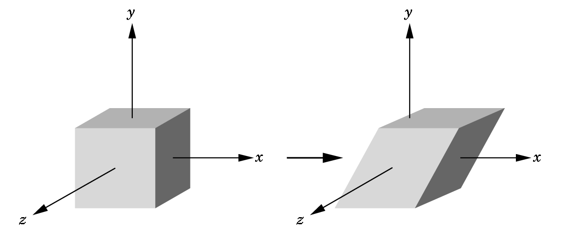
SHEARS
These are not basic affine transformations, but they are important so we deal with them separately:
Each shear is characterized by a single angle Θ which is the angle formed with the axis used for the shear.
In this case, we have an
x-shear. The x-shear matrix is:
x'= x + y cot Θ
y' = y
z' = z
⎡ 1 cot Θ 0 0⎤
H_{X}(Θ) = ⎢ 0 1 0 0⎢
⎢ 0 0 1 0 ⎢
⎣ 0 0 0 1⎦

Slide 31
A BETTER APPROACH TO SHEARS
Not in the text
The general shearing matrix is
⎡ 1 h_{YX} h_{ZX} 0⎤
⎢ h_{XY} 1 h_{ZY} 0 ⎢ where each h_{IJ} is a percentage
⎢ h_{XZ} h_{YZ} 1 0 ⎢
⎣ 0 0 0 1⎦
It can be shown that the matrix above can be obtained as a sequence of affine transformations, but it is usually simpler to load this in GL_MODELVIEW mode directly with
glMultMatrixf(m);
where we have predefined the matrix m using
glFloat m[] = {1.0, h_{YX} , h_{ZX} , 0.0, //row 1
h_{XY}, 1.0, h_{ZY}, 0.0, //row 2
…}
It is interesting to play with the different shears.

