Slide 1
THE MATHEMATICS CHAPTER
Frames and OpenGL
Sections 4.4, 4.9.5-6,4.10

Slide 2
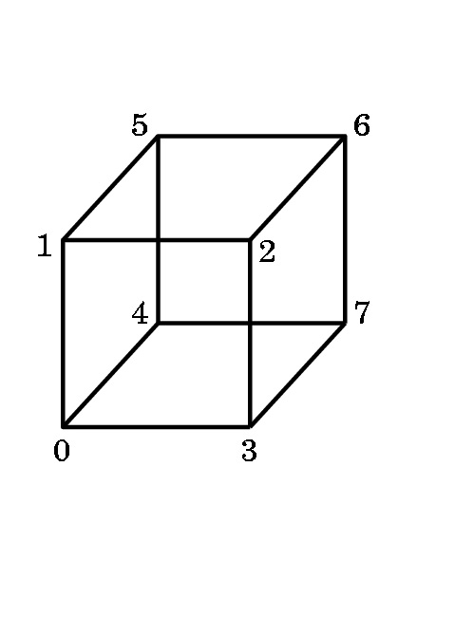
DOING ALL THESE NEAT THINGS IN OPENGL
Modeling a Rotating Cube
The simplest object we can model is a cube.
We number the vertices so we can refer to them.
There are several decisions we must make.
1) Will we view this as a primitive object that we manipulate?
2) Will we view this as only a collection of 8 vertices that the hardware manipulates?
OpenGL programming tends to encourage a middle ground- we view this as made up of the six polygons that define the faces , or facets, of the cube.

Slide 3
Modeling a Rotating Cube
Define the cube centered around the origin as this makes calculations simpler:
Note: some of the books have an error on pg 156.
The vertices in this code are from the program on page 551+, not in the text part!
3
2
7
6
0
1
4
5
GLfloat vertices[][3] = {{-1.0,-1.0,-1.0},{1.0,-1.0,-1.0}, {1.0,1.0,-1.0}, {-1.0,1.0,-1.0}, {-1.0,-1.0,1.0}, {1.0,-1.0,1.0}, {1.0,1.0,1.0}, {-1.0,1.0,1.0}};
But, we want to view this as more than a collection of vertices. We want to include the faces.

Slide 4
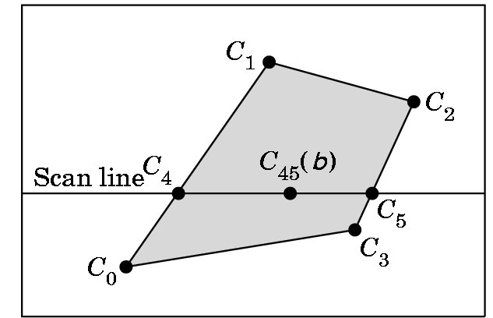
Modeling a Rotating Cube
3
2
7
6
0
1
We model the color cube by selecting colors for the vertices:
4
5
GLfloat colors[][3] = {{0.0,0.0,0.0},{1.0,0.0,0.0},{1.0,1.0,0.0}, {0.0,1.0,0.0}, {0.0,0.0,1.0}, {1.0,0.0,1.0}, {1.0,1.0,1.0}, {0.0,1.0,1.0}};
vertex 0 is black 4 is blue
1 is red 5 is magenta
2 is yellow 6 is white
3 is green 7 is cyan
OpenGL will interpolate the color between the vertices if we model the faces as polygons using a scan-line interpolation algorithm when it draws the polygon.

Slide 5
Modeling a Rotating Cube
3
2
7
We want to capture not only the geometry of the cube, but characteristics of it being a cube (i.e. its topology). So, we wish to convey what is inside and what is outside of the cube.
6
0
1
4
5
For each face, we could traverse the edges in one of two directions.
We will specify the outside of a face by a right hand rule:
7
6
7
6
Curl your right hand in the direction of the arrow. If your thumb is pointing out, you want that traversal in the definition.
4
5
4
5
So, 4,5,6,7 defines the correct side of the face as the outside face. (Or, 5,6,7,4 or 6,7,4,5 or 7,4,5,6 --- any of these will do.)

Slide 6
Modeling a Rotating Cube
Vertex normals (or Gouraud normals) are needed for shading or the interpolation of color.
Gouraud normals are the sum of the normals of the polygons intersecting at a point. For the cube centered at the origin, they are easy to calculate:
Each vector is positioned from the origin to the vertex of the cube---i.e.
GLfloat normals[][3] = {{-1.0,-1.0,-1.0},{1.0,-1.0,-1.0}, {1.0,1.0,-1.0}, {-1.0,1.0,-1.0}, {-1.0,-1.0,1.0}, {1.0,-1.0,1.0}, {1.0,1.0,1.0}, {-1.0,1.0,1.0}};
glNormal3f(pointer_to_normal) associates the normal with a vertex.

Slide 7
Modeling a Rotating Cube
Now we write a function to define each face and incorporate color into the face:
void polygon(int a, int b, int c , int d) /* draw a polygon via list of vertices */
{glBegin(GL_POLYGON);
glColor3fv(colors[a]); //change color for vertex a
glNormal3fv(normals[a]); //associate normal with vertex
glVertex3fv(vertices[a]); //draw the point
glColor3fv(colors[b]); //these are the same
glNormal3fv(normals[b]);
glVertex3fv(vertices[b]);
glColor3fv(colors[c]);
glNormal3fv(normals[c]);
glVertex3fv(vertices[c]);
glColor3fv(colors[d]);
glNormal3fv(normals[d]);
glVertex3fv(vertices[d]);
glEnd();
}

Slide 8
Modeling a Rotating Cube
Now we can create the cube as a collection of faces. The ordering
of the vertices in the polygon calls forces the inside-outside orientation on the cube.
void colorcube(void){ /* map vertices to faces */
polygon(0,3,2,1);
polygon(2,3,7,6);
polygon(0,4,7,3);
polygon(1,2,6,5);
polygon(4,5,6,7);
polygon(0,1,5,4);}

Slide 9
Modeling a Rotating Cube
We are only interested in rotation for this program, but the OpenGL affine transformation commands have the form:
  glTranslatef(Xdis, Ydis, Zdis);
  glScalef(Xscale, Yscale, Zscale);
  glRotatef(angle, x, y, z); //rotates the angle specified around the //vector from the origin to the point (x,y,z) // positive is counterclockwise as you look from the //vector to the origin.
So, why did we do all that translate-rotate-undo mess when
this last command is so simple?
  Because, OpenGL performs the calculation as we saw it specified, even though these commands look simple.

Slide 10
Modeling a Rotating Cube
Recall that OpenGL begins with the world frame and the camera frame the same.
Although you will write points as triples and vectors as triples (assuming the tail is at the origin), OpenGL will maintain them as homogeneous coordinates.
Frame changes are made by modifying the current transformation matrix (CTM), a 4 X 4 matrix in OpenGL that represents the cumulative effects of post-multiplying by frame change matrices.
Each affine transformation when invoked, forms the appropriate matrix and post-multiplies the CTM by that matrix ...

Slide 11
Modeling a Rotating Cube
For example, assume we want to do in the following order:
translate by +2, -3, +4,
rotate by 45⁰ around axis formed between origin and 1, 1, 1
scale with respect to the origin by 2 in each direction.
Our code would be
glMatrixMode(GL_MODELVIEW); //select correct mode
glLoadIdentity(); //start with identity
glScalef(2.0,2.0,2.0); //Note: Start with the LAST operation
glRotatef(45.0,1.0,1.0,1.0);
glTranslatef(2.0,-3.0, 4.0); //End with the FIRST operation
The matrix formed will be
C= S(2,2,2) R(45,1,1,1) T(2,-3,4)
Any vertex p specified after C is specified will be transformed to
q = Cp

Slide 12
MOVING MORE THAN ONE OBJECT TO DIFFERENT LOCATIONS
The last matrix loaded into the current transformation matrix determines what is applied to subsequent points.
Example: Two objects are centered at the origin. Move one 10 units along the positive x-axis and one independently of the other 15 units along the negative y-axis.
Klutzy way:
translate 10 units in x
draw 1st object
translate back to origin
translate 15 in y
draw 2nd object
Better way: Use a stack
A stack is a data structure logically viewed as a list with a distinguished end called a top and several operations:
Push something- inserts something at the top into the stack
Pop- removes the top something from the stack and makes it the current transformation matrix

Slide 13
MOVING MORE THAN ONE OBJECT TO DIFFERENT LOCATIONS
The type of code needed:
glPushMatrix(); //store old matrix
glMatrixMode(GL_MODELVIEW);
glLoadIdentity();
glTranslatef(10.0,0.0,0.0);
//code to draw 1st object here
//glPushMatrix(); optional- only if want to use later
glLoadIdentity();
glTranslatef(0.0,15.0,0.0); //Can do more than one operation
//code to draw 2nd object here
glPopMatrix(); //May need more than one
//if you pushed the optional one
//Now you are back to the old matrix

Slide 14
Return to Modeling a Rotating Cube
The frame buffer is called the color buffer in OpenGL.
It's used to hold the image being displayed if single buffering is being used.
The depth buffer (or z-buffer) in OpenGL is used to store information needed to allow for hidden surface removal. (We'll see how this is done later).
With animation, we want double buffering and automatic depth
handling. So, we need in main:
glutInitDisplayMode(GLUT_DOUBLE | GLUT_RGB | GLUT_DEPTH);
glEnable(GL_DEPTH_TEST); // Enable hidden--surface--removal
and before drawing we need to clear the frames:
glClear(GL_COLOR_BUFFER_BIT | GL_DEPTH_BUFFER_BIT);

Slide 15
Modeling a Rotating Cube
Actual spin - at last!
Mouse click chooses axis of rotation:
void mouse(int btn, int state, int x, int y){
/* mouse callback, selects an axis about which to rotate */
if(btn==GLUT_LEFT_BUTTON && state == GLUT_DOWN) axis = 0; //x
if(btn==GLUT_MIDDLE_BUTTON && state == GLUT_DOWN) axis = 1; //y
if(btn==GLUT_RIGHT_BUTTON && state == GLUT_DOWN) axis = 2; //z
}
If you have only two buttons, you can change to keyboard control:
void keys(unsigned char key, int x, int y)
//added so middle button is not needed
{
if (key == 'x') axis = 0; // select x axis
if (key == 'y') axis = 1; // select y axis
if (key == 'z') axis = 2; // select z axis
display();
} //and don't forget to register keys

Slide 16
Modeling a Rotating Cube
The idle callback, spincube, sets
theta[axis] += 2.0;
and adjusts this if the angle becomes greater than 360 degrees.
Then the idle callback calls display which does the drawing.
Note that a callback function CAN be invoked ….
void spinCube(){
/* Idle callback, spin cube 2 degrees about selected axis */
theta[axis] += 2.0;
if( theta[axis] > 360.0 ) theta[axis] -= 360.0;
display(); }

Slide 17
Modeling a Rotating Cube
All that remains is the reshape function which we have seen before:
void myReshape(int w, int h){
glViewport(0, 0, w, h);
glMatrixMode(GL_PROJECTION);
glLoadIdentity();
if (w <= h)
glOrtho(-2.0, 2.0, -2.0 * (GLfloat) h / (GLfloat) w,
2.0 * (GLfloat) h / (GLfloat) w, -10.0, 10.0);
else
glOrtho(-2.0 * (GLfloat) w / (GLfloat) h,
2.0 * (GLfloat) w / (GLfloat) h, -2.0, 2.0, -10.0, 10.0);
glMatrixMode(GL_MODELVIEW);
}
Note- this is still an orthographic projection which looks fine.

