Slide 1
Chapter 5
Classical and Computer Viewing

Slide 2
MATRICES ALL OVER
Most OpenGL programmers quickly become familiar with the modelview and projection matrices.
The modelview matrix controls the viewing and modeling transformations for your scene.
The projection matrix defines the view frustum and controls the how the 3D scene is projected into a 2D image.
The texture matrix is less used; it allows you to transform texture coordinates to accomplish effects such as projected textures or sliding a texture image across a geometric surface. We will look at it later.

Slide 3
MATRICES ALL OVER
A single set of matrix manipulation commands controls all types of OpenGL matrices: glScalef, glTranslatef, glRotatef, glLoadIdentity, glMultMatrixf, and several other commands.
For the efficient saving and restoring of a matrix state, OpenGL provides the glPushMatrix and glPopMatrix commands; each matrix type has its own a stack of matrices.
None of the matrix manipulation commands have an explicit parameter to control which matrix they affect. Instead, OpenGL maintains a current matrix mode that determines which matrix type the previously mentioned matrix manipulation commands actually affects.
To change the matrix mode, use the glMatrixMode command.

Slide 4
MODEL TO SCREEN
All of the phases in moving from the model to the screen involve matrices, some of which the programmer specifies without realizing matrices are involved.
Many of the matrices are developed mathematically in Chapter 5, but we will not develop them here.
Be aware, however, that they exist at each stage of the viewing pipeline ...

Slide 5
THE VIEWING PIPELINE
Each phase is represented by a matrix:
p --------------------> Modelview-----------> p_{E}-----------
(original vertex) Matrix (eye coordinate)
-----> Projection--------> p_{C}------------> Perspective------
Matrix (clip coordinates) Manipulation
(optional)
-----> p_{N} ----------------> Viewport --------------> p_{S}
(normalized Transformation (2D screen
device coordinates) coordinates)
Don't assume, however, that a point is actually transformed one step at a time. Some of these matrices are multiplied into the current state matrix as they are specified. Some transformations can be performed in hardware on some graphics machines.

Slide 6
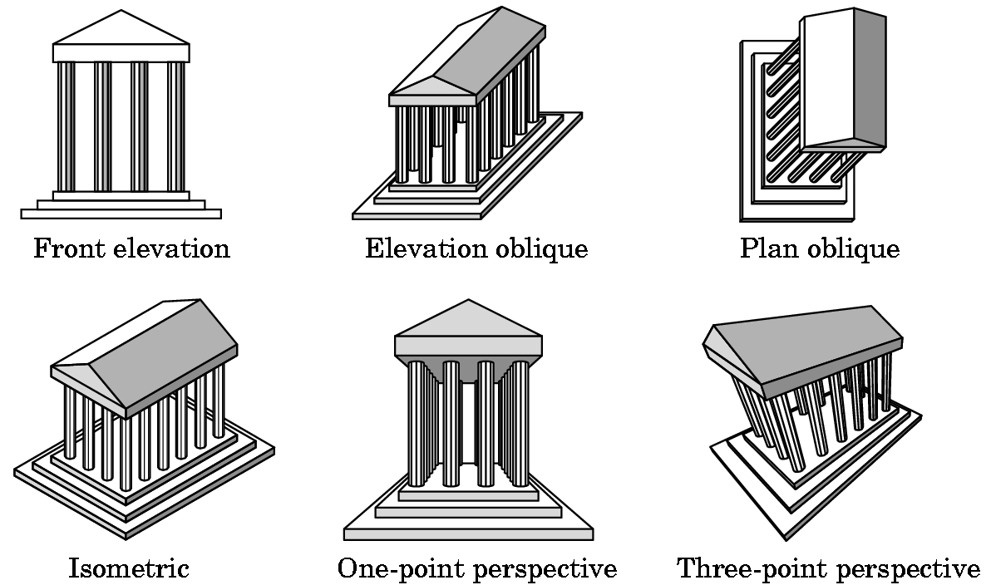
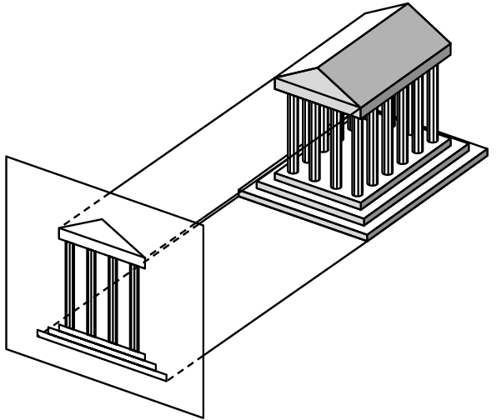
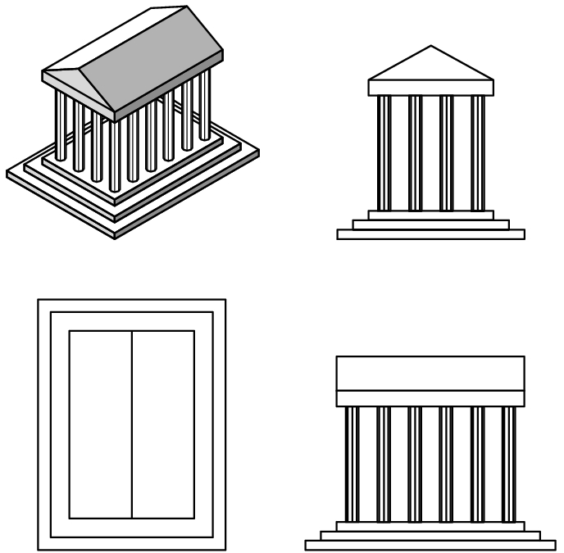
PROJECTION
Many kinds of projections exist. These can be developed in OpenGL, but only two kinds are supported directly:
orthographic
1-point perspective
We have been using the orthographic projection:

Slide 7
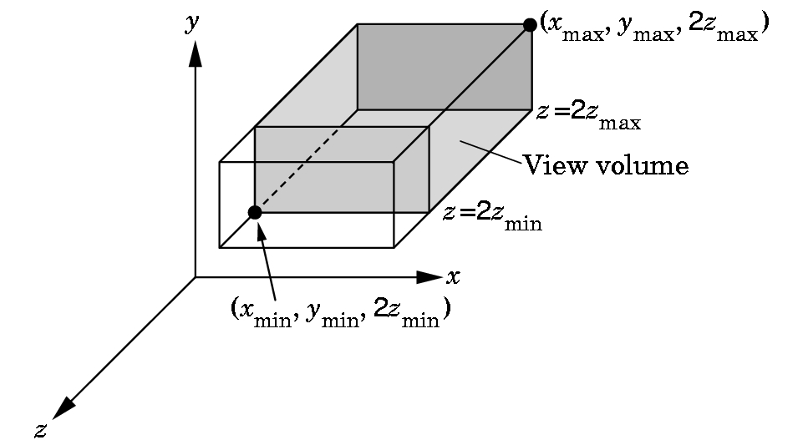
VIEWING VOLUME FOR ORTHOGRAPHIC PROJECTION
Note: Error in book and
(different) error on this
slide:
2z_{max} should be -far
2z_{min} should be -near
There is no restriction
on far and near other
than that far > near.
Set using
glOrtho(xmin, xmax,ymin,ymax,near,far);

Slide 8
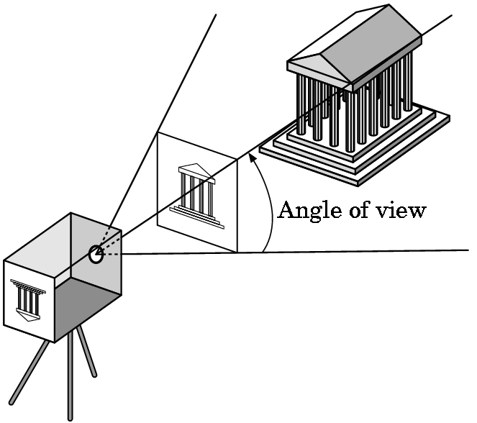
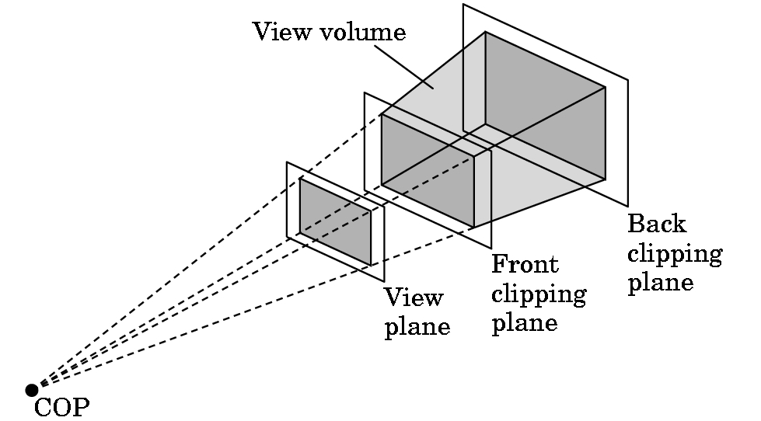
(1-point) PERSPECTIVE PROJECTION
Basic idea for defining the view volume:
Again, we have a front and back clipping plane:
COP = center of projection

Slide 9
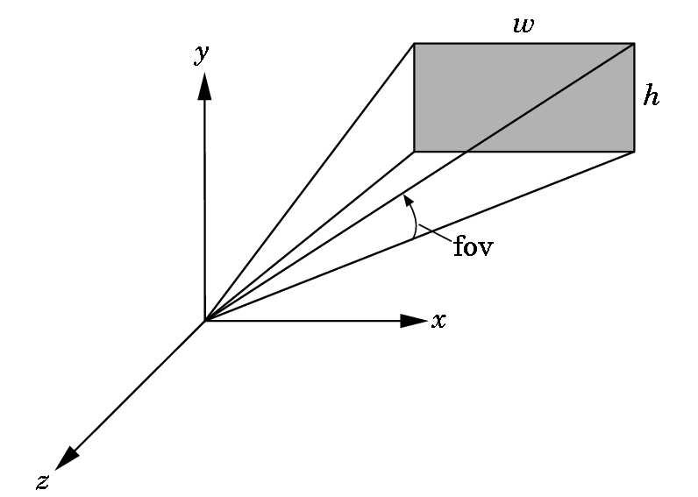
PERSPECTIVE PROJECTION
OpenGL has two functions for specifying perspective views.
The simplest one to use specifies the field of view (fov), the angle between the top and bottom planes:
The function is:
gluPerspective(fov, aspect, near, far);
Near and far are as with glOrtho.
The aspect ratio is the value of w/h.
Note the subtle change to a right-handed coordinate system.

Slide 10
gluPerspective(fov, aspect, near, far);
Typical values for field of view are between 60 to 30 degrees.
The larger the value, the greater the apparent depth effect.
Try experimenting with the value, however, as you can achieve some interesting effects with it---like changing the lens on a camera. A wide angle lens means a wide field of view.
Note that when the window is resized, the new width and height are provided so this function can easily be used to maintain the correct aspect ratio.

Slide 11
gluPerspective(fov, aspect, near, far);
Choosing values for near and far:
Don't choose these too far apart. Why?
The values in the depth buffer are normalized to the range 0.0 to 1.0.
The smaller the values that must be represented, the better differentiation that will occur in the calculated depth of objects.
If the far/near ratio isn't small, you might see round-off errors in the z-values. This produces z-fighting where pixels from various polygons that are close to the same depth are intermixed in the image.
But, if you don't see anything, spread your near and far apart. It is easy to choose wrong values.

Slide 12
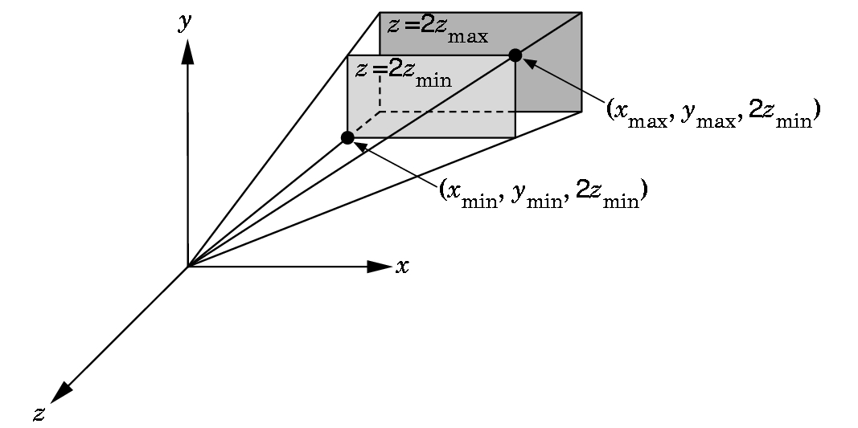
THE OTHER PERSPECTIVE COMMAND
The more powerful and more difficult to use command:
glFrustrum(xmin,xmax,ymin,ymax,near,far);
Note: Error in book and
(different) error on this
slide:
2z_{max} should be -far
2z_{min} should be -near
The near and far distances must be positive and are
measured from the COP to these planes, both of which must be parallel to the plane z = 0.

Slide 13
glFrustrum(xmin,xmax,ymin,ymax,near,far);
This is more powerful as you can have nonsymmetric viewing volumes.
Why is this more powerful?
For example, you might have the interior of a cockpit modeled, with two cockpit windows split by a vertical support.
Then you could have the left frustrum specify a distance -x as the left parameter and 0 as the right. The right frustrum could specify 0 as the left and x as the right. Then use two viewports to obtain the view.

Slide 14
WHEN DO WE SET THE PERSPECTIVE?
.
Changes to the model-view matrix move the world frame relative
to the camera.
These changes affect the camera's view of all objects defined afterwards as their vertices are specified relative to the repositioned world frame.
The projection and model-view matrices are part of the state.
When an object is drawn, the system uses the present state to obtain
the matrices to apply to it.
Thus, in reality, we change the state and then draw an object even though we might be imagining we are moving the object!

Slide 15
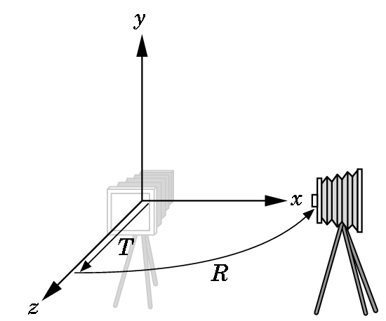
A TYPICAL SEQUENCE
glMatrixMode(GL_PROJECTION);
/* Now update the projection matrix. */
glLoadIdentity();
glFrustum(-3.0, 3.0, -3.0, 3.0, 1.0, 40.0);
glMatrixMode(GL_MODELVIEW);
/* Now update the modelview matrix. */
glPushMatrix(); //save old one
glLoadIdentity();
glTranslate(0.0, 0.0, -2.0); //recall that rotation is done first
glRotatef(-90.0, 0.0, 1.0, 0.0); //rotate around y-axis negative 90 degrees
render(); //a drawing routine
glPopMatrix();
Rotates the world frame
relative to the camera frame
then moves them apart:

Slide 16
MASTERING THE MODELVIEW MATRIX
Individually the transformations are easy to visualize.
Visualizing their interactions takes some practice.
Standard Example: Introduced in the original OpenGL Programming Guide:
  We want to model part of the solar system.
  Place sun in the center.
  The earth will rotate around the sun in a circular orbit in 365 days.
  The earth will rotate around its own axis in 24 hours.
  The moon will rotate around the earth in a circular orbit in 1/12 of year.
  The moon will rotate around its own axis, but it keeps its same side to the earth.
  We want the plane of the elliptic to be tilted slightly.

Slide 17
SOLAR SYSTEM PROGRAM LAYOUT
Main- as usual
  Double buffer
  Set up window on screen with title
  Call the initialization routine
  Register callback functions
  Enter main event loop.
Initialization Routine
  Set shading model (which we haven't talked about yet)
  Set background color
  Set depth buffer
  Enable depth testing

Slide 18
SOLAR SYSTEM PROGRAM LAYOUT
RESHAPE
  Set viewport
  Set perspective
For example:
h = (h==0) ? 1 : h; //set defaults
w= (w==0) ? 1 : w;
glViewport(0,0,w,h);
glMatrixMode(GL_PROJECTION);
glLoadIdentity();
gluPerspective(45.0f,(GLfloat)w/(GLfloat)h, 1.0f, 20,0f);
glMatrixMode(GL_MODELVIEW); //good idea to do here

Slide 19
SOLAR SYSTEM PROGRAM
//animation values
static int HourOfDay=0, DayOfYear = 0;
static int AnimateIncrement = 24;
// can be sped up or slowed down by mouse buttons
void mouse(int btn, int state, int x, int y){
/* Changes animation speed */
if(btn==GLUT_LEFT_BUTTON && state == GLUT_DOWN)
{ AnimateIncrement *=2;
if (0 == AnimateIncrement) AnimateIncrement = 1;
}
if(btn==GLUT_RIGHT_BUTTON && state == GLUT_DOWN)
AnimateIncrement /=2;
}

Slide 20
SOLAR SYSTEM PROGRAM---display
// clear the frame and depth buffers
glClear(GL_COLOR_BUFFER_BIT | GL_DEPTH_BUFFER_BIT);
//update animation parameters
HourOfDay += AnimateIncrement; //see previous slide for values and use
DayOfYear += HourOfDay/24;
HourOfDay = HourOfDay % 24; //keep in bounds
DayOfYear = DayOfYear % 365;
// tilt the elliptic plane and back the camera off the origin
glLoadIdentity();
glTranslatef(0.0f, 0.0f,-5.0f); //watch the order
glRotatef(5.0f, 1.0f, 0.0f, 0.0f);
// select color for sun and draw the sun as wireframe
glColor3f(1.0f, 1.0f, 1.0f); //assuming white sun
draw(1.0f) //a routine for drawing a sphere with radius 1

Slide 21
SOLAR SYSTEM PROGRAM---display
// move coordinate system to the location of earth and rotate in orbit
glRotatef( (GLfloat) (360.0*DayOfYear/365.0, 0.0f, 1.0f, 0.0f);
glTranslate(4.0f, 0.0f, 0.0f); //again, watch order
glPushMatrix(); //save so we can handle moon later
//the modelview matrix doesn't change until the next line
//rotate the earth - note this is done first, then the above
glRotatef((GLfloat) 360.0*HourOfDay/24.0, 0.0f, 1.0f, 0.0f);
//select color and draw earth
glColor3f(0.2f, 0.2f, 1.0f); //predominately blue- touch of yellow
draw(0.2f);
glPopMatrix(); //restore coordinate system for moon
//translate moon relative to earth and rotate it before drawing
glRotatef((GLfloat) 360.0*12.5*DayOfYear/365.0, 0.0f, 1.0f, 0.0f);
glTranslate(0.5f, 0.0f, 0.0f);
glColor3f(0.3f, 0.3f, 0.3f); //grey color
draw(0.05f);
//then flush pipeline and swap buffers //NOW all goes on screen

Slide 22
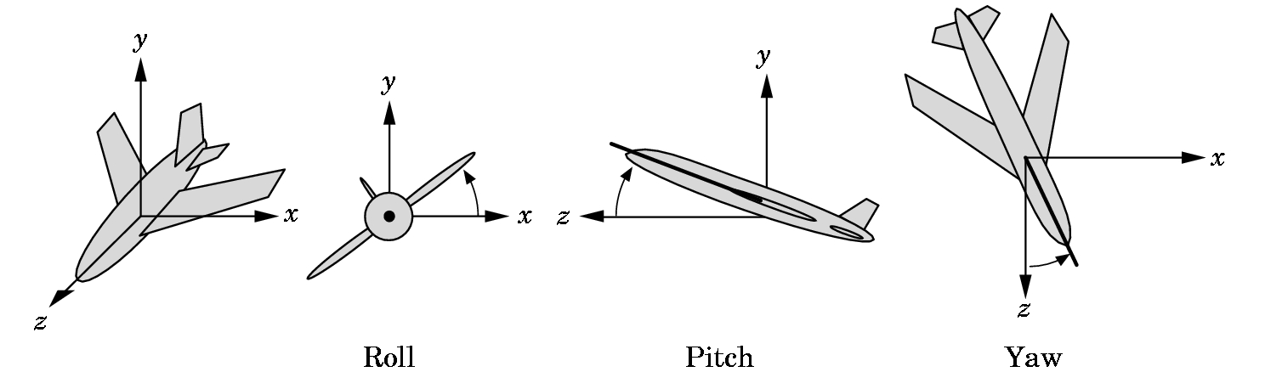
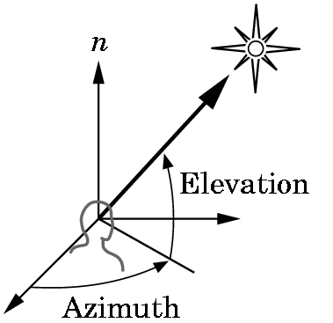
POSITIONING THE CAMERA
There are several ways to do this.
  Solar system example- an example of instance transformations that we discussed in Chapter 4 and are discussed further in Section 5.2
  LookAt vector method- handled shortly
  Two methods discussed in the problem set
    5.2 Motion in terms of roll, pitch, and yaw of an airplane
    5.3 Motion in terms of polar coordinates

Slide 23
POSITIONING THE CAMERA
OpenGL directly supports only some of the methods.
Other methods can be obtained if the programmer wishes to load the
necessary matrices directly.
We must be careful when doing animation. Where in a program we
define the position of the camera depends on which of the following we choose:
  Do we want to place the camera in a fixed position in a scene?
  Do we want the camera attached to a particular object?

Slide 24
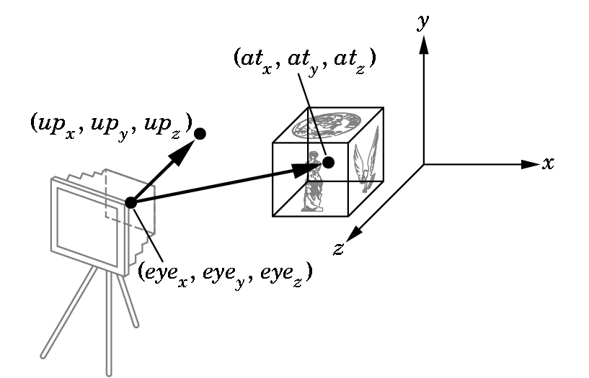
POSITIONING THE CAMERA with gluLookAt
The concept is simple and allows us to move our camera relative to an object:
gluLookAt(eyex, eyey, eyez, atx, aty, atz, upx, upy, upz);
alters the modelview matrix for a camera pointed along the given line.

Slide 25
gluLookAt
IS PARTICULARLY GOOD FOR CAMERA MOTION
To pan along a scene:
  Take the At point to be in a particular place.
  Calculate the eye to be a distance from that point.
  Then vary the At point to produce the pan.
To walk through a scene:
  Example A.11 page 562+ (or cubeview.c source code)
  In Chapter 4, the cube rotated about the origin.
  We used an orthographic projection so we just used the camera in a default direction.

Slide 26
cubeview.c
Now use perspective viewing and allow the viewer to move the camera by depressing the x, X, y, Y, z, and Z keys while pointing the camera always as the center of the cube using gluLookAt.
An array viewer[3] holds the camera position. Its contents are changed by keys in the text version:
void keys(unsigned char key, int x, int y){
/* Use x, X, y, Y, z, and Z keys to move viewer */
if(key == 'x') viewer[0]-= 1.0;
if(key == 'X') viewer[0]+= 1.0;
if(key == 'y') viewer[1]-= 1.0;
if(key == 'Y') viewer[1]+= 1.0;
if(key == 'z') viewer[2]-= 1.0;
if(key == 'Z') viewer[2]+= 1.0;
display();}

Slide 27
cubeview.c
Again, in my version , I included the mouse commands in the keys
function and dropped the mouse function so I could avoid the middle
mouse:
//added to keys to allow avoidance of the middle mouse button
if (key == '0') axis = 0; // select x axis
if (key == '1') axis = 1; // select y axis
if (key == '2') axis = 2; // select z axis
if ((key == '0') || (key == '1') || (key == '2'))
{theta[axis] += 2.0;
if( theta[axis] > 360.0 ) theta[axis] -= 360.0;
}

Slide 28
cubeview.c
We use gluLookAt in display:
static GLfloat theta[] = {0.0,0.0,0.0};
static GLint axis = 2;
static GLdouble viewer[]= {0.0, 0.0, 5.0};
/* initial viewer location */
void display(void){
glClear(GL_COLOR_BUFFER_BIT | GL_DEPTH_BUFFER_BIT);
/* Update viewer position in modelview matrix */
glLoadIdentity();
//recall keys change by +1(caps) or -1 eye; origin is at point; y-axis is up
gluLookAt(viewer[0],viewer[1],viewer[2], 0.0, 0.0, 0.0, 0.0, 1.0, 0.0);
/* rotate cube */
glRotatef(theta[0], 1.0, 0.0, 0.0);
glRotatef(theta[1], 0.0, 1.0, 0.0);
glRotatef(theta[2], 0.0, 0.0, 1.0);
colorcube();
glFlush();
glutSwapBuffers();}

Slide 29
cubeview.c
Reshape can select the perspective via glFrustrum or gluPerspective
void myReshape(int w, int h){
glViewport(0, 0, w, h);
/* Use a perspective view */
glMatrixMode(GL_PROJECTION);
glLoadIdentity();
if(w<=h) glFrustum(-2.0, 2.0, -2.0 * (GLfloat) h/ (GLfloat) w,
2.0* (GLfloat) h / (GLfloat) w, 2.0, 20.0);
else glFrustum(-2.0, 2.0, -2.0 * (GLfloat) w/ (GLfloat) h,
2.0* (GLfloat) w / (GLfloat) h, 2.0, 20.0);
/* Or we can use gluPerspective */
/* gluPerspective(45.0, w/h, -10.0, 10.0); */
glMatrixMode(GL_MODELVIEW);}

Slide 30
REMINDERS
TEST: Covers chapters 1-4 (notes, slides, class material, and I will have assumed you have run the programs we have discussed)
Given 1:30-3:30pm in H-203 (NOT H-214) on Tuesday, Feb 20, 2001. You will have the full amount of time but you may not need it.
No class on Thursday Feb 22
Look on web site in a few days for the next programming assignment.
Read Chapter 8. Then we will do Chapter 6.
Doing an IRC? - you should be coding!!!
Hopefully I'll have email contact, but I can't guarantee it! Usually I'll connect late at night.

