Slide 1
CHAPTER 6
LIGHT SOURCES

Slide 2
SHADING MODEL
A shading model dictates how light is scattered or reflected from a surface.
In graphics, we typical use two kinds of lights:
  point light sources - lights that shine on objects
  ambient light - light reflecting off of other surfaces
The amount of light reaching the synthetic camera must be calculated.

Slide 3
SHADING MODEL
The amount of light that reaches the eye is dependent upon many things:
  geometry of the surface specified, for example, by
    normal n to surface at a point p
    vector from p to viewer's eye
    vector s from p to light surface
  nature of the material
  the RGB components of the light
OpenGL is excellent as it allows you to play with different pieces and see what happens.

Slide 4
LIGHT IN REAL WORLD
Overview
RGB values for a pixel are not enough to give realistic pictures.
Need to handle light.
An object either
  emits light --- for example, a taillight
  or is illuminated by one of the different kinds of light
    ambient light
    diffuse light
    specular light

Slide 5
AMBIENT LIGHT
Doesn't come from a particular direction.
Has a source, but has bounced around so much it is directionless.
The intensity is the same at every point on the surface.
Often achieved through large sources that shine through a diffuser that scatters light in all directions.
Examples typical light from: cloudy day
moonlight
sunlight scattered by fog or haze

Slide 6
DIFFUSE LIGHT
Comes from a particular direction, but it is reflected evenly off of a surface.
Although the reflection is even, the surface is brighter if the light is pointed directly onto the surface rather than on an angle.
Examples are:
fluorescent lighting
noon sunlight streaming in a side window
(not a solid beam)

Slide 7
SPECULAR LIGHT
Directional like diffuse light, but it is reflected sharply and in a particular direction.
A high specular light often leaves a highlight on an object called the specular highlight.
Examples: spotlight
sun beam

Slide 8
LIGHTING- some facts
When light strikes an object, some of it is reflected and the rest is absorbed as heat.
For example, a red surface absorbs all of the light components except the red ones which are what your eye sees. Color is really a reflection property.
Moreover, light is made up of different parts of the 3 types:
specular
diffuse
ambient

Slide 9
AN EXAMPLE
A RED LASER BEAM IN A LABORATORY
Composed almost entirely of a pure red specular component of the light.
• But, smoke or dust particles scatter the beam so it
can be seen traveling across the room. Scattering
represents the diffuse component of the light.
• If the beam is bright and no other light sources are
present, you might notice objects in the room taking
on a red hue. This would be a very small ambient
component of the light.

Slide 10
AN EXAMPLE
A RED LASER BEAM IN A LABORATORY
In OpenGL, and many graphics packages, we can specify the different components of light for each gun by specifying a number in the range of 0.0 (none) to 1.0.
For the red laser beam in a laboratory, the laser light
source may be specified as using
  green and blue guns have components of 0.0
  the red gun might be specified as
    specular 0.99
    diffuse 0 .10
    ambient 0.05

Slide 11
SPECIFYING LIGHT SOURCES IN OPENGL
You can specify 8 light sources named GL_LIGHT0 to GL_LIGHT7.
Properties of the light sources are specified using: :glLightfv(sourcename, propertyname,vectorsettings);
After setting the properties you must enable each light: glEnable(GL_LIGHT0);
Each light source you use requires both commands.

Slide 12
SPECIFYING LIGHT SOURCES IN OPENGL
glLightfv(sourcename, propertyname,vectorsettings)
Some of the property names and values to specify are:
  GL_AMBIENT R,G,B,alpha components as GLfloat
  GL_DIFFUSE "
  GL_SPECULAR "
  GL_POSITION A homogeneous coordinate. Use 0 in last slot for a true position; use 1 for infinitely far away.
  GL_SPOT_DIRECTION vertex of vector
  GL_SPOT_CUTOFF angle cutoff to allow a true spot.If not used, it defaults to 180 degrees.

Slide 13
GOOD SOURCES OF EXAMPLES YOU CAN RUN AND LOOK AT THE CODE
On web site: dinoshade.c, lightlab.c,spots.c
Example:
Glfloat ambient[] ={0.3f, 0.3f, 0.3f, 1.0f};
Glfloat diffuse[] ={0.7f, 0.7f, 0.7f, 1.0f};
Glfloat pos[] ={-50.0f, 50.0f, 100.0f, 1.0f};
glLightfv(G L_LIGHT0, GL_AMBIENT, ambient);
glLightfv(GL_LIGHT0, GL_DIFFUSE, diffuse);
glLightfv(GL_LIGHT0, GL_POSITION, pos);
glEnable(GL_LIGHT0);
Gives a moderately white light, upper left, slightly behind
the viewer. (at origin looking down the -z axis)
To model bright sunlight,
add a specular component of 1,1,1,1.

Slide 14
MATERIAL PROPERTIES
LIGHT PROPERTIES ARE NOT ENOUGH
Given a light, different materials reflect the light differently.
Material settings are set as with light settings:
  glMaterialfv(whichfaces, property, settings);
Properties are GL_DIFFUSE, etc.
plus GL_SHININESS in the range 1 to 128.
Whichfaces are GL_FRONT, GL_BACK, GL_FRONT_AND_BACK
As with all OpenGL commands, before you draw an
object, set its material properties and be sure your light
properties are set.

Slide 15
DIFFUSE REFLECTOR
BRIGHTNESS DEPENDS UPON:
The components of white light it reflects.
The strength of the ambient and direct light striking the surface.
The position of the direct light sources.
The orientation of the reflecting surface relative to the direct light source.
The type of surface.
Note:Reflected light is scattered in all directions for a
diffuse surface.
Matte surfaces such as flat paint and ordinary paper
are predominately diffuse reflectors.

Slide 16
SPECULAR REFLECTOR
BRIGHTNESS DEPENDS UPON:
The strength of directional light sources.
The position of directional light sources.
The orientation of the surface with respect to the light sources.
The position of the viewer.
The surface roughness.
Note: Highlights are the result of light being scattering in a narrow range of angles close to angle of reflection.
A mirror is an example of a perfect specular reflector.
Shiny plastic exhibits both diffuse and specular reflection,
but the specular component is high.

Slide 17
TRANSLUCENT SURFACES
Allow some light to penetrate the surface and emerge from another location on the light.
Some light might be reflected at the surface.
Water and glass are translucent surfaces.
Translucent properties are set with the alpha channel, the fourth component in the color settings. We'll discuss details of these settings in Chapter 9.
Different material properties can be seen on Plate 25.

Slide 18
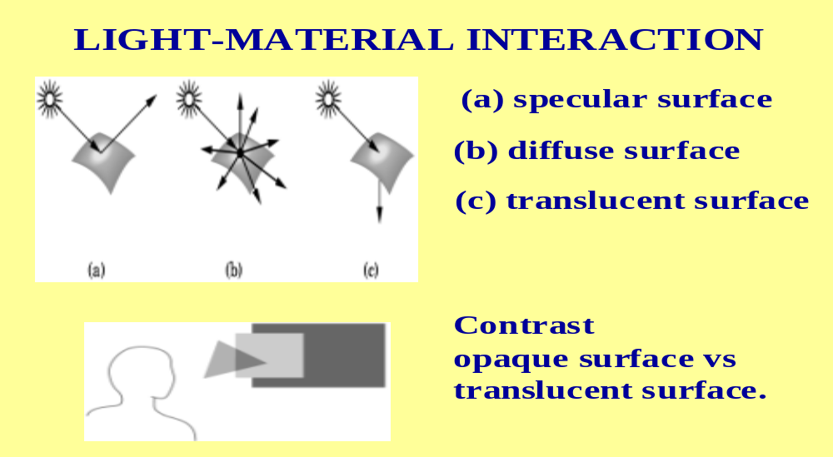
INTERACTIONS OF THE SETTINGS

Slide 19
CHOOSING VALUES FOR LIGHT AND MATERIALS
Light:
    1.0 brightest
    0.5 half intensity
    0.9 none
Material:
    1.0 reflects the color completely
    0.5 reflects half the color
    0.0 reflects none of the color

Slide 20
MATERIAL SETTINGS DETERMINE WHETHER AN OBJECT "LOOKS RIGHT" OR NOT
Brass:
    0.33, 0.22, 0.03, 1.0 ambient
    0.78, 0.57, 0.11, 1.0 diffuse
    0.99, 0.91, 0.81, 1.0 specular
    27.8 shininess
Red plastic:
    0.0, 0.0, 0.0 ambient
    0.5, 0.0, 0.0 diffuse
    0.7, 0.6, 0.6 specular
    32 shininess

Slide 21
SELECTING MATERIAL PROPERTIES
Ambient light: Defines the dominant color when no direct light is on that part of the surface.
Diffuse light: Defines the dominant color when the surface is illuminated.
For most physically-based materials or real-world materials these are the similar values.

Slide 22
SELECTING MATERIAL PROPERTIES
Specular light: Determines the color of the highlights shown.
Colored glass with white light on it has highlights the same color as the glass. So, set this to the same as the object's ambient and diffuse light.
But, highlights for chrome reflect the color of the light shining on it. So set this to the same as the light's color.
Shininess: Controls the focus of the highlight. A low value spreads the reflection over the surface while a high value concentrates the highlight making it smaller and brighter.

