Slide 1
CHAPTER 8
WORKING WITH MODELS
Sections 8.1-8.4 only at this time

Slide 2
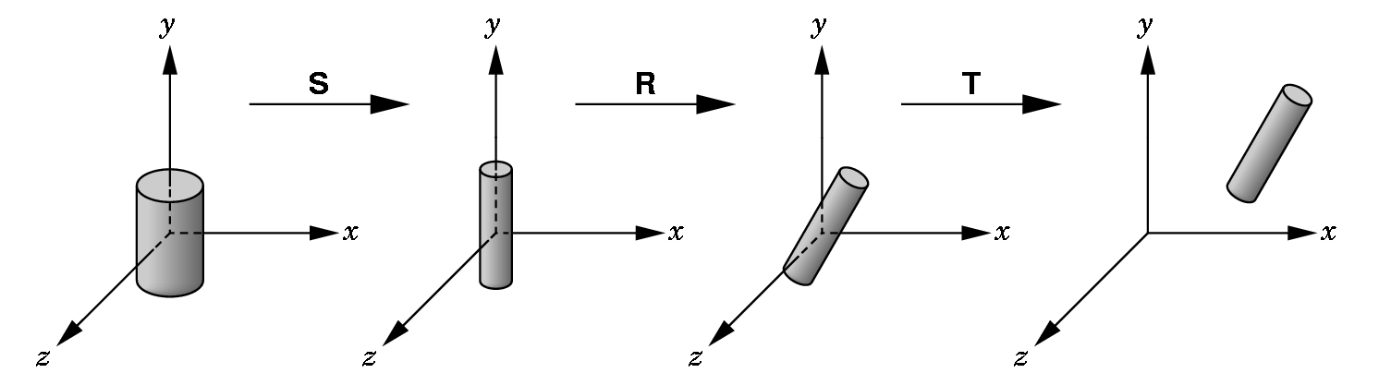
ALREADY WE HAVE SEEN WE CAN MODEL WITH OBJECTS
And we move the objects into the proper place with
  scale
  rotate
  translate

Slide 3
SO WE OFTEN SEE CODE SUCH AS
glMatrixMode(GL_MODELVIEW);
glLoadIdentity();
glTranslatef(…);
glRotatef(…);
glScalef(…);
glutSolidCylinder(…);
These are called instance transformations.
But, what if we wish to build hierarchical models--- i.e. models composed of different components that work together?

Slide 4
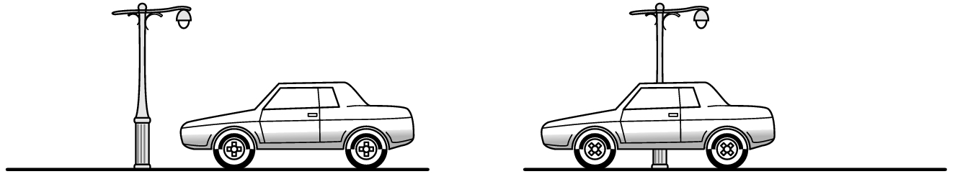
AN EXAMPLE OF A HIERARCHICAL MODEL- A CAR
When doing animation, we DON'T want to write code such as:
calculate speed s
calculate direction d
draw right front wheel using s and d
draw right back wheel using s and d
draw left front wheel using s and d
draw left back wheel using s and d
draw chassis using s and d
THE PROBLEM IS WE ARE NOT EXPLOITING THE RELATIONSHIPS INHERENT IN THE MODEL!

Slide 5

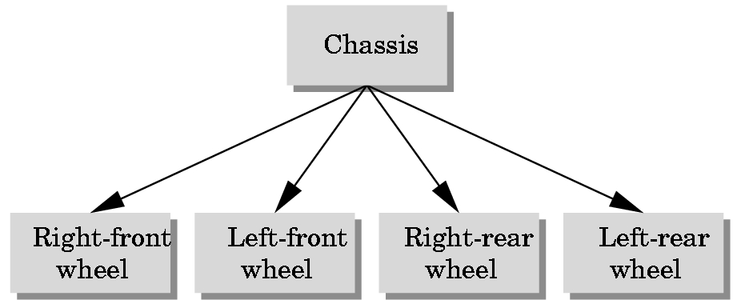
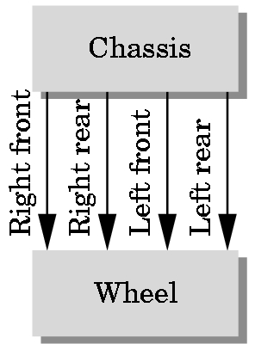
RELATIONSHIPS IN THE MODEL
The motion of the wheels and the motion of the chassis are tied together.
The 4 wheels are all the same--- they are just in different positions and orientations/
We use the concepts of graph theory to represent the relationships between different elements in the physical world:
Two possible representations: A tree structure and DAG (directed- acyclic graph)

Slide 6
GRAPH THEORY DEFINITIONS
A graph is a set of nodes (or vertices) and a set of edges.
Edges connect pairs of nodes or a node to itself.
Edges can have a direction associated with them; such graphs are called directed graphs.
•
•
•
• An undirected graph assumes no orientation on the edges:
•
• •
directed graph
undirected graph

Slide 7
GRAPH THEORY DEFINITIONS
A (connected) tree is a directed graph without closed paths or loops.
Each node, except one which is called the root node has one edge entering it.
Thus, every node, except the root node, has a unique parent node.
Each parent node can have one or more child nodes.
A node without a child is a terminal node or a leaf node.

Slide 8
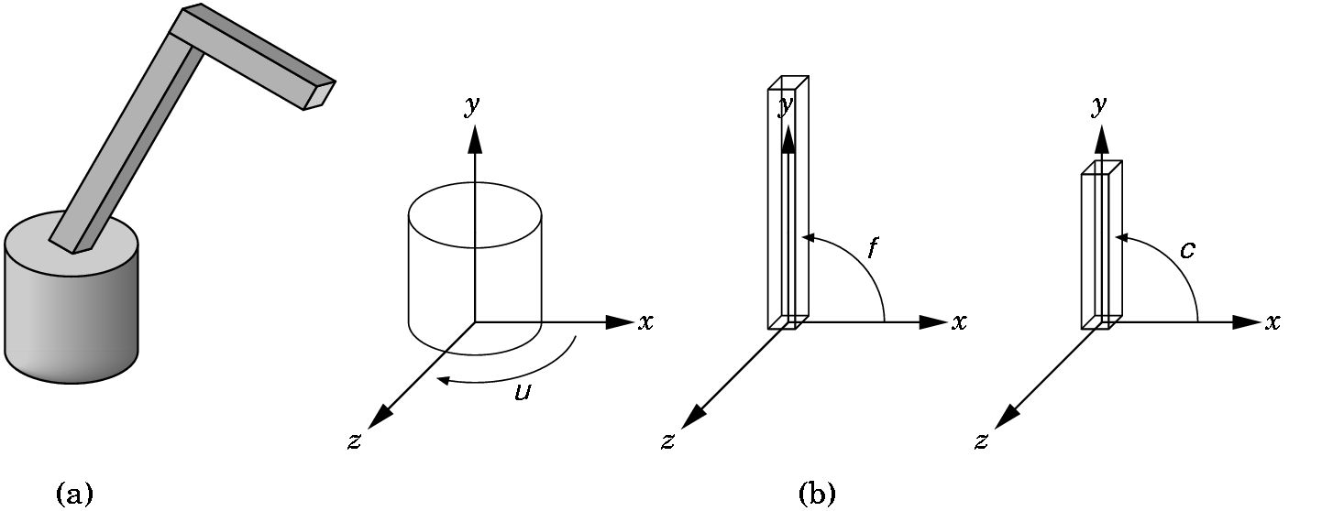
MODELING A ROBOT ARM
(a) The complete model
(b) The component parts modeled from a cylinder and two parallelepipeds (i.e. scaled cubes!).
The arm has 3 degrees of freedom which can be described by the 3 angles shown. By varying the angles, we can position the arm in 3 dimensional space.

Slide 9
MODELING A ROBOT ARM
BASE:Sits on xz-plane with y = 0.
Can rotate by angle μ from the x-axis to some point on base around y-axis.
When we choose μ ,we'll use R_{y}(μ) for positioning.
LOWER ARM:
Parallelepiped sitting on top of the base.
To place it in the proper place, we must translate it using T(0,h,0), where h is the height off of the base.
Then we must position it using R_{z}(f).

Slide 10
MODELING A ROBOT ARM
Note: If the base moves by R_{y}(μ), then the lower arm moves by R_{y}(μ)*T(0,h,0)
So, every time we move the lower arm by an angle f, we must
use the following matrix to control the lower arm:
R_{y}(μ)*T(0,h,0)*R_{z}(f)
UPPER ARM: The same ideas apply. It's motion matrix is R_{z}(c), but relative to the others, we must use
R_{y}(μ)*T(0,h₁,0)*R_{z}(f)*T(0,h_{2,}0)* R_{z}(c)
where h₁ and h₂ are the necessary heights. Note that h₁ was h.

Slide 11
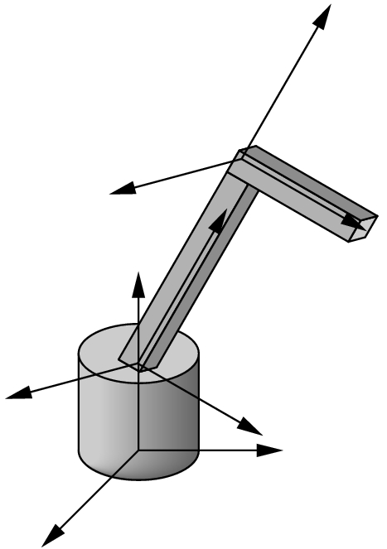
MODELING A ROBOT ARM
Note that we are thinking of different frames initially. Then the frames are moved.
R_{y}(μ)*T(0,h₁,0)*R_{z}(f)*T(0,h_{2,}0) *R_{z}(c)
translates into the drawing code:
display() {
glRotate(theta[0], 0.0,1.0, 0.0); //y rotation of angle mu
base();
glTranslate(0.0,h1,0.0);
glRotate(theta[1],0.0,0.0,1.0); //z rotationof angle f
lower_arm();
glTranslate(0.0,h2,0.0);
glRotatef(theta[2],0.0,0.0,1.0); //z rotation of angle c
upper_arm();}

Slide 12
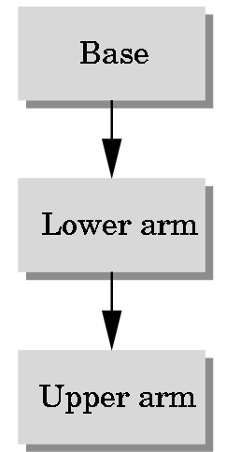
MODELING A ROBOT ARM
We model the robot arm as a simple tree:
Code for a program that moves the robot arm can be found at the text site as robot.c:
/* Robot program (Chapter 8).
Cylinder for base, scaled cube for arms
Shows use of instance transformation to define parts (symbols) The cylinder is a quadric object from the GLU library
The cube is also obtained from GLU */

Slide 13
THE GLU LIBRARY
Many shapes are available in the GLU library. Check the OpenGL documentation. They are called quadric objects and all have a similar form:
In your init routine declare an object and allocate space:
p=gluNewQuadric(); // allocate quadric object gluQuadricDrawStyle(p, GLU_LINE); // render it as wireframe
Each drawing object has a different format
gluCylinder(GLUquadricObj *obj, //this would be the p above
GLdouble baseRadius,
GLdouble topRadius, //if same, have true cylinder
GLdouble height,
GLint slices, //number of sides
GLint stacks) //number of chunks shown
Runs along z-axis with (0,0,0) center of base and (0,0,height) as center of top.

Slide 14
GLUT LIBRARY
Some objects are defined in the GLUT library, also. Check the GLUT documentation. For example, the cubes are modeled with
glutWireCube(1.0);
which draws a wireframe cube at the origin with sides of length 1.0.
Code is straightforward if you remember that instance transformations are made relative to the other parts of the arm:
The drawing routines scale and translate:

Slide 15
/* Define the three parts. Note the use of push/pop to return the modelview
matrix to its state before functions are entered. Rotation, translation, and scaling is used to create instances of symbols (cube and cylinder) */
void base(){
glPushMatrix();
/* rotate cylinder to align with y axis */
glRotatef(-90.0, 1.0, 0.0, 0.0);
/* cylinder aligned with z axis, render with 5 slices for base and 5
along length */
gluCylinder(p, BASE_RADIUS, BASE_RADIUS, BASE_HEIGHT, 5, 5);
glPopMatrix();}

Slide 16
void upper_arm(){
glPushMatrix();
glTranslatef(0.0, 0.5*UPPER_ARM_HEIGHT, 0.0);
glScalef(UPPER_ARM_WIDTH, UPPER_ARM_HEIGHT,
UPPER_ARM_WIDTH);
glutWireCube(1.0);
glPopMatrix();}
void lower_arm(){
glPushMatrix();
glTranslatef(0.0, 0.5*LOWER_ARM_HEIGHT, 0.0);
glScalef(LOWER_ARM_WIDTH, LOWER_ARM_HEIGHT,
LOWER_ARM_WIDTH);
glutWireCube(1.0);
glPopMatrix();}

Slide 17
The display is similar to what we had before:
void display(void){
/* Accumulate ModelView Matrix as we traverse tree */
glClear(GL_COLOR_BUFFER_BIT);
glLoadIdentity(); //M= I
glColor3f(1.0, 0.0, 0.0);
glRotatef(theta[0], 0.0, 1.0, 0.0); //M = I*R_{y}(theta[0])
base();
//push matrix M above
//define instance rotation //M= I*R_{y}(theta[0])*R_{x}(-90)
//draw base using M
//pop matrix // M= I*R_{y}(theta[0])
glTranslatef(0.0, BASE_HEIGHT, 0.0);
glRotatef(theta[1], 0.0, 0.0, 1.0);
lower_arm(); //be sure you see how this is done
glTranslatef(0.0, LOWER_ARM_HEIGHT, 0.0);
glRotatef(theta[2], 0.0, 0.0, 1.0);
upper_arm(); //and this one also
glFlush();
glutSwapBuffers();}

Slide 18
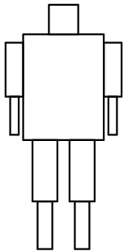
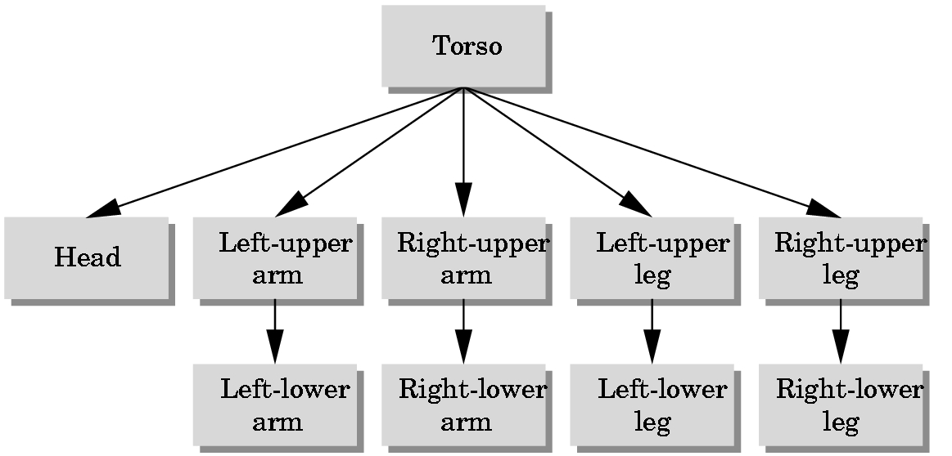
MORE COMPLEX SCENES
ARTICULATED FIGURES
Once you understand the basic idea, it is easy to model complex interrelated objects. For example.
figure
tree representation of figure

Slide 19
ROBOT :
  Head is sphere
    Use gluSphere
  All other parts will be cylinders.
    Use gluCylinder
  As before, write code for producing instances of each part:
  Define each part:
  GLUquadricObj *t, *h, *lua, *lla, *rua, *rla, *lll, *rll, *rul, *lul;
For example, t = torso, h = head, lua = left upper arm, etc.

Slide 20
SAMPLE INSTANCE CODE FOR ROBOT
Note: These are solid. Ignore lighting stuff now
void head(){
glPushMatrix();
glTranslatef(0.0, 0.5*HEAD_HEIGHT,0.0);
glScalef(HEAD_RADIUS, HEAD_HEIGHT, HEAD_RADIUS);
gluSphere(h,1.0,10,10); //recall h is object. 1.0 is radius
glPopMatrix();}
The first 10 in gluSphere is the number of slices (like longitude) and
second 10 is the number of stacks (like latitude).
All limbs are just handled by setting the cylinders upright:
void left_upper_arm(){
glPushMatrix();
glRotatef(-90.0, 1.0, 0.0, 0.0);
gluCylinder(lua,UPPER_ARM_RADIUS, UPPER_ARM_RADIUS,
UPPER_ARM_HEIGHT,10,10);
glPopMatrix();}

Slide 21
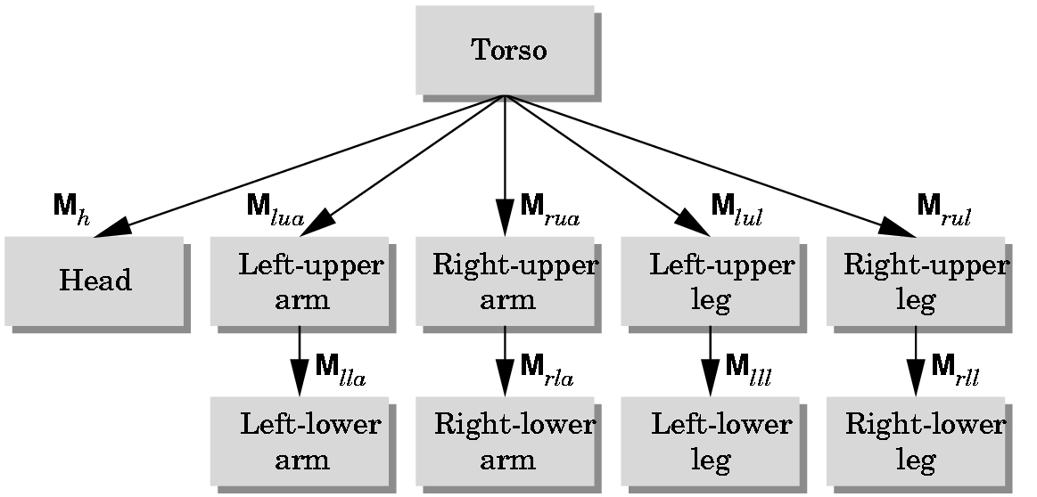
NOW WE HAVE TO DRAW THE FIGURE ITSELF
Consider the model's tree structure:
We will traverse the tree using a preorder traversal - pushing the Modelview matrix as we start down the tree and popping the matrix as we move back to the root.
Each matrix M_{abc} is formed and post multiplied into the current Modelview matrix before the instance is drawn at the node.

Slide 22
PREORDER TRAVERSAL OF A TREE
Recursive:
Process node
Process tree with the leftmost child as the root
Process tree with the next child (in a left to right ordering) as the root.
...
Process tree with the rightmost child as the root
For example, a preorder traversal of the robot representation would process the nodes in the order
t, h, lua, lla, rua, rla, lul, lll, rul, rll

Slide 23
void display(void){ //we'll do a preorder traversal of the tree below
glClear(GL_COLOR_BUFFER_BIT|GL_DEPTH_BUFFER_BIT);
glLoadIdentity();
glColor3f(1.0, 0.0, 0.0);
glRotatef(theta[0], 0.0, 1.0, 0.0); //left-right torso motion
torso();
glPushMatrix(); //save torso matrix as go down tree
glTranslatef(0.0, TORSO_HEIGHT+0.5*HEAD_HEIGHT, 0.0);
glRotatef(theta[1], 1.0, 0.0, 0.0); //up-down head motion
glRotatef(theta[2], 0.0, 1.0, 0.0); //right-left head motion
glTranslatef(0.0, -0.5*HEAD_HEIGHT, 0.0);
head();
glPopMatrix(); //restore matrix for torso
form
M_{h}
Above processes
Torso and
Head

Slide 24
glPushMatrix(); //save torso matrix
glTranslatef(-(TORSO_RADIUS+UPPER_ARM_RADIUS),
0.9*TORSO_HEIGHT, 0.0);
glRotatef(theta[3], 1.0, 0.0, 0.0); //up-down arm motion
left_upper_arm();
form
M_{lua}
glTranslatef(0.0, UPPER_ARM_HEIGHT, 0.0);
glRotatef(theta[4], 1.0, 0.0, 0.0);
left_lower_arm();
form
M_{lla}
glPopMatrix(); //restore matrix for torso
glPushMatrix(); //save it again
glTranslatef(TORSO_RADIUS+UPPER_ARM_RADIUS,
0.9*TORSO_HEIGHT, 0.0);
glRotatef(theta[5], 1.0, 0.0, 0.0);
right_upper_arm();
form
M_{ruaa}
etc for the rest of the tree

Slide 25
glTranslatef(0.0, UPPER_ARM_HEIGHT, 0.0); glRotatef(theta[6], 1.0, 0.0, 0.0); right_lower_arm(); glPopMatrix(); glPushMatrix(); glTranslatef(-(TORSO_RADIUS+UPPER_LEG_RADIUS), 0.1*UPPER_LEG_HEIGHT, 0.0); glRotatef(theta[7], 1.0, 0.0, 0.0); left_upper_leg(); glTranslatef(0.0, UPPER_LEG_HEIGHT, 0.0); glRotatef(theta[8], 1.0, 0.0, 0.0); left_lower_leg(); glPopMatrix(); glPushMatrix(); glTranslatef(TORSO_RADIUS+UPPER_LEG_RADIUS, 0.1*UPPER_LEG_HEIGHT, 0.0); glRotatef(theta[9], 1.0, 0.0, 0.0); right_upper_leg(); glTranslatef(0.0, UPPER_LEG_HEIGHT, 0.0); glRotatef(theta[10], 1.0, 0.0, 0.0); right_lower_leg(); glPopMatrix(); glFlush(); glutSwapBuffers();}

