Slide 1
CHAPTER 9
DISCRETE TECHNIQUES
(Texture mapping, antialiasing, compositing, and alpha blending)

Slide 2
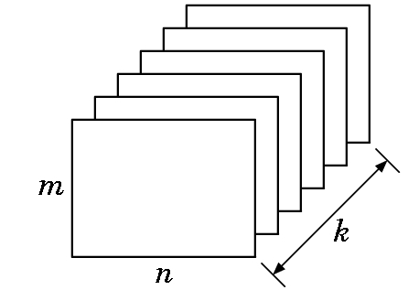
BUFFERS
Buffer: - A block of memory with a spatial resolution of n X m k-bit elements:
Bitplane: Any of planes
Pixel: All k elements at
given spatial location.
For the frame buffer,
n and m are screen resolution values
k is color depth.
For the depth buffer,
n and m are screen resolution values
k is the depth resolution that the system will support.

Slide 3
MAPPINGS
If we model an orange by only using a sphere and distorting it, it may not look right since an orange has
  imperfections
  bumps
  a slightly irregular shape
One approach is to try to model it exactly with curves (which will look at shortly).
But, a simpler means is to use
  a simple model (such as the sphere)
  a mapping of an image to the surface

Slide 4
MAPPINGS
Some of the kind of mappings are:
Texture mapping
  Uses a pattern (called a texture) to determine the color of part of an image
Bump mapping
  Distorts the shape of a surface to create variations
Reflection or environmental mapping
  Allows us to create images that look like ray traced examples.

Slide 5
MAPPINGS
All 3 methods have some common concepts:
  Alter shading of individual pixels
  Implemented as part of the shading process
  Rely on the map being stored as a 1D, 2D, or 3D image
  All are subject to aliasing errors
  All cause lighting to change in somewhat strange ways.
  None are simple 1-2-3 step processes as the images being used for texturing can be in many different formats and each is handled differently.

Slide 6
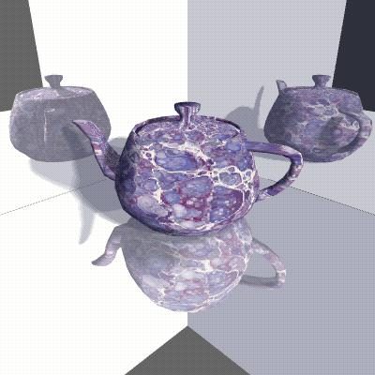
Teapot is a texture mapped image.
The reflections are reflection or environmental mapped images.

Slide 7
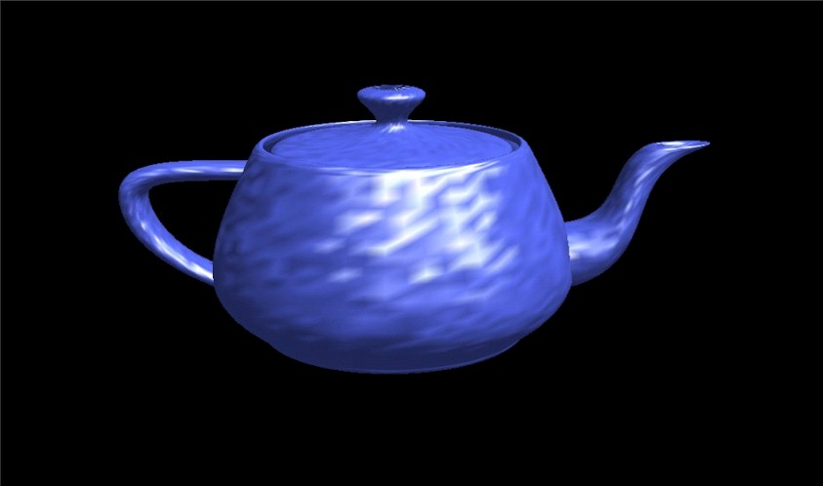
A bumped mapped image.

Slide 8
OPENGL AND TEXTURE MAPS
Texture mapping is one of OpenGL's most productive features, and one of the reasons so many of today's games use OpenGL for 3D drawing.
Once one loads an RGB or RGBA texture from an image file or other source, OpenGL makes it somewhat simple to filter, scale, and manage 2D texture maps.
The difficult part is really the loading of the image!

Slide 9
TEXTURING TASKS
Obtain an image- this is easy
Load image- this can be a pain since there are so many possible formats
Generate texture coordinates- rather straightforward
Filter- can become complicated if you want very unusual effects, but for flat maps, this is not hard
Apply to application

Slide 10
2D TEXTURE MAPPING-
Obtain the image
You can do texture mapping in any dimension (even 4D!), but the 3D methods require high-end hardware.
So, we'll concentrate on 2D mappings.
Ultimately we need a pattern stored in an n X m array of what are called texture elements or texels.
The pattern can be either
generated
or read in from a file

Slide 11
IN THE BOUNCING DINOSAUR
/* Nice floor texture tiling pattern. */
static char *circles[] = {
"....xxxx........",
"..xxxxxxxx......",
".xxxxxxxxxx.....",
".xxx....xxx.....",
"xxx......xxx....",
"xxx......xxx....",
"xxx......xxx....",
"xxx......xxx....",
".xxx....xxx.....",
".xxxxxxxxxx.....",
"..xxxxxxxx......",
"....xxxx........",
"................",
"................",
"................",
"................",
};
The pattern was generated.
See the code for details.

Slide 12
USING AN EXISTING IMAGE
Clearly the most common approach.
Sources of images:
  Many sites on the nets contain images that are free to use
  Or, you can scan your own picture
  Or, use a digital camera.
Be sure, however, that you are not violating copyrights. Some examples of sites:
  http://www.aaabackgrounds.com/
  http://www.3dcafe.com/asp/textures.asp
  http://members.aol.com/slpryfox/textures/page2.html
  There are many of these--- you can find almost any texture you might desire.

Slide 13
LOADING THE IMAGE
Images can be stored in a bewildering number of formats:
JPEG- Joint Photographic Experts Group
  Supports high color and image resolution
  Consumes little file space
  Offers a choice of the percentage of full qualityin which you want to store the image
  Very good file compression --- i.e. small file usually results
  Lossy compression --- i.e. some quality is lost
  Used by many web applications
BMP- Windows Bitmap
  Not a compression format so full quality.
  Just an image displayed as an array of colored dots or pixels in the Windows environment.

Slide 14
FILE FORMATS
TIFF-Tagged Image File Format
  Used by both Windows and Macs
  Another non-compressed, full quality format
  Good for maintaining the fidelity of an image when doing a scan, for example.
GIF- Graphics Image Format
  Defined by Compuserve
  A compression format that uses the LZW (Lempel-Ziv-Welch) compression algorithm that is quite sophisticated.
  Has been the center of a lot of lawsuits.
Specs say GIF is pronounced "jif" as in "jiffy"; but many pronounce it with the hard "g" as in "graphics"!

Slide 15
FILE FORMATS
TGA- Targa
  One I will use for texturing
  It is cross platform
  It can be generated from other formats by photoshop
Other formats could be used, but you need an operative loading program.
Don't get the idea that these are the only file formats around !

Slide 16
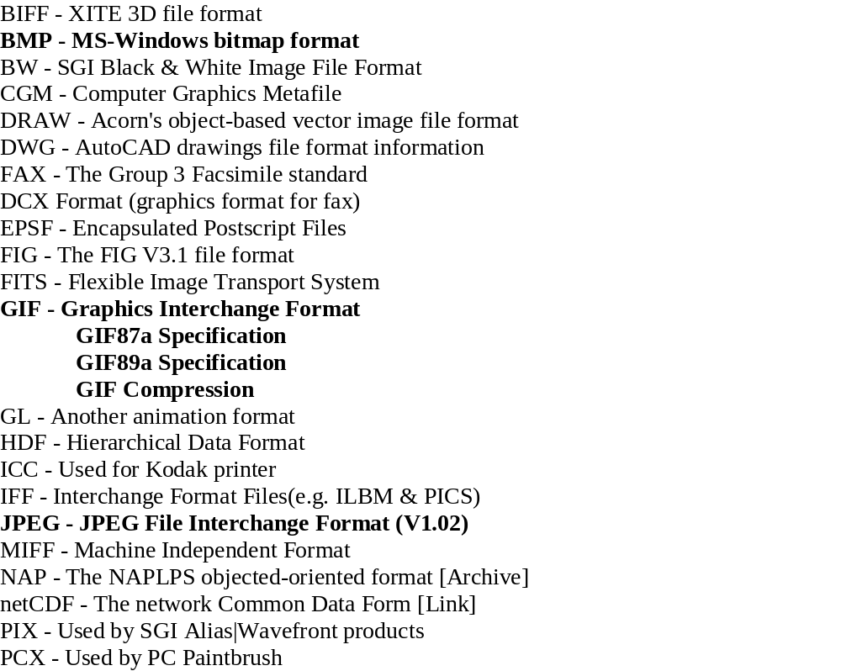
SOME FILE FORMATS

Slide 17
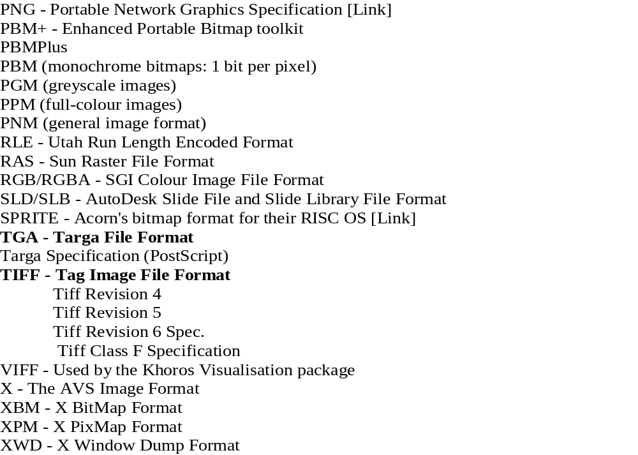
AND SOME MORE FILE FORMATS!

Slide 18
TARGA FORMAT
Type: Bitmap Extension: .tga
Color Depth: 1- to 32-bits (8, 16, 24, and 32 typical)
Maintainer: Truevision Inc.
Specification:
  The TGA format is one of the most widely used bitmap file formats for the storage of 24- and 32-bit truecolor images.
  TGA supports colormaps, alpha channel, gamma value, postage stamp image, textual information, and developer-definable data.
See the following for a peek at the format specifications:
http://astronomy.swin.edu.au/pbourke/dataformats/tga/

Slide 19
The header (18 bytes) might be defined as follows for C/C++. You should be
careful with this since it has byte values which some compilers will align to natural
boundaries. This is checked by printing the sizeof(HEADER); if it greater than 18,
then byte alignment is taking effect and a fread() using the struct below will not
give the right results. In that case you either need to read your compiler manual and
turn off boundary alignment, of read the components one at a time.
typedef struct {
char idlength; // length of a string located after the header
char colormaptype;
char datatypecode; //targa format code- see next slide
short int colormaporigin;
short int colormaplength;
char colormapdepth;
short int x_origin;
short int y_origin;
short width;
short height;
char bitsperpixel; //size of each color value
char imagedescriptor;
} HEADER;

Slide 20
All Targa formats are identified by a Data Type field, which is a one byte binary
integer located in byte three of the file. These data types are:
0 - No image data included.
1 - Uncompressed, color-mapped images.
2 - Uncompressed, RGB images.
3 - Uncompressed, black and white images.
9 - Runlength encoded color-mapped images.
10 - Runlength encoded RGB images.
11 - Compressed, black and white images.
32 - Compressed color-mapped data, using Huffman, Delta, and
runlength encoding.
33 - Compressed color-mapped data, using Huffman, Delta, and
runlength encoding. 4-pass quadtree-type process.
For the bitsperpixel: When 24 or 32 the normal conventions apply. For 16 bits each
color component is stored as 5 bits and the remaining bit is a binary alpha value.
The color components are converted into single byte components by simply shifting
each component up by 3 bits (multiply by 8).

Slide 21
CONVERTING OTHER FORMATS TO TGA FORMAT
Write your own conversion program.
Find a conversion program on the nets and use that.
Use some existing software such as Adobe Photoshop. Even old versions do quite well.
  For example, if Photoshop can open the file, you can save it in Targa format by using
    file => save as => other => select Targa

Slide 22
ONE OF THE FIRST HURDLES--- THE INPUT OF THE IMAGE TO MEMORY
Too often you see:
"This article will cover the basics of texture mapping in
OpenGL. This includes the uploading of the texture to the
video memory and the application of the texture onto
geometry. This article will not cover the actual loading
of the texture data itself. That is left up to the reader."

