Slide 1
SOME SPECTACULAR EXAMPLES

Slide 2
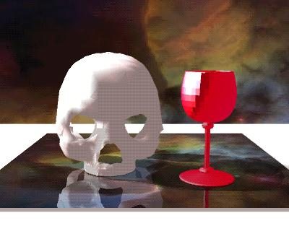

Slide 3


Slide 4
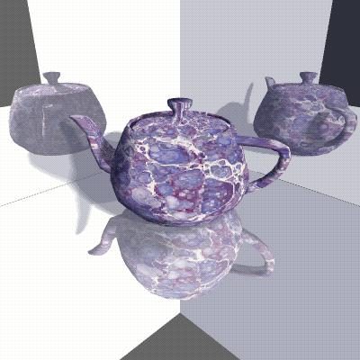

Slide 5
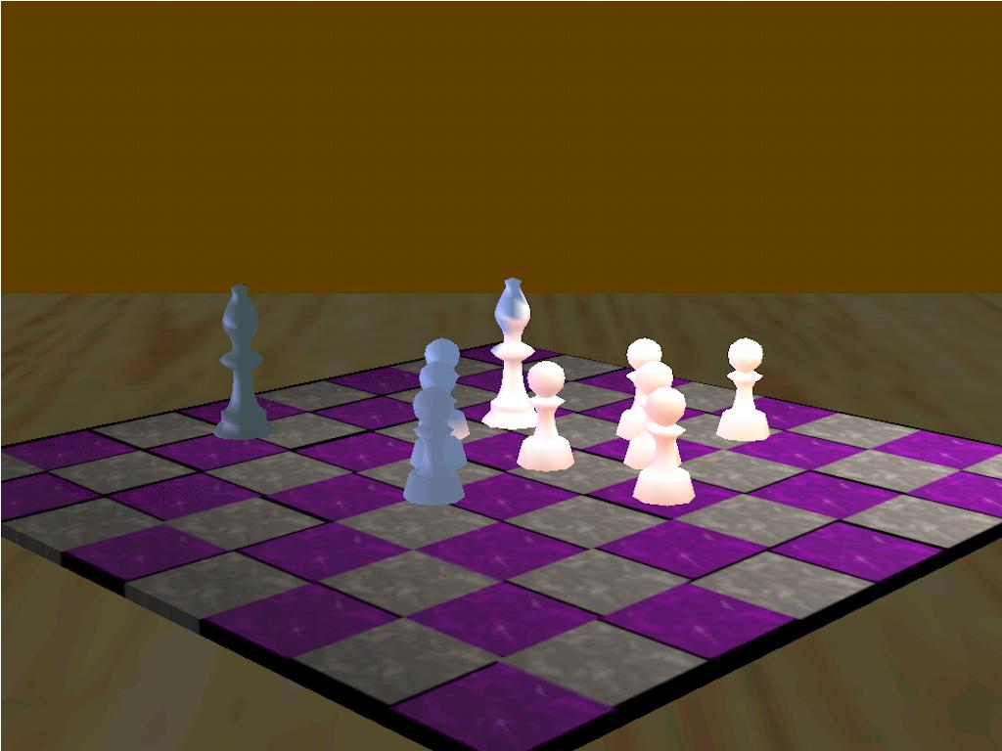

Slide 6
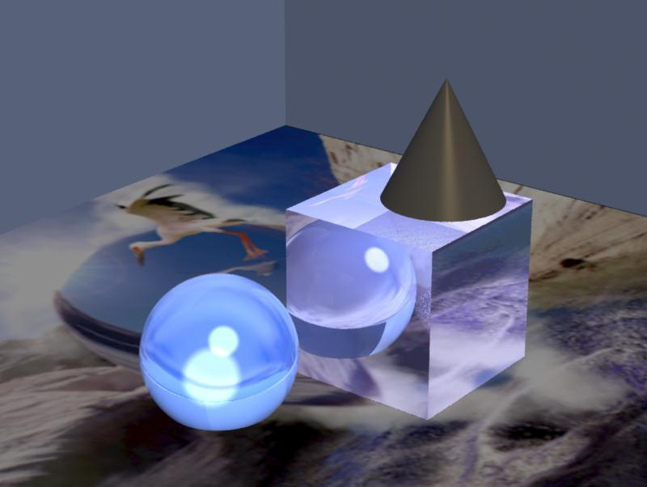

Slide 7
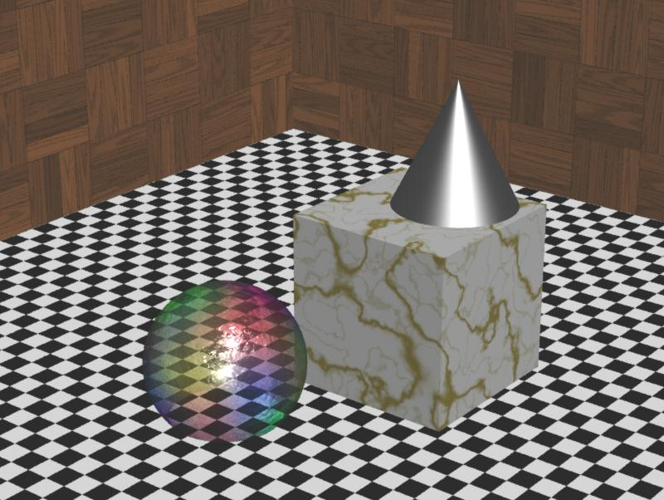
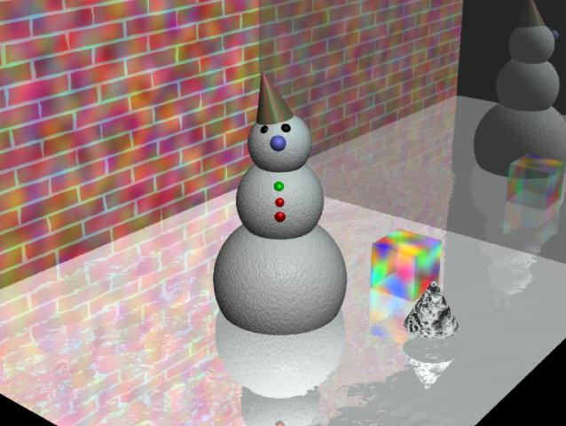

Slide 8
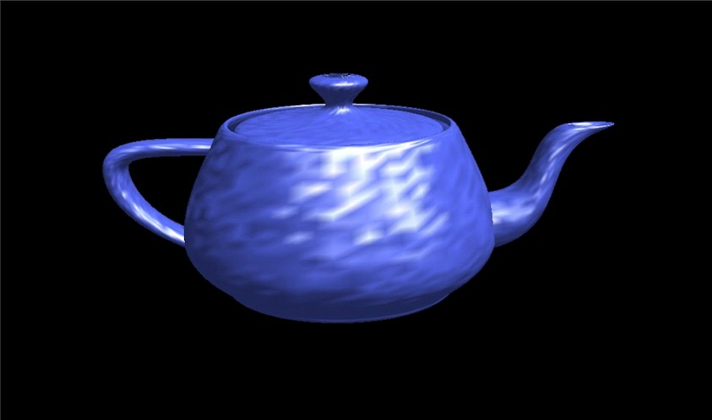

Slide 9
Pictures are from student projects at the web sites:
http://www.depaul.edu/~rwolfe/539/hmwk1gallery/gallery.html
http://www.depaul.edu/~rwolfe/469/w99demos/index.html

