Slide 1
Chapter 2
Graphics Programming

Slide 2
OpenGL
OpenGL is an API (application programmer’s interface)
Many APIs exist
Forerunner of OpenGL was GL from Silicon Graphics, Inc.(SGI) designed for highend IRIS workstations which is optimized for display, has ultrafast matrix transformations, and support for depth buffering.
OpenGL was SGI’s attempt to improve graphics portability.

Slide 3
OpenGL
Introduced July 1, 1992 at first Win32 developers conference.
SGI demonstrated how OpenGL had been used for Terminator2 and medical imaging.
Although Microsoft distributes OpenGL with Windows version, it does not control it. There is an OpenGL Architecture Review Board which includes SGI, IBM, Intel, and Microsoft. Meetings are open, but you must obtain attendance approval in advance.
Version1.1 was released in Dec, 1995

Slide 4
DESCRIPTIVE vs PROCEDURAL
GRAPHICS LANGUAGE
Descriptive
  Describe the scene and how it should appear
Procedural
  Programmer actually describes the steps necessary to achieve a certain appearance or effect
OpenGL is a procedural graphics language
The steps involve calls to various commands and functions (120+)
These draw graphical primitives such as points, lines, and polygons in 3D.

Slide 5
OPENGL
Add lighting, shading, texture mapping, animation, curve drawing, and other special effects.
Does not include any functions for window management, user interaction, or file I/O. Each host environment has its own way of handing over to OpenGL the drawing control of a window or bitmap.

Slide 6
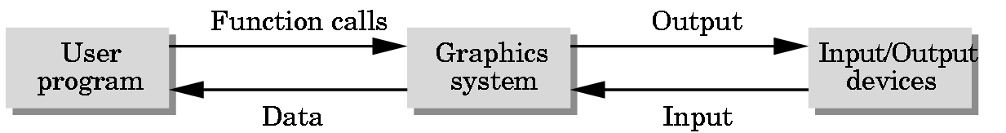
POSITIONING OF GRAPHICS SYSTEM

Slide 7
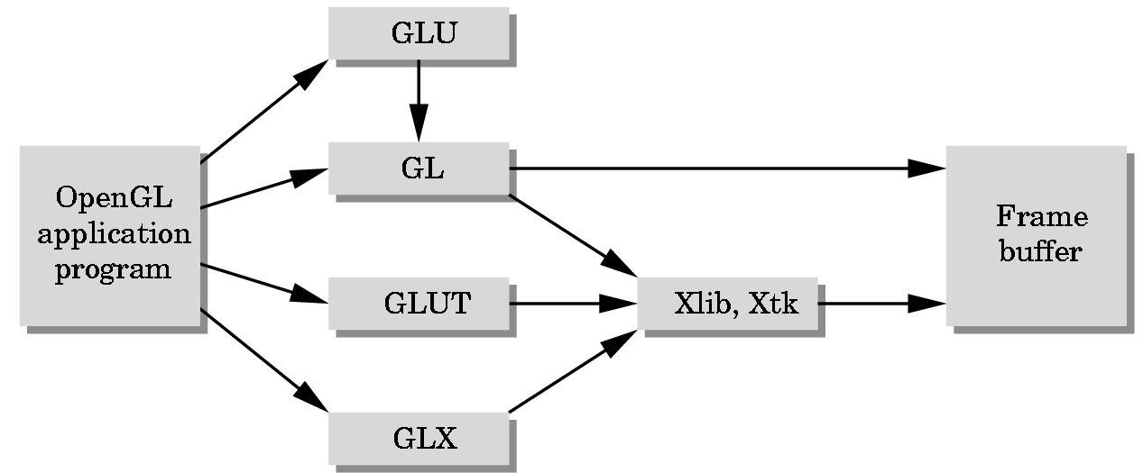
GLUT = GL Utility Toolkit

Slide 8
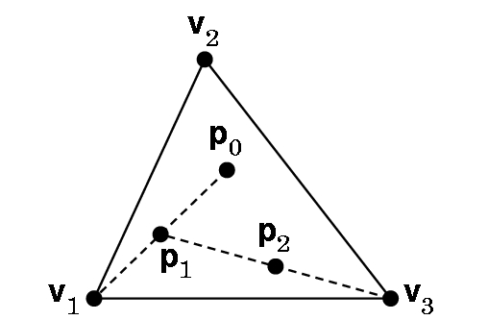
FIRST EXAMPLE:
Sierpinski Gasket- fractal pattern

Slide 9
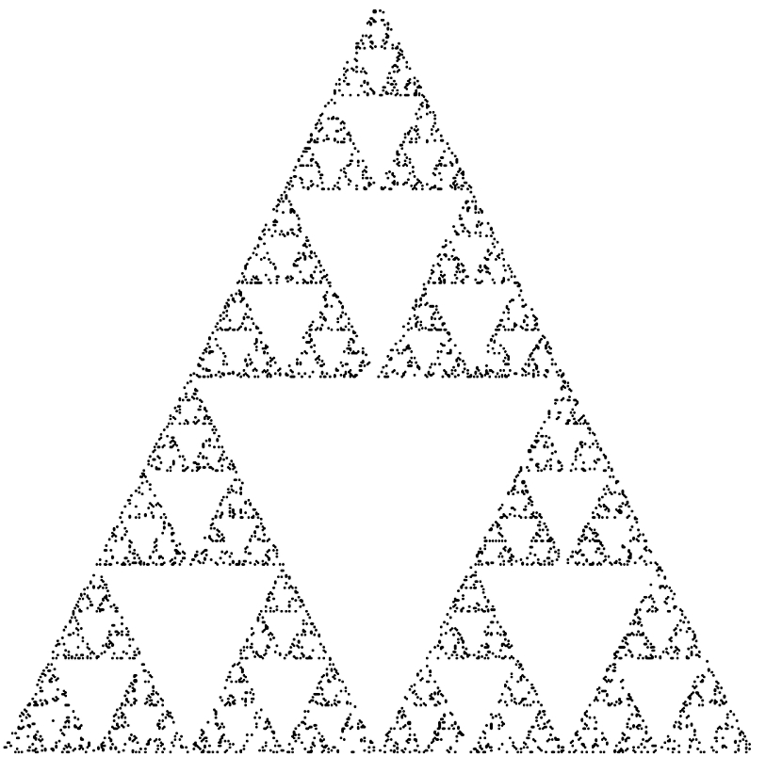
THE SIERPINSKI GASKET

Slide 10
NEED TO DETERMINE SEVERAL THINGS- some are ….
How are the points specified?
What colors are used?
How are colors specified?
Where on the screen will the image appear?
How will the image be sized?
How is the window created for image?
How much of 2D drawing surface which represents the image will be displayed?
How long will the image remain on the screen?

Slide 11
What a program… main()
{initialize_the_system(); for (some_number_of_points)
{ generate_a_point(); display_the_point();
} cleanup();
}

Slide 12
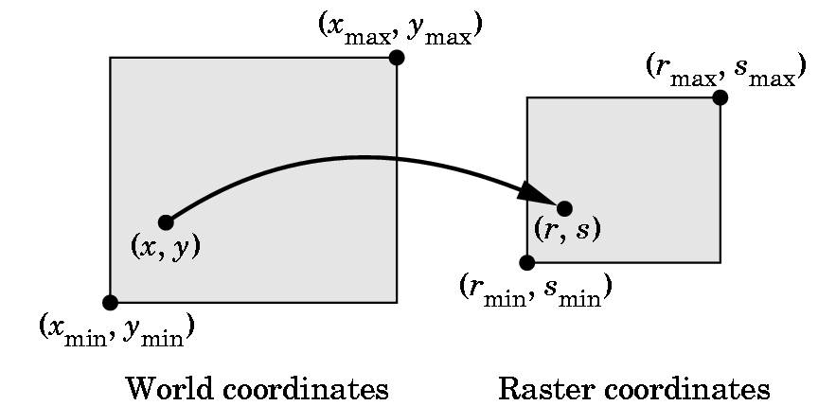
HOW DO WE SPECIFY POINTS? What coordinates do we use?

Slide 13
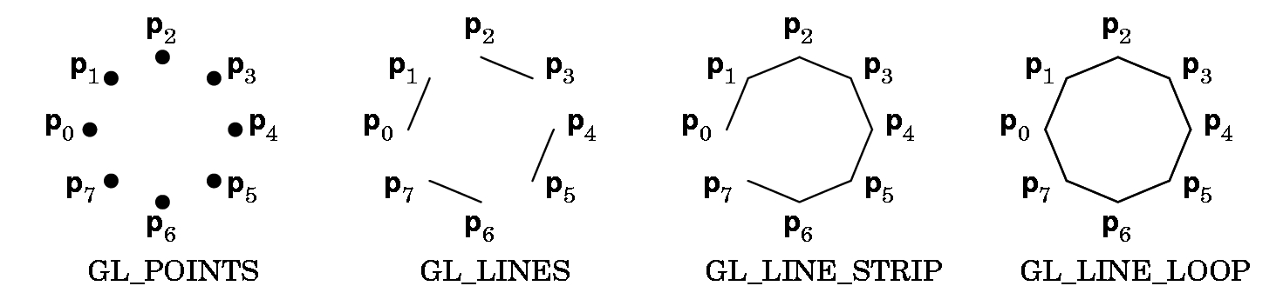
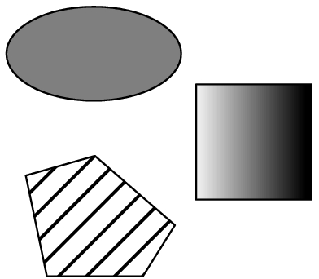
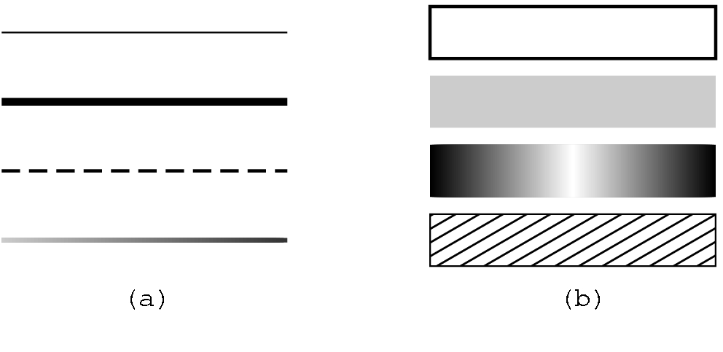
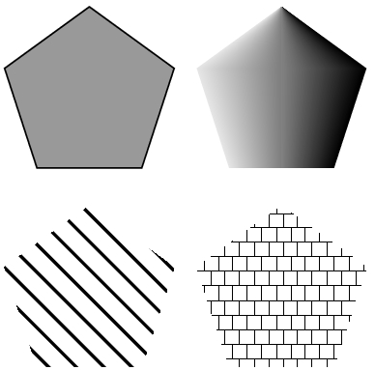
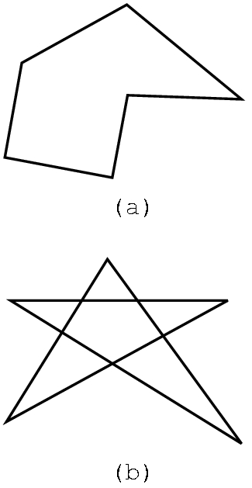
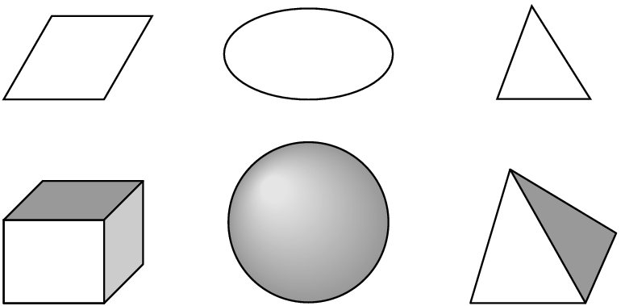
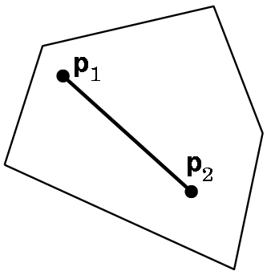

Slide 14
