Slide 1
Chapter 5
Fundamental Techniques

Slide 2
We’ll look at 3 very fundamental design paradigms:
Greedy method
  Often used in problems involving
    weighted graphs
    data compression problems
Divide and conquer method
  Already seen this is merge-sort and quick-sort
  Here we’ll concentrate on the analyzing of problems solved by this method by solving recurrence relations
Dynamic programming
  Very powerful technique IF we can build a certain characterization
  Used in solving many problems that superficially do not seem to have much in common.
There are other paradigms, but these are really quite basic.

Slide 3
The Greedy Method

Slide 4
Outline and Reading
The Greedy Method Technique (§5.1)
Fractional Knapsack Problem (§5.1.1)
Task Scheduling (§5.1.2)
Minimum Spanning Trees (§7.3) [future lecture]

Slide 5
The Greedy Method Technique- summary
The greedy method is a general algorithm design paradigm, built on the following elements:
  configurations: different choices, collections, or values to find
  an objective function: a score assigned to configurations, which we want to either maximize or minimize
It works best when applied to problems with the greedy-choice property:
  A globally-optimal solution can always be found by a series of local improvements from a starting configuration.

Slide 6
On each step in the algorithm, the choice must be:
Feasible - i.e. it satisfies the problems constraints
Locally optimal – i.e. it has to be the best local choice among all feasible choices available at the step
Irrevocable – i.e. once made, it cannot be changed on subsequent steps of the algorithm
“Greed, for lack of a better word, is good! Greed is right! Greed works!”
Gordon Gecko played by Michael Douglas in film Wall Street (1987)

Slide 7
Theory Behind the Technique
Actually rather sophisticated.
Based on an abstract combinatorial structure called a matroid.
We won’t go into that here, but, if interested, see
Cormen, T.H., Leiserson, C.E., Rivest, R.L. and C. Stein, Introduction to Algorithms, 2nd edition, MIT Press, Cambridge, MA, 2001.
Note: The above book is often used in many graduate level algorithm courses.

Slide 8
When using a greedy algorithm, if we want to guarantee an optimal solution we must prove that our method of choosing the next item works.
There are times, as we will see later, when we are willing to settle for a good approximation to an optimal solution.
The greedy technique is often useful in those cases even when we don’t obtain optimality.

Slide 9
Making Change
Problem: A dollar amount to reach and a collection of coin amounts to use to get there.
Configuration: A dollar amount yet to return to a customer plus the coins already returned
Objective function: Minimize number of coins returned.
Greedy solution: Always return the largest coin you can
Example 1: Coins are valued $.32, $.08, $.01
  Has the greedy-choice property, since no amount over $.32 can be made with a minimum number of coins by omitting a $.32 coin (similarly for amounts over $.08, but under $.32 etc.).
Example 2: Coins are valued $.30, $.20, $.05, $.01
  Does not have greedy-choice property, since $.40 is best made with two $.20’s, but the greedy solution will pick three coins (which ones?)

Slide 10
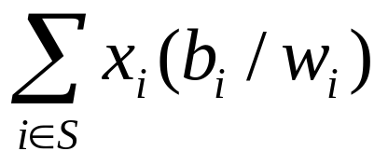
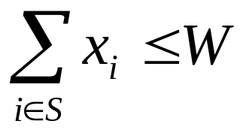
The Fractional Knapsack Problem
Given: A set S of n items, with each item i having
  b_{i} - a positive benefit
  w_{i} - a positive weight
Goal: Choose items with maximum total value but with weight at most W.
  The value of an item is its benefit/weight ratio.
If we are allowed to take fractional amounts, then this is the fractional knapsack problem.
  In this case, we let x_{i} denote the amount we take of item i
  0 ≤ x_{i} ≤ w_{i}
  Objective: maximize
  Constraint:

Slide 11

Example
Given: A set S of n items, with each item i having
  b_{i} - a positive benefit
  w_{i} - a positive weight
Goal: Choose items with maximum total value but with weight at most W.
“knapsack”
Solution:
1 ml of 5
2 ml of 3
6 ml of 4
1 ml of 2
Items:
1
2
3
4
5
Weight:
4 ml
8 ml
2 ml
6 ml
1 ml
Benefit:
$12
$32
$40
$30
$50
10 ml
Value:
3
4
20
5
50
($ per ml)

Slide 12
The Fractional Knapsack Algorithm
Greedy choice: Keep taking item with highest value (benefit to weight ratio b_{i} / w_{i} )
Run time: O(n log n). Why?
Use a max-heap priority queue
Algorithm fractionalKnapsack(S, W)
Input: set S of items w/ benefit b_{i} and weight w_{i}; max. weight W Output: amount x_{i} of each item i to maximize benefit w/ weight at most W
for each item i in S
  x_{i} ← 0
  v_{i} ← b_{i} / w_{i} {value}
  w ← 0 {total weight}
  while w < W
  remove item i w/ highest v_{i}
  x_{i} ← min{w_{i} , W - w}
  w ← w + min{w_{i} , W - w}

Slide 13
Need to Prove This Type of Strategy Works For This Type of Problem to Yield an Optimal Solution
Theorem: Given a collection S of n items, such that each item i has a benefit b_{i} and a weight w_{i}, we can construct a maximum-benefit subset of S, allowing for fractional amounts, that has a total weight W by choosing at each step x_{i} of the item with the largest ratio b_{i}/w_{i}. Moreover, this can be done in O(nlogn) time.
A maximum-benefit subset of S is one which
maximizes

Slide 14
Task Scheduling
Given: a set T of n tasks, each having:
  A start time, s_{i}
  A finish time, f_{i} (where s_{i} < f_{i})
Goal: Perform all the tasks using a minimum number of “machines.”
Machine 3
Machine 2
Machine 1
1
2
3
4
5
6
7
8
9

Slide 15
Example
Given: a set T of n tasks, each having:
  A start time, s_{i}
  A finish time, f_{i} (where s_{i} < f_{i})
  [1,4], [1,3], [2,5], [3,7], [4,7], [6,9], [7,8] (ordered by start)
Goal: Perform all tasks on min. number of machines
Machine 3
Machine 2
Machine 1
1
2
3
4
5
6
7
8
9

Slide 16
Task Scheduling Algorithm
Greedy choice: consider tasks by their start time and use as few machines as possible with this order.
  Run time: O(n log n). Why?
Correctness: Suppose there is a better schedule.
  We can use k-1 machines
  The algorithm uses k
  Let i be first task scheduled on machine k
  Machine i must conflict with k-1 other tasks
  But that means there is no non-conflicting schedule using k-1 machines
Algorithm taskSchedule(T)
Input: set T of tasks w/ start time s_{i} and finish time f_{i}
Output: non-conflicting schedule with minimum number of machines
m ← 0 {no. of machines}
  while T is not empty
  remove task i w/ smallest s_{i}
  if there’s a machine j for i then
  schedule i on machine j
  else
  m ← m + 1
  schedule i on machine m

Slide 17
Divide-and-Conquer
7 2 ⏐ 9 4 → 2 4 7 9
7 ⏐ 2 → 2 7
9 ⏐ 4 → 4 9
7 → 7
2 → 2
9 → 9
4 → 4

Slide 18
Outline and Reading
Divide-and-conquer paradigm (§5.2)
Review Merge-sort (§4.1.1)
Recurrence Equations (§5.2.1)
  Iterative substitution
  Recursion trees
  Guess-and-test
  The master method
Integer Multiplication (§5.2.2)
Note: Many load balancing algorithms for parallel machines use divide-and-conquer algorithms.

Slide 19
Divide-and-Conquer
Divide-and conquer is a general algorithm design paradigm:
  Divide: divide the input data S in two or more disjoint subsets S₁, S₂, …
  Recur: solve the subproblems recursively
  Conquer: combine the solutions for S₁, S₂, …, into a solution for S
The base case for the recursion are subproblems of constant size
Analysis can be done using recurrence equations

Slide 20
Merge-Sort Review
Merge-sort on an input sequence S with n elements consists of three steps:
  Divide: partition S into two sequences S₁ and S₂ of about n/2 elements each
  Recur: recursively sort S₁ and S₂
  Conquer: merge S₁ and S₂ into a unique sorted sequence
Algorithm mergeSort(S, C)
Input sequence S with n elements, comparator C
Output sequence S sorted
  according to C
  if S.size() > 1
  (S₁, S₂) ← partition(S, n/2)
  mergeSort(S₁, C)
  mergeSort(S₂, C)
  S ← merge(S₁, S₂)

Slide 21
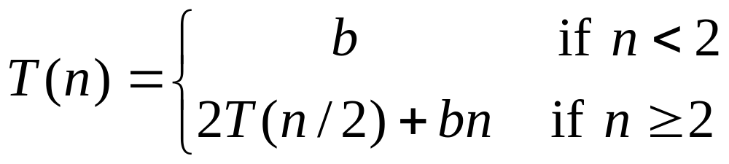
Recurrence Equation Analysis
The conquer step of merge-sort consists of merging two sorted sequences, each with n/2 elements and implemented by means of a doubly linked list, takes at most bn steps, for some constant b.
Likewise, the basis case (n < 2) will take at b most steps.
Therefore, if we let T(n) denote the running time of merge-sort:
We can therefore analyze the running time of merge-sort by finding a closed form solution to the above equation.
  That is, a solution that has T(n) only on the left-hand side.

Slide 22
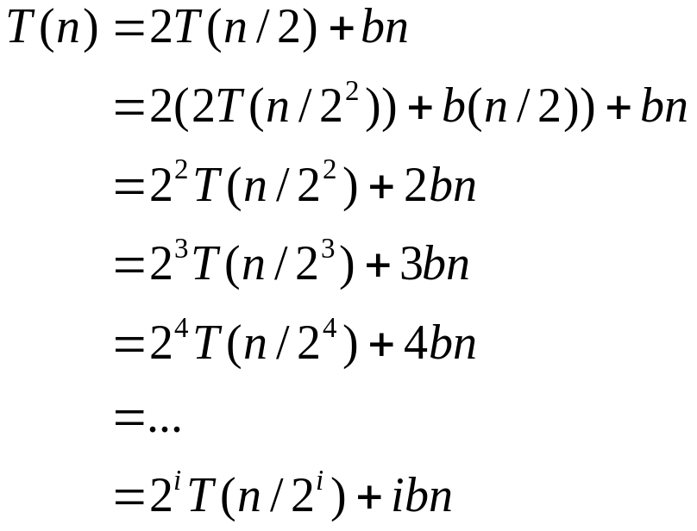

Iterative Substitution
In the iterative substitution, or “plug-and-chug,” technique, we iteratively apply the recurrence equation to itself and see if we can find a pattern:
Note that base, T(n)=b, case occurs when 2^{i}=n. That is, i = log n.
So,
Thus, T(n) is O(n log n) if we can prove this equals the recurrence relation previously developed. How: by induction!

Slide 23
Another approach- examine the recursion tree
Draw the recursion tree for the recurrence relation and look for a pattern:
depth | T’s | size
0 | 1 | n
1 | 2 | n/2
i | 2^{i} | n/2^{i}
… | … | …
time
bn
bn
bn
…
Total time = bn + bn log n
(last level plus all previous levels)

Slide 24
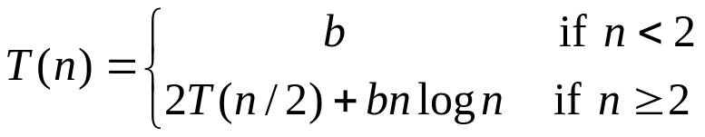
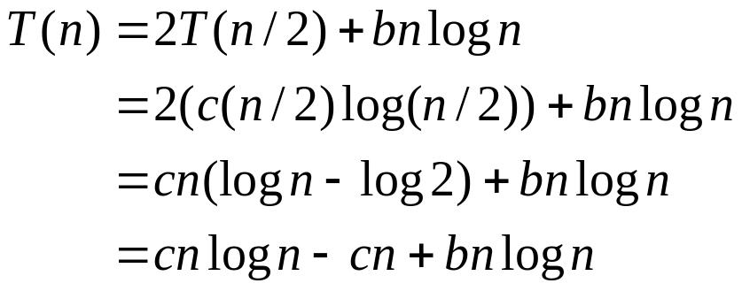
Still another method – “The Guess-and-Test Method”
In the guess-and-test method, we guess a closed form solution and then try to prove it is true by induction:
Guess: T(n) < cn log n.
Wrong: we cannot make this last line be less than c n log n

Slide 25
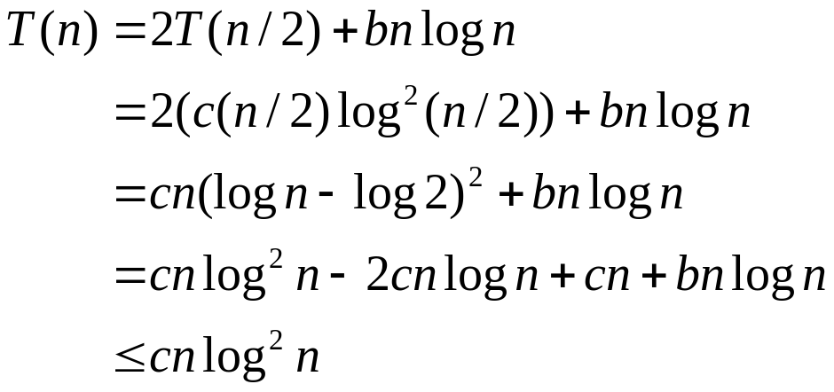
Guess-and-Test Method, Part 2
Recall the recurrence equation:
Guess #2: T(n) < cn log² n.
  if c > b.
So, T(n) is O(n log² n).
In general, to use this method, you need to have a good guess and you need to be good at induction proofs.

Slide 26
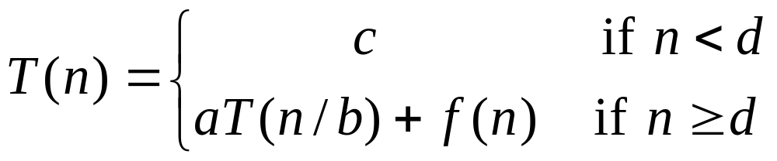
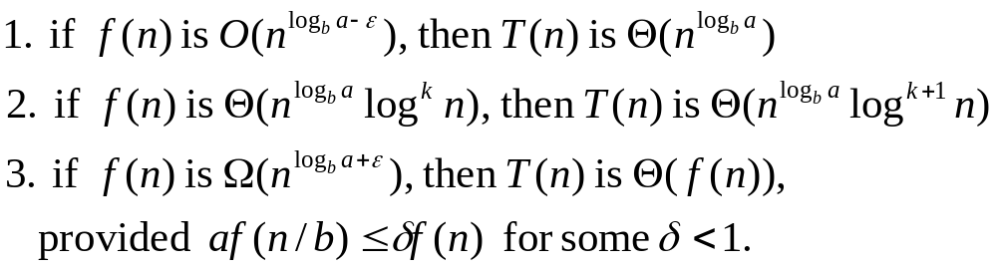
Master Method
Many divide-and-conquer recurrence equations have the form:
The Master Theorem:

Slide 27
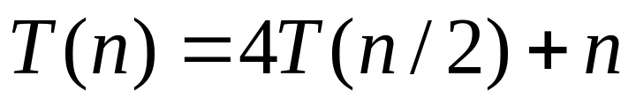
Master Method, Example 1
The form:
The Master Theorem:
Example:
Solution: log_{b}a=2, so case 1 says T(n) is Θ(n²).

Slide 28
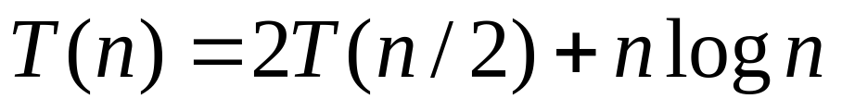
Master Method, Example 2
The form:
The Master Theorem:
Example:
Solution: log_{b}a=1, so case 2 says T(n) is Θ(n log² n).

Slide 29
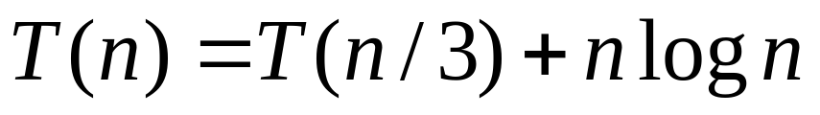
Master Method, Example 3
The form:
The Master Theorem:
Example:
Solution: log_{b}a=0, so case 3 says T(n) is Θ(n log n).

Slide 30
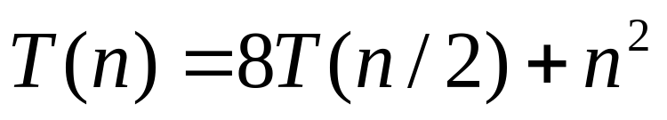
Master Method, Example 4
The form:
The Master Theorem:
Example:
Solution: log_{b}a=3, so case 1 says T(n) is Θ(n³).

Slide 31
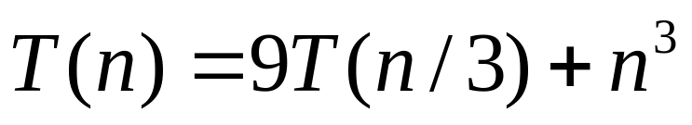
Master Method, Example 5
The form:
The Master Theorem:
Example:
Solution: log_{b}a=2, so case 3 says T(n) is Θ(n³).

Slide 32
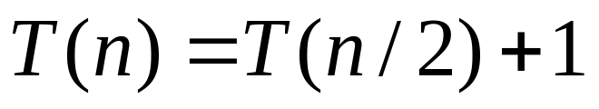
Master Method, Example 6
The form:
The Master Theorem:
Example:
(binary search)
Solution: log_{b}a=0, so case 2 says T(n) is Θ(log n).

Slide 33
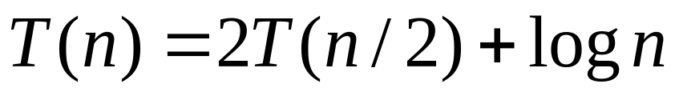
Master Method, Example 7
The form:
The Master Theorem:
Example:
(heap construction)
Solution: log_{b}a=1, so case 1 says T(n) is Θ(n).

Slide 34
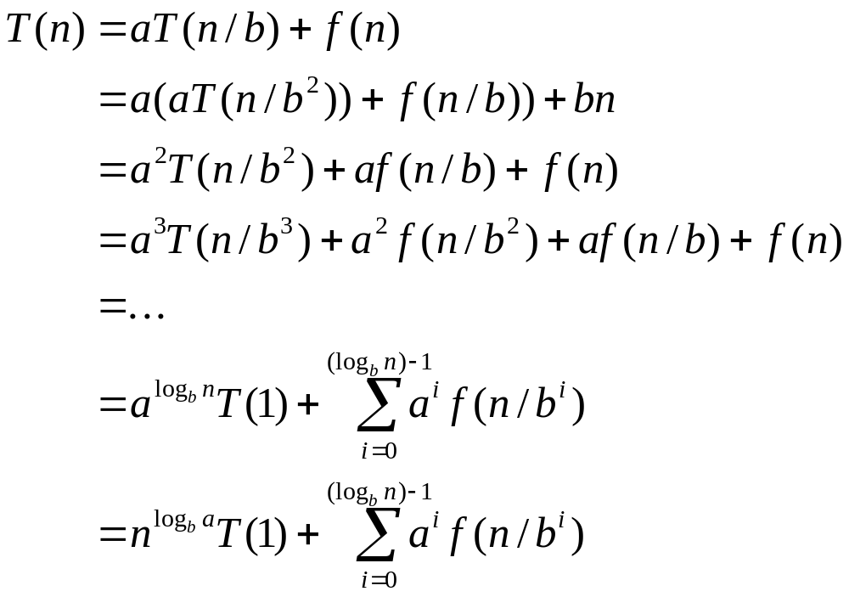
Iterative “Proof” of the Master Theorem
Using iterative substitution, let us see if we can find a pattern:
We then distinguish the three cases as
  The first term is dominant
  Each part of the summation is equally dominant
  The summation is a geometric series

Slide 35
Rather than rigorously proving The Master Theorem, we’ll utilize it to develop an algorithm
BIG INTEGER MULTIPLICATION:
Problem: Given two n-bit integers, I and J, that can’t be handled by the hardware of a machine, devise an algorithm with good complexity that multiplies these two numbers.
Applications:
Encryption schemes used in security work.
Note: Common grade school algorithm is Θ(n²)
when multiplications are counted.
Can we do better?
We will assume n is a power of 2; otherwise, pad with zeroes.

Slide 36
Some Neat Observations:
Multiplying a binary number I by a power of two is trivial
  Just shift left k bits for 2^{k}.
  So, assuming a shift takes constant time, multiplying a binary number by 2^{k} can be done in O(k) time.
Notation: If we split an integer I into two parts, we let I_{h} be the high order bits and I_{l} be the low order bits.

Slide 37
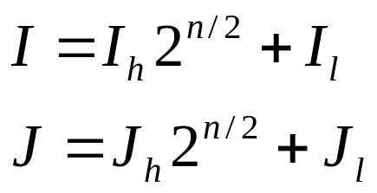
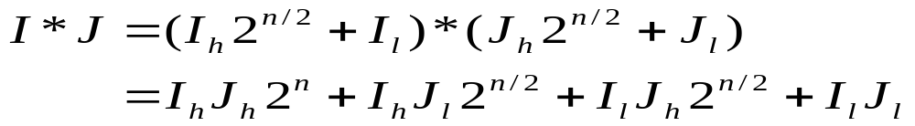
Integer Multiplication
Algorithm: Multiply two n-bit integers I and J.
  Divide step: Split I and J into high-order and low-order bits
  We can then define I*J by multiplying the parts and adding:
  We use this as a basis of a recursive algorithm.

Slide 38
Idea of algorithm:
Divide the bit representations of I and J in half.
Recursively compute the 4 products of n/2 bits each as above and merge the solutions to these subproducts in O(n) time using addition and multiplication by powers of 2.
Terminate the recursion when we need to multiply two 1-bit numbers.
Recurrence relation for running time is
  T(n) = 4T(n/2) + cn

Slide 39
Complexity of T(n)
So, T(n) = 4T(n/2) + n,
Unfortunately, using The Master Theorem,
we note log₂4 = 2
So T(n) is Θ(n²)...no good!
That is no better than the algorithm we learned in grade school.
But, The Master Theorem tells us we can do better if we can reduce the number of recursive calls.
But, how to do that? Can we be REALLY clever

Slide 40
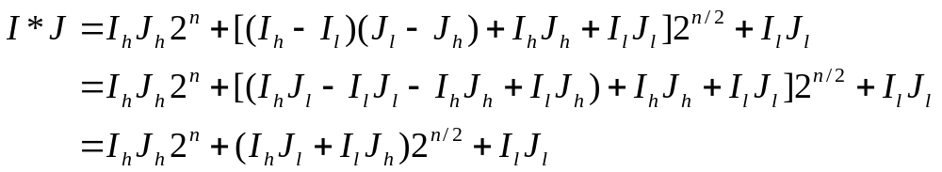
An Improved Integer Multiplication Algorithm
Algorithm: Multiply two n-bit integers I and J.
  Divide step: Split I and J into high-order and low-order bits
  Observe that there is a different way to multiply parts:
  Recursion requires 3 products of n/2 bits each plus O(n) additional work.
  So, T(n) = 3T(n/2) + n, which implies T(n) is Θ(n^{log}₂³), by the Master Theorem.
  Thus, T(n) is Θ(n^{1.585}).

Slide 41
Dynamic Programming

Slide 42
A Gentle Introduction to Dynamic Programming – An Interesting History
Invented by a mathematician, Richard Bellman, in 1950s as a method for optimizing multistage decision processes.
So the word programming refers to planning (as in programming for KC), not computer programming.
Later computer scientists realized it was a technique that could be applied to problems that were not special types of optimization problems.

Slide 43
The Basic Idea
The technique solves problems with overlapping subproblems.
Typically the subproblems arise through a recursive solution to a problem.
Rather than solve the subproblems repeatedly, we solve the smaller subproblem and save the results in a table from which we can form a solution to the original problem.
Although this suggests a space-time tradeoff, in reality when you see a dynamic programming solution you often find you do not need much extra space if you are careful.

Slide 44
A Simple Example
Consider the calculation of the Fibonacci numbers using the simple recurrence
  F(n) = F(n-1) + F(n-2) for n ≥ 2 and the two initial conditions
  F(0) = 0 and
  F(1) = 1.
If we blindly use recursion to solve this, you will be recomputing the same values many times.
In fact, the recursion tree suggests a simpler solution:

Slide 45
F(5)
F(4) F(3)
F(3) F(2) F(2) F(1)
F(2) F(1) F(1) F(0) F(1) F(0)
F(1) F(0)
So, one solution, a dynamic programming one, would be to keep an array and record each F(k) as it is computed.
But, we notice we don’t even need to maintain all of the entries, only the last two. So, in truth, looking at the solution this other way provides us with a very efficient solution that utilizes only 2 variables for the storage.
Not all problems that fall to dynamic programming are this simple, but this is a good one to remember of how the technique works.

Slide 46
Outline and Reading
Matrix Chain-Product (§5.3.1)
The General Technique (§5.3.2)
0-1 Knapsack Problem (§5.3.3)
Other examples are:
Compute the binormial coefficients
Floyd-Warshall Algorithm ((§6.4.2)- determining the pairs of nodes (v,w) in a directed graph such that w is reachable from v.

Slide 47
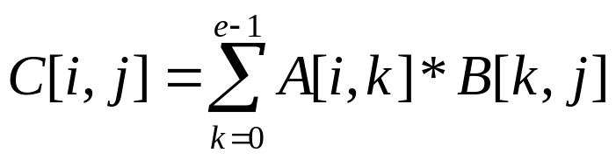
Matrix Chain-Products
Dynamic Programming is a general algorithm design paradigm.
  Rather than give the general structure, let us first give a motivating example:
  Matrix Chain-Products
Review: Matrix Multiplication.
  C = A*B
  A is d × e and B is e × f
Counting multiplications,
we have d x e x f of them.
f
B
j
e
e
A
C
d
i
i,j
d
f

Slide 48
Matrix Chain-Products Problem
Matrix Chain-Product:
  Compute A=A₀*A₁*…*A_{n-1}
  A_{i} is d_{i} × d_{i+1}
  Problem: How to parenthesize to minimize the number of multiplications?
Example shows not all attempts are equal:
  B is 3 × 100
  C is 100 × 5
  D is 5 × 5
  (B*C)*D takes 1500 + 75 = 1575 ops
  because B*C is 3 x 5
  B*(C*D) takes 1500 + 2500 = 4000 ops
  because C*D is 100 X 5

Slide 49
An Enumeration Approach
Matrix Chain-Product Alg.:
  Try all possible ways to parenthesize A=A₀*A₁*…*A_{n-1}
  Calculate number of ops for each one
  Pick the one that is best
Running time:
  The number of possibilities is equal to the number of binary trees with n external nodes
Example: Consider associating a binary tree with a unique parenthesis scheme (actually pull the idea from compiler writing!)
(Without proof) The number of binary trees with n external nodes is the (n-1) Catalan number (The book said n, but that is the number of binary trees with n nodes- this association scheme is easy to see so we’ll use that one)

Slide 50
The Running Time
  The nth Catalan number is given by
  C(n) = ((2n)!/n!n!)(1/(n+1) for n > 0 and
  with C(0) = 1
  The growth is quite fast,
    C(2) = 2 as we saw
    C(3) = 5 as we saw
    C(4) = 14 as was claimed
  In fact, it can be shown that C(n) is Ω(4^{n}/n^{3/2}) ie this is exponential!
  This is a terrible algorithm (as you might have suspected)!

Slide 51
A Greedy Approach
Idea #1: Repeatedly select the product that uses the most operations.
Counter-example:
  A is 10 × 5
  B is 5 × 10
  C is 10 × 5
  D is 5 × 10
  Greedy idea #1 gives (A*B)*(C*D), which takes 500+1000+500 = 2000 ops
  A*((B*C)*D) takes 500+250+250 = 1000 ops
Note- this doesn’t tell us there is NO greedy approach.

Slide 52
Another Greedy Approach
Idea #2: repeatedly select the product that uses the fewest operations.
Counter-example:
  A is 101 × 11
  B is 11 × 9
  C is 9 × 100
  D is 100 × 99
  Greedy idea #2 gives A*((B*C)*D)), which takes 109989+9900+108900=228789 ops
  (A*B)*(C*D) takes 9999+89991+89100=189090 ops
The greedy approach is not giving us seemingly the optimal value.

Slide 53
A “Recursive” Approach
Define subproblems:
  Find the best parenthesization of A_{i}*A_{i+1}*…*A_{j}.
  Let N_{i,j} denote the number of operations done by this subproblem.
  The optimal solution for the whole problem is N_{0,n-1}.
Subproblem optimality: The optimal solution can be defined in terms of optimal subproblems
  There has to be a final multiplication (root of the expression tree) for the optimal solution.
  Say, the final multiply is at index i: (A₀*…*A_{i})*(A_{i+1}*…*A_{n-1}).
  Then the optimal solution N_{0,n-1} is the sum of two optimal subproblems, N_{0,i} and N_{i+1,n-1} plus the time for the last multiply.
  If the global optimum did not have these optimal subproblems, we could define an even better “optimal” solution.

Slide 54
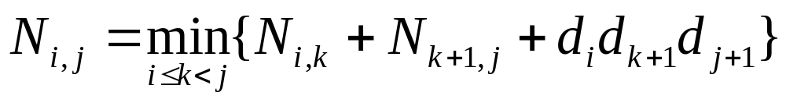
A Characterizing Equation
The global optimal has to be defined in terms of optimal subproblems, depending on where the final multiply is.
Let us consider all possible places for that final multiply:
  Recall that A_{i} is a d_{i} × d_{i+1} dimensional matrix.
  So, a characterizing equation for N_{i,j} is the following:
Note that subproblems are not independent--the subproblems overlap.

Slide 55
A Dynamic Programming Algorithm Visualization
A bottom-up construction fills in the N array by diagonals
N_{i,j} gets values from pervious entries in i-th row and j-th column
Filling in each entry in the N table takes ? time. See next slide.
Getting actual parenthesization can be done by remembering “k” for each N entry as we will see.
answer
N
0
1
2
j
…
n-1
0
1
…
i
n-1

Slide 56
A Dynamic Programming Algorithm
Since subproblems overlap, we don’t use recursion.
Instead, we construct optimal subproblems “bottom-up.”
N_{i,i}’s are easy, so start with them
Then do length 2,3,… subproblems, and so on.
Look at loops for timing
Running time: O(n³)
Algorithm matrixChain(S):
Input: sequence S of n matrices to be multiplied
Output: number of operations in an optimal paranethization of S
  for i ← 1 to n-1 do
  N_{i,i} ← 0
  for b ← 1 to n-1 do
  for i ← 0 to n-b-1 do
  j ← i+b
  N_{i,j} ← +infinity
  for k ← i to j-1 do
  N_{i,j} ← min{N_{i,j} , N_{i,k} +N_{k+1,j} +d_{i} d_{k+1} d_{j+1}}

Slide 57
The General Dynamic Programming Technique
Applies to a problem that at first seems to require a lot of time (possibly exponential), provided we have:
  Simple subproblems: the subproblems can be defined in terms of a few variables, such as j, k, l, m, and so on.
  Subproblem optimality: the global optimum value can be defined in terms of optimal subproblems
  Subproblem overlap: the subproblems are not independent, but instead they overlap (hence, should be constructed bottom-up).

Slide 58
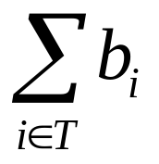
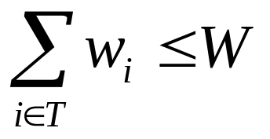
The 0/1 Knapsack Problem
Given: A set S of n items, with each item i having
  b_{i} - a positive benefit
  w_{i} - a positive weight
Goal: Choose items with maximum total benefit but with weight at most W.
If we are not allowed to take fractional amounts, then this is the 0/1 knapsack problem.
  In this case, we let T denote the set of items we take
  Objective: maximize
  Constraint:

Slide 59
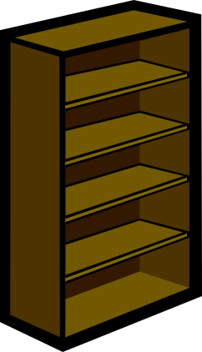
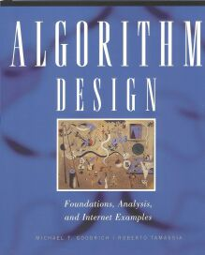
Example
Given: A set S of n items, with each item i having
  b_{i} - a positive benefit
  w_{i} - a positive weight
Goal: Choose items with maximum total benefit but with weight at most W.
“knapsack”
Solution:
5 (2 in)
3 (2 in)
1 (4 in)
Items:
1
2
3
4
5
Weight:
4 in
2 in
2 in
6 in
2 in
Benefit:
9 in
$20
$3
$6
$25
$80

Slide 60
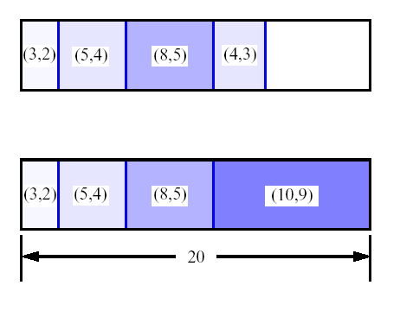
A 0/1 Knapsack Algorithm, First Attempt
S_{k}: Set of items numbered 1 to k.
Define B[k] = best selection from S_{k}.
Problem: does not have subproblem optimality:
  Consider S={(3,2),(5,4),(8,5),(4,3),10,9)} weight-benefit pairs
Best for S₄:
Best for S₅:

Slide 61
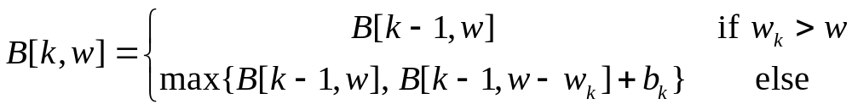
A 0/1 Knapsack Algorithm, Second Attempt
S_{k}: Set of items numbered 1 to k.
Define B[k,w] = best selection from S_{k} with weight at most w (Note: 2 errors on pg 280)
Good news: this does have subproblem optimality:
I.e., best subset of S_{k} with weight exactly w is either the best subset of S_{k-1} w/ weight w or the best subset of S_{k-1} w/ weight w-w_{k} plus item k.

Slide 62
The 0/1 Knapsack Algorithm
Recall definition of B[k,w]:
Since B[k,w] is defined in terms of B[k-1,*], we can reuse the same array
Running time: O(nW).
Not a polynomial-time algorithm if W is large
This is a pseudo-polynomial time algorithm
Algorithm 01Knapsack(S, W):
Input: set S of items w/ benefit b_{i} and weight w_{i}; max. weight W
Output: benefit of best subset with weight at most W
for w ← 0 to W do
  B[w] ← 0
  for k ← 1 to n do
  for w ← W downto w_{k} do
  if B[w-w_{k}]+b_{k} > B[w] then
  B[w] ← B[w-w_{k}]+b_{k}

