Slide 1
Chapter 4
(Sections 4.1-4.6)
Sorting- Part 1

Slide 2
Merge Sort
7 2 ⏐ 9 4 → 2 4 7 9
7 ⏐ 2 → 2 7
9 ⏐ 4 → 4 9
7 → 7
2 → 2
9 → 9
4 → 4

Slide 3
Outline and Reading
Divide-and-conquer paradigm (§4.1.1)
Merge-sort (§4.1.1)
  Algorithm
  Merging two sorted sequences
  Merge-sort tree
  Execution example
  Analysis
Generic merging and set operations (§4.2.1)
Summary of sorting algorithms (§4.2.1)

Slide 4
Divide-and-Conquer
Divide-and conquer is a general algorithm design paradigm:
  Divide: divide the input data S in two disjoint subsets S₁ and S₂
  Recur: solve the subproblems associated with S₁ and S₂
  Conquer: combine the solutions for S₁ and S₂ into a solution for S
The base case for the recursion is of size 0 or 1
Merge-sort is a sorting algorithm based on the divide-and-conquer paradigm
Like heap-sort
  It uses a comparator
  It has O(n log n) running time
Unlike heap-sort
  It does not use an auxiliary priority queue
  It accesses data in a sequential manner (suitable to sort data on a disk)

Slide 5
Merge-Sort
Merge-sort on an input sequence S with n elements consists of three steps:
  Divide: partition S into two sequences S₁ and S₂ of about n/2 elements each
  Recur: recursively sort S₁ and S₂
  Conquer: merge S₁ and S₂ into a unique sorted sequence

Slide 6
Merge-Sort
Algorithm mergeSort(S, C)
Input sequence S with n elements, comparator C
Output sequence S sorted according to C
  if S.size() > 1
  (S1, S2) ← partition(S, n/2)
  mergeSort(S1, C)
  mergeSort(S2, C)
  S ← merge(S1, S2)

Slide 7
Merging Two Sorted Sequences
The conquer step of merge-sort consists of merging two sorted sequences A and B into a sorted sequence S containing the elements of A and B
Merging two sorted sequences, each with n/2 elements and implemented by means of a doubly linked list, takes O(n) time because of
Theorem 4.2: Merging two sorted sequences S₁ and S₂, each of size n_{i}, takes O(n₁+n₂) time.
  Proof- look at the pseudocode and analyze the 3 loops ....

Slide 8
Merging Two Sorted Sequences
Algorithm merge(A, B)
Input sequences A and B with
n/2 elements each
Output sorted sequence of A ∪ B
  S ← empty sequence
  while ¬A.isEmpty() ∧ ¬B.isEmpty()
  if A.first().element() < B.first().element()
  S.insertLast(A.remove(A.first()))
  else
  S.insertLast(B.remove(B.first()))
  while ¬A.isEmpty() S.insertLast(A.remove(A.first()))
  while ¬B.isEmpty() S.insertLast(B.remove(B.first()))
  return S
Merging two sorted sequences, each with n/2 elements and implemented by means of a doubly linked list, takes O(n) time

Slide 9
Merge-Sort Tree
An execution of merge-sort can be depicted by a binary tree
  Each node represents a recursive call of merge-sort and stores
    unsorted sequence before the execution and its partition
    sorted sequence at the end of the execution
  The root is the initial call
  The leaves are calls on subsequences of size 0 or 1
7 2 ⏐ 9 4 → 2 4 7 9
7 ⏐ 2 → 2 7
9 ⏐ 4 → 4 9
7 → 7
2 → 2
9 → 9
4 → 4

Slide 10
Execution Example
Pivot selection
7 2 9 4 3 7 6 1 → 1 2 3 4 6 7 8 9
7 2 9 4 → 2 4 7 9
3 8 6 1 → 1 3 8 6
2 → 2
9 4 → 4 9
3 → 3
8 → 8
9 → 9
4 → 4

Slide 11
Execution Example (cont.)
Partition, recursive call, pivot selection
7 2 9 4 3 7 6 1 → 1 2 3 4 6 7 8 9
2 4 3 1 → 2 4 7 9
3 8 6 1 → 1 3 8 6
2 → 2
9 4 → 4 9
3 → 3
8 → 8
9 → 9
4 → 4

Slide 12
Execution Example (cont.)
Partition, recursive call, base case
7 2 9 4 3 7 6 1 → → 1 2 3 4 6 7 8 9
2 4 3 1 →→ 2 4 7
3 8 6 1 → 1 3 8 6
1 → 1
9 4 → 4 9
3 → 3
8 → 8
9 → 9
4 → 4

Slide 13
Execution Example (cont.)
Recursive call, …, base case, join
7 2 9 4 3 7 6 1 → 1 2 3 4 6 7 8 9
2 4 3 1 → 1 2 3 4
3 8 6 1 → 1 3 8 6
1 → 1
4 3 → 3 4
3 → 3
8 → 8
9 → 9
4 → 4

Slide 14
Execution Example (cont.)
Recursive call, pivot selection
7 2 9 4 3 7 6 1 → 1 2 3 4 6 7 8 9
2 4 3 1 → 1 2 3 4
7 9 7 1 → 1 3 8 6
1 → 1
4 3 → 3 4
8 → 8
9 → 9
9 → 9
4 → 4

Slide 15
Execution Example (cont.)
Partition, …, recursive call, base case
7 2 9 4 3 7 6 1 → 1 2 3 4 6 7 8 9
2 4 3 1 → 1 2 3 4
7 9 7 1 → 1 3 8 6
1 → 1
4 3 → 3 4
8 → 8
9 → 9
9 → 9
4 → 4

Slide 16
Execution Example (cont.)
Join, join
7 2 9 4 3 7 6 1 → 1 2 3 4 6 7 7 9
2 4 3 1 → 1 2 3 4
7 9 7 → 17 7 9
1 → 1
4 3 → 3 4
8 → 8
9 → 9
9 → 9
4 → 4

Slide 17
Analysis of Merge-Sort
The height h of the merge-sort tree is O(log n)
  At each recursive call we divide in half the sequence
The overall amount or work done at the nodes of depth i is O(n)
  We partition and merge 2^{i} sequences of size n/2^{i}
  We make 2^{i+1} recursive calls
Thus, the total running time of merge-sort is O(n log n)

Slide 18
Analysis of Merge-Sort
(Visually)
depth #seqs size
0 1 n
1 2 n/2
i 2i n/2i
… … …

Slide 19
Summary of Sorting Algorithms
Algorithm | Time | Notes
selection-sort | O(n²) | slow in-place for small data sets (< 1K)
insertion-sort | O(n²) | slow in-place for small data sets (< 1K)
heap-sort | O(n log n) | fast in-place for large data sets (1K — 1M)
merge-sort | O(n log n) | fast sequential data access for huge data sets (> 1M)

Slide 20
Quick-Sort
7 4 9 6 2 → 2 4 6 7 9
4 2 → 2 4
7 9 → 7 9
2 → 2
9 → 9

Slide 21
Outline and Reading
Quick-sort (§4.3)
  Algorithm
  Partition step
  Quick-sort tree
  Execution example
Analysis of quick-sort (4.3.1)
In-place quick-sort (§4.8)
Summary of sorting algorithms

Slide 22
Quick-Sort
Quick-sort is a randomized sorting algorithm based on the divide-and-conquer paradigm:
  Divide: pick a random element x (called pivot) and partition S into
    L elements less than x
    E elements equal x
    G elements greater than x
  Recur: sort L and G
  Conquer: join L, E and G
x
x
L
G
E
x

Slide 23
Partition
We partition an input sequence as follows:
  We remove, in turn, each element y from S and
  We insert y into L, E or G, depending on the result of the comparison with the pivot x
Each insertion and removal is at the beginning or at the end of a sequence, and hence takes O(1) time
Thus, the partition step of quick-sort takes O(n) time

Slide 24
Partition
Algorithm partition(S, p)
Input sequence S, position p of pivot
Output subsequences L, E, G of the
elements of S less than, equal to,
or greater than the pivot, respectively
L, E, G ← empty sequences
  x ← S.remove(p)
  while ¬S.isEmpty()
  y ← S.remove(S.first())
  if y < x
  L.insertLast(y)
  else if y = x
  E.insertLast(y)
  else { y > x }
  G.insertLast(y)
  return L, E, G

Slide 25
Quick-Sort Tree
An execution of quick-sort is best depicted by a binary tree
  Each node represents a recursive call of quick-sort and stores
    Unsorted sequence before the execution and its pivot
    Sorted sequence at the end of the execution
  The root is the initial call
  The leaves are calls on subsequences of size 0 or 1
7 4 9 6 2 → 2 4 6 7 9
4 2 → 2 4
7 9 → 7 9
2 → 2
9 → 9

Slide 26
Execution Example
Pivot selection
7 2 9 4 3 7 6 1 → 1 2 3 4 6 7 8 9
7 2 9 4 → 2 4 7 9
3 8 6 1 → 1 3 8 6
2 → 2
9 4 → 4 9
3 → 3
8 → 8
9 → 9
4 → 4

Slide 27
Execution Example (cont.)
Partition, recursive call, pivot selection
7 2 9 4 3 7 6 1 → 1 2 3 4 6 7 8 9
2 4 3 1 → 2 4 7 9
3 8 6 1 → 1 3 8 6
2 → 2
9 4 → 4 9
3 → 3
8 → 8
9 → 9
4 → 4

Slide 28
Execution Example (cont.)
Partition, recursive call, base case
7 2 9 4 3 7 6 1 → → 1 2 3 4 6 7 8 9
2 4 3 1 →→ 2 4 7
3 8 6 1 → 1 3 8 6
1 → 1
9 4 → 4 9
3 → 3
8 → 8
9 → 9
4 → 4

Slide 29
Execution Example (cont.)
Recursive call, …, base case, join
7 2 9 4 3 7 6 1 → 1 2 3 4 6 7 8 9
2 4 3 1 → 1 2 3 4
3 8 6 1 → 1 3 8 6
1 → 1
4 3 → 3 4
3 → 3
8 → 8
9 → 9
4 → 4

Slide 30
Execution Example (cont.)
Recursive call, pivot selection
7 2 9 4 3 7 6 1 → 1 2 3 4 6 7 8 9
2 4 3 1 → 1 2 3 4
7 9 7 1 → 1 3 8 6
1 → 1
4 3 → 3 4
8 → 8
9 → 9
9 → 9
4 → 4

Slide 31
Execution Example (cont.)
Partition, …, recursive call, base case
7 2 9 4 3 7 6 1 → 1 2 3 4 6 7 8 9
2 4 3 1 → 1 2 3 4
7 9 7 1 → 1 3 8 6
1 → 1
4 3 → 3 4
8 → 8
9 → 9
9 → 9
4 → 4

Slide 32
Execution Example (cont.)
Join, join
7 2 9 4 3 7 6 1 → 1 2 3 4 6 7 7 9
2 4 3 1 → 1 2 3 4
7 9 7 → 17 7 9
1 → 1
4 3 → 3 4
8 → 8
9 → 9
9 → 9
4 → 4

Slide 33
Worst-case Running Time
The worst case for quick-sort occurs when the pivot is the unique minimum or maximum element
One of L and G has size n − 1 and the other has size 0
The running time is proportional to the sum
n + (n − 1) + … + 2 + 1
Thus, the worst-case running time of quick-sort is O(n²)
depth | time
0 | n
1 | n − 1
… | …
n − 1 | 1
…

Slide 34
Expected Running Time
Consider a recursive call of quick-sort on a sequence of size s
  Good call: the sizes of L and G are each less than 3s/4
  Bad call: one of L and G has size greater than 3s/4
A call is good with probability 1/2
  1/2 of the possible pivots cause good calls:
7 2 9 4 3 7 6 1 9
7 2 9 4 3 7 6 1
2 4 3 1
7 9 7 1 → 1
1
7 2 9 4 3 7 6
Good call
Bad call
1 2 3 4 5 6 7 8 9 10 11 12 13 14 15 16
Bad pivots
Good pivots
Bad pivots

Slide 35
Expected Running Time, Part 2
Probabilistic Fact: The expected number of coin tosses required in order to get k heads is 2k
For a node of depth i, we expect
  i/2 ancestors are good calls
  The size of the input sequence for the current call is at most (3/4)^{i/2}n
Therefore, we have
  For a node of depth 2log_{4/3}n, the expected input size is one
  The expected height of the quick-sort tree is O(log n)
The amount or work done at the nodes of the same depth is O(n)
Thus, the expected running time of quick-sort is O(n log n)

Slide 36
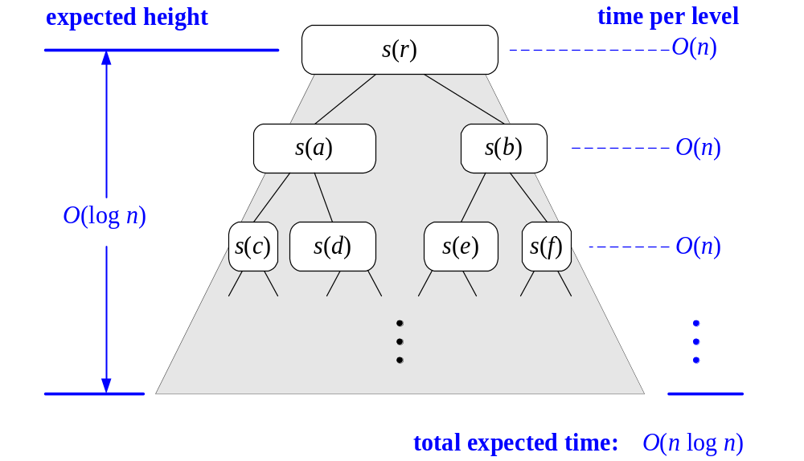
Expected Running Time, Part 2

Slide 37
In-Place Quick-Sort
Quick-sort can be implemented to run in-place
In the partition step, we use replace operations to rearrange the elements of the input sequence such that
  the elements less than the pivot have rank less than h
  the elements equal to the pivot have rank between h and k
  the elements greater than the pivot have rank greater than k
The recursive calls consider
  elements with rank less than h
  elements with rank greater than k

Slide 38
In-Place Quick-Sort
Algorithm inPlaceQuickSort(S, l, r)
Input sequence S, ranks l and r
Output sequence S with the
elements of rank between l and r
rearranged in increasing order
if l ≥ r
  return
  i ← a random integer between l and r
  x ← S.elemAtRank(i)
  (h, k) ← inPlacePartition(x)
  inPlaceQuickSort(S, l, h - 1)
  inPlaceQuickSort(S, k + 1, r)

Slide 39
In-Place Partitioning
Perform the partition using two indices to split S into L and E U G (a similar method can split E U G into E and G).
Repeat until j and k cross:
  Scan j to the right until finding an element > x.
  Scan k to the left until finding an element < x.
  Swap elements at indices j and k
j
k
3 2 5 1 0 7 3 5 9 2 7 9 8 9 7 6 9
(pivot = 6)
j
k
3 2 5 1 0 7 3 5 9 2 7 9 8 9 7 6 9

Slide 40
Summary of Sorting Algorithms
Algorithm | Time | Notes
selection-sort | O(n²) | in-place slow (good for small inputs)
insertion-sort | O(n²) | in-place slow (good for small inputs)
quick-sort | O(n log n) expected | in-place, randomized fastest (good for large inputs)
heap-sort | O(n log n) | in-place fast (good for large inputs)
merge-sort | O(n log n) | sequential data access fast (good for huge inputs)

