Slide 1
Chapter 4
(Sections 4.1-4.6)
Sorting- Part 2

Slide 2

Sorting Lower Bound

Slide 3

Comparison-Based Sorting (§ 4.4)
Many sorting algorithms are comparison based.
  They sort by making comparisons between pairs of objects
  Examples: bubble-sort, selection-sort, insertion-sort, heap-sort, merge-sort, quick-sort, ...
Let us therefore derive a lower bound on the running time of any algorithm that uses comparisons to sort n elements, x₁, x₂, …, x_{n}.
Is x_{i} < x_{j}?
no
yes

Slide 4
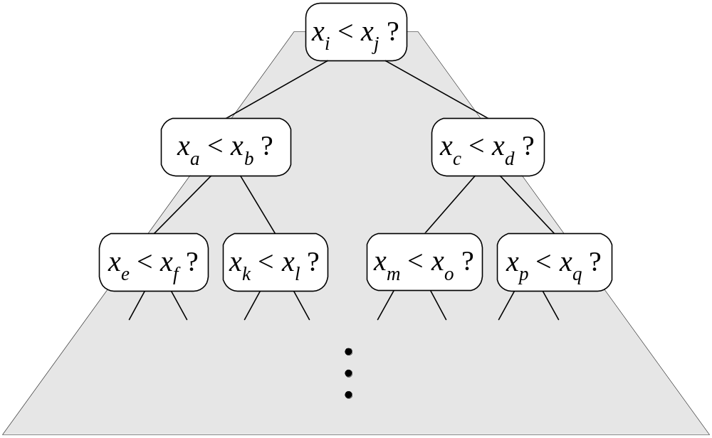
Counting Comparisons
Let us just count comparisons then.
Each possible run of the algorithm corresponds to a root-to-leaf path in a decision tree

Slide 5
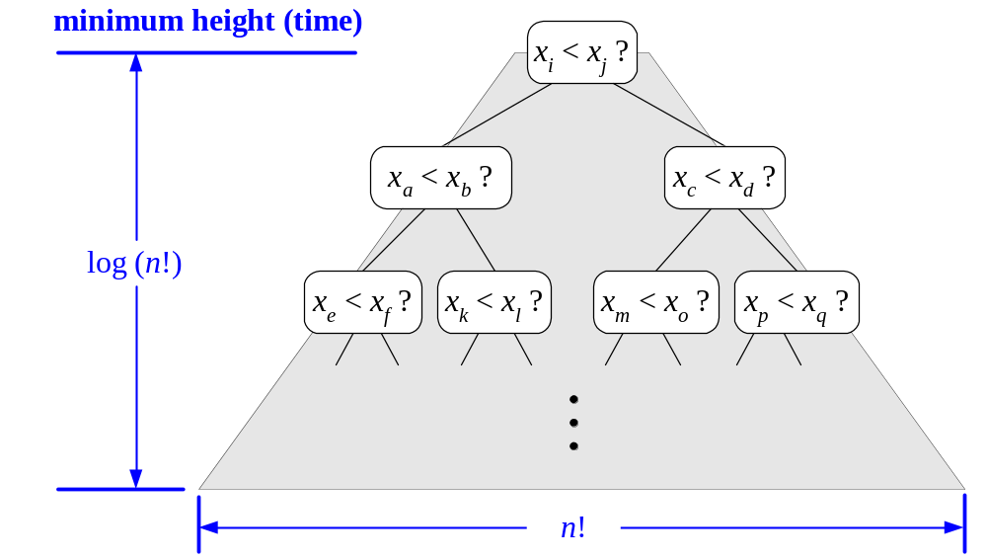
Decision Tree Height
The height of this decision tree is a lower bound on the running time
Every possible input permutation must lead to a separate leaf output.
  If not, some input …4…5… would have same output ordering as …5…4…, which would be wrong.
Since there are n!=1*2*…*n leaves, the height is at least log (n!)

Slide 6

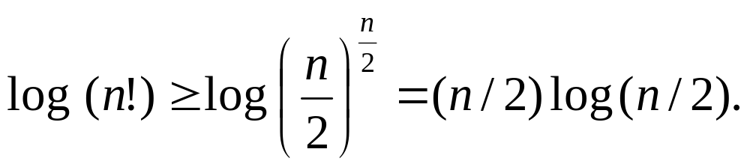
The Lower Bound
Any comparison-based sorting algorithms takes at least log (n!) time
Therefore, any such algorithm takes time at least
That is, any comparison-based sorting algorithm must run in Ω(n log n) time.

Slide 7
Bucket-Sort and Radix-Sort
1, c
3, a
3, b
7, d
7, g
7, e
∅
∅
∅
∅
∅
∅
∅
B
0
1
2
3
4
5
6
7
8
9

Slide 8

Bucket-Sort (§ 4.5.1)
Let be S be a sequence of n (key, element) items with keys in the range [0, N − 1]
Bucket-sort uses the keys as indices into an auxiliary array B of sequences (buckets)
  Phase 1: Empty sequence S by moving each item (k, o) into its bucket B[k]
  Phase 2: For i = 0, …, N − 1, move the items of bucket B[i] to the end of sequence S
Analysis:
  Phase 1 takes O(n) time
  Phase 2 takes O(n + N) time
Bucket-sort takes O(n + N) time
Algorithm bucketSort(S, N)
Input sequence S of (key, element)
items with keys in the range
[0, N − 1]
Output sequence S sorted by
increasing keys
B ← array of N empty sequences
  while ¬S.isEmpty()
  f ← S.first()
  (k, o) ← S.remove(f)
  B[k].insertLast((k, o))
  for i ← 0 to N − 1
  while ¬B[i].isEmpty()
  f ← B[i].first()
  (k, o) ← B[i].remove(f)
  S.insertLast((k, o))

Slide 9

Example
Key range [0, 9]
7, d
1, c
3, a
7, g
3, b
7, e
Phase 1
1, c
3, a
3, b
7, d
7, g
7, e
B
0
1
2
3
4
5
6
7
8
9
∅
∅
∅
∅
∅
∅
∅
Phase 2
1, c
3, a
3, b
7, d
7, g
7, e

Slide 10

Properties and Extensions
Key-type Property
  The keys are used as indices into an array and cannot be arbitrary objects
  No external comparator
Stable Sort Property
  The relative order of any two items with the same key is preserved after the execution of the algorithm
Extensions
  Integer keys in the range [a, b]
    Put item (k, o) into bucket
    B[k − a]
  String keys from a set D of possible strings, where D has constant size (e.g., names of the 50 U.S. states)
    Sort D and compute the rank r(k) of each string k of D in the sorted sequence
    Put item (k, o) into bucket
    B[r(k)]

Slide 11

Lexicographic Order
A d-tuple is a sequence of d keys (k₁, k₂, …, k_{d}), where key k_{i} is said to be the i-th dimension of the tuple
Example:
  The Cartesian coordinates of a point in space are a 3-tuple
The lexicographic order of two d-tuples is recursively defined as follows
(x₁, x₂, …, x_{d}) < (y₁, y₂, …, y_{d})
⇔
x₁ < y₁ ∨ x₁ = y₁ ∧ (x₂, …, x_{d}) < (y₂, …, y_{d})
I.e., the tuples are compared by the first dimension, then by the second dimension, etc.

Slide 12
Lexicographic-Sort
Let C_{i} be the comparator that compares two tuples by their i-th dimension
Let stableSort(S, C) be a stable sorting algorithm that uses comparator C
Lexicographic-sort sorts a sequence of d-tuples in lexicographic order by executing d times algorithm stableSort, one per dimension
Lexicographic-sort runs in O(dT(n)) time, where T(n) is the running time of stableSort
Algorithm lexicographicSort(S)
Input sequence S of d-tuples
Output sequence S sorted in
lexicographic order
for i ← d downto 1
  stableSort(S, C_{i})
Example:
(7,4,6) (5,1,5) (2,4,6) (2, 1, 4) (3, 2, 4)
(2, 1, 4) (3, 2, 4) (5,1,5) (7,4,6) (2,4,6)
(2, 1, 4) (5,1,5) (3, 2, 4) (7,4,6) (2,4,6)
(2, 1, 4) (2,4,6) (3, 2, 4) (5,1,5) (7,4,6)

Slide 13

Radix-Sort (§ 4.5.2)
Radix-sort is a specialization of lexicographic-sort that uses bucket-sort as the stable sorting algorithm in each dimension
Radix-sort is applicable to tuples where the keys in each dimension i are integers in the range [0, N − 1]
Radix-sort runs in time O(d( n + N))
Algorithm radixSort(S, N)
Input sequence S of d-tuples such
that (0, …, 0) ≤ (x₁, …, x_{d}) and
(x₁, …, x_{d}) ≤ (N − 1, …, N − 1)
for each tuple (x₁, …, x_{d}) in S
Output sequence S sorted in
lexicographic order
for i ← d downto 1
  bucketSort(S, N)

Slide 14

Radix-Sort for Binary Numbers
Consider a sequence of n b-bit integers
x = x_{b − 1} … x₁x₀
We represent each element as a b-tuple of integers in the range [0, 1] and apply radix-sort with N = 2
This application of the radix-sort algorithm runs in O(bn) time
For example, we can sort a sequence of 32-bit integers in linear time
Algorithm binaryRadixSort(S)
Input sequence S of b-bit
integers
Output sequence S sorted
replace each element x
of S with the item (0, x)
for i ← 0 to b − 1
replace the key k of
each item (k, x) of S with bit x_{i} of x
bucketSort(S, 2)

Slide 15
Example
Sorting a sequence of 4-bit integers
1001
0010
1001
1001
0001
0010
1110
1101
0001
0010
1101
1001
0001
0010
1001
0001
1101
0010
1101
1101
1110
0001
1110
1110
1110

