Slide 1
Shortest Paths
0
8
A
4
2
8
7
2
1
3
B
C
D
5
3
9
8
2
E
F
5

Slide 2
Outline and Reading
Weighted graphs (§7.1)
  Shortest path problem
  Shortest path properties
Dijkstra’s algorithm (§7.1.1) - 1959
  Algorithm
  Edge relaxation
The Bellman-Ford algorithm (§7.1.2)
  Bellman 1958; Ford 1962
Shortest paths in DAGS (§7.1.3)
All-pairs shortest paths (§7.2.1)

Slide 3
Weighted Graphs
In a weighted graph, each edge has an associated numerical value, called the weight of the edge
Edge weights may represent, distances, costs, etc.
Example:
  In a flight route graph, the weight of an edge represents the distance in miles between the endpoint airports
849
PVD
1843
ORD
142
SFO
802
LGA
1743
1205
337
1387
HNL
2555
1099
LAX
1233
DFW
1120
MIA

Slide 4
Shortest Path Problem
Given a weighted graph and two vertices u and v, we want to find a path of minimum total weight between u and v.
  Length of a path is the sum of the weights of its edges.
Example:
  Shortest path between Providence and Honolulu
Applications
  Internet packet routing
  Flight reservations
  Driving directions
Note: BFS solved problem where weights are assumed to be 1 on edges.
849
PVD
1843
ORD
142
SFO
802
LGA
1743
1205
337
1387
HNL
2555
1099
LAX
1233
DFW
1120
MIA

Slide 5
Shortest Path Properties
Property 1:
A subpath of a shortest path is itself a shortest path
Property 2:
There is a tree of shortest paths from a start vertex to all the other vertices
Example:
Tree of shortest paths from Providence
Single-source Shortest Path Problem: Find all the shortest paths from a distinguished node v to each of the other nodes in the graph.
849
PVD
1843
ORD
142
SFO
802
LGA
1743
1205
337
1387
HNL
2555
1099
LAX
1233
DFW
1120
MIA

Slide 6
Dijkstra’s Algorithm
The distance of a vertex v from a vertex s is the length of a shortest path between s and v
Dijkstra’s algorithm computes the distances of all the vertices from a given start vertex s
Assumptions:
  the graph is connected
  the edges are undirected
  the edge weights are nonnegative
We grow a “cloud” of vertices, beginning with s and eventually covering all the vertices
We store with each vertex v a label d(v) representing the distance of v from s in the subgraph consisting of the cloud and its adjacent vertices
At each step
  We add to the cloud the vertex u outside the cloud with the smallest distance label, d(u)
  We update the labels of the vertices adjacent to u

Slide 7
Dijkstra’s Algorithm
Observe: This is a greedy algorithm where the function we are trying to optimize is the one we are trying to compute --- i.e. the shortest path distance.
This seems to be a bit circular in its reasoning, but we “bootstrap” the distance.
We use an approximation to the distance function which at the end will be the true distance.

Slide 8
Edge Relaxation- approximating the distance function
Consider an edge e = (u,z) such that
  u is the vertex most recently added to the cloud
  z is not in the cloud
Let d(v), for a vertex v, be the approximate distance from s to v. It will always store the length of the best path found so far.
The relaxation of edge e updates distance d(z) as follows:
d(z) ← min{d(z),d(u) + weight(e)}
d(u) = 50
10
d(z) = 75
u
e
s
z
d(u) = 50
10
d(z) = 60
u
e
s
z

Slide 9
Edge Relaxation- approximating the distance function
At each iteration of the algorithm, we select a vertex not in cloud with the smallest d(v) label and pull it into the cloud.
We then update the label of each vertex adjacent to the new vertex that is outside cloud to reflect the fact there is a better way to reach z through u.
The word relaxation refers to how a spring is stretched out and then “relaxed” back to its true shape.

Slide 10
Example
0
0
8
A
4
8
A
4
2
2
8
7
2
1
4
8
7
2
1
3
B
C
D
B
C
D
∞
3
9
∞
5
3
9
8
2
E
F
5
2
E
F
5
0
0
8
A
4
8
A
4
2
2
8
7
2
1
3
7
7
2
1
3
B
C
D
B
C
D
5
3
9
11
5
3
9
8
2
E
F
5
2
E
F
5

Slide 11
Example (cont.)
0
8
A
4
2
7
7
2
1
3
B
C
D
5
3
9
8
2
E
F
5
0
8
A
4
2
7
7
2
1
3
B
C
D
5
3
9
8
2
E
F
5

Slide 12
Dijkstra’s Algorithm
A priority queue stores the vertices outside the cloud
  Key: distance
  Element: vertex
Locator-based methods
  insert(k,e) returns a locator
  replaceKey(l,k) changes the key of an item
We store two labels with each vertex:
  Distance (d(v) label)
  locator in priority queue
Algorithm DijkstraDistances(G, s)
Q ← new heap-based priority queue
for all v ∈ G.vertices()
if v = s
setDistance(v, 0)
else
setDistance(v, ∞)
l ← Q.insert(getDistance(v), v)
  setLocator(v,l)
  while ¬Q.isEmpty()
  u ← Q.removeMin()
  for all e ∈ G.incidentEdges(u)
  { relax edge e }
  z ← G.opposite(u,e)
  r ← getDistance(u) + weight(e)
  if r < getDistance(z)
  setDistance(z,r)
  Q.replaceKey(getLocator(z),r)

Slide 13
Why Dijkstra’s Algorithm Works --- basic idea of the proof
Dijkstra’s algorithm is based on the greedy method. It adds vertices by increasing distance.
  Suppose it didn’t find all shortest distances. Let F be the first wrong vertex the algorithm processed.
  When the previous node, D, on the true shortest path was considered, its distance was correct.
  But the edge (D,F) was relaxed at that time --= i.e. d(F) ← min{d(F), d(D) + weight (edge(D,F))}!
  Thus, so long as d(F)>d(D), F’s distance cannot be wrong. That is, there is no wrong vertex.
0
8
A
4
2
7
7
2
1
3
B
C
D
5
3
9
8
2
E
F
5

Slide 14
Why It Doesn’t Work for Negative-Weight Edges
Dijkstra’s algorithm is based on the greedy method. It adds vertices by increasing distance.
0
8
A
4
  If a node with a negative incident edge were to be added late to the cloud, it could mess up distances for vertices already in the cloud.
6
7
7
5
1
4
B
C
D
5
0
-8
9
2
E
F
5
C’s true distance is 1, but it is already in the cloud with d(C)=5!

Slide 15
Dijkstra’s Algorithm
A priority queue stores the vertices outside the cloud
  Key: distance
  Element: vertex
Locator-based methods
  insert(k,e) returns a locator
  replaceKey(l,k) changes the key of an item
We store two labels with each vertex:
  Distance (d(v) label)
  locator in priority queue
Algorithm DijkstraDistances(G, s)
Q ← new heap-based priority queue
for all v ∈ G.vertices()
if v = s
setDistance(v, 0)
else
setDistance(v, ∞)
l ← Q.insert(getDistance(v), v)
  setLocator(v,l)
  while ¬Q.isEmpty()
  u ← Q.removeMin()
  for all e ∈ G.incidentEdges(u)
  { relax edge e }
  z ← G.opposite(u,e)
  r ← getDistance(u) + weight(e)
  if r < getDistance(z)
  setDistance(z,r)
  Q.replaceKey(getLocator(z),r)

Slide 16
Analysis
Graph operations
  Method incidentEdges is called once for each vertex
Label operations
  We set/get the distance and locator labels of vertex z O(deg(z)) times
  Setting/getting a label takes O(1) time
Priority queue operations
  Each vertex is inserted once into and removed once from the priority queue, where each insertion or removal takes O(log n) time
  The key of a vertex in the priority queue is modified at most deg(w) times, where each key change takes O(log n) time
Dijkstra’s algorithm runs in O((n + m) log n) time provided the graph is represented by the adjacency list structure
  Recall that Σ_{v} deg(v) = 2m
The running time can also be expressed as O(m log n) since the graph is connected

Slide 17
Bellman-Ford Example
Nodes are labeled with their d(v) values
8
0
4
8
0
4
-2
-2
7
1
8
7
-2
1
4
∞
∞
∞
∞
∞
∞
3
9
3
9
-2
∞
∞
5
-2
∞
∞
5
8
0
4
8
0
4
-2
-2
5
8
7
-2
1
4
-1
5
7
-2
1
-1
1
3
9
3
9
-2
6
9
5
-2
4
5
∞
∞
1
9

Slide 18
Bellman-Ford Algorithm
Works even with negative-weight edges
Must assume directed edges (for otherwise we would have negative-weight cycles)
Iteration i finds all shortest paths that use i edges.
Running time: O(nm).
Can be extended to detect a negative-weight cycle if it exists
  How?
Algorithm BellmanFord(G, s)
for all v ∈ G.vertices()
if v = s
setDistance(v, 0)
else
setDistance(v, ∞)
for i ← 1 to n-1 do
  for each e ∈ G.edges()
  { relax edge e }
  u ← G.origin(e)
  z ← G.opposite(u,e)
  r ← getDistance(u) + weight(e)
  if r < getDistance(z)
  setDistance(z,r)

Slide 19
DAG-based Algorithm Example
1
Nodes are labeled with their d(v) values
1
1
8
0
4
8
0
4
-2
-2
3
7
2
1
4
3
8
7
2
-2
1
4
4
∞
∞
∞
∞
∞
∞
3
9
3
9
-5
∞
∞
5
-5
∞
∞
5
6
5
6
5
1
1
8
0
4
8
0
4
-2
-2
3
5
7
2
1
4
-1
3
7
2
1
4
8
-2
4
5
-2
-1
3
9
3
9
-5
1
7
5
-5
0
4
5
∞
∞
1
7
6
5
6
5
(two steps)

Slide 20
DAG-based Algorithm
Algorithm DagDistances(G, s)
for all v ∈ G.vertices()
if v = s
setDistance(v, 0)
else
setDistance(v, ∞)
Perform a topological sort of the vertices
for u ← 1 to n do {in topological order}
  for each e ∈ G.outEdges(u)
  { relax edge e }
  z ← G.opposite(u,e)
  r ← getDistance(u) + weight(e)
  if r < getDistance(z)
  setDistance(z,r)
Works even with negative-weight edges
Uses topological order
Doesn’t use any fancy data structures
Is much faster than Dijkstra’s algorithm
Running time: O(n+m).

Slide 21
All-Pairs Shortest Paths
Find the distance between every pair of vertices in a weighted directed graph G.
We can make n calls to Dijkstra’s algorithm (if no negative edges), which takes O(nmlog n) time.
Likewise, n calls to Bellman-Ford would take O(n²m) time.
We can achieve O(n³) time using dynamic programming (similar to the Floyd-Warshall algorithm).
Algorithm AllPair(G) {assumes vertices 1,…,n}
for all vertex pairs (i,j)
if i = j
D₀[i,i] ← 0
else if (i,j) is an edge in G
D₀[i,j] ← weight of edge (i,j)
else
D₀[i,j] ← + ∞
for k ← 1 to n do
for i ← 1 to n do
for j ← 1 to n do
D_{k}[i,j] ← min{D_{k-1}[i,j], D_{k-1}[i,k]+D_{k-1}[k,j]}
return D_{n}
i
Uses only vertices numbered 1,…,k
(compute weight of this edge)
Uses only vertices
numbered 1,…,k-1
j
k
Uses only vertices
numbered 1,…,k-1

Slide 22
Minimum Spanning Trees
2704
867
BOS
849
PVD
ORD
740
187
144
1846
621
JFK
802
184
1258
SFO
1391
BWI
337
1464
1090
LAX
1235
DFW
946
1121
MIA
2342

Slide 23
Outline and Reading
Minimum Spanning Trees (§7.3)
  Definitions
  A crucial fact
The Prim-Jarnik Algorithm (§7.3.2) 1930,1957
Kruskal's Algorithm (§7.3.1) 1956
Baruvka's Algorithm (§7.3.3) 1926

Slide 24
Minimum Spanning Tree
Spanning subgraph
  Subgraph of a graph G containing all the vertices of G
Spanning tree
  Spanning subgraph that is itself a (free) tree
Minimum spanning tree (MST)
  Spanning tree of a weighted graph with minimum total edge weight
Applications
  Communications networks
  Transportation networks
ORD
10
1
PIT
DEN
6
7
9
3
DCA
4
STL
8
5
2
DFW
ATL

Slide 25
Cycle Property
f
8
Cycle Property:
  Let T be a minimum spanning tree of a weighted graph G
  Let e be an edge of G that is not in T and C let be the cycle formed by e with T
  For every edge f of C, weight(f) ≤ weight(e)
  Proof:
  By contradiction
  If weight(f) > weight(e) we can get a spanning tree of smaller weight by replacing e with f
4
C
9
2
6
3
e
8
7
7
Replacing f with e yields
a better spanning tree
f
8
4
C
9
2
6
3
e
8
7
7

Slide 26
Partition Property
Partition Property:
  Consider a partition of the vertices of G into subsets U and V
  Let e be an edge of minimum weight across the partition ---i.e. weight(e) ≤ weight(x), for any edge x connecting sets.
  There is a minimum spanning tree of G containing edge e
  Proof:
  Let T be an MST of G
  If T does not contain e, consider the cycle C formed by e with T and let f be an edge of C across the partition
  By the cycle property,
  weight(f) ≤ weight(e)
  But, so weight(f) = weight(e)
  We obtain another MST by replacing f with e
U
V
f
7
4
9
2
5
8
8
e
3
7
Replacing f with e yields
another MST
U
V
f
7
4
9
2
5
8
8
e
3
7

Slide 27
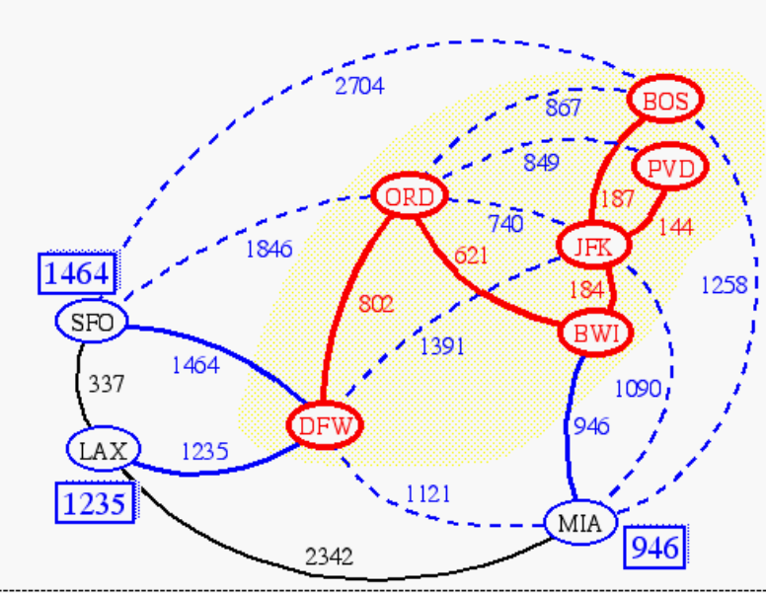
Prim-Jarnik’s Algorithm
Similar to Dijkstra’s algorithm (for a connected graph)
We pick an arbitrary vertex s and we grow the MST as a cloud of vertices, starting from s
We store with each vertex v a label d(v) = the smallest weight of an edge connecting v to a vertex in the cloud
At each step:
  We add to the cloud the vertex u outside the cloud with the smallest distance label
  We update the labels of the vertices adjacent to u

Slide 28
Example
∞
7
2
7
D
2
7
D
B
4
B
4
8
9
∞
5
9
∞
2
5
F
2
5
F
C
8
C
8
8
3
8
3
E
E
A
7
7
A
7
7
0
0
7
7
2
7
D
7
D
B
4
2
B
4
5
9
∞
9
4
2
5
F
5
5
C
2
F
8
C
8
8
3
3
E
8
A
7
E
0
7
A
7
7
0

Slide 29
Example (contd.)
7
2
7
D
B
4
5
9
4
2
5
F
C
8
8
3
E
A
7
3
7
0
7
D
2
B
4
5
9
4
2
5
F
C
8
8
3
E
A
7
3
0

Slide 30
Prim-Jarnik’s Algorithm (cont.)
A priority queue stores the vertices outside the cloud
  Key: distance
  Element: vertex
Locator-based methods
  insert(k,e) returns a locator
  replaceKey(l,k) changes the key of an item
We store three labels with each vertex:
  Distance
  Parent edge in MST
  Locator in priority queue
Algorithm PrimJarnikMST(G)
Q ← new heap-based priority queue
s ← a vertex of G
for all v ∈ G.vertices()
if v = s
setDistance(v, 0)
else
setDistance(v, ∞)
setParent(v, ∅)
l ← Q.insert(getDistance(v), v)
  setLocator(v,l)
  while ¬Q.isEmpty()
  u ← Q.removeMin()
  for all e ∈ G.incidentEdges(u)
  z ← G.opposite(u,e)
  r ← weight(e)
  if r < getDistance(z)
  setDistance(z,r)
  setParent(z,e)
  Q.replaceKey(getLocator(z),r)

Slide 31
Analysis
Graph operations
  Method incidentEdges is called once for each vertex
Label operations
  We set/get the distance, parent and locator labels of vertex z O(deg(z)) times
  Setting/getting a label takes O(1) time
Priority queue operations
  Each vertex is inserted once into and removed once from the priority queue, where each insertion or removal takes O(log n) time
  The key of a vertex w in the priority queue is modified at most deg(w) times, where each key change takes O(log n) time
Prim-Jarnik’s algorithm runs in O((n + m) log n) time provided the graph is represented by the adjacency list structure
  Recall that Σ_{v} deg(v) = 2m
The running time is O(m log n) since the graph is connected

Slide 32
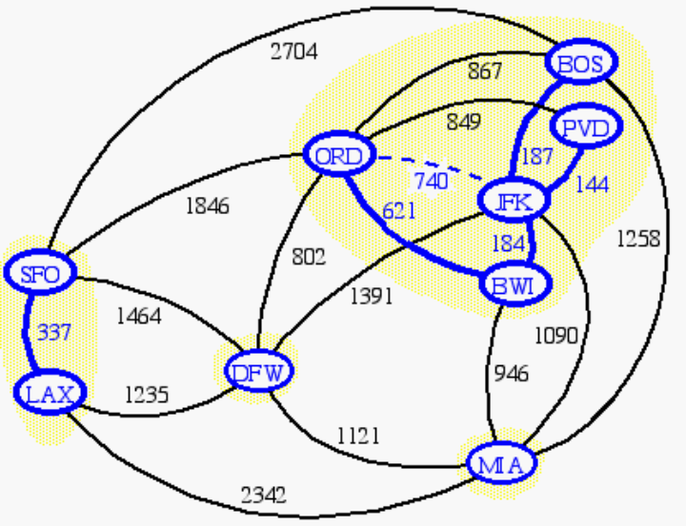
Basic Idea for Kruskal’s Algorithm
This algorithm maintains a forest of trees.
Initially, each vertex is its own tree.
Edges are then considered iteratively in order by increasing weight.
An edge is accepted it if connects distinct trees and discarded if it is in the same tree.
When an edge is accepted, the two trees are merged into one.

Slide 33
Kruskal Example
2704
867
BOS
849
PVD
ORD
187
740
144
1846
621
JFK
184
1258
802
SFO
BWI
1391
1464
337
1090
DFW
946
LAX
1235
1121
MIA
2342

Slide 34
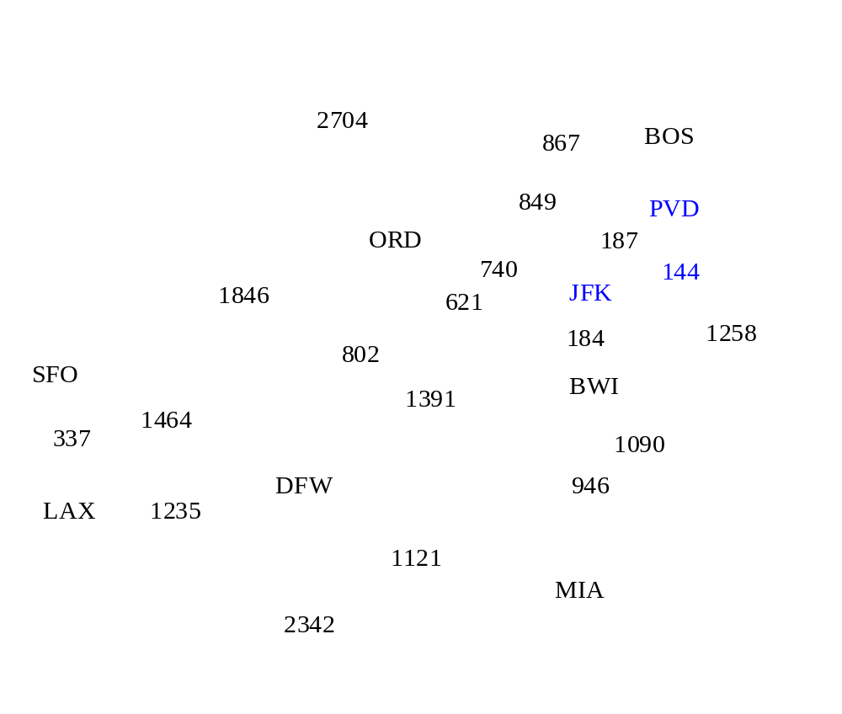
Example

Slide 35
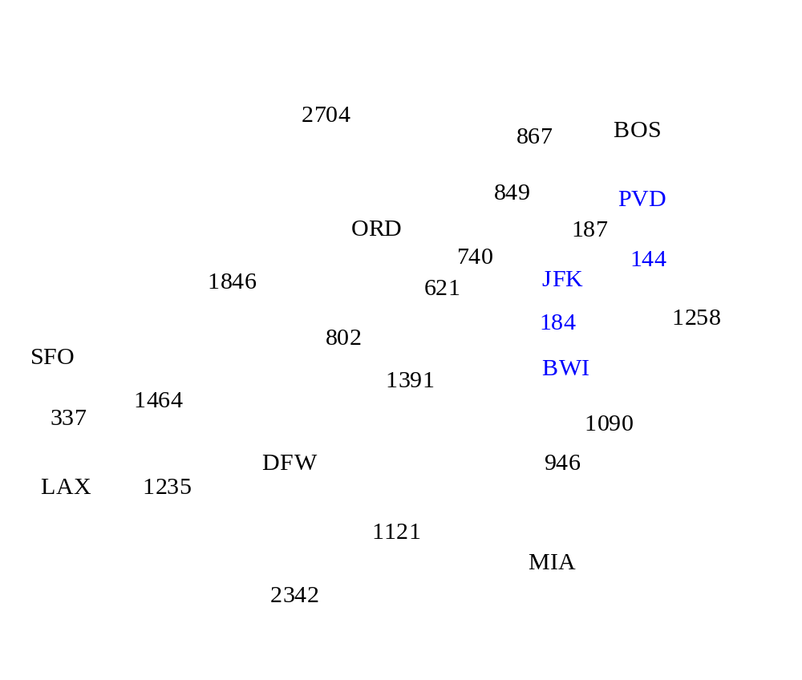
Example

Slide 36
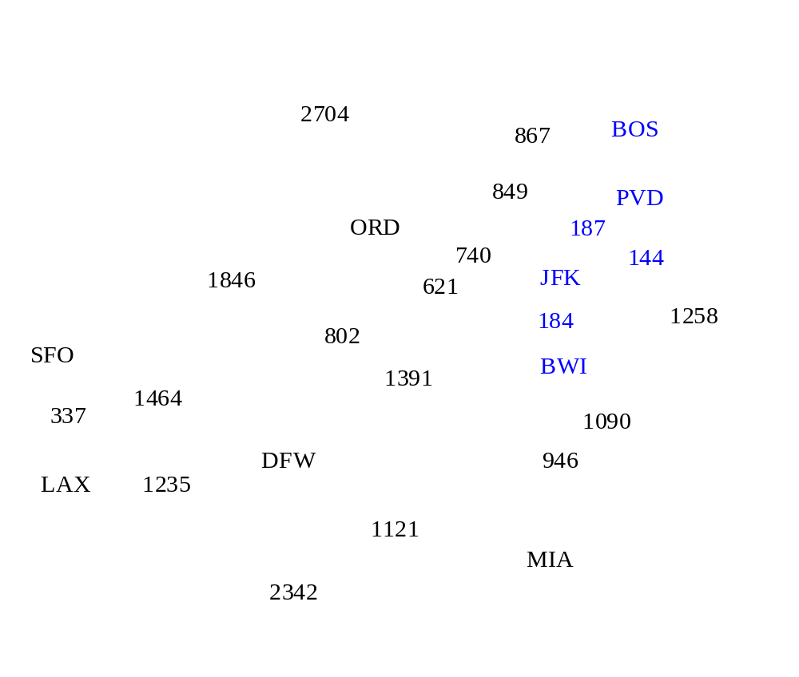
Example

Slide 37
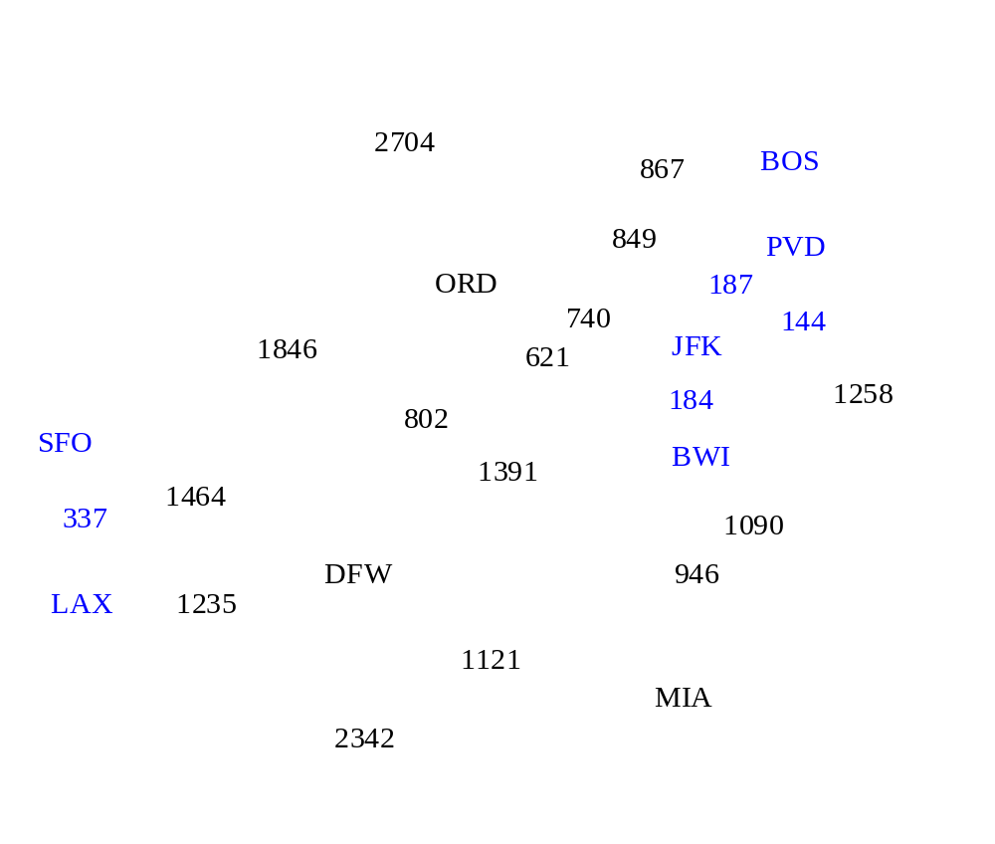
Example

Slide 38
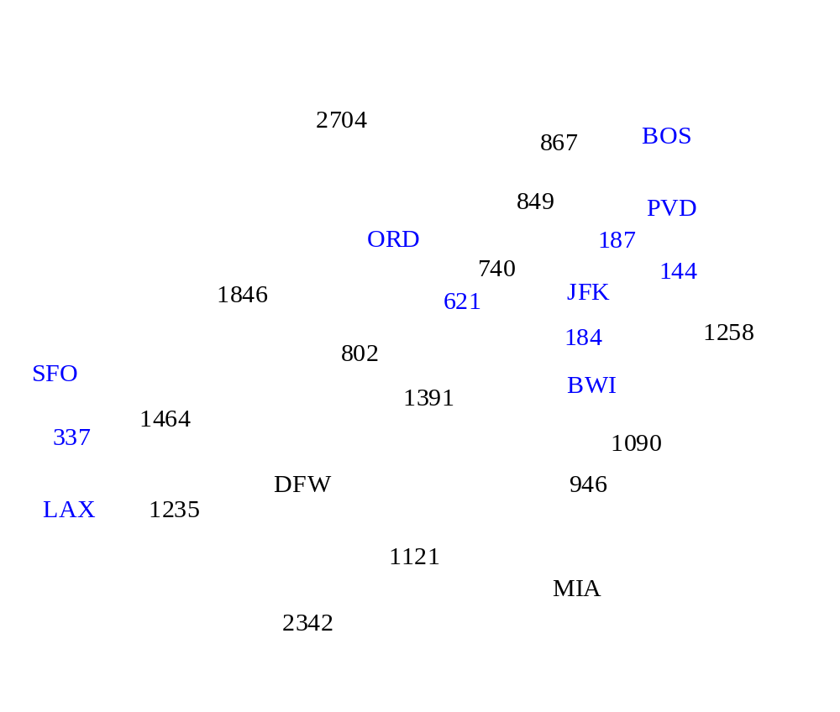
Example

Slide 39
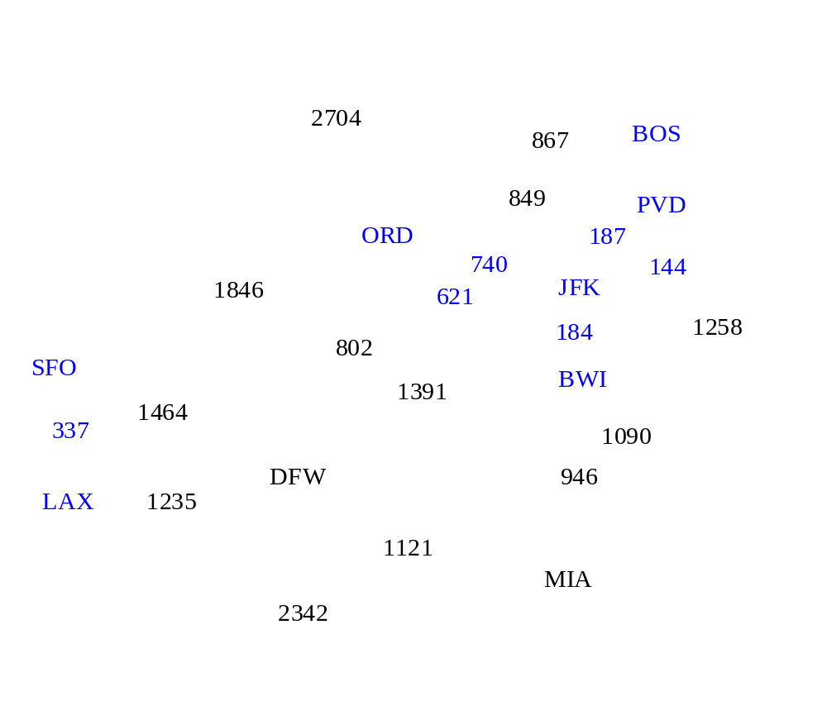
Example

Slide 40
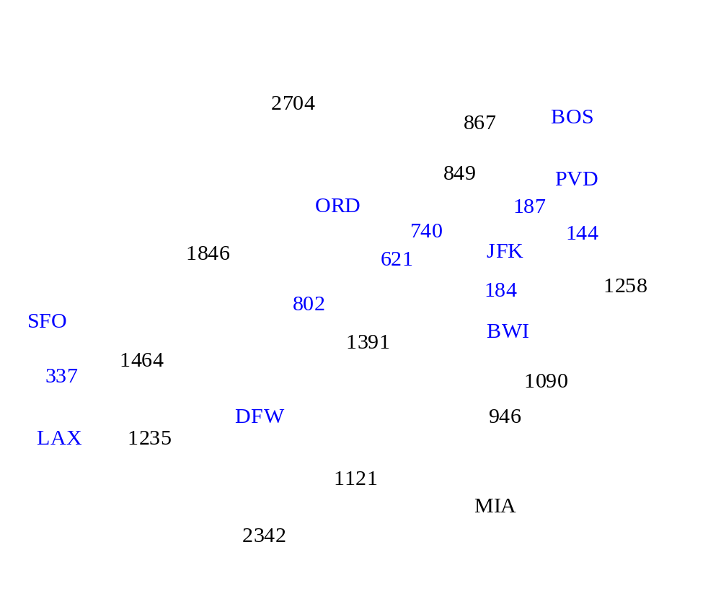
Example

Slide 41
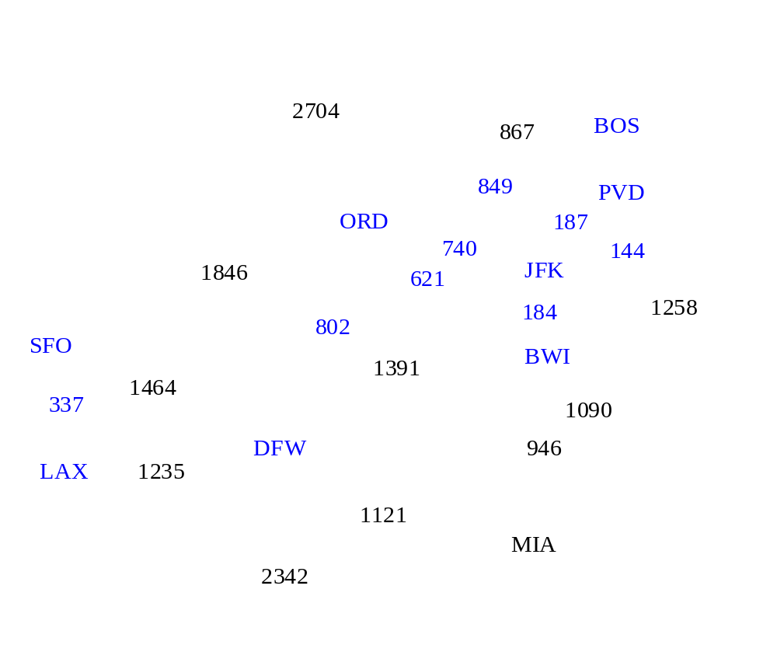
Example

Slide 42
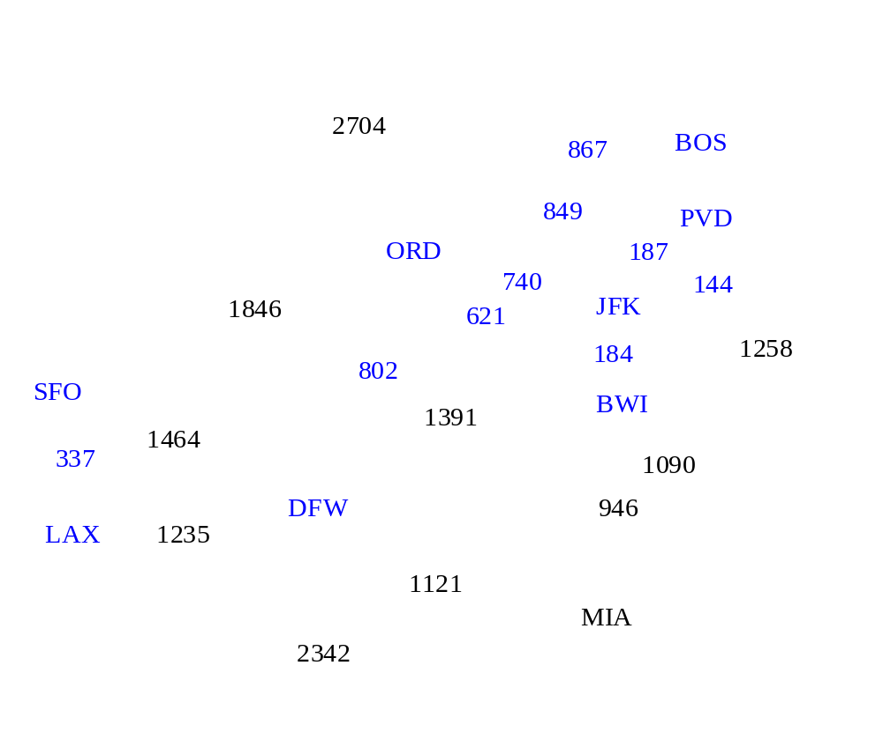
Example

Slide 43

Example

Slide 44
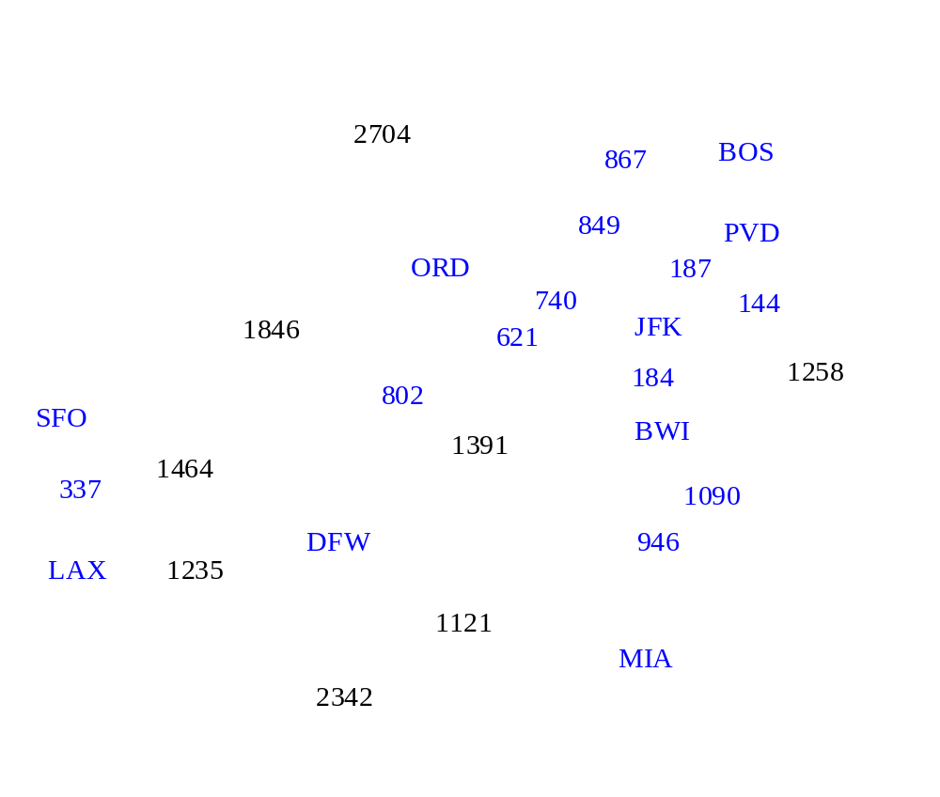
Example

Slide 45

Example

Slide 46
Example
2704
867
BOS
849
PVD
ORD
187
740
144
1846
621
JFK
184
1258
802
SFO
BWI
1391
1464
337
1090
DFW
946
LAX
1235
1121
MIA
2342

Slide 47
Kruskal’s Algorithm
A priority queue stores the edges outside the cloud
  Key: weight
  Element: edge
At the end of the algorithm
  We are left with one cloud that encompasses the MST
  A tree T which is our MST
Algorithm KruskalMST(G)
for each vertex V in G do
define a Cloud(v) of ← {v}
let Q be a priority queue.
Insert all edges into Q using their weights as the key
T ← ∅
while T has fewer than n-1 edges do edge e = T.removeMin()
Let u, v be the endpoints of e
if Cloud(v) ≠ Cloud(u) then
Add edge e to T
Merge Cloud(v) and Cloud(u)
return T

Slide 48
Implementing Kruskal’s Algorithm
We need a data structure that maintains a partition, i.e., a collection of disjoint sets, with the operations:
-find(u): return the set storing u
-union(u,v): replace the sets storing
u and v with their union
-makeSet(e): Create a singleton set containing the element e and return a locator for e
and implements these efficiently.

Slide 49
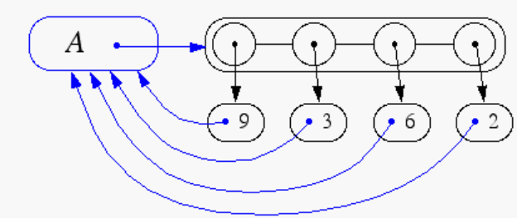
Representation of a Partition
Each set is stored in a sequence
Each element has a reference back to the set
  operation find(u) takes O(1) time, and returns the set of which u is a member.
  in operation union(u,v), we move the elements of the smaller set to the sequence of the larger set and update their references
  the time for operation union(u,v) is min(n_{u},n_{v}), where n_{u} and n_{v} are the sizes of the sets storing u and v
Whenever an element is processed, it goes into a set of size at least double, hence each element is processed at most log n times

Slide 50
Partition-Based Implementation
A partition-based version of Kruskal’s Algorithm performs cloud merges as unions and tests as finds.
Algorithm Kruskal(G):
Input: A weighted graph G.
Output: An MST T for G.
Let P be a partition of the vertices of G, where each vertex forms a separate set.
Let Q be a priority queue storing the edges of G, sorted by their weights
Let T be an initially-empty tree
while Q is not empty do
(u,v) ← Q.removeMinElement()
if P.find(u) != P.find(v) then
Add (u,v) to T
P.union(u,v)
return T
Running time: O((n+m)log n)

Slide 51
Baruvka’s Algorithm
Like Kruskal’s Algorithm, Baruvka’s algorithm grows many “clouds” at once.
Each iteration of the while-loop halves the number of connected compontents in T.
  The running time is O(m log n).
Algorithm BaruvkaMST(G)
T ← V {just the vertices of G}
while T has fewer than n-1 edges do
for each connected component C in T do
Let edge e be the smallest-weight edge from C to another component in T.
if e is not already in T then
Add edge e to T
return T

Slide 52
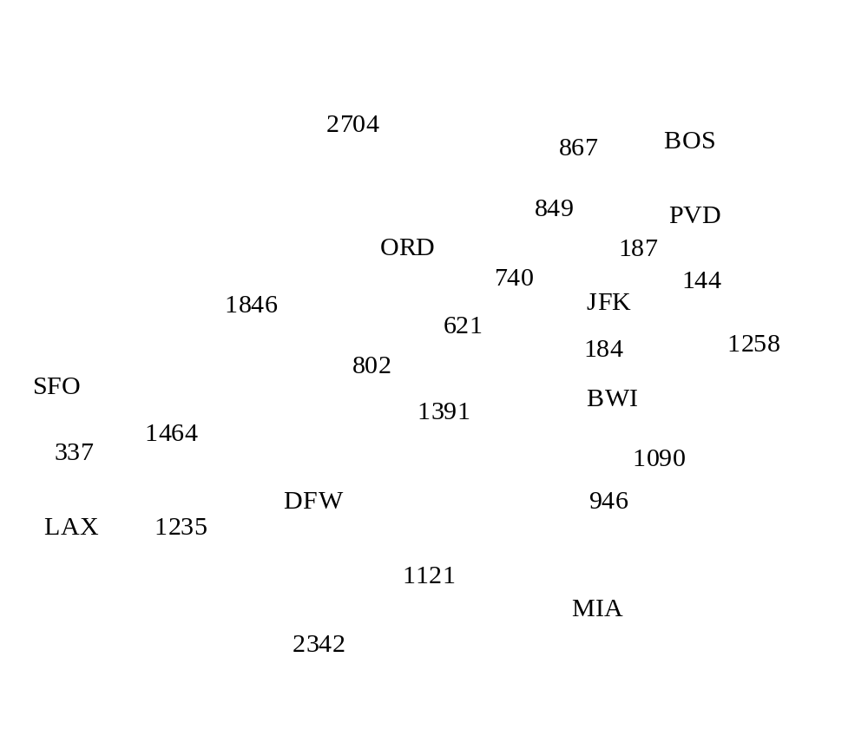
Baruvka Example

Slide 53
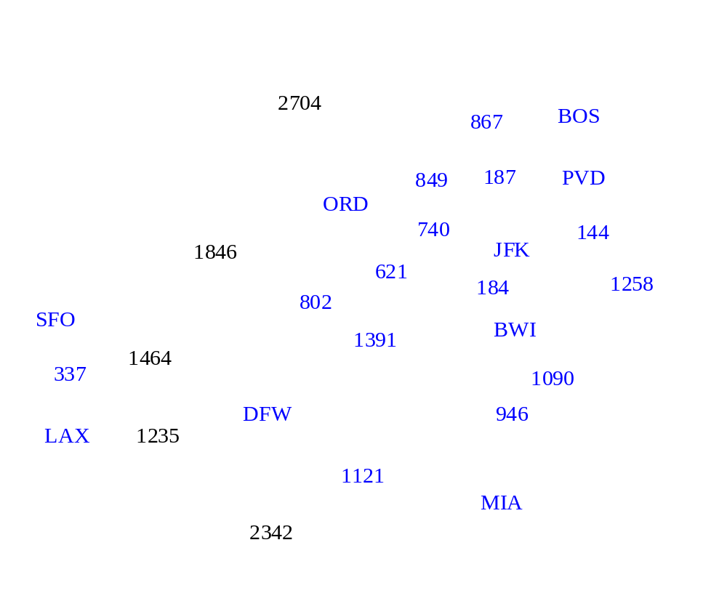
Example

Slide 54
Example
2704
867
BOS
849
187
PVD
ORD
740
144
1846
JFK
621
184
1258
802
SFO
BWI
1391
1464
337
1090
DFW
946
LAX
1235
1121
MIA
2342

Slide 55
Baruvka Algorithm
Quite simple if we do the following:
Maintain a forest T subject to edge insertions.
  O(1) time using an adjacency list
Identify connected components
  O(n) time using a depth first search of T
Mark vertices with the name of the cluster they belong to
  Add an extra instance variable for each vertex
Identify a smallest-weight edge incident upon a cluster
  Scan the adjacency lists for the cluster.

