Slide 1
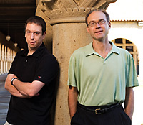
Computer Security
CS 155
Spring 2008
Dan Boneh and John Mitchell
http://crypto.stanford.edu/cs155

Slide 2
What’s this course about?
Some challenging fun projects
  Learn about attacks
  Learn about preventing attacks
Lectures on many topics
  Application security
  Operating system security
  Network security
  not a course on Cryptography (take CS255)

Slide 3
General course info (see web)
Prerequisite: Operating systems (CS140)
Textbook: none – reading online
Coursework
  3 projects, 2 homeworks, final exam
  grade: 0.3 H + 0.5 P + 0.2 F
Teaching assistants
  Mike Hamburg, Gary Luu, Craig Gentry, Naef Imam, Arnab Roy
Occasional optional section
  Fridays, 4:15 - 5:05, Gates B03 (live on E4)

Slide 4


Current Trends

Slide 5
Some things in the news
Nigerian letter (419 Scams) still works:
  Michigan Treasurer Sends 1.2MUSD of State Funds !!!
Many zero-day attacks in 2007
  Google, Excel, Word, Powerpoint, Office …
Numerous stolen or lost laptops, storage media, containing customer information
  Second-hand computers (hard drives) pose risk
Phishing fraudsters get flashy
Vint Cerf estimates ¼ of PCs on Internet are bots
Undetected for 50 days, Gozi trojan steals data from SSL streams

Slide 6
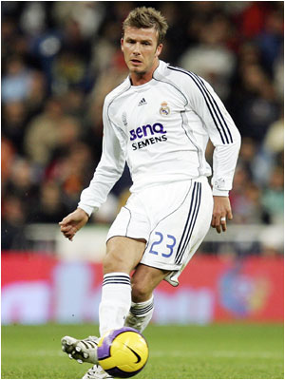
Steal cars with a laptop
NEW YORK - Security technology created to protect luxury vehicles may now make it easier for tech-savy thieves to drive away with them.
In April ‘07, high-tech criminals made international headlines when they used a laptop and transmitter to open the locks and start the ignition of an armor-plated BMW X5 belonging to soccer player David Beckham, the second X5 stolen from him using this technology within six months.
… Beckham's BMW X5s were stolen by thieves who hacked into the codes for the vehicles' RFID chips …

Slide 7
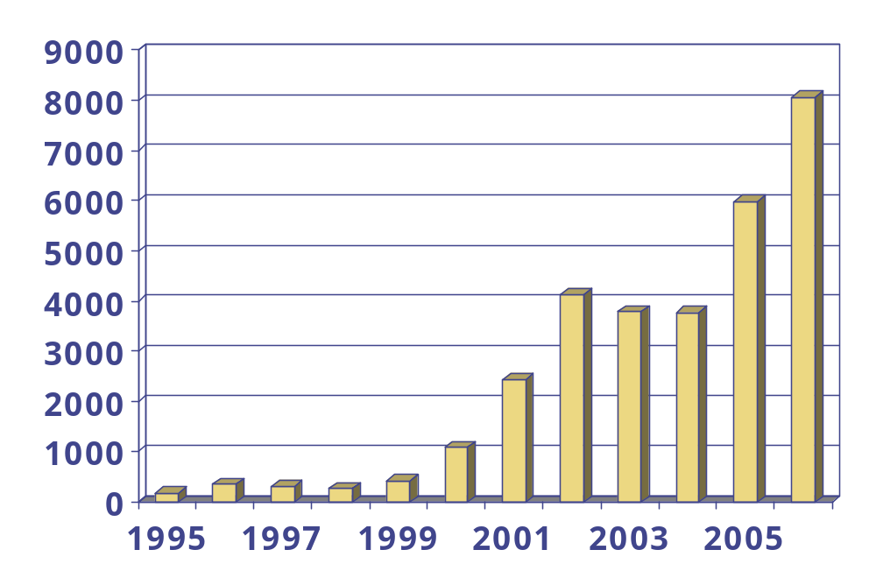
How big is the security problem?
CERT Vulnerabilities reported
http://www.cert.org/stats/

Slide 8

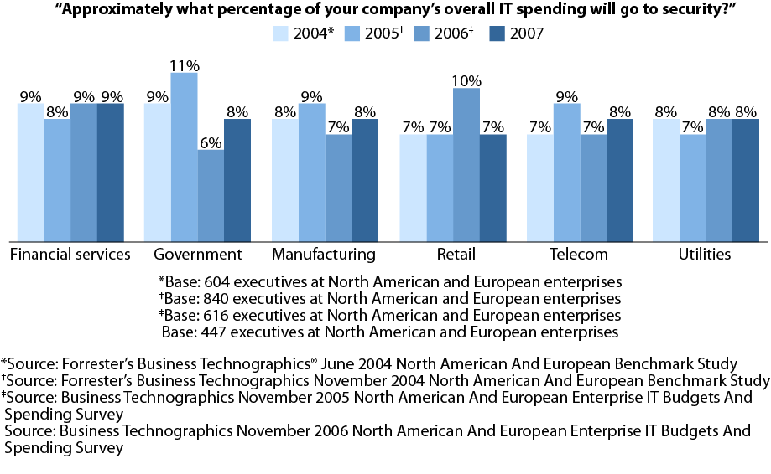
Security Spending Variance By Industry
January 2007, Trends “2007 Security Budgets Increase: The Transition To Information Risk Management Begins”

Slide 9
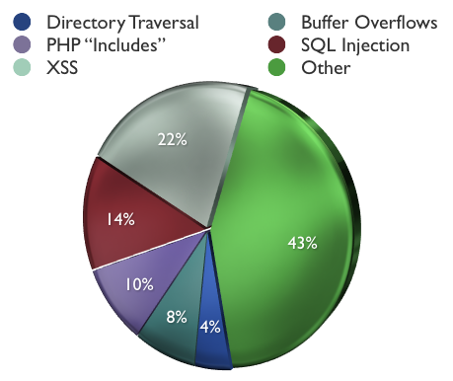
Most-common attacks on systems
2006 MITRE CVE stats:
  21.5 % of CVEs were XSS
  14 percent SQL injection
  9.5 percent php "includes“
  7.9 buffer overflow.
  2005 was the first year that XSS jumped ahead of buffer overflows …

Slide 10
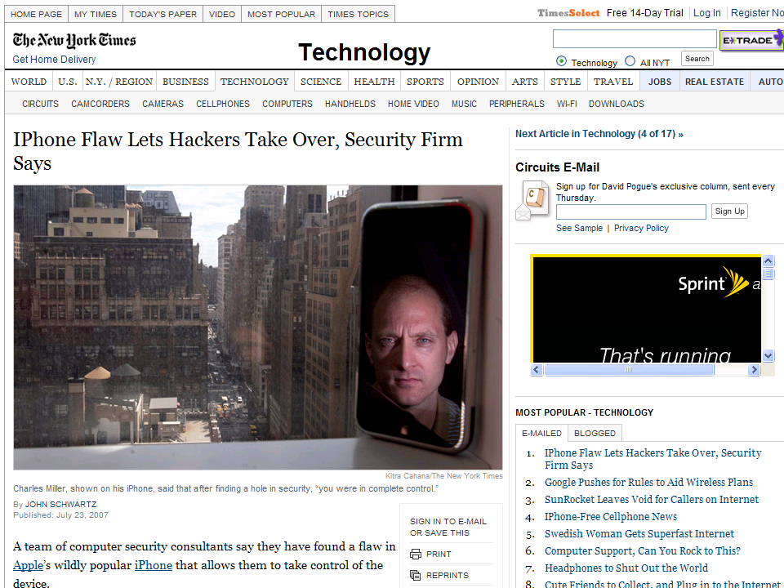

Slide 11
iPhone attack (summer 2007)
iPhone Safari downloads malicious web page
  Arbitrary code is run with administrative privileges
  Can read SMS log, address book, call history, other data
  Can perform physical actions on the phone.
    system sound and vibrate the phone for a second
    could dial phone numbers, send text messages, or record
    audio (as a bugging device)
  Transmitted any collected data over network to attacker
See http://www.securityevaluators.com/iphone/

Slide 12
iPhone security measures
“Reduced attack surface”
  Stripped down and customized version of Mac OS X
    does not have common binaries such as bash, ssh, or even ls.
  MobileSafari - many features of Safari have been removed
    No Flash plug-in, many file types cannot be downloaded
Some internal protection
  If USB syncing with iTunes, file system cannot be mounted
  File system accessible to iTunes is chroot’ed
Weak security architecture
  All processes of interest run with administrative privileges
  iPhone does not utilize some widely accepted practices
    Address randomization
      Each time a process runs, the stack, heap, and executable code located at precisely the same spot in memory
    Non-executable heaps
      Buffer overflow on heap can write executable instructions

Slide 13
Analysis methods
Extract and statically analyze binaries
  Using jailbreak and iPhoneInterface,
Audit related open-source code
  MobileSafari and MobileMail applications are based on the open source WebKit project
Dynamic analysis, or “fuzzing”
  Sending malformed data to cause a fault or crash
  Look at error messages, memory dump, etc.
MobileSafari attack discovered using fuzzing
  What kind of vulnerability do you think it was?

Slide 14
Suggestions for improvement
Run applications as an unprivileged user
  This would result in a successful attacker only gaining the rights of this unprivileged user.
chroot apps to prevent access to unrelated data
  MobileSafari does not need access to email or SMS msgs
  MobileMail deos not need access to browsing history
Add heap and stack address randomization
  This will serve to make the development of exploits for vulnerabilities more difficult
Memory protection: no pages both writable and executable
See http://www.securityevaluators.com/iphone/exploitingiphone.pdf

Slide 15
Why are there security problems?
Lots of buggy software...
  Why do programmers write insecure code?
  Awareness is the main issue
Some contributing factors
  Few courses in computer security
  Programming text books do not emphasize security
  Few security audits
  C is an unsafe language
  Programmers are lazy
  Legacy software (some solutions, e.g. Sandboxing)
  Consumers do not care about security
  Security is expensive and takes time

Slide 16
If you remember only one thing from this course:
A vulnerability that is “too complicated for anyone to ever find” will be found !
We hope you remember more than one thing

Slide 17
Ethical use of security information
We discuss vulnerabilities and attacks
  Most vulnerabilities have been fixed
  Some attacks may still cause harm
  Do not try these at home
Purpose of this class
  Learn to prevent malicious attacks
  Use knowledge for good purposes

Slide 18
Law enforcement
Sean Smith
  Melissa virus: 5 years in prison, $150K fine
Ehud Tenenbaum (“The Analyzer”)
  Broke into US DoD computers
  6 mos service, suspended prison, $18K fine
Dmitry Sklyarov
  Broke Adobe ebooks
  Prosecuted under DMCA

Slide 19
Difficult problem: insider threat
Easy to hide code in large software packages
  Virtually impossible to detect back doors
  Skill level needed to hide malicious code is much lower than needed to find it
  Anyone with access to development environment is capable
slides: Avi Rubin

Slide 20
Example insider attack
Hidden trap door in Linux, Nov 2003
  Allows attacker to take over a computer
  Practically undetectable change
  Uncovered by anomaly in CVS usage
Inserted line in wait4()
  Looks like a standard error check
  Anyone see the problem?
if ((options == (__WCLONE|__WALL)) && (current->uid = 0))
retval = -EINVAL;
See: http://lwn.net/Articles/57135/

Slide 21
Example #2
Rob Harris case - slot machines
  an insider: worked for Gaming Control Board
Malicious code in testing unit
  when testers checked slot machines
    downloaded malicious code to slot machine
  was never detected
  special sequence of coins activated “winning mode”
Caught when greed sparked investigation
  $100,000 jackpot

Slide 22
Example #3
Breeder’s cup race
  Upgrade of software to phone betting system
  Insider, Christopher Harn, rigged software
  Allowed him and accomplices to call in
    change the bets that were placed
    undetectable
  Caught when got greedy
    won $3 million
http://horseracing.about.com/library/weekly/aa110102a.htm

Slide 23
Software dangers
Software is complex
  top metric for measuring #of flaws is lines of code
Windows Operating System
  tens of millions of lines of code
  new “critical” security bug announced every week
Unintended security flaws unavoidable
Intentional security flaws undetectable

Slide 24

Ken Thompson
What code can we trust?
  Consider "login" or "su" in Unix
  Is RedHat binary reliable?
  Does it send your passwd to someone?
Can't trust binary so check source, recompile
  Read source code or write your own
  Does this solve problem?
Reflections on Trusting Trust, http://www.acm.org/classics/sep95/

Slide 25
Compiler backdoor
This is the basis of Thompson's attack
  Compiler looks for source code that looks like login program
  If found, insert login backdoor (allow special user to log in)
How do we solve this?
  Inspect the compiler source

Slide 26
C compiler is written in C
Change compiler source S
  compiler(S) {
  if (match(S, "login-pattern")) {
  compile (login-backdoor)
  return
  }
  if (match(S, "compiler-pattern")) {
  compile (compiler-backdoor)
  return
  }
  .... /* compile as usual */
  }

Slide 27
Clever trick to avoid detection
Compile this compiler and delete backdoor tests from source
  Someone can compile standard compiler source to get new compiler, then compile login, and get login with backdoor
Simplest approach will only work once
  Compiling the compiler twice might lose the backdoor
  But can making code for compiler backdoor output itself
    (Can you write a program that prints itself? Recursion thm)
Read Thompson's article
  Short, but requires thought

Slide 28

Social engineering
Many examples
  We are not going to talk about social engineering a lot, but good to remember that there are many attacks that don't use computers
  Call system administrator
  Dive in the dumpster
  Online version
    send trojan in email
    picture or movie with malicious code

Slide 29
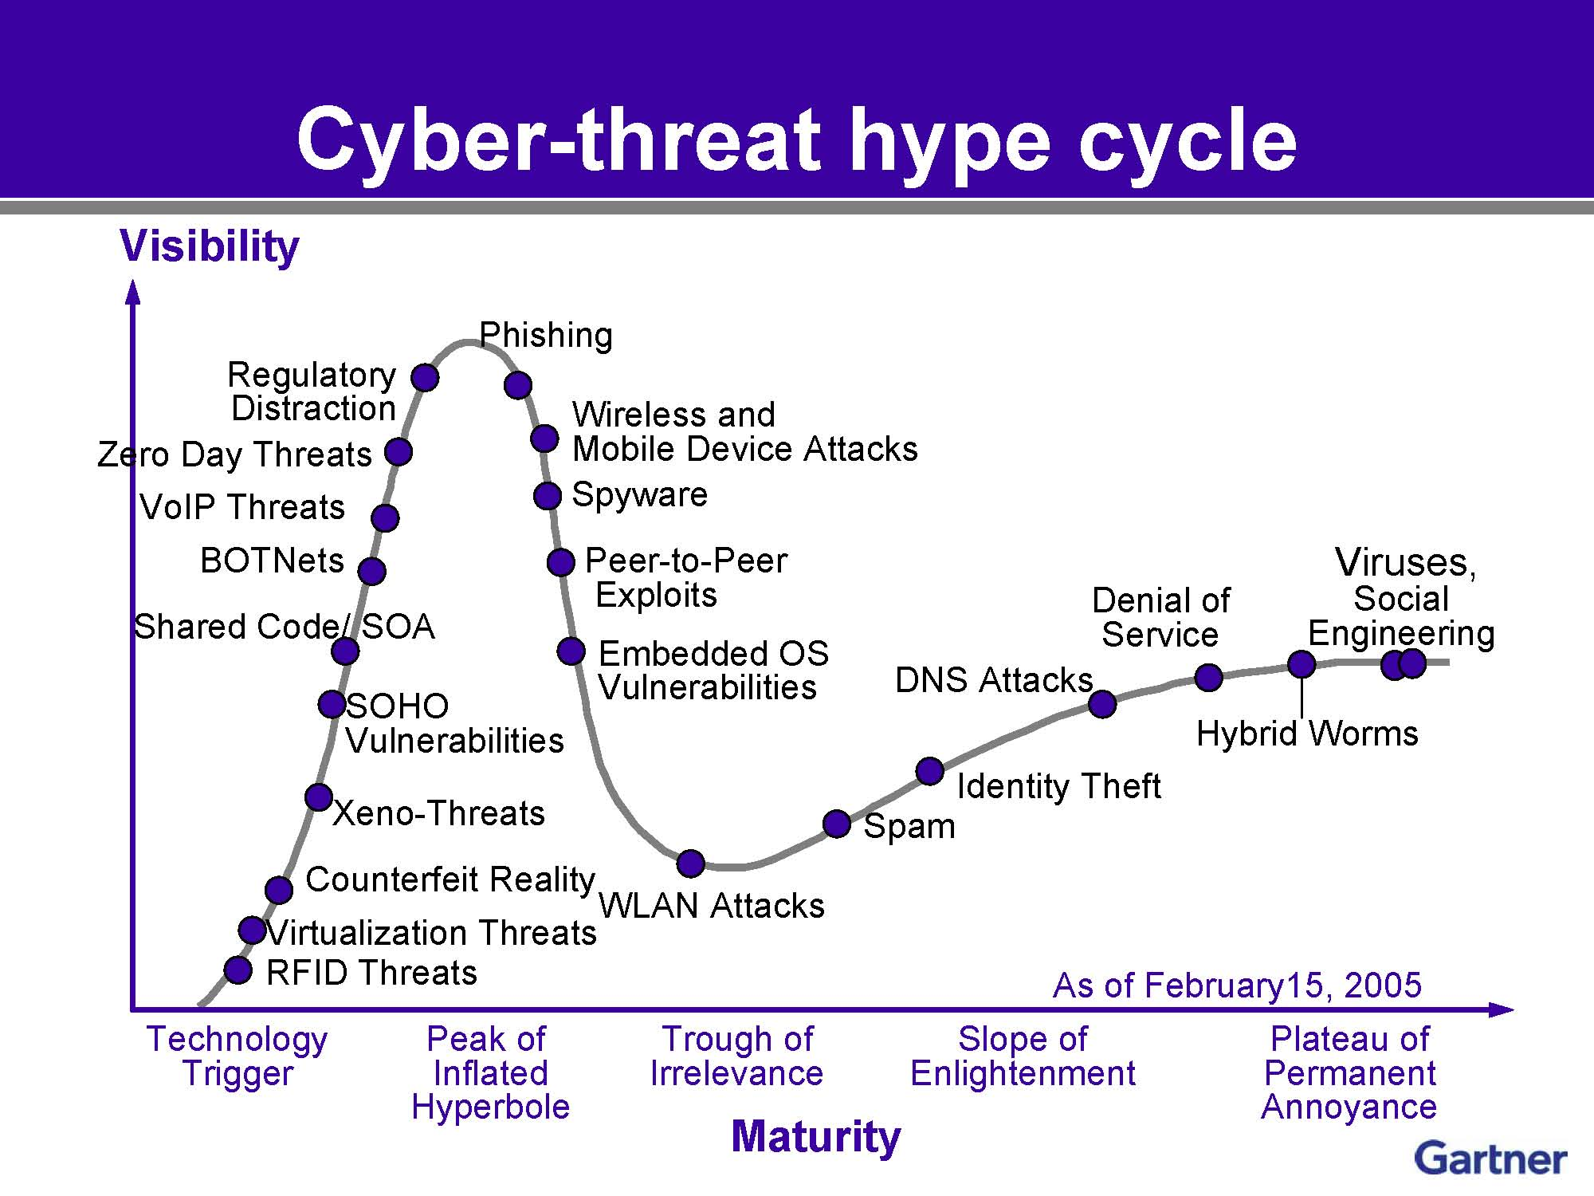

Slide 30
