Slide 1
Security in Networks
Chapter 7
Part 1

Slide 2
Basic Concepts

Slide 3
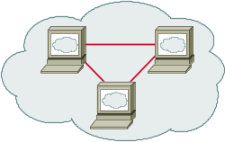


Internet Infrastructure
Backbone
ISP
ISP
Local and interdomain routing
  TCP/IP for routing, connections
  BGP for routing announcements
Domain Name System
  Find IP address (i.e. 206.57.41.44) from symbolic name (i.e. cs.hiram.edu)

Slide 4
TCP/IP
The Transmission Control Protocol (TCP) is one of the core protocols of the Internet Protocol Suite.
TCP is so central that the entire suite is often referred to as "TCP/IP."
IP handles lower-level transmissions from computer to computer as a message makes its way across the Internet
TCP operates at a higher level, concerned only with the two end systems, for example a Web browser and a Web server.

Slide 5
TCP/IP
TCP provides reliable delivery of a stream of bytes from one program on one computer to another program on another computer.
Besides the Web, other common applications of TCP include e-mail and file transfer.
Among its management tasks, TCP controls message size, the rate at which messages are exchanged, and network traffic congestion.

Slide 6
BGP
The Border Gateway Protocol (BGP) is the core routing protocol of the Internet.
It works by maintaining a table of IP networks or 'prefixes' which designate network reachability among autonomous systems.
It is described as a path vector protocol. BGP does not use traditional metrics, but makes routing decisions based on path, network policies or rule sets.

Slide 7
IP Addresses
Every device connected to the public Internet is assigned a unique number known as an Internet Protocol (IP) address.
IP addresses consist of four numbers separated by periods (also called a 'dotted-quad') and look something like 127.0.0.1.
Since these numbers are usually assigned to internet service providers within region-based blocks, an IP address can often be used to identify the region or country from which a computer is connecting to the Internet.

Slide 8
IP Addresses
An IP address can sometimes be used to show the user's general location.
Because the numbers may be tedious to deal with, an IP address may also be assigned to a Host name, which is sometimes easier to remember.
Hostnames may be looked up to find IP addresses, and vice-versa.
At one time ISPs issued one IP address to each user.
These are called static IP addresses.

Slide 9
IP Addresses
The IP address can provide additional information about an IP address.
These details include the hostname, geographic location information (includes country, region/state, city, latitude, longitude and telephone area code.), and a location specific map.
The geographic details are pulled from a commercially available geolocation database.

Slide 10
IP Addresses
Geolocation technology can never be 100% accurate in providing the location of an IP address.
When the IP address is a proxy server and it does not expose the user's IP address it is virtually impossible to locate the user.
The country accuracy is estimated at about 99%.
For IP addresses in the United States, it is 90% accurate on the state level, and 81% accurate within a 25 mile radius.
World-wide users indicate 60% accuracy within 25 miles.

Slide 11
What is a Proxy Server?
A proxy server is a server on a network which services the requests of its clients by forwarding requests to other servers.
A client connects to the proxy server, requesting some service, such as a file, connection, web page, or other resource, available from a different server.
The proxy server provides the resource by connecting to the specified server or to another proxy server and, eventually, requesting the service on behalf of the client.

Slide 12
There Are Many Kinds of Proxy Servers
We're concerned here with the following:
Anonymous proxy server
  An anonymous proxy server (sometimes called a web proxy) generally attempts to provide a certain degree of anonymous web surfing.
  These can easily be overridden by site administrators, and thus rendered useless in some cases.

Slide 13
Hostile proxy server
  Proxies can be installed by online criminals, in order to eavesdrop upon the dataflow between the client machine and the web.
  All accessed pages, as well as all forms submitted, can be captured and analyzed by the proxy operator.
  For this reason, passwords to online services should be changed if an unauthorized proxy is detected.

Slide 14
Transparent proxy server
A transparent proxy is a proxy that does not modify the request or response beyond what is required for proxy authentication and identification.
Some providers of proxy server listings specify additional modifying words such as high anonymous proxy server or elite anonymous proxy server.
There are clear definitions for these.

Slide 15
Some of the Reasons for Using a Proxy
It helps provide a way to hide your identity from the sites which can see your personal information.
It can provide you greater flexibility to control your network.
It can give access to sites which are blocked in your area.
Some times it increases the browsing speed by storing frequently used pages in cache.
Since an identity can be hid, a cracker can enter sites without revealing who they are.

Slide 16
Where are Some of the Proxy Servers?
There are many lists available:
http://www.proxy4free.com/page1.html
http://samair.ru/proxy/
Tor is both a network of proxy servers and software that allow access to the network which is run by volunteers.
  The free software for accessing Tor can be found at http://www.torproject.org/index.html.en
I do not guarantee that these are secure.

Slide 17
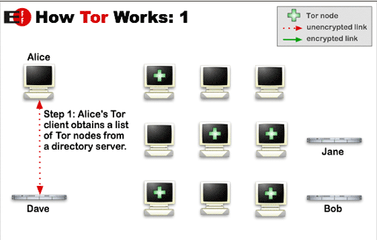
How Tor Works
Tor helps to reduce the risks of traffic analysis by distributing transactions over several places on the Internet, so no single point can link source to destination.
http://www.torproject.org/overview.html.en

Slide 18
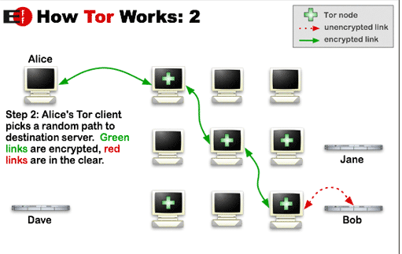
The user's software or client incrementally builds a circuit of individually negotiated encrypted connections through relays on the network.
The circuit is extended one hop at a time.
Each relay along the way knows only which relay gave it data and which relay it is giving data to.
No individual relay ever knows the complete path that a data packet has taken.

Slide 19
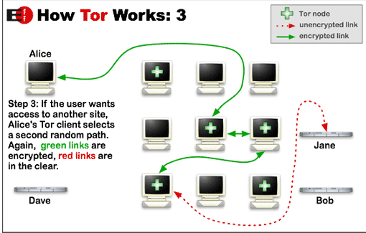
Once a circuit has been established, data can be exchanged and some software applications can be deployed over the Tor network.
Each relay sees only one hop in the circuit.
For efficiency, the Tor software uses the same circuit for connections that happen within the same ten minutes or so.
Later requests are given a new circuit, to prevent the linking of earlier actions to the new ones.

Slide 20
Risks With Some Proxy Servers
A malicious proxy server can record everything sent to it: including unencrypted logins and passwords.
By chaining proxies which do not reveal data about the original requester, it is possible to obfuscate activities from the eyes of the user's destination.
  However, then more traces will be left on the intermediate hops, which could be used to trace the user's activities.

Slide 21
Risks With Some Proxy Servers
If the policies and administrators of these other proxies are unknown, the user may fall victim to a false sense of security just because those details are out of sight and mind.
Be wary when using proxy servers, and only use proxy servers of known integrity.
If there is no choice but to use unknown proxy servers, do not pass any private information (unless it is properly encrypted) through the proxy.

Slide 22
Risks With Some Proxy Servers
In what is more of an inconvenience than a risk, proxy users may find themselves being blocked from certain Web sites, as numerous forums and Web sites block IP addresses from proxies known to have spammed or trolled the site.
There is still another problem to overcome when you wish to make an anonymous connection.
Your browser broadcasts a lot of information about you.

Slide 23
IP Addresses
An IP address (or Internet Protocol address) is a unique address that certain electronic devices use in order to identify and communicate with each other on a computer network utilizing the Internet Protocol standard (IP)- i.e., a computer address.
Any participating network devices such as routers, switches, computers, infrastructure servers, printers, Internet fax machines, and some telephones—can have its own address that is unique within the scope of the specific network.
Some IP addresses are intended to be unique within the scope of the global Internet, while others need to be unique only within a local scope.

Slide 24
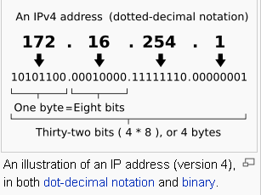
Format of an IP Address
The Internet Protocol (IP) has two versions currently in use.
Each version has its own format.
Because of its prevalence, "IP address" typically refers to those defined by IPv4, and this is the only one we'll consider.
http://en.wikipedia.org/wiki/IP_address

Slide 25
Obtaining an IP Address
On the public Internet, IP addresses are managed and created by the Internet Assigned Numbers Authority (IANA).
The IANA generally allocates super-blocks to Regional Internet Registries, who in turn allocate smaller blocks to Internet service providers and enterprises.
A system administrator, after obtaining the first two numbers of an IP address, can allocate the other two numbers for their private internets or intranets.

Slide 26
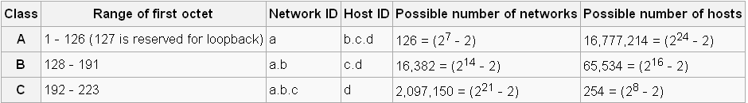
The IP Address Provides Some Information About the Possible Network Size
Currently, three classes of networks are used.
If a.b.c.d is the IP address, the chart below shows the relationship between the address and the possible size of a network.
Note: cs.hiram.edu is 206.57.41.44
home.hiram.edu is 143.206.107.71
http://en.wikipedia.org/wiki/IP_address

Slide 27
Unfortunately, the IP Address Provides More Than the Network Size
Many websites and most hackers use IP addresses to monitor your personal business
If your IP address is known, there is a lot of information immediately available about your computer configuration
Your home address and other personal information about you can be retrieved once your IP address is known

Slide 28
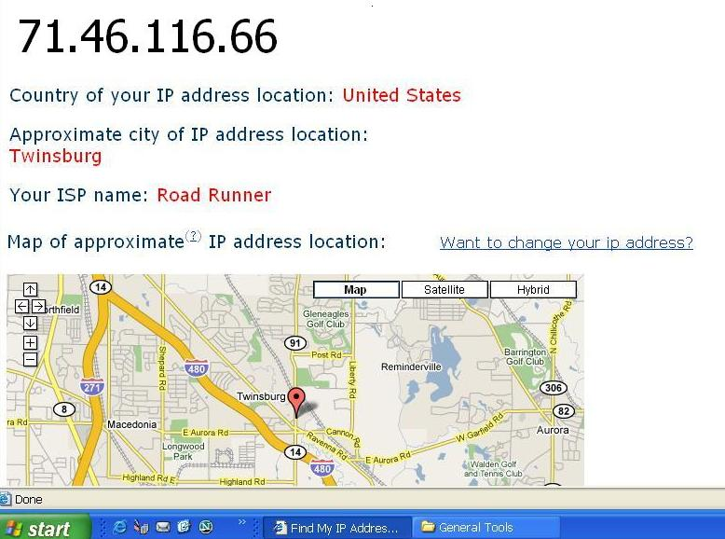
Before IP Address Is Hidden

Slide 29
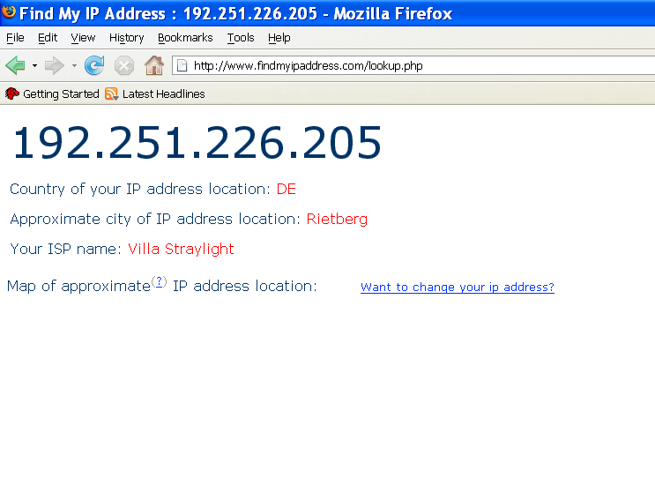
After Using Proxy Servers

Slide 30
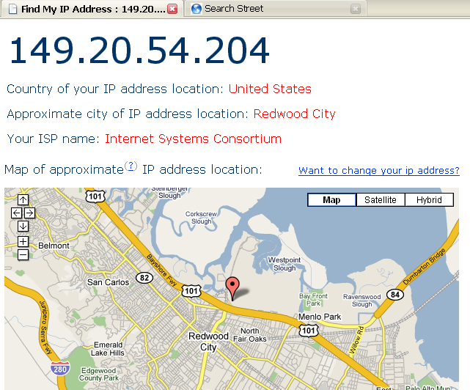
Another Session With Proxy Servers

Slide 31
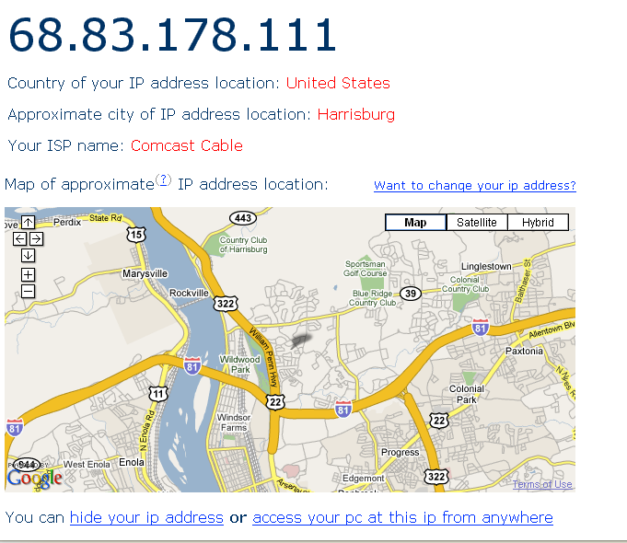
And, One More

Slide 32
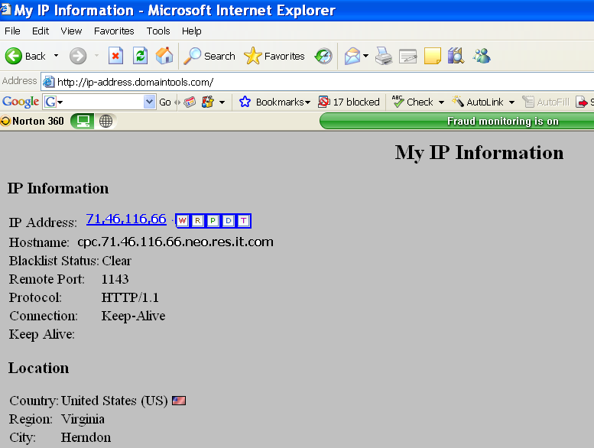
This Website Shows Even More for the IP Address

Slide 33
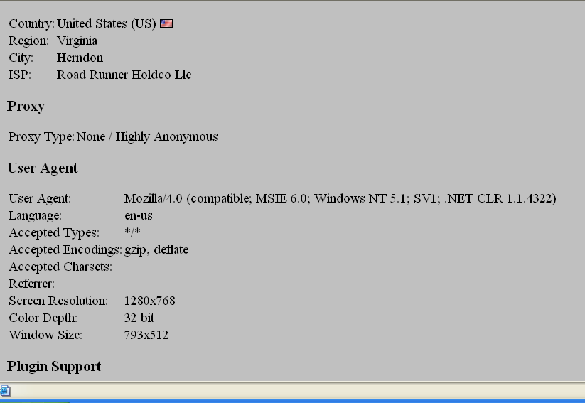
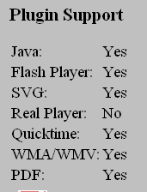

Slide 34
What is the Concern About Knowing This Information?

Slide 35
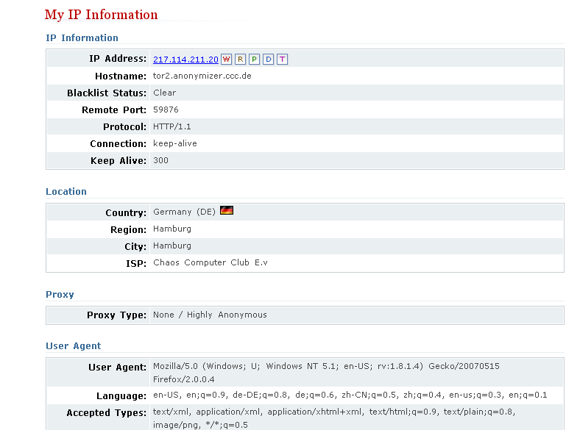
Using the Tor Network

Slide 36
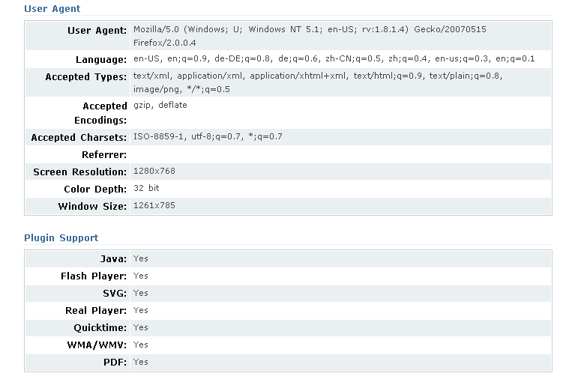

Slide 37
How Can You Net Surf Somewhat Anonymously?
Download software such as the Tor software (free) and use that network of proxies.
  Torbutton is a Firefox plugin that allows you to access the Tor network seamlessly.
  http://www.torproject.org/download.html.en
Change your IP address when you surf.
  There are many free and low cost services available for doing this.
  (free) http://www.computerhope.com/issues/ch000784.htm
  (low cost - changes IP and automatically uses Tor)- $29.95 http://www.hide-my-ip-address.com/hideip/?pu=false&srec=true

Slide 38
There Are Many Web Sites That Will Check Your IP Address
http://ip-address.domaintools.com/
http://www.findmyipaddress.com/lookup.php
http://www.findmyip.com/
http://www.hide-my-ip.com/
and many others exist!
Note: You should ALWAYS hide your IP address and use proxies if you decide to cruise hacker sites!!!

Slide 39
Pitfalls Still Exist When Using Proxy Networks Like Tor
Tor only protects Internet applications that are configured to send their traffic through Tor — it doesn't magically anonymize all your traffic just because you install it.
Browser plugins such as Java, Flash, ActiveX, RealPlayer, Quicktime, Adobe's PDF plugin, and others can be manipulated into revealing your IP address.
You should probably uninstall your plugins (go to "about:plugins" to see what is installed), or investigate QuickJava, FlashBlock, and NoScript if you really need them.

Slide 40
Pitfalls
Consider removing extensions that look up more information about the websites you select (like Google toolbar), as they may bypass Tor and/or broadcast sensitive information.
Some people use two browsers (one for Tor, one for unsafe browsing).
Beware of cookies: if you ever browse without Tor and Privoxy and a site gives you a cookie, that cookie could identify you even when you start using Tor again.
You should clear your cookies frequently. CookieCuller can help protect any cookies you do not want to lose.

Slide 41
Pitfalls
Tor anonymizes the origin of your traffic, and it encrypts everything inside the Tor network, but it can't encrypt your traffic between the Tor network and its final destination.
If you are communicating sensitive information, you should use as much care as you would on the normal scary Internet — use HTTPS or other end-to-end encryption and authentication.
While Tor blocks attackers on your local network from discovering or influencing your destination, it opens new risks: malicious or misconfigured Tor exit nodes can send you the wrong page, or even send you embedded Java applets disguised as domains you trust.

Slide 42
Building a Network
There are many things to be considered when building a network:
  What hardware (cables, optical fibers, plugs, sockets etc.) will we use?
    How do we encode data bits on the hardware? What voltages, what speed?
    Do we want to use binary values or something more complicated?
  What standard of service do we wish to provide?
    Reliable, connectionless, stream-oriented, packet-switched or what?
    Is flow control included to prevent a fast machine from overwhelming a slow one?

Slide 43
Building a Network
  What interface to computers do we want? How do programmers actually use the network?
  What protocols should we use to connect applications?
    For example, how is information passed along the WWW?
  Etc.
Observe that we need to establish standards from the lowest part (the hardware) up to the highest level (the software) if we want any two computers in the world to communicate.

Slide 44
Standards
We could establish one huge standard that specifies everything from the lowest to the highest level.
  However, this is a bad idea as we would lose flexibility.
  Suppose we want to upgrade the hardware.
    With a monolithic standard, we would have to rewrite our browser to accommodate the new standard.
As with all programs, we want to modularize our standard so one part can be changed without impacting the other parts – i.e. decompose the big problem into several smaller problems.

Slide 45
The 7 Layer OSI Model
In 1983, a layered standard was proposed, the ISO Open Systems Interconnection (OSI) Reference Model.
It describes several principles you should think about when approaching a standard for a model.
It doesn’t actually give a standard for a network, although there was one based on it that was established.

Slide 46
The 7 Layer OSI Model
The OSI or Open System Interconnection, model defines a networking framework for implementing protocols in seven layers.
Control is passed from one layer to the next, starting at the application layer in one station, proceeding to the bottom layer, over the channel to the next station and back up the hierarchy.
Summaries on this model are from http://www.webopedia.com/quick_ref/OSI_Layers.asp

Slide 47
Application (Layer 7)
This layer supports application and end-user processes.
Communication partners are identified, quality of service is identified, user authentication and privacy are considered, and any constraints on data syntax are identified.
Everything at this layer is application-specific.
This layer provides application services for file transfers, e-mail, and other network software services.
Telnet and FTP are applications that exist entirely in the application level.

Slide 48
Presentation (Layer 6)
This layer provides independence from differences in data representation (e.g., encryption) by translating from application to network format, and vice versa.
The presentation layer works to transform data into the form that the application layer can accept.
This layer formats and encrypts data to be sent across a network, providing freedom from compatibility problems.
It is sometimes called the syntax layer.

Slide 49
Session (Layer 5)
This layer establishes, manages and terminates connections between applications.
The session layer sets up, coordinates, and terminates conversations, exchanges, and dialogues between the applications at each end.
It deals with session and connection coordination.

Slide 50
Transport (Layer 4)
This layer provides transparent transfer of data between end systems, or hosts, and is responsible for end-to-end error recovery and flow control.
It ensures complete data transfer.

Slide 51
Network (Layer 3)
This layer provides switching and routing technologies, creating logical paths, known as virtual circuits, for transmitting data from node to node.
Routing and forwarding are functions of this layer, as well as addressing, internetworking, error handling, congestion control and packet sequencing.

Slide 52
Data Link (Layer 2)
At this layer, data packets are encoded and decoded into bits.
It furnishes transmission protocol knowledge and management and handles errors in the physical layer, flow control and frame synchronization.
The data link layer is divided into two sub layers: The Media Access Control (MAC) layer and the Logical Link Control (LLC) layer.
The MAC sub layer controls how a computer on the network gains access to the data and permission to transmit it.
The LLC layer controls frame synchronization, flow control and error checking.

Slide 53
Physical (Layer 1)
This layer conveys the bit stream - electrical impulse, light or radio signal -- through the network at the electrical and mechanical level.
It provides the hardware means of sending and receiving data on a carrier, including defining cables, cards and physical aspects.
Fast Ethernet, RS232 and ATM are protocols with physical layer components.

Slide 54
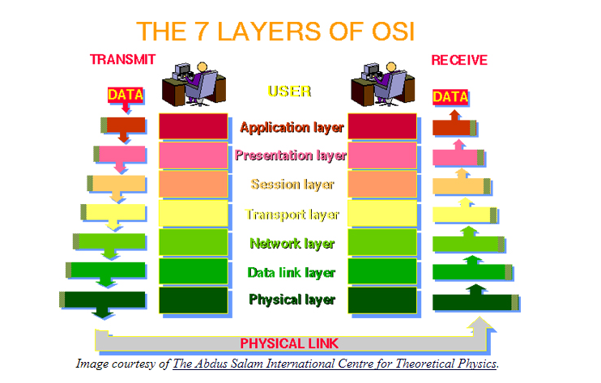

Slide 55
The TCP Protocol Model
Application protocol
Application
Application
Transport
TCP protocol
Transport
Network
IP protocol
IP
IP protocol
Network
Link
Data Link
Network Access
Data Link
Link

Slide 56
Data Formats
TCP Header
Application
Application message - data
message
Transport (TCP, UDP)
segment
TCP
data
TCP
data
TCP
data
Network (IP)
packet
IP
TCP
data
Link Layer
frame
ETH
IP
TCP
data
ETF
IP Header
Link (Ethernet)
Header
Link (Ethernet)
Trailer

Slide 57
Internet Protocol
IP
Connectionless
  Unreliable
  Best effort
Transfer datagram
  Header
  Data
Version
Header Length
Type of Service
Total Length
Identification
Flags
Fragment Offset
Time to Live
Protocol
Header Checksum
Source Address of Originating Host
Destination Address of Target Host
Options
Padding
IP Data

Slide 58

IP Routing
Meg
Office gateway
Packet
Source
121.42.33.12
Tom
121.42.33.12
Destination
132.14.11.51
132.14.11.1
ISP
132.14.11.51
121.42.33.1
Internet routing uses numeric IP address
Typical route uses several hops

Slide 59
IP Protocol Functions (Summary)
Routing
  IP host knows location of router (gateway)
  IP gateway must know route to other networks
Fragmentation and reassembly
  If max-packet-size less than the user-data-size
Error reporting
  ICMP packet to source if packet is dropped

